Slide 2
Challenges in demonstrating biosimilarity and interchangeability of biosimilar products
OMICS Group Biosimilars 2015 Birmingham, UK
10-11 Aug 2015
Hazel Gorham
GorhamHazel@prahs.com

Slide 3
Topics
What is a Biosimilar and Why?
Demonstrating Similarity
  Quality attributes
  Non-clinical animal
  PK/PD Bioequivalence
  Phase III equivalence; Efficacy and Safety comparability
Interchangeability
  Acceptance of interchangeability
  Demonstrating interchangeability – Is it possible?

Slide 4
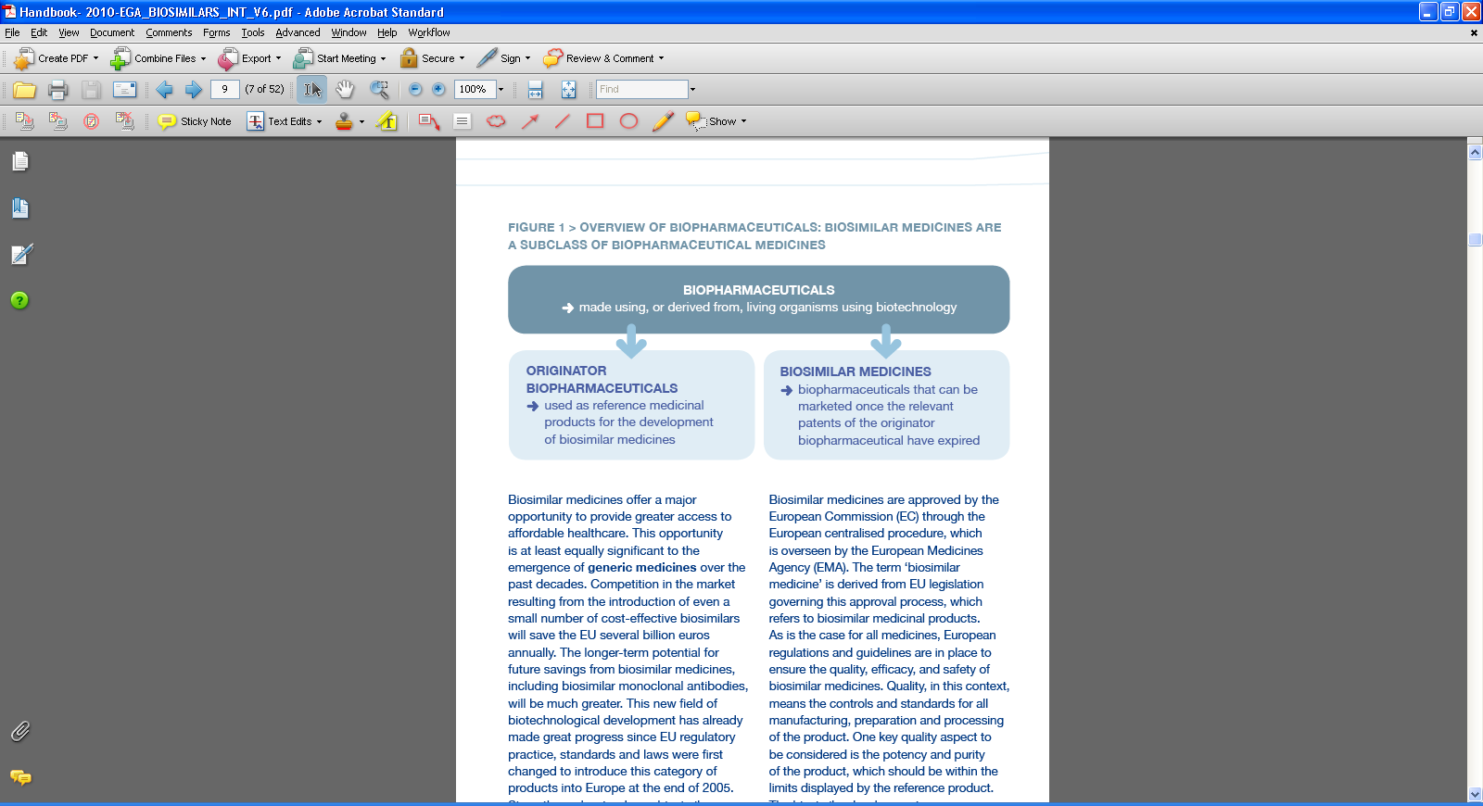
What are Biosimilars?

Slide 5
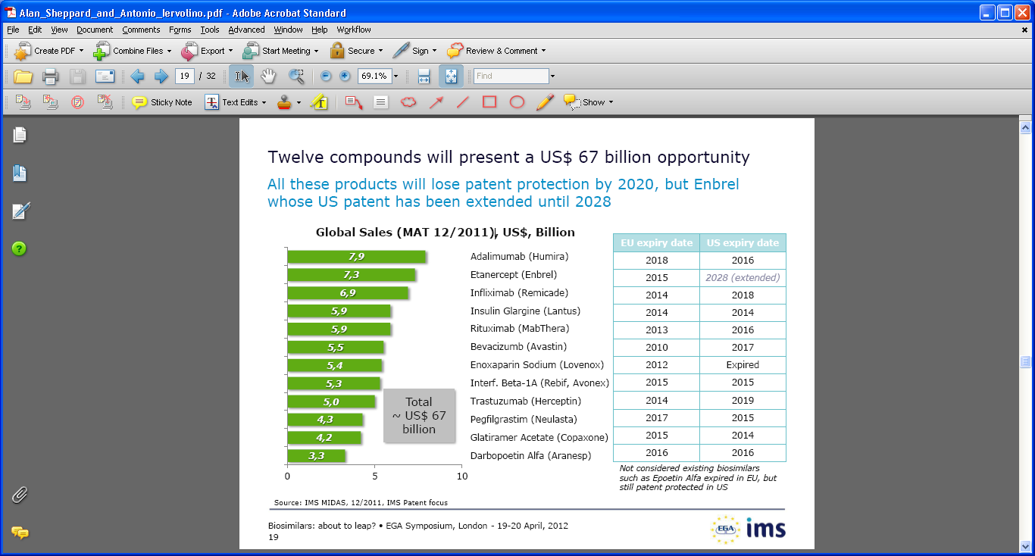
Patent Cliff

Slide 6
The Potential value of biosimilars
Biologic therapies are a key driver of increased drug cost
To maximise health gain from a limited budget, then spend on those interventions that produce the most health gain per pound/dollar
Cost reductions would be the significant driver to the increased use of targeted biologic cancer drugs in many countries
Significantly more patients will be treated as biologics costs fall
EU- savings between 11.8 -33.4 Billion between 2007-2020*
*(Haustein et al GaBI 2012,1(3-4) 120-6)

Slide 7
Global Biosimilar Concept
Generic approach is not appropriate
Step-wise comparability approach
Global similarity in all aspects:
  Quality
  Efficacy
  Safety
Case by case approach
Pharmacovigilance is critical

Slide 8
Demonstrating Similarity

Slide 9
Principles of establishing biosimilarity
“The guiding principle of a biosimilar development programme is to establish similarity between the biosimilar and the reference product by the best possible means, ensuring that the previously proven safety and efficacy of the reference medicinal product also applies to the biosimilar.”

Slide 10
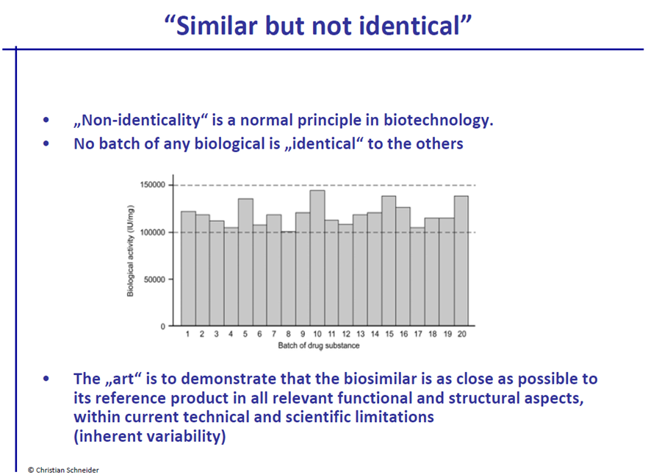
Similarity

Slide 11
Demonstrating “similarity”
Quality attributes
Non-clinical animal
PK/PD Bioequivalence
Phase III equivalence; Efficacy and Safety comparability

Slide 12
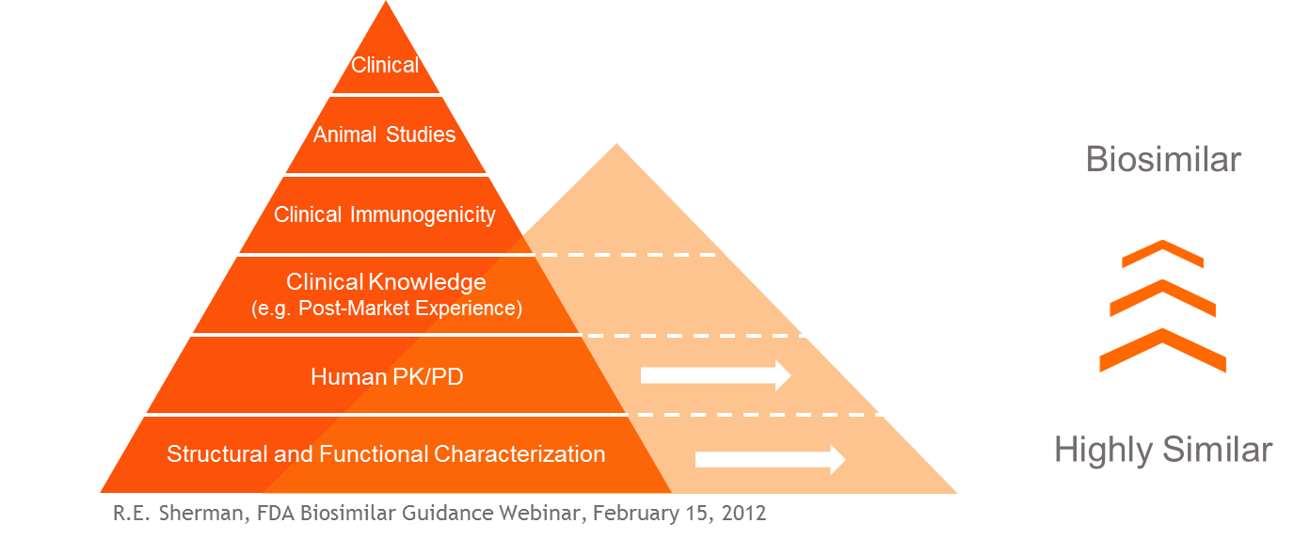
Comprehensive Biosimilarity Exercise

Slide 13
Similarity of Quality Attributes
EMA
Quality Target Product Profile (QTPP)
The “goal posts” for each critical quality attribute need to be established
FDA
Fingerprint-like analysis algorithm
“Such a strategy can further quantify the overall similarity between two products and may provide a basis for a more selective and targeted approach to subsequent animal and/or clinical studies.”

Slide 14
Similarity non-clinical animal comparability
Case by Case approach
EU applies the principles of the 3Rs (replacement, refinement, reduction)
US and others require more studies

Slide 15
Similarity clinical “bioequivalence”
General principle: A test product is considered to be bioequivalent to a reference product if the 90% confidence interval of the geometric mean ratio of AUC and Cmax between the test and reference fall within 80-125%.
Not applicable to the assessment of biosimilarity between highly variable biological (intra-subject variability greater than 30% C.V.)
High variability → large Phase I studies 150-300 HVs

Slide 16
Demonstrating Biosimilarity- Clinical phase III
Sensitive homogenous population
Assay sensitivity/ Similarity

Slide 17
Sensitive Homogeneous Population and Endpoints
Sensitive Homogeneous Population
  In principle, the most sensitive model and study conditions (pharmacodynamic or clinical) should be used in a homogeneous patient population
Selection of Endpoints
  The most sensitive clinical endpoint that is able to detect product-related differences
Study design, study population and/or endpoints may be different to those used to establish therapeutic benefit of the reference product

Slide 18
Determination of margins-Effect size
An appropriate equivalence margin that is adequate to detect clinically meaningful differences in effectiveness and safety
The smaller the equivalence margin → the narrower the confidence interval → larger the sample size.
The choice of margin and its justification are usually supported by statistical estimation based on historical data of the reference product and by comparison of prior study design

Slide 19
Assay Sensitivity- ICH E10
As for all clinical comparability trial designs, assay sensitivity (see ICH topic E10) has to be ensured (EMEA/CHMP/BMWP/42832/2005)
Determining that historical evidence of sensitivity to drug effects exists. Without this determination, demonstration of efficacy from a showing of non-inferiority is not possible and should not be attempted.
Designing a trial. Important details of the trial design, e.g., study population, concomitant therapy, endpoints, run-in periods, should adhere closely to the design of the trials used to determine that historical evidence of sensitivity to drug effects exists
Setting a margin. An acceptable non-inferiority margin should be defined, taking into account the historical data and relevant clinical and statistical considerations
Conducting the trial. The trial conduct should also adhere closely to that of the historical trials and should be of high quality

Slide 20
Equivalence OR
Non-Inferiority

Slide 21
Non-Clinical and Clinical
In general, an equivalence design should be used
The use of a non-inferiority design may be acceptable if justified on the basis of a strong scientific rationale and taking into consideration:
  The characteristics of the reference product, e.g. safety profile/tolerability, dose range, dose-response relationship.
A non-inferiority trial may only be accepted where the possibility of increased efficacy can be excluded on scientific and mechanistic grounds
However, as in equivalence trials assay sensitivity has to be considered

Slide 22
Interchangeability

Slide 23
Demonstrating interchangeability- US
Under the 2010 Biosimilar Price Competition and Innovation (BCPI) Act—passed with the Patient Protection and Affordable Care Act (PPACA)—FDA is required to release a definition for interchangeable products
Dug company would have to show that nothing happens to the patient if you switch them back and forth between the two products. But how the company would show that to regulators remains wide open

Slide 24
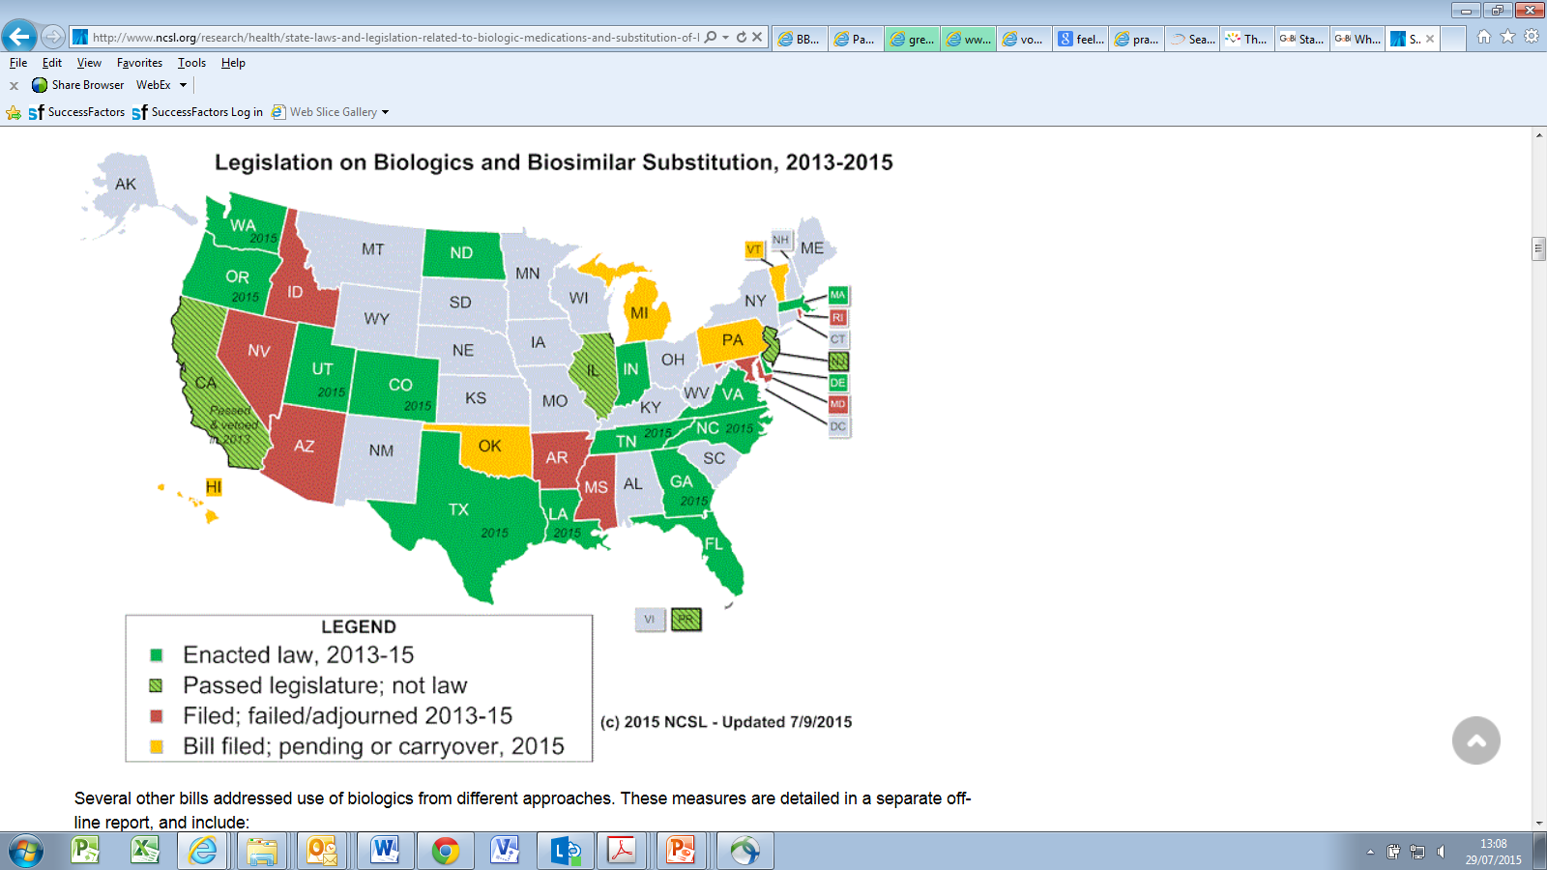
http://www.ncsl.org/research/health/state-laws-and-legislation-related-to-biologic-medications-and-substitution-of-biosimilars.aspx
United States

Slide 25
ROW
EU: biosimilars developed in line with EU requirements can be considered therapeutic alternatives to their respective reference products however decisions on the interchangeability or substitution of biosimilars and originator biologicals are not made by EMA but at the national level
Health Canada : biosimilar products are not interchangeable; Canadian provinces could still pay for SEB
South Africa does not allow biosimilars to be interchangeable with their reference product and automatic substitution cannot apply to biosimilars
Japan's approach is similar, but also points out that substitution of a biosimilar with its reference or innovator product should be avoided throughout treatment
Emerging countries: differing views mostly driven by cost

Slide 26
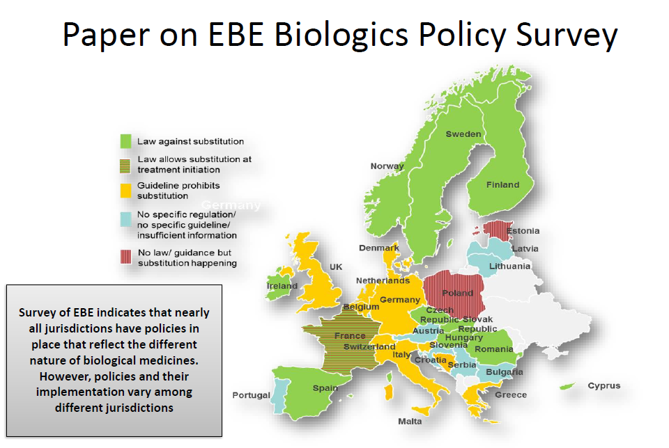
http://gabi-journal.net/what-pricing-and-reimbursement-policies-to-use-for-off-patent-biologicals-results-from-the-ebe-2014-biological-medicines-policy-survey.html

Slide 27
Recently announced positions of 2 authorities
The Finnish Medicines Agency, announced on 22 May 2015 that biosimilars licensed in the EU are interchangeable
The Fimea however, does not recommend automatic substitution at the pharmacy level.
The agency specifically recommends that biosimilars are interchangeable with their reference products only under the supervision of a healthcare professional.
Australia Therapeutic Good Administration (TGA) has approved Eli Lilly’s biosimilar insulin glargine
TGA also said it will consider marking the biosimilars equivalent,. ‘a’ flagging, meaning substitutable at pharmacy level
Substitution will not be applied to SBMPs [similar biological medicinal products, biosimilars] at this time unless TGA issued statement supportive of ‘a’ flagging is available’.
And in fact it has even rejected ‘a’ flagging in the case of the filgrastim biosimilar, Nivestim before.

Slide 28
Demonstrating Interchangeability.
Is it possible?

Slide 29
Study design challenges-
What to measure, who to measure and for how long?
Endpoints
Duration of evaluation
Response margin
Each indication?
A question that remains is, if a product is deemed interchangeable with the reference product, does this automatically also mean that a product is interchangeable with other (interchangeable) biosimilars?

Slide 30
Interchangeability key cog in biosimilar debate!
Biosimilar Interchangeability Problems Pose Complex Challenge for Regulators
“The big elephant in the room is interchangeability, and whether we’re going to consider a biologic product more like a New Molecular Entity (NME)—a new product that has a similar function but is a completely different drug in how we prescribe it—or if we going to be able to see biosimilars as interchangeable.”

Slide 31
Guidelines
CHMP/437/04 Rev 1: Guideline on similar biological medicinal products, 23 October 2014
EMA/CHMP/BWP/247713/2012: Guideline on similar biological medicinal products containing biotechnology-derived proteins as active substance: quality issues (revision 1), 22 May 2014
FDA, Draft Guidance for Industry Clinical Pharmacology Data to Support a Demonstration of Biosimilarity to a Reference Product, May 2014
EMEA/CHMP/BMWP/42832/2005 Rev. 1; Similar biological medicinal products containing biotechnology-derived proteins as active substance: non-clinical and clinical issues
FDA draft guideline: Scientific Considerations in Demonstrating Biosimilarity to a Reference Product

Slide 32
THANK YOU

