Slide 1



Purification, Characterization of Lipase Enzyme from Lactobacillus brevis and Immobilization onto Magnetic Florosil NPs
Hayrunnisa NADAROGLU^{1,2}, Seyedeh Sara SOLEIMANI², Zulal KESMEN³
¹Ataturk University, Erzurum Vocational School, Department of Food Technology, Erzurum Turkey
²Ataturk University, Faculty of Engineering, Department of Nano-Science and Nano-Engineering, 25240 Erzurum, TURKEY
³Erciyes University, Faculty of Faculty of Engineering, Department of Food Engineering, 38280 Kayseri, TURKEY

Slide 2
Lipase enzyme
Lipases (E.C.3.1.1.3; triglycerol acylhydrolases) enzymes can catalyze
hydrolysis,
interesterification,
esterification,
alcoholysis,
acidolysis and
aminolysis reactions.

Slide 3
Lipase enzyme
Lipases are used for many applications such as
detergent,
food,
synthesis of pharmaceutics,
paper industry,
cosmetics,
leather and
other numerous industrial fields.

Slide 4
Lipase enzyme
Lipases constitute approximately 75% of industrial enzymes.
The largest commercial application of lipases is in laundry detergents.
Approximately, 1.000 tons of lipase has been added to 12 billion tons of detergent produced every year.

Slide 5
Lipase enzyme
Industrial lipases are generally provided from species of microorganisms producing extracellular lipase.
This is because catalytic activities of microorganism derived enzymes are much higher than plant or animal-based enzymes.

Slide 6
Enzyme immobilization
Reuse of free enzyme in industrial areas without losting its activity is difficult.
It is quite hard to remove enzyme from medium at any time and to control formation of undesirable side products in studies conducted with free enzyme.
In order to reuse enzyme, it is required to be obtained again from reaction medium.

Slide 7
Enzyme immobilization
Enzyme immobilization techniques are developed in order to eliminate such problems.
Especially immobilization of enzyme to magnetic support materials ensures to remove easily enzyme from reaction medium when desired.

Slide 8
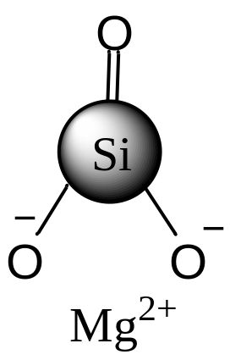
Support material = Florisil
Florisil is
a magnesia silica gel,
a polar sorbent capable to extract polar compounds from non-polar matrix.
Florisil characteristic
Surface area | 300 m²/g
Mesh | 60-100
Silica base | Irregular shaped

Slide 9
Support material = Florisil
Florisil has been used for the cleanup of
pesticide residues and other chlorinated hydrocarbons;
nitrogen compounds;
aromatic compounds;
fats, oils and waxes;
steroids, esters, ketones, glycerides, alkaloids and some carbohydrates.

Slide 10
Aim
For this reason, lipase enzyme
was extracellularly produced from L. brevis bacteria,
was purified by using (NH₄)₂SO₄ precipitation, ion-exchange chromatography (DEAE-Sephadex) and gel filtration chromatography (Sephacryl S200) techniques.

Slide 11
Aim
In addition, it was aimed to investigate
the covalent immobilization of purified lipase enzyme onto florisil support material magnetized with γ-Fe₃O₄ NPs through L-glutaraldehyde spacer arm as well as its usability as a detergent additive,
and
its washing performance was tested for removing olive oil from cotton cloths.

Slide 12
MATERIALS & METHODS
L. brevis was isolated and characterized from the Turkish sausage using 16 S rRNA gene squence method by Dr. Z. Kesmen.
Kesmen, Z., Yetiman, A.E., Gulluce, A., Kacmaz, N., Sagdic, O., Cetin, B., Adiguzel, A., Sahin, F., Yetim, H. Combination of culture - dependent and culture - independent molecular methods for the determination of lactic microbiota in sucuk. Int. J. Food Microbiol. 153(3) (2012) 428-435

Slide 13
Lipase enzyme production
1
L. brevis was incubated in MRS broth medium during 48 h at 30°C and 200 rpm at pH 7.0 containing (g/L): peptone (10.0 g); yeast extract (5.0 g); NaCl (5.0 g) and 1% olive oil; (pH 7.0) (medium A).
2
After 48 h, olive oil (1%) (medium B) was added to medium A and this culture was produced in aerobic condition at 160 rpm and 30°C temperature during 36 h.
3
Then, the obtained cultures were centrifuged at 12.000 xg for 15 min at 4°C and the supernatant was used for purification of lipase enzyme.

Slide 14
Lipase enzyme was purified in 3 steps by using supernatant part of centrifuged culture.
Supernatant was precipitated using 0-20% saturation with (NH₄)₂SO₄
First
The precipitate was dissolved and dialyzed by using 0.05 M Tris / HCl (pH:8.0) buffer
Second
Dialyzed concentrate was loaded to ion exchange column (DEAE-Sephadex; 2.5 cm x 30 cm)
After active fractions obtained from ion exchange chromatography were concentrated by using 10 kDa-Amicon membrane concentrator
Third
They were applied to Sephacryl S-200 column (20 cm × 1.2 cm) gel filtration column

Slide 15
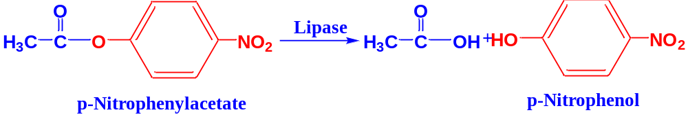
Lipase Assay
Lipolytic activity was determined by using a spectrophotometric method in which p- nitrophenyl acetate (p-NPA) was used as a substrate.

Slide 16
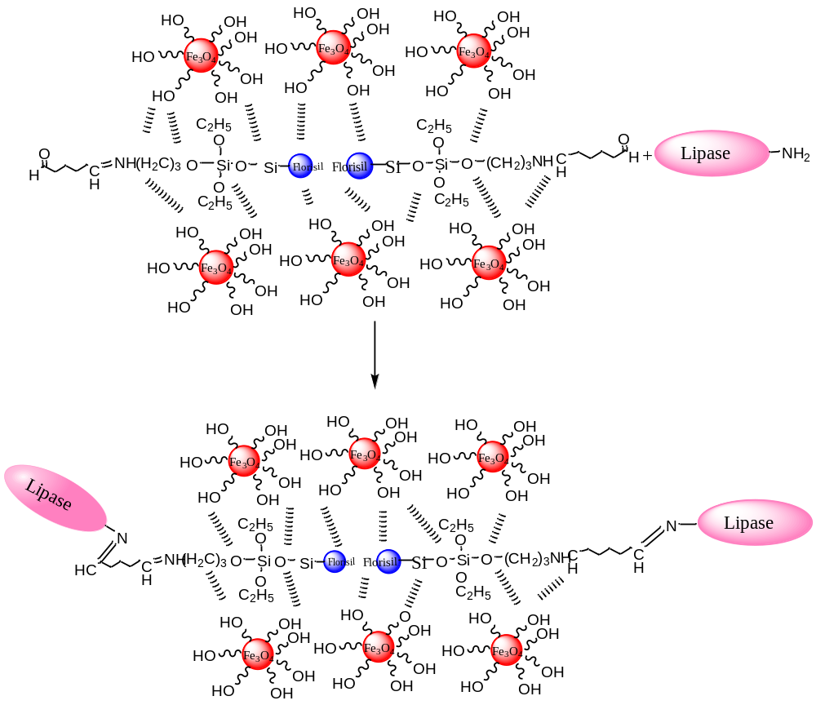
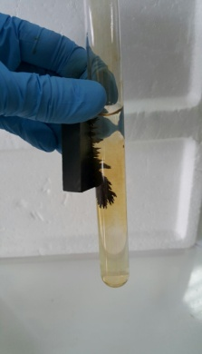
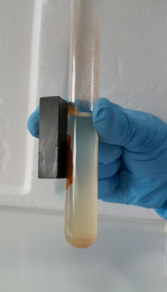
Preparation of Magnetic Florisil NPs and Lipase Immobilization
γ-Fe₃O₄
IML onto MF

Slide 17
Determination of Optimum Conditions For Immobilization of Purified Lipase Enzyme Onto Magnetite-FL-NPs
To determine the most suitable immobilization conditions of lipase enzyme to support material, the following studies were performed :
Optimum pH and Stable pH
Optimum Temperature and Stable Temperature
Nadaroglu H, Onem H, J Food Nut Res, 2014; 2(12): 938-945.
Onem H, Cicek S, Nadaroglu H, CYTA - J Food, 2016; 50(5) 1158-1165.
Nadaroglu H., Sonmez, Z., Digest Journal of Nanomaterials and Biostructures, 2016; 11(2) 685 – 697.
Onem H, Nadaroglu H I I J. Sci Tech Trans A: Sci 2016; DOI: 10.1007/s40995-016-0111-y.

Slide 18
Also, it was investigated
Effect of Some Effectors on Free and Immobilized Lipase
Usability of Immobilized Lipase as A Detergent Additive Agent

Slide 19
Surface Characterization of Native and Lipase Immobilized Magnetite Florisil NPs
The chemicals compositions of native and IML on MF NPs samples were determined by
Scanning electron microscopy (SEM),
X-ray diffraction (XRD) and
Fourier transform infrared (FTIR) spectroscopy, spectral analyses.

Slide 20
Results
Table 1 Purification steps of Lactobacillus brevis lipase
Purification steps | Volume | Activity | Total activity |  | Protein amount | Spesific Activity
 | mL | EU/mL | EU | % | (mg/mL) | EU/mg protein | Purification fold
Crude extract | 50 | 79.0 ± 0.11 | 3.95x10³ | 100 | 283.6±0.66 | 0.28 | -
(NH₄)₂SO₄ (0-20%) | 30 | 54.8 ± 0.11 | 1.64x10³ | 41.6 | 24.7±0.08 | 2.22 | 7.92
DEAE-Sephadex | 30 | 35.5 ± 1.3 | 1.07 x10³ | 26.96 | 6.2±0. 33 | 5.72 | 20.44
Sephacryl S 200 | 20 | 24.6±1.5 | 4.92x10² | 12.45 | 0.65±2.4 | 37.85 | 135.2
Lipase enzyme was purified from Lactobacillus brevis bacteria by using ammonium sulphate precipitation, DEAE-Sephadex ion-exchange chromatography and gel filtration chromatography techniques. Purification coefficient and yield were calculated by performing lipase enzyme activity assay and protein determination in fractions. Enzyme was purified 135.2 fold with a yield of 12.45% (Table 1).

Slide 21
A
B
Figure 1. (A) DEAE sephadex ion exchange chromatography and (B) Sephacry S 200 gel filtration cromatography

Slide 22
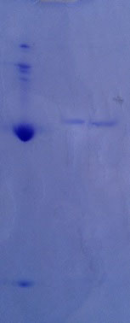
The molecular weight was measured as 57 kDa by SDS-PAGE for lipase purified from L. brevis
Figure 2. SDS-PAGE electrophoretic pattern of lipase [Lane (I); high protein marker (Sigma), bands marked: 205 kDa, myosin, 116 kDa, β-galactosidase, 97 kDa, phosporylase b; 66 kDa, bovine serum albumin; 55 kDa, glutamic dehydrogenase, 45 kDa, ovoalbumin; 36 kDa, glyceraldehyde-3-phosphate dehydrogenase; 29 kDa; carbonic anhydrase)line (II); purified lipase enzyme from Lactobacillus brevis]

Slide 23
Figure 3. The changes of the percentage binding (○) and activity (●) of immobilized lipase depending on the pH and temperature
Immobilization process carried out at different pH and temperature values and activity of immobilized L. brevis lipase enzyme was determined. As was seen from Figure 3, L. brevis lipase showed the maximum lipase enzyme activity and attached to immobilized material at the highest rate in pH 6.0 and 20 ºC.

Slide 24
Figure 4. The changes of the percentage binding (○) and activity (●) of immobilized lipase depending on the time
Immobilization was performed at pre-determined pH 6.0 and 20 ºC for 4 hours in order to determine the period of covalent immobilization of pure L. brevis lipase onto MG FL NPs.
Pure lipase enzyme was bound to the support material at a maximum rate of 83.1% at the end of the 1-hour immobilization period and there was no increase in binding percentage as immobilization period.

Slide 25
Figure 5. The changes of the percentage binding (○) and activity (●) of immobilized lipase depending on the amount of lipase enzyme
To determine optimum lipase enzyme concentration, immobilization studies were conducted at 0.25, 0.5, 1.0, 1.5 and 2 mg/mL of protein concentrations. The maximum lipase activity was obtained in immobilization study performed at 1 mg/mL concentration.

Slide 26
Figure 6. The effects of pHs on free and immobilized lipase enzyme
The optimum pHs of L. brevis lipase which is free and immobilized onto MF NPs were determined and Figure 6 showed the results. It was determined that FL and IML enzyme did not show activity below pH 6.00 and above pH 10.00. Also, they showed maximum activity at pH 9.00.

Slide 27
Free enzyme
Figure 7. The effects of pHs on free and immobilized lipase enzyme stabilities
Both FL and immobilized L. brevis lipase enzymes were determined to be very stable in the range of 5.0-11.0 pH. Also, IML enzyme activity was more stable after 7 days compared to FL enzyme and maintained 89.2% of its activity at pH 9.0.

Slide 28
Figure 8. The effect of temperature on free and immobilized lipase enzyme activities
Activity measurements were performed by using borate buffer prepared in the range 10 - 90°C and at pH 9.00 in order to determine the effect of temperature on activity of FL and IML onto MF NPs.
Optimum temperatures of both FL and IML enzymes were determined as 60 ºC.

Slide 29
Immobilized enzyme
Figure 9. The effects of temperature on free and immobilized lipase enzyme stabilities
Activity determination of both FL and IML enzyme was performed at temperature range of 50-90 ºC for 2 hours and Figure 9 show related results.
It was observed from results that IML enzyme was more stable at all temperatures compared to FL enzyme. It was observed that its activity remained at rate of 82% at the end of 2 hours.

Slide 30
Table 2. The effects of some metal ions onto free and immobilized lipase
Free lipase
Metal ions | Concentration (mM) | Relative activity (%) | Concentration (mM) | Relative activity (%)
None | - | 100 ± 0.005 | - | 100 ± 0.005
Cu²⁺ | 1 | 125.47 ± 0.87 | 5 | 147.17 ± 2.2
Zn²⁺ | 1 | 124.5 ± 0.53 | 5 | 171.69 ± 4.8
Mg²⁺ | 1 | 128.3 ± 0.89 | 5 | 143.39 ± 4.01
Fe²⁺ | 1 | 40.57 ± 0.6 | 5 | 10.38 ± 3.3
Ca²⁺ | 1 | 116.04 ± 0.35 | 5 | 127.36 ± 0.43
Hg²⁺ | 1 | 40.57 ± 0.14 | 5 | 4.25 ± 2.54
Immobilized lipase
Metal ions | Concentration (mM) | Relative activity (%) | Concentration (mM) | Relative activity (%)
None | - | 100 ± 0.0 | - | 100 ± 0.0
Cu²⁺ | 1 | 134.9 ± 4.56 | 5 | 180.2 ± 6.31
Zn²⁺ | 1 | 167.92 ± 0.2 | 5 | 187.02 ± 2.6
Mg²⁺ | 1 | 151.89 ± 0.14 | 5 | 183.02 ± 2.33
Fe²⁺ | 1 | 64.15 ± 2.05 | 5 | 11.13 ± 0.13
Ca²⁺ | 1 | 122.64 ± 0.22 | 5 | 131.13 ± 0.96
Hg²⁺ | 1 | 69.81 ± 0.23 | 5 | 12.26 ± 0.18
The effects of certain metal ions on activities of FL and IML enzymes were investigated and it was seen from Table 2 that IML onto MF NPs maintained its activity against all metal ions at higher rate.

Slide 31
Table 3. Vmax and Km values for free and immobilized lipase
Substrate | Free lipase (FL) |  | Immobilized lipase (IML)
 | Vmax (μmol/L.dak) | Km (mM) | Vmax (μmol/L.dak) | Km (mM)
p-nitrophenyl acetate | 1.175 | 0.376 | 6.28 | 0.25
p-nitrophenyl palmitate | 0.476 | 0.47 | 0.63 | 0.84
p-nitrophenyl laurate | 0.7085 | 1.18 | 1.761 | 0.36
Methyl heptanoate | 2.91 | 1.108 | 3.15 | 2.89
Methyl propionate | 0.558 | 0.62 | 1.39 | 0.85
For both FL and IML enzymes, Vmax and Km values were calculated with the help of Lineweaver burk graph for p- NPA, p- nitrophenyl palmitate, p- nitrophenyl laurate, methyl heptanoate and methyl propionate substrates and Table 3 shows these values. IML enzyme had higher activity against all substrates than FL.

Slide 32
Figure 10. FT-IR spectrum of native florisil, magnetite florosil NPs, lipase immobilized florisil with purified lipase from Lactobacillus brevis
Immobilization of lipase enzyme onto surface of MF NPs through L-glutaraldehyde spacer arm was also characterized by using Fourier transform infrared spectroscopy (FTIR). Figure 10 shows FTIR spectra belonging to Native florisil, MF NPs and IML MF NPs .

Slide 33
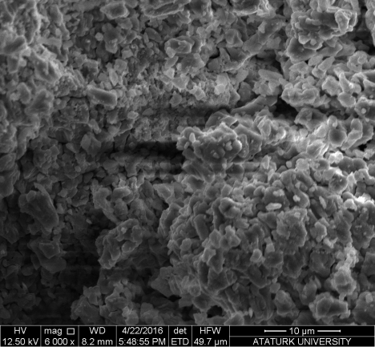
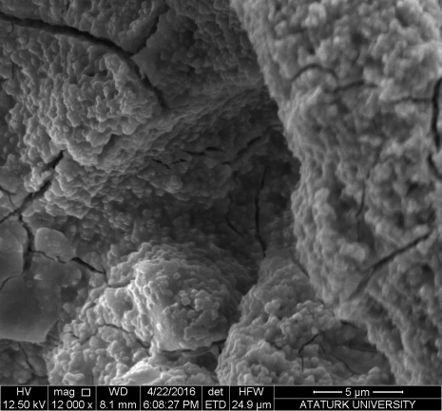
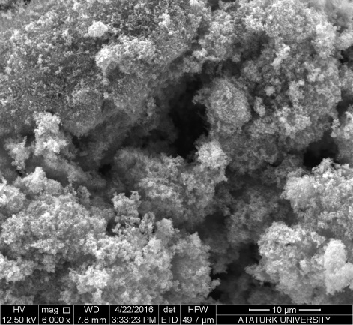
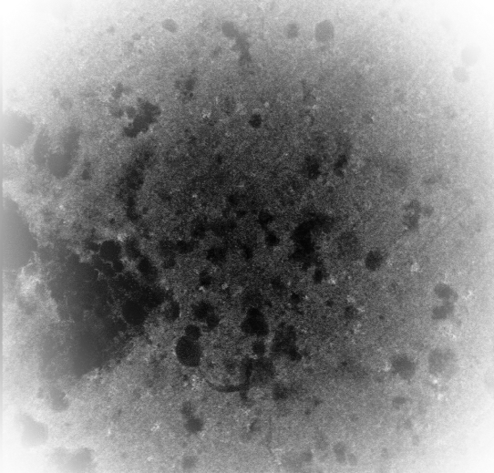
A
B
A
B
C
C
D
Figure 11. SEM images A: nature florisil; B: Magnetic Florisil NPs; C: Purified lipase immobilized onto Magnetic Florisil NPs; D: TEM image IML onto MF-NPs
Surface morphologies of florisil, MF NPs and after enzyme immobilized MF NPs were examined from SEM images.

Slide 34
Figure 12. XRD photographs for magnetic florisil NPs and immobilized lipase onto magnetic florisil NPs
X-ray diffraction (XRD) patterns of MF NPs and IML onto MF NPs were carried out using X’pert XRD system.

Slide 35
The Effect of Washing on Removal of Olive Oil
FL and IML enzymes with 10 EU activity (1 mL) were treated both alone and with a commercial detergent (%0.1 (w/v)) on olive oil treated cotton clothes.
When removal of olive oil by lipase enzyme was compared for 1 hour, it was determined that FL including detergent provided maximum oil removal at the rate of 65% after 45 minutes, immobilized enzyme provided maximum oil removal at the rate of 72% from cotton cloths.
It was found that IML enzyme was more effective than the commercial detergent.

Slide 36
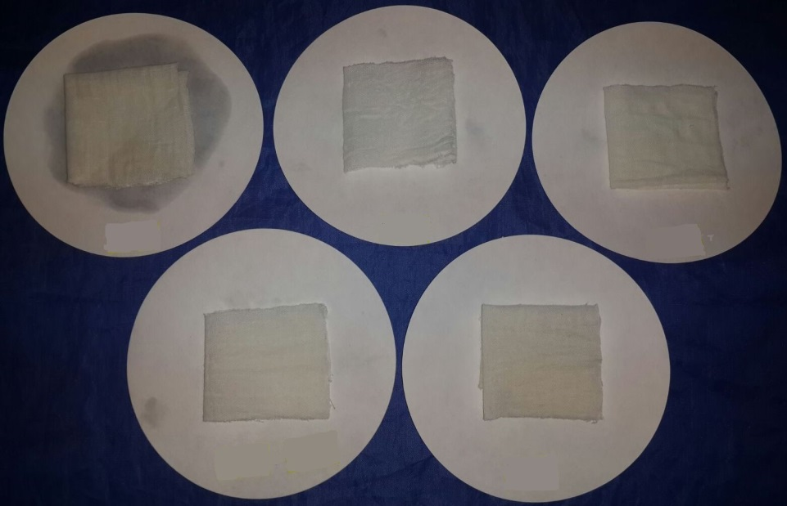
The Effect of Washing on Removal of Olive Oil
I
II
III
IV
V
Figure 13. Effect of washing time on oil removal (experimental conditions: detergent concentration 0.5%; lipase amount 40 U; Washing temperature 40ºC). All values are represented as mean ± sd of three replications.
(Photograph of effect of washing of cotton fibers different detergent additives
I: blank, II: immobilized lipase, III: detergent+free lipase, IV: detergent+immobilized lipase, V: free lipase)
The effects of FL and IML enzyme as a detergent additive agent were examined and Figure 13 shows its results.

Slide 37
Conclusion
Lipase enzyme produced by Lactobacillus brevis bacteria was purified and characterized.
Purified lipase enzyme was covalently immobilized onto florisil support material modified with γ-Fe₃O₄ NPs through L-glutaraldehyde spacer arm.
Especially, IML enzyme showed high activity and stability at high temperatures and pHs.
It is also thought to be quite effective as a detergent additive agent and use of Lactobacillus brevis lipase enzyme in detergent industry has a great potential.
It could be done with both solid and liquid formulations by using IML onto MF NPs system.

Slide 38
Conclusion
This mainly contributed to the non-cost and effective detergent production by using immobilized microbial lipase MF NPs.
The success of incorporation of the alkaline immobilized lipase enzyme in detergent preparation will mostly reduce the use of surfactants and other compounds that are carcinogenic and allergenic and are environmentally friendly.

Slide 39

Thank you…

Slide 40

Thank you…

