Slide 1
Amelioration of Cyclosporine Induced Nephrotoxicity by Dipeptidyl peptidase Inhibitior Vildagliptin
Hayam Ateyya M.D.
Assistant professor at Department of clinical Pharmacology
Faculty of Medicine, Cairo University, Egypt &
Taibah university, KSA

Slide 2
Objectives
Introduction & Background
Purpose
Methods
Results
Conclusion
References

Slide 3
Background

Cyclosporine A (CsA) is an immunosuppressive drug used in several autoimmune diseases and prevention of allograft rejection in solid organ transplantation but its clinical uses may be limited due to its dose-related nephrotoxicity which is characterized by tubular atrophy, interstitial fibrosis and progressive renal impairment.



Slide 4
Background
The exact mehanism of CsA nephrotoxicity is still not well elucidated. but several evidences indicated that:
Oxidative stress played a major role in different kidney diseases especially in toxic or ischemic or immunological conditions
Free radicals may be derived directly from CsA or during its metabolism by the cytochrome P4503A.
The implications of ROS in CsA nephrotoxicity was strengthened by the fact that many antioxidants & free radical scavengers provide marked
protection against CsA nephrotoxicity
CsA induced renal damage through lipid peroxidation by ROS & increased the synthesis of thromboxane A2. It also can modified the expression and activity of several renal enzymes such as: cyclooxygenase, superoxide-dismutase, catalase & glutathione-peroxidase
 CsA may induced apoptotic cell death in renal tissues by increased the pro-apoptotic Bax and decreased the anti-apoptotic Bcl-2 levels.
 It stimulated inflammatory
mediators
◆
❖
⬥

Slide 5
Background
Dipeptidyl Peptidase-4 (DPP-4) is serine protease which modulates the function of insulin-releasing incretins such as gastric inhibitory peptide (GIP) and glucagon-like peptide-1 (GLP-1). Incretins involved in the regulation of postprandial glucose homeostasis through increasing insulin release and inhibiting glucagon secretion
DPP-4 inhibitors protect endogenous GIP and GLP-1 from degradation and they are used to improve glucose tolerance in type-II diabetic patients.

Slide 6
Background
Apart from incretins actions on the pancreas, they have systemic effects in a variety of tissues such as kidney, heart, lung, the central and peripheral nervous system, and the digestive system due to the presence of both DPP-4 and incretin receptors (GLP-1R) in these tissues



Slide 7
Background
DPP-4 exists in two forms both of which are capable of proteolytic activity
Membrane bound form
Soluble form
Which is expressed on
the surface of many cells including kidney tubular cells, endothelial cells & T-cells.
Which is localized in the circulation and involved in glucose homeostasis

Slide 8
Background
Studies revealed that the brush border of the proximal tubule of the kidney is the site where DPP4 and several other peptidases are located, this suggests that DPP-4 is involved in the degradation/catabolism of many proteins in the kidney, specially the proline containing peptides
GLP-1R are expressed in the proximal tubules, in the renal glomerulus and on podocytes.
Activation of GLP-1R in the kidney leads to diuretic and natriuretic effects, possibly through direct actions on renal tubular cells & sodium transporters

Slide 9
Background
◆
Studies revealed
❖
DPP-4 inhibitors produce a dose-dependent protective effect on kidney function after ischemic reperfusion injury in a diabetic rat model & proved that incretins protect the vascular endothelium from injury by binding to GLP-1R, thereby ameliorating the oxidative stress & the local inflammatory response
Vildagliptin is a potent competitive and reversible DPP-4 inhibitor with high selectivity for DPP-4 over other peptidases enzymes
DPP-4 inhibitors protect diabetic rats from the loss of renal vascular reactivity & the development of glomerulosclerosis perhaps secondary the enhancement of active GLP-1 which activated GLP-1R leading to antioxidative and antiapoptotic effects.

Slide 10
Research Aim
This novel study was carried out to investigate the possible protective effect of one of the DPP4- inhibitors, vildagliptin in cyclosporine induced nephrotoxicity in rats and the possible underlying mechanism.

Slide 11
Methods
Animal grouping
27 Male Wistar albino rats, aged 8 weeks, weighing (180–220 g)
Rats were randomly divided into four groups each consists of 6 rats except CsA treated group was 9 rats and all are treated for 28 days.

Slide 12
Methods
Served as the normal control group. Animals were treated with SC injections of sunflower oil; the CsA vehicle.
Group-I
Rats were treated with VLD (10 mg/kg/day o.d).
Group-II
Rats were administered CsA (20 mg/kg in sunflower oil, S.C.)
Group-III
Rats were treated with VLD (10 mg/kg/day, o.d) 4 days before and along with CsA administration for 28 consecutive days.
Group-VI

Slide 13
Methods
Over a 24 h period between days 26 and 28, each rat was placed separately in a metabolic cage containing a urine collection funnel to measure urine excretion.
Micro total protein
Creatinine clearance
&
were measured in these urine samples

Slide 14
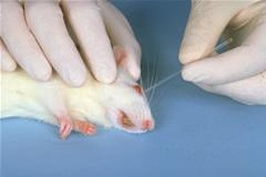
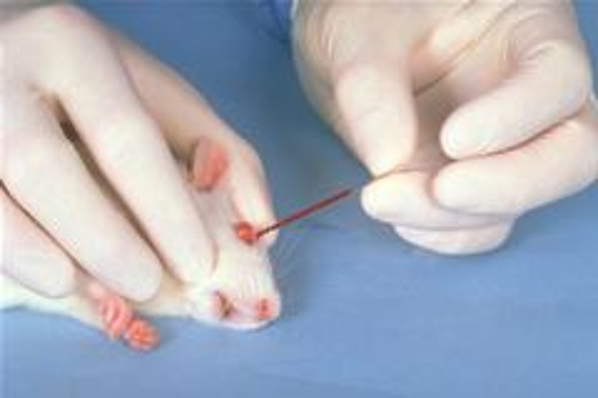
Methods
Then, blood samples were obtained from the retro-orbital plexus under light ether anesthesia in non-heparinized tubes
Lactate
dehydrogenase
Creatinine
Bilirubin
Albumin
Were measured in rats sera

Slide 15
Methods
The kidneys were immediately isolated and washed with ice-cold isotonic saline after the rats were sacrificed by cervical dislocation under ether anesthesia at the end of the experimental
period
The left kidneys were used for Preparation of kidney homogenate
for determination of:
The right kidneys were used for assessment of histopathological renal damage.
GSH
SOD
MDA
Total antioxidant

Slide 16
Methods
Immunohistochemical analysis for renal Bax & Bcl₂ expression
Sections from each renal sample were taken & stained by IHC for determination of Bax & Bcl₂. The intensity of staining was graded and each specimen was assigned a score on a scale from 0 to 3 as
0----- (negative)
1---------- (weak)
2 -----(moderate)
3--------- (strong)
Also, 10 fields of vision in each slice were observed and number of positive cells were counted. The presence of brown punctuate or granular substances are an indication of positive staining. The same operation was repeated three times & the mean value used for analysis.

Slide 17
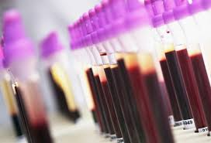
Results
Effect of co-administration of Cyclosporine &Vildagliptin on kidney functions parameters
in rats sera

Slide 18
Effect CsA &VLD administration on kidney function parameters
Serum Creatinine (Cr)
*
#
10mg/kg
20mg/kg
20+10mg/kg
Data are expressed as mean ± SEM, n = 6.
Cr: Serum creatinine; VLD: vildagliptin; CsA: cyclosporine A
* #Significantly different from control and CsA-treated groups, respectively (P<0.05).

Slide 19
Effect CsA &VLD administration on kidney function parameters
Blood urea nitrogen (BUN)
*
#
10mg/kg
20mg/kg
20+10mg/kg
Data are expressed as mean ± SEM, n = 6.
BUN: Blood urea nitrogen; VLD: vildagliptin; CsA: cyclosporine A
* #Significantly different from control and CsA-treated groups, respectively (P<0.05).

Slide 20
Effect CsA &VLD administration on kidney function parameters
lactate dehydrogenase (LDH)
*
#
*
10mg/kg
20mg/kg
20+10mg/kg
Data are expressed as mean ± SEM, n = 6.
LDH: lactate dehydrogenase; VLD: vildagliptin; CsA: cyclosporine A
* #Significantly different from control and CsA-treated groups, respectively (P<0.05).

Slide 21
Effect CsA &VLD administration on kidney function parameters
Albumin
#
*
10mg/kg
20mg/kg
20+10mg/kg
Data are expressed as mean ± SEM, n = 6.
VLD: vildagliptin; CsA: cyclosporine A
* #Significantly different from control and CsA-treated groups, respectively (P<0.05).

Slide 22
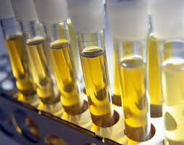
Results
Effect of co-administration of Cyclosporine &Vildagliptin on kidney functions parameters
in rats urine

Slide 23
Effect of CsA and/ or VLD on kidney function parameters
in rats’ urine.
Creatinine clearance(CrCl) Micro-total protein (MTP)
#
*
#
*
Data are expressed as mean ± SEM, n = 6.
(CrCl): Creatinine clearance; MTP: micro total protein; VLD: vildagliptin; CsA:cyclosporine
* #Significantly different from control and CsA-treated groups, respectively (P < 0.05).

Slide 24
Results
Effect of co-administration of Cyclosporine &Vildagliptin on renal oxidative damage

Slide 25
Effect of CsA and/or VLD administration on renal antioxidant status.
Malondialdehyde (MDA)
*
#
Data are expressed as mean ± SEM, n = 6.
MDA, malondialdehyde; VLD: vildagliptin; CsA: cyclosporine A
* #Significantly different from control and CsA-treated groups, respectively (P < 0.05).

Slide 26
Effect of CsA and/or VLD administration on renal antioxidant status.
Total antioxidant (TAO)
#
*
Data are expressed as mean ± SEM, n = 6.
TAO, total antioxidant; VLD: vildagliptin; CsA: cyclosporine A
* #Significantly different from control and CsA-treated groups, respectively (P < 0.05).

Slide 27
Effect of CsA and/or VLD administration on renal antioxidant status.
Glutathione (GSH)
#
*
Data are expressed as mean ± SEM, n = 6.
GSH, glutathione; SOD, superoxide dismutase; VLD: vildagliptin; CsA: cyclosporine A
* #Significantly different from control and CsA-treated groups, respectively (P < 0.05).

Slide 28
Effect of CsA and/or VLD administration on renal antioxidant status.
Superoxide dismutase (SOD)
#
*
Data are expressed as mean ± SEM, n = 6.
SOD, superoxide dismutase; VLD: vildagliptin; CsA: cyclosporine A
* #Significantly different from control and CsA-treated groups, respectively (P <0.05).

Slide 29
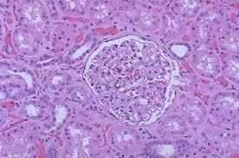
Results
Effect of co-administration of Cyclosporine &Vildagliptin on renal pathology

Slide 30
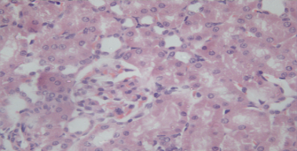
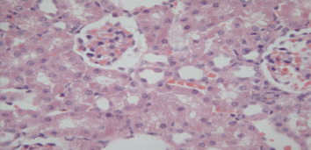
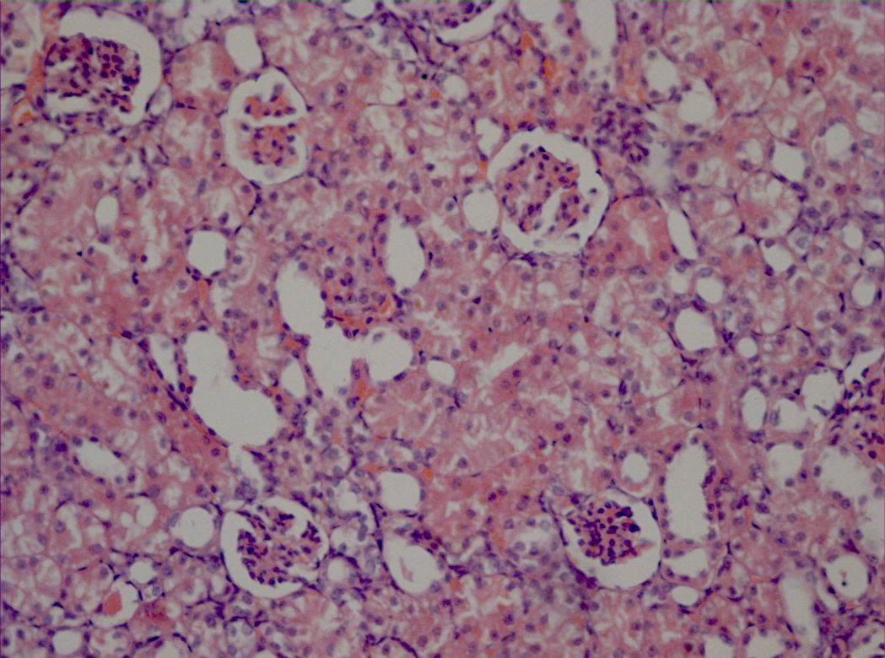
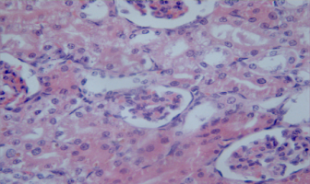
Effect of VLD/CsA on pathological changes in rat kidney induced by CsA (H&E×400):
a
b
c
d
a) Control group & b) VLD group, section showed normal structure, c) CsA group; section showed atrophied tubules(red arrow), glomeruli show wide glomerular space (thick arrows), d) CsA + VLD group; section showed marked improvement in tubules and glomeruli

Slide 31
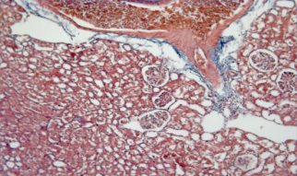
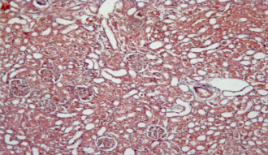
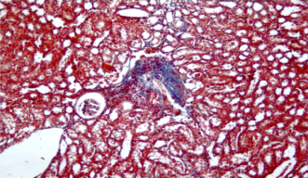
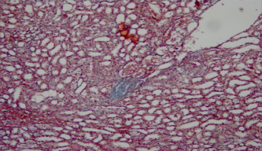
Effect of VLD/CsA on fibrosis development in rat kidney induced by CsA (Masson trichome×100):
a
b
c
d
a) Control group & b) VLD group; section showed no fibrosis,
c) CsA group; section showeds triped fibrosis
d) CsA + VLD group; section showed significant improvement in fibrotic areas

Slide 32
Effect of vidagliptin co-administration with cyclosporine on fibrosis scoring using Masson Trichome stain in rats
*
#

Slide 33
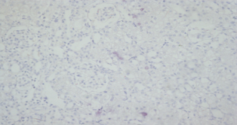
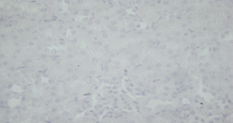
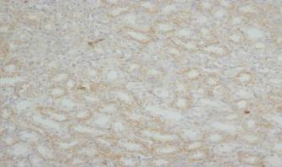
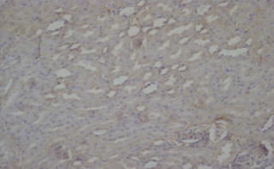
Effect of VLD/CsA on renal Bax expression changes in rat induced by CsA using (IHC) (100x)
a
b
c
d
a) Control group & b) VLD group; section showed no stain, c) CsA group; section showed moderate tubular staining in 75% of tubules thin arrows , d) CsA + VLD; section showed weak tubular staining in 50% of tubules thin arrows.

Slide 34
Effect of VLD/CsA on renal Bax score in rat induced by CsA

Slide 35
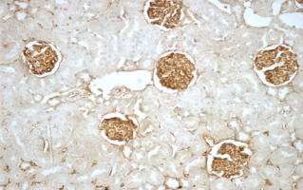
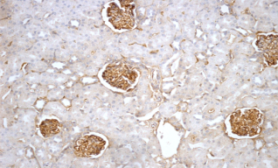
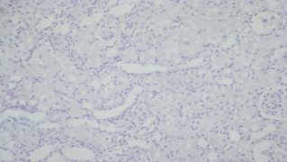
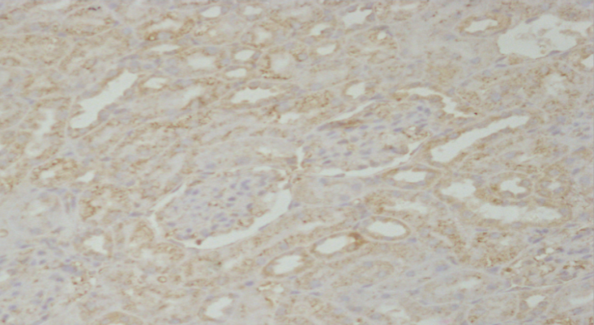
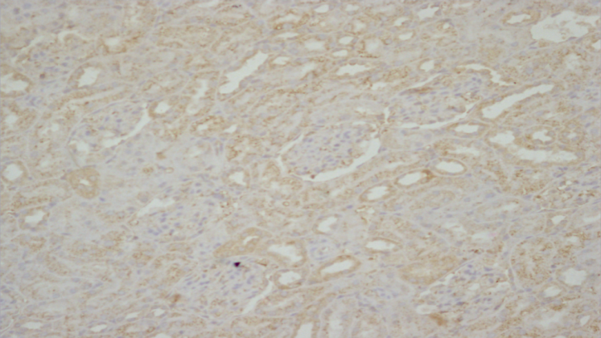
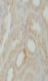
Effect of VLD/CsA on renal Bcl₂ expression changes in rat induced by CsA using (IHC) (200x)
a
b
c
d
a) Control group & b) VLD group; section showed intermediate glomerular staining in 100% of the glomeruli (thin arrows) and intermediate tubular staining in 25% of the tubules , c) CsA group showed no staining in both glomeruli and tubules ( thin and thick arrows respectively, d) CsA + VLD showed mild staining in the tubules thick arrows.

Slide 36
Effect of VLD/CsA on renal Bcl₂ score changes in rat induced by CsA

Slide 37

Conclusion

The present study revealed that treatment with vildagliptin for 4 weeks attenuated cyclosporin-induced renal dysfunction and tubulointerstitial fibrosis. Moreover, these improvements were accompanied by
a reduction in oxidative stress and apoptosis.

This protective effect of vildagliptin may be partly explained by its ability to restore the prooxidant–antioxidant balance by enhancing general radical-scavenging activities, increase the antioxidant defense and prevent the formation of free radicals originating from peroxidation products and from metabolism of CsA.

Slide 38
References
Satyanarayana PS, Chopra K. Oxidative stress-mediated renal dysfunction by cyclosporine A in rats: attenuation by trimetazidine. Ren Fail. 2002; 24(3): 259-74.
Masajtis-Zagajewska A, Kurnatowska I, Wajdlich M, Jagodzińska M, Nowicki M. Influence of hemodialysis on incretin hormones and insulin secretion in diabetic and nondiabetic patients. IntUrolNephrol. 2013; 45 (6):1733-40.
Marchetti C, Di Carlo A, Facchiano F, Senatore C, De Cristofaro R, Luzi A. et al. High mobility group box 1 is a novel substrate of dipeptidylpeptidaseIV. Diabetologia. 2012; 55(1): 236-244.
Von Websky K, Reichetzeder C, Hocher B. Physiology and pathophysiology of incretins in the kidney.CurrOpinNephrolHypertens. 2014;23 (1):54-60.
Tanaka T, Higashijima Y, Wada T, Nangaku M. The potential for renoprotection with incretin-based drugs. Kidney Int. 2014; 86(4): 701-711.

Slide 39




