Slide 1

An Extremely Rare Case Report
Haya J. Azouz
3rd year medical student
College of Medicine, Alfaisal University, Riyadh, Saudi Arabia

Slide 2
Case Report
37-year-old male
5-week Hx of left flank pain & early satiety
PE: left flank ― moderately enlarged & tender mass
All labs normal
Notes:
Liver, renal, hormonal profiles Hormonal evaluation including measurements of mid- night and morning serum cortisol concentrations, morn- ing serum dehydroepiandrosterone sulfate, aldosterone, 17-hydroxyprogesterone, testosterone and chromogra- nin A, plasma adrenocorticotropic hormone, and plasma renin activity

Slide 3
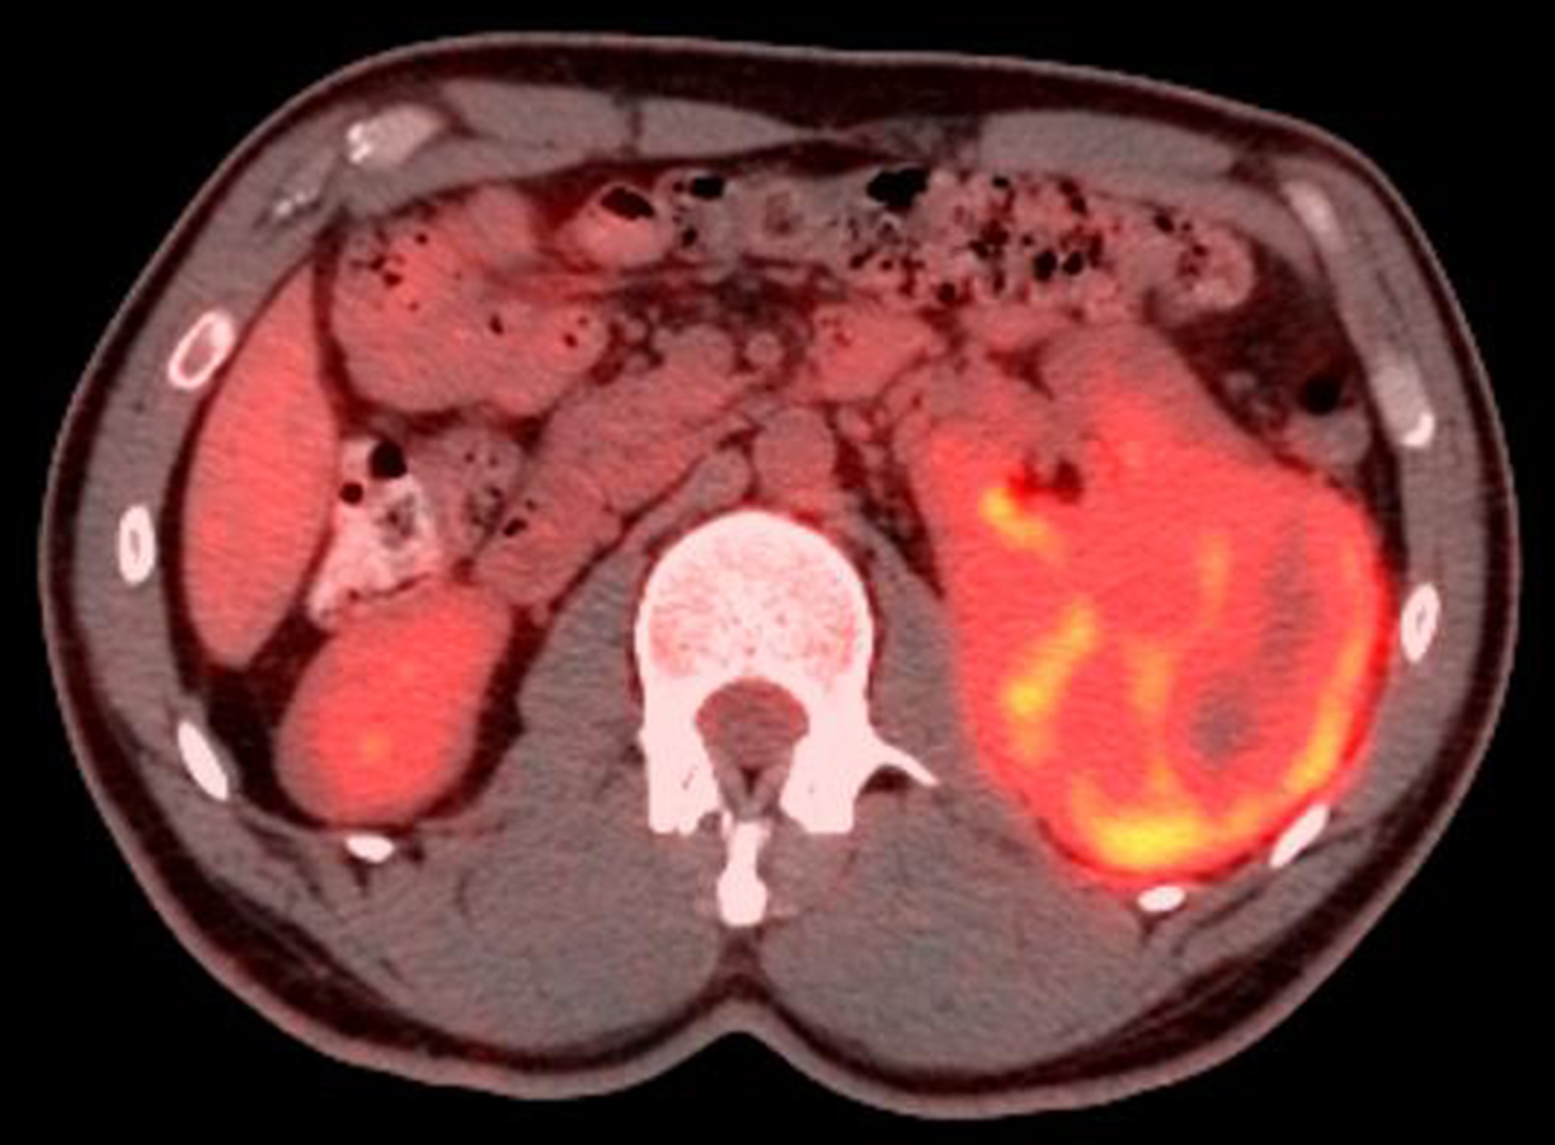
PET―CT Scan
PET―CT Scan:
14 x 11 cm hypermetabolic FDG-avid mass lesion involving the left adrenal gland & dorsal part of the left hemi-diaphragm.

Slide 4
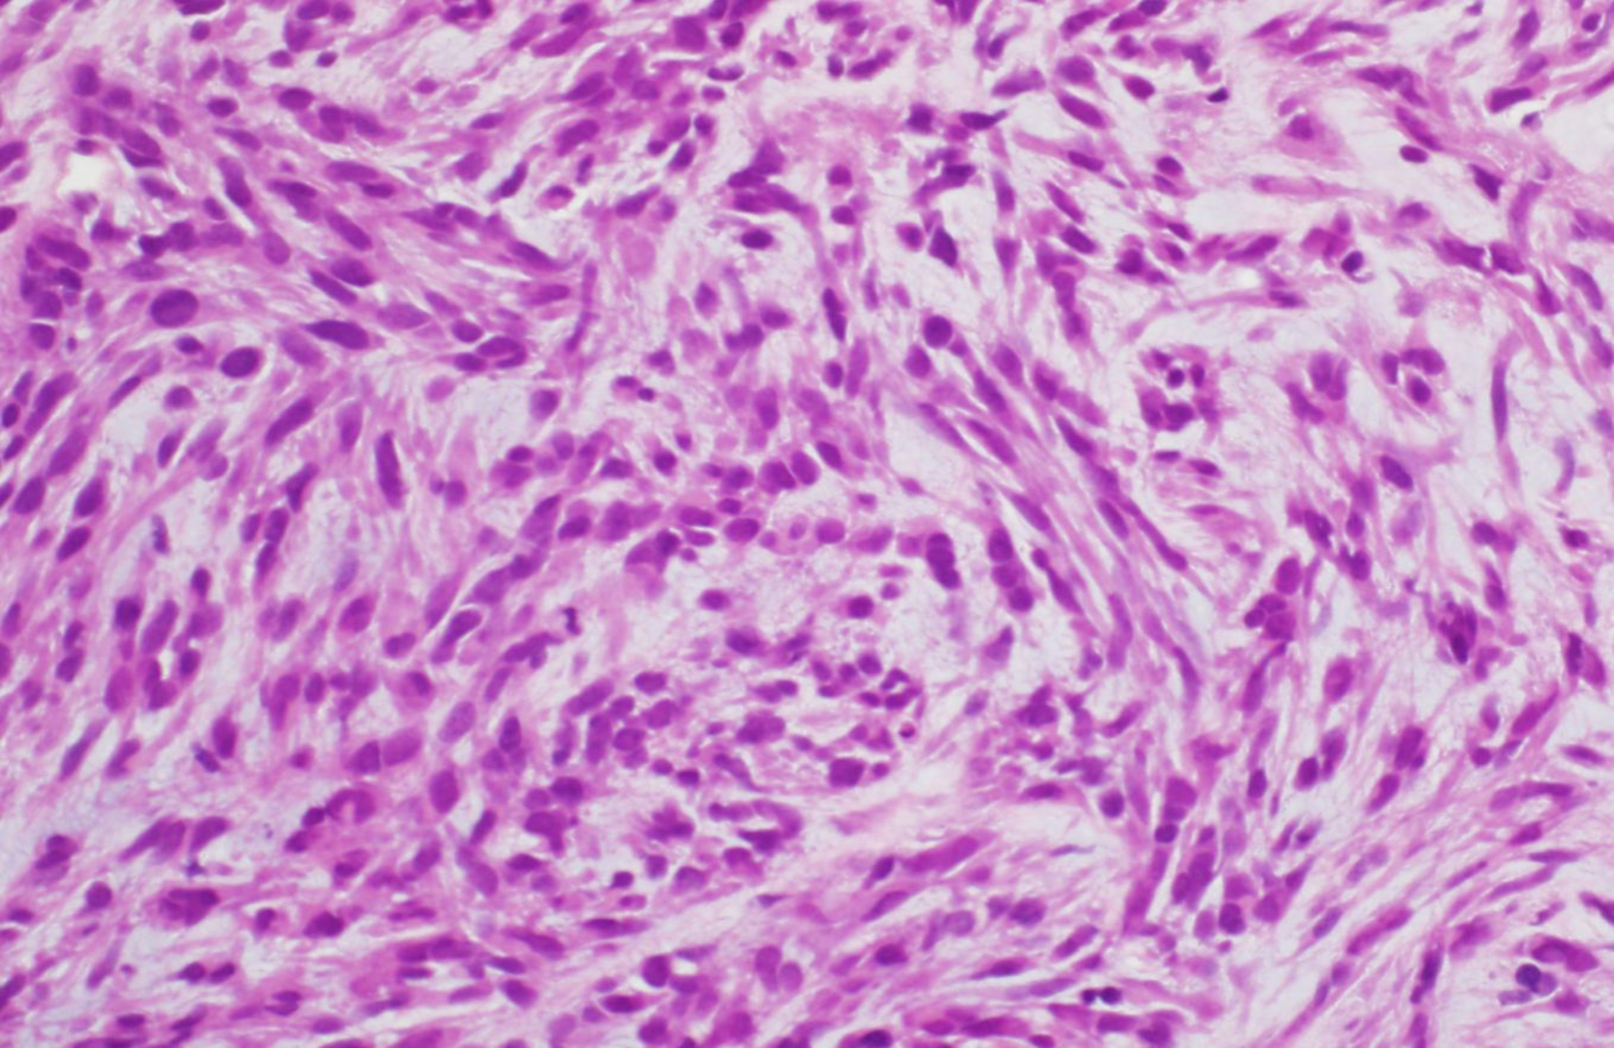
Hematoxylin & Eosin Stain

Slide 5
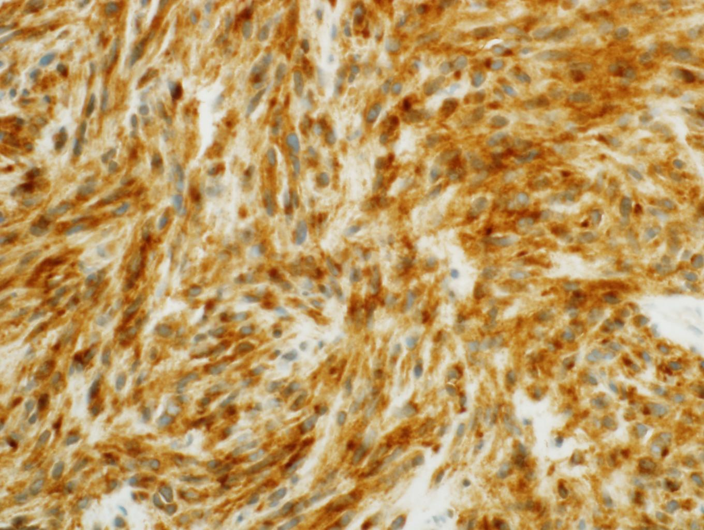
Immunoreactivity to CD-117 (c-kit)

Slide 6
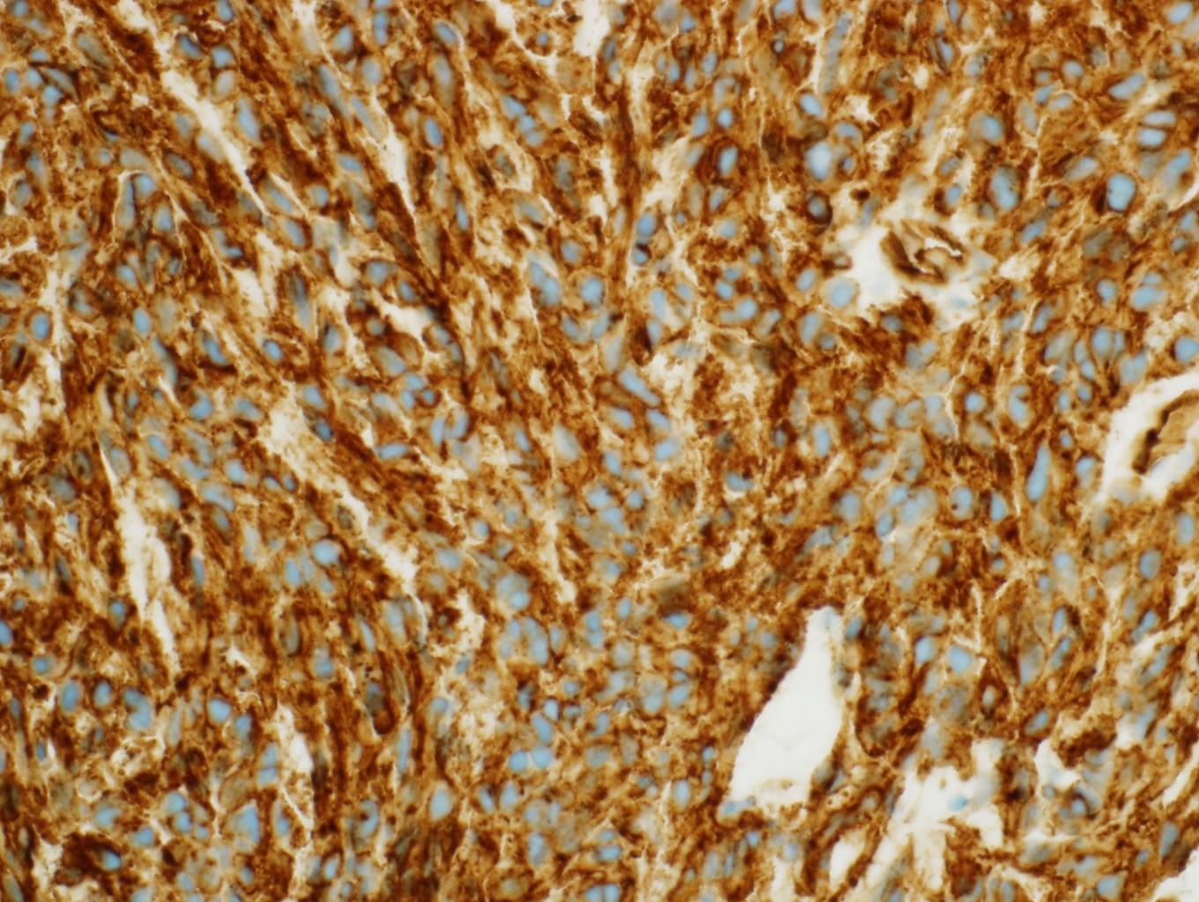
Immunoreactivity to CD-34

Slide 7
Final Diagnosis
Primary Gastro-Intestinal Stromal Tumor (GIST) of the left adrenal gland
Surgery was advised
  Patient refused
  Alternative treatment was imatinib

Slide 8
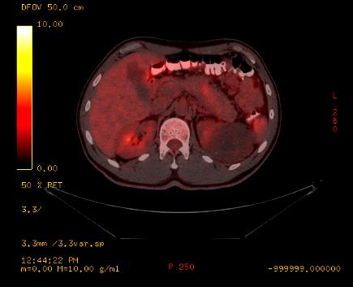
3-month F/U PET―CT

Slide 9
PET―CT: pre and post Tx

Slide 10
GIST (1/8)
Mesenchymal tumors
Arise from interstitial cells of Cajal
c-kit (90%) and PDGFRA mutations
Common sites:
  Stomach (40-70%)
  Small intestine (20-40%)
  Esophagus, colon & rectum (< 10%)
Notes:
GISTs are believed to be derived from interstitial cells of Cajal (ICC) (pacemaker cells) which are present in the muscular layer of the gastrointestinal walls [21]. ICCs express CD117 (c-kit, a transmembrane tyrosine kinase receptor) and CD34 (a highly glycosylated cell surface antigen)

Slide 11
GIST (2/8)
Uncommon sites:
  Adrenal gland
  Only 1 published “case report”
    Sereg et al. Gastrointestinal stromal tumor presenting as a hormonally inactive adrenal mass Endocrine. 2011 Feb;39(1):1-5
Notes:
EGISTs may develop from the pluripotent mesenchymal stem cells, while others proposed that they may be the consequence of an extensive outgrowth of GISTs loosing their contact with the gut wall
CD117 and smooth muscle actin ( alpha SMA)

Slide 12
GIST (3/8)
70% of cases are symptomatic
Common symptoms:
  Mass effect
  Abdominal pain, GI bleeding, fatigue, bloating, weight loss
Radiologic modality:
  CT Scan
  PET―CT scan: FDG-avid lesions

Slide 13
GIST (4/8)
Histopathology:
  Spindle cell (70%) neoplasm
  Epitheliod cell (30%) neoplasm
Immunohistochemistry:
  95% positive to CD-117 (c-kit)
  ??% positive to CD-34
  Negative to CK, CD-31, S-100, desmin, vimentin

Slide 14
GIST (5/8)
Management:
  Surgery: the gold standard
  Imatinib: alternative therapy
    Tyrosine kinase inhibitor (TKI)
    Decrease tumor size and recurrence rate
    Safe and well-tolerated
    Drug resistance in some patients
Notes:
Patients who develop resistance to imatinib may be suc- cessfully treated with sunitinib, a new member of tyrosine kinase inhibitors [26]. Most recent reports indicate that imatinib may be useful even in an adjuvant setting, as its use after resection of the primary GIST increased the recurrence-free survival of seemingly tumor-free patients compared with placebo [28].

Slide 15
GIST (6/8)
Prognosis:
  tumor size and mitotic activity → not applicable to EGIST
  most common type of mesenchymal tumors
  <1% of tumors in GI
  Encourage follow-up with patient
Notes:
Mention 1 fact about its clinical behavior

Slide 16
GIST (7/8)
Adrenal incidentoloma:
  0.6 to 1.3% of all abdominal CT
  Possible DDx:
    adenoma, myelolipoma, cyst, lipoma, pheochromocytoma, adrenal cancer, metastatic cancer, hyperplasia, TB
Notes:
Because of the high likelihood of adrenal tumors originating from the stomach, and because of the proximity of the greater curvature to the left adrenal gland, a biopsy was excised from the greater curvature of the stomach.
Results excluded stomach involvement, thus, reinforcing diagnosis of a primary left adrenal GIST.

Slide 17
GIST (8/8)
Positive immunoreactivity to CD-117 and CD-34
Negative immunoreactivity to:
CD-31 –angioma, angiosarcmas,
S-100 – melanoma, schwanoma, neurofibroma,
cytokeratin – glandular epithelia tumors
desmin and vimentin– sarcomas
GI leiomyoma – Desmin 100% positive
Fibromatosis – CD117 and CD34 negative

Slide 18
Conclusion (1/2)
Primary E-GIST arising adrenal gland is extremely rare.
  Only 1 reported case report in literature
The proximity of the left adrenal gland to the greater curvature can be misleading

Slide 19
Conclusion (2/2)
Radiological investigations (PET―CT scan) and immunohistochemical staining (CD-117 and CD-34) are essential to delineate the tumor and confirm diagnosis.
Imatinib therapy for GISTs & EGISTs has been shown to be promising in resolving tumor and symptoms

Slide 20

Thank You
Riyadh, Saudi Arabia

