Slide 1


Growth form and germination requirements can shape plant diversity and community structure in arid Arabian deserts
Ali El-Keblawy¹, Hatem A. Shabana² and Teresa Navarro³
¹Applied Biology Department, University of Sharjah, Sharjah, UAE
² Sharjah Seed Bank and Herbarium, Sharjah Research Academy, Sharjah, UAE
³ Departmento de Biología Vegetal, Universidad de Málaga, Málaga, Spain

Slide 2
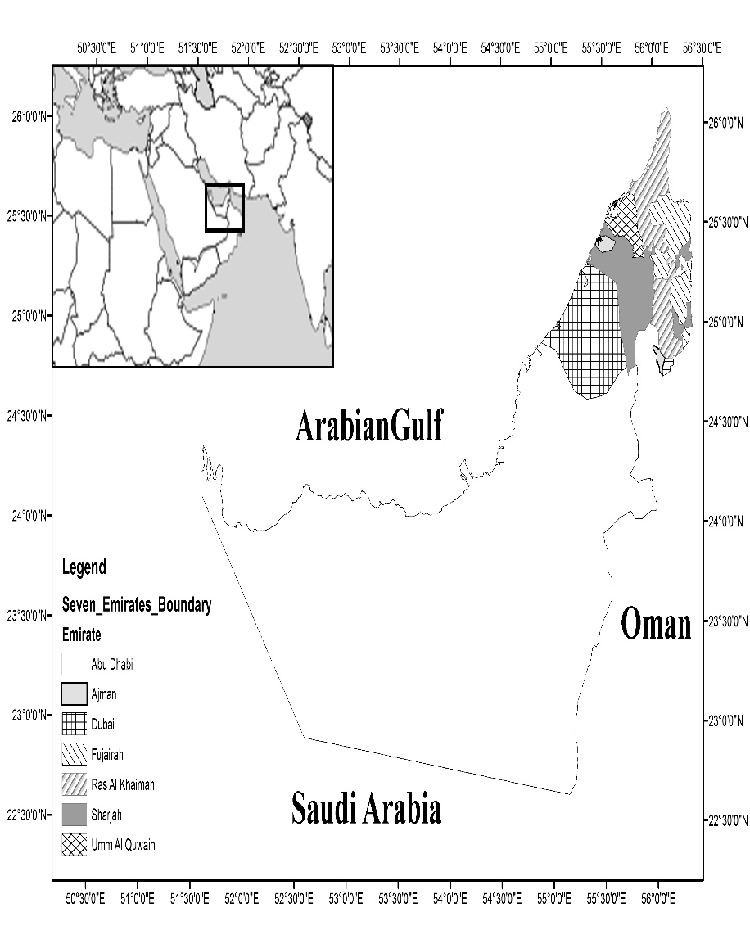
Study area
The United Arab Emirates (UAE) is located at the southeastern part of the Arabian Peninsula.
It is hyper-arid region with a hot-sunny climate and low sporadic rainfall.

Slide 3
Overview
Seed dormancy is an adaptation of many plant species in unpredictable heterogeneous environments, such as arid desert.
Dormancy advantage, delay seed germination until the arrival of favourable conditions that allow seedling establishment and minimize seedling mortality.
Light, temperature and moisture are the most important factors that determine germination time and place in desert environments.

Slide 4
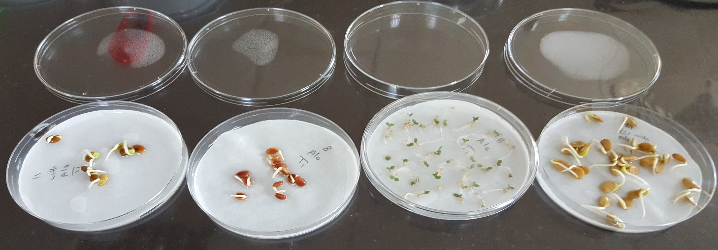
Overview
Seed size:
Generally, large seeds produce bigger seedlings with better competitive ability than smaller seeds, especially under resource-limited.

Slide 5
Overview
In general, dormancy is negatively correlated with seed mass and size.
lower dormancy in large-seeded species and high dormancy in small-seeded species.
Opposite trend reported by Wang et al. (2016), he investigated the relationship of seed mass and dormancy in 124 species found that heavier seeds (> 1 mg) had higher dormancy than smaller seeds (<0.1 mg).

Slide 6
Overview
Growth Form:
In trees, The heavier diaspore unit (fruit or seed) of trees might be dispersed down by gravity or dispersed away from the crown.
Small shrubs have dense short canopy laid over the ground so limit the dispersal for heavier seeds, but lighter seeds have the chance to be dispersed by winds.
Herbs have shorter opened crown that might allow their lighter seeds to disperse far away from maternal plants.
The relationship between storage place and growth form would be especially important for species have aerial seed bank.

Slide 7
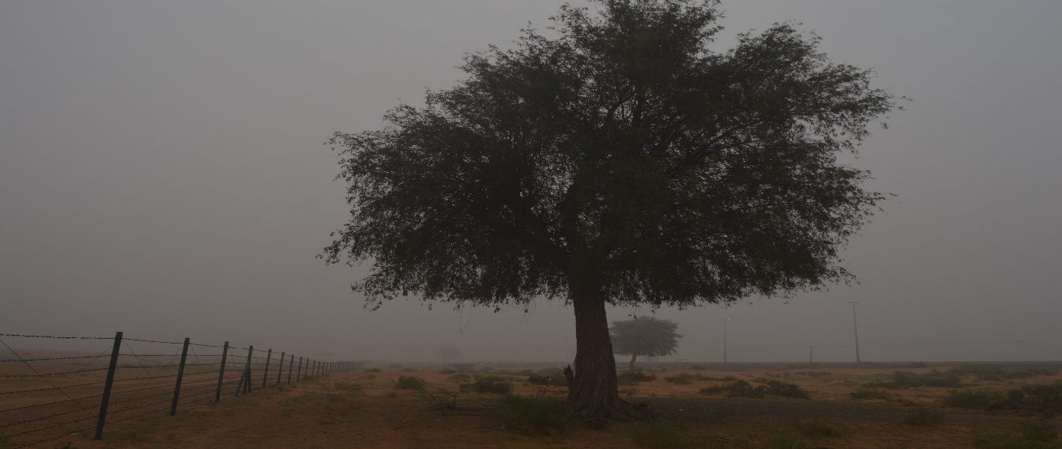
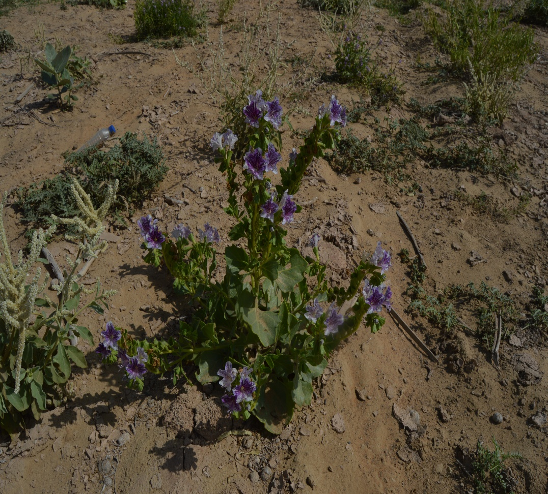
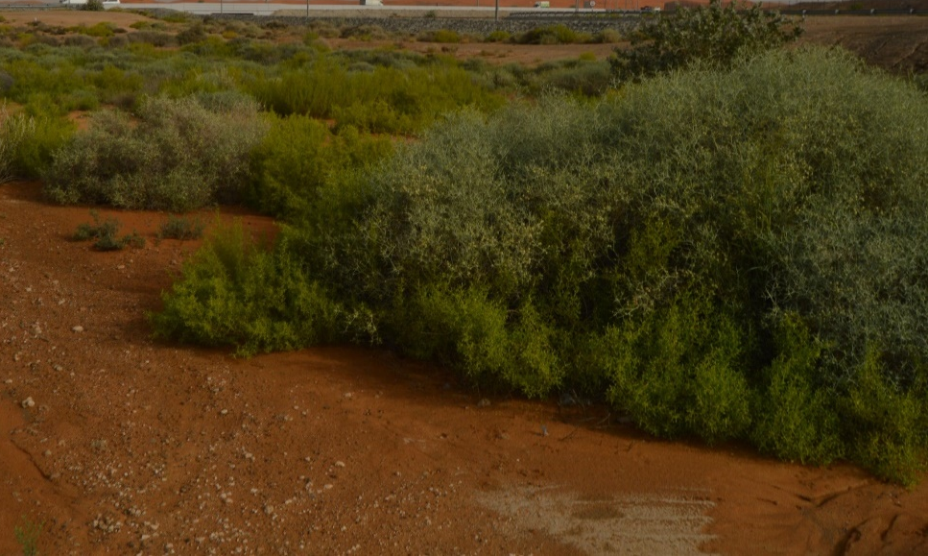
Growth forms

Slide 8
Aims
Assess the impact of plant growth form, seed storage, and seed size on light and temperature requirements during germination of 23 desert plants with aerial seed bank.

Slide 9
Methods
Mature fresh seeds of the 23 species were collected during May – June 2015 from the northern emirates, UAE.
These fresh seed divided into two parts; one part was germinated immediately and the second stored in brown paper bags at room temperatures (20±2 ºC) until their germination with field storage seeds.
In February 2016, field storage seed of the same species were collected (from the canopy or soil) and germinated.

Slide 10
Methods
The germination was conducted in petri-dishes containing one disk filter paper, with 10 ml distilled water.
Four replicates of 25 seeds.
Fresh and stored seeds were germinated in three programmed incubators set at 15/25°C, 20/30°C and 25/35°C in both alternating 12h light/12h darkness and continuous darkness .

Slide 11
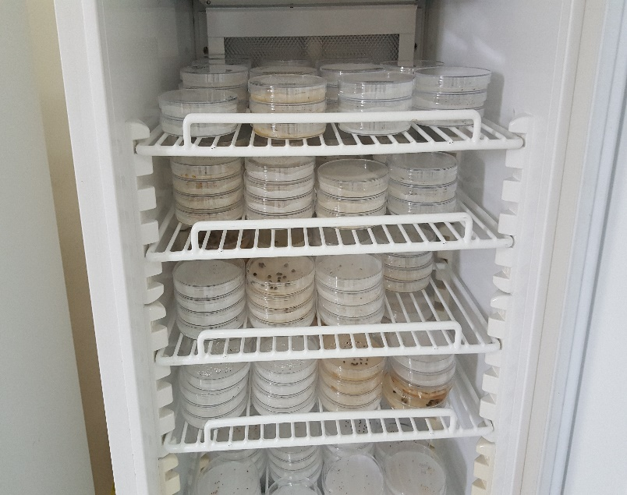
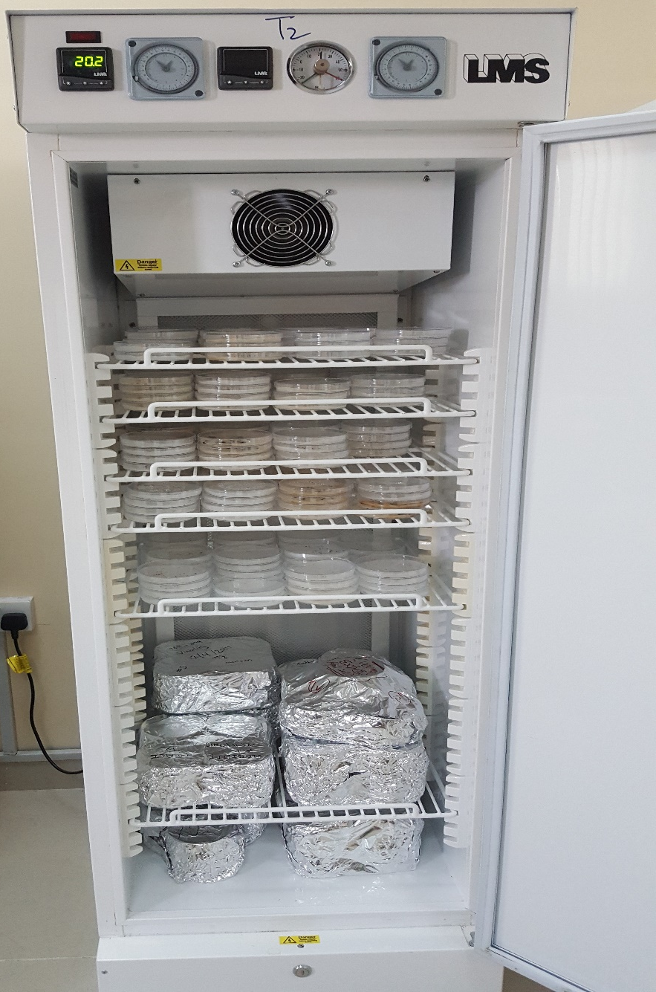
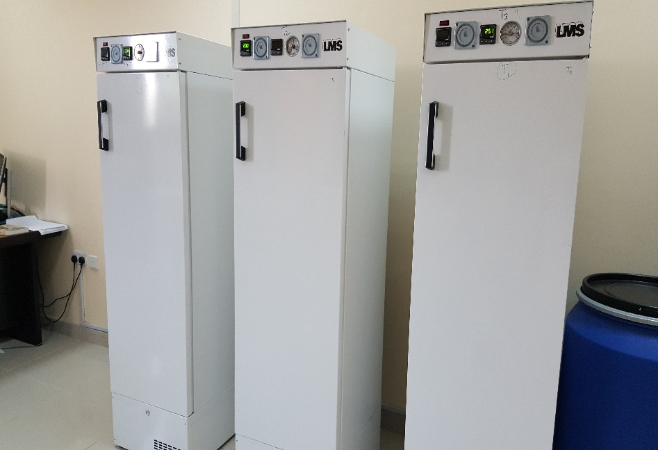
Methods

Slide 12
Methods
Germination recorded with emergence of the radicle.
Germinated seedlings were counted and removed every alternate day for 24.
average seed mass was determined by weighing three replicates, each of 100 seeds.
average seed size was assessed by measuring the length of 50 seeds.

Slide 13
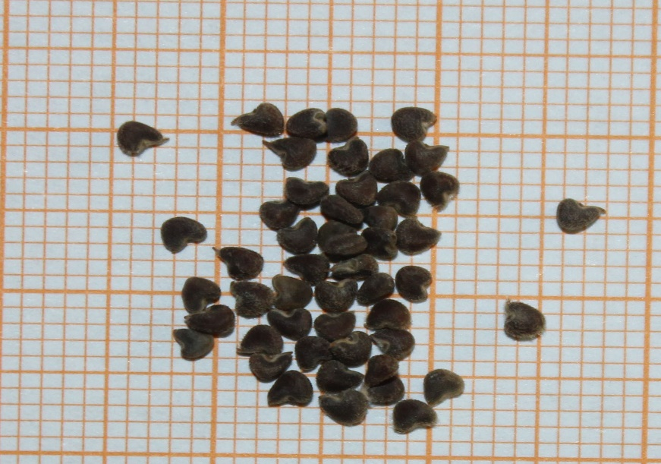
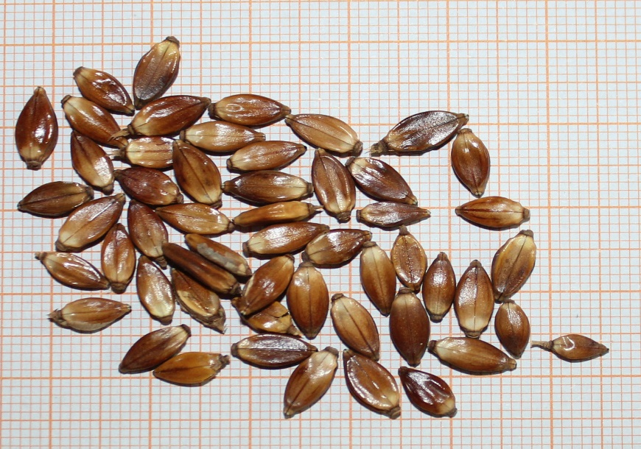
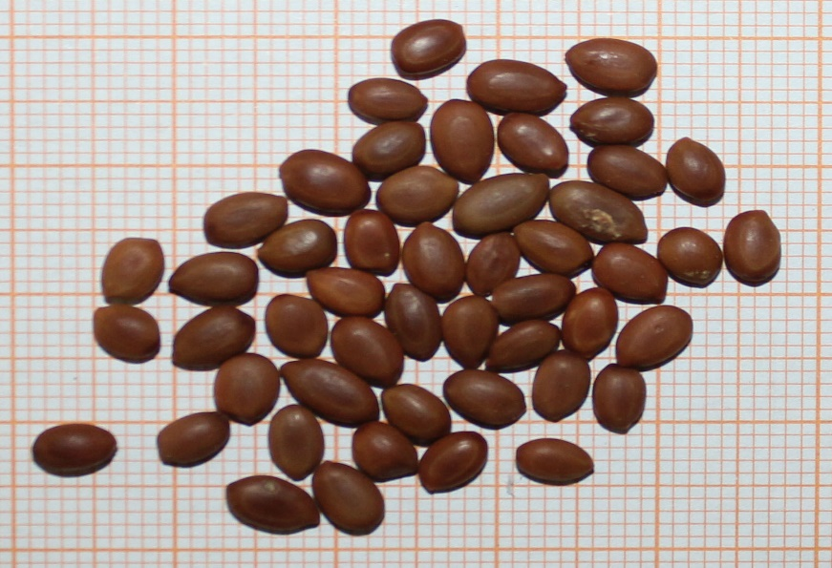
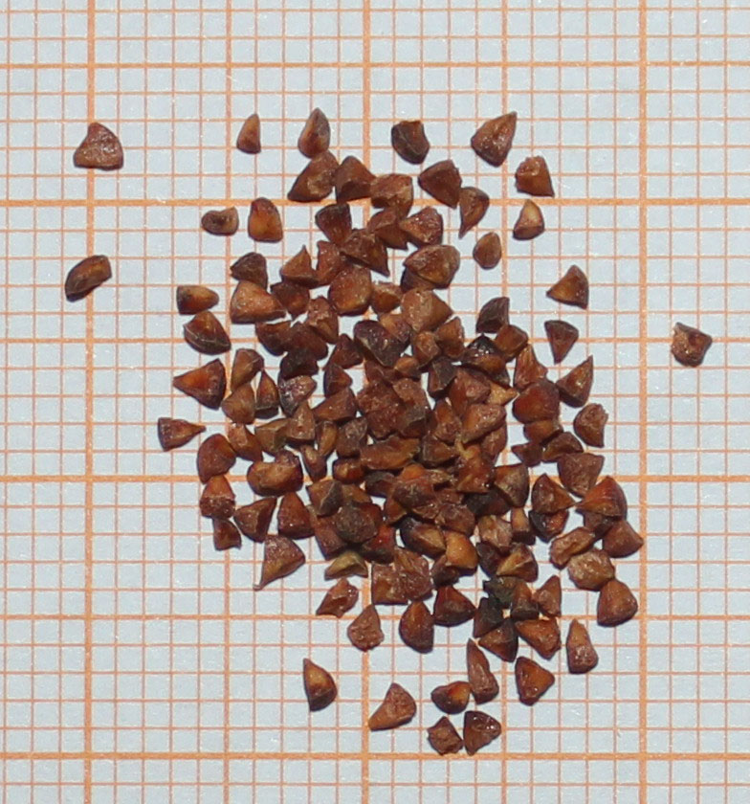
Methods

Slide 14
Methods
Assessed final germination percentage, Relative light germination (RLG, expresses the light requirement for seed germination), and The germination rate (GRI).
Used ANOVA and Pearson correlation coefficients to data analysis by using SYSTAT, version 13.0.

Slide 15
Results
Herbaceous plants have smaller and lighter seeds.
Room temperature storage improved final germination.
Germination of herbaceous and trees species was greater than that of shrubby plants.
Germination in light was greater than in darkness.
Unlike light, temperature had limited role in seed germination

Slide 16
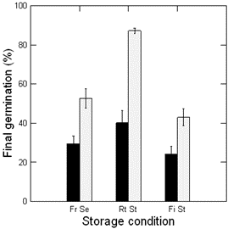
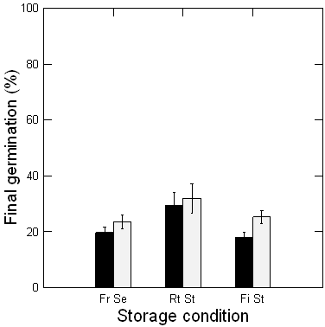
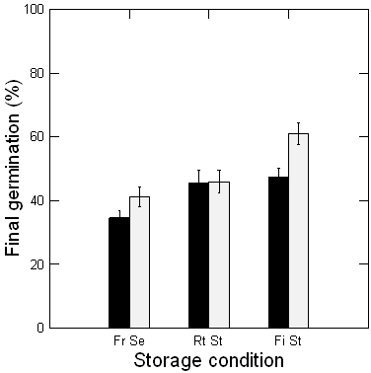
Results
Final germination of growth form.
Herbaceous Shrubs Trees

Slide 17
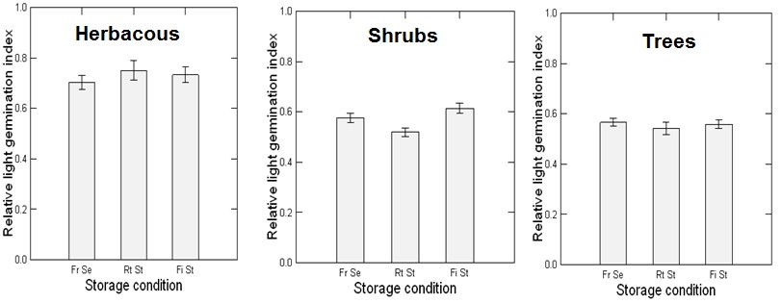
Results
RLG was positively photoblastic (near from 1 value) in herbaceous plants (0.73), but was neutrally in both shrubs and trees (near from 0.5 value).

Slide 18
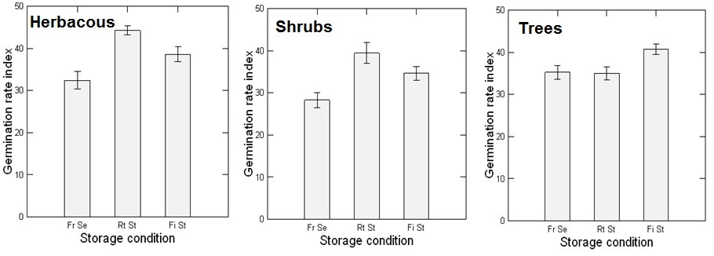
Results
(GRI), Both herbaceous and shrubby species, room temperature seeds attained faster germination than fresh seeds and field stored seeds.

Slide 19
Results
The relationships between seed size and final germination :
- Positive in dark and negative in light. This indicates that more large-seeded-species germinated better in dark, but more small-seeded species germinated better in light.
Germination was positive in herbaceous and trees, but negative in shrubby species.

Slide 20
Results
The relationship between seed size and LGI was positive in shrubs; but was negative in herbs and trees.
GRI was greater for bigger seeds of herbs and shrubs. But in trees the greater was for small seeds.

Slide 21
Discussion
Generally, shrubs and trees attained lower germination than herbaceous plants. This indicates that smaller seeds germinate much more than larger seeds.
Smaller seeds of herbs have greater chance for dispersal with winds than larger seeds of the other growth forms and explore new favourable condition, especially in the unpredictable desert habitats.

Slide 22
Discussion
In herbaceous plants, the small-seeded herbs contribute their seeds to soil seed bank, but large-seeded invest more in their regeneration.
Herbs with small seeds distribute the risk along time and retain a fraction of un-germinated seeds for the future.

Slide 23
Discussion
Small-seeded herbs required more light for germination, but large-seeded ones germinated better in darkness.
Small seeds buried too deep in the soil avoid possible fatal germination.
Small seeds have little resources that limit seedling emerge from a depth deeper than superficial soils.
The more food reserves of larger seeds enable them to emerge even from a deeper soil.

Slide 24
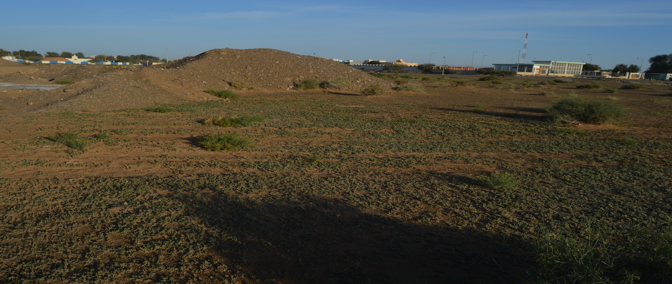
Discussion
Germination of larger seeds at deeper soil ensures that they will be closer to the wet soil, which would increase the chance of the seedling establishment.

Slide 25
Discussion
In shrubs, large-seeded species germinate less than small-seeded ones.
Fewer large seeds that could germinate do that mainly in light.
Canopy of small shrubs are dense, rounded and laid over the ground so heavier larger seeds are expected to be retained under the canopies would expose them to lower R:FR (red/far-red) ratio and consequently result in lower germination, especially in dark.
larger seeds of shrubby plants should be dispersed away from their canopies.

Slide 26
Discussion
The better chance of small seed for germination under the canopies of nurse plants to provide shade protect them from direct thermal radiation.
The reduction of germination of the larger seeds under the canopy would reduce inter- and intra-specific competition.
large seeds that would germinate away from canopies can produce bigger seedlings that might adapt to dryness of exposed soils.

Slide 27
Discussion
In trees, species with large-seeded trees germinated more in dark, but small-seeded ones germinated better in light.
The result could be explained according to the mode of dispersal of the studied tree species.
Heavy diaspore unit which dispersed primarily by gravity germinated under the canopies

Slide 28
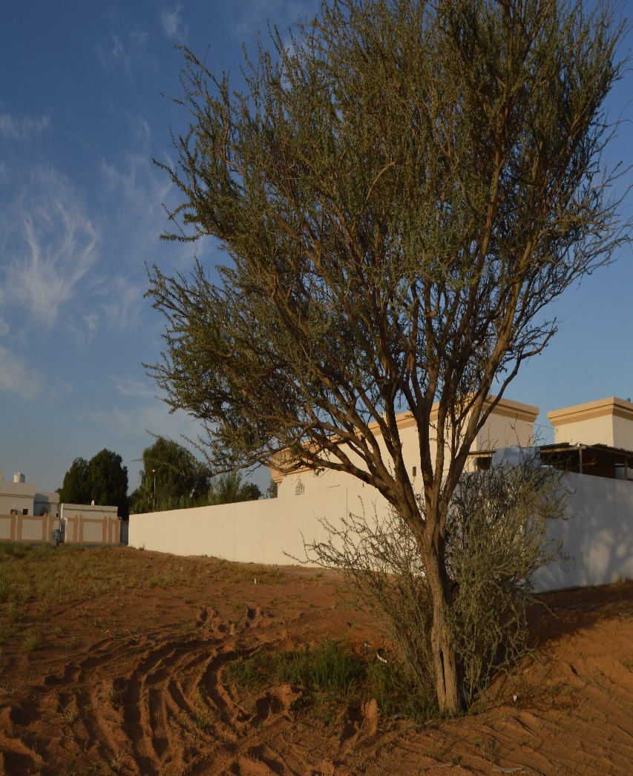
Discussion
Endozoochorous species would disperse within the feces of grazing animals and consequently germinate in darkness; either within the feces or when feces buried in soil.
When large seeds germinated under tree canopies they will produce larger seedlings that could compete with the maternal trees in the long term.

Slide 29
Discussion
Field storage didn’t improve germination of seeds of herbaceous and shrubby plants, but improved it in seeds of trees.
Under field condition, physical dormancy of many species is broken down by sand scarification.
Diurnal fluctuations in day and night moisture and temperatures could result in break down physical dormancy.

Slide 30
Discussion
Room temperature storage resulted in greater germination of herbaceous and shrubs seeds.
Room temperature storage could mimic the natural conditions under litters and dead plants.

Slide 31
Conclusion
The seed size and storage, and light requirement during germination of species belong to different growth forms could explain their distribution in the community and consequently could help explain community structure and composition.
It is important to differentiate between the effects of storage of seeds retained in the maternal tissue crowns of the plants (i.e., serotiny) and that of seeds stored on soil surface.

Slide 32
Acknowledgments
Many thanks for Sharjah Seed Bank & Herbarium, Sharjah Research Academy, for using their germination facilities. Thanks, are also for Mr. Tamer Mahmoud, Mohamed Hassan, Mohamed Fiaz and Dr. Sanjay Gariola, for their help in the seed collection.

Slide 33
References
Baker, H. G. 1972. Seed weight in relation to environmental conditions in California. Ecology 53:997-1010.
Baskin, J. M., & Baskin, C. C. 2000. Evolutionary considerations of claims for physical dormancy-break by microbial action and abrasion by soil particles. Seed Science Research 10: 409-413
El-Keblawy, A. 2003. Effects of achene dimorphism on dormancy and progeny traits in the two ephemerals Hedypnois cretica and Crepis aspera (Asteraceae). Canadian Journal of Botany. 81: 550-559.

Slide 34
References
El-Keblawy, A. & Al-Rawai, A. 2006. Effects of seed maturation time and dry storage on light and temperature requirements during germination in invasive Prosopis juliflora. Flora-Morphology, Distribution, Functional Ecology of Plants 201: 135-143.
El-Keblawy, A. 2014. Effects of seed storage on germination of desert halophytes with transient seed bank. In Sabkha Ecosystems: Volume IV: Cash Crop Halophyte and Biodiversity Conservation (pp. 93-103). Springer Netherlands.

Slide 35
References
Gross, K. L. 1984. Effects of seed size and growth form on seedling establishment of six monocarpic perennial plants. The Journal of Ecology 369-387.
Gutterman, Y. 2012. Seed germination in desert plants. Springer Science & Business Media.
Fenner, M. & Thompson K. 2005. The Ecology of Seeds. Cambridge University Press, Cambridge
Wang, Z., Qian, J. & Liu, B. 2016. Seed Mass, Shape and Dormancy in Arid Temperate Degraded Grassland in Northeastern Inner Mongolia, China. Land Degradation & Development.

