Slide 1
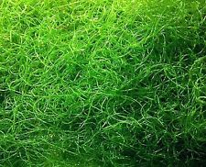
Sustainable Utilization of Seaweeds
International Conference on
Pollution Control & Sustainable Environment
April 25-26, 2016 Dubai, UAE
Hassan I. El Shimi¹ and Soha S. Moustafa²
¹Chemical Engineering Department, Faculty of Engineering, Cairo University (CUFE), Egypt
²Microbiology Department, Soils, Water and Enviroment Research Institute (SWERI), Agricultural Research Center (ARC), Egypt
Dubai, UAE in April 26th, 2016

Slide 2
Agenda
Introduction to Seaweed “Macroalgae”
Potentials of Seaweeds
Nutritional value of Macroalgae
Energy extraction from seaweed
Bio refinery and Utilization Paths for Macro algae
Conclusions
References

Slide 3
Introduction
Algae are unicellular and multi-cellular aquatic “plants” and possess chlorophyll without true stems and roots.
Algae are divided by size into Macroalgae “Seaweed” and Microalgae; microscopic single cell organisms (1µm-100µm).
15 Million Tons of Macroalgae are cultivated per year
Raw seaweed comminution
Carbohydrates
Fermentation
Chemical conversion
Minerals
Proteins
Residues
Energy source
Fertilizer
Food
Cosmetics
Animal feed
Vitamins
Food
Biofuel
Bulk chemicals
Biofuel
Bulk chemicals

Slide 4
Considerable amounts of algae are accumulated on Seas offshores which resist the ships motion and polluting the people’s bodies upon swimming (Seawater Pollution), so it must be removed.
For Sustainable Environment, utilization of marine will be beneficial in energy or cosmetics sectors.
Chemical Constituents of Common Seaweed
 | Ascophyllum nodosum | Laminaria digitata | Alaria esculenta | Palmaria palmata | Porphyra yezoensis | Ulva species
Type | Brown | Brown | Brown | Red | Red | Green
Water (%) | 70-85 | 73-90 | 73-86 | 79-88 | nd | 78
Ash | 15-25 | 21-35 | 14-32 | 15-30 | 7.8 | 13-22
Total carbohydrates | - | - | - | - | 44.4 | 42-46
Alginic acid | 15-30 | 20-45 | 21-42 | 0 | 0 | 0
Xylans | 0 | 0 | 0 | 29-45 | 0 | 0
Laminaran | 0-10 | 0-18 | 0-34 | 0 | 0 | 0
Mannitol | 5-10 | 4-16 | 4-13 | 0 | 0 | 0
Fucoidan | 4-10 | 2-4 | nd | 0 | 0 | 0
Floridoside | 0 | 0 | 0 | 2-20 | nd | 0
Other carbohydrates | c. 10 | 1-2 | 1-2 | nd | nd | nd
Protein | 5-10 | 8-15 | 9-18 | 8-25 | 43.6 | 15-25
Fat | 2-7 | 1-2 | 1-2 | 0.3-0.8 | 2.1 | 0.6-0.7
Tannins | 2-10 | c. 1 | 0.5-6.0 | nd | nd | nd
Potassium | 2-3 | 1.3-3.8 | nd | 7-9 | 2.4 | o.7
Sodium | 3-4 | 0.9-2.2 | nd | 2.0-2.5 | 0.6 | 3.3
Magnesium | 0.5-0.9 | 0.5-0.8 | nd | 0.4-0.5 | nd | nd
Iodine | 0.01-0.1 | 0.3-1.1 | 0.05 | 0.01-0.1 | nd | nd

Slide 5
Algae as sustainable future source for biofuel
Algae don not require agricultural land for cultivation as terrestrial crops investigated for biofuel production.
Many species grown on brackish and saline water (1kg biomass requiring 1m³ wastewater) avoiding food competition which required fresh water.
The biomass yield of algae per unit area is higher than that of terrestrial crops; e.g. brown seaweeds having yield of 13.1kg dry biomass compared to 10kg for sugarcane.
Algae convert CO₂ to biofuel (biodiesel, bioethanol and bio butanol) and other chemical feedstocks so, they described as potential sunlight-driven cell factories.

Slide 6
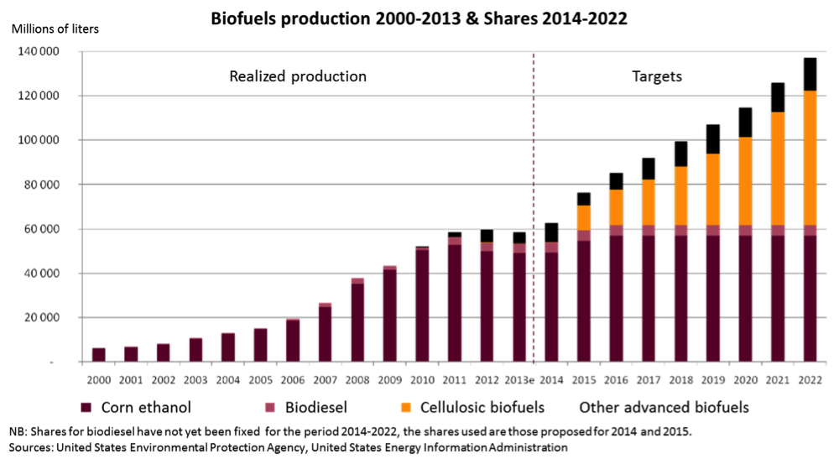
Algae as sustainable future source for biofuel

Slide 7

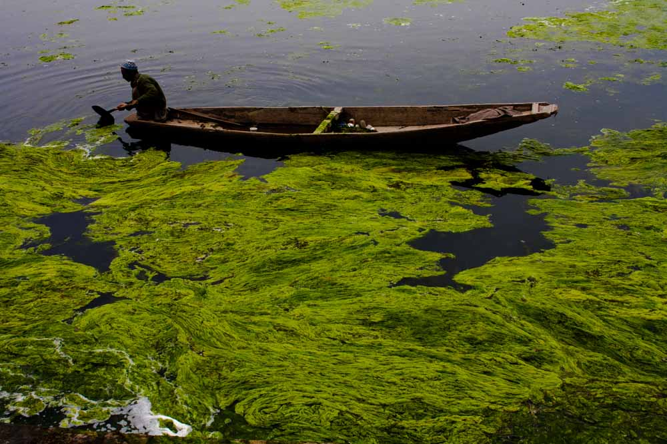
Algae Business (AB)
Up to now, no economically-viable commercial scale fuel production from micro- or macroalgae; because of the lower Energy Return on Investment (EROI) compared to petroleum products.
Considering full spectrum of products that might be extracted from algal biomass in addition to biofuels, in so-called “Bio refineries” could enhancing the algae business.
Today the global utilization of (non-fuel) products obtained from macroalgae is a multi-billion dollar industry, and Asia is the main market.

Slide 8
Algae Business (AB)
Current uses of seaweeds include human foods, fertilizers, cosmetics ingredients and phycocolloids.
Worldwide 221 species of macroalgae are known to be exploited by humankind, in which 66% of the species used as food with 86000 tons production rate.
Luminaria (reclassified as Saccharine for some species), Undrain, Porphyria, Euphemia, and Gracilaria, representing 76% of the total tonnage for cultured macroalgae.

Slide 9
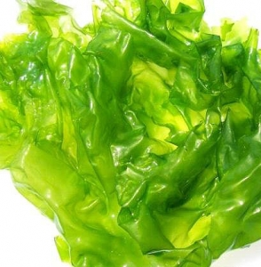
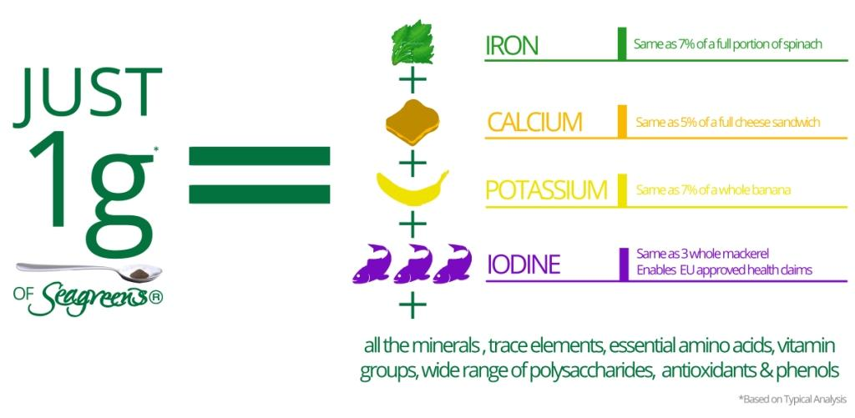
Health Benefits of Seaweed
Protein 12%
Calories 2%
Nutrients
Vitamin A 100%
Vitamin C 65%
Vitamins
Mn 49%
Fe 10%
Cu 13%
K 10%
Minerals
Carbo-hydrates 2%
Dietary Fiber 1%
Minerals & Vitamins rich
Mood balancing properties for women
Helps to strengthen eyes and hair
Used in soups, salads & eat it on its own
Aids in reducing accumulation of fats and aids in weight loss
Helps to prevent colon cancer and helps to detoxify and cleans body

Slide 10
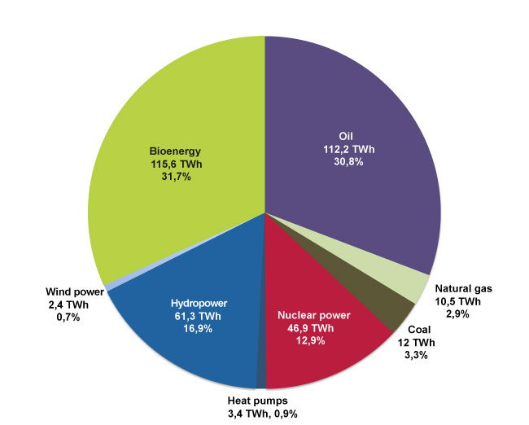
BioEnergy Extraction from Macroalgae
BioEnergy Extraction Technologies
Requiring biomass drying
Don’t requiring biomass drying
Combustion
Pyrolysis
Gasification
Transesterification
Fermentation
Hydrothermal treatment
Anaerobic digestion

Slide 11
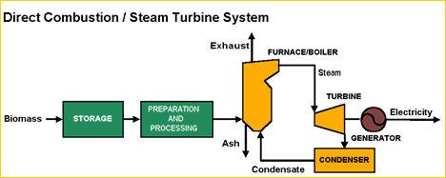
Direct Combustion
Historically, direct combustion of biomass is carried out to generate heat or steam for household and industrial uses or electricity production, but it isn’t yet applied for macroalgae due to the low thermal value (14-16 MJ/kg).
Seaweed moisture content may reduce the heat available by 20%, and CANNOT be exceed 50% for direct combustion fuel.
Macroalgae e.g. Laminaria has ash or residues up to 33% after firing which is too high compared to 0.5-2% for wood. This algal ash lead to boilers fouling and detrimentally impacts on the overall process efficiency.

Slide 12
Direct Combustion
High Sulphur content (1-2.5%) and N₂ (1-5%) contents of Seaweed will also hinder its utilization as a direct combustion fuel.
Fluidized bed boilers are suggested to fire marine biomass, and the particle size has to be ground down to <0.18 mm in order to minimize “heat-transfer resistance”.
Co-combustion of seaweed in coal-fired plants is attractive option to improve the process economics and generate electricity, but that requires local heat demand.

Slide 13
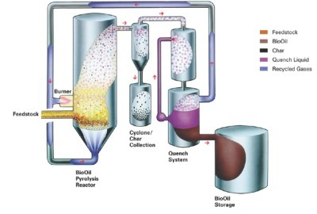
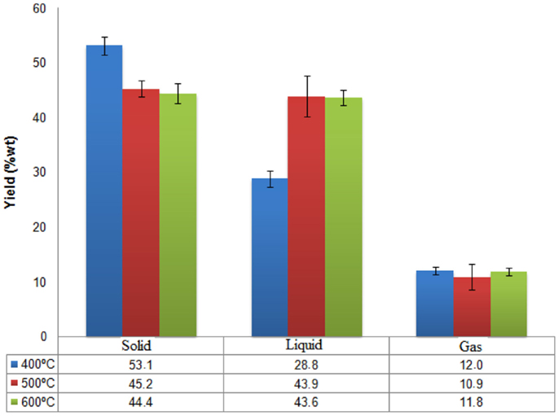
Pyrolysis
Thermal conversion (destruction) of organic biomass in absence of air producing biogas, biooil and char.
By temperature and process time, pyrolysis is classified as slow (<400ºC for days) , fast (=500ºC for min.) and flash (>500ºC for sec.).
Fast and flash pyrolysis has potential of commercial biofuel production from seaweed as bio-oil is the main product (70-80%).
Bio-oil composition depends on biomass type and pyrolysis protocol.

Slide 14
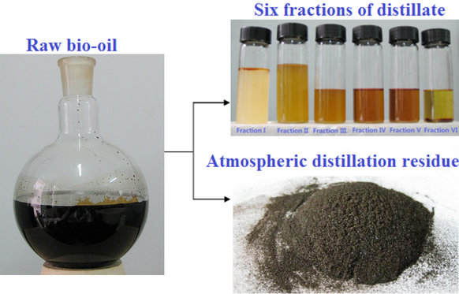
Pyrolysis
Algal bio-oil is complex mixtures of highly oxygenated organic compounds, polar, viscous and corrosive, so it is unstable and unsuitable for use in conventional fuel engines unless refined.
Bio-oil refining has possibility of chemical and food products.
Pyrolysis in presence of solvents liberates biofuels with different properties, e.g. Enteromorpha prolifera at 300ºC with VGO gives Hydrocarbons, while in presence of Ethanol gives Oxygenated Products.
Better bio-oil quality is obtained from pyrolysis of Chlorella with yield 55% as HHV of Chlorella and its bio-Oil was 23.6 and 39.7 MJ/kg dry weight.

Slide 15
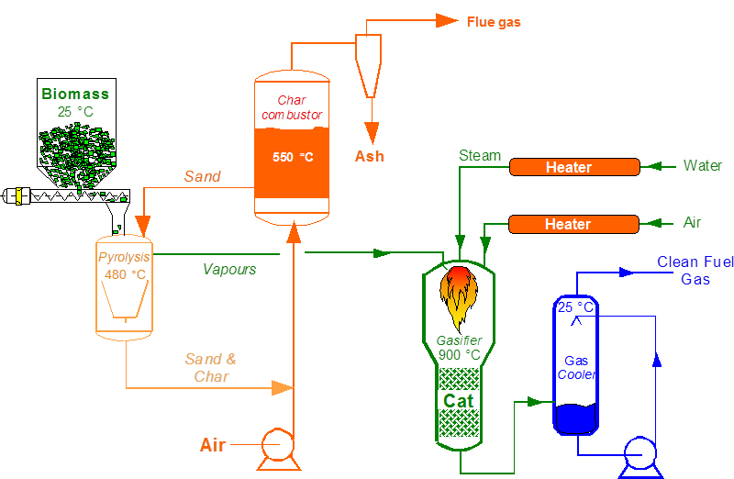
Gasification
Thermal conversion (partial oxidation) of biomass at elevated temperatures (800-1000ºC) into combustible gas mix (Syngas) with CV of 6MJ/m³. It composed of H₂ (30-40%), CO (20-30%), CH₄ (10-15%) and C₂H₄ (1%).
Syngas can be burnt to produce heat or electricity in combined gas turbine systems, or as feedstock for CH₃OH and H₂ production as a transport fuel but, it is still non-economic.
Syngas from macroalgae gasification can be converted catalytically into Hydrocarbons through Fischer-Tropsch Synthesis (FTS)

Slide 16
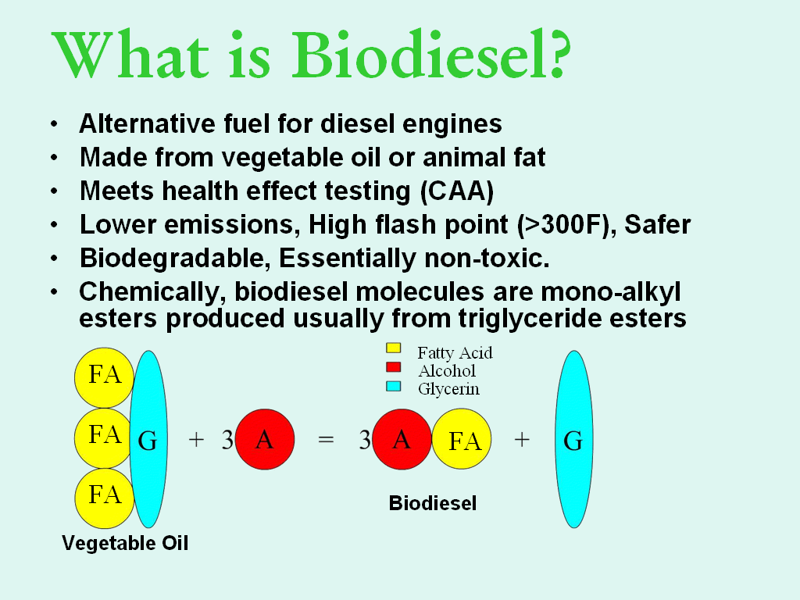
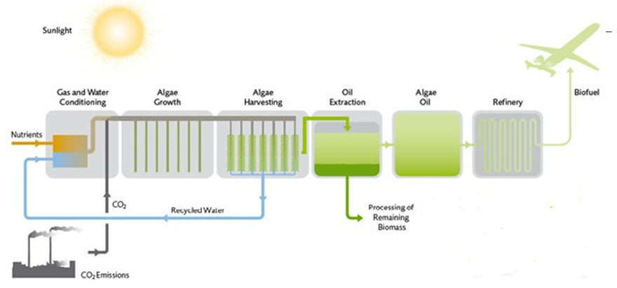
Transesterification
It is a reaction between the algal lipids and alcohol (e.g. methanol) in presence of catalyst to yield fatty acid alkyl esters (biodiesel) and crude glycerol.
This is usually achieved for Microalgae NOT Macroalgae.
Microalgae
Biodiesel Upgrading
Petrochemicals
In-Situ Transesterification

Slide 17
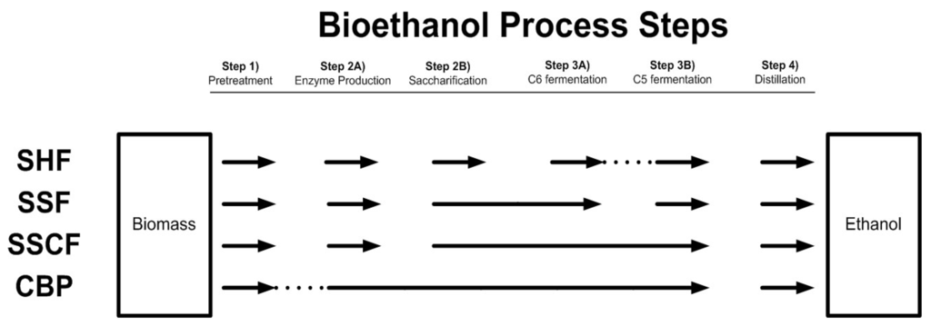
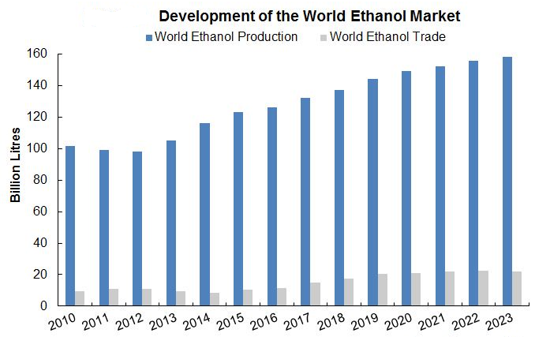
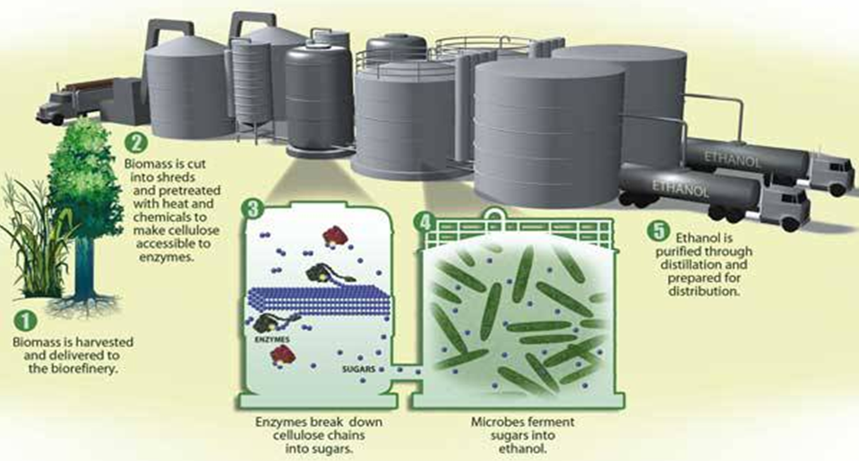
Fermentation

Slide 18
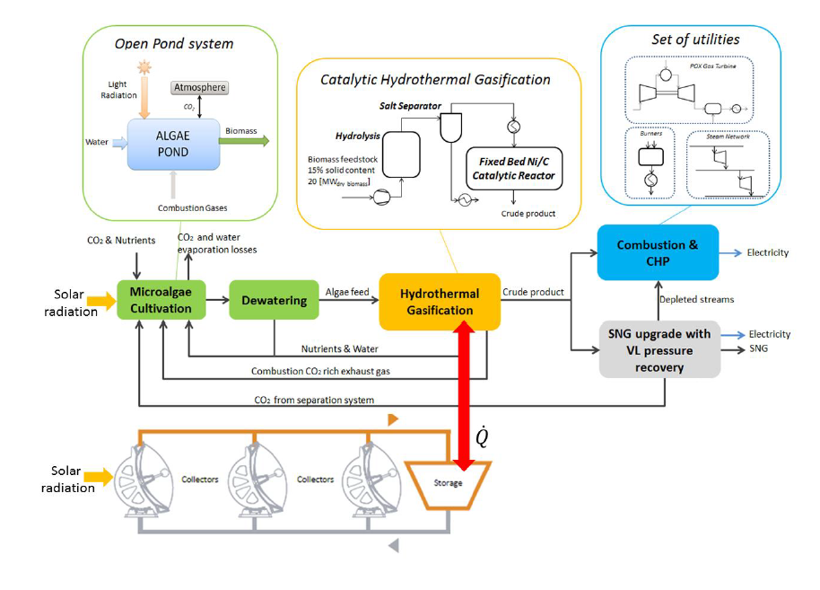
Hydrothermal Treatment

Slide 19
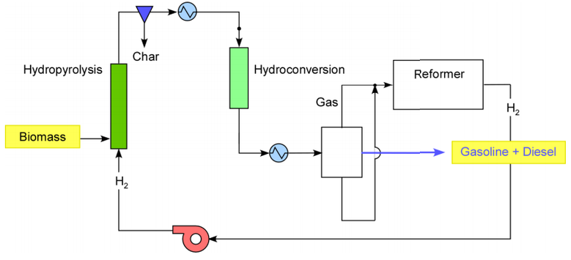
Bio refinery and Utilization Approaches
Integrated Hydro pyrolysis
Directly make desired products.
Run all steps at moderate H₂ pressure (100-500psi).
Utilize C1-C3 gas to make all H₂ required,
Avoid making “bad stuff” made in pyrolysis.

Slide 20
Bio refinery and Utilization Approaches
Egypt solar energy
Seaweed biomass
H₂ Production
Coal
Solar Gasification
Direct combustion
Syngas
(H₂, CO & CH₄)
Natural Gas
Steam-methane reforming
Gas clean-up
FTS
Further upgrading
Kerosene/Diesel
Waxes

Slide 21
Bio refinery and Utilization Approaches
Water + Nutrients + Seaweed seeds
Clean water
Sunlight
Waste water
Biomass production
Biomass recovery
Biomass extraction
CO₂
Animal Feed
Fertilizer
Electricity
Power generation
Biogas
Biochar
Bio-oil
… ?
Electricity to grid
Commercial Heat
Integrated Uses of Algal Biomass

Slide 22
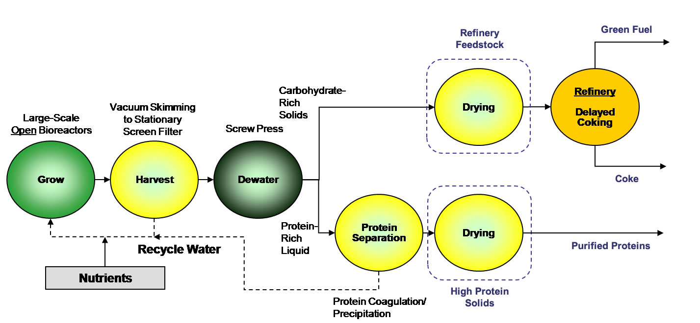
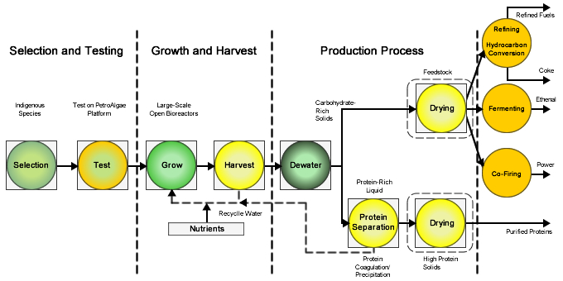
Bio refinery and Utilization Approaches

Slide 23
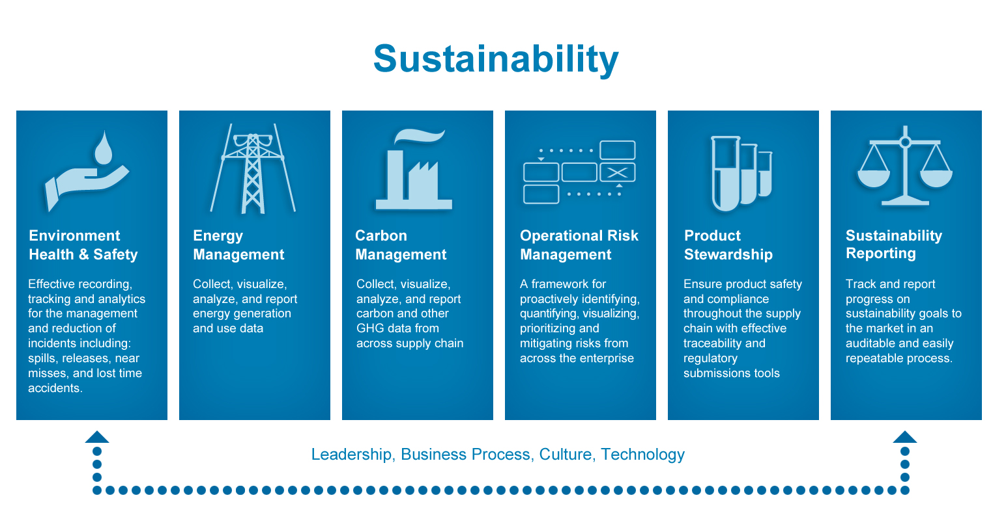
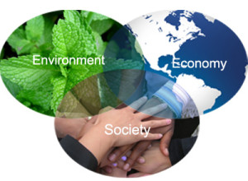
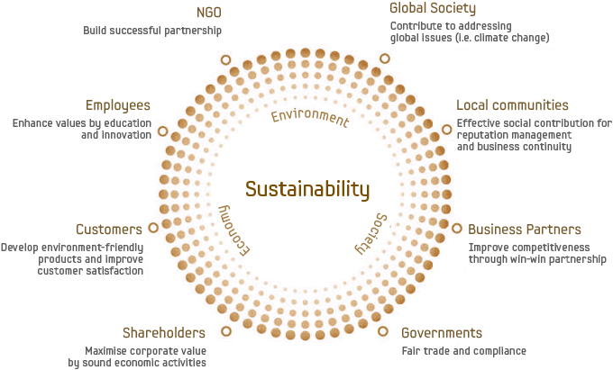
Sustainability
Sustainable Business Organizations participate in environmentally friendly or green practices in order to make certain that all processes, products and manufacturing activities sufficiently address current environmental concerns while still retaining a profit.

Slide 24
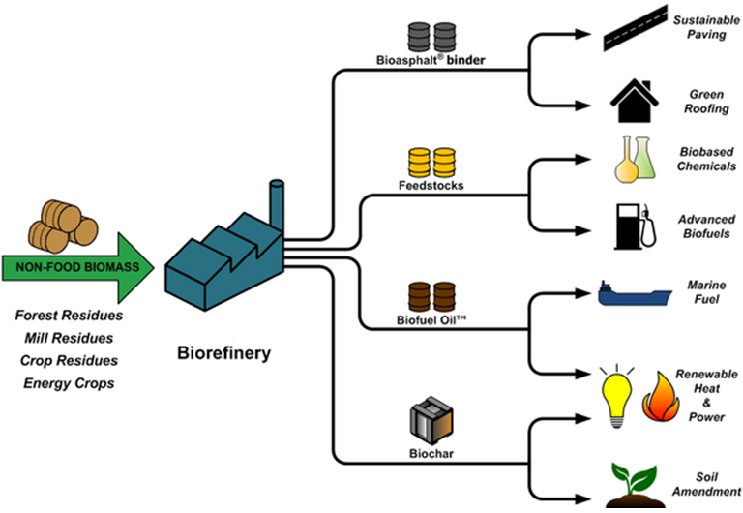
Marine Sustainable Bio Refinery
Environmental
Economic
Social
Marine Biomass
Conversion Technology
Marketable Bio products

Slide 25
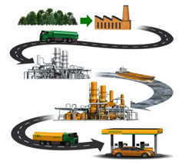
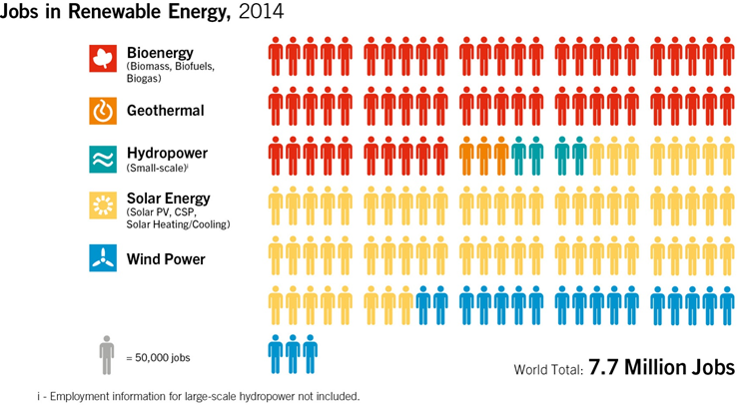
Benefits of Seaweed Utilization
Obtaining valuable products like proteins (Omega 3&6), minerals as nutrition value, bio fertilizer, commercial heat and electricity to grid.
Sustainable utilization of Egypt Solar energy, GHG (CO₂) from coal plants and power stations, and huge amounts of wastewater.
Solve the environmental problems associated from accumulation of seaweed on seas offshores.
Reducing unemployment % via jobs offerization.

Slide 26
Assessment of Technologies Suggested for Sustainable Utilization of Seaweeds
Assessment Criteria | Suggested Approaches for Seaweed Utilization
 | Approach 1 | Approach 2 | ……..
Sustainability
Process Complexity
Total Capital Investment (TCI)
Total Manufacturing Cost (TMC)
Net Profit (NP)
Energy Return On Investment (EROI)
Pay-back Period
Rate of Return (ROR)
Products Market Situation
Country Policy
Country Economic Affairs
EIA

Slide 27
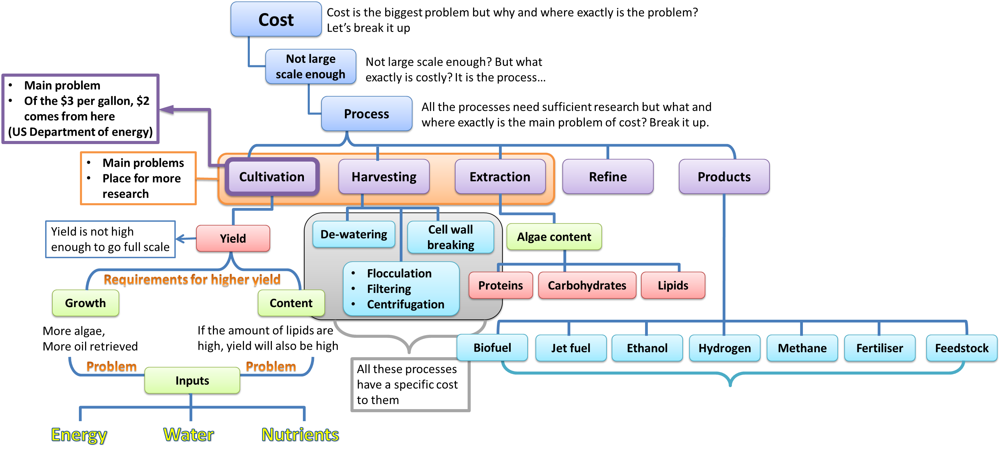
Concluding remark
Seaweed are potential sunlight-driven cell factories, so for sustainable utilization of Seaweed, each step needs to optimize individually according to the market conditions and the country economics.

Slide 28
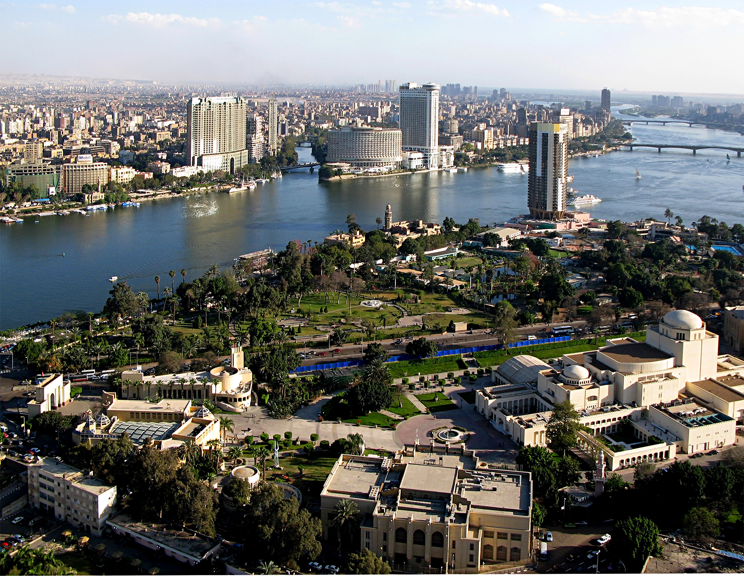

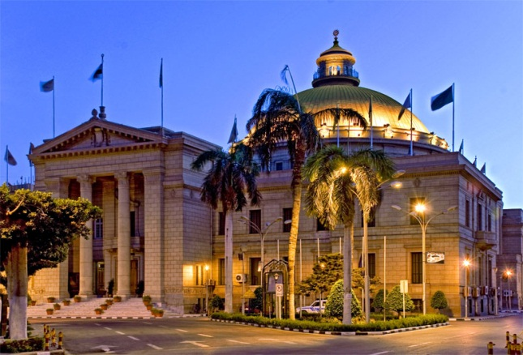



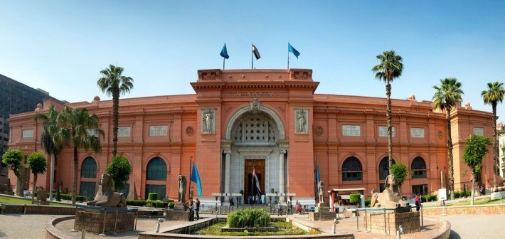
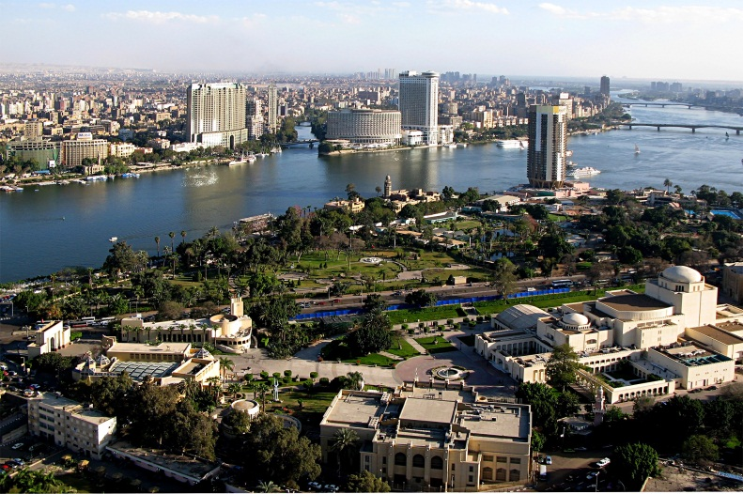
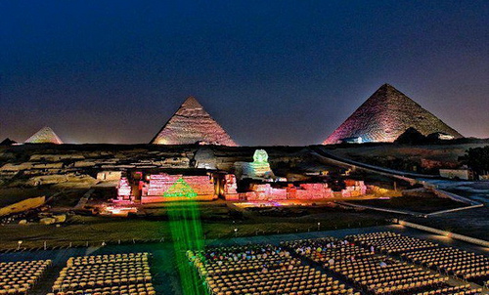

Egypt CAN DO
I think Egypt CAN do that but more feasibility studies are still required
Welcome to visit Egypt
Welcome to Invest in Egypt
Cheap labor
Wide desert areas
Huge wastewater
GHG Emissions
Seaweeds on Seas Offshores
Country policies
Incomplexicity of investment regulations
Taxes offers

Slide 29
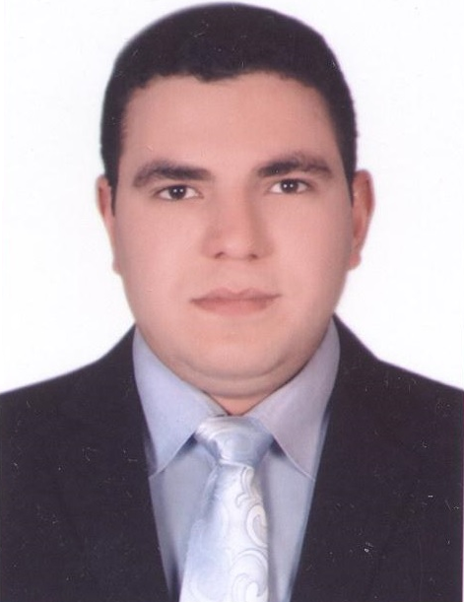
Author Biography
Hassan I. El Shimi, PhD.
Researcher in Green Chemistry Applications
Lecturer at Chemical Engineering Department
Cairo University, Egypt
Member of Arab Engineers’ Federation
Linked in: https://eg.linkedin.com/in/hassan-el-shimi-883755a4
Website: http://scholar.cu.edu.eg/?q=hassanelshimi/
Cairo Univ. St., Giza, Egypt
Tel. : +2 01024497780
: +2 01118087862
Email : hassanshimi@gmail.com
Research area
Renewable energy "Biofuels", Storage of energy from renewable sources, Environmental engineering "Solid waste management and Wastewater treatment", Process and plant design, Process economics, Industrial Biotechnology, Experiments Statistics. In addition, International arbitration in engineering contracts "FIDIC & BOT".

Slide 30
Thank you for your time!

