Slide 1
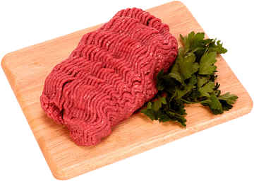
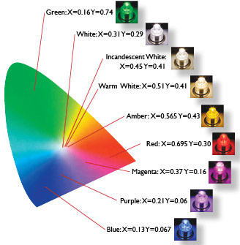
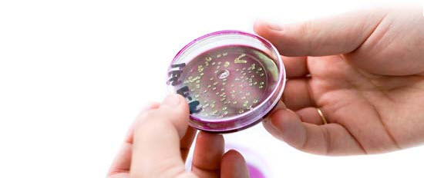
The Effects of Different Light Sources on the Microbial Flora of Ground Beef
Res. Asst. Hasan İbrahim KOZAN
yeni özelliklerde gezinti

Slide 2
Introduction
Intro
Minced meat is a quite popular meat product because of its functionality and serviceableness for further products and easy prepares to consume. However, it is pretty suitable for spoilage due to extended surface area in grinding process thus, minced meat stored refrigeration temperatures has a very low shelf-life. Various studies have been developed to improve the quality and extend the shelf-life of minced meat (No et al., 2007; Esmer Kizilirmak et al., 2011; Ayari et al., 2012). Modified atmosphere packaging, natural or synthetic additives for food preservation, refrigerating, ionizing irradiation, coating, canning and pressurizing may be listed as some of the most effective methods for the shelf life extension of minced meat to control the rate of deteriorative changes (Gould, 1996).
1

Slide 3
Introduction
Intro
The reasons for the deteriorative changes can be examined in two parts as endogenous factors such pH-value or the degree of acidity of the meat, a_{w} value or the amount of moisture available in the product, and the concentration of nutrients that influence types and growth of bacteria and exogenous factors such oxygen (from the air), microorganisms, temperature, light, packaging properties and evaporation and desiccation (Lambert et al., 1991; Blixt and Borch, 2002).
2

Slide 4
Introduction
Intro
Light is a very important factor on the effectiveness and even on shelf life of the meat quality and on determining retail selection. It has been clearly exhibited in numerous studies that the most important effect on the decide of retail selection is the appearance of meat (Dunsing, 1959; Jeremiah et al., 1972; Kropf, 1980; Calkins et al., 1986; Van Oeckel et al., 1999).
2

Slide 5
Introduction
Intro
Light is a very important factor on the effectiveness and even on shelf life of the meat quality and on determining retail selection. It has been clearly exhibited in numerous studies that the most important effect on the decide of retail selection is the appearance of meat (Dunsing, 1959; Jeremiah et al., 1972; Kropf, 1980; Calkins et al., 1986; Van Oeckel et al., 1999).
It has been observed that fluorescent, metal halide and incandescent lamps are now being used in the retail stores of the meat products, especially in the cold meat part of delicatessen stores (Barbut, 2001). Fluorescent and metal halide lamps have more efficiency than incandescent on illumination (Bickford and Dunn, 1972) and FL lamps are more popular on using as display source due to low energy consumption. On the other side, INC lamps are one of the cheapest lamps compared to the others.
2

Slide 6
The objective of this study was to determine The Effects of Different Light Sources on the Microbial Flora of ground beef during storage at 4 ºC.

Slide 7

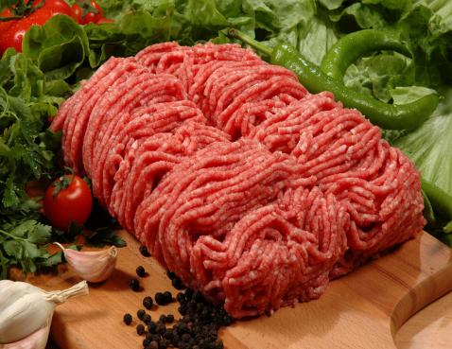
Materials and methods
Raw materials
Beef as boneless rounds was purchased from a local supermarket in Konya, Turkey. The beef were transported to the Food Engineering Department in Agriculture Faculty of Selçuk University under hygienic conditions and processed immediately upon arrival. After removing visible fat and connective tissue, the beef was cut into small pieces. To make the product homogeneous, beef pieces were cut into small cubes and minced with a meat grinder (Kitchenaid Classic Model K45SS, USA) using 8 mm (coarse) and 3 mm (fine) plates simultaneously to obtain ground beef. The diet history and production practices of the beef were unknown.

Slide 8

After grinding (mincing), the samples were assigned to one of the following six treatments. Ground beef meat was divided into 24 samples (6 treatments x 4 storage times) in smaller portions (about 500 g each) and transferred into strerile plates.
All samples were stored in a cold-storage chamber at 4 °C simulating retail conditions at supermarket. The light exposure was performed in a cold-storage chamber at 4 °C with different light sources placed in a distance of approximately 18 cm over the shelves. Light sources included: metal halide (Philips MHN-TD 220 V, 70 W x 87 LE, Poland), incandescent (Osram 60W, 220 V, 60W x 15LE, Germany), ultraviolet-B (Ushio 8 W, 220 V, 283.3 mm x 16 mm, Hungary) ultraviolet-C (Philips 8 W, 220 V, 283.3 mm x 16 mm, Hungary) and fluorescent (Philips 8 W x 60 LE, 220 V, 283.3 mm x 16 mm, Hungary).
The positions of the samples in the cabinet were rotated every 24 h to minimize light intensity differences and possible temperature variations at the surface of meat. Twenty-four samples (3 for each lot) were removed from the cabinet at 1, 2, 3, and 4 days for subsequent analysis.
Preparation of samples and storage conditions

Slide 9
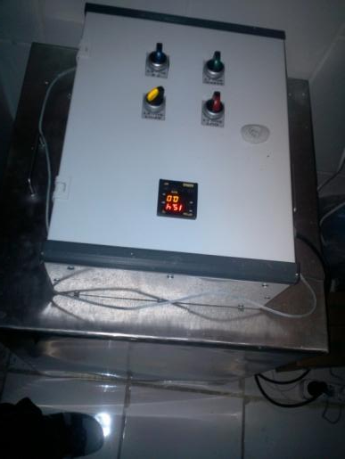
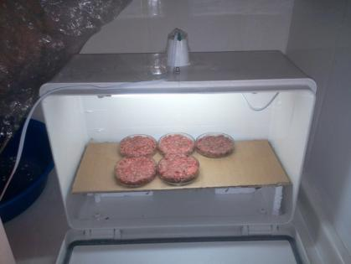
Preparation of samples and storage conditions

Slide 10
Proximate analyses and pH
Moisture (hot air oven), protein (Kjeldahl, Nx6.25), ash (muffle furnace) and fat (ether-extraction) contents were determined using standard methods of the AOAC (2003). Moisture (%) was determined by drying a 5 g sample at 105 ºC to constant weight. Protein (%) was analyzed according to the Kjeldahl method. Factor 6.25 was used for conversion of nitrogen to crude protein. Ash content (%) was determined by ashing at 550 ºC for 24 h. Fat content (%) was determined by using a Soxhlet fat extraction apparatus. For pH determination, the sample (10 g) was homogenized in 100 mL of distilled water for 1 min using a blender (Waring Commercial Blendor®, USA). Then, pH was measured using a pH meter (pH 315i/SET WTW, Germany) (Ockerman 1985).
Preparation of samples and storage conditions

Slide 11
Colour measurements
Colour measurements were performed on ground beef samples at room temperature (20 ± 2 °C) using a chromameter CR-400 (Konica Minolta, Inc., Osaka, Japan) with illuminate D65, 2º observer, Diffuse/O mode, 8 mm aperture of the instrument for illumination and 8 mm for measurement. The chromameter was standardized with a white ceramic tile [L* = 98.11, a* = −0.53 and b* = 2.21] before the measurements. The L*, a* (redness) and b* (yellowness) colour coordinates were determined according to the CIELab colour space system. The visual impression of colour is formed from hue-angle [h = tan⁻¹(b*/a*)] and chroma [C* = (a*² + b*²)^{1/2}]. For colour measurements, American Meat Science Association guidelines were followed (Hunt et al. 1991)
Preparation of samples and storage conditions

Slide 12
The average of three replicate measurements was used to calculate the hue-angle (h) which represents the relative position of colour between redness and yellowness and chroma (C*) which assesses the colour intensity. Colour stability was expressed as the rate of change (the slope of the fitted linear model) in L*, h and C*. Colour properties (L*, a* and b* values) of the ground beef samples were measured at 1, 2, 3 and 4 days of storage. The colour measurements were done for three different spots on the surface of each ground beef sample and the average taken.
Preparation of samples and storage conditions

Slide 13
Microbiological analysis
At the end storage time, ground beef samples were analyzed for total aerobic mesophilic bacteria (TAMB) and total aerobic pyscrophilic bacteria (TAPB). A 10 g aliquot of each meat sample was aseptically obtained and transferred into a sterile stomacher bag. It was then homogenized with 90 mL of sterile 1.5 % peptone water in a Stomacher 400 (Mayo Homogenius HG 400V Stomacher, Italy) for 1.5 min. Aliquotes were serial diluted in peptone water and plated out following standard methodologies (Gerhardt et al., 1994). Total aerobic mesophilic microbial counts were determined on Plate Count Agar (PCA, Merck, Darmstadt, Germany) with plates incubated at 37 ºC for 2 days. Total aerobic pyscrophilic microbial counts were determined on Plate Count Agar (PCA, Merck, Darmstadt, Germany), and the plates were incubated at 7 ºC for 10 days. Microbial colonies were counted and expressed as log₁₀ colony forming units (cfu)/g beef meat.
Preparation of samples and storage conditions

Slide 14
Statistical analysis
Each parameter was tested in triplicate samples with two replications. Collected data was subjected to statistical analysis using MINITAB for Windows Release 14® (Minitab 2003). Multifactor analysis of variance (ANOVA) was used to evaluate the effect of treatments ((control-dark ambience, metal halide (MH), incandescent (INC), ultraviolet-B (UV-B), ultraviolet-C (UV-C) and fluorescent (FL) light sources)) and storage time (1, 2, 3 and 4 days) as main effects, and all their interactions. Microbiological data were transferred into logarithms of the number of colony forming units (cfu/g) were subjected to statistical analysis. When a significant (P < 0.05; P < 0.01) main effect was found, the mean values were further analyzed using Duncan’s Multiple Range Test (MstatC, 1986) (Snedecor & Cochran, 1994). The results of statistical analyses are shown as mean values ± standard deviations in the tables.
Preparation of samples and storage conditions

Slide 15

Results and discussion

Slide 16

Biochemical composition of the gorund meat used through for this study was determined (AOAC, 1995) and the results were %15±2.00 protein, %52.98±4.90 moisture, %30.10±1.90 fat and %0.72±0.06 ash. Ertaş (1979) determined the fat content of ground meat as %21.42 and protein rate of the ground meat as %18.39. On the other side, Candoğan (2009) has determined the moisture, protein, fat and ash values as %59.90±0.60, 16.84±0.17, %23.91±0.91 and %1.15±0.04 respectively in one of her study.
In this study, protein value of the ground meat was lower than when compared with the results of Ertaş (1979) but it was similar with Candoğan (2009)’s results. On the other side, while moisture value of the gorund meat was lower when compared with these two studies, fat content was higher than them.

Slide 17


Table 3
The results of microbiological analysis of ground beef samples of various light sources at the end of storage time (log cfu/g).
Mean value ± standard deviation. TAMB, total aerobic mesophilic bacteria; TAPB, total aerobic psychrotrophic bacteria.
Control (dark ambiance); MH: metal halide; INC: incandescent lamp; UV-B: ultraviolet light-B; UV-C: ultraviolet light-C and FL: fluorescent lamp
Light sources | TMAB | TPAB
Control | 6.33 ± 1.08 | 5.40 ± 1.04
MH | 7.20 ± 0.50 | 3.80 ± 3.80
INC | 7.28 ± 0.91 | 3.02 ± 3.42
UV-B | 6.62 ± 1.03 | 6.37 ± 0.94
UV-C | 6.66 ± 1.01 | 7.20 ± 2.69
FL | 6.63 ± 1.17 | 6.33 ± 1.07

Slide 18
Average results of microbiological quality values are shown in Table 3. Acoording to the this results, total mesophilic aerobic bacteria load of minced meat samples illuminate with incandescent lamp and metal halide lamp was found the highest. The ground beef samples stored in the dark had the lowest TMAB load. The results of the TMAB values for Fluorescent, UV-C and UV-B lamps were similar and the normal compared with the samples stored in dark. It has been observed that in one study of Candoğan (2009)the TMAB value of ground beef was detected as 4,46 log cfu/g in the first day of the study and 7,53 log cfu/g in the fourth day. In our study the results of the samples were similar with this values but a bit lower than Candoğan’s. The reason of that can be due to higher fat content of the minced meat.

Slide 19
The reason of higher TMAB values of minced meat samples illuminated with incandescent lamp and metal halide lamp when compared with others can be estimated as heat from the light sources. On the other hand, that heat reduced the moisture value during storage. This reduced moisture may inhibit the possibility of high TMAB value than current one.

Slide 20
Average results of psychrophilic microorganisms values are shown in Table 3. Ground beef samples illuminated with UV-C lamp had the highest total psychrophilic bacteria value. Ground beef samples illuminated by incandescent lamps 3. and 4. days while there is no growth, illuminated by MH 3 days greatly reduced the number of ground beef samples TPAB, 4. days there was no growth at all.

Slide 21
In one study of Martinez et all (2007), the sausage samples enriched with various antioxidants has been exposed to the FL, low-UV balanced lamp and a combine of FL+UV lamp and the results for the Total Psychrophilic Aerobic Bacteria counts were the lowest while the others were similar with each other. In our study, the lowest counts were detected in the samples exposed to MH and Incandescent Lamps. The reason of that can be related with the low moisture value of the samples.

Slide 22
results and recommendations
As a result of our findings we detected that the highest number of bacteria was found in the samples illuminated with incandescent and metal halide lamps. On the other hand, the control samples which has been illuminated with no-light source as dark had lower number of bacteria than all. In this case, it clearly shows that any light source is encouraging the bacterial growth and increasing the number of bacteria.
I can indicate that, the illumination sources to enlighten meat and meat products are very important for bacterial growth and i can recommend that using UV-C , UV-B or Fluorescent lamp in retail stores or in shopping centers instead of incandescent and metal halide lamps can reduce the total bacteria count and it’ll support to extend shelf life of the product. But further studies are needed to understand what’s the main effect of the light on meat or how is effecting to the bacteria.

Slide 23

THANK YOU
FOR LISTENING ME
AND
FOR YOUR PATIENT
Research Assistant PhD.
Hasan İbrahim KOZAN

