Slide 1
3rd International Conference and Exhibition on Food Processing & Technology Las Vegas
European and Turkish dairy sector: Traditional dairy products at a glance
Prof. Dr. Harun Raşit UYSAL
Ege University Tire Kutsan Vocational High School

Slide 2
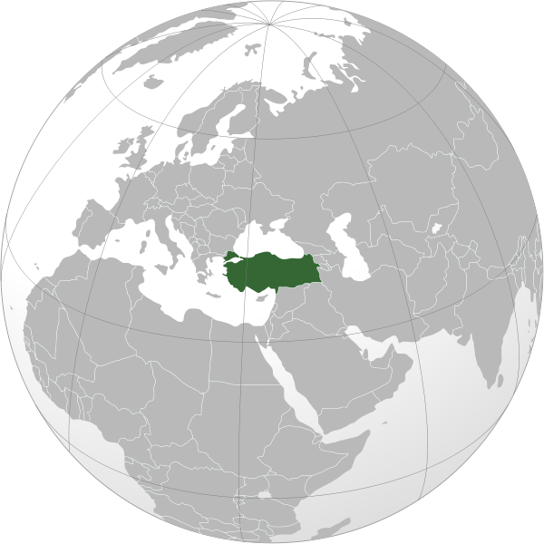
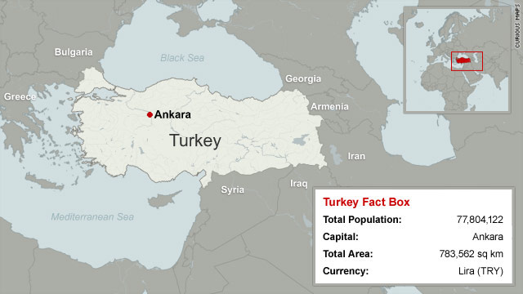
TURKEY AT A GLANCE
REPULIC OF TURKEY
Population: 77.804.122
Most Populous City: Istanbul
Goverment: Parliamentary Democracy
Offical Language: Turkish

Slide 3
Agriculture in TURKEY
Agricultural product of Turkey valued 62 billion $
This value made Turkey seventh of scale in the world
The balance between export and import in agricultural and food industry is in favor of export with 4.5 billion $
Turkish dairy sector’value is the first in food sector
Raw milk production shows the same situation in the livestock

Slide 4
Livestock Holding
Year | Cattle | Buffalo | Total Bovine Animals | Sheep | Goat | Total Sheep and Goat
2009 | 10.723.958 | 87.207 | 10.811.165 | 21.749.508 | 5.128.285 | 26.877.793
2010 | 11.369.800 | 84.726 | 11.454.526 | 23.089.691 | 6.293.233 | 29.382.924
2011 | 12.386.337 | 97.632 | 12.483.969 | 25.031.565 | 7.277.953 | 32.309.518
2012 | 13.914.912 | 107.435 | 14.022.347 | 27.425.233 | 8.357.286 | 35.782.519
2013 | 14.415.257 | 117.591 | 14.532.848 | 29.284.247 | 9.225.548 | 38.509.795
Total Livestock in 2013
53.042.643 Heads

Slide 5
Milking
Animals
Year/Head | Cow | Sheep | Goat | Buffalo | Total
2009 | 4.133.148 | 9.407.866 | 1.830.814 | 32.361 | 15.404.189
2010 | 4.384.130 | 10.583.608 | 2.582.539 | 35.726 | 17.563.350
2011 | 4.761.142 | 11.561.144 | 3.033.111 | 40.218 | 19.395.615
2012 | 5.431.400 | 13.068.428 | 3.502.272 | 38.205 | 22.040.305
2013 | 5.607.272 | 14.287.237 | 3.943.318 | 51.940 | 23.889.767
Population growth rate for total milking animals between 2009-2013: 55 %

Slide 6
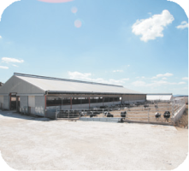
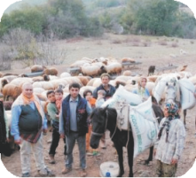
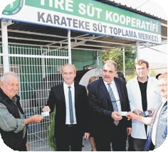
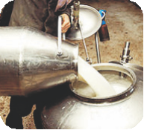
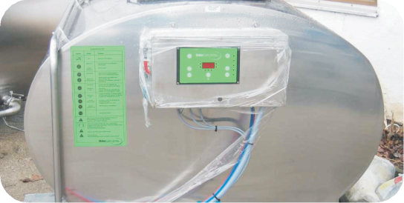
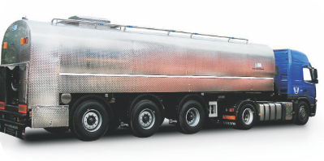
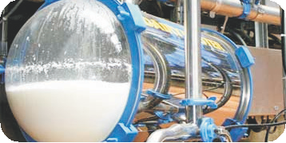
The
Supply of
Raw
milk
Farms
Cottages
Cooperatives
Merchaits
Cooling Center
Transfer
Production

Slide 7
Milk
Production
in
Turkey
(million
tonnes)
Milk production increase rate for the last 4 years
40 %

Slide 8
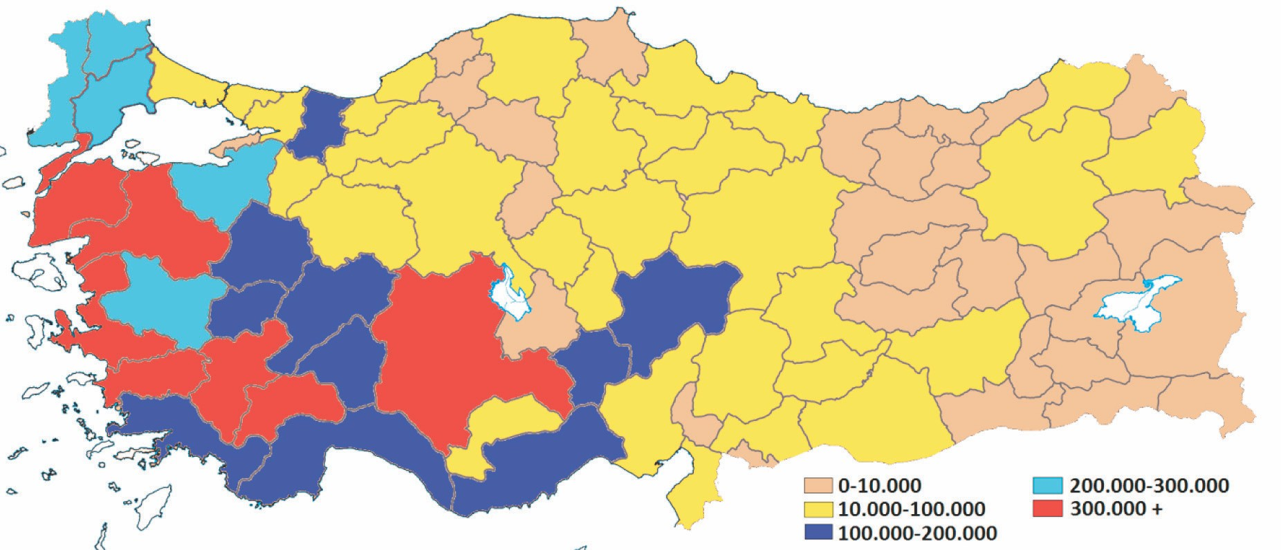
Regional
Milk
Production
(tonnes)
Most
Producing
Provinces
Izmir, Balıkesir, Konya, Aydın,
Çanakkale, Denizli, Burdur

Slide 9
Liquid
Milk
Production
Liquid
Milk
is produced
Liquid milk production growth rate between 2009-2013; 20 %
UHT 90 %
Pasteurised 10 %

Slide 10
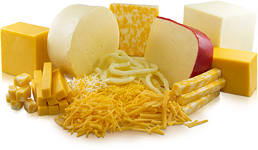
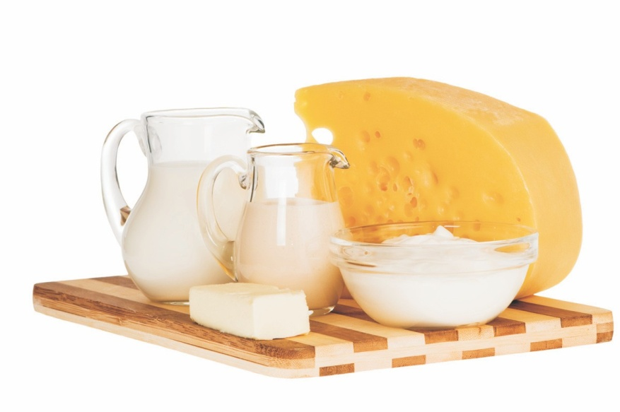
Cheese
Production
96 % of the total production is made from cow’s milk
Cheese production growth rate during last four years
120 %
204 Different kind of cheese is
produced

Slide 11
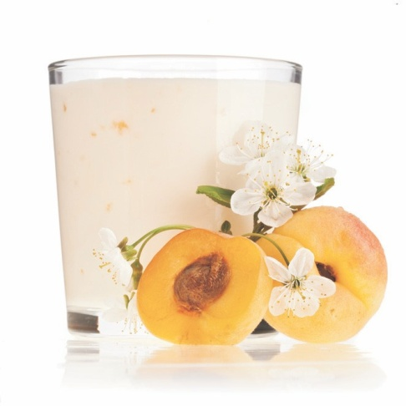
Yogurt and
Ayran
Production (x1000 tonnes)
Yogurt production growth rate between 2009-2013: 38 %
Ayran production growth rate between 2009-2013: 97 %

Slide 12
Butter, milk powder, concentrated milk production
Amount (tonnes)
*:the first ten months period

Slide 13
Yearly
Milk/Feed
Price
1,8
1,6
1,4
1,2
1,0
0,8
0,6
0,4
0,2
0
1,562
_{1,226} ^{1,331}
^{1,137} 1,113 ^{1,163}
^{0,7637} 0,707 ^{0,825}
0,543 ^{0,6062} 0,567
^{0,445} 0,709
30,426 0,489
1,378
1,2
0,9
0,709
0,75
0,533
0,635
0,44
0,323
2006
2007
2008
2009
2010
2011
2012
2013
Feed Price
0,323
0,443
0,533
0,426
0,489
0,635
0,709
0,75
Raw Milk Price
0,445
0,543
0,6062
0,567
0,764
0,707
0,825
0,9
Ratio
1,378
1,226
1,137
1,331
1,562
1,113
1,163
1,2

Slide 14
Liquid Milk Consumption
PER CAPITA MILK CONSUMPTION IN MILK EQUIVALENT: 230 KG
2012 2013
Liquid Milk Consumption
per capita is
estimated
33,1 kg

Slide 15
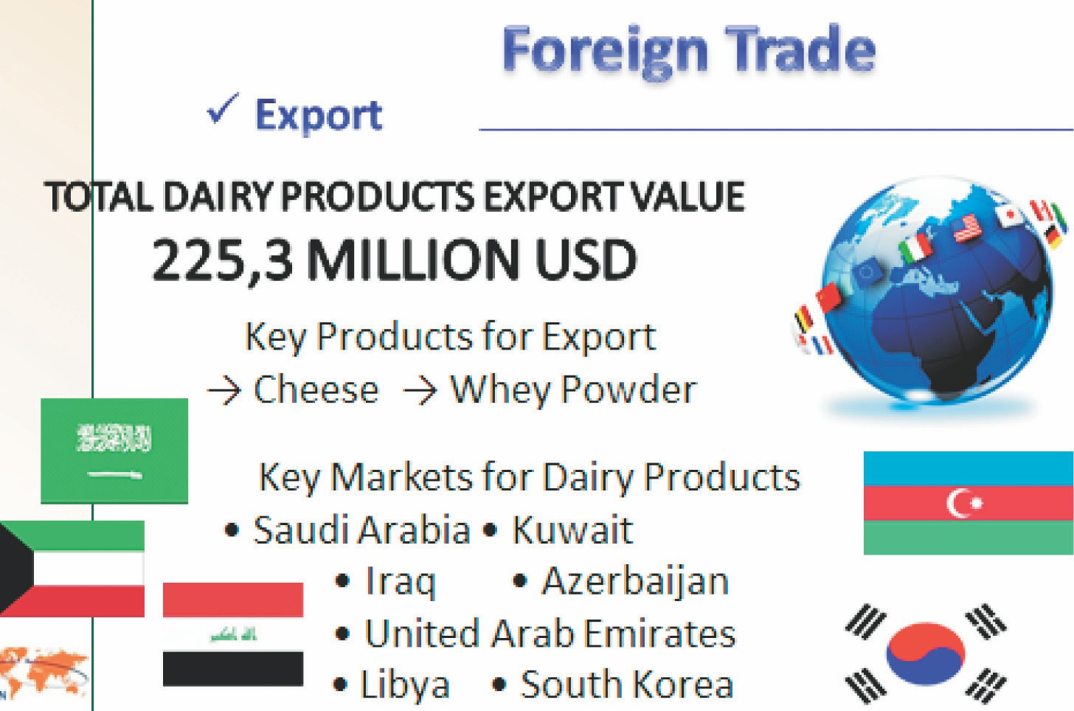
Foreign Trade
282

Slide 16
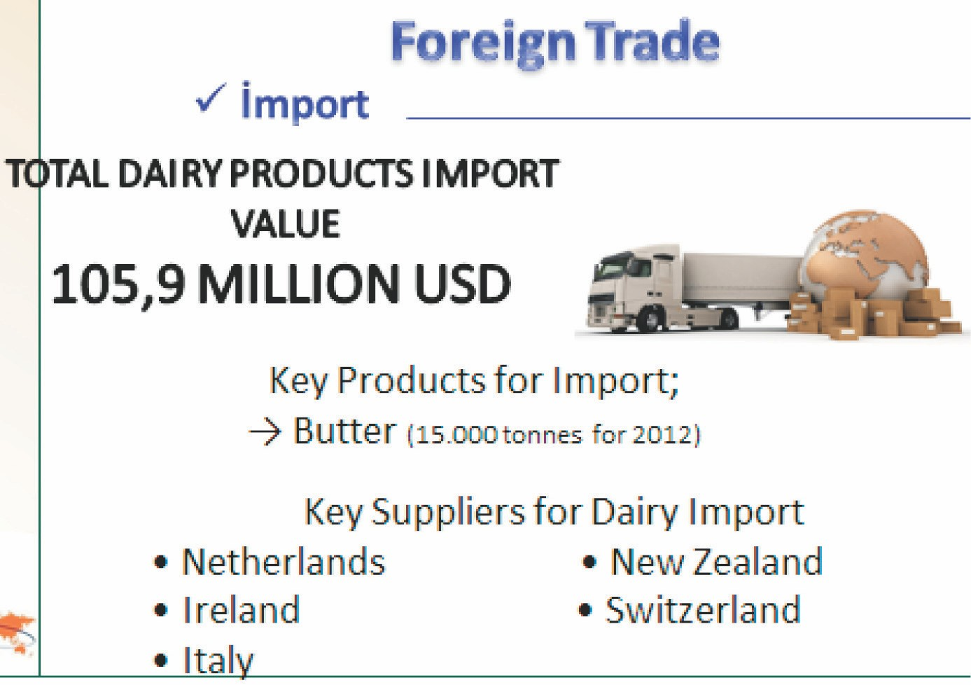
Foreign Trade

Slide 17
Farm
Structure
FARM SIZE (HEAD) | NUMBER OF FARMS | SHARE IN TOTAL % | COW HOLDINGS (HEAD)
1--5 | 811,778 | 58,74 | 2,063,726
6--9 | 293,799 | 21,25 | 2,095,781
10--25 | 198,117 | 14,35 | 2,767,188
26--49 | 62,858 | 4,54 | 1,812,749
50--100 | 11,681 | 0,84 | 899,921
101--199 | 2,798 | 0,20 | 388,490
200+ | 1,190 | 0,08 | 378,959
TOTAL | 1,382,221 | 100 | 10,406,814
80 % of total farms have between 1-9 cows

Slide 18
  EU Cooperatives

Slide 19
Analysis of the Sectoral Situation
Strengths | Weaknesses
Loam structure | Cooperatives not sufficiently developed
Suitable climatic conditions | Unplanned
Product variety Potential labor force | The height of Input Costs Import
Opportunities | Threats
Strategic geographic location | Increase in migration from rural to urban
The increased importance of the food sector | Urbanization of fertile farmland
High education level

Slide 20
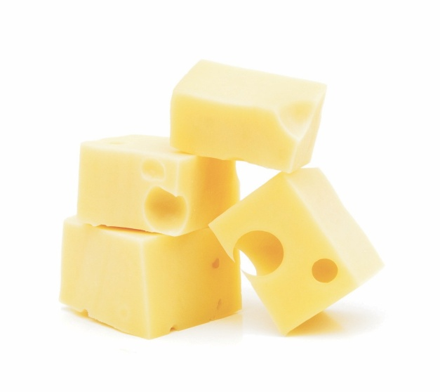
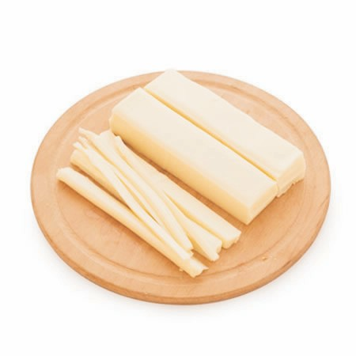
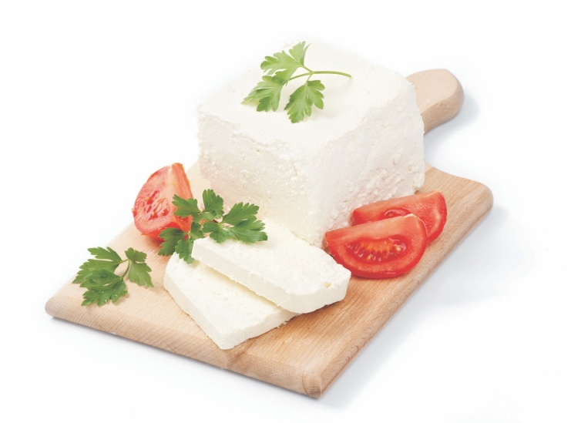
TRADITIONAL CHEESE
TRADITIONAL
CHEESE
TOTAL NUMBER OF UNITS
TOTAL PRODUCTION
(TONNES/YEAR)
Cheese
755
158
65
143
13
667
171
5692111
95981
1279
24171
1037
2794754
368811
White
Processed Cheese
Precipitated Cheese
Dil Cheese (Tongue)
Hellim Cheese
Kasar Cheese (Khasckaval)
Village Type of Cheese

Slide 21
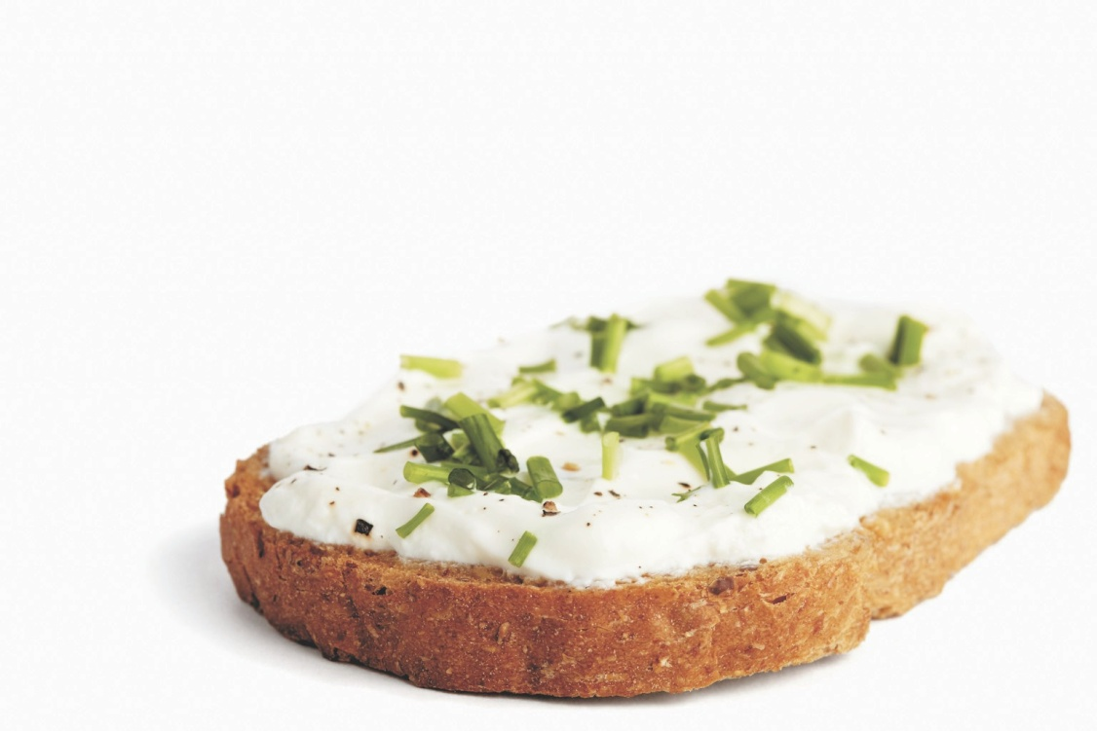
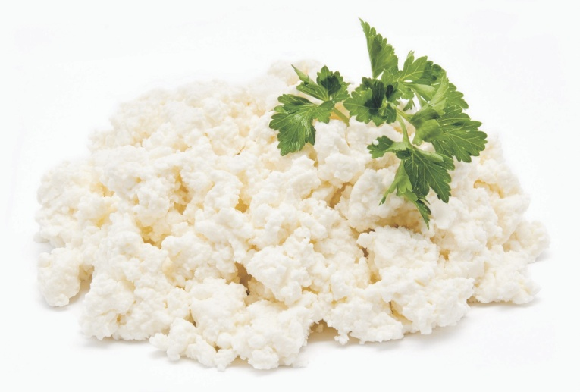
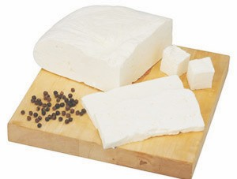
TRADITIONAL CHEESE
TRADITIONAL
CHEESE
TOTAL NUMBER OF UNITS
TOTAL PRODUCTION
(TONNES/YEAR)
8
506
19
169
37
371
11
119.6
387388
571.9
38885
442.5
599885
11547
Moldy Cheese
Lor Cheese
Herby Cheese (Otlu)
Mesh Cheese (Orgu)
Fresh Cream Cheese
Tulum Cheese (Skin)
Fresh Cheese (Flavored)

Slide 22

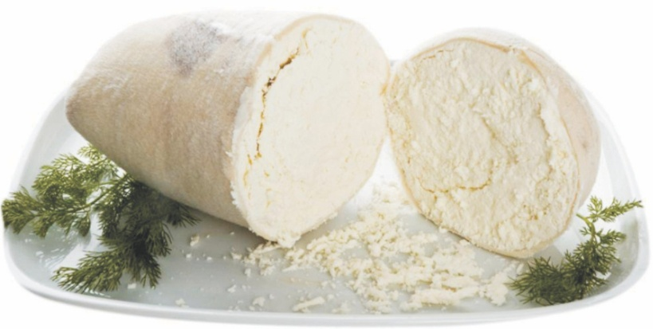
LOCAL CHEESE
LOCAL CHEESE
TOTAL NUMBER OF UNITS
TOTAL PRODUCTION
(TONNES/YEAR)
15
4
7
8
58
103
2673
2388
90,6
323
2904
2786.4
Ezine Cheese
Yoruk Cheese
Kolot Cheese (Golot)
Maras Parmesan Cheese
Antep Cheese
Other Local Cheeses

Slide 23
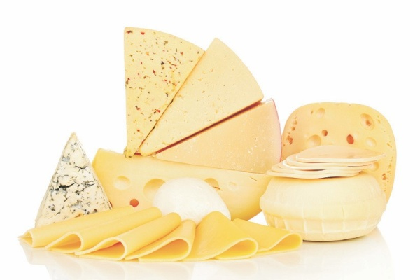
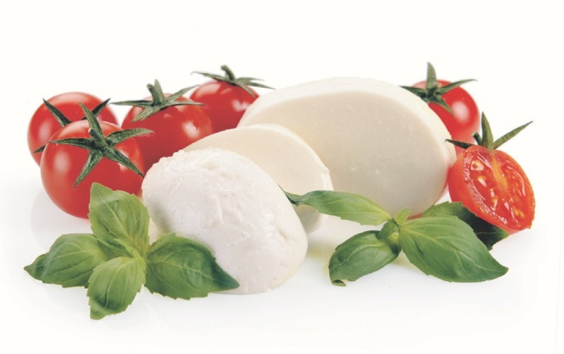
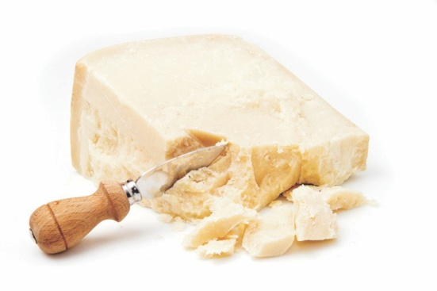
FOREIGN
STYLE
CHEESE
FOREI
GN STYLE CHEESE
TOTAL NUMBER OF UNITS
TOTAL PRODUCTION
(TONNES/YEAR)
1
7
5
3
3
13
2
18
0.0
5365
11927
3336
12702
219
10.6
4934,4
Camambert Cheese
Cheddar Cheese
Edam Cheese
Emmental Cheese
Gouda Cheese
Gruyere Cheese
Parmesan Cheese
Mozzarella Cheese

Slide 24


