Slide 1
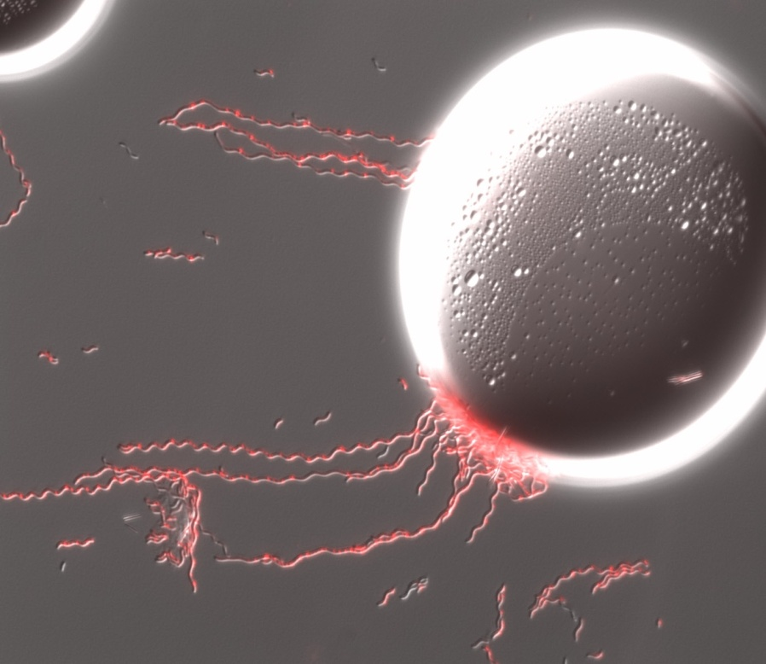
A Fermentation Strategy for Industrial Application of Purple Bacteria, based on Computational Modeling
Hartmut Grammel,
Hochschule Biberach, Biberach University of Applied Sciences
Max Planck Institute for Dynamics of Complex Technical Systems, Magdeburg
3rd International Conference on Bioprocess and Biosystems Engineering September 14, 2015, Baltimore

Slide 2
Fermentation Technology, Bioprocess and cell culture
Phototrophic vs. Dark Fermentation
Aerobic – Anaerobic – Microaerobic
online-Spectroscopy Monitoring and Control
Computational Modeling (Stoichiometric, Kinetic, Process Models)
Continuous Cultivation (Cytostat)

Slide 3
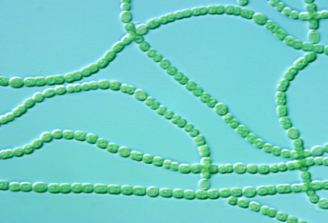
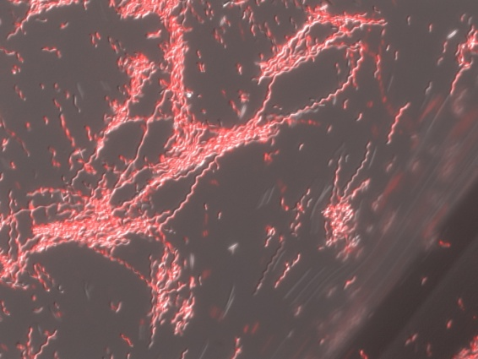
Photosynthetic Metabolism as a Source for Chemical Products
Algae and Cyanobacteria
Biofuels
Biodiesel
Biohydrogen
Bioethanol
Lipids
etc
Photo taken from http://biology.ucsd.edu/
Purple Bacteria (Rhodospirillaceae)
  facultative photosynthetic, anoxygenic
- Single cell protein
- Vitamins
- Coenzyme Q10
- Biopesticides
- Biopolyesters
- Biofertilizers
etc.

Slide 4
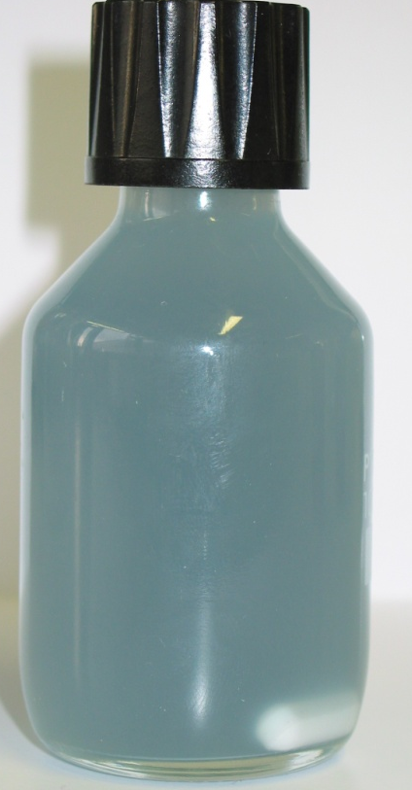
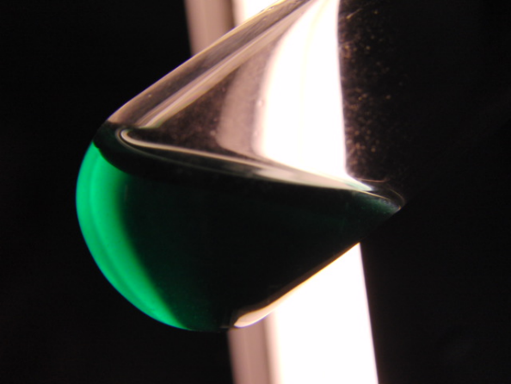
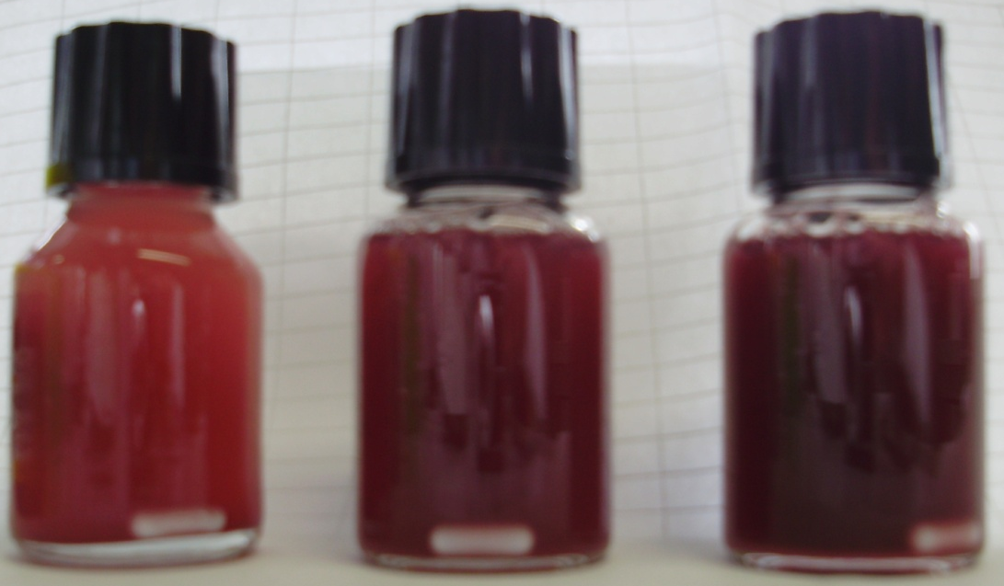
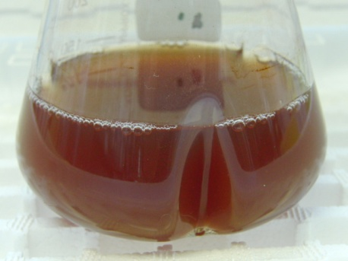
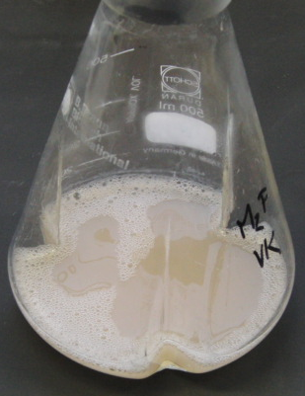
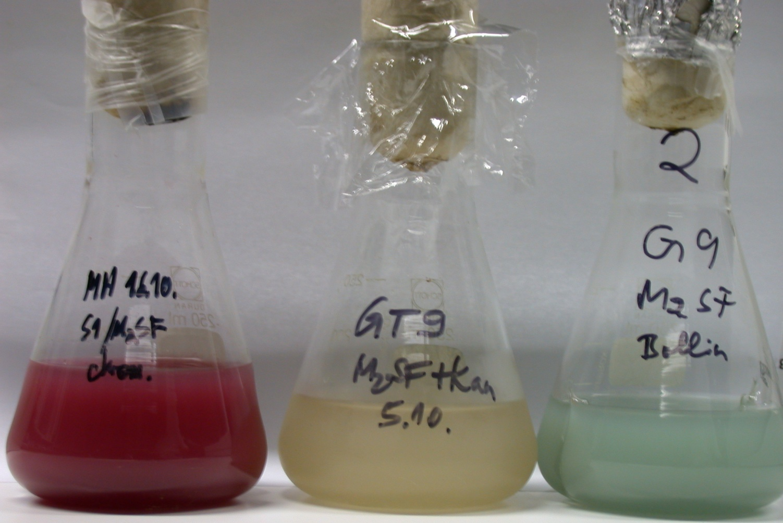
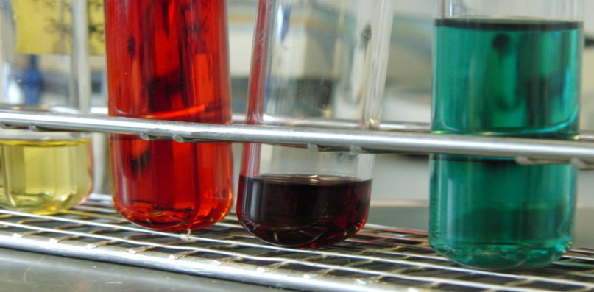
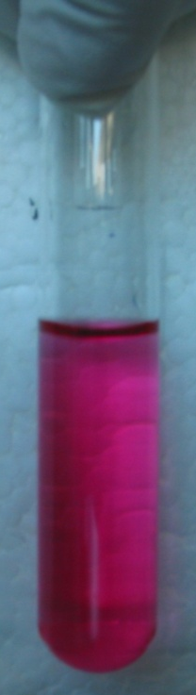
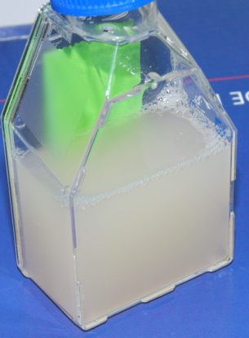
Photosynthetic Products of Purple Non-Sulfur Bacteria
Species
Rc. gelatinosus Rb. sphaeroides Rb. capsulatus R. tenue R. rubrum Rps. palustris R. molichianum Rps. viridis ...
Feedstock
Wheat bran Whey Cassava starch Soybean waste Biogas plant slurry Wastewater Waste sulfite liquor from wood ...
Product/Application
SCP, animal feed Cholesterol-lowering food supplement Vitamin B2 Vitamin E Vitamin B12 Carotenoids Porphyrines Coenzyme Q10 Enzymes Waste treatment Biopolymers Biopesticides (5-ALA) Biohydrogen recombinant membrane proteins ...

Slide 5
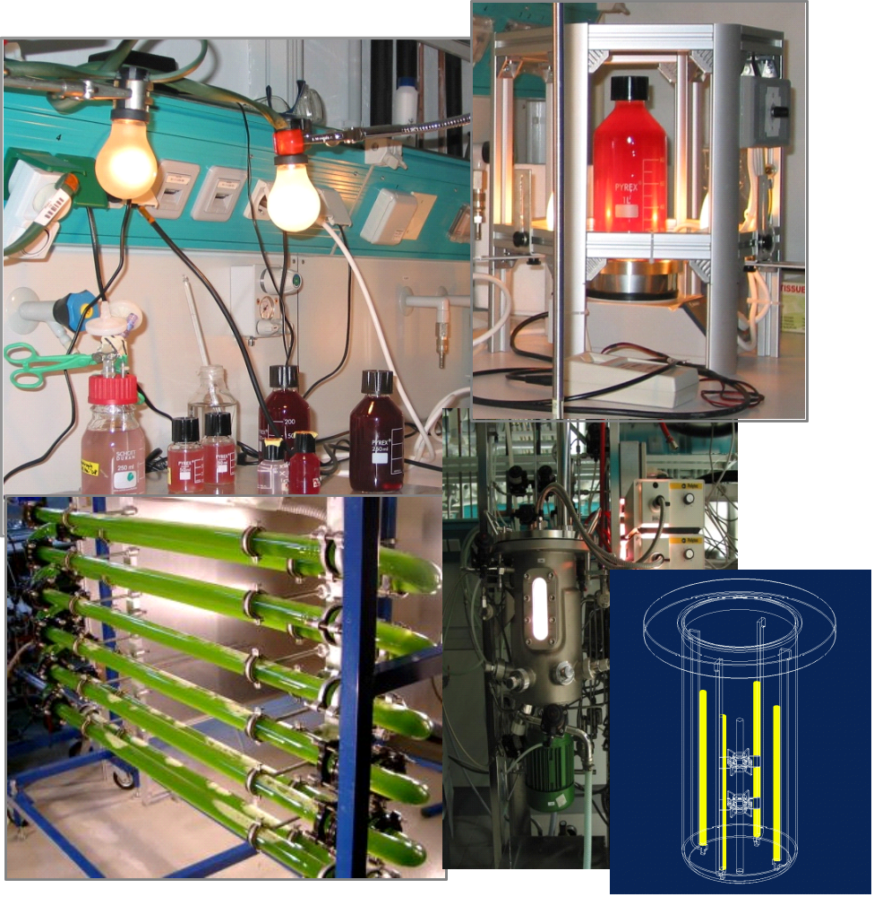
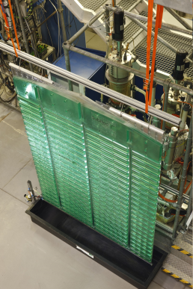
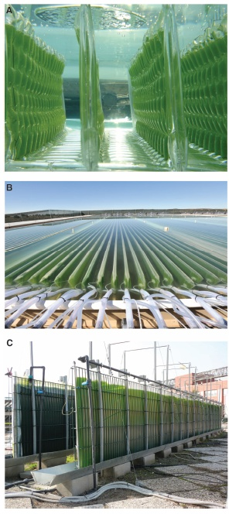
Phototrophic Cultivation Systems...
Greenovation Biotech GmbH, Flatpane-Airlift Reactor, IGB Stuttgart
http://www.bio-pro.de/de/region/freiburg/magazin/04647/index.html
SCIENCE VOL 329 13 AUGUST 2010

Slide 6
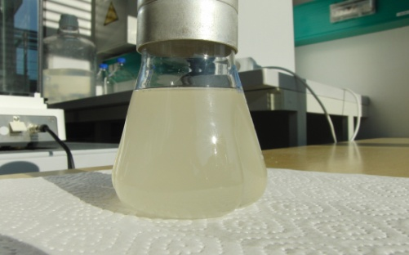
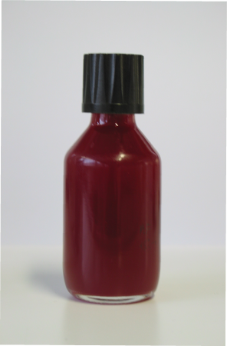
Induction of Photosynthetic Membranes by Environmental Factors, Oxygen and Light
  + O₂: aerobic respration
  - O₂: anaerobic respiration, fermentation
Photosynthesis,
Formation of Intracytoplasmic membranes
- O₂
+ O₂
Photosynthetic gene expression repressed
Expression of photosynthetic genes
pfla'
pta
cbiD
137
411
481
L
H
I
J
K
cupB
cdpA
C
D
E
F
C
X
Y
Z
WBA
ack
L
M
Notes:
6

Slide 7
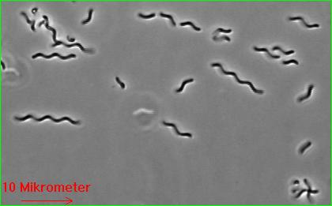
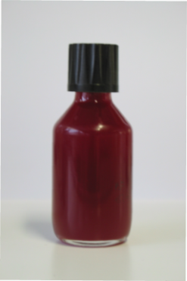
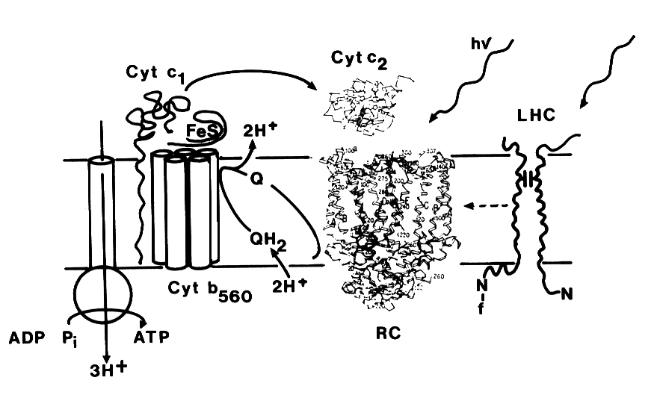
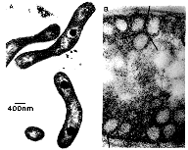
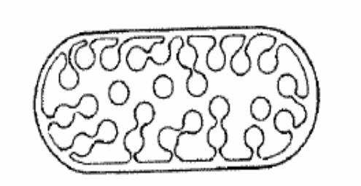
Expression of Photosynthetic Membranes in Purple Bacteria
Intracytoplasmic photosynthetic membranes in Rhodospirillum rubrum
Cyclic photophosphorylation in photosynthetic membranes
Notes:
7

Slide 8
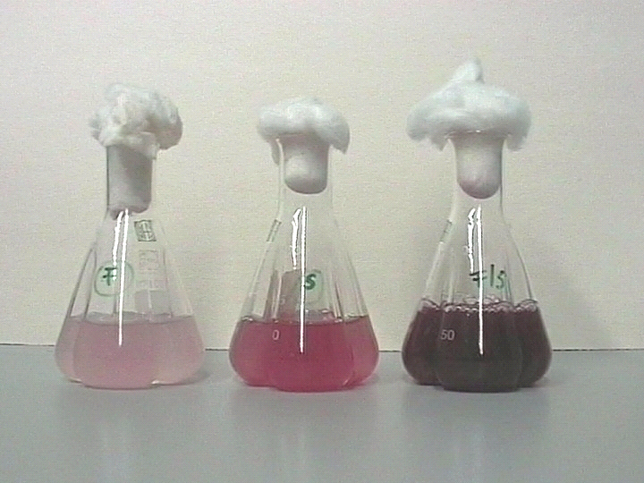
High Level Expression of Photosynthetic Membranes as Model System for Redox Signaling and Control
Succinate
Succinate
Semiaerobic cultivation of R. rubrum in the dark with different carbon substrates
Notes:
8
8

Slide 9
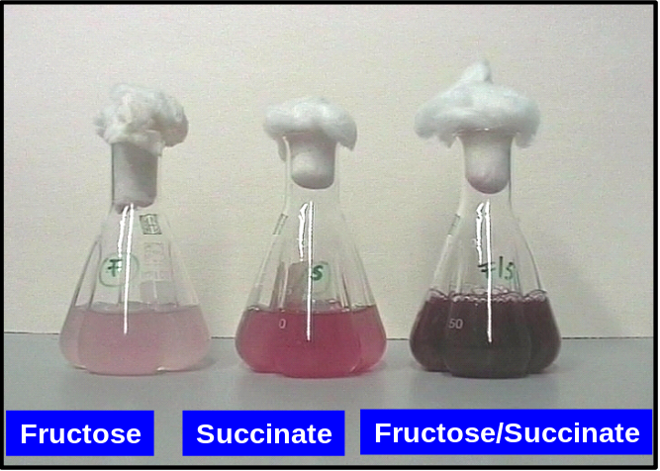
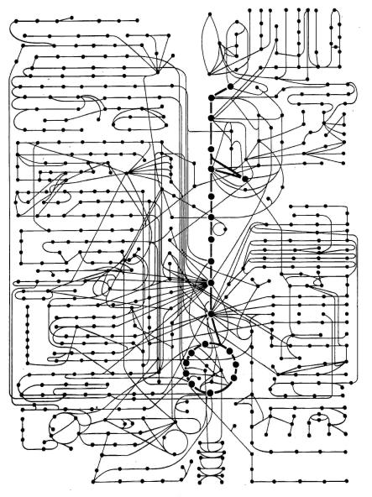


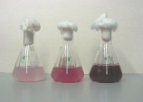
High Level Expression of Photosynthetic Membranes as Model System for Redox Signaling and Control
O₂
LIGHT
CARBON
SOURCE
?
?
Semiaerobic cultivation of R. rubrum in the dark with different carbon substrates
?
Redox
signalling
?
Photosynthetic gene expression
137
pfla
137
pfla
'
'
pta
pta
cbiD
cbiD
411
411
481
481
L
L
H
H
I
I
J
J
K
K
cupB
cupB
cdpA
cdpA
C
C
D
D
E
E
F
F
C
C
X
ack
X
ack
cdpA
C
D
E
F
C
X
Y
Z
WBA
L
M
Fructose/
Fructose/
Succinate
Fructose
Succinate
Fructose
Succinate
Succinate
Ghosh et al. 1994. Appl. Env. Microbiol. 60(5):1698
Grammel, H. and R. Ghosh . 2008, J. Bacteriol. 190 (14):4912-4921
Notes:
9
9

Slide 10
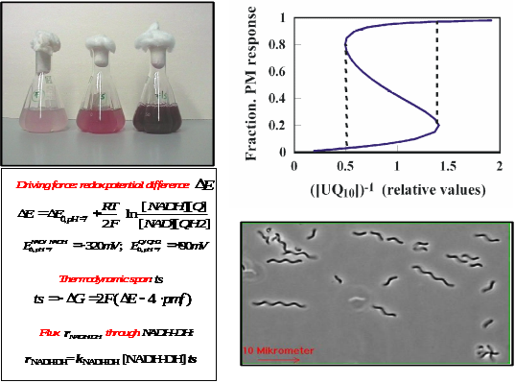
Development of Rhodospirillum rubrum for Applications in Biotechnology
- A Systems Biology Approach
Theoretical Analysis
Computational Modeling
Experimental Analysis
Bioreactor Cultivations
Metabolomics
13C isotope metabolic flux analysis
Kinetic modeling of electron transfer chains and redox signaling
Metabolic network analysis
Enzyme activities
Process modeling, model-based control
Gene expression profiling
Cybernetics models
In vivo online spectroscopy
Notes:
10
10

Slide 11

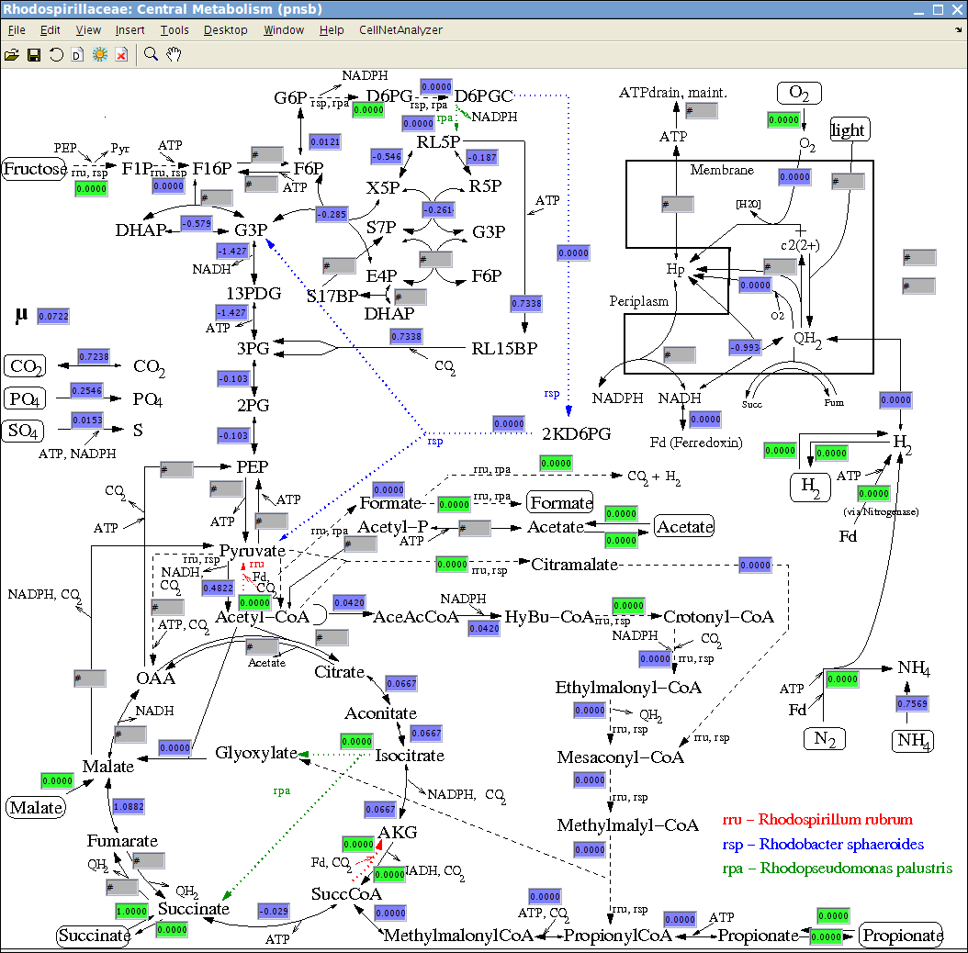
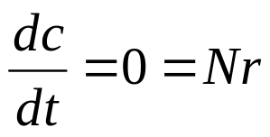
Software Tool: CellNetAnalyzer
Stoichiometric Modeling and Metabolic Network Analysis
stoichiometric model of central metabolic pathways in purple non-sulfur bacteria.
119 metabolites
142 enzymatic reactions
- MFA and FBA and FVA analysis with measured extracellular rates
Linear metabolite balancing equation:
N : stoichiometric matrix
(rows: metabolites; columns: reactions with stoichmiometric coefficients)
r: vector of reaction rates, (mmol/g h)
(Hädicke, O., H. Grammel, and S. Klamt. 2011. Metabolic network modeling of redox balancing and biohydrogen production in purple nonsulfur bacteria. BMC Syst. Biol. 5:150. )
www.mpi-magdeburg.mpg.de/projects/cna/cna.html

Slide 12
Software Tool: CellNetAnalyzer
Stoichiometric Modeling and Metabolic Network Analysis
MATLAB toolbox with
graphical user interface
comprehensive toolbox
with algorithms for biological
network analysis:
- metabolic networks
- signal transduction and
regulatory networks
Application for optimization of the metabolic network (target reactions for gene overexpression of knock-outs)
(Hädicke, O., H. Grammel, and S. Klamt. 2011. Metabolic network modeling of redox balancing and biohydrogen production in purple nonsulfur bacteria. BMC Syst. Biol. 5:150. )
www.mpi-magdeburg.mpg.de/projects/cna/cna.html
Klamt et al., 2007, BMC Systems Biology 1:2
BioMicroWorld2011

Slide 13
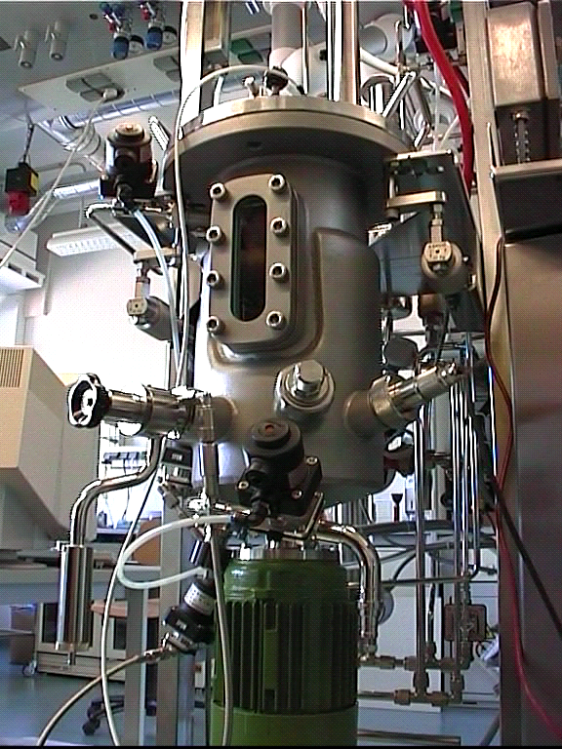
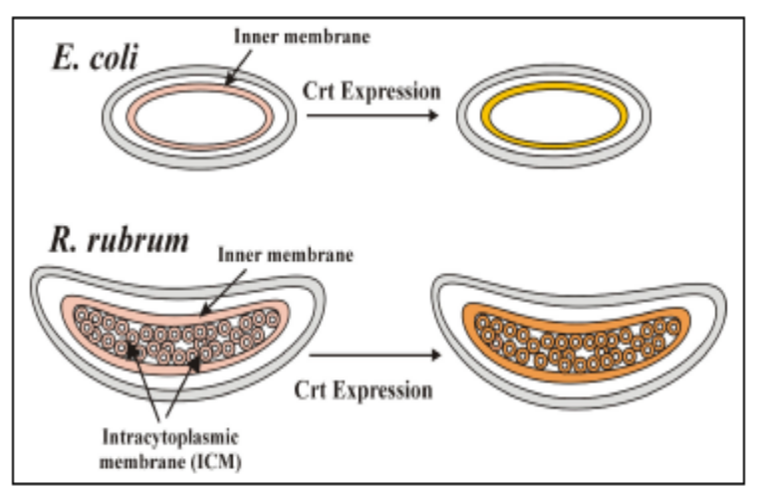
Biotechnological Potential of Purple Non-Sulfur Bacteria
Production of:
Porphyrins
Photodynamic Tumor Therapy
Poly-β-hydroxyalkanoates
Biopolymers
Biohydrogen
Energy carrier
Carotenoids
Food supplement
Vitamins, Coenzymes
Food industry
B₁₂, Q₁₀
Membrane proteins
Vaccines
…
…independent of light at microaerobic conditions and at high cell densities !
Notes:
13
13

Slide 14


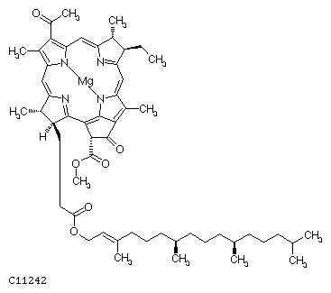
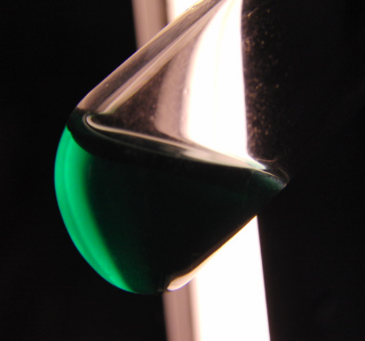
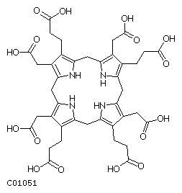
Development of Rhodospirillum rubrum for Applications in Biotechnology
Photodynamic tumor therapy using bacteriochlorophyll derivatives
Laser light
¹O₂
Bacteriochlorophyll a
Background image from http://www.photofrin.com
Bacteriopheophorbide
m/z 611.2 [M+H⁺]⁺,
λ_{max} (nm) 358, 524, 748

Slide 15
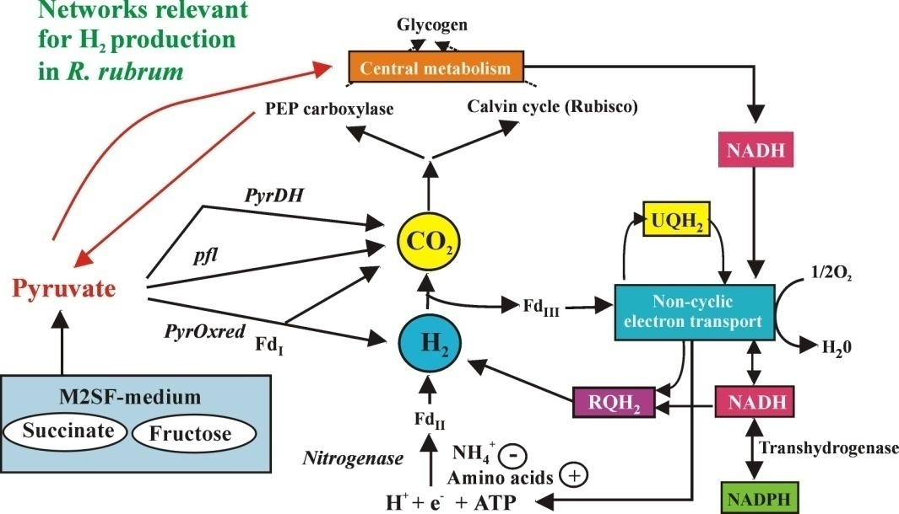
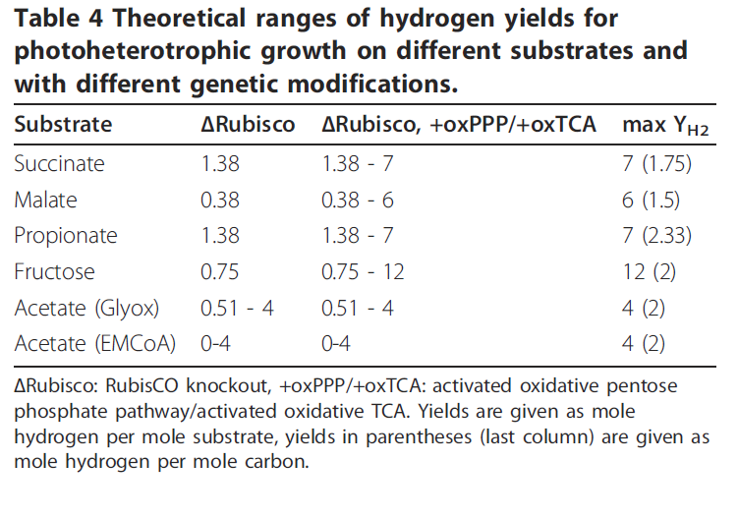
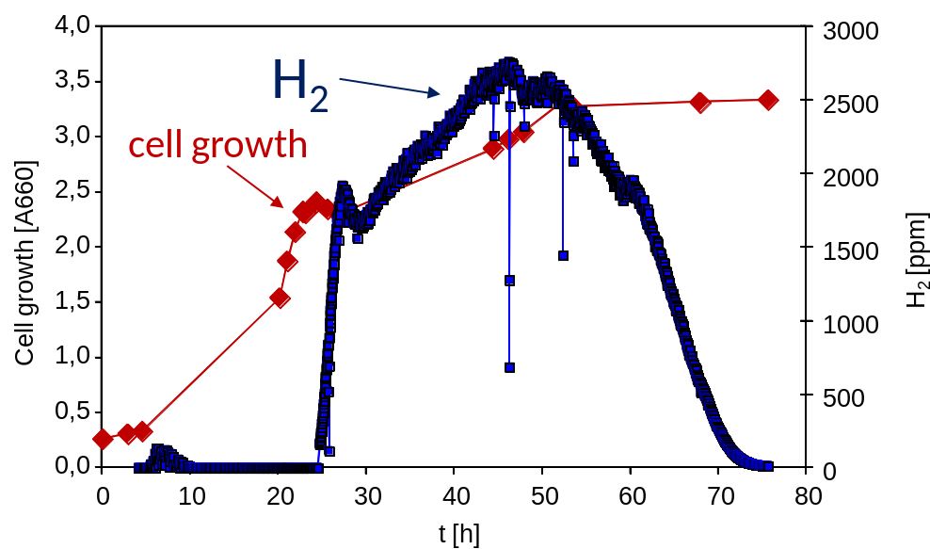
Biotechnological Applications of Photosynthetic Bacteria
Biohydrogen
(Hädicke, O., H. Grammel, and S. Klamt. 2011. Metabolic network modeling of redox balancing and biohydrogen production in purple nonsulfur bacteria. BMC Syst. Biol. 5:150. )

Slide 16


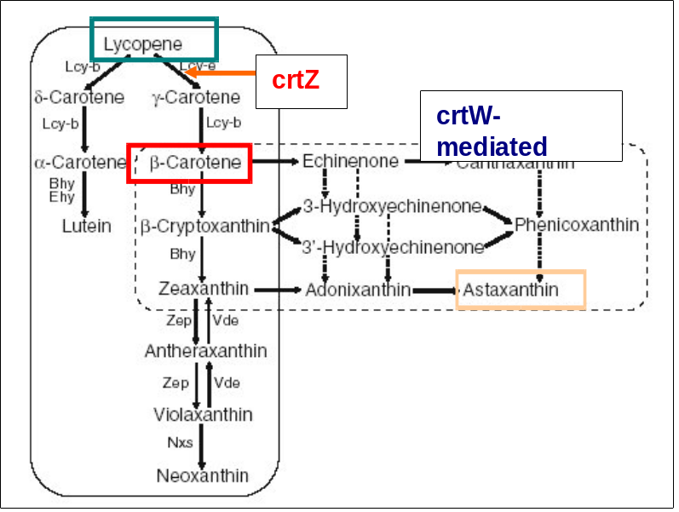
Development of Rhodospirillum rubrum , for High-Level Expression of Industrially Relevant Carotenoids
Center Systems Biology, University of Stuttgart,
MaCS, Magdeburg Centre For Systems Biology,
Notes:
16
16
16

Slide 17
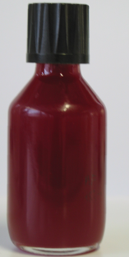
Microaerobic Microbial Phenomena
Microaerobic conditions were shown to be important not only for…
  Photosynthetic Products in R. rubrum without light
  (Rudolf et al., Zeiger and Grammel, 2010; Grammel and Ghosh, Grammel et al.,)
  but also for….
  bacterial pathogenicity
(Park et al., 2011; Schueller and Phillips, 2010)
  industrial waste water treatment
(Zheng and Cui, 2012)
  industrial production of cellulosic ethanol
(Agbogbo and Coward-Kelly, 2008)
  …and many others

Slide 18
How much Oxygen is Microaerobic?
  Microaerobic expression of photosynthetic membranes is induced below 0.5 % DO
  Respiratory growth in E. coli was shown to occur at ≤ 3 nM (Stolper et al., 2010. PNAS, 107:18755) )
…well below the measurement range of conventional oxygen probes!

Slide 19
Microaerobic Process Control
How to achieve microaerobic conditions in a bioreactor?
pH-stat → photosynthetic products in R. rubrum
Respiratory quotient → 2,3 butanediol in Enterobacter aerogenes (Zeng et al., 1994)
Culture redox potential (CRP) as controlled variable
  many industrial and environmental processes

Slide 20
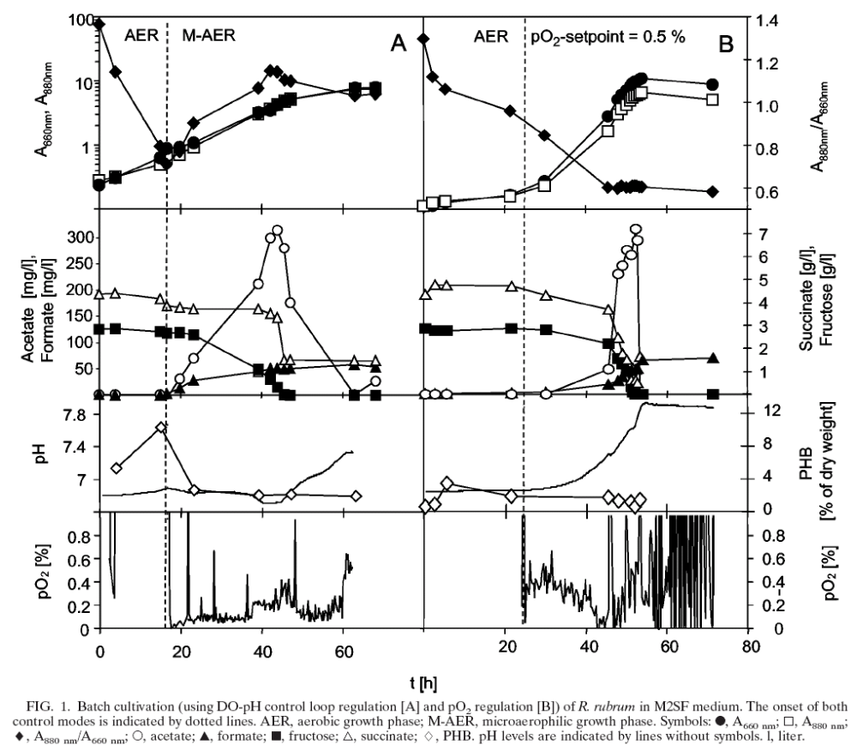
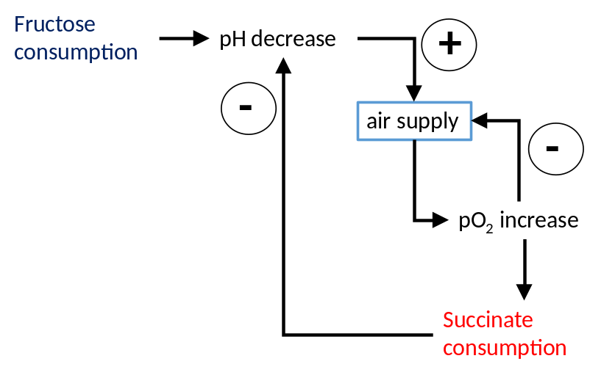
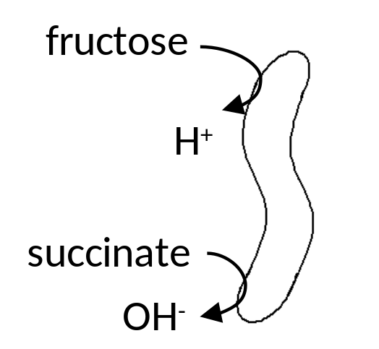
Expression of Photosynthetic Membranes in Bioreactor Cultivations of Rhodospirillum rubrum under Microaerobic Dark Conditions
Grammel, H., Gilles, E.D., and Ghosh, R. (2003)
Appl Env Microbiol 69, 6577-6586
photosynthetic membrane
photosynthetic membrane
cell growth
Notes:
20

Slide 21
in vivo Whole Cell UV/Vis/NIR Absorption Spectroscopy of R. rubrum
Photosynthetic membrane expression as cellular redox indicator
LH1, RC
LH1
carotenoids,
cytochrome c
AU
LH1, RC
RC
300
400
500
600
700
800
900
nm

Slide 22
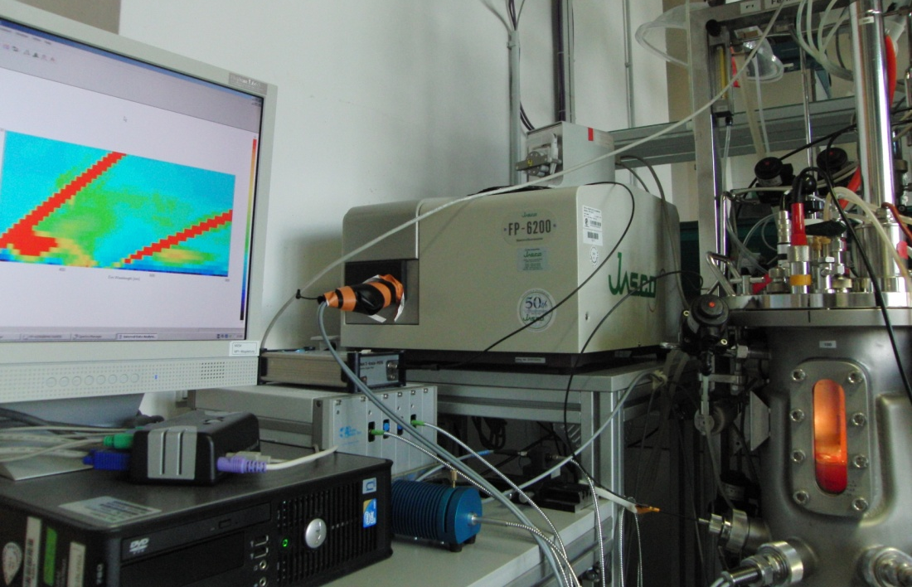
Online Spectroscopical Process Monitoring – Technical Equipment
Fluorescence spectrometer
Bioreactor
CCD spectrometers
Fibre optics

Slide 23
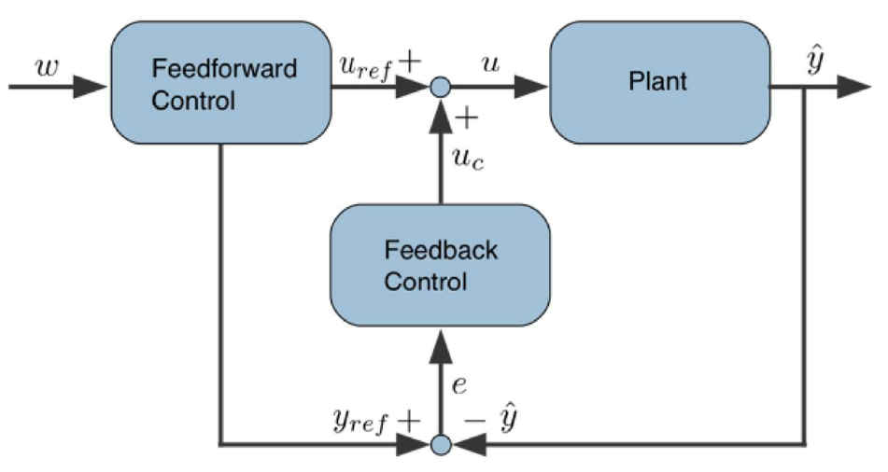
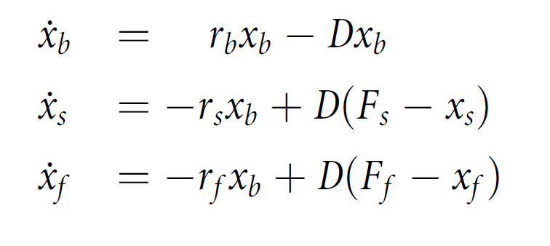
Model-based Control of Microaerobic Steady-States
model-based. CRP-dependent 2DOF controller
online Biomass and PM spectroscopic
data
model-based. CRP-dependent 2DOF controller
Unstructured process model
r_{b}(CRP,x_{s}, x_{f}) (specific growth rate)
Dilution rate
output
trajectory
Model
trajectory

Slide 24
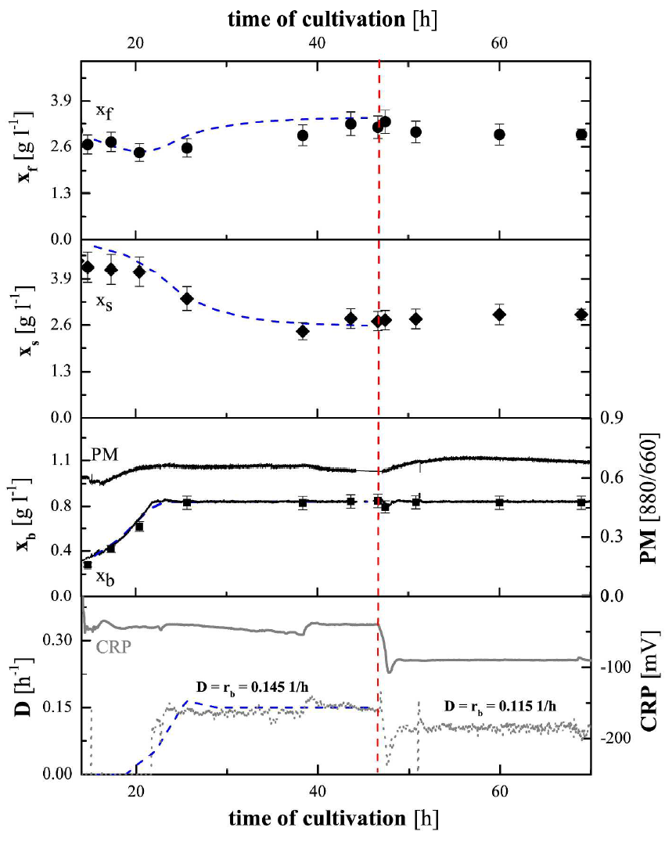
CRP – 50 mV
CRP – 100 mV
Model-based Control of Microaerobic Steady-States
model-based 2 DOF control and online spectroscopy allows switch from – 50 mV to -100 mV without disturance or oscillations.
New dilution rate adjusted to reach the desired steady state

Slide 25
Biotechnological Potential of Purple Non-Sulfur Bacteria
Production of:
Porphyrins
Photodynamic Tumor Therapy
Poly-β-hydroxyalkanoates
Biopolymers
Biohydrogen
Energy carrier
Carotenoids
Food supplement
Vitamins, Coenzymes
Food industry
B₁₂, Q₁₀
Membrane proteins
Vaccines
…
…independent of light; at high cell densities ?
Notes:
25
25

Slide 26
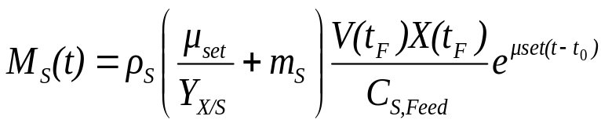

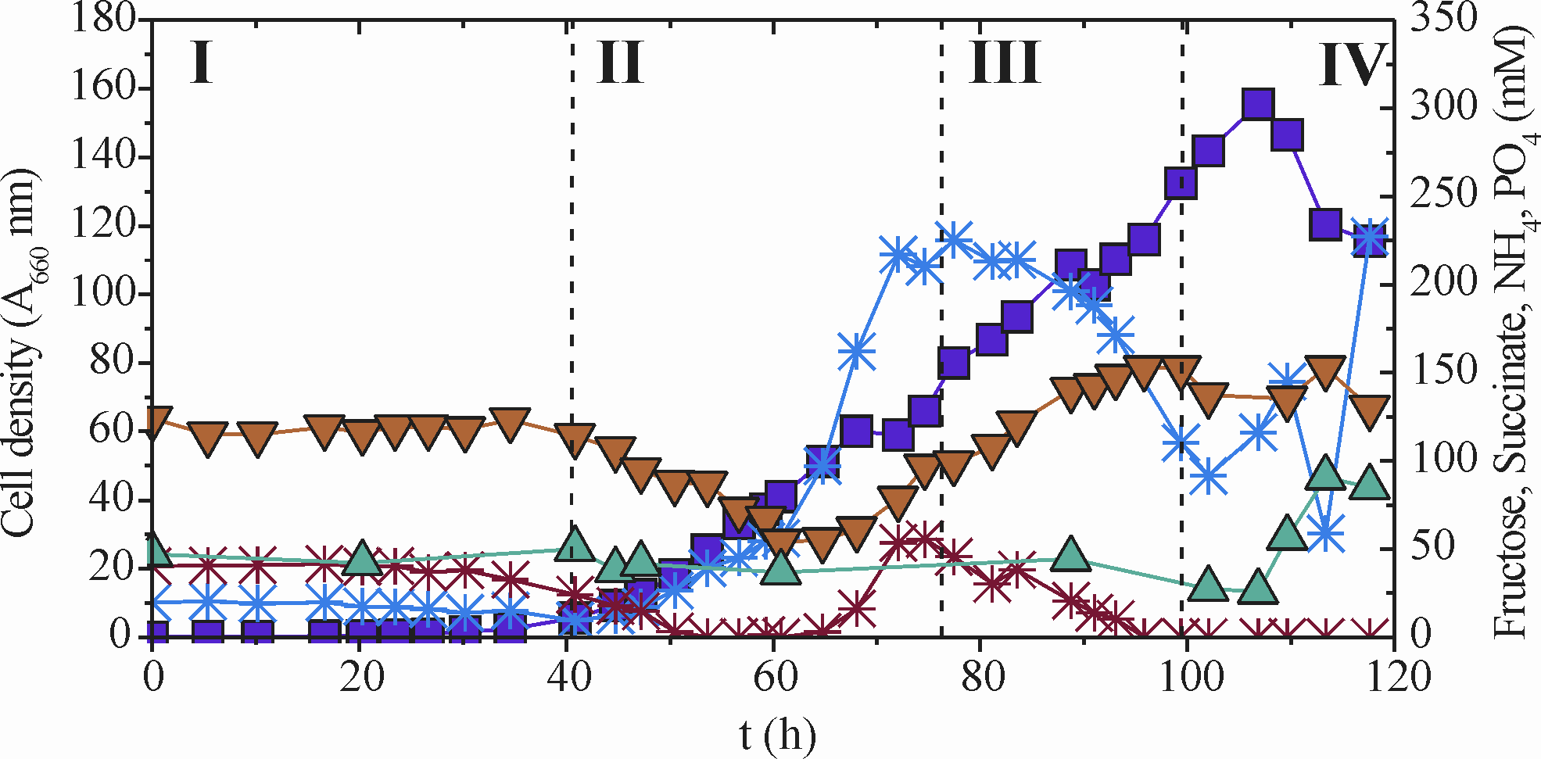
High Cell Density Cultivation of Rhodospirillum rubrum
Model-based high cell density cultivation:
~ 60 g/l cell dry weight
(Zeiger and Grammel, 2010. Biotechnol. Bioeng.105(4):729-39.)
A₆₆₀ nm
Fructose
Ammonium
Succinate, Phosphate
Notes:
26
26

Slide 27









Acknowledgements
Partners
Biberach University of Applied Science
Max Planck Institute for Dynamics of Complex Technical Systems, Magdeburg
University Stuttgart
Center for Systems Biology, Stuttgart
FZ Jülich
NMI Reutlingen
Philipps-University Marburg, Loewe Center for Synthetic Microbiology
Thank you for the attention!

Slide 28


Slide 29
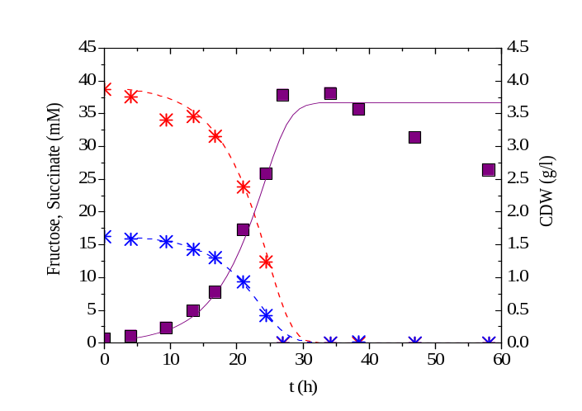
Process Model for R. rubrum
Mass and volume balances
Single substrates
+
80
4.0
+
(
+
(
(
F
F
F
F
F
F
)
)
dCx
)
dCx
dCx
=
=
=
μ
μ
μ
−
−
−
N
N
N
P
P
P
C
C
,
C
,
Cx
,
Cx
Cx
Cx
Cx
dt
Cx
dt
dt
V
V
V
60
3.0
F
Fructose, Succinate (mM)
F
dC
F
dC
dC
F
F
=
F
CDW (g/l)
=
=
−
−
−
−
−
−
+
+
+
−
−
−
−
−
−
N
N
N
P
P
,
P
,
Suc
,
Suc
Suc
q
q
q
Cx
Cx
Cx
m
m
m
Cx
Cx
Cx
C
C
C
(
(
(
C
C
C
C
C
C
)
)
)
C
C
Suc
C
40
2.0
Suc
Suc
Suc
Suc
Suc
Feed
Feed
Feed
Suc
Suc
Suc
Suc
Suc
Suc
Suc
Suc
,
Suc
,
dt
,
dt
dt
V
V
V
V
V
V
F
20
1.0
F
dC
F
dC
dC
F
F
=
F
=
=
−
−
−
−
−
−
+
+
+
−
−
−
−
−
−
N
N
N
P
P
,
P
,
Fru
,
Fru
Fru
q
q
q
Cx
Cx
Cx
m
m
m
Cx
Cx
Cx
C
C
C
(
(
(
C
C
C
C
C
C
)
)
)
C
C
Fru
C
Fru
Fru
Fru
Fru
Fru
Feed
Feed
Feed
Fru
Fru
Fru
Fru
Fru
Fru
Fru
Fru
,
Fru
,
dt
,
dt
dt
V
V
V
V
V
V
0
0.0
0
10
20
30
40
50
60
70
80
90
100
F
t (h)
F
dC
F
dC
dC
F
F
=
F
=
=
−
−
−
+
+
+
−
−
−
−
−
N
−
N
N
P
P
,
P
,
q
,
q
q
Cx
Cx
Cx
(
(
(
C
C
C
C
C
C
)
)
)
C
C
PO
C
PO
PO
C
C
4
C
4
4
PO
PO
PO
Feed
Feed
Feed
PO
PO
PO
PO
PO
PO
PO
PO
4
PO
4
4
,
,
,
4
4
4
4
4
4
4
4
dt
4
dt
dt
V
V
V
V
V
V
F
Mixed-substrate (M2SF)
F
dC
F
dC
dC
F
F
F
F
F
´
F
´
=
´
=
=
−
−
−
+
+
+
−
−
−
+
+
+
−
−
−
−
−
N
−
N
N
P
P
,
P
,
NH
,
NH
NH
q
q
q
Cx
Cx
Cx
(
(
(
C
C
C
C
C
C
)
)
)
C
C
C
(
(
(
C
C
C
C
C
C
)
)
)
C
C
C
C
C
4
C
4
4
NH
NH
NH
Feed
Feed
Feed
NH
NH
NH
NH
NH
NH
Feed
Feed
Feed
NH
NH
NH
NH
NH
NH
NH
NH
4
NH
4
4
,
,
,
4
4
4
4
4
4
,
,
,
4
4
4
exp
exp
exp
4
4
4
4
4
dt
4
dt
dt
V
V
V
V
V
V
V
V
V
C
C
μ
C
μ
μ
=
=
=
μ
μ
μ
Fru
Fru
Fru
+
+
Fru
+
Fru
Fru
sim
sim
sim
Fru
Fru
max,
Fru
max,
max,
,
,
,
(
(
(
K
K
K
C
C
C
)
)
Fru
)
Fru
Fru
Fru
Fru
Fru
C
C
C
Mixed-substrate kinetics for fed-batch cultivation
with succinate/fructose
μ
μ
μ
=
=
=
μ
μ
μ
Suc
Suc
Suc
Suc
Suc
Suc
sim
sim
sim
Suc
Suc
max,
Suc
max,
max,
,
,
,
2
2
C
2
C
+
C
+
+
+
+
(
+
(
(
K
K
K
C
C
C
Suc
Suc
Suc
)
)
Suc
)
Suc
Suc
Suc
Suc
Suc
K
K
K
i
i
i
Suc
Suc
,
Suc
,
,
C
C
C
C
C
1
C
1
μ
1
μ
μ
=
=
=
μ
μ
μ
μ
μ
μ
+
+
+
μ
μ
μ
NH
NH
NH
PO
PO
(
PO
Zeiger and Grammel, 2010. Biotechnol. Bioeng.105(4):729-39.
(
(
k
k
k
k
k
k
)(
)(
)(
)(
)(
)(
)(
)(
)(
)
)
4
)
4
4
4
4
+
4
+
+
+
+
+
+
+
M
+
M
M
SF
SF
SF
Suc
Suc
Suc
Fru
Fru
max,
Fru
max,
max,
2
2
2
1
1
1
2
2
2
k
k
k
k
k
k
0
0
0
.
.
.
00001
00001
00001
C
C
C
0
0
0
.
.
.
00001
00001
00001
C
C
NH
C
NH
NH
PO
PO
1
PO
1
1
2
2
2
4
4
4
4
4
4

Slide 30
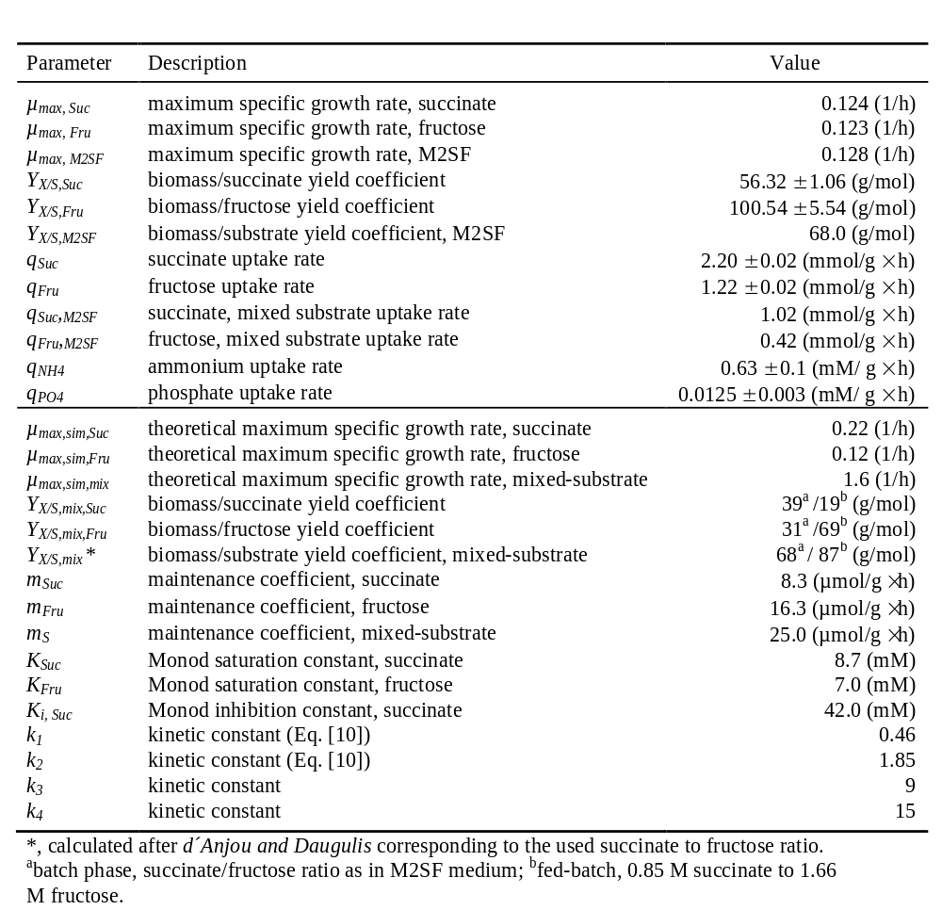

Fed-Batch Cultivation of R. rubrum: Basic Growth Parameters
Fructose
Succinate
μ
=
μ
C
Suc
Suc
max,
sim
,
Suc
+
+
C
2
(
K
Suc
C
Suc
Suc
)
K
i
,
Suc
μ
=
μ
C
Fru
Fru
max,
sim
,
Fru
(
K
+
C
)
Fru
Fru
Zeiger and Grammel, 2010. Biotechnol. Bioeng.105(4):729-39.
Notes:
30
30

Slide 31


High Level Expression of Photosynthetic Membranes as Model System for Redox Signaling and Control
O₂
LIGHT
CARBON
SOURCE
?
?
Semiaerobic cultivation of R. rubrum in the dark with different carbon substrates
?
Redox
signalling
?
Photosynthetic gene expression
137
pfla
137
pfla
'
'
pta
pta
cbiD
cbiD
411
411
481
481
L
L
H
H
I
I
J
J
K
K
cupB
cupB
cdpA
cdpA
C
C
D
D
E
E
F
F
C
C
X
ack
X
ack
cdpA
C
D
E
F
C
X
Y
Z
WBA
L
M
Fructose/
Fructose/
Succinate
Fructose
Succinate
Fructose
Succinate
Succinate
Ubiquinone (Coenzyme Q10);
A metabolic signal in gene regulation ?
Ghosh et al. 1994. Appl. Env. Microbiol. 60(5):1698
Grammel, H. and R. Ghosh . 2008, J. Bacteriol. 190 (14):4912-4921
Notes:
31
31

Slide 32

Modeling the Electron Transport Chain (ETC) of Rhodospirillaceae
Issues:
Stoichiometric model (elementary modes, etc.)
- Kinetic model (rate laws of electron transfer reactions based on redox potentials
QH2 (Ubiquinone-10) as major regulatory signal
anaerobic in light
(photosynthesis)
aerobic
(respiration)
respiration + photosynthesis
Klamt, S., H. Grammel, R. Straube, R. Ghosh, and E.D. Gilles. 2008. Mol. Syst. Biol. 4:156.

Slide 33



Kinetic Model of the Electron Transport Chain
Kinetic description of the electron transfer processes in the ETC based on the driving forces: redox potential differences
Driving force: redox potential difference
Thermodynamic span: ts
ts_{NADH-DH} = – ΔG= F(2ΔE_{NADH-DH} – 4⋅ pmf)
Reaction rate r_{NADH-DH} :
r_{NADH-DH}= k_{NADH-DH} ts_{NADH-DH}
Klamt, S., H. Grammel, R. Straube, R. Ghosh, and E.D. Gilles. 2008. Mol. Syst. Biol. 4:156.

Slide 34

Kinetic Model of the Electron Transport Chain
Simulation studies: Steady-state response curves of selected model variables under different environmental conditions

Slide 35


In vivo Spectroscopy of Cellular Redox Dynamics
NAD(P)H-fluorescence during aerobic-anaerobic switch
FMN, FAD
NAD(P)H
Protein
2D fluorescence scan of bioreactor cultivation of R. rubrum

