Slide 1
Gait parameters across three attentional loading conditions during Timed Up and Go Test: A comparative study between age- matched healthy individuals and stroke survivors.
SUBMITTED BY
DR. HARSH AGRAWAL (PT)
INDIAN ASSOCIATION OF PHYSIOTHERAPY

Slide 2
INTRODUCTION
Walking is a complex task whose performance relies not only on the sensorimotor system but also critically depends on cognitive resources, specifically executive function that orchestrates goal directed activities.
Age may affect several characteristics of gait including speed, step width and double support phase. These effects of age on gait may be partly due to deterioration in sensory and motor systems that are important for safe walking.
The magnitude of gait deterioration is thought to be proportional to the complexity of the motor task being performed.

Slide 3
The apparent relationship between increased fall risk when performing an attention demanding task while walking, and the relationship between step kinematic variability and fall risk raises the question of whether attention demanding tasks influence step kinematic variability.
Attention can be classified into separate functions, including focused or selective, sustained, divided and alternating. Dividing attention refers to carry out more than one task at the same time and alternating attention refers to rapid shifting of attention from one task to another.

Slide 4
Dual task training is also one of the methods of rehabilitation. Dual task training is effective in improving balance control under dual task contexts in elderly individuals with impaired balance.
The TUG test is a simple and quick functional mobility test that requires a subject to stand up, walk 3m, turn, walk back, and sit down.
A widely selected instrument to assess functional mobility and balance problems in older people.
Although a number of studies have been done on assessing gait parameters during various types of dual tasks in elderly as well as stroke population, but no study has been done to compare stroke patients and age-matched healthy individuals for gait parameters during various attention loading tasks.

Slide 5
Statement of Question
Whether there is any comparison in gait parameters across three attentional loading conditions during Timed Up and Go Test between age-matched healthy individuals and stroke patients?
Aims and Objectives
To determine the difference and compare the effects of attentional loading conditions during Timed Up and Go Test on gait parameters in age-matched healthy individuals and stroke patients.

Slide 6
Need of the study
Although a lot of researches are being done to see the effect of TUG test on gait parameters within age- matched healthy older adults and stroke survivors individually but no study has been done to compare gait parameters during TUG test between stroke survivors and age- matched healthy individuals during different types of attentional loading demands.
The benefits of the study are that it may improve motor functions along with cognition and activity limitation which occurs with ageing. The results of the study can be used judiciously, in the management of motor function of old adults as well as stroke survivors.

Slide 7
Hypothesis
Research Hypothesis
There is significant difference in gait parameter during Timed Up and Go Test across three attentional loading conditions between age-matched healthy individuals and stroke patients.
Null Hypothesis
There is no significant difference in gait parameter during Timed Up and Go Test across three attentional loading conditions between age-matched healthy individuals and stroke patients.

Slide 8
REVIEW OF LITERATURE
Pratima Silsupadol et al in 2009, conducted a study on older adults in which they proved that dual task training programs were superior to single task training in involving walking under dual task contexts.
Coppin AK et al did a study in 2009 on association between executive function and performance difference on complex versus usual walking tasks in a sample of non- demented older adults in which he proved that the cost associated with the addition of a challenge to the basic walking task differs by executive function and the nature of the task.

Slide 9
Otmar Bock in 2008 did an experimental study on healthy young and elderly persons on dual task costs while walking stating that combination of walking and concurrent visual observation which are common in everyday life, may contribute towards distributed gait and falls during daily activities in old age. Prevention and rehabilitation programs for seniors should therefore include training of such combinations.
In year 2010, a study was done by Neelesh. K.Nadkarni on effect of working memory and spatial attention tasks on gait in healthy young and older adults concluded that there was a main effect of task condition on gait speed, stride length and double support time independent of the group.

Slide 10
In the year 2000, a study was done by Shumway- Cook on predicting the probability for falls in community dwelling older adults using TUG concluded that simultaneous programme of a secondary task had a deterious effect on functional mobility.
Shamay. S. Ng in year 2005, did a study on reliability of TUG, in which the TUG test showed high degree of test-retest reliability in TUG scorers in elderly subjects with chronic stroke. Subjects with chronic stroke had significantly more spastic and weaker plantar flexors, slower walking speeds and poorer walking endurance when compared with healthy elderly subjects.

Slide 11
A study done by Olivier Beauchet on dual task related gait changes in transitionally frail older adults in 2005, concluded that counting backward while walking caused characteristic gait changes that appears to be a marker for decline in gait control, this suggests that the choice of the attention- splitting task in dual task gait assessment must be made carefully.
In year 2006, a study done on dual task related gait changes in individuals with stroke by Yea-Ru Yang et al stated that subjects with stroke have difficulty performing two motor tasks concurrently.

Slide 12
METHODOLOGY
Sample
Sample Size
The subjects were selected only if they met the inclusion criteria. In this study, 30 subjects were selected. The selected subjects were randomly assigned to one of the two groups by chit picking. Group A consisted of 15 stroke subjects who performed attention demanding task along with Timed up and go test. Group B consisted of the 15 age- matched healthy older adults, who performed attention demanding task with Timed up and go test.
Source of subject
Senior citizens of I.T.S. Paramedical College and Stroke patients of Indraprastha Apollo Hospitals, Delhi.

Slide 13
Inclusion Criteria
At least 6 months post stroke with unilateral hemiparesis as diagnosed by a medical
physician.
All stroke patients should be MCA Stroke.
All subjects should be male.
Age range between 40 to 70 years old.
Able to walk continuously for 10 meters independently without walking aid.
Able to hold a glass full of water with the non- affected hand.
Able to follow one step commands.
MMSE should be greater or equal to 24.

Slide 14
Exclusion Criteria
Any musculoskeletal and cardiopulmonary diagnosis.
Significant visual or auditory impairments.
More than one stroke episode in last 6 months.
Recent history of loss of consciousness or hip or knee surgery
Colour blindness
Fracture or lower limb deformity
Amputation of lower limb.
MMSE less than 24.

Slide 15
Study Design
The study was a quasi- experimental study design.
Duration of study
1 year duration
Dependent Variables
Gait parameters: - Number of Steps and Walking Velocity during TUG test, time taken to perform TUG test .
Independent Variables
Attention demanding task and Timed up and go test in experimental group (stroke patients), attention demanding task and Timed up and go test in control group(age matched healthy individuals).

Slide 16
Procedure
A sample of 30 subjects was recruited on the basis of inclusion and exclusion criteria.
A brief description was given to all the subjects about the protocol and the procedure which was to be followed.
An informed consent was obtained from the subjects who wanted to participate in the study.
The demographic details of all the subjects were taken using the data collection form. Gait parameters i.e. number of steps, time taken to perform Timed Up and Go Test and walking velocity were calculated for both groups using Timed Up and Go Test during 3m paper walk way method.

Slide 17
Subjects ambulated 3 meters on a paper walk way with ink patches on their shoes which left behind a foot print. The readings were taken as the subject stands up from the chair and according to the placement of foot on the paper walk way during 3m forward walking followed by turning 180 degrees and the returning back to the starting position and sitting back on the chair.
Whole of the procedure was done while performing Timed Up and Go Test along with attentional demanding tasks.
A cone was placed at a distance of 3 meters and the subjects were instructed to walk and turn around the cone and then return back to the staring position.

Slide 18
Ambulation time was recorded using a stopwatch and the walking velocity was calculated as the total distance travelled/time taken and accordingly number of steps were calculated taken by the subjects to complete TUG test .
Attention demanding task during Timed Up and Go Test was given to stroke patients in experimental group and age-matched healthy individuals in control group.

Slide 19
DATA ANALYSIS
From the recorded video, we obtained our primary outcomes, which were time, number of steps and walking velocity taken to complete the TUG test. The data were analyzed using the IBM SPSS statistical software version 15.5 (IBM, Armonk, NY) and Microsoft Excel 2007.
Independent t test was used to find differences in gait parameters during TUG test between Group 1 and Group 2 . Descriptive statistics and tests for normality were carried out for all outcome variables.

Slide 20
Repeated measures analysis of variance (ANOVA) was used to analyze gait parameters across 3 attentional loading conditions (single-, dual-motor, and dual- cognitive task conditions) within groups individually . A post hoc Bonferroni comparison was performed when the repeated measure ANOVA test revealed a significant difference (P < .05).

Slide 21
RESULTS
MEAN±SD values of age, weight and height across group 1 and group 2 were 53.53±8.91 and 51.60±7.10, 61.44±6.70 and 63.58±9.86, 161.26±6.12 and 163.86±3.33 respectively. Hence, it was also found that “t” and “p” value for age is 0.656 and 0.517 respectively, for height is 0.697 and 0.492 respectively and for weight is 1.444 and 0.160 respectively.

Slide 22
TUG TIME comparison between group 1 and group 2 showing MEAN±SD of TUGS, TUGDT and TUGCB as 17.21±1.31 and 13.74±3.72, 18.52±1.40 and 13.68±0.91 , 18.52±1.40 and 15.74±2.03 respectively.
Comparison of TUG TIME data between Group 1 and Group2 On comparison of Mean TUGS of group 1 and group 2, ‘t’ value was 3.40 and ’p’ value was 0.002. Hence there was significant difference in Mean TUGS between group 1 and group 2.
On comparison of Mean TUGDT of group 1 and group 2, ‘t’ value was 11.14 and ’p’ value was 0.001. Hence there was significant difference in Mean TUGDT between group 1 and group 2.
On comparison of Mean TUGCB of group 1 and group 2, ‘t’ value was 4.34 and ’p’ value was 0.001. Hence there was significant difference in Mean TUGCB between group 1 and group 2.

Slide 23
Graphical representation of TUG TIME across group 1 and group 2.

Slide 24
Number of steps comparison between group 1 and group 2 showing MEAN±SD of NSS, NSDT and NSCB as 15.26±1.94 and 13.33±1.44, 15.26±1.94 and 14.00±1.36 , 15.86±1.76and 14.86±1.72 respectively.
On comparison of Mean NSS of group 1 and group 2, ‘t’ value was 3.08 and ’p’ value was 0.005. Hence there was significant difference in Mean NSS between group 1 and group 2.
On comparison of Mean NSDT of group 1 and group 2, ‘t’ value was 2.066 and ’p’ value was 0.048. Hence there was significant difference in Mean NSDT between group 1 and group 2.
On comparison of Mean NSCB of group 1 and group 2, ‘t’ value was 1.56 and ’p’ value was 0.128. Hence there was no significant difference in Mean NSCB between group 1 and group 2.

Slide 25
Graphical representation of Number of steps taken to perform TUG across group 1 and group 2.

Slide 26
WALKING VELOCITY comparison between group 1 and group 2 showing MEAN±SD of WVS, WVDT and WVCB as 35.13±2.55 and 49.40±5.56, 33.53±2.13 and 43.93±2.78, 32.53±2.26 and 38.53±4.71 respectively.
Comparison of Walking Velocity Data during TUG test between Group 1 and Group2 On comparison of Mean WVS of group 1 and group 2, ‘t’ value was 9.02 and ’p’ value was 0.001. Hence there was significant difference in Mean WVS between group 1 and group 2.
On comparison of Mean WVDT of group 1 and group 2, ‘t’ value was 11.46 and ’p’ value was 0.001. Hence there was significant difference in Mean WVDT between group 1 and group 2.
On comparison of Mean WVCB of group 1and group 2, ‘t’ value was 4.44 and ’p’ value was 0.001. Hence there was no significant difference in Mean WVCB between group 1 and group 2.

Slide 27
Graphical representation of Walking Velocity during TUG test across group
1 and group 2.

Slide 28
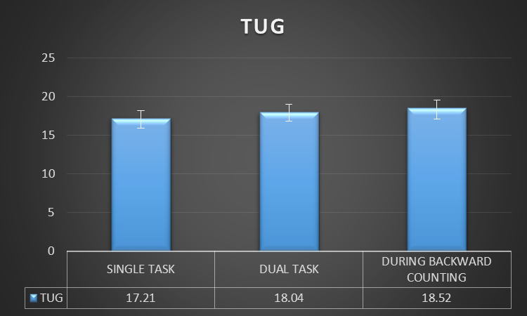
TUG time across three attentional loading tasks within group 1 is significant with p ≥ 0.05.
The POST HOC analysis of TUGS and TUGDT within group 1 is significant with p≥0.05.
The POST HOC analysis of TUGS and TUGCB within group 1 is significant with p≥0.05.
The POST HOC analysis of TUGDT and TUGCB within group 1 is non-significant with p≤0.05.

Slide 29
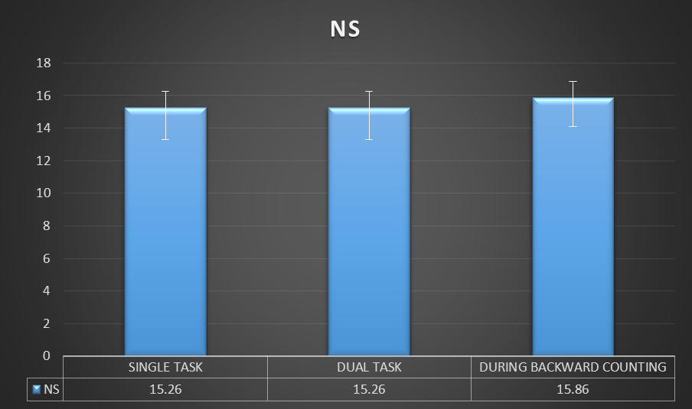
Number of steps taken to perform TUG across three attentional loading tasks in group 1 is significant with p ≥ 0.05.
The POST HOC analysis of NSS and NSDT within group 1 is non-significant with p≤0.05.
The POST HOC analysis of NSS and NSCB within group 1 is non-significant with p≤0.05.
The POST HOC analysis of NSDT and NSCB within group 1 is non-significant with p≤0.05.

Slide 30
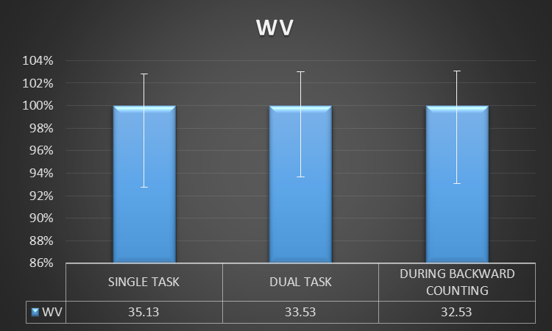
WALKING VELOCITY taken to perform TUG across three attentional loading tasks in group 1 is significant with p ≥ 0.05.
The POST HOC analysis of WVS and WVDT within group 1 is significant as p≥0.05.
The POST HOC analysis of WVS and WVCB within group 1 is significant as p≥0.05.
The POST HOC analysis of WVDT and WVCB within group 1 is significant as p≥0.05.

Slide 31
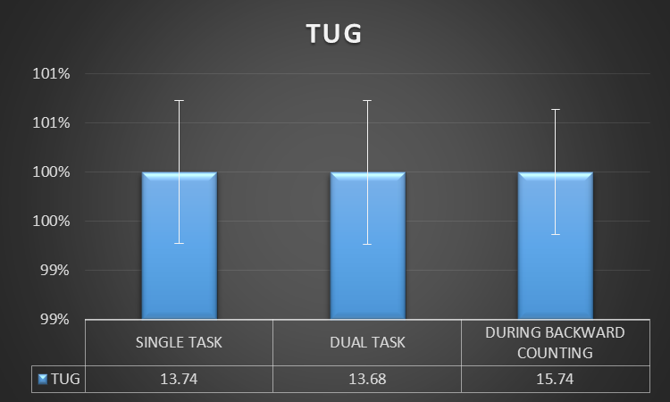
TUG time across three attentional loading tasks within group 2 is significant with p ≥ 0.05.
The POST HOC analysis of TUGS and TUGDT within group 2 is non-significant as p≤0.05.
The POST HOC analysis of TUGS and TUGCB within group 2 is significant as p≥0.05.
The POST HOC analysis of TUGDT and TUGCB within group 2 is significant as p≥0.05.

Slide 32
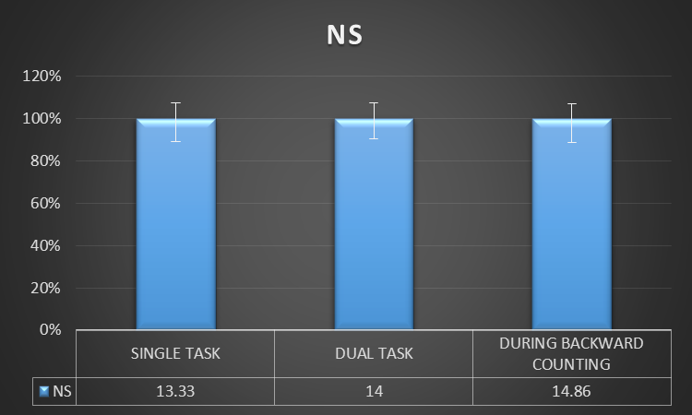
Number of steps taken to perform TUG across three attentional loading tasks in group 2 is significant with p ≥ 0.05.
The POST HOC analysis of NSS and NSDT within group 2 is non-significant as p≤0.05.
The POST HOC analysis of NSS and NSCB within group 2 is significant as p≥0.05.
The POST HOC between NSDT and NSCB within group 2 is non-significant as p≤0.05.

Slide 33
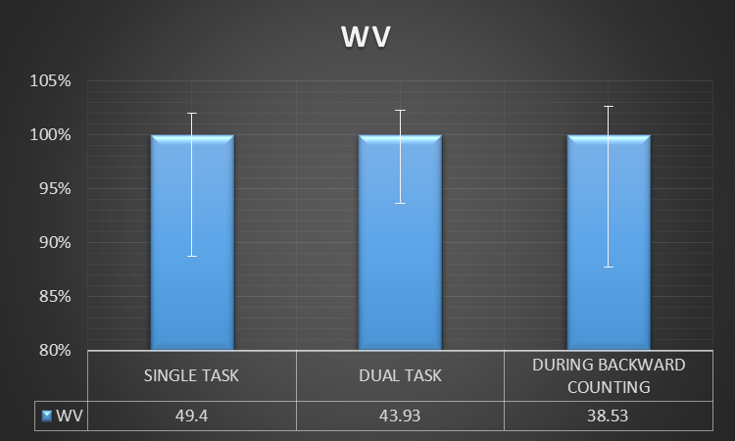
WALKING VELOCITY taken to perform TUG across three attentional loading tasks in group 2 is significant with p ≥ 0.05.
The POST HOC analysis of WVS and WVDT within group 2 is significant as p≥0.05.
The POST HOC analysis of WVS and WVCB within group 2 is significant as p≥0.05.
The POST HOC analysis of WVDT and WVCB within group 2 is significant as p≥0.05.

Slide 34
DISCUSSION

Slide 35
Within group comparison of TUG Time across three attentional loading conditions in Stroke Survivors
On comparison of mean TUG time (Single Task) with mean TUG Time (Dual Motor Task) statistically significant difference was found. (p≥0.05).
This may possibly be due to a combination of various factors including deficits in executive function, impaired divided attention and gait impairments in stroke survivors.
On comparison of mean TUG time (Single Task) with mean TUG Time (Dual Cognitive Task ) statistically significant difference was found (p≥0.05).
According to the capacity- sharing model, dual task interference will depend on several factors including task complexity, familiarity and importance and will occur only if the available resource capacity is exceeded, resulting in a decline in performance on one or both the tasks.

Slide 36
Within group comparison of Walking Velocity during TUG test across three attentional loading conditions in Stroke Survivors
Significant Difference with p ≥0.05.
Prudence Plummer- D Amato did a study on Interactions between cognitive tasks and gait after stroke in year 2008 which states that gait speed declines if walking is performed in addition to any other cognitive tasks.

Slide 37
Within group comparison of TUG Time across three attentional loading conditions in age-matched healthy older adults
On comparison of mean TUG time (Single Task) with mean TUG Time (Dual Motor Task ) statistically no significant difference was found. (p≤0.05).
This may possibly due to the fact that, neuromuscular coordination and dynamic balance of the patients is intact, suggesting that patient will not feel much difficulty in holding a cup of water in hand while walking.
On comparison of mean TUG time (Single Task) with mean TUG Time (Dual Cognitive Task ) Statistically significant difference was found with p≥0.05

Slide 38
Within group comparison of Walking Velocity across three attentional loading conditions in age-matched healthy older adults
Significant difference was found (p≥0.05)
N.L Watson et al in year 2010 stated that considering evidence of cerebral small- vessel injury, white matter hyperintensities on brain magnetic resonance imaging preferentially inﬂuence executive and motor functions, although associations with memory have been reported.
These common cerebrovascular alterations in aging and hypertension predict gait speed decline, disability, and dementia, suggesting that underlying microvascular disease may in part explain associations of cognitive and gait performance in older adults.

Slide 39
Comparison of Number Of Steps during TUG test across three attentional loading conditions in stroke survivors and age-matched healthy older adults.
Non- significant difference ,with p≤0.05
A study done by Haidzir Manaf et al stating that number of steps required to perform dual-motor and dual- cognitive task were more affected than single task during TUG test.

Slide 40
Between group comparison among stroke survivors and age-matched healthy older adults
Significant difference in TUG time, Number of Steps and Walking Velocity during TUG test.
First study comparing the Timed Up and Go test gait parameters amongst stroke survivors and age matched healthy individuals.
Hence the finding of this study shows that gait parameters and significantly affected in stroke survivors in comparison to healthy older adults.

Slide 41
Limitations
Small sample size
No female subjects were included.
Reading and understanding language was necessary.

Slide 42
Future Research
It is recommended that future studies compare female stroke survivors to healthy age matched control group . In addition, the procedure was conducted with a leveled walking surface that might not be representative of a regular environment encountered by the participants on a daily basis.

Slide 43
CONCLUSION
In the results of the present study, we accept our experimental hypothesis stating that there is significant difference in gait parameters during Timed Up and Go Test across three attentional loading conditions between age-matched healthy individuals and stroke patients.

Slide 44
REFERENCES
Decker LM, Cignetti F, Potter JF, Studenski SA, Stergiou N. Use of motor abundance in young and older adults during dual-task treadmill training.OLoS One. 2012 July20; 7(7): e41306.
Harold Pashler. Dual-Task Interference in Simple Tasks: Data and Theory. Psychological Bulletin 1994. Vol. 116. No. 2. 220-244.
Mark D Grabiner and Karen L Troy. Attention demanding tasks during treadmill walking reduce step width variability in young adults. Journal of Neuro Engineering and Rehabilitation 2005, 2:25.
Patima Silsupadol, Anne Shumway-Cook et al. Effects of Single-Task Versus Dual-Task Training on Balance Performance in Older Adults: A Double-Blind, Randomized Controlled Trial. Arch Phys Med Rehabil. 2009 March ; 90(3): 381–387.
Prudence Plummer- D Amato. Interactions between cognitive tasks and gait after stroke: A dual task study.Gait and Posture 2008 May; 27(4): 683-688.

Slide 45
Sheridan PL, Solomont J, Kowall N, Hausdorff JM: Influence of executive function on locomotor function: divided attention. increases gait variability in Alzheimer's disease. J Am Geriatr Soc 2003, 51:1653-1637.
Olivier Beauchet, Véronique Dubost, Régis Gonthier, Reto W. Kressig. Dual-Task-Related Gait Changes in Transitionally Frail Older Adults: The Type of the Walking-Associated Cognitive Task Matters. Gerontology 2005;51:48–52.
Galit Yogev, Jeffrey M. Hausdorff and Nir Giladi. The Role of Executive Function and Attention in Gait. Mov Disord. 2008 February 15; 23(3): 329–472.
Otmar Bock. Dual-task costs while walking increase in old age for some, but not for other tasks: an experimental study of healthy young and elderly persons. Journal of NeuroEngineering and Rehabilitation 2008, 5:27.

Slide 46
THANK YOU

