Slide 1
A novel translational approach for
neurodegenerative Diseases (e.g. AD, ALS,PD)
Harish c. Pant NINDS/NIH, Bethesda, MD
International Conference on Brain Disorders &
Therapeutics, August 24-26, 2015, London UK

Slide 2

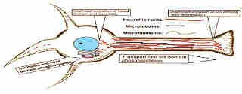


In mature neurons cytoskeletal protein phosphorylation is topographically & tightly regulated under physiological conditions.
(S/T-P)
40 - >100
(Ser) S/T (Thr)-P
Tau
N
C
12 - 24
(S/T-P)
Topographic regulation of cytoskeletal protein phosphorylation
MAPs
ALS
Normal
Human cervical spinal neuron

Slide 3
Cdk5, Cyclin dependent kinase 5, A neuron specific Cdk;
While studying the compartment specific phosphorylation of neuronal cytoskelelal proteins on proline-directed serine (Ser)/threonine (Thr) residues, we discovered cyclin- dependent kinase 5, (Cdk5), is the major kinase involved in the regulation of phosphorylation in the nervous system. Cdk5 is a multifunctional kinase ,essential for neuronal survival and plays a key role in the nervous system development, maturation of mammalian nervous system and neurodegeneration.

Slide 4
Cdk5 is unique among the Cdk family of kinases; it is not activated by a cyclin, although it binds with cyclin D/E
Activity is found primarily in neurons due to its association with neuron specific molecules p35 and p39.
  p35 is the major activator.
Cdk5 is the major kinase phosphorylating S/T-P residues
in the nervous tissue

Slide 5
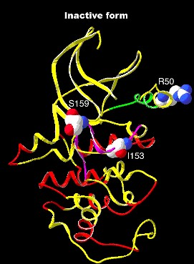
Cdk5
Cyclin dependent kinase 5 (Cdk5):Yin & Yang of the
Nervous System

Slide 6
Cdk5; in vivo and in vitro studies;
Activity is Spatially and Topographically regulated
Cdk5 (-/-) mice,
*
Embryonically lethal ( E16.5 - P0), wide spread defects in neuronal
migration in cortex, hippocampus and cerebellum.
*
Ballooned neuronal perikarya of spinal cord and brain stem motor neurons.
*
*
Aberrant phosphorylation of cytoskeletal proteins and apoptosis.
Higher MAPks ( Erk1/2), SAPKs ( JNK3) and reduced lipid kinases ( PI3K) activity (Cdk5 - cross talk).
These studies suggest that Cdk5 modulates various signal transduction pathways, tightly regulating neuronal function & survival.

Slide 7
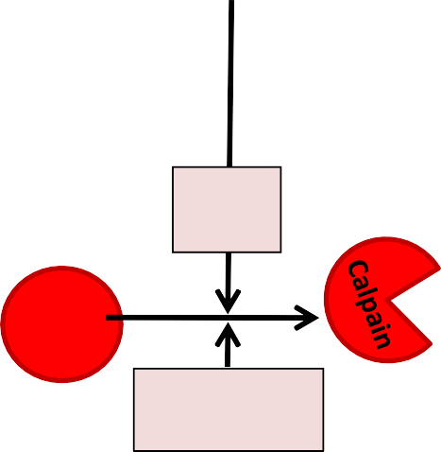
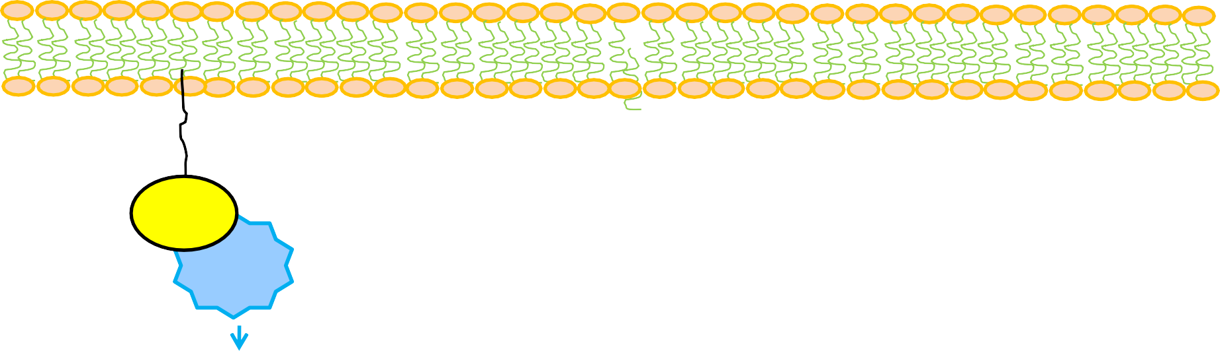




Role of Cdk5 in neurophysiology and pathology
Pathology upon neuronal insults / stress (e.g.Aβ, Glutamate
toxicity, oxidative stress, glucose toxicity, mutations)
Physiology
N
N
_{Ca}2+
influx
p35
Cdk5
Calpain
Physiology;
p35
Intracellular _{Ca}2+
Cdk5
Neuronal processes regulated by Cdk5
Neuronal development and migration, Axonal Transport
Phosphorylation of
cytoskeletal proteins
Kinase cross-talk
Cognition and memory
Synaptic Plasticity
Neuronal survival
Cell Adhesion
Exocytosis
Pain
Inflammation
Pathology ( e.g. AD, ALS); Cdk5/p25 is a therapeutic
Deregulation
p25
Cdk5
target
Deregulated Cdk5 activity; elevated & sustained activation.
Neuroinflammation - Neurodegeneration; AD ,ALS, FTD, PD, HD, N-PC
Pathology

Slide 8
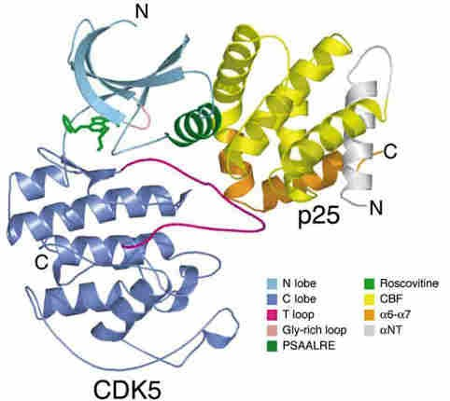
Crystal structure of the Cdk5/p25 complex with roscovitine
Tarricone et al., 2001; Mapeli et al., 2005
Small lobe
Glycine rich loop, ATP
_{roscovitin}Bi_{e}nding Domain
PSTAIRE
Activation loop
Km (p25): 70-100
nM
Km (ATP): 300μM
Large lobe

Slide 9
What is the effect of smaller peptides derived from P25 fragment Protein?
Can these smaller peptides derived from p25 deregulator, more devastating or rescue the deregulated Cdk5 activity inducing apoptosis?

Slide 10

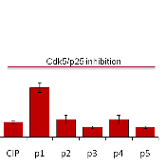
Cdk5/p25 a therapeutic target; Roscovitine like compounds (ATP analogs) are non specific and toxic; We used truncated peptides derived from p25 within 3.5A interface (using Cdk5/p25 crystal structure) to study the role of these peptides on Cdk5 activity.
To our surprise some of them inhibited Cdk5 activity.
P25 P15 P14
CIP
P1 P2 P3
P4
P5
209 aa
Ki
> 5µM
~ 2µM
142 aa
136 aa
126 aa
57 aa
47 aa
41 aa
29 aa
++
+
++
+++
++
+++
40nM
24 aa
20nM
Zheng et al., JBC 2010, EMBO J 2005

Slide 11
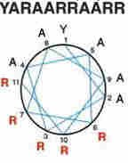
Modified p5 – To pass BBB named as TFP5
p5 (24 aa):
KEAFWDRCLSVINLMSSKMLQINA
TFP5:
FITC-GGGKEAFWDRCLSVINLMSSKMLQINA
p5
Modified TAT-peptide
Scrambled peptide:
FITC-GGGGGGFWDRCLSGKGKMSSKGGGINAYARAARRAARR
TFP5 US Patent # 8597660.

Slide 12
TFPP5-modified peptide is a better inhibitor of Cdk5/p25 activity compared to Roscovitine
140
120
100
80
60
³²P CPM (x 1000)
40
P5-mod.
Roscovitine
20
0
Cdk5/p25
5
10 5
10
Concentration (µM)

Slide 13
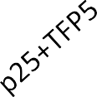


A
Kinase Assay using cortical neurons with Cdk5 IP
³²P-histone H1
H1-Coommassie stain
*
B
40
Kinase Assay ( mean density)
30
20
10
0
EV p25 TFP5 p25+TFP5
P5 modified peptide inhibits specifically Cdk5/p25 but not endogenous Cdk5/p35 activity
in situ - neuronal cultures

Slide 14
A
Kinase Assay using cortical neurons with Cdk5 IP
³²P-histone H1
H1-Coommassie stain
*
B
40
Kinase Assay ( mean density)
30
20
10
0
EV p25 TFP5 p25+TFP5
P5 modified peptide inhibits specifically Cdk5/p25 but not endogenous Cdk5/p35 activity
in situ - neuronal cultures

Slide 15
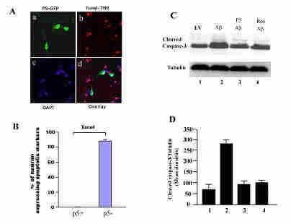
TFP5 inhibits Aβ induced toxicity in cortical neurons

Slide 16

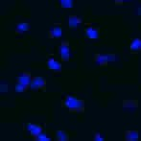
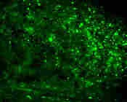
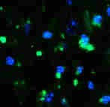
Mouse Cerebral Cortex- Single injection,TFP5 40 mg/Kg
4 days post injection
PBS
10X
PBS/DAPI
40X
A
B
TFP5
TFP5/DAPI
C
D
TFP5 Crosses the Blood Brain Barrier

Slide 17
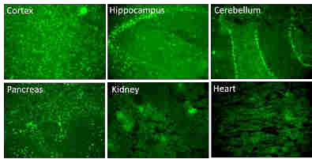
P5- modified peptide distribution in various regions at day 4 after 3
consecutive ip injections
IP injection of TFP5 crosses the blood brain barrier and localized in different parts of brain

Slide 18


Sporadic AD model mouse; p25 Tg
Pathology; Cdk5/p25 is a therapeutic
p25
target
Cdk5
Deregulated Cdk5 hyperactivity; elevated & sustained activation.
Neurodegeneration; AD ,ALS and others
Pathology

Slide 19



p25 Transgenic mice - AD mouse model in collaboration with Drs Tsai and Kesavapany’s
laboratories
C57BL/6-Tg(tetO-p25/GFP)
B6;CBA-Tg( Camk2a-tTA)
The camk2a transgenic mice expressing the tetracycline-controlled transactivator protein (tTA) under regulatory control of the
forebrain-specific Camk2a promoter
The p25 transgenic mice expressing the p25 protein bearing a carboxy-terminal GFP tag, under the control of the tetracycline operator
Bi-Tg(tetO-p25/GFP/Camk2a-tTA)
Induction of p25 expression at the age of 6wk by the
removal of doxycycline in water

Slide 20
Phenotypic expression of p25Tg AD model mouse include:
p25 expression
Cdk5 Hyperactivity
Aβ plaques, Amyloid plaques
hyperphosphorylation and aggregation of Tau, NFTs and NFPs
Neuroinflammation (activated astrocytes and microglia)
behavioral defects

Slide 21
Can TFP5 treatment prevent AD phenotypes
in sporadic AD model (p25Tg)
mice?. A Proof of concept.

Slide 22
Can TFP5 reduce the AD phenotypes in P25 Tg AD model mice?
Five groups of mice were injected either with saline, TFP5 or scrambled peptide starting after 12 weeks on DOX followed by 6wks off DOX during which the AD phenotypes are expressed.
For six weeks, all injections were given 3 times every week i.e., 18
injections in total.
After treatment, Y maze and rota-rod and other behavioral studies were carried out before animals were sacrificed for biochemical and cell biological analyses.
All the behavioral studies are double blinded.

Slide 23
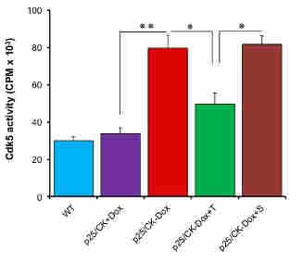
Hyperactivation of Cdk5 is reduced significantly upon TFP5 treatment
Cdk5 Kinase Assay
TFP5 peptide treatment rescues hyperactivation of Cdk5 in P25Tg AD model mice.

Slide 24
TFP5 treatment rescued synaptic activity in P25Tg AD model mice;
To record field excitatory postsynaptic long term potentials (eLTP), synaptic activity marker of memory and learning measured using transverse hippocampal slices prepared from five different groups of mice (1) WT controls, (2) p25 non- expressing, (3) p25 over expressing ( p25Tg, AD model), (4) p25Tg mice treated with TFP5 and
(5) p25Tg mice treated with scrambled TFP5.
CA1 field potentials evoked by Schaffer collateral stimulation were measured.
After recording of stable baseline , LTP was induced by two episodes of theta burst stimulation (TBS) with 10 s intervals. TBS consisted of ten bursts (each with four pulses at 100 Hz) of stimuli delivered every 200 ms

Slide 25

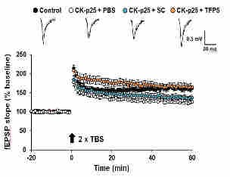
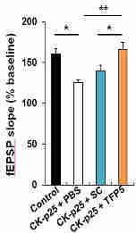
p25-mediated synaptic dysfunction rescued in CK-p25 expressing mice post TFP5 administration; loss of synatic activity (eLTP) is prevented in FTP5 treated p25 Tg AD model mice.

Slide 26
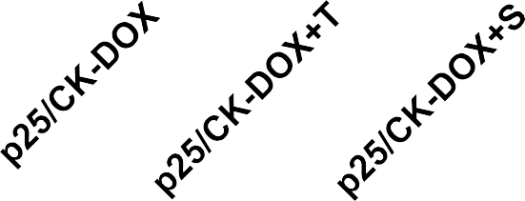
Spatial memory (Y- Maze) deficit is rescued in p25Tg TFP5 injections
p25Tg
12 weeks on DOX
thrice TFP5 0.2 mM / week 6 weeks off DOX
Significant Rescue
70
٭٭٭
65
٭
٭
٭
60
55
50
45
40
% Alternation

Slide 27
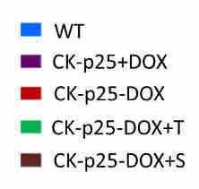
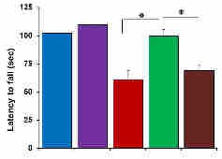
TFP5 treatment prevented motor defects in p25 Tg AD model mice
Rota rod: Motor deficit

Slide 28
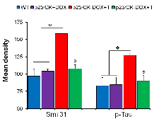
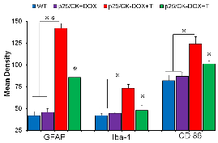
Hyperphosphorylation of cytoskeletal proteins and neuroinflammation is reduced upon TFP5 treatment
TFP5 treatment reduced hyperphosphorylation of p-neurofilament (p-NF-H/M) and p-tau in p25Tg AD model mice
NeuroinflammationTFP5- treatment reduced in p25Tg AD model mice

Slide 29
Does TFP5 prevent hyperactivation of Cdk5 and abnormal phenotypes in double transgenic familial (5XFAD) AD model mice?
5XFAD mouse has the following five familial Alzheimer Disease (FAD) mutations:
Three APP (695) mutations:
•Swedish (K670N/ M671L)
•Florida (I716V)
•London (V717I)
Two Presenilin l (PS1) mutations:
• M146L
• L286V
Phenotypic expression of 5XFAD mouse include:
  p25 expression
  Cdk5 Hyperactivity
  Aβ plaques, Amyloid plaques
  hyperphosphorylation and aggregation of Tau, NFTs and NFPs
  Neuroinflammation (activated astrocytes and microglia)
  behavioral defects

Slide 30
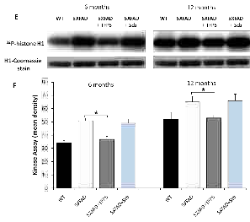
TFP5 peptide prevents hyperactivation of Cdk5 in 5XFAD mouse brain

Slide 31

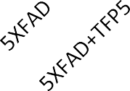


Rescue of spatial memory deficit by TFP5 treatment in AD model mice:
Y-maze Spontaneous Alternation Test ( memory).
Spontaneous alternation behavior (SAB) % = ^{Total number of triad entry} X 100 (working memory)
Total number of arm entry - 2
Hsiao et al., Science (1996) Holocomb et al., Nature (1998)
3 months
n =3
6 months
n =8
9 months
n =11
12 months
n =10
70
*
*
65
*
% Alternation
60
55
50
45
40
All the behavioral studies were double blinded.

Slide 32
TFP5 injection rescued motor deficit in 12 month old 5XFAD model mice (Rota-rod test, motor behavior )
200
6 months
9 months
12 months
160
Latency (sec)
120
**
*
80
40
WT
5XFAD
WT
5XFAD
WT
5XFAD 5XFAD+TFP5

Slide 33

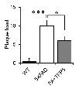
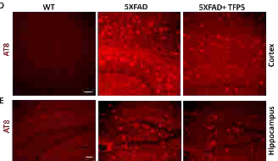


Aβ and phospho-tau were reduced post TFP5 treatment
Aβ plaques
Phospho-tau

Slide 34



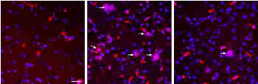
Neuroinflammation is reduced upon TFP5 treatment
WT 5XFAD 5XFAD+TFP5
GFAP
_{H} Activated astrocytes
50
٭٭ ٭
Relative intensity
40
30
20
10
E
F
G
0
WT
5XFAD 5X+TFP5
WT
OX42/DAPI
5XFAD
5XFAD+TFP5
L
Activated microglia
٭٭ ٭
20
Relative intensity
10
0
I
J
K
WT
5XFAD 5X+TFP5

Slide 35

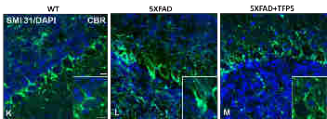
P5-mod treatment inhibits hyperphosphorylation of NF-M/H and Tau of 5XFAD mice brain ; Western blots and ICC using p-NF-M/H and p-tau specific antibodies
I
J

Slide 36
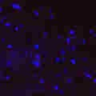
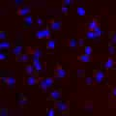
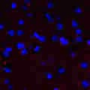
Neuronal cell loss is reduced upon P5-modified peptide treatment of AD mice
Cleaved caspase 3 (apoptotic cell marker)
WT
5XFAD
5XFAD+P5-mod
Apoptotic cells
CC3/DAPI
30
٭٭٭
٭
CC3 positive cells
20
10
0
A
B
C
WT
5XFAD 5X+TFP5

Slide 37
Since it is well documented that deregulation of Cdk5 activity is associated with ALS pathology, and expression of p25 and Cdk5 hyperactivity have been demonstrated in ALS brain and spinal cords (Nguyen et al.,2001; Cruz et al., 2004 ), we asked the following question:
Can TFP5 ameliorate ALS pathology?

Slide 38
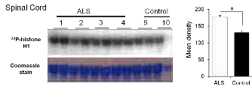
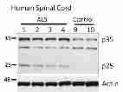
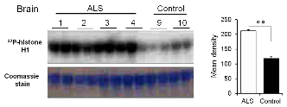
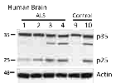
Cdk5 activity is elevated brain and spinal cord of ALS patients

Slide 39
TFP5 Injection paradigms for ALS mice
Slow ALS (SOD1 G37R)
Onset 140-150 days
End stage 170 days
G37R (line 42) mice treated with TFP5 (0.4mM)/ once a week starting
from 80 days carried out till the end stage of mice ( criteria set by Vet.)
80 days were chosen to make sure that injections are given well before the onset of the disease.
We also did 0.2mM one injection per week which did not show any rescue.
Fast ALS (SOD1 G93A)
Onset 100-110 days
End stage 130 days
G93A mice treated with TFP5 (0.4mM)/twice a week starting from 35 days
carried out till the end stage of mice ( Criteria by Vet.)
35 days were chosen to make sure that injections are given well before the onset of the disease.
We also did one injection per week which was not effective. Therefore changed to two injections per week.

Slide 40
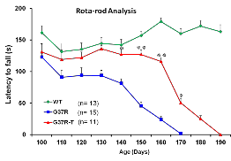
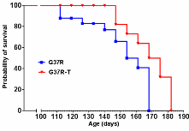

Survival plot of G37R (line 42) mice treated with TFP5 (0.4mM ; 100mg/kg)/ once a week
starting from 80 days
Survival Plot
G37R survival = 160 days ± 5
G37R-T survival = 175 days ± 3.5
Survival increased by 15 days

Slide 41
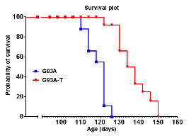
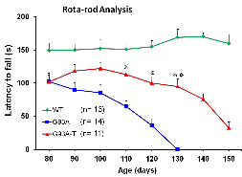

Survival plot of G93A mice treated with TFP5 (0.4mM)/twice a week starting from 35 days
G93A survival = 117 days ± 1
G93A-T survival = 134.6 days ± 2.5
Survival increased by 17.5 days

Slide 42
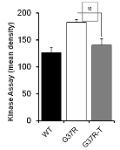
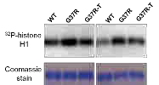




Elevated Cdk5 activity of G37R ALS model mice brain reduced to wild type activity upon TFP5 treatment
Reduction in phospho - NF and pTau
after TFP5 treatment in G37R mice
Neuroinflammation is reduced post TFP5 treatment in G37R mice
W M
M + T
245
180
100
75
48
GFAP
Smi 31
20
17
Iba-1
63
AT8
Actin
48
75
CD 86

Slide 43
TFP5 can ameliorate ALS phenotypes in SOD1 mutant mice

Slide 44


Longer preincubation facilitates TFP-5 mediated neuroprotection in cells treated with 3NP (mitochondrial electron transport complex1)
Rat cortical neurons
1h preincubation with TFP-5 24h exposure to 3-NP
Rat Cortical Neurons
24h preincubation with TFP-5 Then 24h exposure to 3-NP
p<0.001
0.3
p<0.001
0.4
MTT Cell Viability
Absorbance
0.3
MTT Cell Viability
Absorbance
0.2
0.2
0.1
0.1
0.0
0.0
Media
3 mM 3-NP
Media
3 mM 3-NP
3-NP + 10 nM TFP-5
3-NP + 1 uM TFP-5
3-NP + 10 nM TFP-5
3-NP + 1 uM TFP-5
3-NP + 100 nM TFP-⁵
3-NP + 100 nM TFP-5

Slide 46
Cdk5 deregulation in Parkinsion’s Disease (PD)
Recent evidence indicates that Cdk5 is also hyperactivated in PD. Following few experiments show that TFP5 or TP5 also inhibit Cdk5 hyperactivation in vivo and in vitro, rescues nigrostriatal dopaminergic (NS) neurodegeneration induced by 1-methyl- 4-phenyl-1,2,3,6-tetrahydropyridine (MPTP/MPP+), in a mouse model of PD. TFP5 peptide treatment also blocked dopamine depletion in the striatum and improved gait dysfunction due to MPTP administration. The neuroprotective effect of TFP5 peptide is also associated with marked reduction in neuroinflammation and apoptosis.

Slide 47

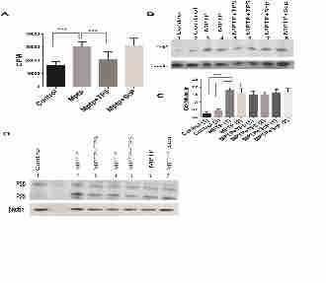
TFP5 inhibits MPTP-induced Cdk5/p25 hyperactivity in PD model mice

Slide 48
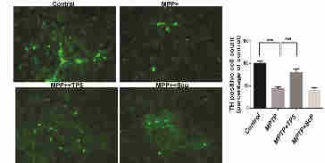
Dopaminergic neuronal loss in SN due to MPTP is reduced significantly by TP5 treatment

Slide 49
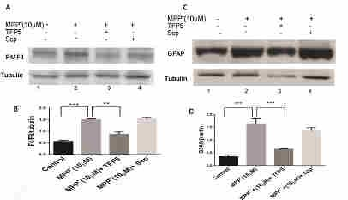
TFP5 treatment inhibits MPP+ -induced inflammation and apoptosis in mesencephalic primary cultures

Slide 50

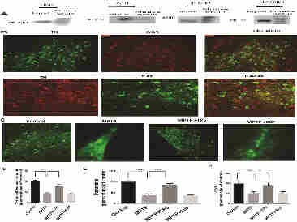
Dopaminergic neurons of the SN express Cdk5/p35 and are protected from cell death by TP5 after MPTP induction

Slide 51
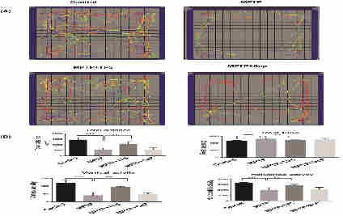
TP5 treatment improves significantly the Locomotor Function in MPTP exposed Mice

Slide 52
Conclusion
TFP5 provides neuroprotection in the 1-methyl- 4-phenyl-1,2,3,6- tetrahydropyridine (MPTP) model of Parkinson's disease mice.

Slide 53
TFP5 – A therapeutic candidate
Passes through BBB due to modified TAT attached.
Can be visualized due to FITC.
Does not cause toxicity in the mouse even at the concentration of >2000mg/Kg.
No neurological stress observed post TFP5 injections.
No change in the body weight before and after injections.
Rescues following AD phenotypes:
➢Specifically inhibits Cdk5/p25 hyperactivity
➢Rescues spatial memory deficit
➢Reduces p-tau, p-NF aggregates and beta-amyloid plaques
➢Reduces neuroinflammation and apoptosis

Slide 54
Summary
A 24 amino acid, modified peptide (TFP5), reduced / prevented AD phenotypes in familial 5XFAD model mice upon ip injection of TFP5.
TFP5 treatment also reduced AD phenotypes in p25 Tg AD model mice, proof of concept.
On going studies are also providing the evevience that TFP5 and ALS pathologies in Model mice.
can ameliorate PD

Slide 55
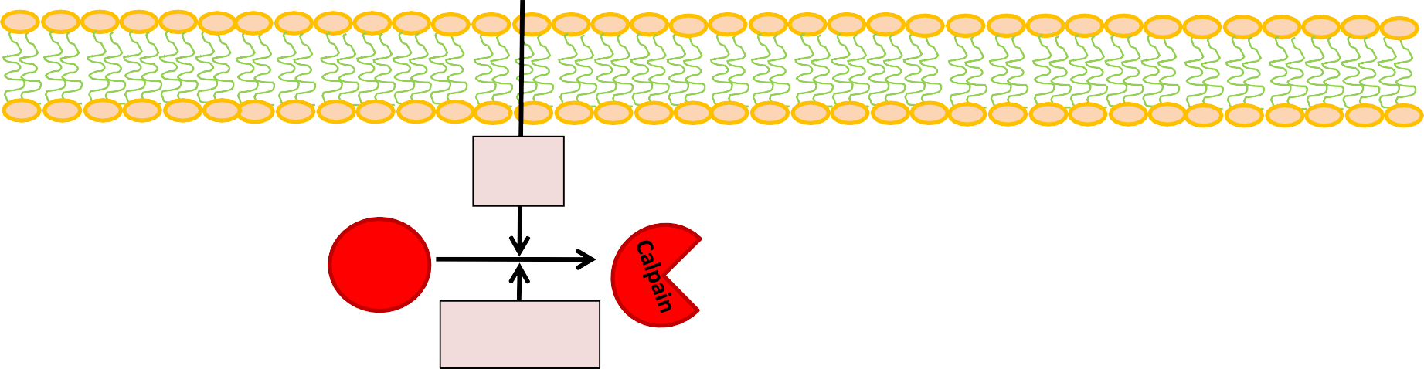
Summary: TFP5 selectively inhibits the deregulated Cdk5/p25 but not Cdk5/p35, the regulated, normal activity in situ & in vivo , ameliorate pathology.
Physiology
Pathology upon neuronal insults
TFP5 Recovery
N
N
N
_{Ca}2+
influx
TFP5
MT
p35
MT
p67
p67
MT
p67
Calpain
p35
p35
TFP5
Intracellular _{Ca}2+
Cdk5
Cdk5
Cdk5
p25
Cdk5
p25
Regulated Cdk5 activity
Regulated Cdk5 activity
Cdk5
Neuronal development and migration
Phosphorylation of
cytoskeletal proteins
Kinase cross-talk
Cognition and memory
Synaptic Plasticity
Neuronal survival
Cell Adhesion
Exocytosis
Deregulated Cdk5 activity
TFP5
Aberrant hyperphosphorylation of cytoskeletal proteins (NF, tau and MT)
Cdk5
p25
Inhibition of
hyperactivity
Neurodegeneration/Pathology

Slide 56
In p25Tg mice neuroinflammation occurs before Aβ and pTau expression ; (Sundaram JR et al.; J. Neurosci 32, 1020-34, 2012).
On the basis of these studies we propose Cdk5/p25 acts like a double edged sword in neuropathology.

Slide 57
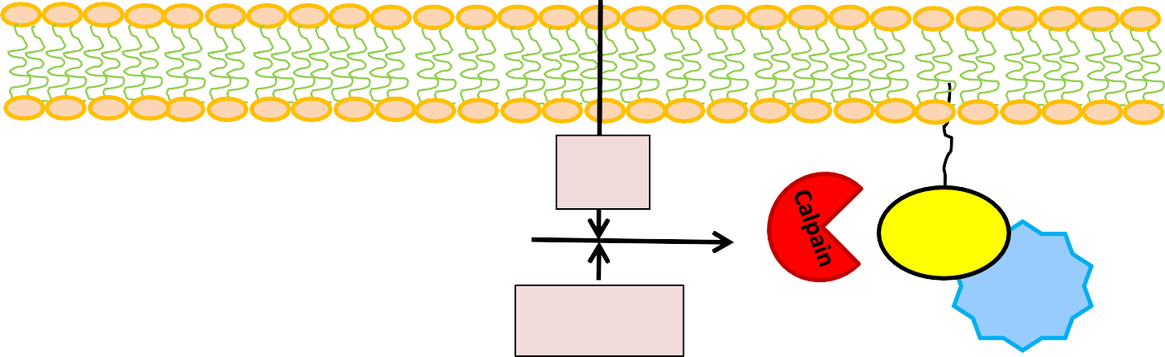

Hypothesis
Deregulated Cdk5 activity acts like a double edged sword in neuropathology
Neuronal insults (e.g. Aβ, Glutamate toxicity, oxidative stress, Mutations (e.g.SOD1),
neuroinflammation)
N
Hyd^{H}rolyses membrane phospholipids
P
cPLA2
active
_{Ca}2+
influx
Higher phosphorylation of cPLA2 by Cdk5/p25 compared to Cdk5/p35
_{Ca}2+
p35
Calpain
Cdk5
Arachidonic Acid
Intracellular _{Ca}2+
5-Lipo Leukotrienes
Cox
cPLA2
active
p25
Cdk5
Eicosanoids
Cytokines,chemokines ,LPC & other production.
Deregulated Cdk5 activity; elevated & sustained activation.
Activation of receptors
Activation of glia
and microglia
Neurodegeneration; AD, ALS, FTD, PD, HD, N-PC
Neuroinflammation

Slide 58
CPR-NINDS laboratory, NINDS, NIH
Colleagues
N. Amin
P. Grant
V. Shukla Binu Kumar Susan Kuntz Joe Steiner
M. Bhaskar
Collaborators
Y. Zheng, Department of Nephrology, Ningxia People’s Hospital, Province, China
S. Kesavapany GSK, Singapore
L.H. Tsai, , J. Soe MIT, Boston

Slide 59
Thank You

Slide 60
WT mouse : single i.p 40mg/kg wt (0.2mM)
After 4th and 7th day, TFP5 was observed in the following regions: (12µm thick frozen sections)
Regions
Relative expression
 | Day 4 | Day 7
Brain: Cortex | ++++ | +++
Hippocampus | +++ | ++
Cerebellum | +++ | +
Pancreas | ++++ | +++
Kidney | +++ | ++
Heart | ++ | +
Liver | + | -

Slide 61
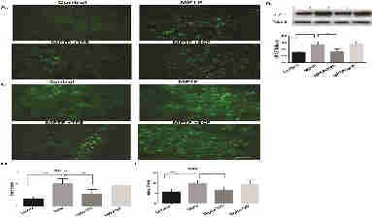
TP5 suppresses MPTP-induced astroglial and microglial activation in the SN in vivo

Slide 62
Dopaminergic neurons of the SN express Cdk5/p35 and are protected from cell death by TP5 after MPTP induction

Slide 63
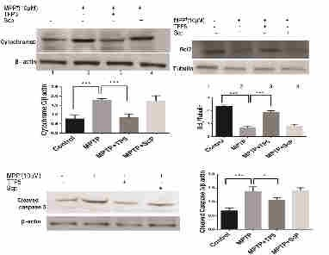
Apoptosis is prevented in SN neurons of
PD model mice( in vivo studies) upon TFP5 treatment

Slide 64
Elevated Cdk5 activity of G37R ALS model mice brain reduced to wild type activity upon TFP5 treatment
Reduction in phospho - NF and pTau
after TFP5 treatment in G37R mice
Neuroinflammation is reduced post TFP5 treatment in G37R mice
W M
M + T
245
180
100
75
48
GFAP
Smi 31
20
17
Iba-1
63
AT8
Actin
48
75
CD 86

Slide 65
TFP-5 prevents neuronal cell loss in
Abeta/Tat treated neurons
Neuronal cell count 48h post treatment
5000
p<0.0001
Neuronal Cell Count
4000
p<0.001
3000
2000
1000
0
Media
20 uM Abeta
20 Abeta + 40 nM Tat
10 Abeta + 1uM Tat
20 Abeta + 1 uM TFP5
20 Abeta + 180 nM Tat
Abeta + 40 nM Tat + TFP5
10 Abeta + 1uM Tat + TFP5
20 Abeta + 180 nM Tat + TFP5

Slide 67
Selectivity of TFP5
In situ and in vivo Cdk5 exists as a multimeric complex , with cytoskeletal and synaptic proteins.

Slide 68
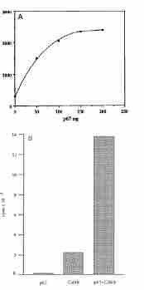

Cdk5 associates with p67 ( Munc/18) and elevates its activity

Slide 69

p67 ( Munc 18/ n-sec1); P67 affects Cdk5/p35 but not Cdk5/p25 activity
***
P67 binds with Cdk5/p35 but not Cdk5/p25

Slide 70


Cdk5/p35 in multimeric complex associated with cytoskeletal and synaptic
proteins in situ & in vivo
Rat brain lysate was immunoprecipitated (IP) with p67 (Munc 18) antibody and then immunodetected with Western blot (WB) analysis using respective antibodies as shown

Slide 71

Cdk5/p35 activity in cortical neurons transfected with p67siRNA is inhibited by TFP5
The expression of p67 was “knocked down” in cortical neurons transfected with p67 siRNA (upper panel, lane 4-6); however, p35 and Cdk5 expressions were unaffected (two middle panels). B: The Cdk5 kinase activity in the cells transfected with p67 siRNA and treated with TFP5 was inhibited (lane 5), C: The bar graph shows the mean density of autoradiographs of the Cdk5 kinase activity. The results represent the values of three experiments. * p<0.01.

Slide 72

Only Cdk5/p25 activity is inhibited by TP5 in HEK 293 cells overexpressing Cdk5/p35 or Cdk5/p25. p35 interaction with macromolecules (e.g,microtubules) spares Cdk5/p35 activity.
HEK293 cells over expressing p35/Cdk5 or p25/Cdk5 were treated with different concentrations of the TFP5. p35/Cdk5 kinase activities (lane 2-5) were unaffected; p25/Cdk5 kinase activities , however, were inhibited (lane 6-9). B. The bar graph quantitates the results. Standard errors are shown for three experiments* p<0.01

Slide 73
Summary: CIP and or TFP5 selectively inhibits the deregulated Cdk5/p25 but not Cdk5/p35, the regulated, normal activity in the presence of cytoskeletal and or synaptic
proteins.
Physiology
Pathology upon neuronal insults
TFP5 Recovery
N
N
N
_{Ca}2+
influx
TFP5
MT
p35
MT
p67
p67
MT
p67
Calpain
p35
p35
TFP5
Intracellular _{Ca}2+
Cdk5
Cdk5
Cdk5
p25
Cdk5
p25
Regulated Cdk5 activity
Regulated Cdk5 activity
Cdk5
Neuronal development and migration
Phosphorylation of
cytoskeletal proteins
Kinase cross-talk
Cognition and memory
Synaptic Plasticity
Neuronal survival
Cell Adhesion
Exocytosis
Deregulated Cdk5 activity
TFP5
Aberrant hyperphosphorylation of cytoskeletal proteins (NF, tau and MT)
Cdk5
p25
Inhibition of
hyperactivity
Neurodegeneration/Pathology

Slide 74


Proposed molecular model; p5/TFP5 competes with p25 and inhibits Cdk5 deregulated activity
Approximate position of p5 peptide in the inactive Cdk5 (Cdk2 homology structure)
Position of p5 peptide in Cdk5/p25 crystal (1H4L)
Tarricone et al., 2001; Mapeli et al., 2005
P5
S159
PSSALRE
Inactive
Computational Molecular Modeling
Active
Km (p25): 70-100 nM
Ki (p5): 20nM

Slide 76
TFP-5 attenuates neuronal fragmentation
following Ab/Tat treatment for 48h
Neurona Cell Puncta 48h post Tx
Degenerating Neuronal puncta
p<0.0001
p<0.0001
1500
1000
500
0
Media
+ TFP5
20 uM Abeta
20 Abeta + 40 nM Tat
10 Abeta + 1uM Tat
20 Abeta + 1 uM TFP5
20 Abeta + 180 nM Tat
Abeta + 40 nM Tat + TFP5
20 Abeta + 180 nM Tat + TFP5
10 Abeta + 1uM Tat

Slide 77

20 μM Aβ + 1 μM TFP-5
Media/Saline
Media/1 μM TFP-5
βIII Tubulin-tdTomato expressing neurons
TFP-5

Slide 78
TFP5 Reduces significantly ALS phenotypes in SOD1 mutant mice; A potential therapeutic candidate for ALS

Slide 79
Conclusion:
TFP5 treatment prevents / reduces AD phenotypes in
P25 & 5XFAD Tg, familial and p25 Tg sparodic AD model mice and can be a therapeutic candidate for AD pathology.

Slide 80
The higher levels of p25 expression ( Cdk5 deregulation & hyperactivation) in this sporadic AD model mice induces robust expression of inflammation/neurodegeneration.
To understand the progression of neuroinflammation , it is important to study the early time course of expression of inflammatory factors in p25Tg mice which will provide a better understanding of the onset of pathology.

Slide 81

Unlike MAKPs ( e.g. Erk1/2), Cdk5 activity depends upon the
nature of the amino acid residue following the proline

Slide 82
Kinetic Mechanisms
(unique to Cdk5)
•
•
•
CDK5/p35 has higher affinity for substrate peptides/proteins compared to ATP Km (ATP) =300μM
Km (peptide) =100μM
Therefore, the enzyme kinetics can be explained with a two substrate binding model for CDK5/p35 activation. First, with peptides/proteins, then second ATP.
•
•
Cdk5 has also very high affinity for its activators Km (activator): 70-100 nM
•
•
CDK5 has an order of magnitude lower affinity for ATP compared to other kinases CDK5, Km (ATP): 300- Other kinases Km (ATP): 10-20μM
Consensus sequence X-S/TP-K/R-X; X, neutral or basic amino acid
•

Slide 83

Regulation and Deregulation of Cdk’s activity
Proteolytic Cleavage
Kinase Activity
Cycling Cdks P34 Cdc2
p25/Cdk5
p35/Cdk5
Physiological processes
Pathological processes

Slide 84

Structural basis of Cdk5 activation by p35/p25
Tarricone et al., Molecular cell, 2001

Slide 85

P5 is a better inhibitor than CIP
CIP
P5

Slide 86
Kinetic Mechanisms
(unique to Cdk5)
•
1.
CDK5/p35 has higher affinity for substrate peptides/proteins compared
to ATP
•
•
Km (ATP) =300μM
Km (peptide) =100μM
2. Therefore, the enzyme kinetics can be explained with a two substrate binding model for CDK5/p35 activation. First, with peptides/proteins then ATP.
•
•
CDK5 has also very high affinity for its activators
Km (activator): 70-100 nM (p35)
•
3. CDK5 has an order of magnitude lower affinity for ATP compared to
other kinases
•
•
CDK5, Km (ATP): 300μM
Other kinases Km (ATP): 10-20μM

Slide 87


Human cervical spinal neuron
In mature neurons cytoskeletal protein phosphorylation is topographically & tightly regulated under physiological conditions.
Control
Normal
ALS

Slide 88
To record field excitatory postsynaptic potentials, transverse hippocampal slices were prepared from mice. In brief, the brain was rapidly removed and transferred to ice-cold, oxygenated (95 % O₂ and 5 % CO₂) cutting solution containing (mM) 211 sucrose, 3.3 KCl, 1.3 NaH₂PO₄, 0.5 CaCl₂, 10 MgCl₂, 26 NaHCO₃ and 11 glucose. Hippocampal slices were cut with a Leica VT1000S vibratome (Leica) and transferred for recovery to a holding chamber containing oxygenated artificial cerebrospinal fluid (ACSF) consisted of (mM) 124 NaCl, 3.3 KCl, 1.3
NaH₂PO₄, 2.5 CaCl₂, 1.5 MgCl₂, 26 NaHCO₃ and 11 glucose at 28-30 °C for at least 1 h before recording. CA1 field potentials evoked by Schaffer collateral stimulation were measured. After recording of stable baseline (at least 20 min of stable responses), LTP was induced by two episodes of theta burst stimulation (TBS) with 10 s intervals. TBS consisted of ten bursts (each with four pulses at 100 Hz) of stimuli delivered every 200 ms.
Recordings were performed using an AM-1800 Microelectrode amplifier (A-M systems) and a Digidata 1440A A-D converter (Axon Instruments). All data were digitized and analyzed by the use of pClamp 10 software (Axon Instruments).
Sample traces represent fEPSPs at 1 min before (gray trace) and 1 hr after (black trace) TBS.
Bar graph : average slopes of fEPSP during the last 10 min of recording (percentage of baseline response) Control (p25 only - Dox off) : 160.6 ± 6.1 %, 6 slices from 4 mice
CK-p25 + PBS : 125.2 ± 3.7 %, 5 slices from 3 mice
CK-p25 + SC : 137.5 ± 6.2 %, 7 slices from 4 mice
CK-p25 + TFP5 : 165.7 ± 9.0 %, 6 slices from 4 mice

Slide 89

High glucose induces p25 expression and hyper activates Cdk5 activity in
A
cortical neurons, a time course study

Slide 90

Cdk5 hyper activity and tau hyper phosphorylation induced by high
glucose is inhibited by TFP5 pretreatment in cortical neurons.
A
B

Slide 91

Pre-treatment with TFP5 rescues glucotoxic cortical neurons from oxidative stress due to increased ROS production and decreased antioxidant capacity.
TFP5 behaves like antioxidant

Slide 92

TFP5 reduces increased production of inflammatory cytokines induced by high glucose in cultures of primary cortical neurons; scrambled peptide has no effect
A
B
TFP5 as a anti inflammatory agent

Slide 93

TFP5 protects neuronal loss due to HG toxicity.
TFP5 is anti apoptotic

Slide 94
Modified p5 – To pass BBB as TFP5
p5 (24 aa):
KEAFWDRCLSVINLMSSKMLQINA
TFP5:
FITC-GGGKEAFWDRCLSVINLMSSKMLQINA
p5
Modified HIV-TAT-peptide
Scrambled peptide:
FITC-GGGGGGFWDRCLSGKGKMSSKGGGINAYARAARRAARR
TFP5 US Patent # 8597660.

Slide 95


Slide 96
Summary
Cdk5 activity is tightly regulated in the nervous system, its regulation and deregulation correlates with cytoskeleton phosphorylation and neurophysiology and pathology.
Cdk5 is involved regulation of signal transduction pathways implicated in neuronal survival.
Deregulation of Cdk5 activity causes neuronal cell death.
CIP, a truncated peptide from p25, specifically inhibits Cdk5 deregulation, aberrant tau hyperphosphorylation and induces neuronal survival without affecting normal activity of cdk5 ( Cdk5/p35).
P5, ( 24 aa) a truncated peptide from CIP inhibits cdk5/p25 activity.

Slide 97


P5-mod reduced pathological hallmarks of AD in cortex:
Hyperphosphorylation of aggregated & tangled Tau (AT8)& Alz50

Slide 98








HEK 293 cells transfected with Cdk5/p35 or Cdk5/p25 in the presence or absence of TFP5 and binding with Cdk5 of p35 and p25 is evaluated using Cdk5 antibody
Lysate
1 2 3 4 5 6 7 8
IP: Cdk5 (J-3)
1 2 3 4 5 6 7 8 9
p35
35
25
Cdk5
Cdk5
Actin
43
250
225
200
175
150
125
100
75
EV
EV+TFP5 3. P35
P35+ SCB
P35+ TFP5
6. P25
P25+SCB
P25+TFP5
P25 (lysate, positive control)
mean density
*
TFP5 competes with p25/cdk5 but not with p35/Cdk5

Slide 99




CIP Tg reduced AD like pathology from 12 week induced p25 Tg, in tetra
Transgenic (CIP Tg X p25Tg) mice.
All the behavioral studies were double blinded
(Sundaram, JR et al., J. Neurosci. 2013)

Slide 100

In the presence of p67/ Munc-18, TFP5 selectively inhibits Cdk5/p25 but not Cdk5/p35 activity, (+/- 0.18mg p67)

