Slide 1

Basic Designing of Mechanical
Vapor Compressor in Multi-Effect Distillation for Fresh Water Production
Gyeongsang National University
Hanshik Chung

Slide 2
CONTENTS
Background of Study
Introduction & Objective
Results and discussion
Conclusions

Slide 3
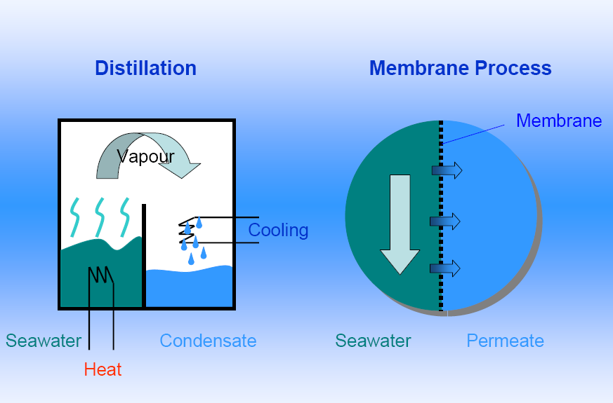
Fresh Water Generation System ;
(Phase-change)
(Single-Phase)

Slide 4
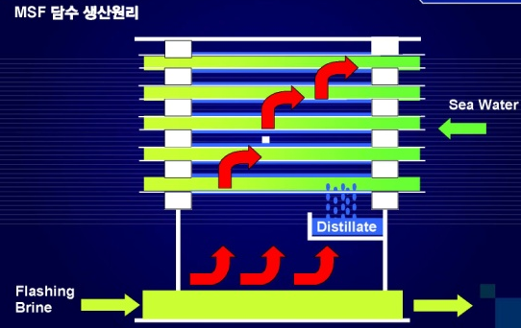
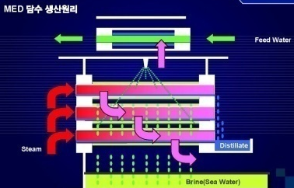
Why and What is MED ?
MSF
( Multi Stage Flash Desalination )
MED
( Multi Effect Desalination )
(1) MED-TVC : MED by TVC (Thermo Vapor Compressor)
(2) MED-MVC : MED by MVC
(Mechanical Vapor Compressor)

Slide 5
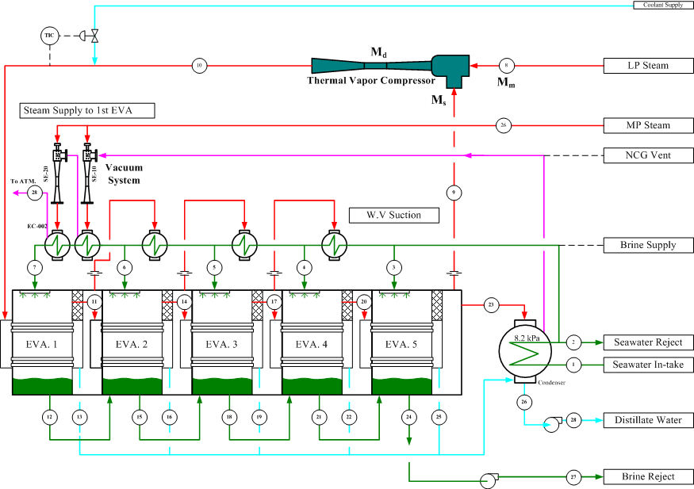
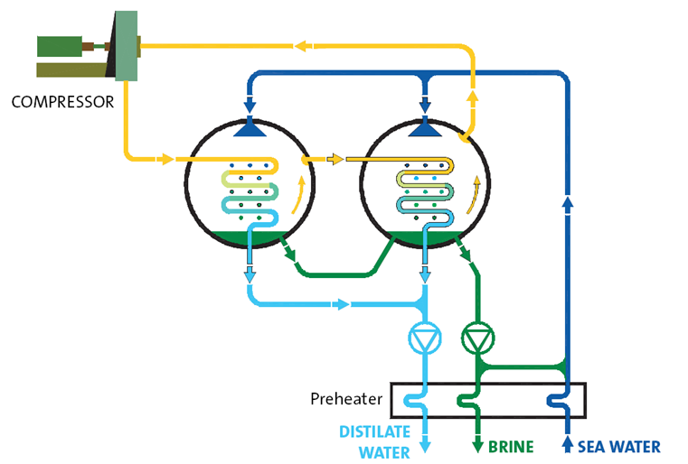
MVC and MED System

Slide 6
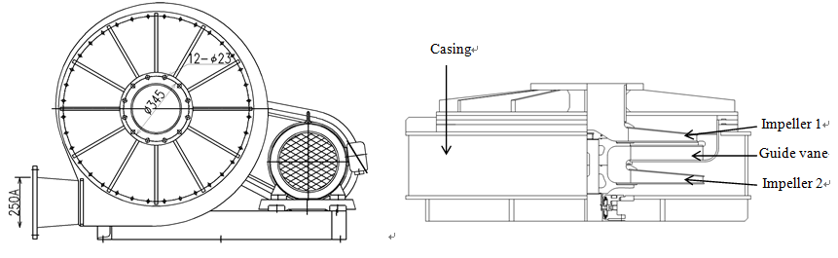
Mechanical vapor compressor design.
Assumptions and Simulation Conditions
Steady state conditions
3D periodic model with CFD software package (CFX 12)
To reduce the computational cost, only single passage
119,291 nodes and 613,893 elements

Slide 7
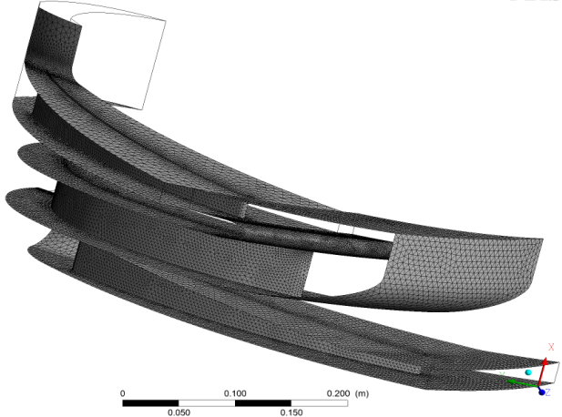
NUMERICAL MODELING
3-Grid computational domain
The inlet boundary conditions;
Subsonic inlet, temperature and total pressure
The turbulence intensity : 5%.
Periodic boundary conditions were applied
Blade hub and shroud : adiabatic walls.

Slide 8
Governing Equation
3-D Reynolds averaged compressible Navier-Stokes equations
SST k-ω turbulence model
Mass and momentum conservation equations

Slide 9
Details of geometry and flow condition in inlet
Number of rotor blades @ each stage | 14
Number of stator blades | 15
Diameter impeller 1 | Inside : 282 mm
 | Outside : 750 mm
Diameter impeller 2 | Inside: 298 mm
 | Outside : 792 mm
Diameter guide vane | Inside : 298 mm
 | Outside : 792 mm
Basic rotating speed | 3650 rpm
Total pressure @ inlet | 24.1 kPa
Specific enthalpy @ inlet | 2.62×10⁶J /kg
Specific entropy @ inlet | 7.84 ×10³ J /kg.K
Static temperature @ inlet | 64.1ºC

Slide 10
Fluid properties
Properties of saturated steam.
Boundary conditions.
PROPERTY | VALUE
Molar mass | 18.015 kg/kmol
Critical Volume | 55.95 cm³/mol
Critical Temperature | 647.14 K
Critical Pressure | 220.64 bar
Boiling temperature | 64.1º C
Acentric Factor | 0.344
SETTING | TYPE
Inlet | Total pressure, total temperature
Outlet | Average static pressure Mass flow out
Interface Models | Frozen Rotor
Blade | Heat transfer | adiabatic
 | Mass and Momentum | no slip wall
 | Wall roughness | smooth wall

Slide 11
RESULTS AND DISCUSSION
Compressors performance map at various rotational speeds.

Slide 12
Mass flow rates and efficiencies for various Rotational speeds.

Slide 13
.Temperature and discharge pressure at various rotational speeds.

Slide 14
(a)
(b)
(c)
Flow field at blade in blade passage at (a) 16.6%, (b) 50%, and (c) 83.3%

Slide 15
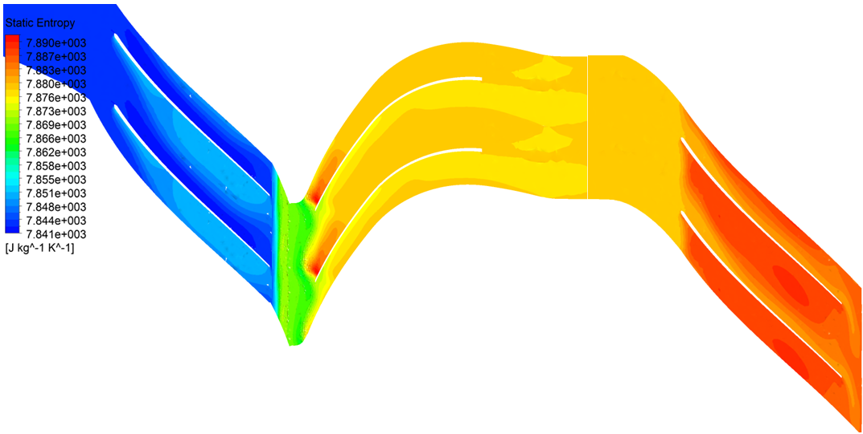
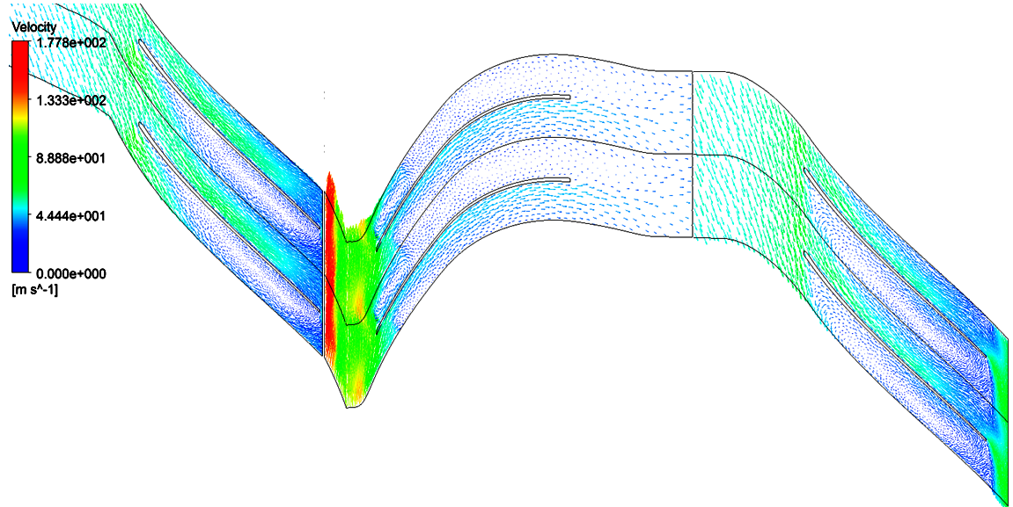
Contour of static entropy and plot of velocity vector for 4500 rpm rotational speed at low suction mass flow rate.

Slide 16
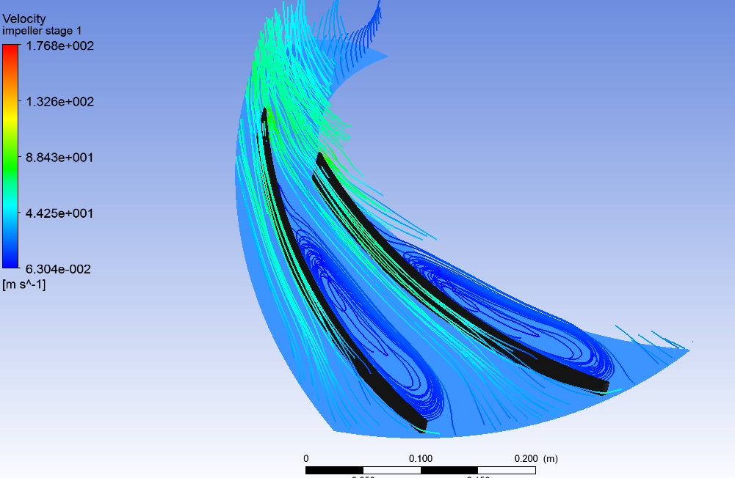
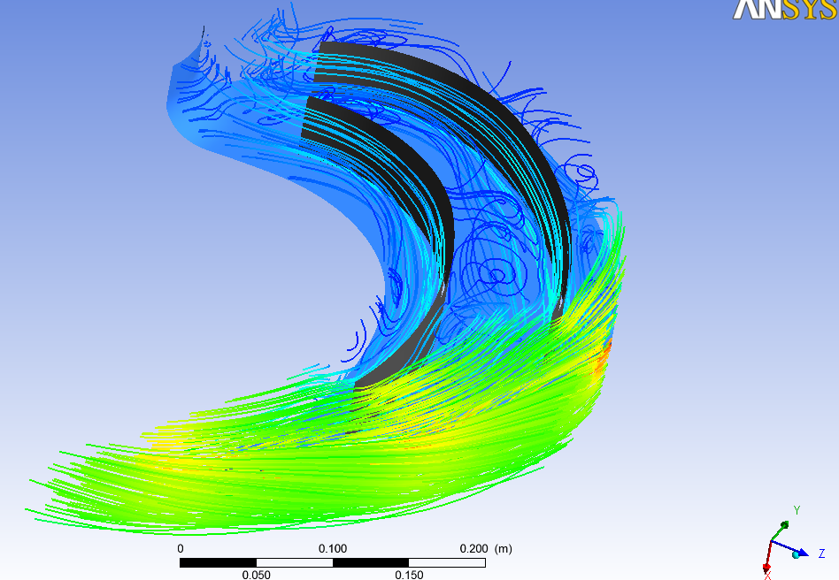
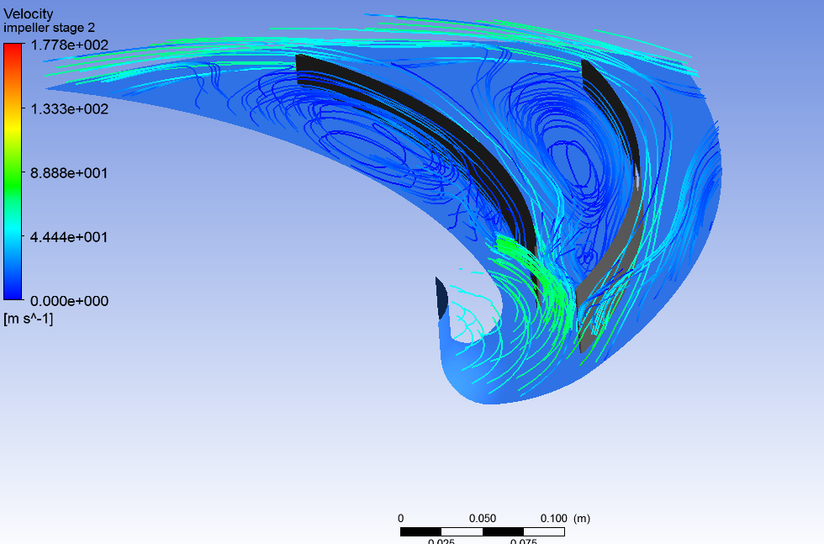
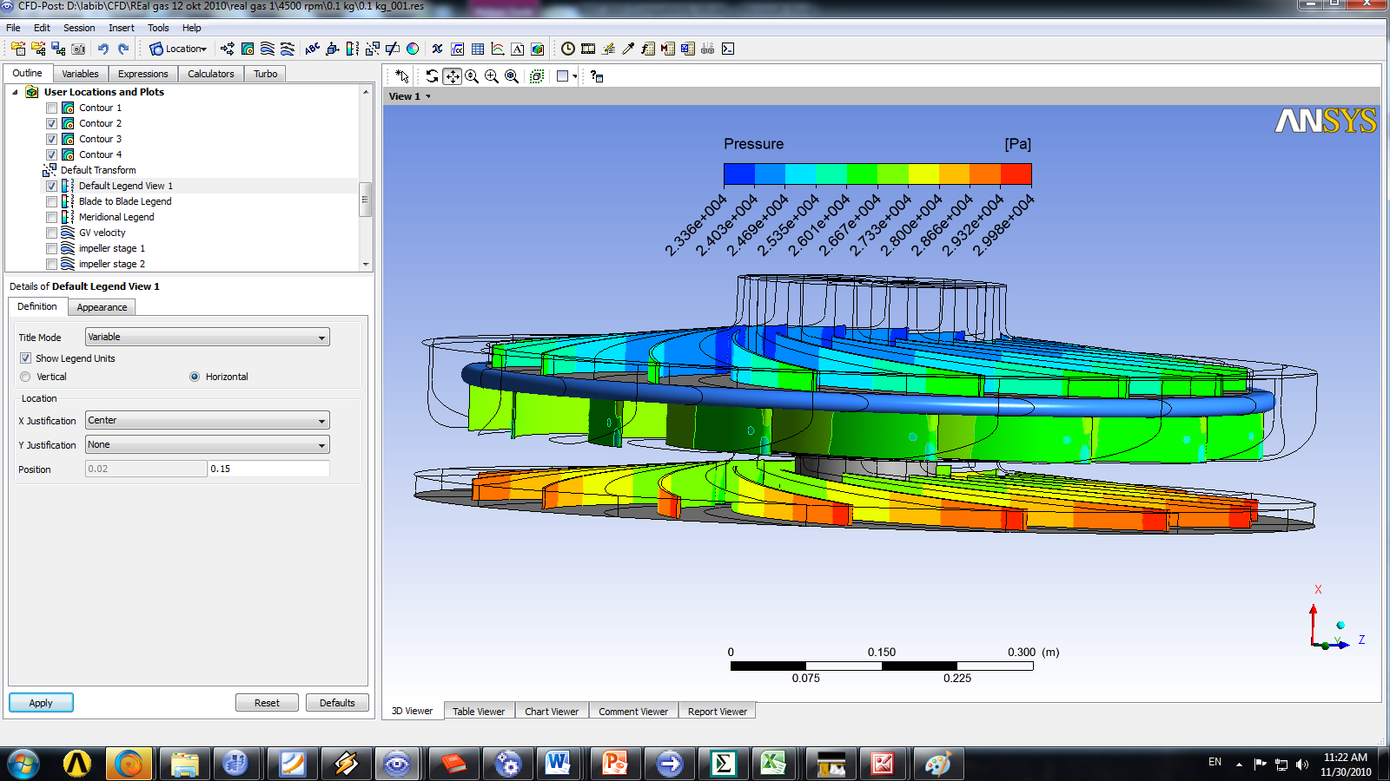
(a)
(b)
(d)
(c)
Three-dimensional flow structure in flow passage (a, b, and c) and blade loading at rotor and stator at low suction mass flow rate.

Slide 17
CONCLUSION
The effects of various operating conditions on the compressor performance have been investigated.
At a high discharge pressure, the blockage effect was very dominant, restricting the flow rate.
A detailed flow analysis was performed in this simulation, along with an examination of secondary phenomena.
The results clearly show the flow characteristics inside the compressor under different operating conditions.
This simulation showed that the widest stable operating zone was located at a high rotational speed.

Slide 18


