Slide 1

Virtualized drug development for (truly) personalized drug therapy
Hans Lehrach
Max Planck Institut für Molekulare Genetik
Dahlem Zentrum für Genomforschung und Medizinische Systembiologie
Alacris Theranostics GmbH
Notes:
Bad news we are not really as far on the way to pers med
Unless we seriously redefine concep of person
Good newslight at the end of the tunnel
Sobering exercise to compare appwe use in cutting edge so called pers med to what we do in other areas
Sky scraper
We would not dream

Slide 2
Every patient is different
No tumor has ever been seen (or treated) before
Tumors are heterogeneous, with subgroups of cell reacting differently to the therapy

Slide 3
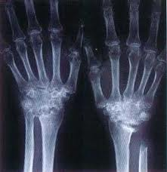
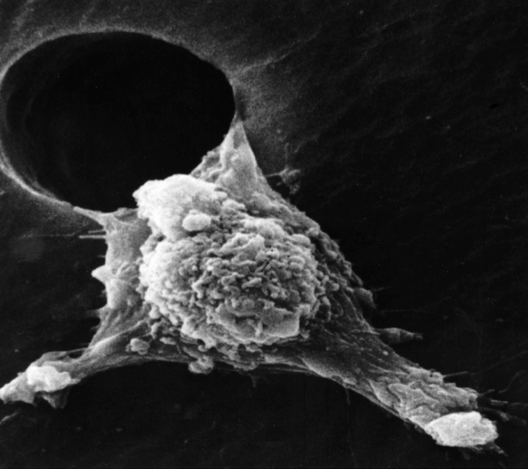
Personalised Medicine?
Source: Dr. Raouf Guirgus. Dr. Liotta's Laboratory

Slide 4
610 | NATURE | VOL 520 | 30 APRIL 2015

Slide 5
Adverse drug reaction related morbidity and mortality cost are estimated to be between US $ 330 billion to US $ 330-1130 billion annually (USA only)

Slide 6
Progress in medicine led to increase of survival rates for some cancer types
Source: McMillan Cancer Support 2011

Slide 7
But not for all types of cancer
Source: McMillan Cancer Support 2011

Slide 8
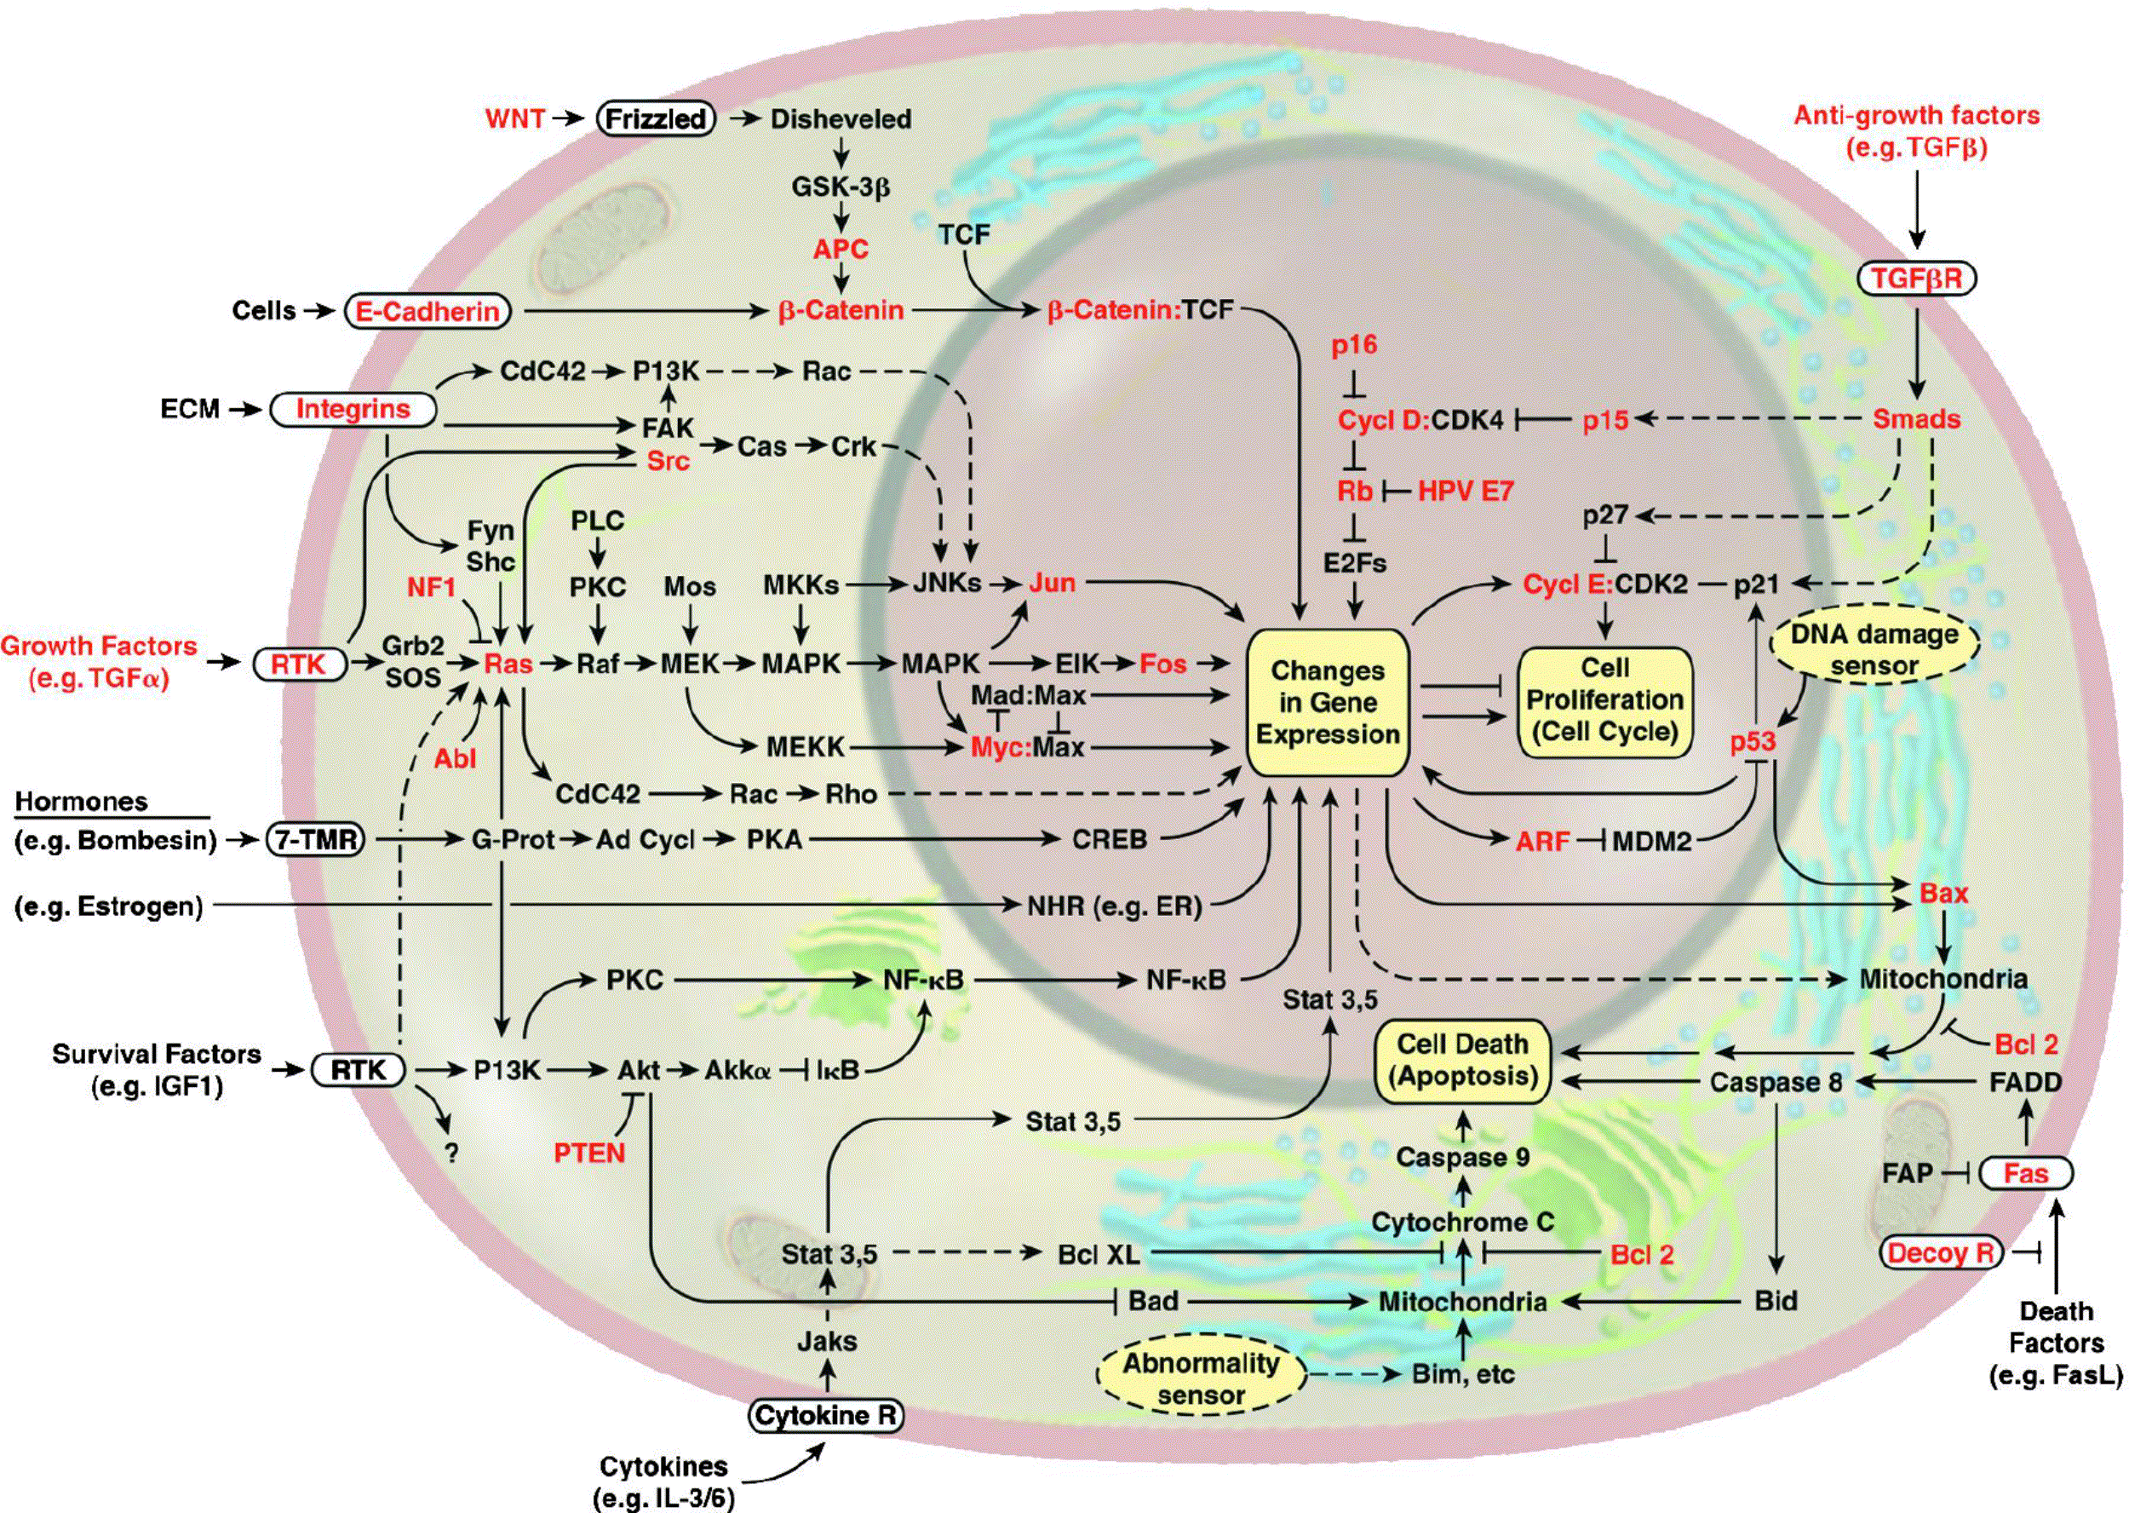
Motility circuits
Cytostatis/differentiation
circuits
Proliferation circuits
Hallmark
capacities
Viability circuits
Oversimplified circuitry of cellular networks regulating operations in cancer cells
Modified from Hanahan and Weinberg, Hallmarks of cancer, Cell, 2000 & 2010

Slide 9
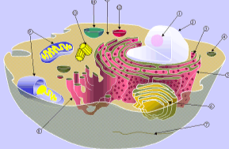
OMICS: DNA sequencing and measurements of biological processes
Proteomics
Metabolomics
Phenomics
Epigenomics
Genomics
Transcriptomics
Data integration into coherent cellular pathways

Slide 10
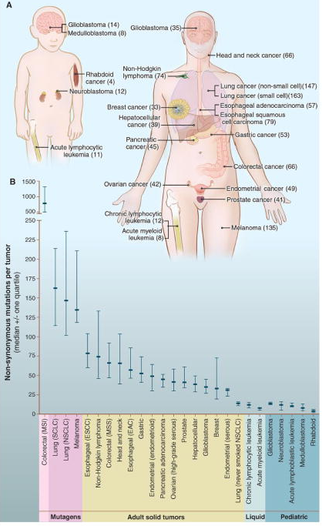
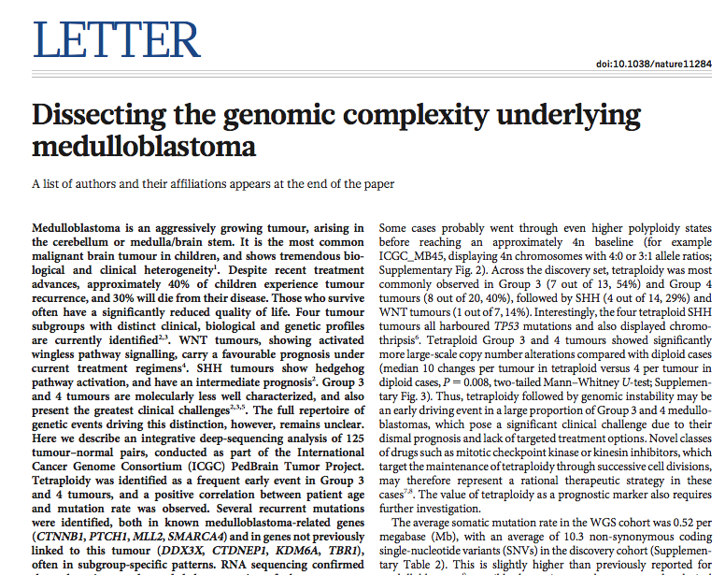
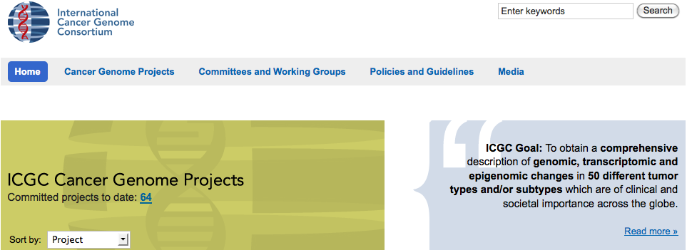
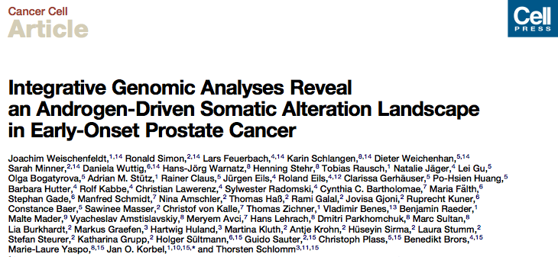
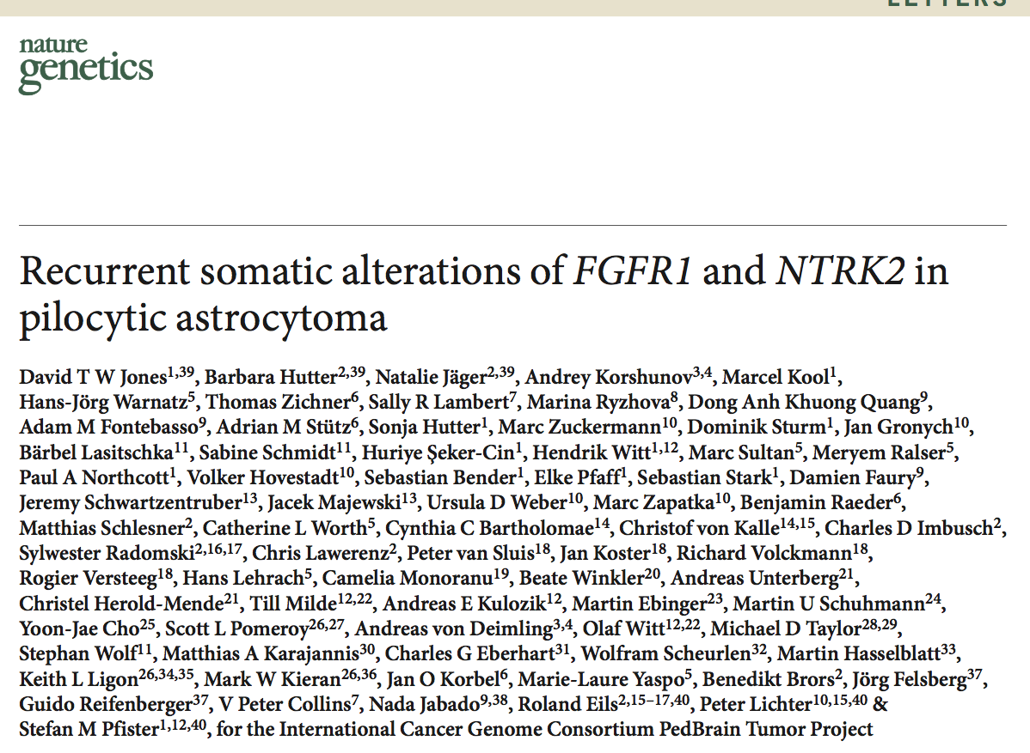
Cancer Genome landscapes. Vogelstein et al. Science 2013

Slide 11
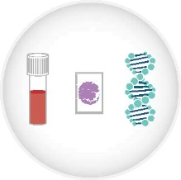
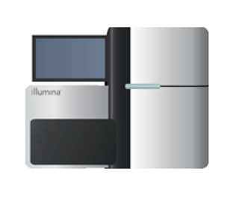
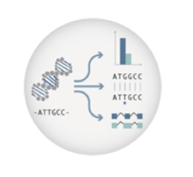

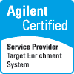

NGS analysis – Workflow for one patient
Sample preparation
“library”
Sequencing
Raw sequencing
data
Analyzed/processed data
ready for interpretation
ACGT
Example 1:
Whole genome
(Tumor + control) and
Transcriptome (tumor)
300 Gb
(genomes, 40x)
12 Gb
(transcriptome)
600 Gb
7 days on
32 cores
1 week
10-14
days
Example 1:
Whole exome
(tumor + control) and
Transcriptome (tumor)
50 Gb
(exome, 150x)
12 Gb
(transcriptome)
250 Gb
3 days on
32 cores
1 week
1 day
www.alacris.de

Slide 12
NGS analysis – Computational analysis
Example 1: Whole genome (Tumor + control) and
Transcriptome (tumor)
Sequencing
Raw data
bcl format
~ 2TB
(image data)
1 day
Converted to
read data fastq
(320 GB gzipped)
1 day
Reads aligned to reference
genome BAM
(320 GB binary)
8 cores
32 cores
1 day
32 cores
Data analysis:
Variant calling, structural
changes
3 days
Processed data BAM
Merging, duplicate removal
(320 GB binary)
16 cores
1-2 days
16 cores
Transcriptome:
gene fusion detection
analysis
Final data: all raw and intermediary
files and analysis results
~600 Gb
www.alacris.de

Slide 13
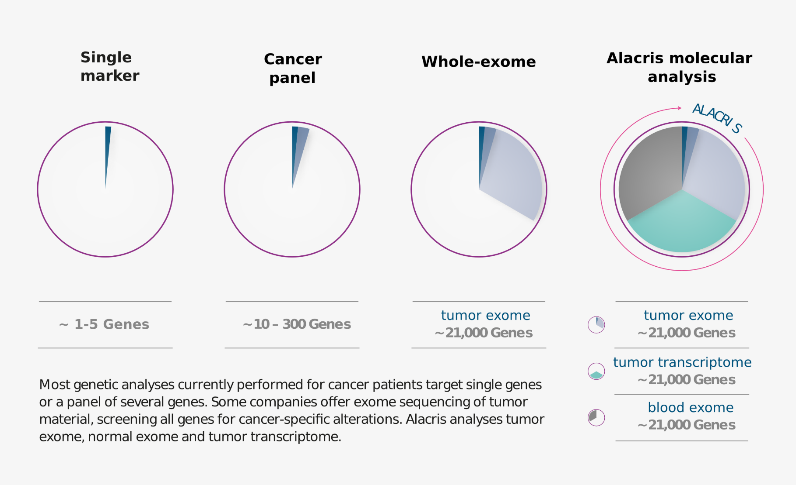
Comprehensive tumor molecular characterisation based on blood whole exome/tumor whole exome and transcriptome analysis (Alacris Theranostics)
Mechanistic models

Slide 14
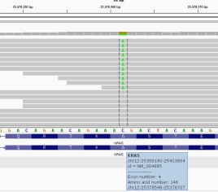
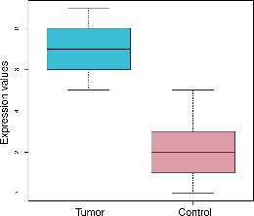
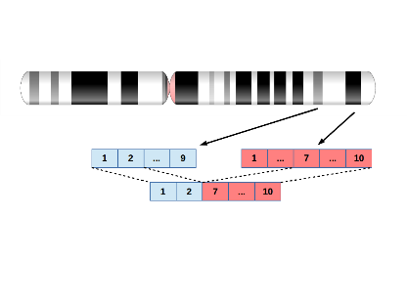
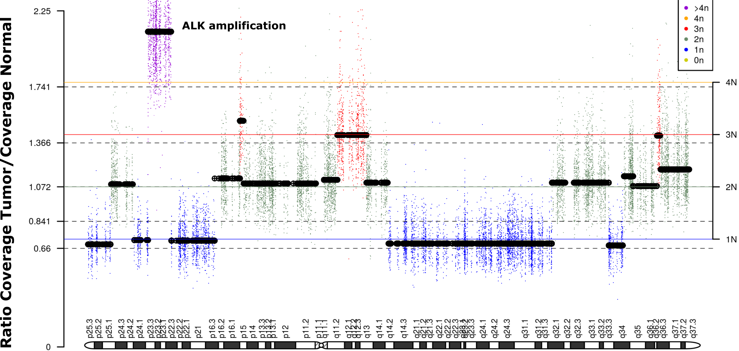
Comprehensive molecular tumor characterization based on
WES and RNAseq analysis
for the identification of clinically actionable variants/modelling
Screening of the whole exome tumor & blood allows to identify canonical and novel driver alterations, germline† alterations, and copy-number changes (“digital karyotype”)
KRAS A146V: testing of codon
12&13 is clinical standard in CRC but non-canonical mutations may provoke EGFR-blockade resistance††††
Expression levels of all protein-coding genes:
-- marker gene expression
-- actionable targets, e.g. immunotherapy against PD-L1
Transcriptome sequencing detects
changes in transcript abundance
and transcript structure in cancer such
as splicing events and gene fusions††
Novel gene fusion
that over-expresses a
transcription factor and
was used as a MRD marker
Integrated DNA and RNA analyses serve as mutual controls to verify potential actionable variants††,†††
ALK amplification on
DNA detected but no ALK gene expression on RNA level -> no treatment against ALK recommended
† Jones et al., Sci. Transl. Med. 7, 283ra53 (2015)
†† Wan et al., N A J Med Sci. ;7(4):156-162 (2014)
††† Wilkerson et al., Nucleic Acids Res. 42(13): e107. (2014)
†††† Robinson et al., Nat Biotechnology 26, ,24-26 (2011)

Slide 15
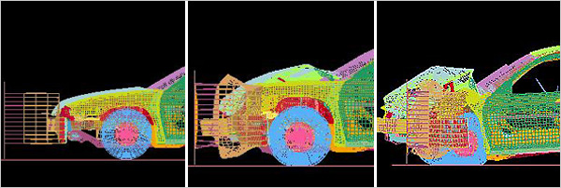
In all other areas we make unavoidable mistakes in computer models, not in reality:
Automobile crash test simulations as analogue of the intended humam health crash tests

Slide 16
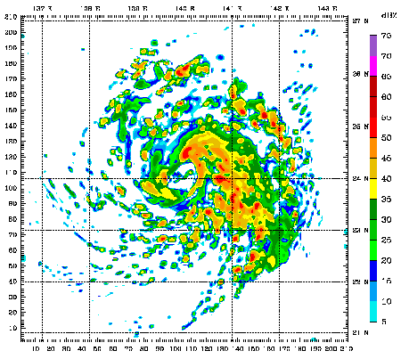
Typhoon Mawar 2005
WRF: The weather research forecasting model

Slide 17
‘A forecast model is only as good as the data put into the model’
(http://www.theweatherprediction.com/habyhints/60/)

Slide 18
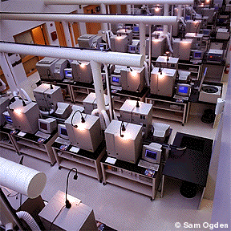
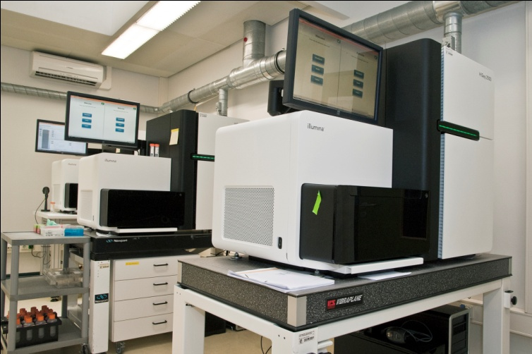
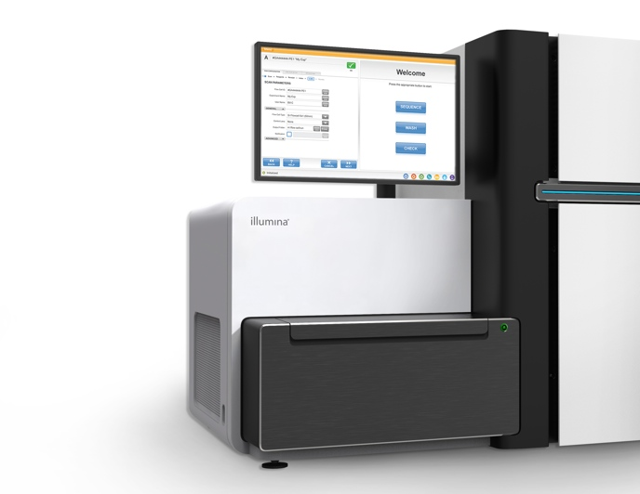
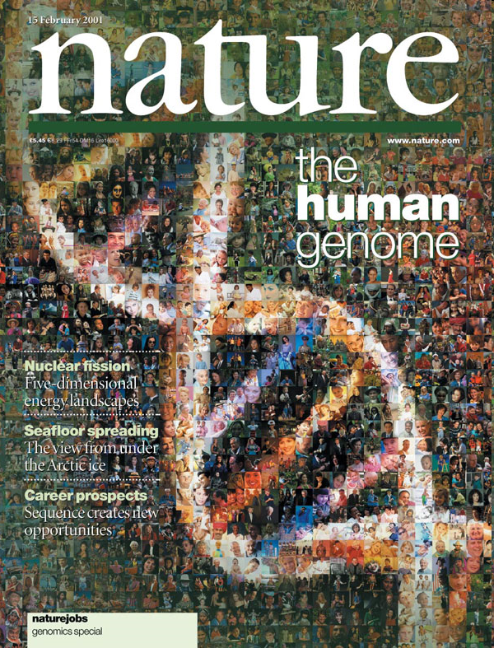
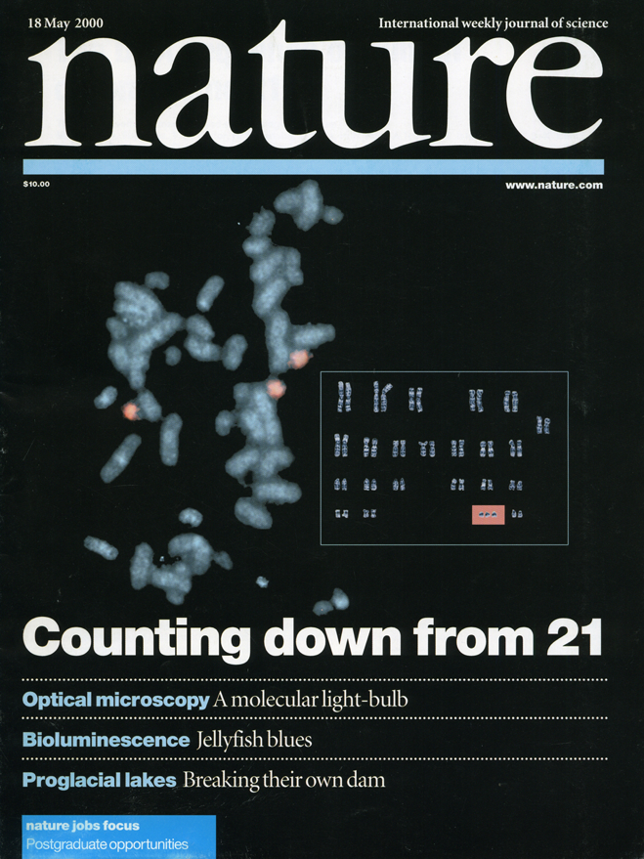
Genomics is dominating „omics“
One NGS run generates as much information as one million runs on the sequencers used 10 years ago
2006-2012
1990-2000
2015
GAII:
Hiseq machines
1 human genome/few days
Human genome project
1 human genome/ 13 years
Hyseq X10: 18 genomes in parallel

Slide 19
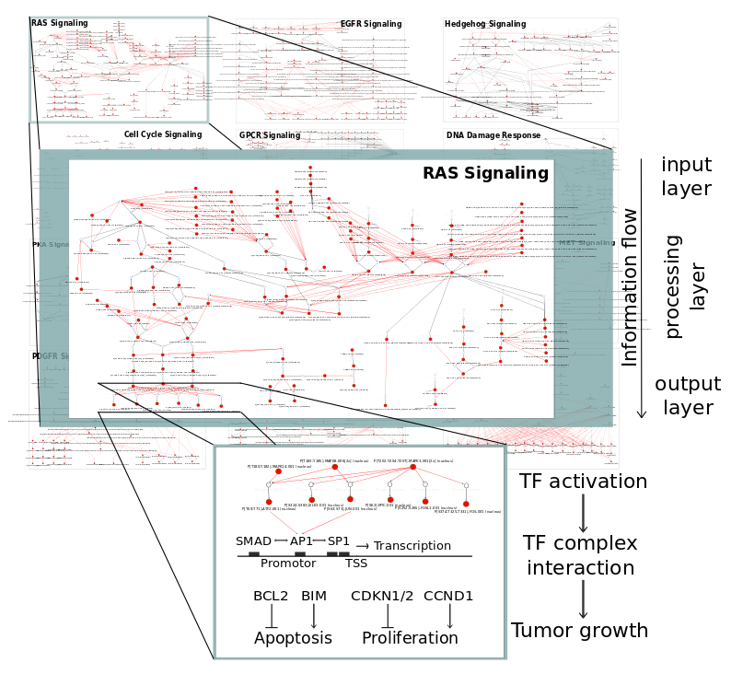
ModCellTM – A Predictive System for the Simulation of Drug Response
ModCellTM
> 45 Pathways
>720 genes
>11000 components
>20000 reactions
>200 targeted drugs
Cancer pathways include:
RTK signaling
(e.g. NGF, EGF, FGF, IGF, PDGF, IGF)
HEDGEHOG
NOTCH
WNT
TGFB signaling
Cytokine signaling (e.g. CSF, IFNA, IL8)
Death receptor signaling (e.g. Fas, TNFa, TRAIL) DNA repair / Cell cycle
(e.g. BRCA1/2, TP53, RB)
GCPR/Hormone signaling (e.g. CXCR4, ESR, AR)
Ephrin signaling
Wierling et al., 2015
PMID:26464088

Slide 20
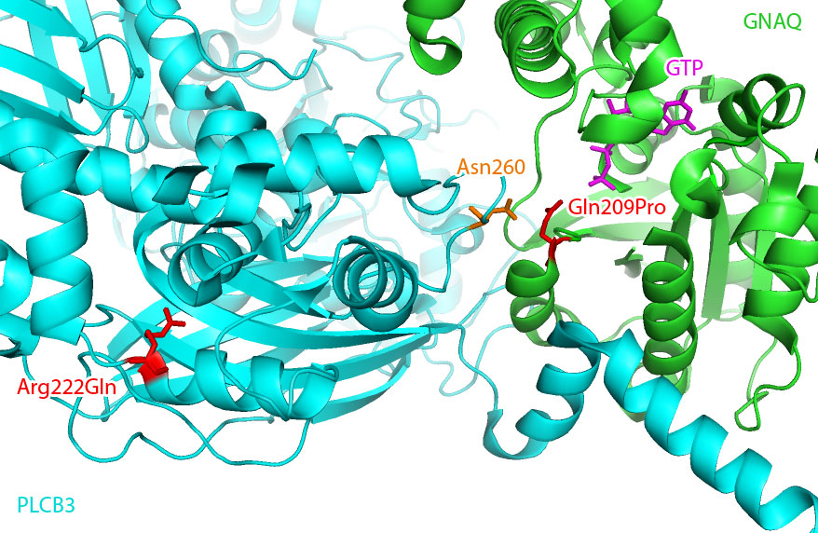
Bona Fide Gain of Function mutation of GNAQ (G209P)
Asn260 interaction with Gln209
=> essential for GNAQ inactivation
Arg222Gln
mutation
in Pat 1

Slide 21
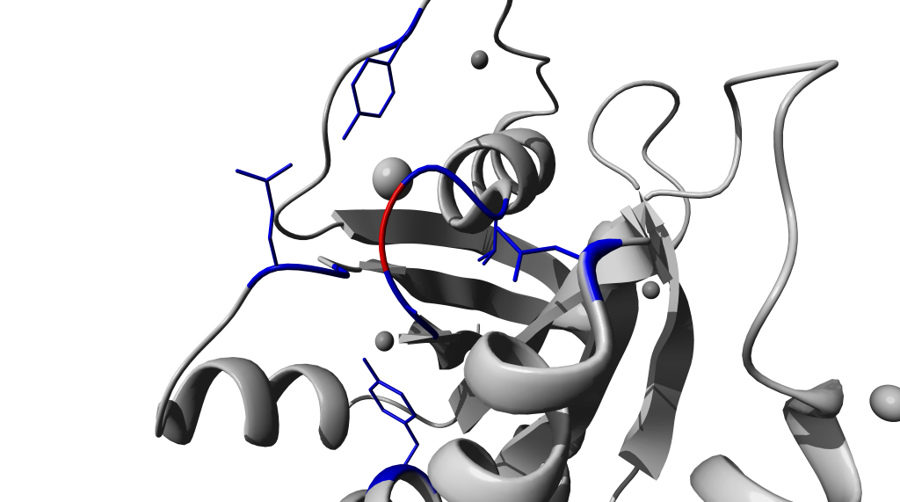
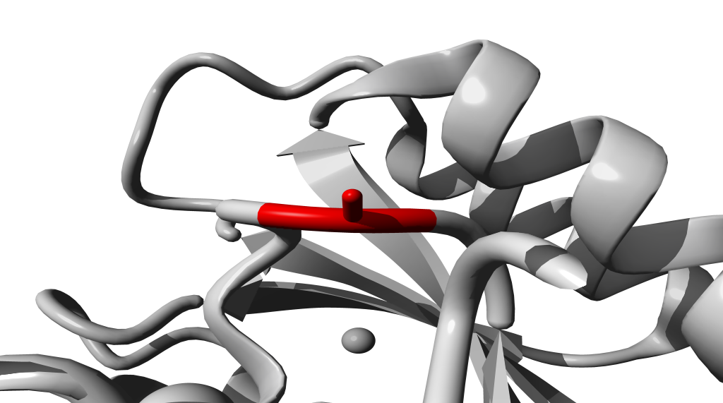
Mutation affect the function of specific proteins
Kras wild type
proliferation
apoptosis
cellular signal
transduction
Kras mutation G12A
increased
proliferation
decreased
apoptosis
increased cellular
signal transduction

Slide 22
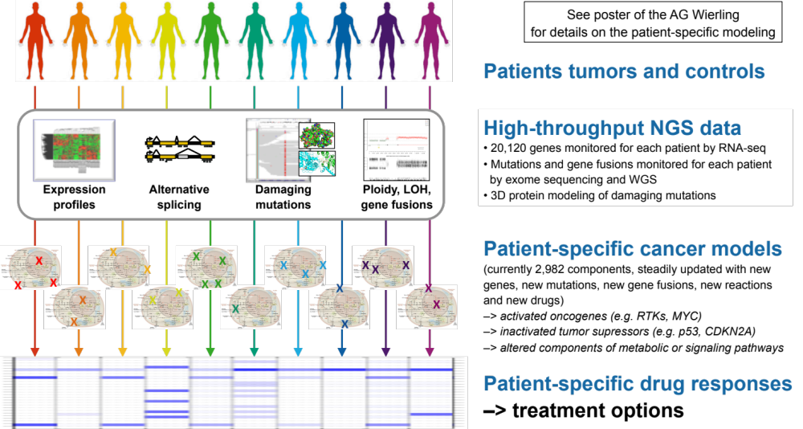
From patient specific –omics data to patient specific drug response predictions

Slide 23
Observe molecular response to drugs in individual patient

Slide 24
The ‘virtual cancer patient’ model
(Pro)-drug
Liver
(Patient genome)
Immune System
Drug
Tumor (effects)
Patient (side effects)
(Patient genome, reference transcriptomes)
(Tumor Cell type specific genomes/transcriptomes)
Tumor stem cells
Tumor cell population A
Tumor cell population B
Tumor cell population C
Stroma
Neuronal cells
Heart cells
Liver cells
Muscle cells
Kidney cells
Lung cells
……

Slide 25
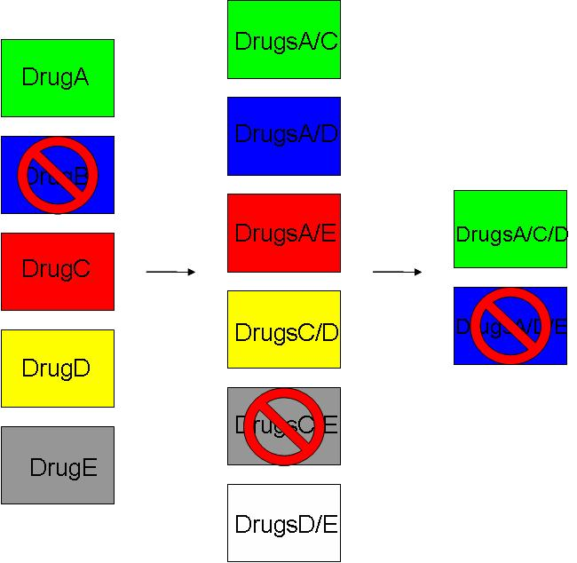
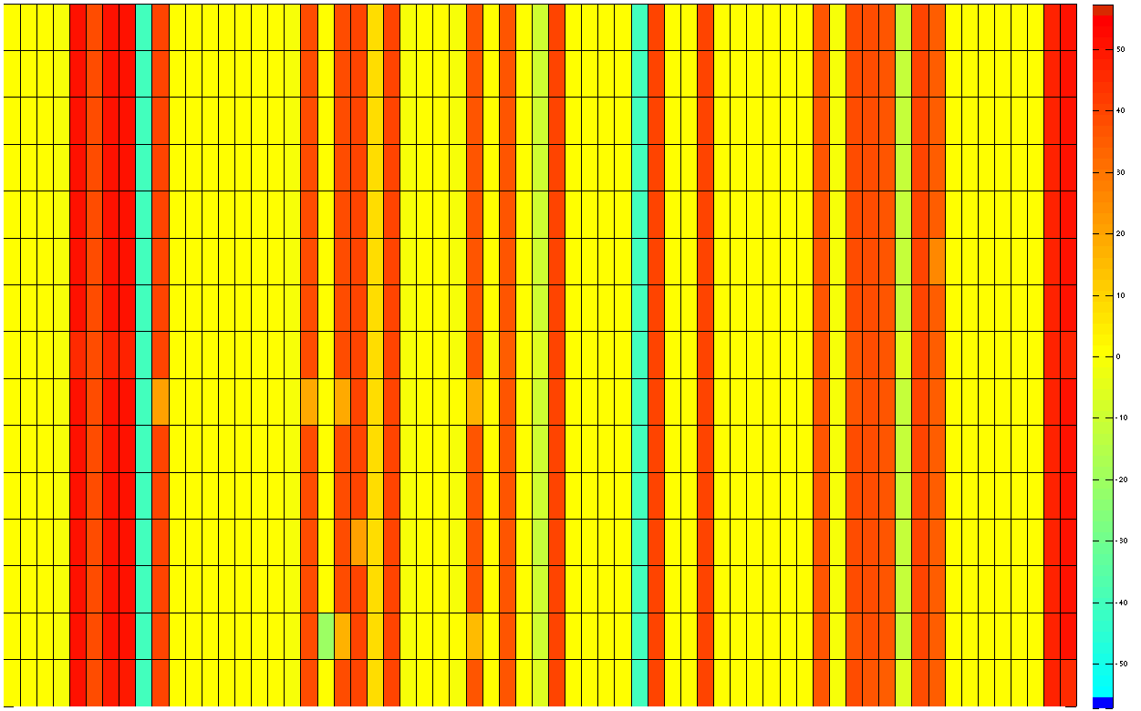
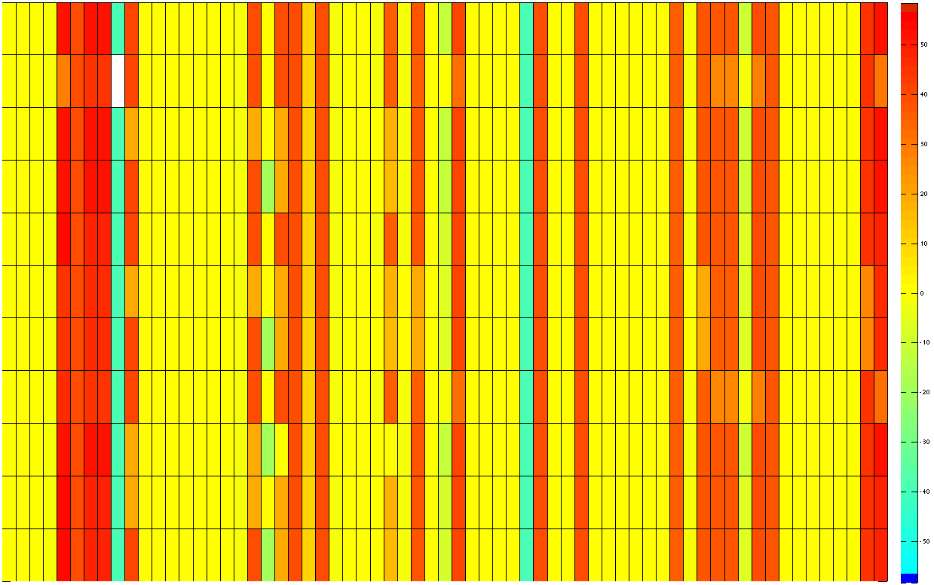
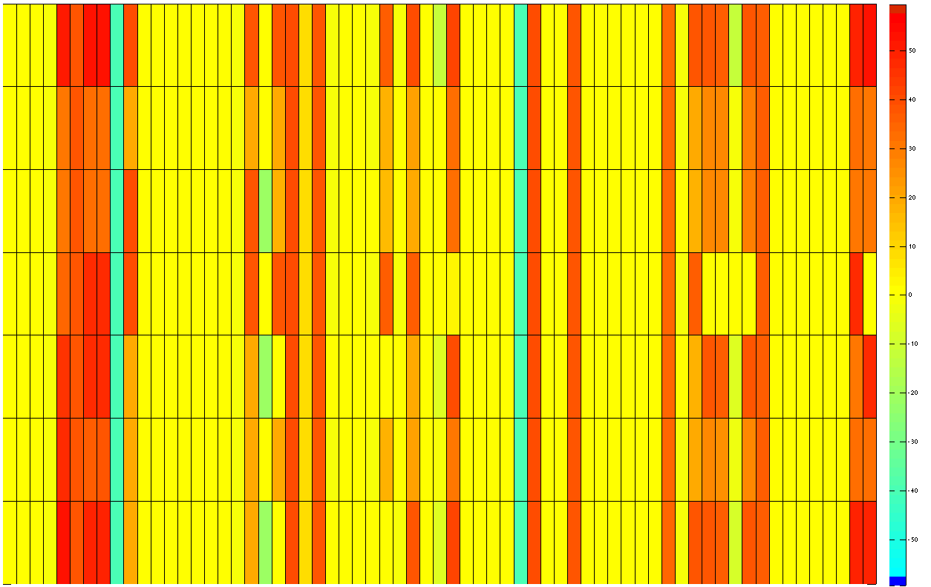
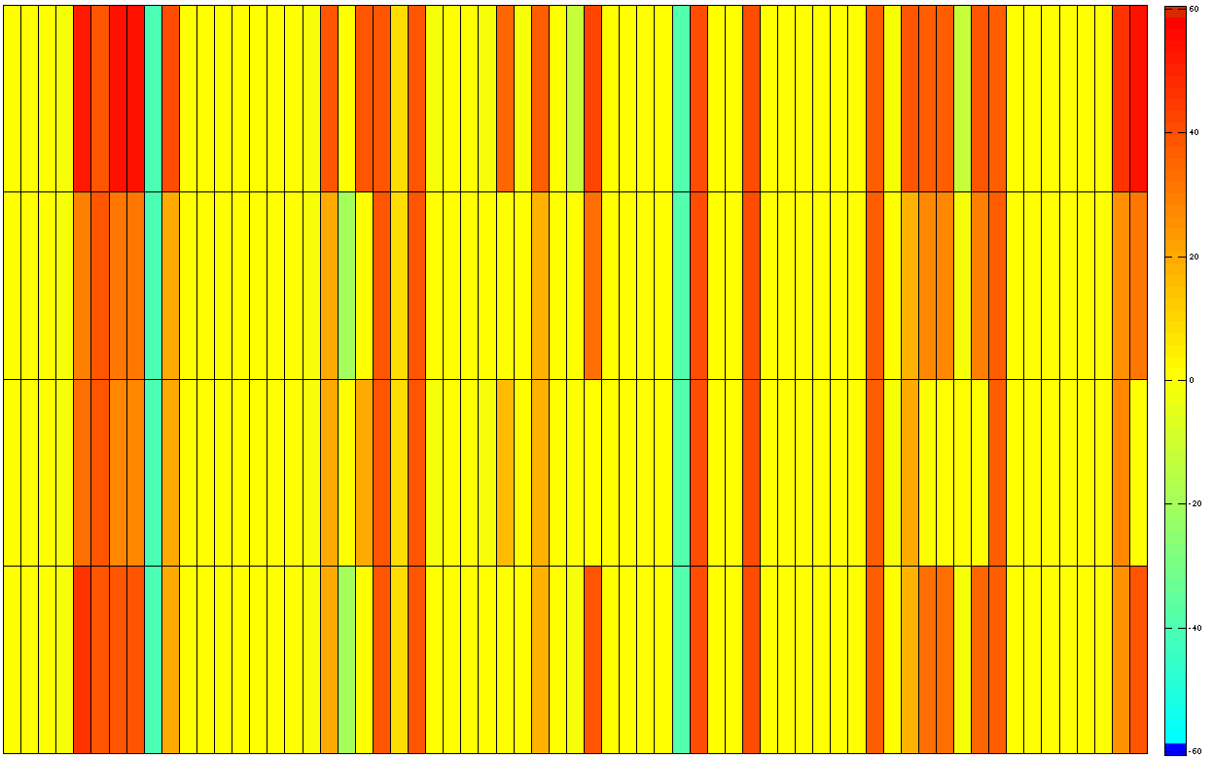
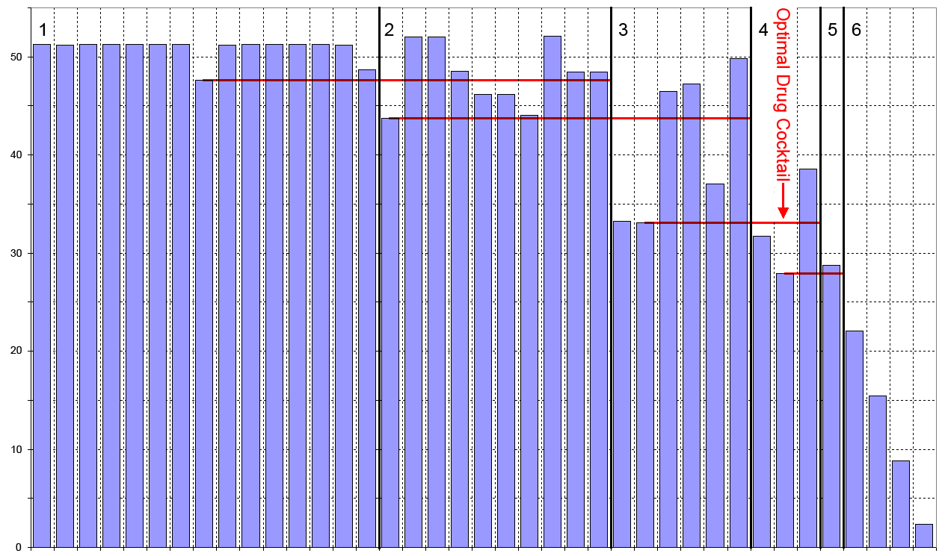
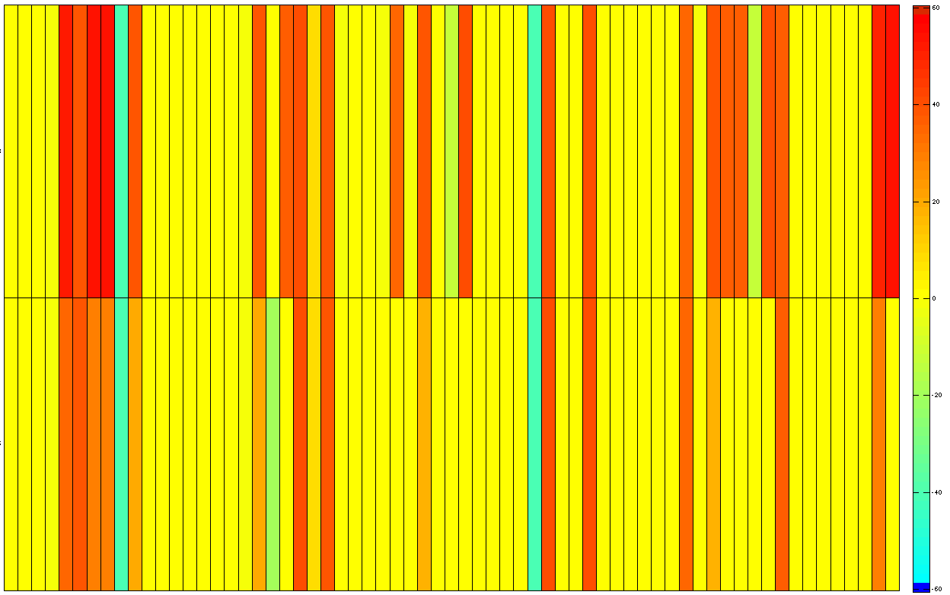
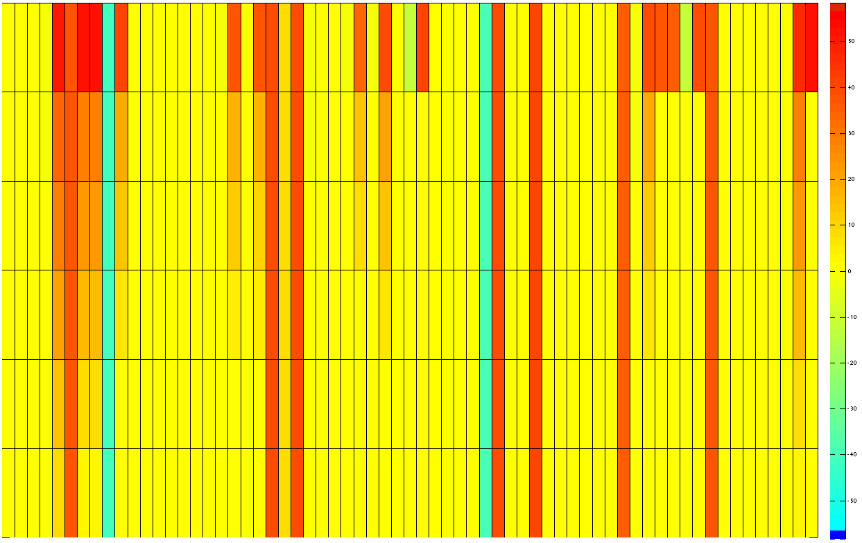
Finding a Patient-Specific Optimal Drug Treatment Combination
Round 1
Single Drugs
Round 2
Double Drugs
Round 3
Round 4
Triple Drugs
Round 5
Quad Drugs
Fiver Drugs
Round 6
MYC
Conc. Optimization
Drugs / Drug Combinations
Various Model Components
Stepwise optimisation of the therapy for an individual patient

Slide 26
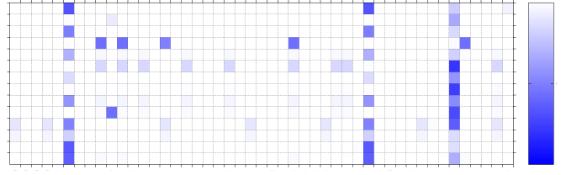
Modelling of P9 and drug prediction
metastatic malignant melanoma patient uveal
primarily received SOC (Fotemustin, ILP, SIRT)
Predicted effect on
tumor growth
0%
Patients
100%
Various Drugs
drug used to treat rheumatoid arthritis (IL1B signaling pathway targeted) –
Successful therapy , patient stable for more than 8 months
www.alacris.de

Slide 27


Heterogeneity of tumors: In-situ transcriptome sequencing?
A
C
tissue section
microarray with coded oligonucleotides
primer extension
RNA molecule
cDNA molecule
transfer of NA molecules to the microarray
b
b
a
a
adding code to the transferred NA molecules
coded surface
coded surface
washing off the coded cDNA and
second strand synthesis
detaching of coded NA molecules from the microarray, preparation of sequencing library
c
introduction of sequencing adapters by PCR
sequencing: codes reveal position of each transcript on the coded surface and thus in the tissue section
B
region corresponding to the sequencing adapter I
region for RNA capture
ready sequencing library
d
b
a
sequencing adapter I
sequencing adapter II
region with a code sequence

Slide 28

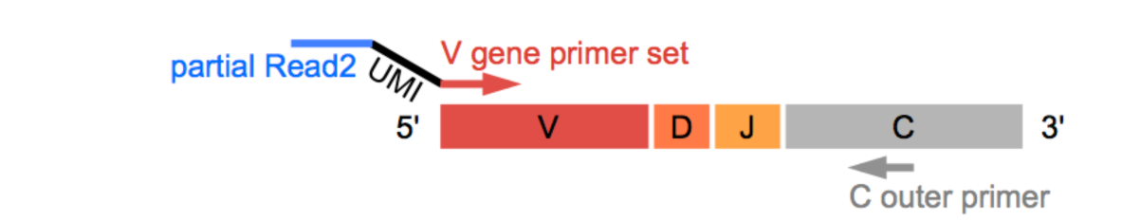
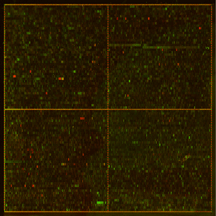
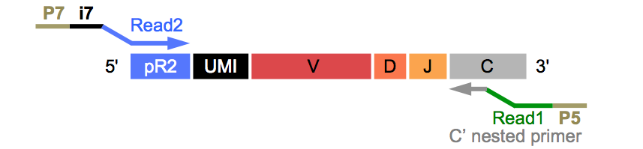
Immune repertoire sequencing for systemic lupus erythematodes
Homozygous twins discordant for lupus
Thomas Dörner
Blood samples
(before / during / after flares)
B cells and T cells
Serum
Antibody and T cell sequencing
(unpaired and paired)
Serum antibody profiling
using peptide arrays
Biomarker discovery
(antigenes, onset, progression, affected organs, ...)

Slide 29
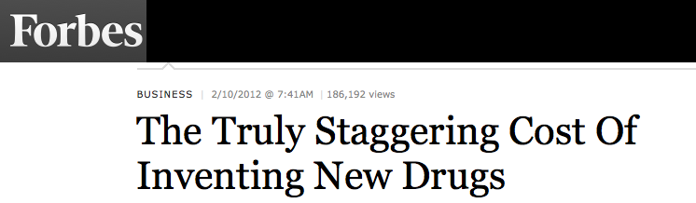
Virtualising drug development: the problem
Research Spending per New Drug
Company | Number of drugs approved | R&D Spending Per Drug ($Mil) | Total R&D Spending 1997-2011 ($Mil)
AstraZeneca | 5 | $11,791 | $58,955
GlaxoSmithKline | 10 | $8,171 | $81,708
Sanofi | 8 | $7,909 | $63,274
Roche Holding AG | 11 | $7,804 | $85,841
Pfizer Inc. | 14 | $7,727 | $108,178
Johnson & Johnson | 15 | $5,886 | $88,285
Eli Lilly & Co. | 11 | $4,577 | $50,347
Abbott Laboratories | 8 | $4,496 | $35,970
Merck & Co Inc | 16 | $4,210 | $67,360
Bristol-Myers Squibb Co. | 11 | $4,152 | $45,675
Novartis AG | 21 | $3,983 | $83,646
Amgen Inc. | 9 | $3,692 | $33,229

Slide 30
Drug development cost
of a cancer therapeutic:
~ 4 - 12 billion $
over 10 - 12 years
Drug treatment cost Extended median survival
Ixempra: $ 4,200 / month 32 days
Avastin: $ 5,000 / month 42 days
Gleevec: $ 7,700 / month years (life-long treatment)
Erbitux: $ 8,400 / month 120 days
Tasigna: $ 9,600 / month 52 days
Sprycel: $ 10,300 / month not demonstrated
Zaltrap: $ 11,000 / month 42 days
Yervoy: $ 39,000 / month 11 months
Notes:
The monthly costs iare ONLY for the drug indicated and do not include hospital costs oradditional drugs (antiemetics, pain killers, etc).
Moreover, most of these drugs are only “effective” if given in combination with other chemotherapy agents. Therefore the total antocancer drug cost is much higher.

Slide 31
Could it be, that most drugs would work?
We just have to find out, on which patients?
Drug response rate
Limit for approval
20%
28%
Approvable with standard methods
Approvable with modeling?

Slide 32
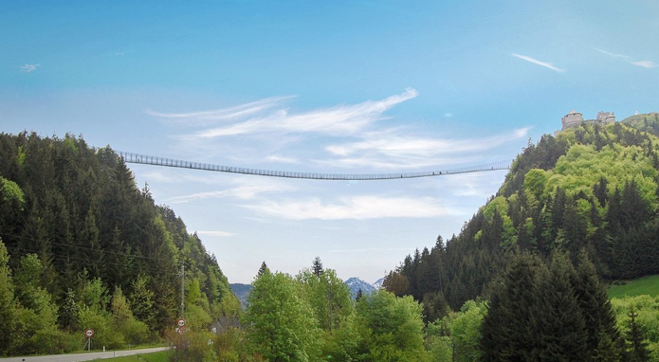
Bridging the gap and implementation
Comprehensive Omics analysis
Routine medical practice

Slide 33
Aktuelle Fakten zur Photovoltaik in Deutschland
Fraunhofer ISE

Slide 34

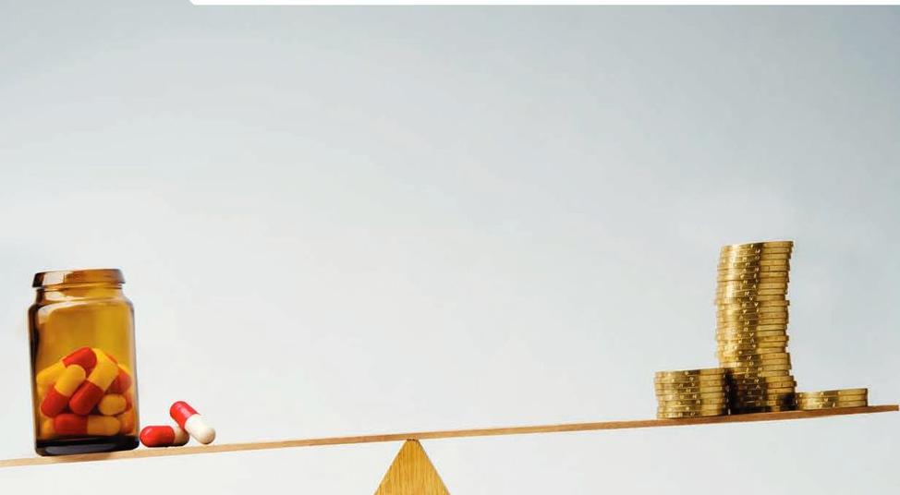

Fiscal Sustainability of

Slide 35

The future of our health care systems?

Slide 36
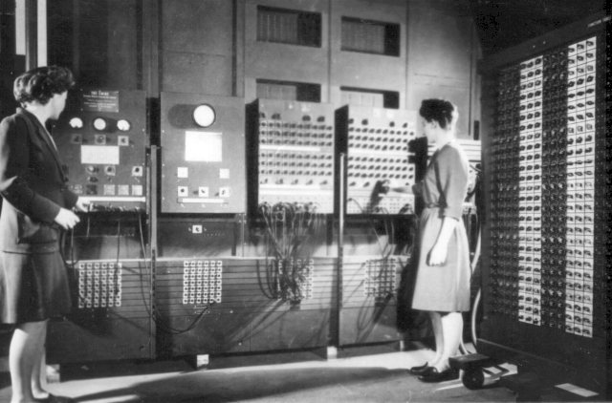
First numerical weather forecasts on ENIAC (early fifties)

Slide 37






Acknowledgements
Dr. Marie-Laure Yaspo
Dr. Hans-Jörg Warnatz
Thomas Risch
Vyacheslav Amstilavskiy
www.molgen.mpg.de
Dr. Bodo Lange
Dr. Moritz Schütte
Dr. Christoph Wierling
Dr. Thomas Kessler
Dr. Tatjana Borodina
Dr. Alexey Shadrin
www.alacris.de
Cancer-Id
Prof. Dr. Peter Schlag
Prof. Dr. Ulrich Keilholz
Prof Dr. Reinhold Schäfer
www.charite.de
HelmholtzZentrum München
Dr. Jan Hasenauer
Fabian Froehlic

Slide 38
Health care compact for Europe
http://www.healthcarecompacteurope.eu
Flagship project consultation
http://www.futurehealtheurope
Alacris Theranostics
http://www.alacris.de

Slide 39
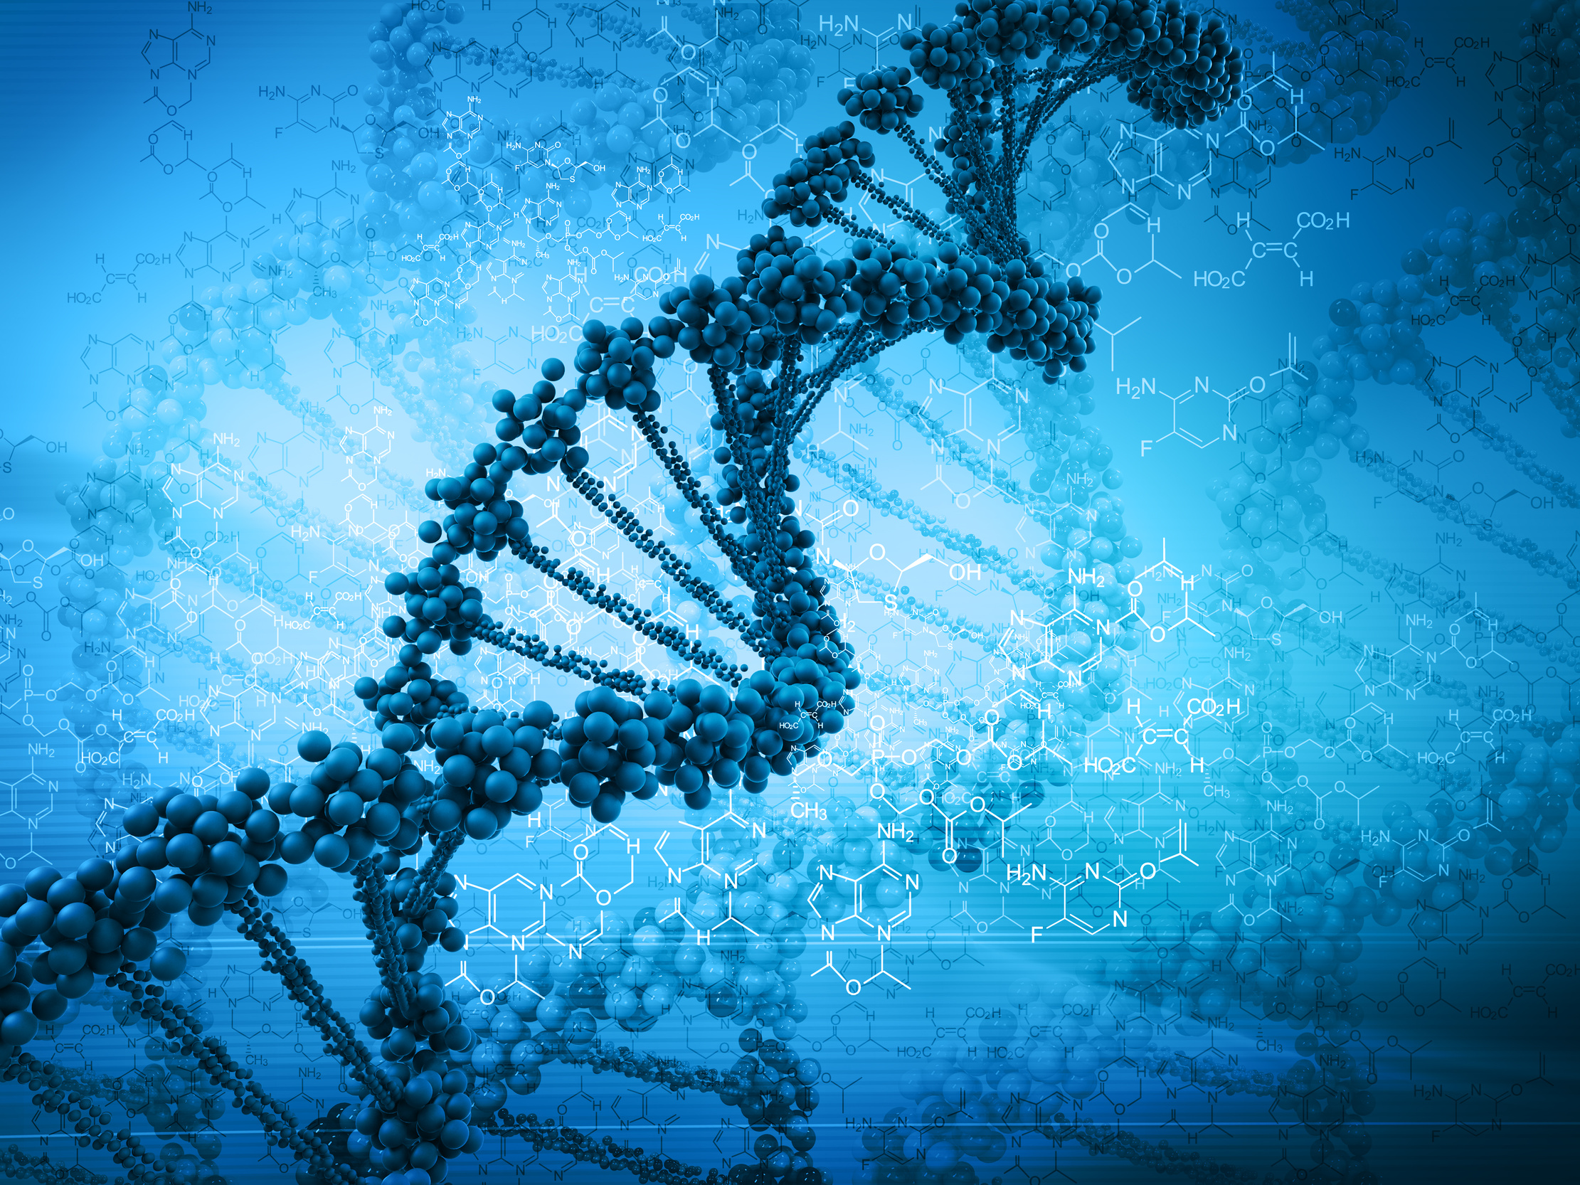
www.alacris.de

