Slide 1

Intrinsically Stable Oxidised Silicon Nanoclusters in Aqueous Solution
Hanieh Yazdanfar, Klaus von Haeften, Mark Watkins, Stuart Thornton, Mumin Koc and Mike McNally
Department of Physics and Astronomy
University of Leicester
Notes:
1

Slide 2
Motivation
Silicon-based fluorescent bio-markers would represent a non-toxic alternative to quantum dots (CdTe, CdSe, CdSo₄ etc.).
Application in drug delivery as well as for biological labels (biolabelling) and sensors (biosensing).
Solvents which are used for synthesis are not harmful (green chemistry).
Nanoparticles in solution
  a requirement for applications in biomedicine is stability in an aqueous environment.
Silicon nanomaterial biocompatibility
  Silicon oxide nanoparticles/antibody bioconjugation successfully applied in immunoﬂuorescent cell imaging.
  The main independent particle variables that determine the in vivo biocompatibility are particles size and dispersibility.
Application in electronics devices; silicon is de-facto standard in electronics; optical signal transmission would enhance performance.
Notes:
2

Slide 3
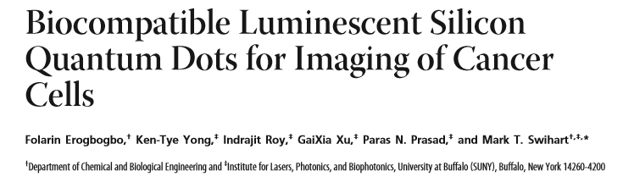
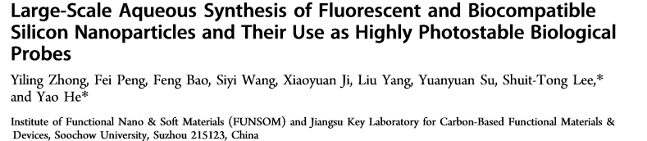
Outline:
Simple
Synthesis method Fast
Requiring no post- treatment
Physical, chemical and dynamic stability Stable blue fluorescence
Stable water-dispersible
Particle Size
Sufficient quantum yield for medical application
Chemical composition
Notes:
3

Slide 4
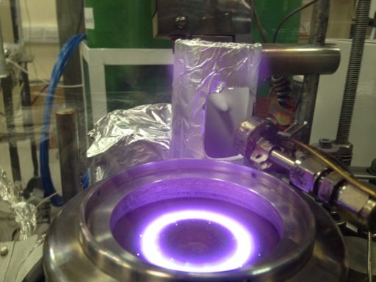
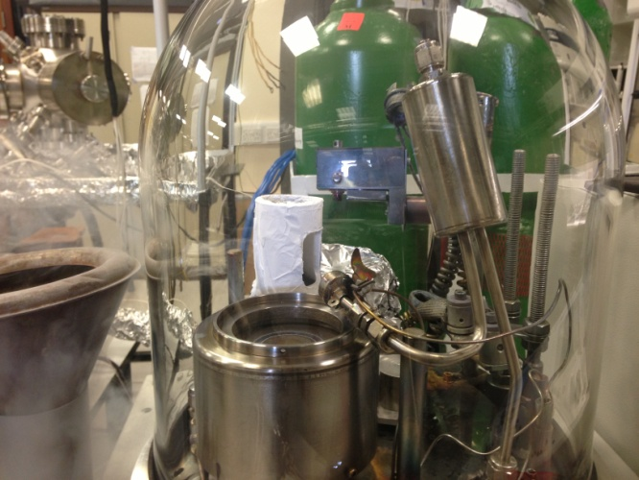
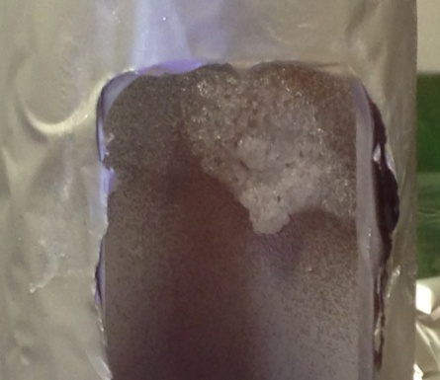
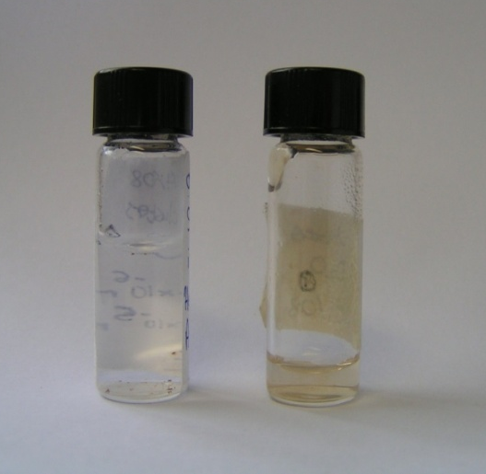
Synthesis of silicon nanoparticles
Silicon nanoparticles are produced by a novel co-deposition technique.
It takes less than 10 minutes to evacuate the chamber and reach to10^-6 mbar.
Liquid jet passes through the atomic silicon vapour and they co-deposit on the inner surface of cold target.
The silicon atoms collide with the surface of the liquid jet, become trapped, diffuse and aggregate into clusters.
In each run of the experiment 15ml of sample can be produced in 20 minutes.

Slide 5
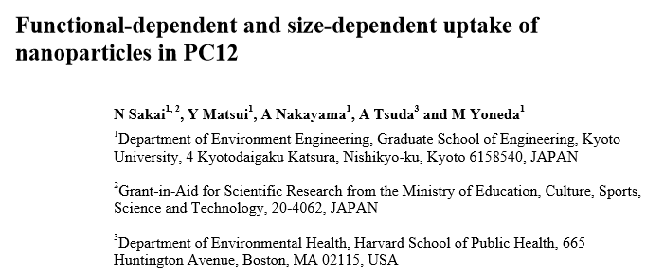
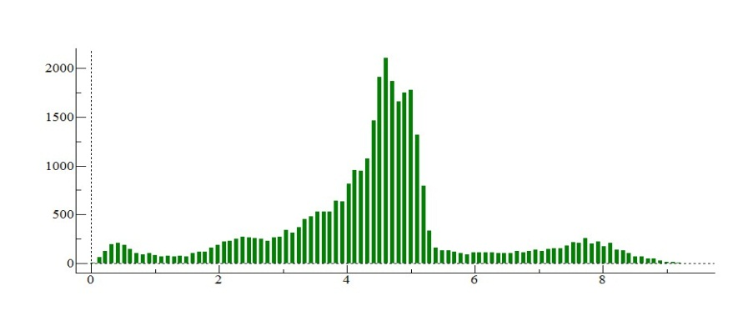
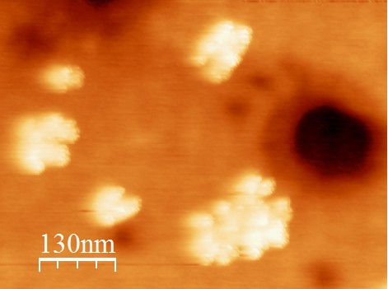
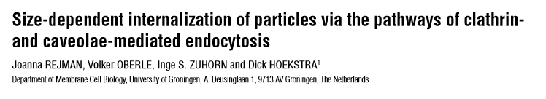
Atomic Force Microscopy (AFM)
Variability of the nanoparticles’ size and size-dependent properties have a wide range of applications in medical diagnostics and therapy.
Layer
Layer
Layer
Si-water
Particles size can determine the path way of entry and processing by cells.
Particles size affect the mechanism of uptake.
The uptake of the nanoparticles was affected by the particle size.
The cells were exposed by three types of the fluorescent particles (22 nm, 100 nm and 1000 nm). The particle number of the 22 nm-nanoparticles taken up by the cells was about 53 times higher than the 100 nm-nanoparticles.
no uptake was seen of particles 1 μm in size.
Most particles have ~ 2 nm height.
Drugs delivery across the blood-brain barrier (BBB)

Slide 6
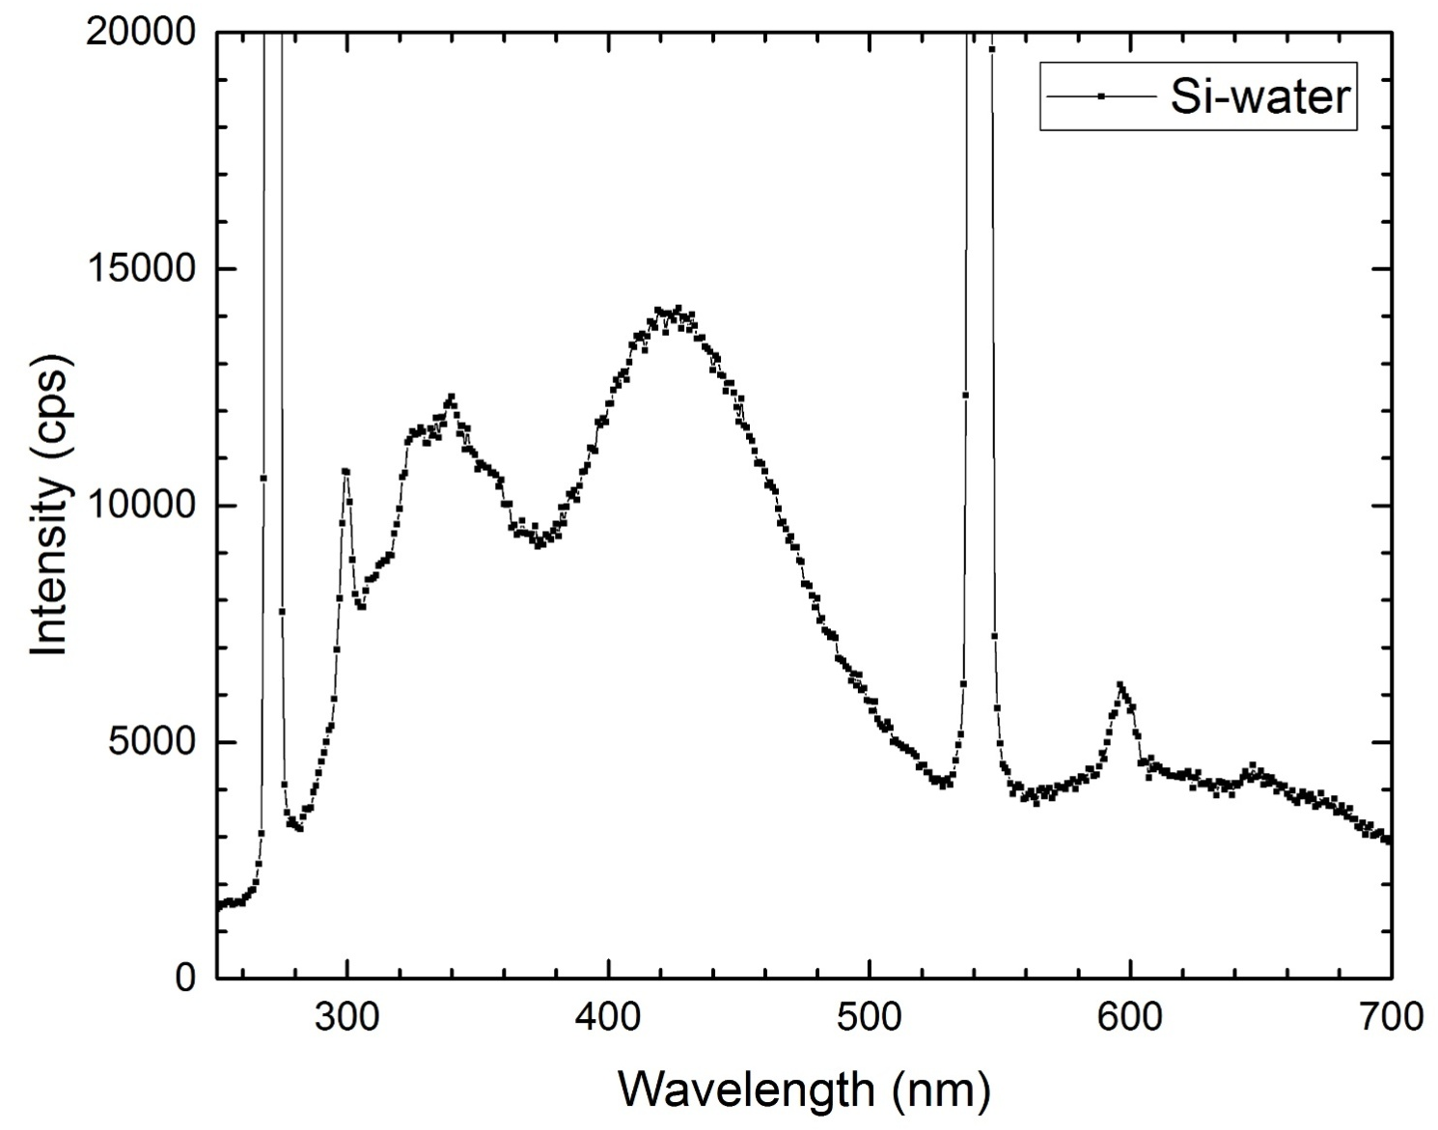
  Fluorescence spectrum of Si_{n} in H₂O nanocluster
1st order Rayleigh peak
Second fluorescence peak
First fluorescence peak
Raman peak of water
Notes:
6

Slide 7
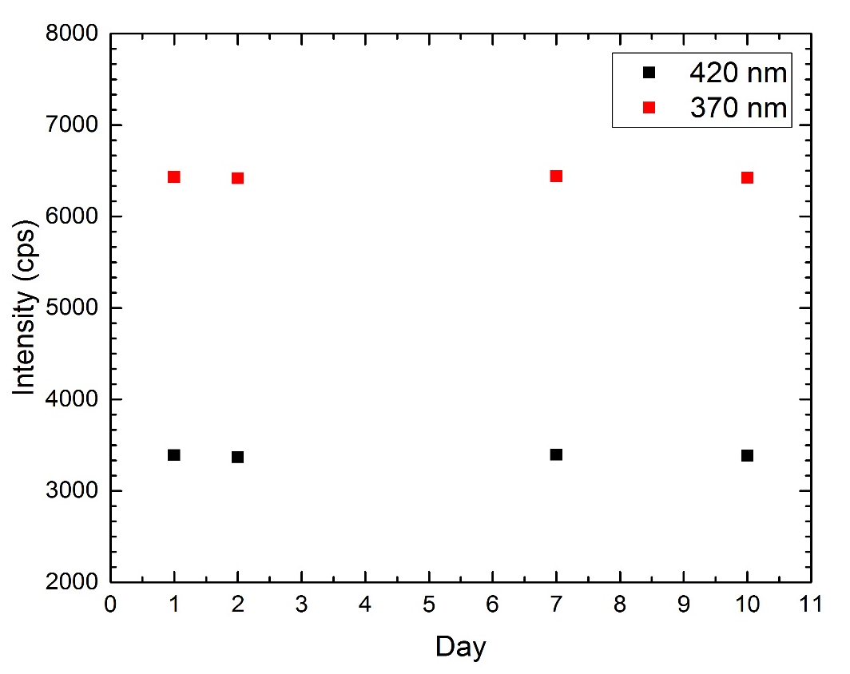
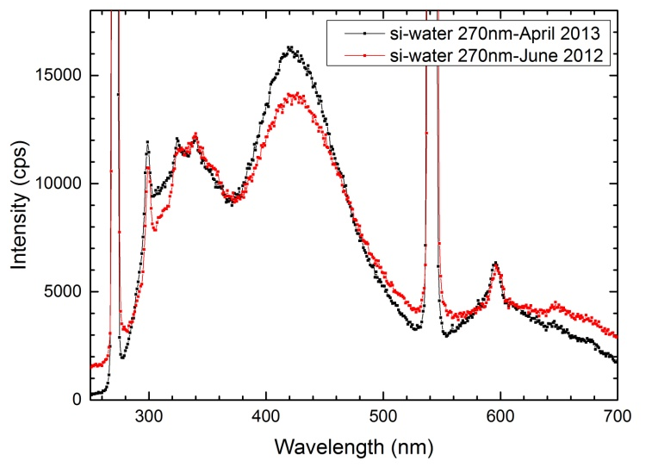
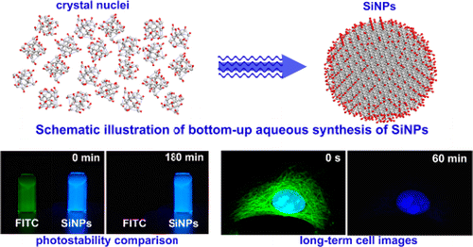
Physical and chemical stability
Produced nanoclusters by this method show a number of extraordinary properties.
  Clusters form a stable phase in water and do not agglomerate (physical stability).
  In water the clusters show strong and exceptionally stable fluorescence when excited with UV light. Fluorescence spectrum did not change after one year and shows the samples are chemically stable.
  quantum yield for the Si-water sample is between 8% and 10% which is suitable for medical application.

Slide 8
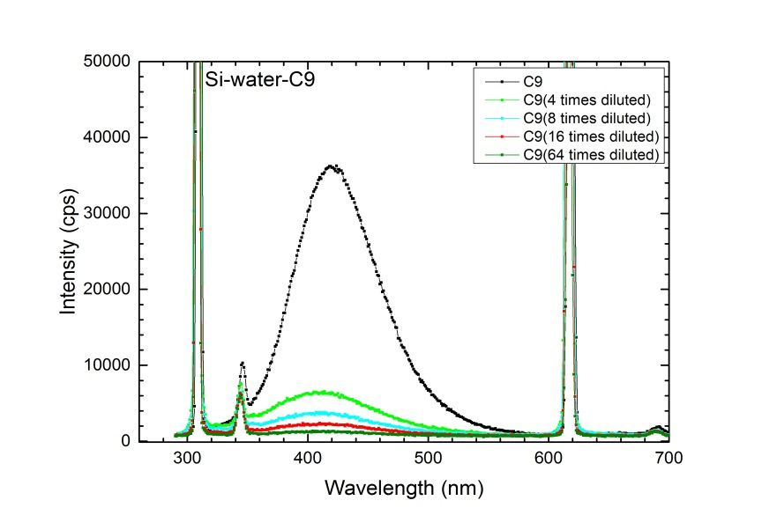
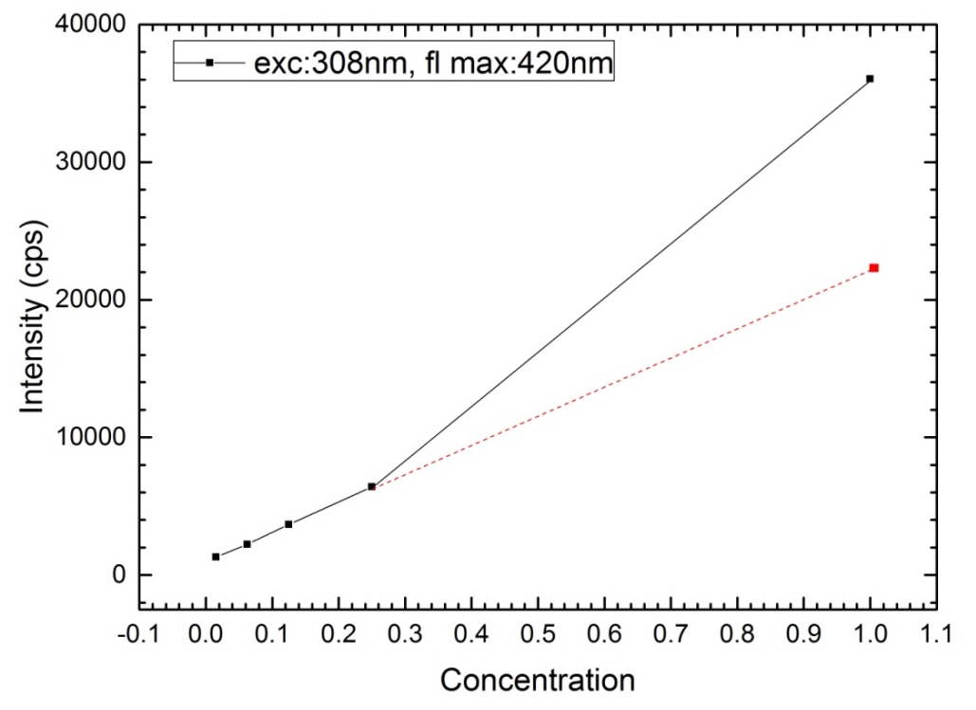
Dynamic stability
Stern-Vollmer plot shows relation between fluorescence yield and nanoparticles concentration.
The Stern-Volmer plot shows a linear relationship between intensity and concentration No quenching

Slide 9
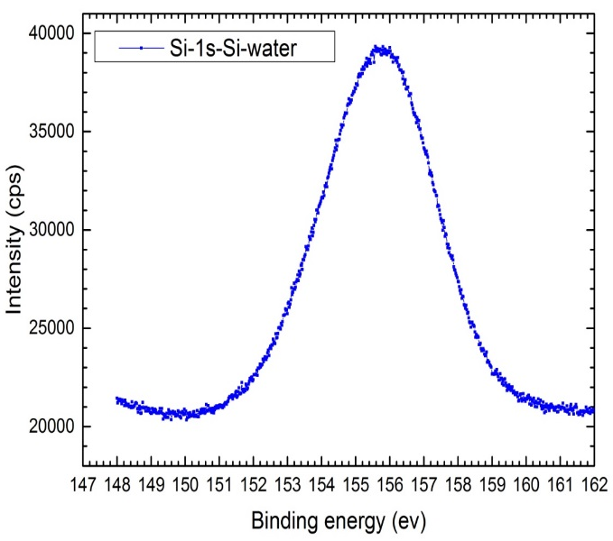
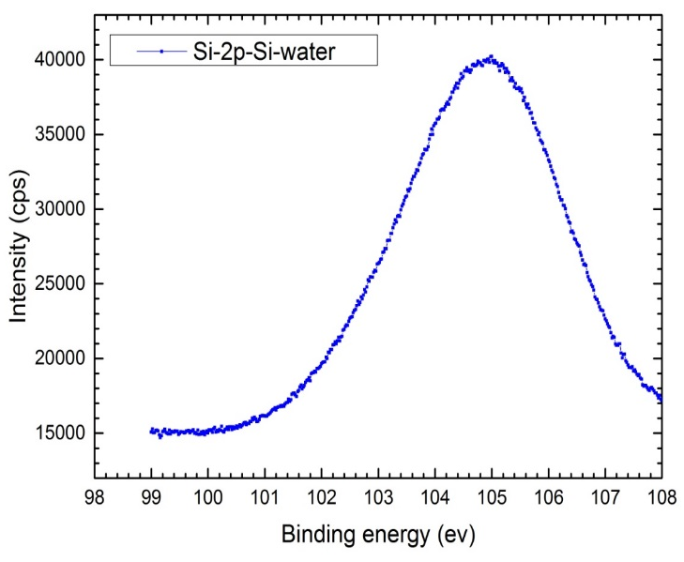
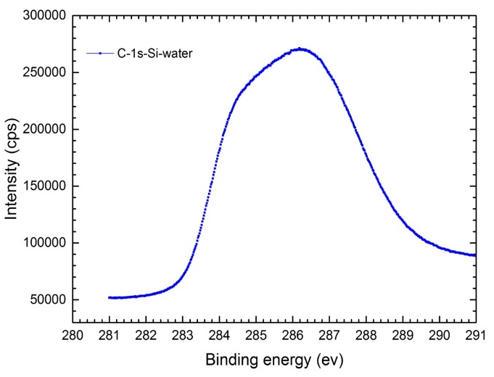
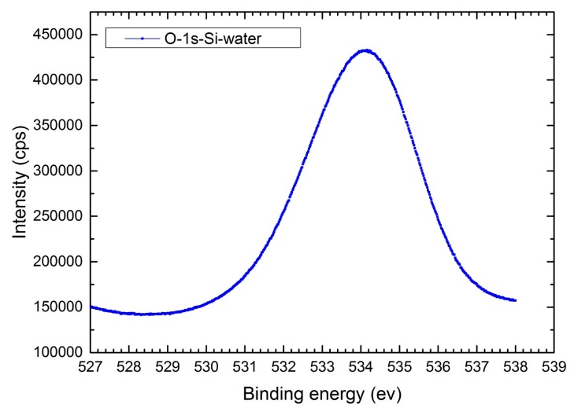
Chemical characterisation
X-ray photoelectron spectroscopy (XPS)
The silicon 2s and 2p peaks indicate that silicon in water is in a high oxidation state.
The peaks are shifted with respect to bulk silicon and show the presence of SiO₂ in water samples.
Si-Si
Si-Si
150.5 ev
99.6 ev
155.8 ev
104.9 ev
SiO₂, SiO_{x>2}
SiO₂, SiO_{x>2}
O-O
531 ev
C-O-C
C-O-H
C/Si
286.4 ev
284.7 ev
534.1 ev
C-C
SiO₂, SiO_{x>2}

Slide 10
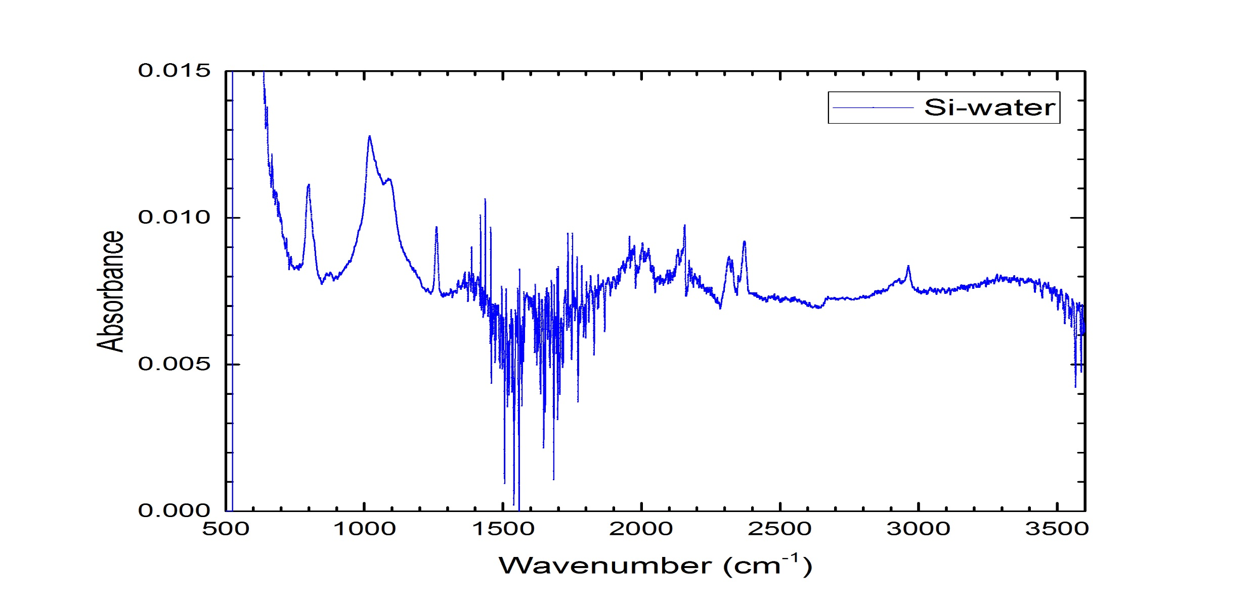
Chemical characterisation
Attenuated Total Reflectance (ATR)
ATR results show that silicon particles are oxidised in water, and form SiO₂ bend at 800 cm⁻¹, Si₂O₃ stretch at 880 cm⁻¹, Si-O-Si stretch at 1018 cm⁻¹, SiO stretch at 1096 cm⁻¹.
Si₂O₃ stretching
SiO stretching
SiO₂ bending
Si-O-Si stretching

Slide 11
Conclusions
Silicon clusters produced by liquid jet method show strong and non-degrading blue fluorescence.
Silicon nanoclusters in water produced with this method are intrinsically stable and show stable fluorescence and high quantum yield without the need for further treatment to stabilize our solution over long period of years.
The samples are physically, chemically and dynamically stable.
Interesting applications in drug delivery as well as in biolabelling (biological labels) and biosensing (biological sensors).
The samples are in range of 2 nm which has application in drug delivery across the blood-brain barrier.
  The level of oxidation is high for Si-water samples and shows the tendency to oxidize silicon nanoparticles.
Notes:
11

Slide 12
Thanks to:
Funding: Royal Society
Dr. Mark Lowe
Thank you for your attention!

