Slide 1
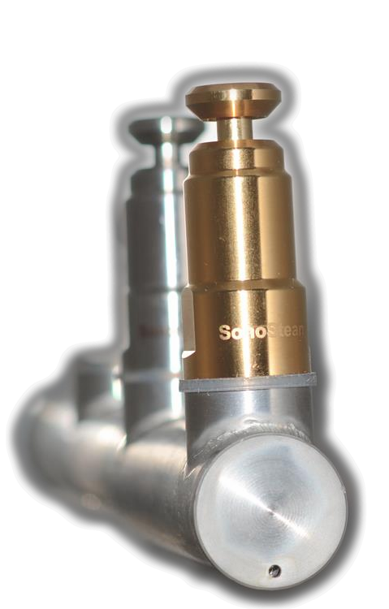
SonoSteam®
Hanieh Musavian,
SonoSteam, FORCE Technology
Factory Trials and Evaluations of Steam-Ultrasound (SonoSteam®) Decontamination of Broilers.

Slide 2
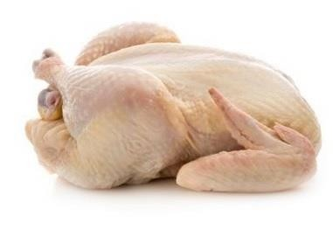
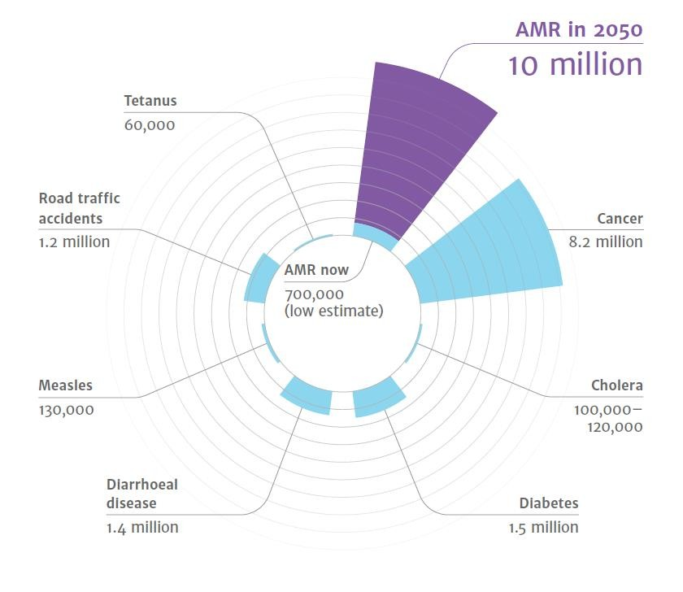
Future Foodsafety Situation
Deaths Attributable to AMR every Year
• 450.000 deaths every year in EU
• Campylobacter and Salmonella from poultry meat
• Evolving microorganisms
• Antimicrobial resistance
• Cross-resistants
• …post antibiotic era?
Superbugs identified in poultry!

Slide 3
What is SonoSteam?
… and how does it work?

Slide 4
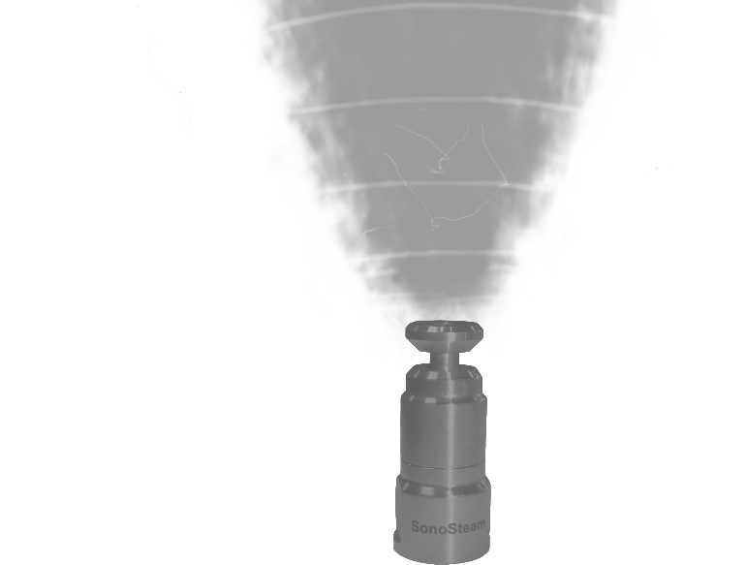
What is SonoSteam?
SonoSteam nozzles
Combined effect of steam and ultrasound
Ultrasound intensified the treatment.
The combined effect offers:
  Few seconds of treatment
  No chemicals
  No adaptive resistance of microorganisms
  Effective against bacteria, viruses, fungi and yeast
  Protects the food product from thermal damages

Slide 5
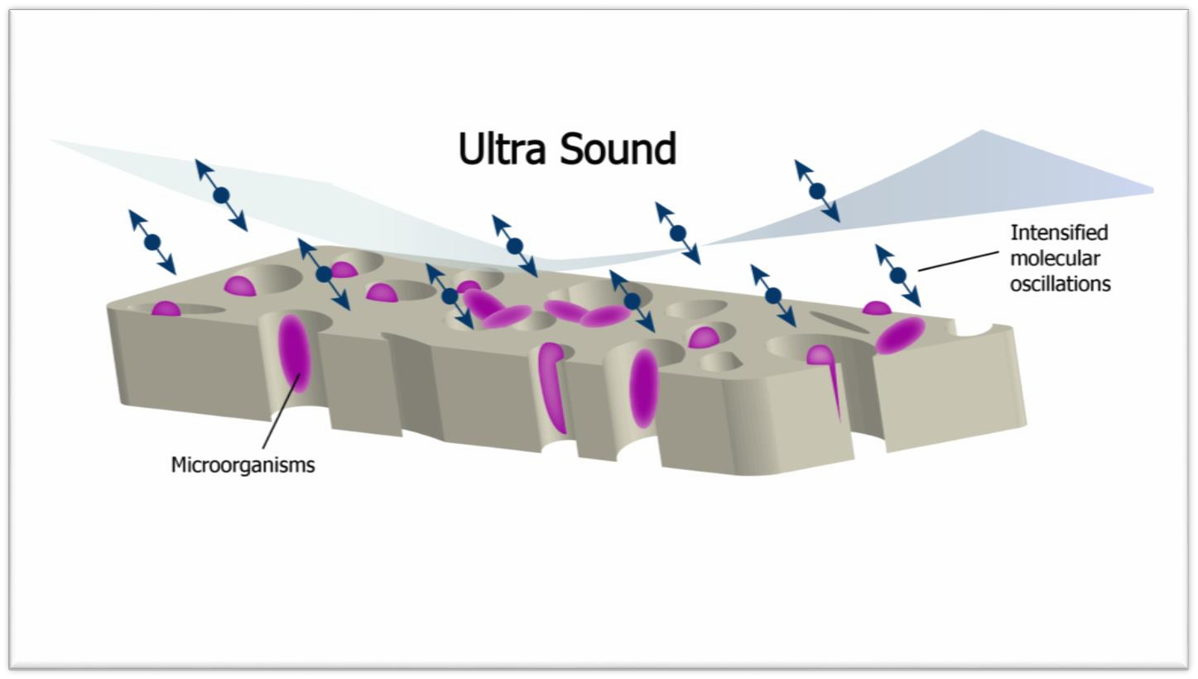
Principle of work for SonoSteam®
Why is the combined use more effective than steam alone?
The Laminar Layer
The ultrasound sets the air of the laminar zone in a state with intensified molecular oscillations. This results in a destruction of the laminar boundary layer.

Slide 6

CFD Simulation video: Principles

Slide 7
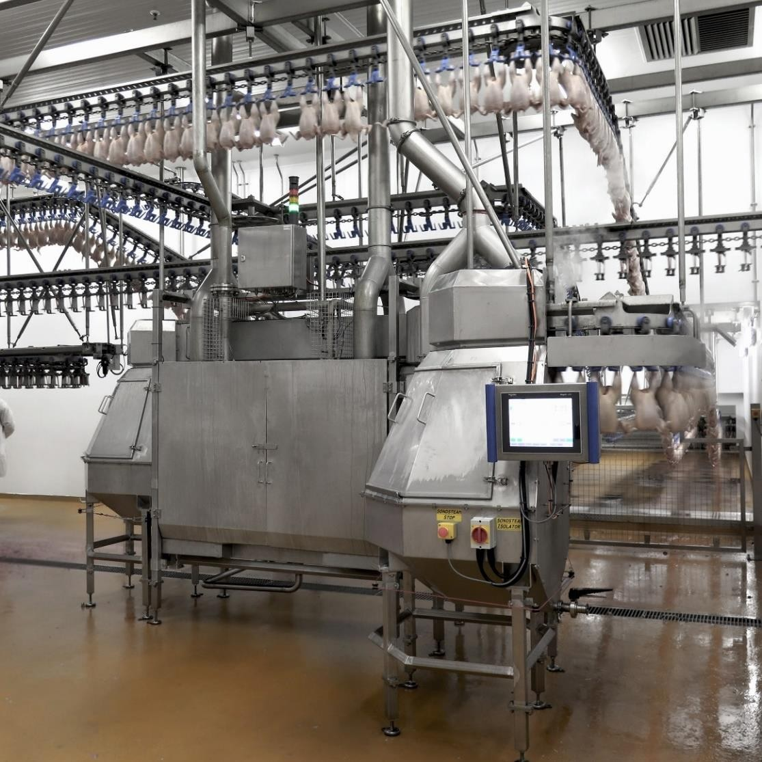
Industrial Application
Full scale application
6000 -14.000 birds/h
First installation was in 2014
In total of 5 installations exist today
Three different slaughterhouses
Ongoing trials every week since 2014
Ongoing optimization and close cooperation with the users

Slide 8
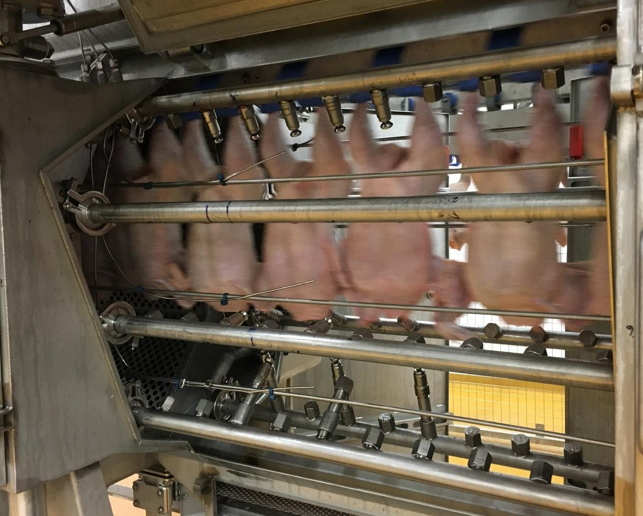

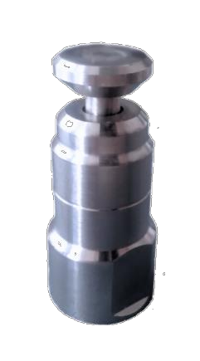

Process Chamber
SonoSteam Nozzles

Slide 9
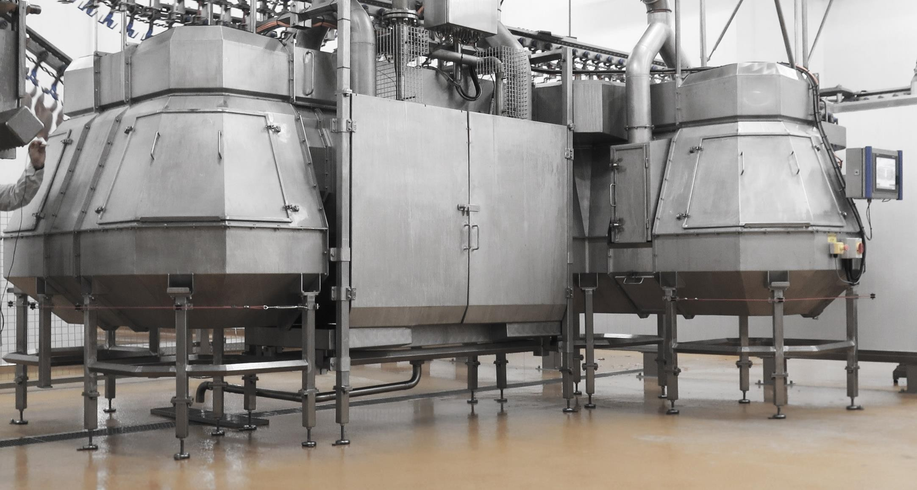
Full-Scale Application for Broiler Disinfection

Slide 10
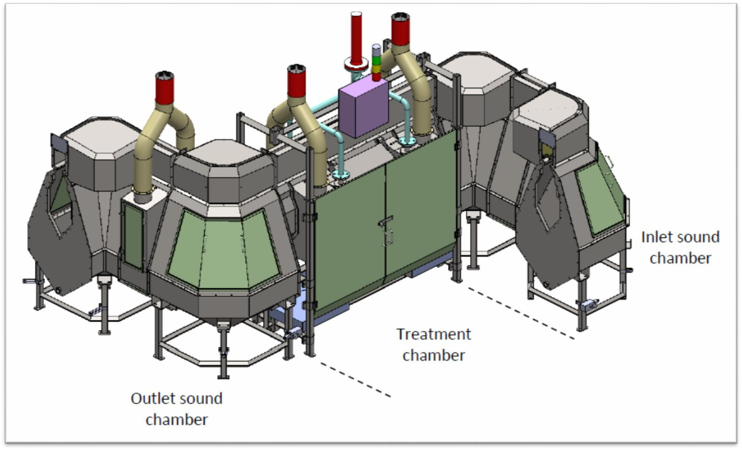
IA Poultry II

Slide 11
Process Control and Adjustments

Slide 12
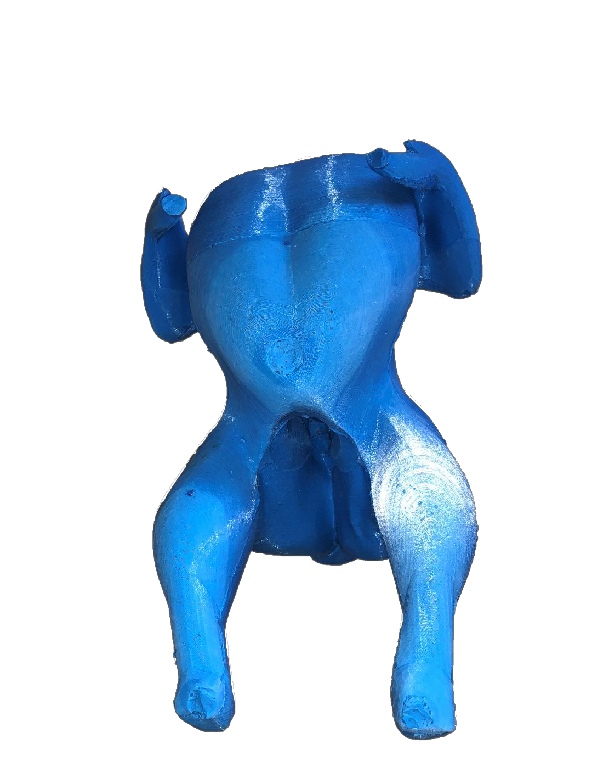
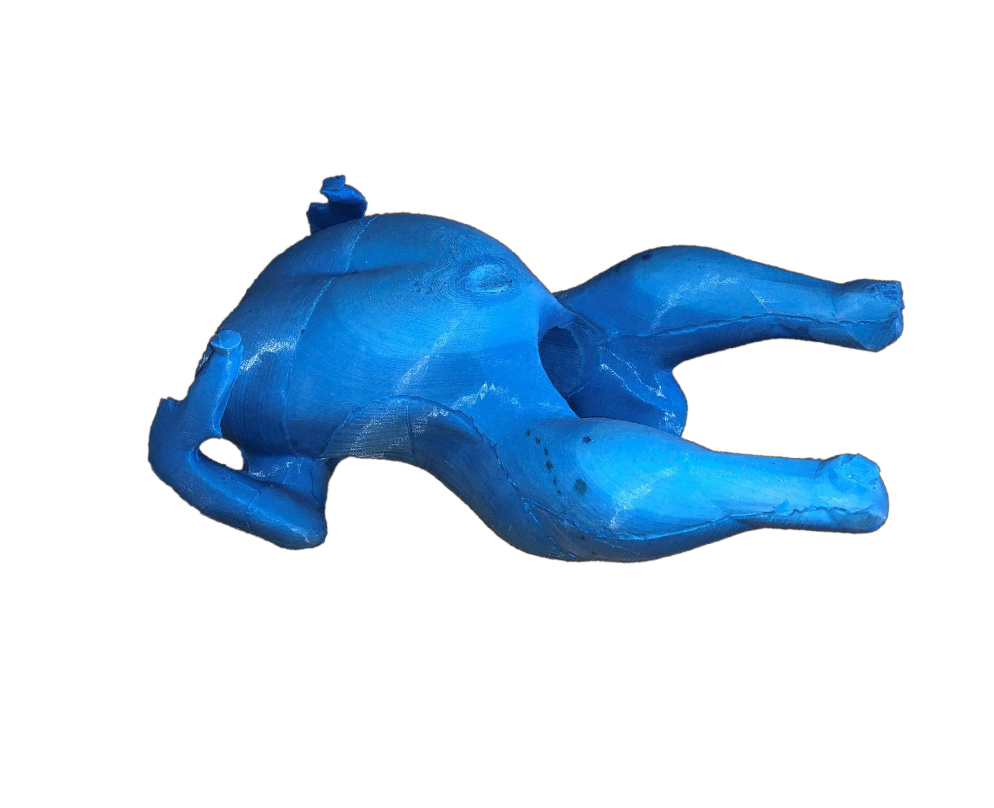
The Chicken Dummy – aTool to Test/Optimize Process

Slide 13
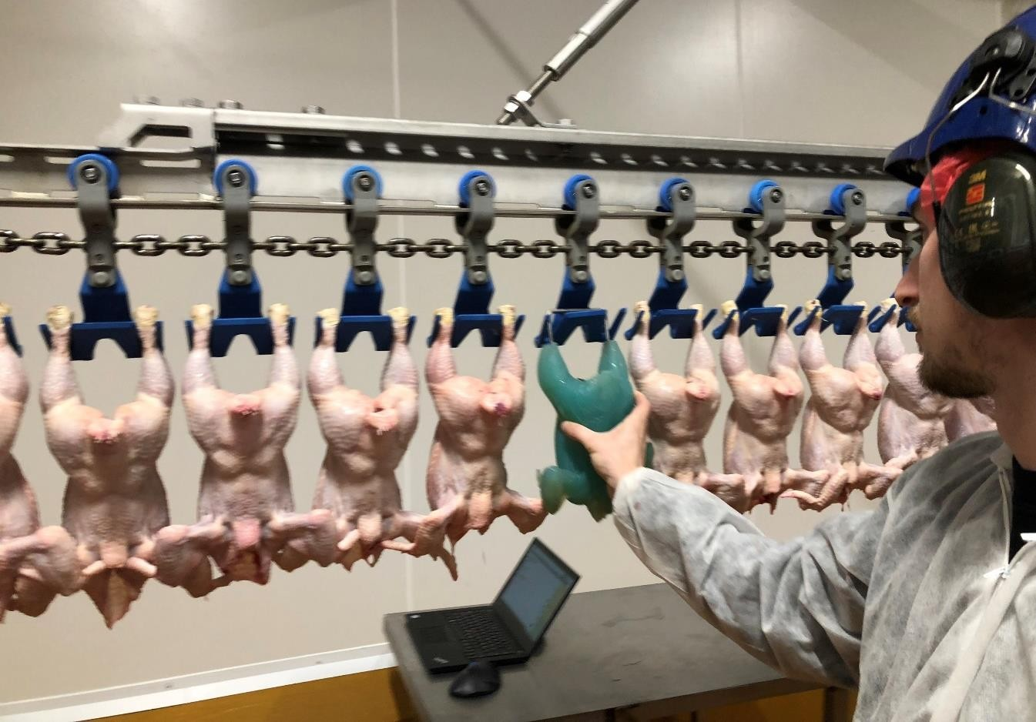
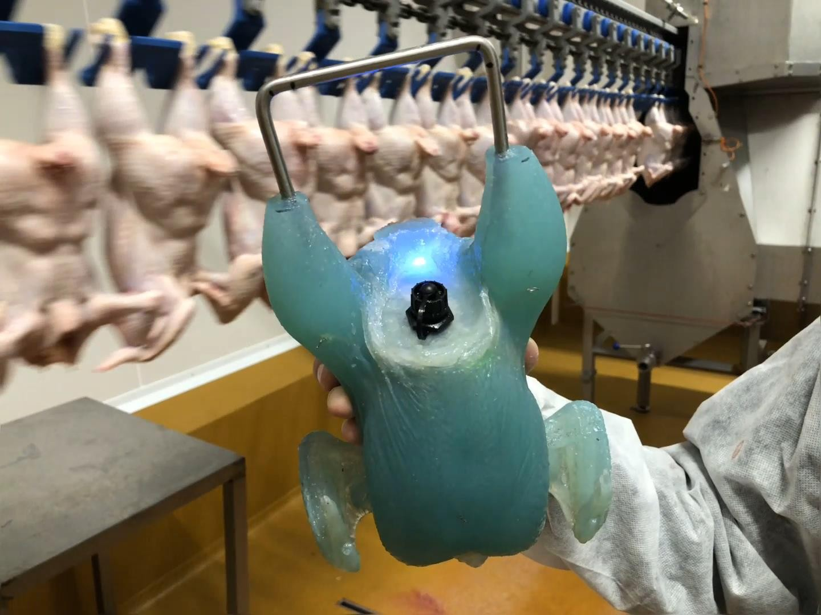
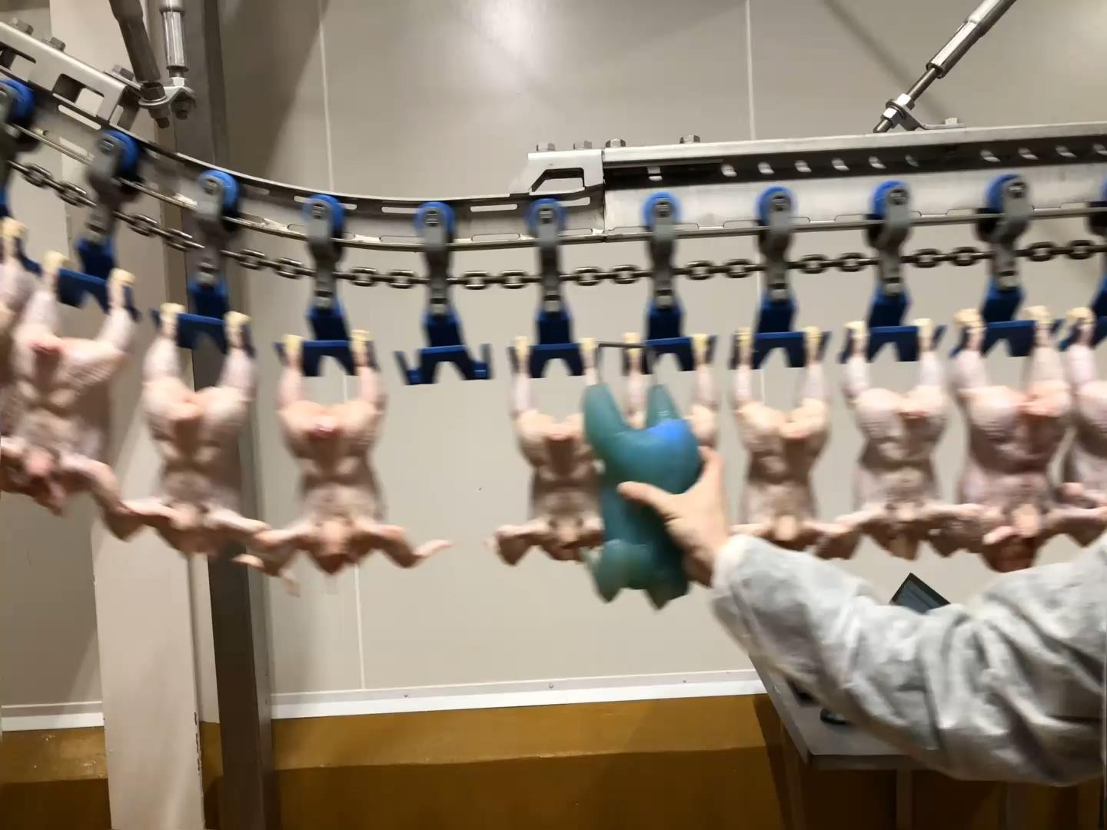
The Dummy Chicken – a Tool to Test/Optimize Process

Slide 14
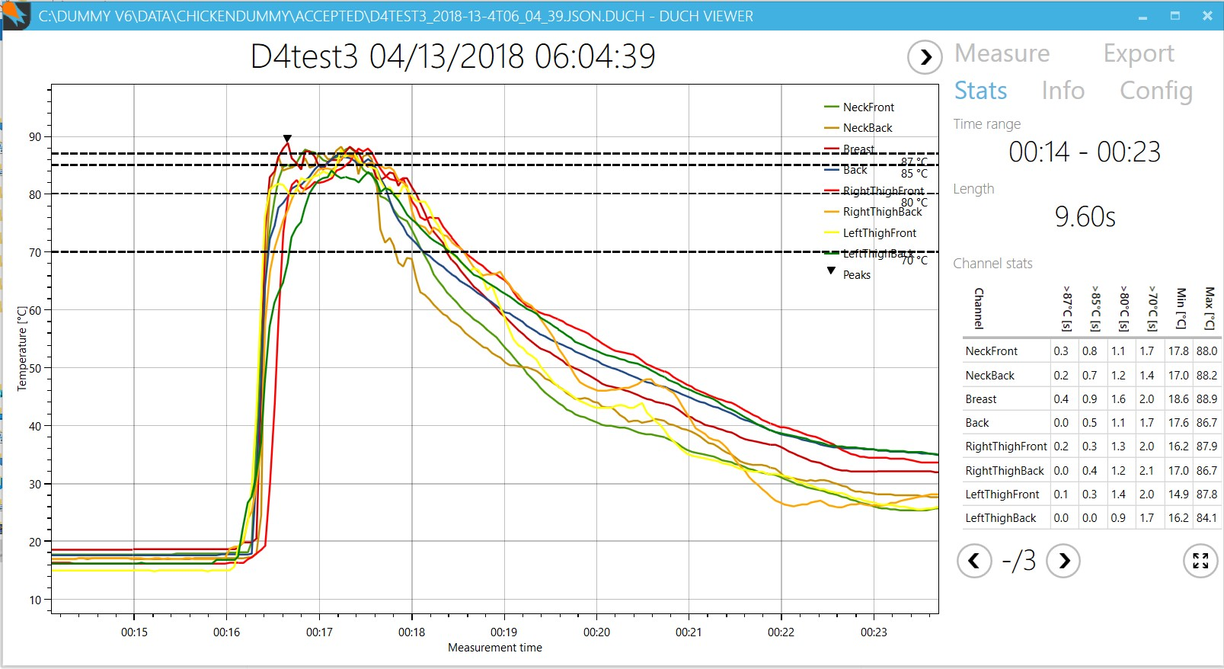
Dummy Chicken Temp. Profiles

Slide 15
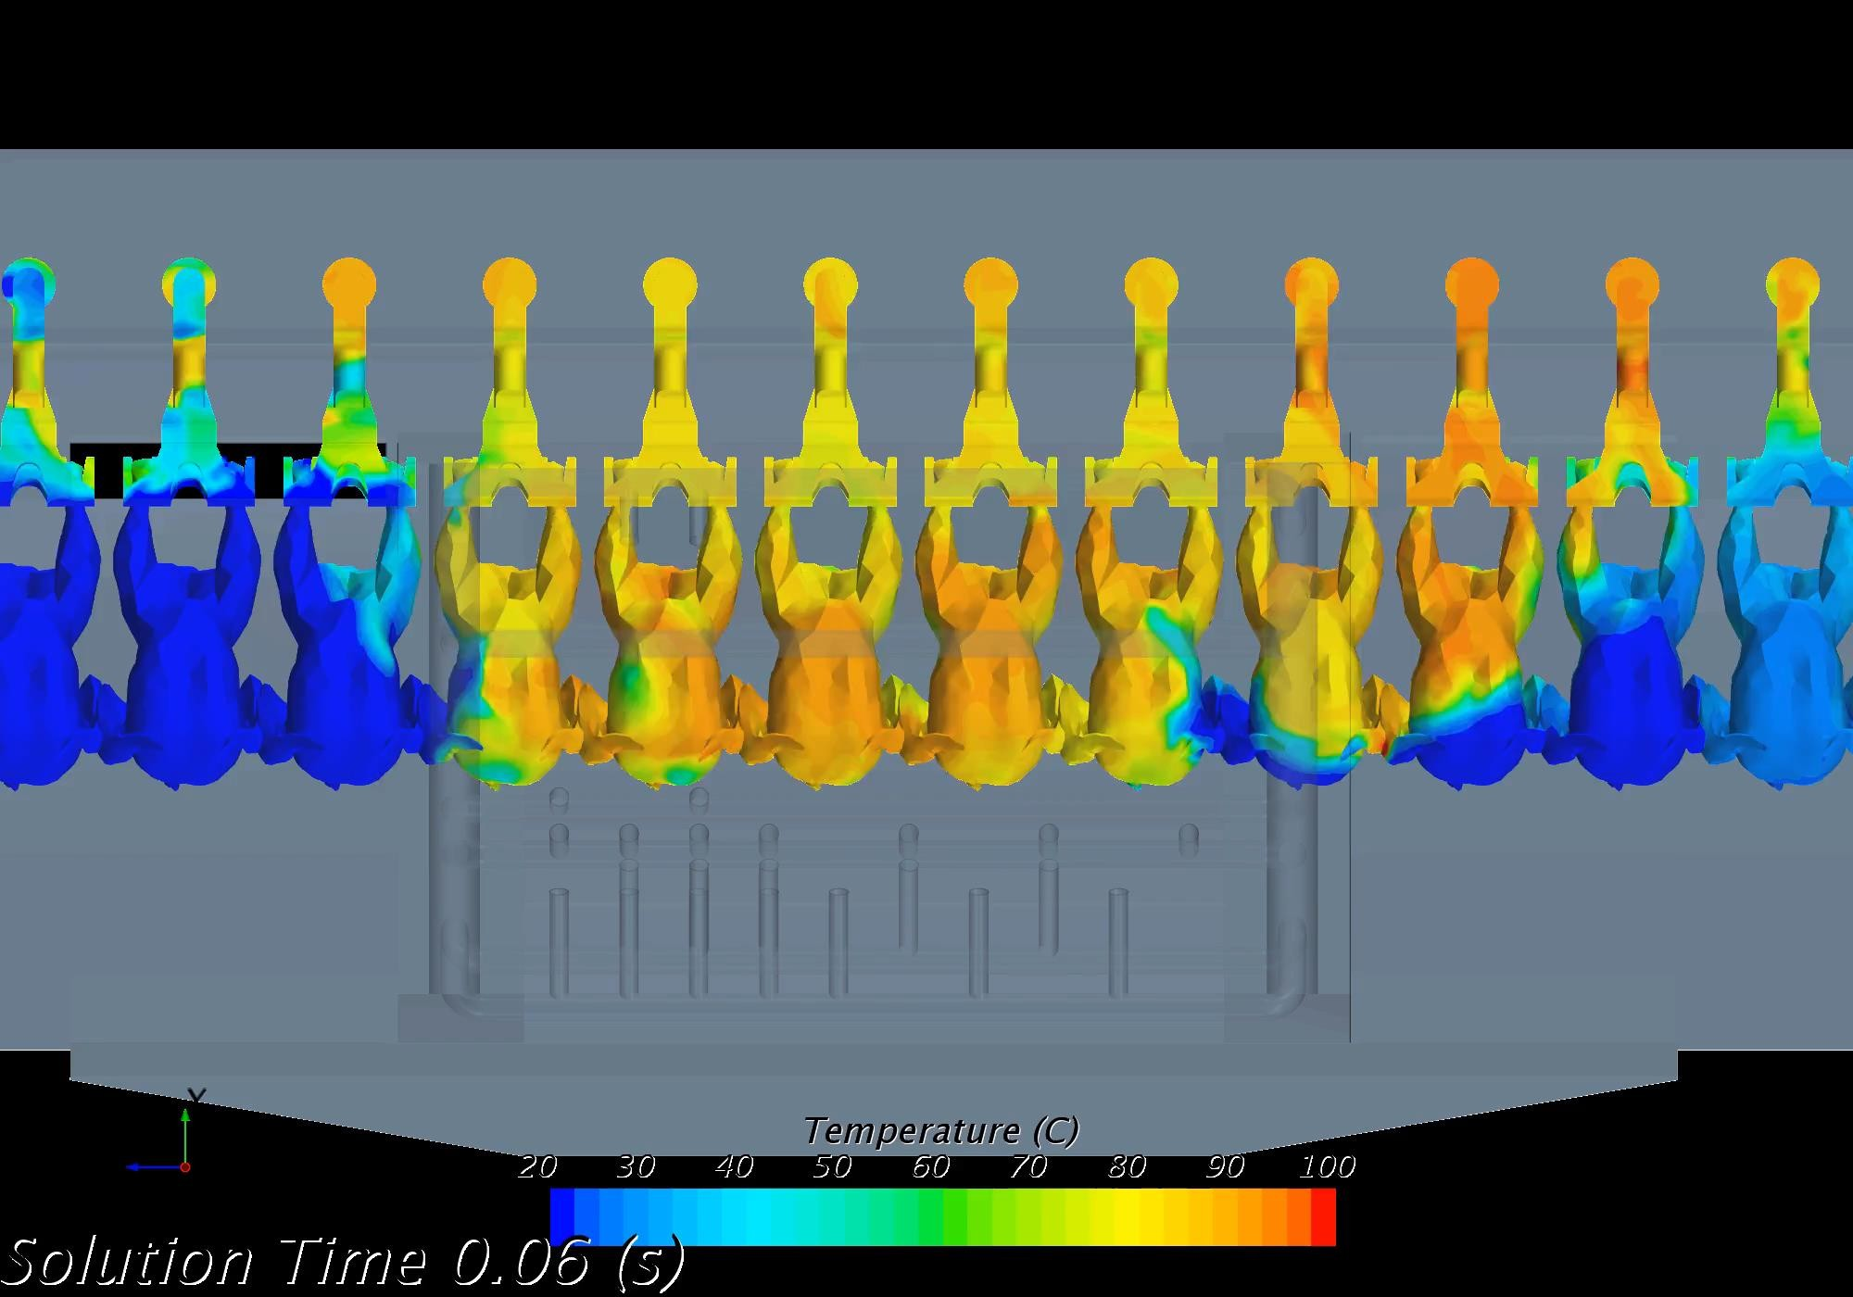
CFD Simulation of Flow and Temperatures

Slide 16
Factory Results

Slide 17
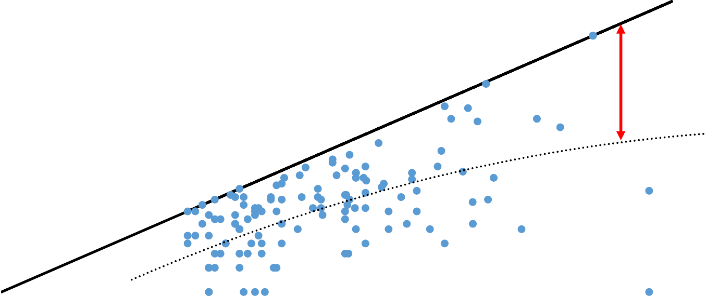
Inline Data from IA Poultry
Levels before and after SonoSteam
5,0
Higher initial levels gives higher absolute reductions
4,5
4,0
Level after SonoSteam
3,5
Dot line:
Trend line. Distance to solid line equals achieved reduction
3,0
2,5
2,0
All paired neck flap samples. High variations due to the neck flap
1,5
1,0
0,5
0,0
1,0
1,5
2,0
2,5 3,0 3,5
Initial level before SonoSteam
4,0
4,5
5,0

Slide 18
Inline data from IA Poultry II
Average reductions in intervals of initial value |  | Range (Log) | Reduction (Log)
27
159 308 |  | [1:2] | 0,53
 |  | [2:3] | 1,05
 |  | [3:4] | 1,08
 |  | [4:5] | 1,32
1,4
1,3
1,2
1,1
1,0
0,9
0,8
0,7
0,6
0,5
0,4
0,3
0,2
0,1
-
Average Log reduction in interval
561 / 497 samples
67
[1,0:2,0]
[2,0:3,0] [3,0:4,0] [4,0:5,0]
Average reduction and corresponding number of samples out of 561 samples
[5,0:6,0]

Slide 19
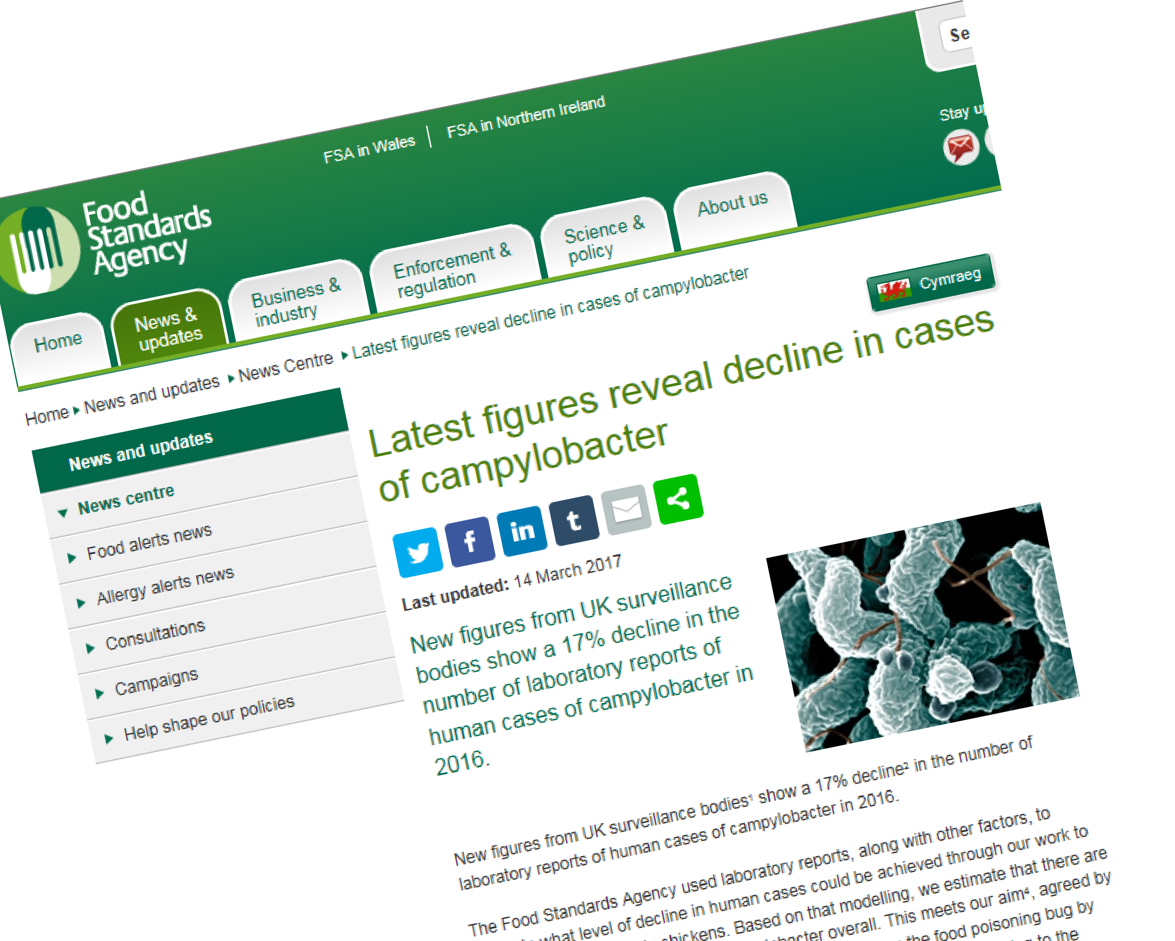
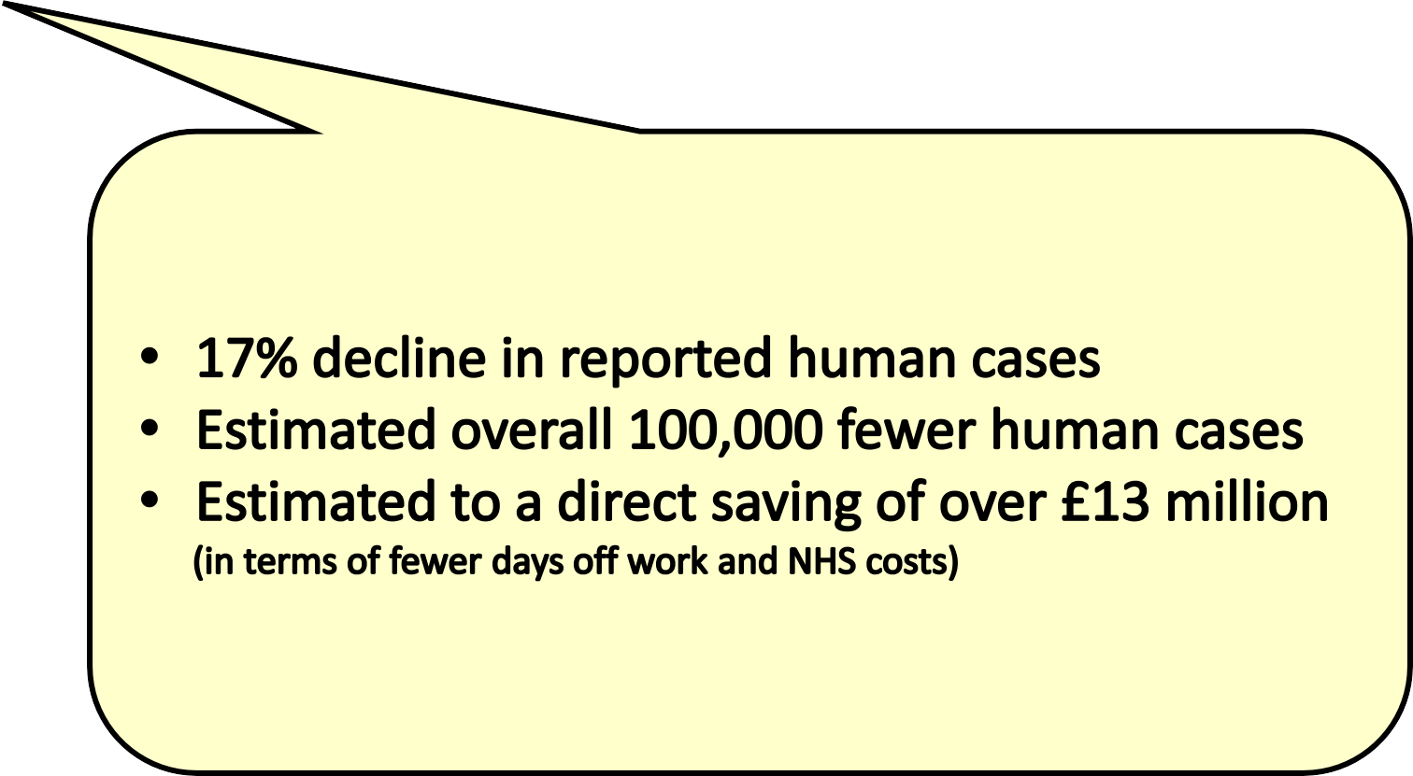
FSA survey published March 14th 2017

Slide 20
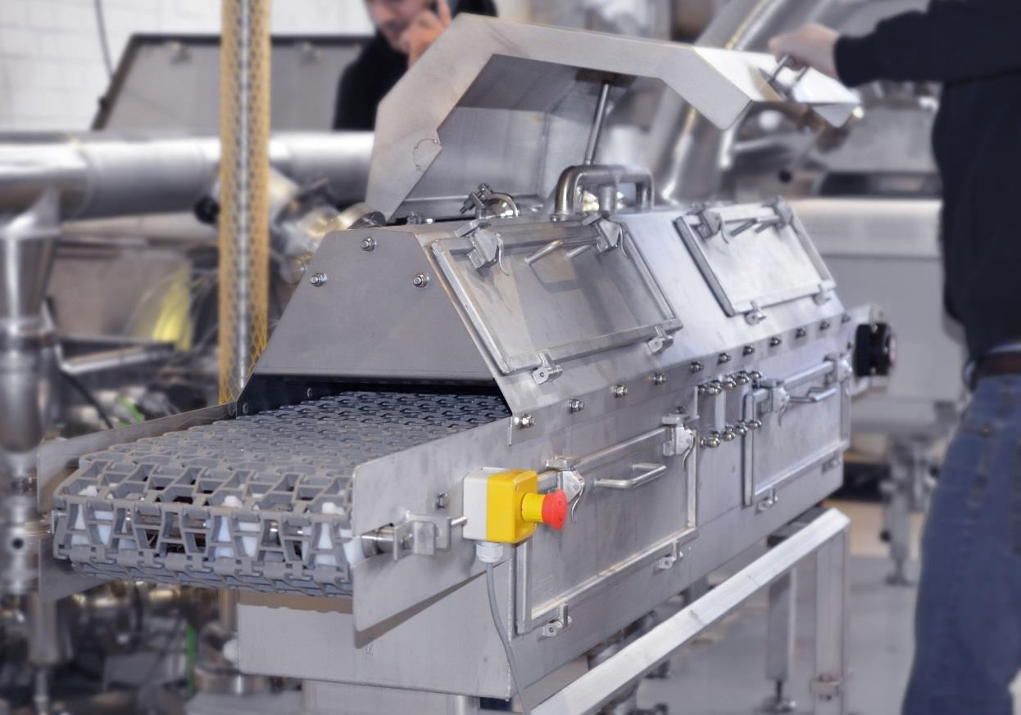
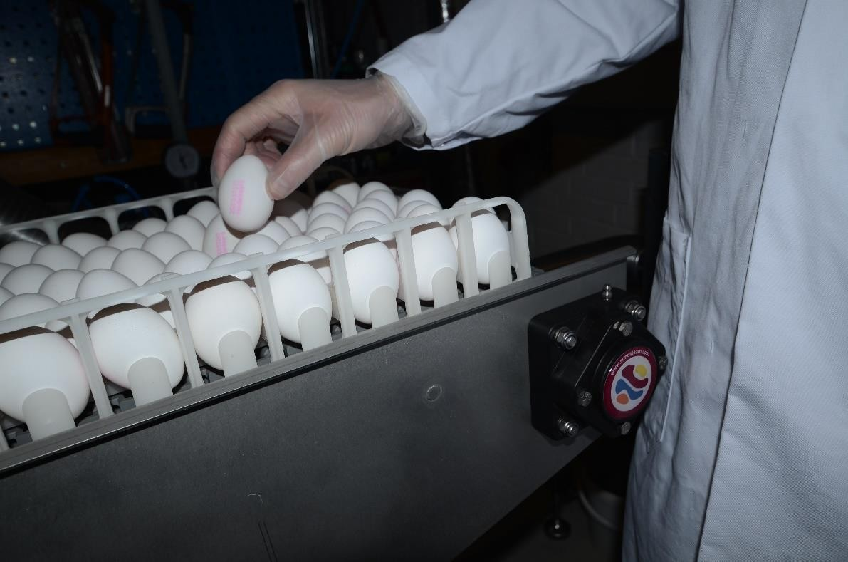
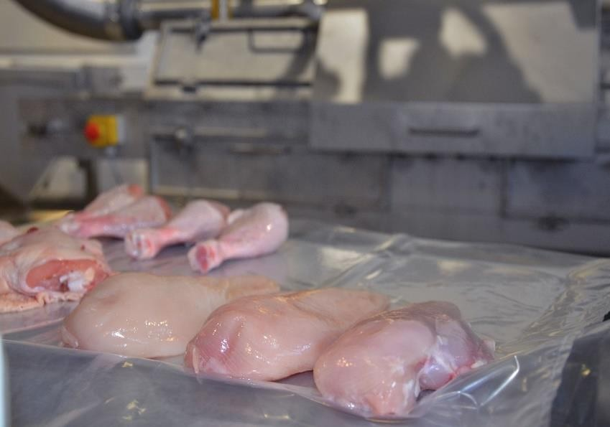
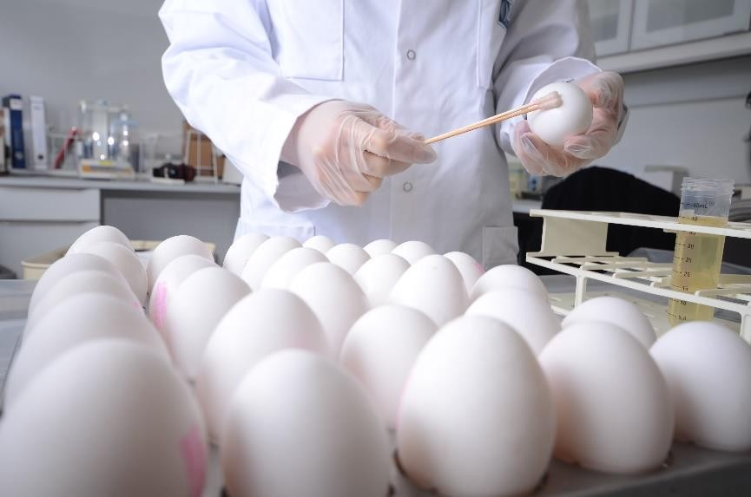
Next Step - Poultry Cut Parts and Whole Eggs
New applications are currently being produced

Slide 21
More Information? Visit our website SonoSteam.com
Thank You!

