Slide 1
5th World Bioenergy Congress and Expo
Hanieh Bamdad
Supervisory Committee:
Dr. Kelly Hawboldt (Supervisor)
Dr. Stephanie MacQuarrie (Co-supervisor)
June 2017
Experimental and statistical Analysis of CO₂ Adsorption Process for Optimization of Carbon based (Biochar) Adsorbent
Notes:
Hello all,
Welcome to my presentation. I am Hani from Memorial University, Canada and in next 10 min, I am gonna talk about …

Slide 2
Outline
Introduction and Overview
Characterization tests
Experimental tests
Results
Notes:
Here is the outline:
First I will introduce my research to you. Then, the Ch tests that I did on biochar samples and the experimental tests for optimization of these samples and Finally, the results.

Slide 3
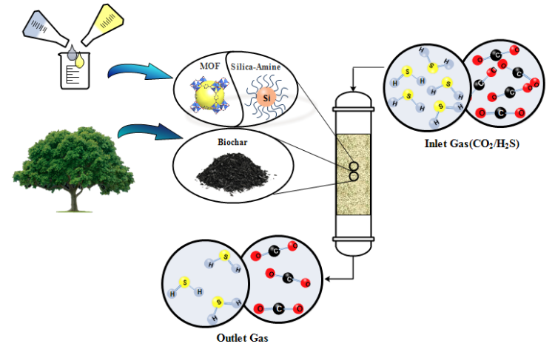
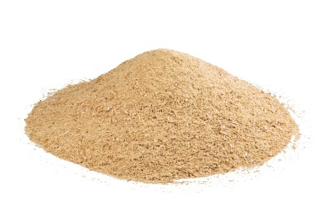
Introduction and Overview
Acid Gas Removal
Absorption
Adsorption
Notes:
There are two methods for removal of acid gases. The first commercial method is liquid absorption using amine solution such as MEA and DEA. This method is costly due to high energy needs for generation and space requirement. The second method is adsorption using porous solids that can be divided in to three groups: metal oxide based adsorbents, silica based, and carbon based. The MOFs and Silica based adsorbents have ordered crystalline structure, while biochar is largely amorphous with some local crystalline structure.
The amine grafted silica adsorbent is similar to aqueous alkaline amine based solvents where the amines covalently linked to the silica chemically bind to the target gaseous components.

Slide 4
Characterization tests
Notes:
These are the feedstocks I used in my research, including … and these are the biochars produced from each of these feedstocks. As you can see, the appearnace of the biochars are almost the same and its because of crushing all the feedstocks by the auger reactor. Auger reactor is the equipment we used for producing char by pyrolysis reaction. The characterization tests can be divided into three groups: Chemical, physical, and morpholygical such as

Slide 5
Results
Characterization tests (Elemental analysis)
 | Samples | C | H | N | O | H:C | O:C | (O+N):C
Feedstock | Sawdust | 47.70 | 5.68 | 0.01 | 46.62 | 0.12 | 0.98 | 0.98
 | Hardwood | 48.70 | 6.05 | 0.35 | 44.90 | 0.12 | 0.92 | 0.93
 | Bark | 49.63 | 6.00 | 0.19 | 44.18 | 0.12 | 0.89 | 0.89
Biochar | SW450-labscale | 79.40 | 3.40 | 0.05 | 12.90 | 0.04 | 0.16 | 0.16
 | SW400 | 70.90 | 3.10 | 0.07 | 25.93 | 0.04 | 0.37 | 0.37
 | SW450 | 74.79 | 3.51 | 0.24 | 21.46 | 0.05 | 0.29 | 0.29
 | SW500 | 78.37 | 2.36 | 0.15 | 19.12 | 0.03 | 0.24 | 0.25
 | HW400 | 72.53 | 3.12 | 0.15 | 24.21 | 0.04 | 0.33 | 0.34
 | HW450 | 73.25 | 3.64 | 0.16 | 22.95 | 0.05 | 0.31 | 0.315
 | HW500 | 74.84 | 2.34 | 0.22 | 22.60 | 0.031 | 0.30 | 0.30
 | BK450 | 67.67 | 3.11 | 0.42 | 28.61 | 0.05 | 0.42 | 0.43
 | Mix BK-SW450 | 69.88 | 2.45 | 0.20 | 27.46 | 0.04 | 0.39 | 0.40
 | AC (Norit) | 81.34 | 2.10 | 0.28 | 16.28 | 0.02 | 0.20 | 0.20
Notes:
The biochar samples have higher carbon contents and less hydrogen and oxygen contents compared to the feedstocks.
The atomic H:C and O:C ratios of biochars decreased with an increase in pyrolysis temperature, which may be due to dehydration, decarboxylation, and decarbonylation.
The highest carbonization with the lowest H:C ratio occurred in sawdust at 500 °C biochar.
The (O+N):C ratios (polarity index) were decreased by increasing pyrolysis temperature. More polar surfaces have the potential to adsorb polar molecules such as hydrogen sulfide more readily

Slide 6
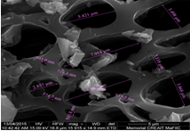
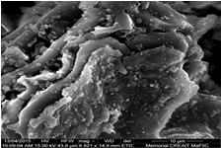
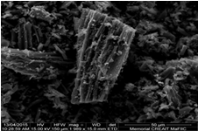
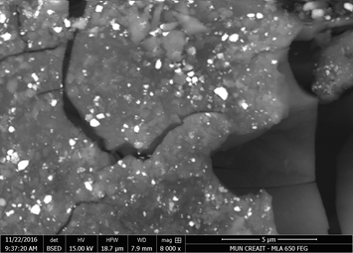
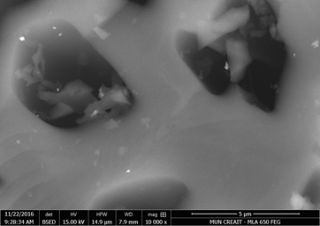
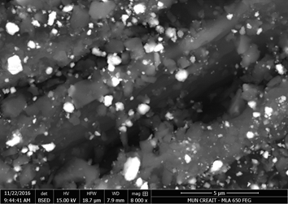
Results
Characterization tests (SEM)
Hardwood 450 °C
Bark 450 °C
Shaving 450 °C
Shaving 400 °C
Shaving 500 °C
Mix Bark and Shaving 450 °C
Notes:
These are the SEM micrographs. Among these, HW 450 and SW500 have more porous in compare to others.

Slide 7
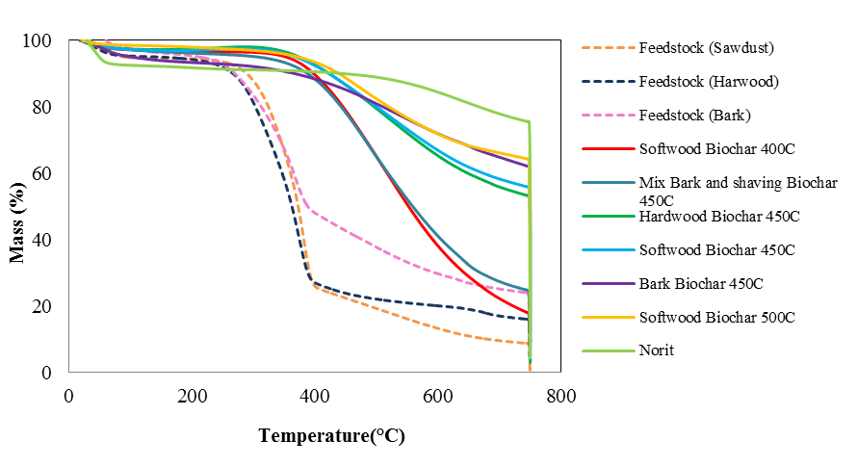
Results
Characterization tests (TGA)
 | SW biochar | HW biochar | BK biochar
pH | 9.982 | 10.740 | 8.977
Ash (wt.%, dry basis) | 10.960 | 8.247 | 9.734
Bulk Density (g cm⁻³) | 0.323 | 0.342 | 0.356
Notes:
From the pH test, we figured out the biochar samples are all basic. The ash contents are between 8-10 %, and the bulk density are below 1g/cm3which shows the high internal porosity. These are the TGA results. The biochar samples have higher carbon content in compare to feedstock which is in agreement with elemental analysis results.

Slide 8
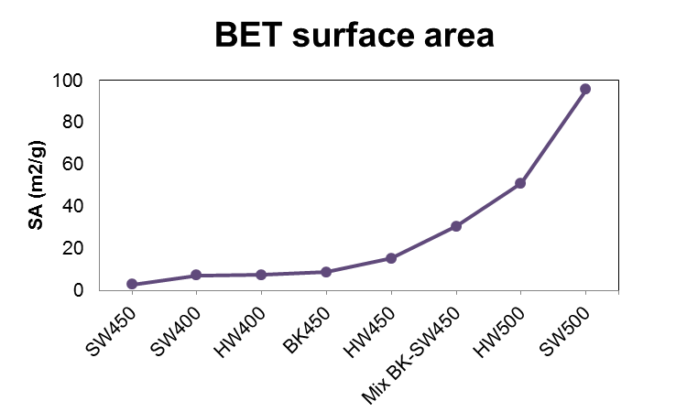
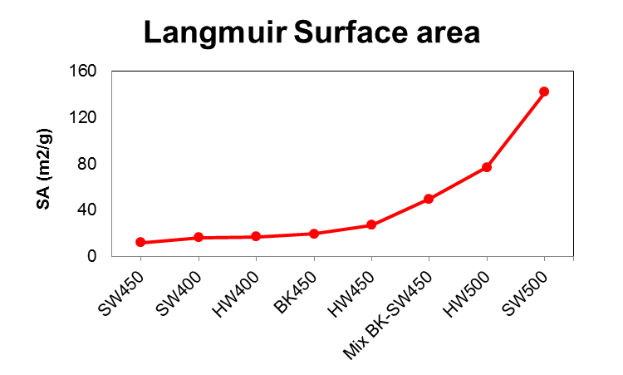
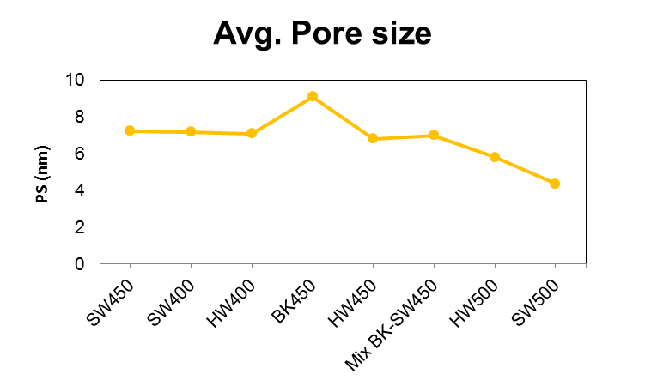
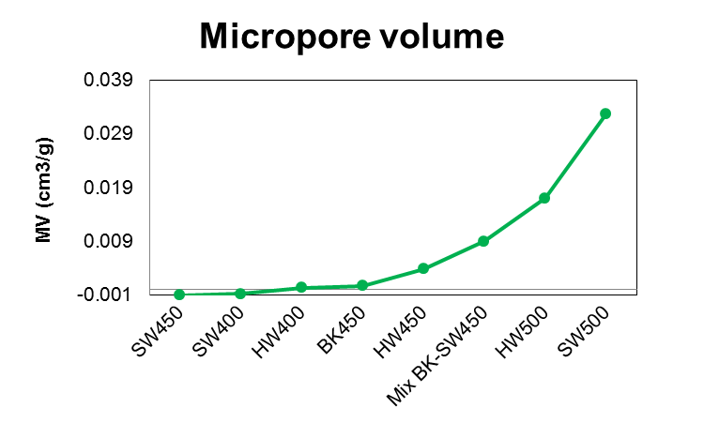
Results
Characterization tests (BET surface area)
Notes:
These are the BET curves of the samples. SW500 C has the highest BET and langmuire surface area and lowest pore size.

Slide 9
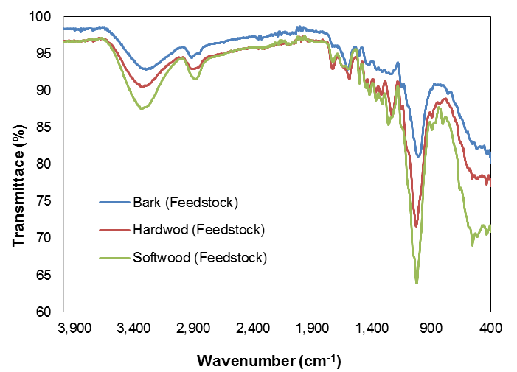
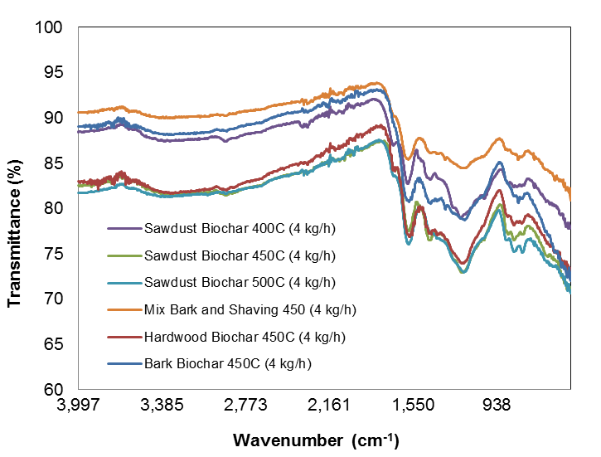
Results
Characterization tests (FTIR)
C-C
C=O
O-H
O-H
C-C
C=C
C-H
C-O-C
C=O
C=C
C-H
C-O-C
Notes:
This slide shows the ftir curves of the feedstock and biochar samples and the functional gropus are detemined.

Slide 10
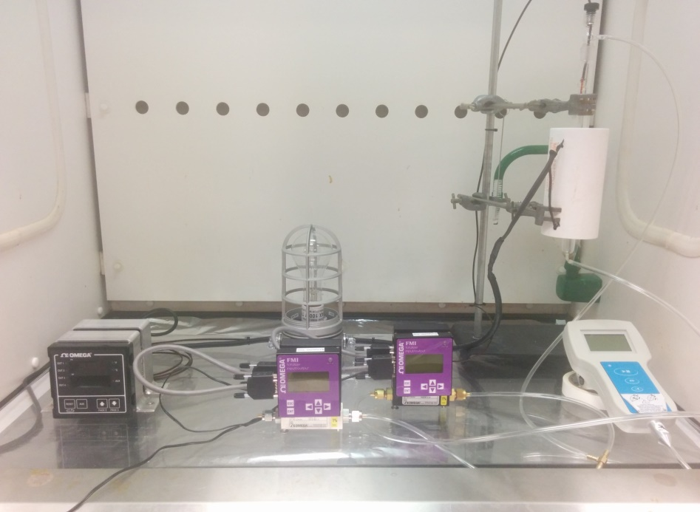
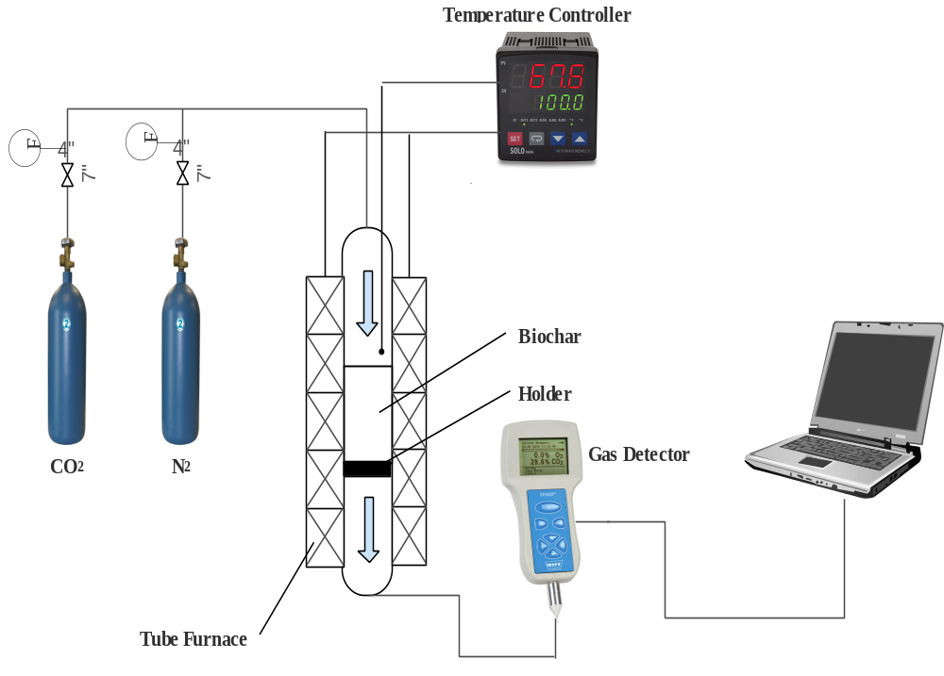
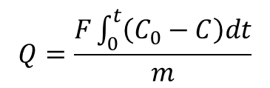
Experimental section
Experimental setup
$$Q=\frac{F\int_{0}^{t}{\left(C_{0}−C\right)dt}}{m}$$
Notes:
where Q is Adsorption capacity (mmol/g), F is Flow rate of inlet CO₂ (ml/min), C₀ is Concentration of inlet CO₂ (mmol/L), C is Concentration of outlet CO₂ (mmol/L), and m is Weight of the adsorbent (g).

Slide 11
Research Methodology
Validation of the experimental setup
Mass of the adsorbent
Optimization
Compare different biochars
1.53 g of Norit AC
30 ml/min
%CO2: 70%
Ambient T,P
1, 2, 3 g of Norit AC
60, 200 ml/min
%CO2: 100%
Ambient T,P
Experimental Design Methodology
Softwood (shaving, Bark (Balsam fir)), Hardwood (ash wood), 400-500 ºC
Notes:
This slide shows the research methodology. First, I validated the experimental setup and compared it with the literature.
Then, changed the mass of the adsorbent and found the best mass. Then, I did a set of experiments to find the optimum condition and finally compare the different samples.

Slide 12
Determining the adsorbent mass
Results
1 g
2 g
CO₂ adsorption capacities (mmol/g) of AC at different conditions
 |  | Total inlet flow rate (ml/min)
 |  | 60 | 200
Mass of Adsorbent (g) | 1 | 3.12 | 2.97
 | 2 | 3.40 | 3.23
Notes:
We tried 1,2, and 3 gram of the adsorbent in the system and found that mass higher than 2 gram cause back pressure and the co2 uptake for 2 gram is higher than 1 gram. So, we concluded that the best adsorbent mass is 2 gram for our system.
The adsorbate uptake increased with an increase in the adsorbent dosage.
The reason behind this fact could be more available number of binding sites with increasing adsorbent bed height resulting in high removal efficiency.

Slide 13
Response Surface Methodology (RSM) coupled with central composite design (CCD) was used to investigate the influence of independent variables CO₂ capacity (Q) as a response parameter.
Optimization of adsorption system
Independent Variables |  |  | Response Variable
A: Temp (ºC) | B: Flow rate (ml/min) | C: %CO₂ (v/v) | CO₂ adsorption capacity (Q, mmol/g)
20-80 | 60-200 | 20-100 | 0.08-2.21
Notes:
The optimization of the adsorption system was conducted by design expert software, RSM coupled with CCD. These are the independent variable: temp in the range of ….

Slide 14
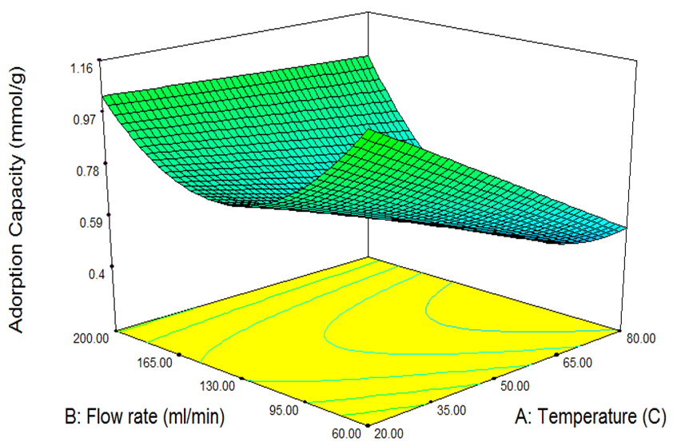
Results of multiple regression analysis and ANOVA
Results
Total flow rate (B) does not have a significant influence on desired response in comparison with other variables.
A slight decrease of adsorption capacity can be seen by increasing the flow rate from 60 to 130 ml/min.
The adsorption capacity increased by raising the flow rate from 130 to 200 ml/min.
Adsorption capacity decreases as
adsorption temperature (A) increases.
In low flow rates, the effect of temperature
on CO2 capture capacity is more
noticeable than the higher flow rates.
Notes:
This 3D graph shows the amount of Q vs. T and flow rates.
However, a slight decrease of adsorption capacity can be seen by increasing the flow rate from 60 to 130 ml/min. This decrease may be due to the lower contact time between adsorbent and adsorbate gas (CO2). In contrast, the adsorption capacity increased by raising the flow rate from 130 to 200 ml/min. This could be due to higher mass transfer which dominates contact time in high flow regions.

Slide 15
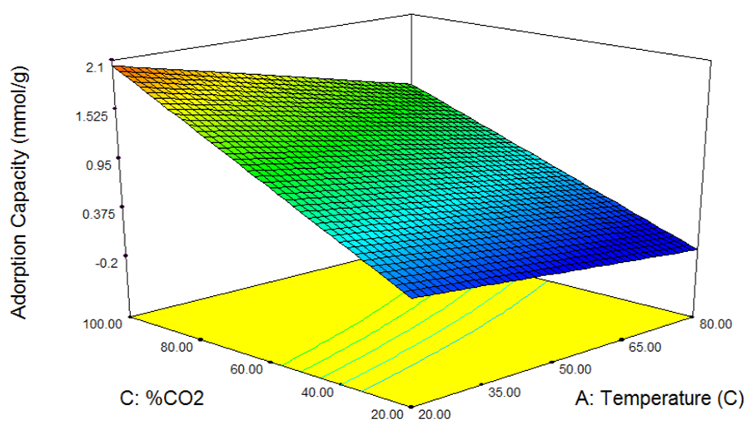
Results
Sorption capacity was increased by increasing CO2 concentration.
At low temperatures, the CO2 capture capacity increased as the ratio of carbon dioxide to inlet gas (% CO2) increased.
At higher temperatures this effect was
not very remarkable and the %CO2 had
slight impact on the CO2 uptake.
The highest CO₂ capture capacity
was obtained at an adsorption
temperature of 20 ºC, %CO₂ of 100,
and inlet flow rate of 60 ml/min.
QM with interactions | 0.61 - 0.16A + 0.083B + 0.78C + 0.14A×B - 0.11A×C + 0.32B²
Code | A: temperature, B: Total Flow rate, C: %CO₂
Notes:
High concentration difference contributed to high driving force to overcome all mass transfer resistances in the adsorption process

Slide 16


