Slide 1


Characterization and regulation of the expression of drug transporters in human skin
Hanan Osman-Ponchet, PhD
hanan.osman-ponchet@galderma.com
7th Euro-Global Summit on
Toxicology and Applied Pharmacology
Rome, Italy October 24-26, 2016

Slide 2

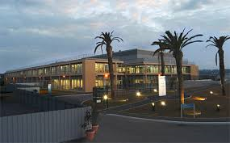
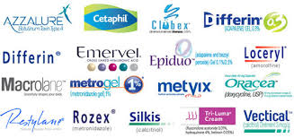
Galderma – Neslé Skin Health
Committed to the future of dermatology
Science-based solutions for the skin, hair and nails

Slide 3
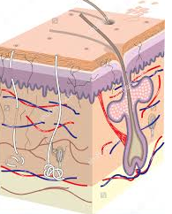
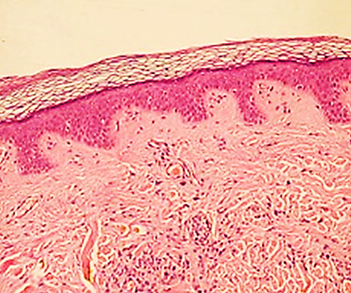
Human skin
Skin is the largest organ of the body
  2 m² surface area
  0.5 – 4 mm thickness
  16% body weight
Skin plays a crucial role in body protection from:
  damage, infection, and drying out
Stratum corneum
Epidermisis
Dermis

Slide 4
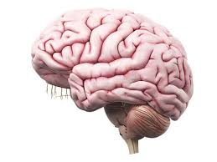
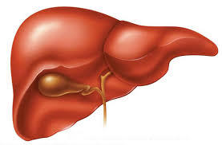
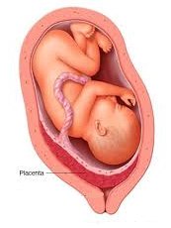
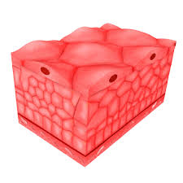
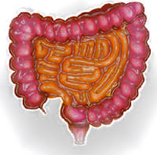
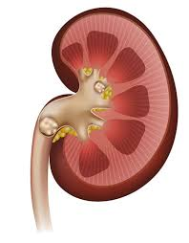
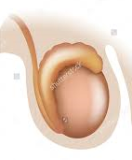
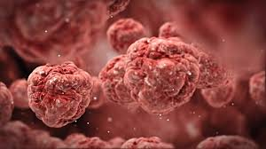
Outline
Drug transporters are well characterized in many key tissues but very little is known about the skin
?
SKIN

Slide 5
Outline
General overview of drug transporters
  ABC and SLC transporters
  Regulatory perspectives
Characterization of drug transporters in human skin
  Expression
  Regulation
  Localisation
  Function
Conclusion

Slide 6
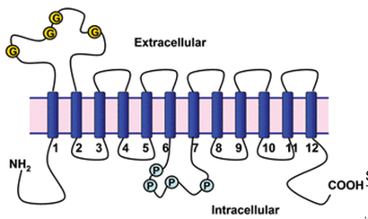
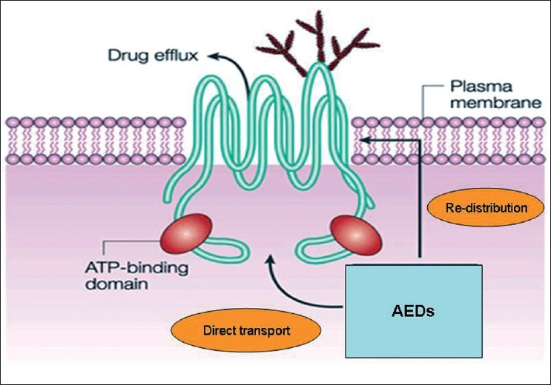
Drug transporters
Most identified drug transporters belong to 2 superfamilies:
  ATP-Binding Cassette (ABC) Drug Efflux (Out)
  Solute Carrier (SLC) Drug Uptake (In)
SLC
ABC
K. Sanjay et al; Physiological Reviews (2015)
A. Das et al; Indian J Human Genetics (2011)

Slide 7
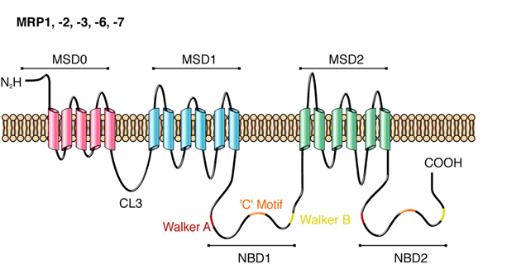
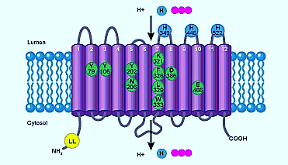
Drug transporter Superfamily
49 human ABC genes grouped into seven subfamilies:
  ABCB1 / MDR1 (Multi-drug resistance)
  ABCC1 & 2 / MRP1 & 2 (Multidrug resistance-associated protein)
  ABCG2/ BCRP (Breast cancer resistance protein)
386 SLC human genes grouped into 52 families
  SLCO: Organic anion transporting polypeptide
  SLC22: Organic anion/cation/zwitterion transporter
  SLC47: Multidrug and toxin extrusion (MATE)
Mutagenetix Labarchives
RG. Deeley et al., Physiological Reviews (2015)

Slide 8
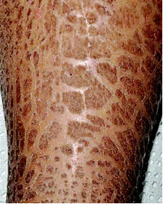
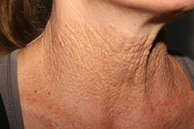
ABC transporters and genetic diseases
In humans, 15 severe genetic diseases are caused by the dysfunction of ABC transporters:
  ABCA1 : Tangier disease
  ABCA12 : Harlequin-type ichthyosis, Lamellar ichthyosis
  ABCB4 : Progressive familial intrahepatic cholestasis
  ABCC2 : Dubin–Johnson syndrome
  ABCC6 : Pseudoxanthoma elasticum
  ABCC7 : Cystic fibrosis
Genetic polymorphisms (SNP, haplotypes) identified, with clinically relevance in drug pharmacokinetics

Slide 9
Role of ABC and SLC transporters
Tissue Distribution:
  Highly abundant in the intestine, liver, kidney,
Physiological role:
  Transport of lipids, steroid conjugates, thyroid hormones, bile salts
Drug disposition
  Significantly modulate the absorption, distribution and elimination
  Efficacy and toxicity of pharmacological agents
Genetic variation contributes to inter-individual pharmacokinetic and pharmacodynamic variability
Mediate drug-drug interactions

Slide 10
Regulatory perspectives
Due to contribution of drug transporters to drug-drug interactions, European and US regulatory agencies require evaluation of drug transporters for the substrate and inhibition potential of drug candidates.
FDA (Guidance 2012):
  7 key transporters: P-gp, BCRP, OATP1B1, OATP1B3, OAT1, OAT3, and OCT2
EMA (Guidance 2013)
  9 key transporters: P-gp, BCRP, OATP1B1, OATP1B3, OAT1, OAT3, OCT2 and OCT1 (and BSEP)
Very recently, evaluation of MATE transporters is required by the regulatory agencies.

Slide 11
Regulatory perspectives
ABC and SLC transporters are well characterized in liver, kidney and intestine but little is known about skin
Objective of this work was the characterization of drug transporters in human skin :
  Expression
  Regulation
  Localization
  Role in drug disposition
In order to meet regulatory agencies requirement for topically applied drugs, and to improve PBPK modeling

Slide 12
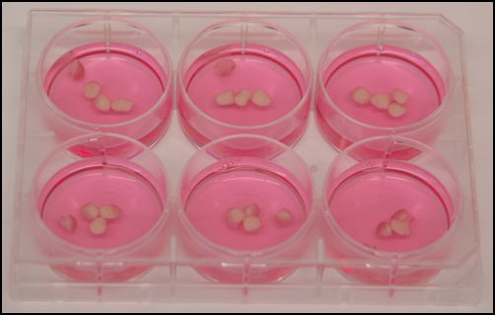
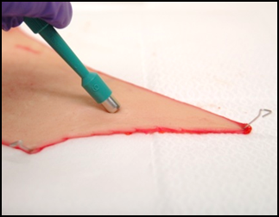
Expression of ABC and SLC transporters in human skin
Human skin biopsies in organ-culture for 3 days
4 skin biopsies (6 mm diameter) per well of 6-well plates.
Culture medium: Long term skin culture medium (Biopredic, France).
RNA extraction followed by quantitative real time RT-PCR (TaqMan technology).
GAPDH gene used as housekeeping gene
Skin biopsy

Slide 13
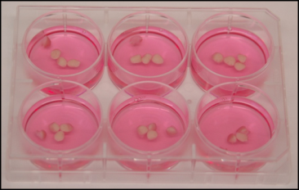
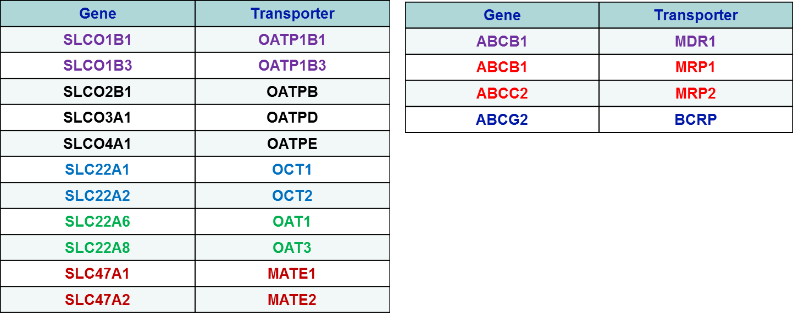
Expression of ABC and SLC transporters in human skin
11 SLC and 4 ABC transporters genes were evaluated
Expression levels measured in human skin, and compared with human liver and kidney.
SLC transporter genes
ABC transporter genes

Slide 14
Expression of ABC and SLC transporters in human skin
SLC transporters
in human skin
(N = 3 donors)
ABC transporters
in human skin
(N = 8 donors)
5 SLC transporters over 11 are expressed in human skin, MATE1 (SLC471) is the most abundant.
All the 4 ABC transporters are expressed in human skin with MRP1 (ABCC1) is the most expressed.

Slide 15
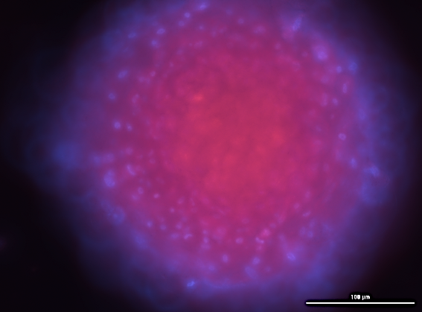
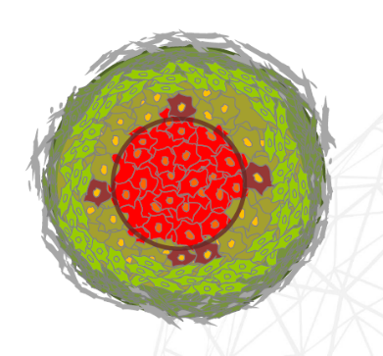
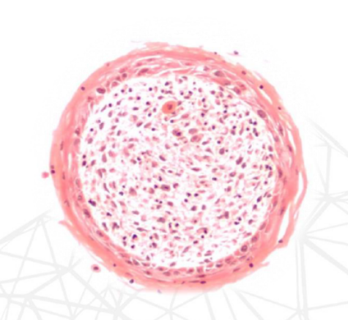
Expression of ABC and SLC transporters in 3D human skin microtissue
Epidermis
Dermis
MRP1 and MATE1 are expressed in 3D Human skin microtissue

Slide 16
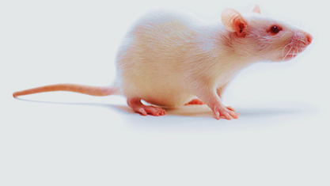
Expression of ABC and SLC transporters in Rat skin
MRP1 and MATE1 are expressed in Rat skin

Slide 17
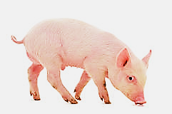
Expression of ABC and SLC transporters in Minipig skin
2-deltaCt
MRP1 is expressed in Minipig skin
SLC transporters not detected in minipig skin.

Slide 18
Expression of ABC and SLC transporters in human skin
Comparison of SLC transporters in Skin, Liver and kidney
    Expression profile very different according to tissue
      SLC47A1 (MATE1) most expressed in skin
      SLC22A1 (OCT1) most expressed in liver
      SLC22A6 (OAT1) most expressed in kidney

Slide 19
Expression of ABC and SLC transporters in human skin
Comparison of ABC transporters in Skin, Liver and kidney
Liver
Kidney
Skin
    Expression profile of ABC transporters very different according to tissue
      ABCC1 (MRP1) most expressed in skin
      ABCC2 (MRP2) most expressed in liver
      ABCB1 (MDR1) most expressed in kidney

Slide 20
Regulation of ABC and SLC transporters in human skin
Effect of Rifampicin on ABC and SLC transporters in Skin
Rifampicin: 50 µM during 72 h
Human skin biopsies in organ-culture
N = 2 or 3 donors
SLC transporters (MATE)
ABC transporters (MRP1)
    Rifampicin markedly decreases expression of MATE and MRP1
    transporters in human skin.

Slide 21
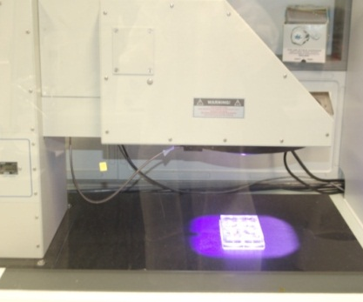
Regulation of ABC and SLC transporters in human skin
Effect of UV irradiation on MATE transporters
Human skin biopsies in organoculture
N = 2 donors
Solar simulator
Irradiation during 1 hour per day for 3 days.
Solar simulator
(830W ; 47.8A;
UVA 110W/m²
UVB: 20W/m²)
    UV irradiation markedly decreases expression of MATE1 and MATE2 transporters in human skin.

Slide 22
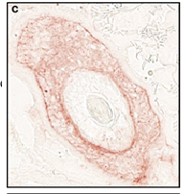
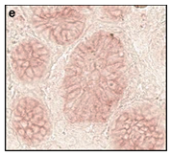
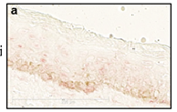
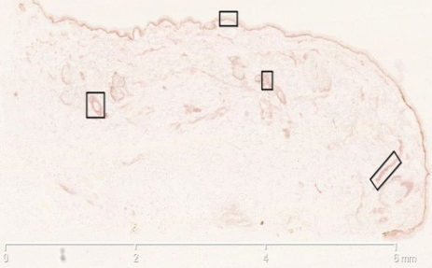
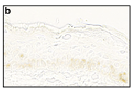
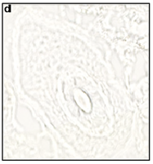
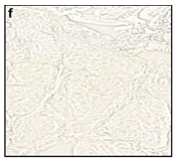
Localization of MRP1 in human skin
Immunohistochemical analysis of MRP1 in human skin
Cryosection of skin, and MRPm6 monoclonal antibody.
Epidermis
Hair follicle
Sweat gland
MRPm6
Human skin cryosection
Control
MRP1 is mainly localized in the hair follicle and sweat gland in the dermis

Slide 23
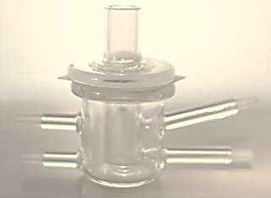
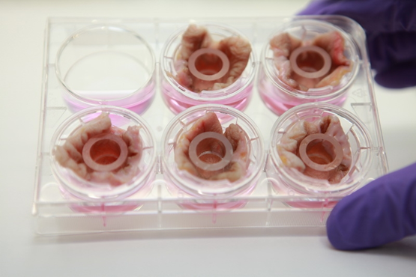
Role of MRP1 transporter in drug absorption in the skin
Skin absorption and distribution of 3 couples of MRP1 substrates and inhibitors were evaluated:
  Rhodamine 123 / Verapamil
  [³H]-Vinblastine / Verapamil
  [³H]-LTC4 / MK571
In vitro model for skin absorption
  Donor compartment (skin) on Transwell porous membrane
  Receptor compartment (culture medium)
Receptor fluid
In vitro skin absorption model
Skin (1 cm²)

Slide 24
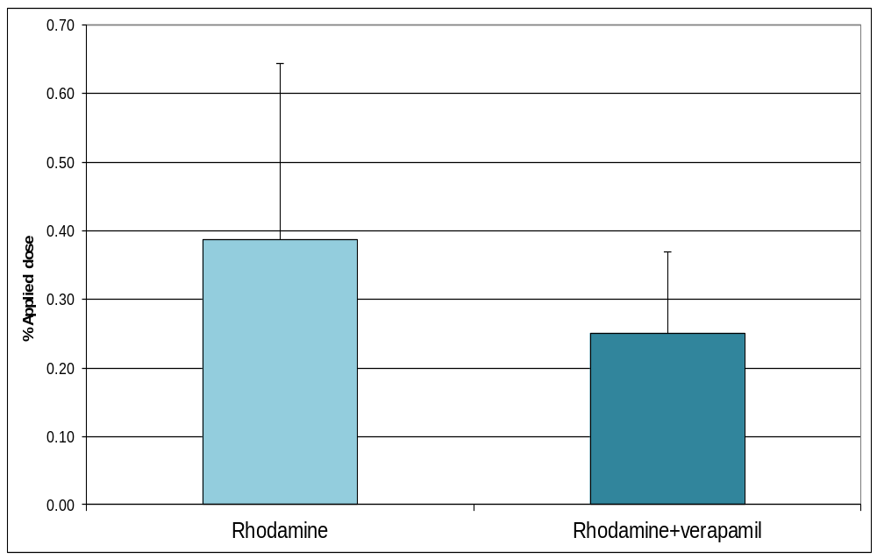

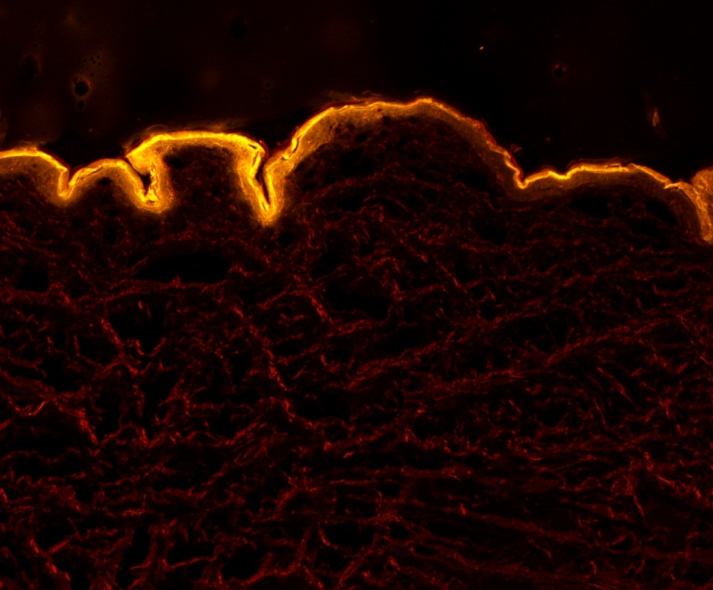
Skin absorption of Rhodamine 123
Skin absorption
Inhibition of MRP1 by verapamil significantly decreases skin absorption of Rhodamine 123.
Rhodamine 123 mainly distributed in the epidermis.
Skin distribution
(Epifluorescent microscopy)
N = 7
Rhodamine 123
x10

Slide 25
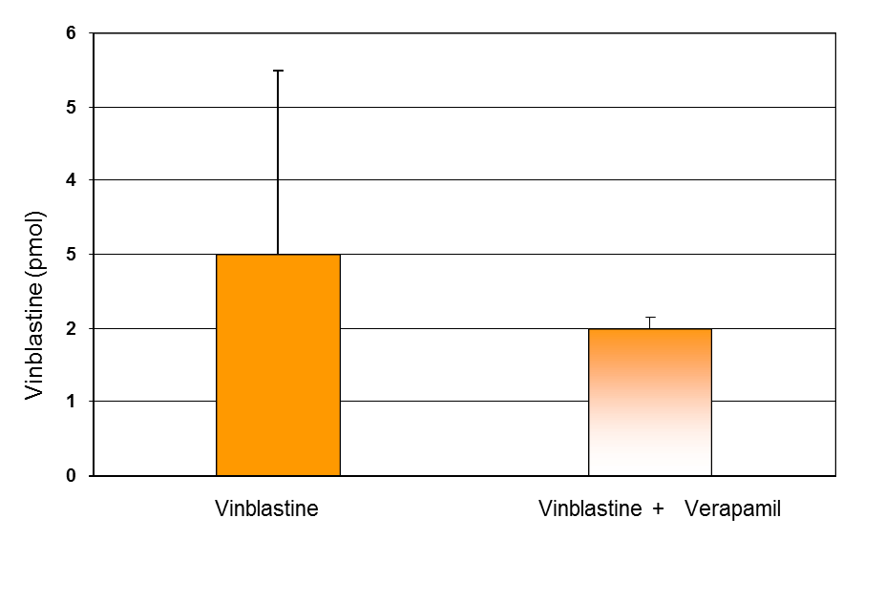
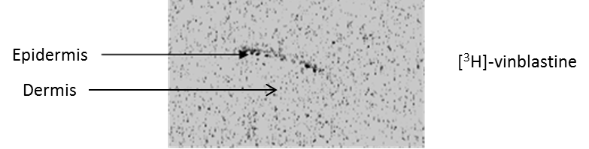
Skin absorption of Vinblastine
Skin absorption
Inhibition of MRP1 by verapamil significantly decreases skin absorption of vinblastine.
Vinblastine mainly distributed in the epidermis
Skin distribution
(Autoradiography)
N = 15

Slide 26
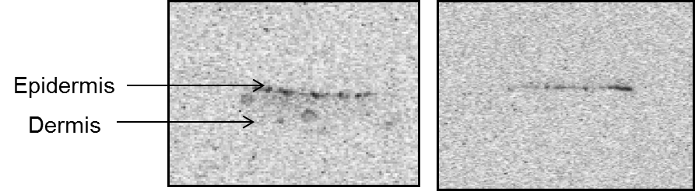
Skin absorption of LTC4
Skin absorption
Inhibition of MRP1 by MK571 significantly decreases skin absorption of LTC4.
Vinblastine distributed in the epidermis and the dermis.
Skin distribution
(Autoradiography)
[³H]-LTC4 [³H]-LTC4 + MK571

Slide 27
Conclusions
Gene expression, localisation and fonctional studies clearly show that MRP1 plays a role in drug absorption in human skin
Role of MATE1 to be clarified.
Further studies needed to clarify the role of drug transporters in drug disposotion and clinical drug-drug interactions with topically applied drugs.
H. Osman-Ponchet et al., 2014, Drug Metabolism and drug interactions
M. Alriquet et al., 2015, ADMET & DMPK

Slide 28
Thank you

Slide 29
Thanks to my team
Anaïs Boulai
Marion Alriquet
Magali Kouidhi
Alexandre Gaborit
Karine Sevin

