Slide 1
Workers’ exposure to bioaerosols from three different types of composting facilities
Hamza Mbareche,
L. Bonifait, M. Veillette, M.E. Dubuis, J. Lavoie, Y. Cloutier, Y. Bernard, G. Marchand and C. Duchaine
Occupational Health and Safety Conference
24th august 2015

Slide 2
Composting
Natural, dynamic biological process used in waste management of organic matter
Breaking up organic waste into a useful humus-like substance by various microorganisms including bacteria, fungi, actinomycetes
New politics for the waste treatment and valorization
  Expansion of composting activities
  Higher number of green job workers
  Importance of the biological safety

Slide 3
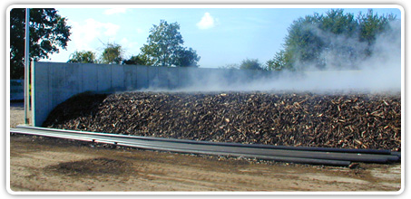
Composting activities
Dynamic movement of material
  Waste delivery
  Shredding
  Pile turning
  Compost screening
Bioaerosol release

Slide 4
Bioaerosols
Biological entities suspended in the air
  Dead or alive microorganisms (bacteria, viruses, molds)
  Structural fragments of microorganisms (toxins, proteins, nucleic acids)
  Fragments of other organisms (animals, plants)
Effect of bioaerosols on health depends on :
  Chemical composition
  Biological composition
  Cell concentration
  Aerodynamic diameter

Slide 5
Bioaerosols & health issues
Occupational exposure to bioaerosols may cause health effects
  Respiratory symptoms
  Gastrointestinal problems
  Skin problems
Occupational risks are derived from the presence of organisms, which can cause adverse effects on workers
  Infectious
  Affect the human airway epithelial
  Allergenic
  Toxic
  Carcinogenic

Slide 6
Aim of the study
There is a lack of knowledge concerning the dispersal of airborne microorganisms emitted in composting activities
The aim of this study was to investigate the workers exposure to bioaerosols from three different types of composting facilities

Slide 7
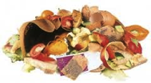

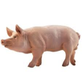
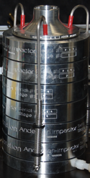
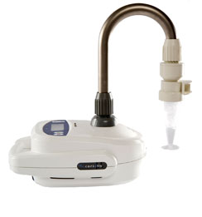
Methods
COMPOSTING PLANT (CP)
Six-stage Andersen impactors
28.3 L/min – 2min
Coriolis µ^{c} air sampler
300 L/min - 10 min
Growth culture
qPCR
Mesophilic bacteria
Mesophilic molds
Thermophilic actinomycetes
A. fumigatus
Total bacteria
Penicillium/Aspergillus
A. Fumigatus
S. Rectivirgula
Mycobacterium
Legionella
Legionella pneumophila

Slide 8
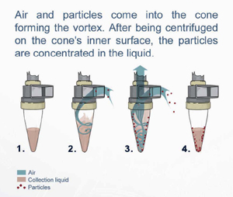
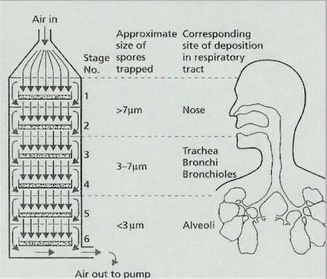
Methods
Coriolis µ®
Andersen
www.geneq.com
http://archive.bio.ed.ac.uk/jdeacon/microbes/airborne.htm

Slide 9
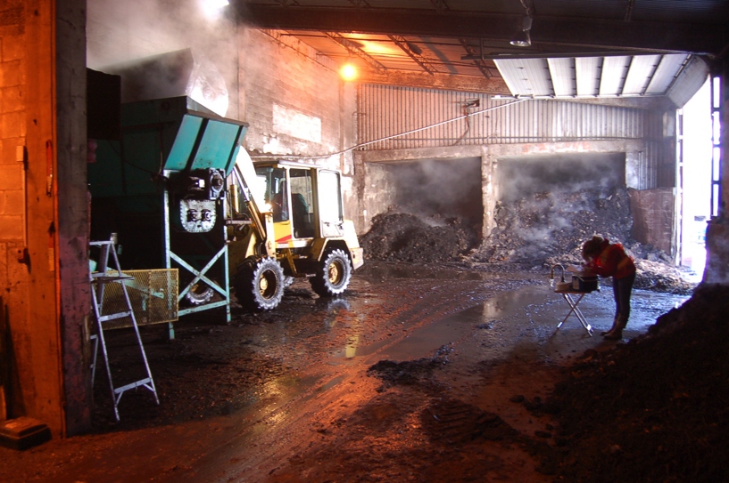
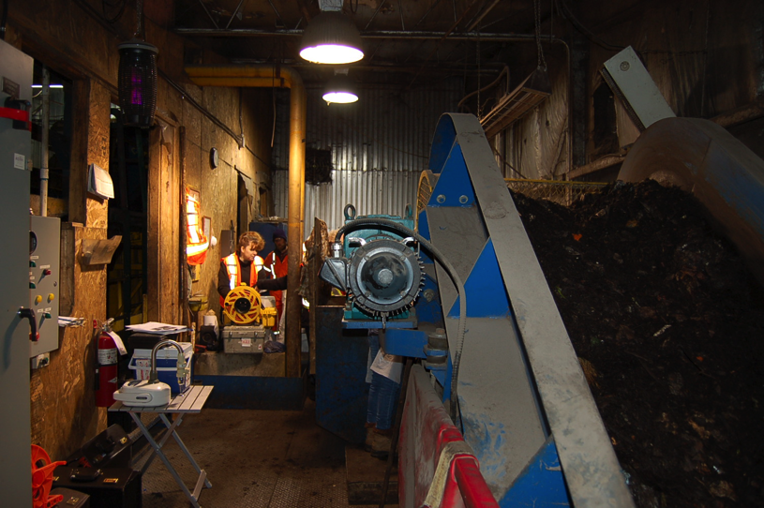
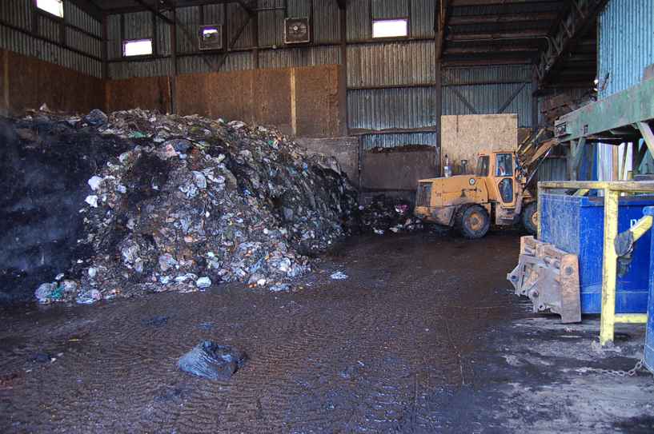
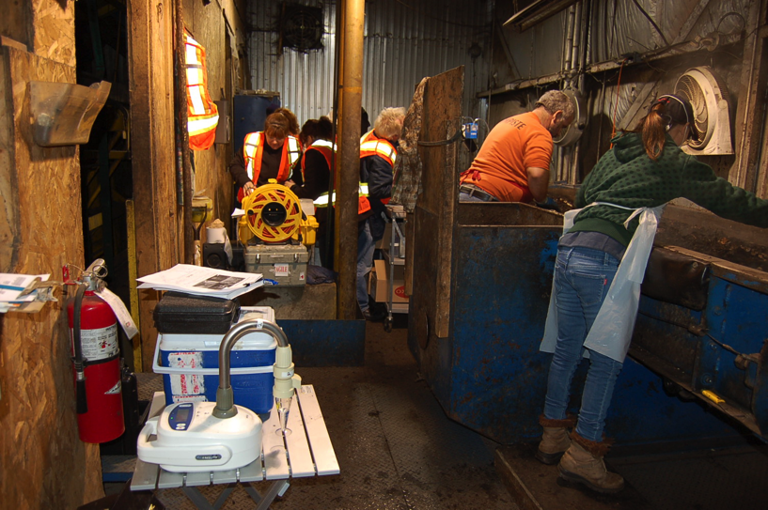
Domestic composting plant
Notes:
We sampled in areas involving workers activity

Slide 10
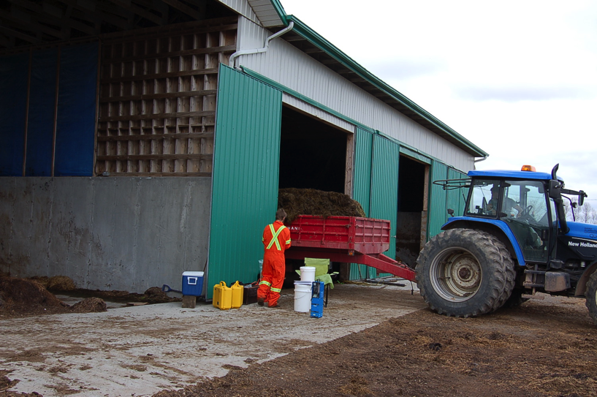
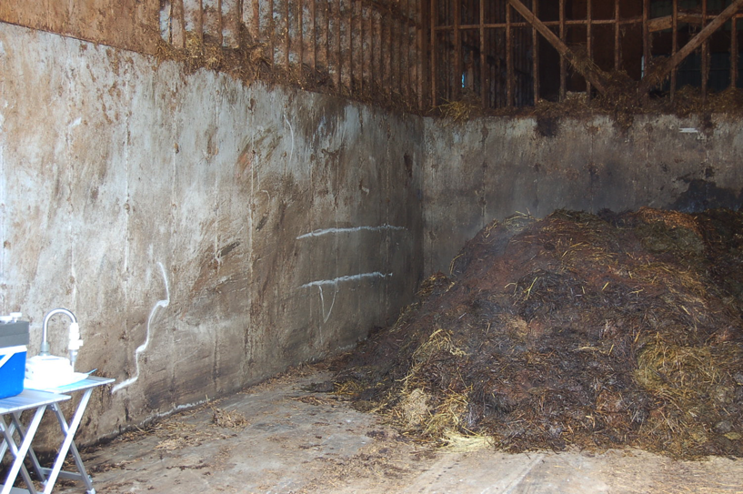
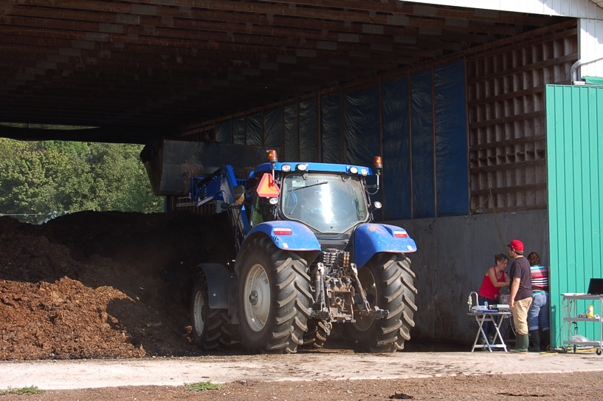
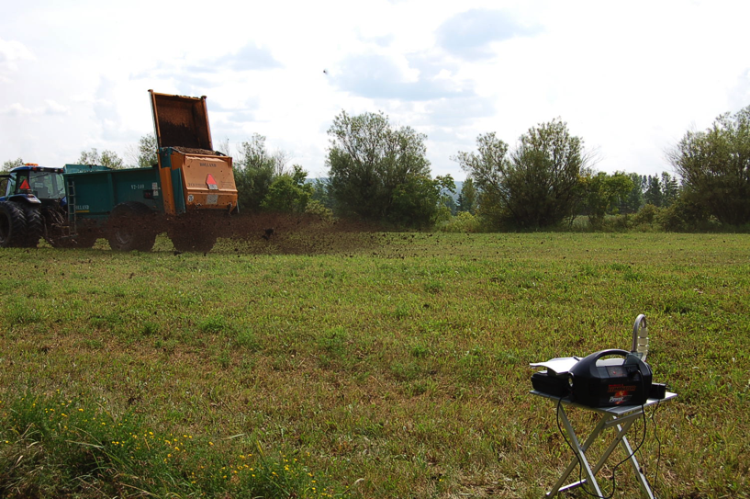
Vegetal composting plant

Slide 11
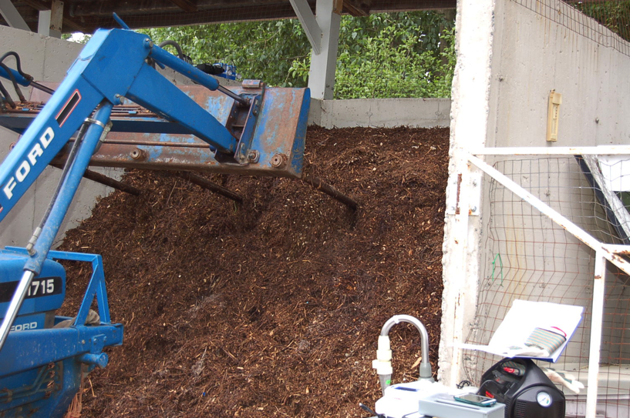
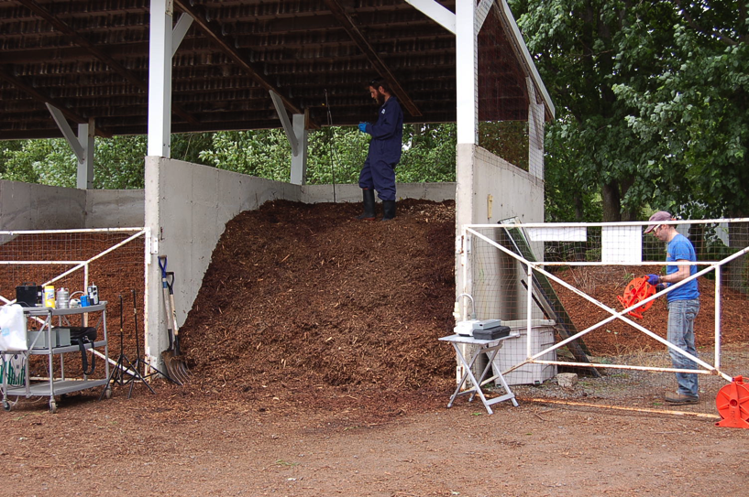
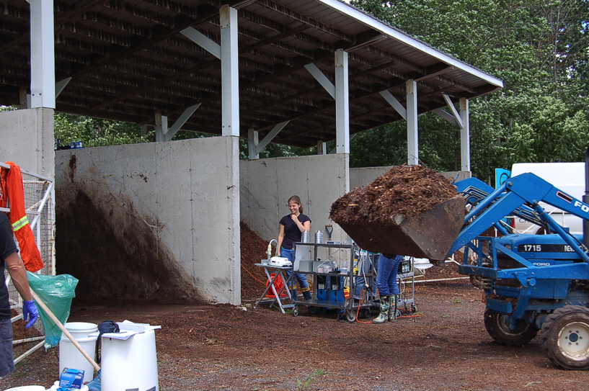
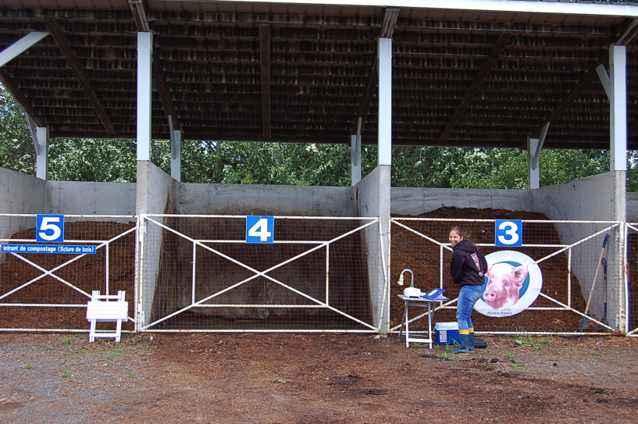
Animal composting plant

Slide 12
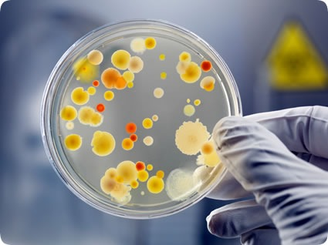
Culture methods

Slide 13
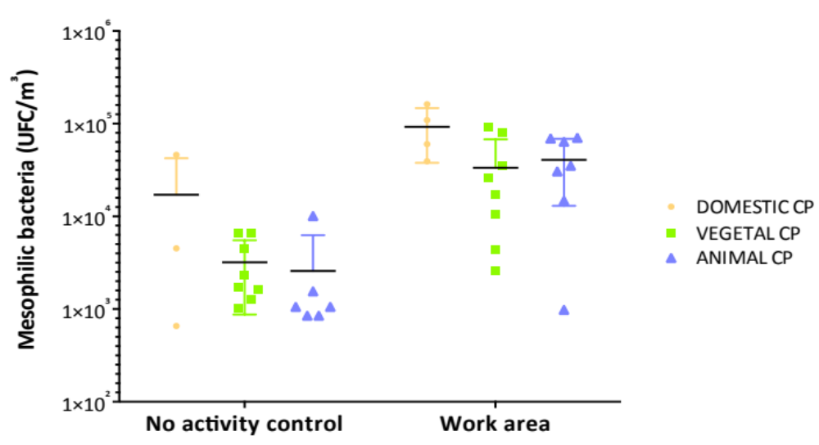
Mesophilic bacteria
The concentrations of microorganisms increases during working activities

Slide 14
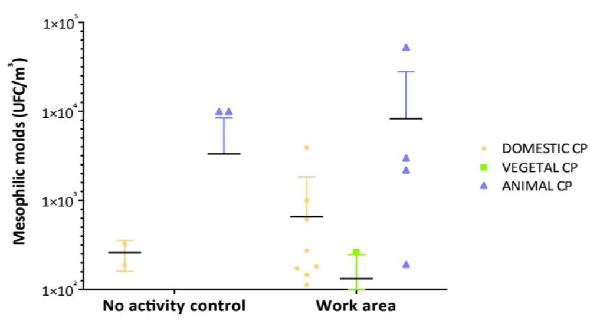
Mesophilic molds
There is variations between the types of compost indicating that the raw material plays a role in the presence of mesophilic molds

Slide 15
Thermophilic actinomycetes & A. fumigatus
Plant | Microbiological group | Background (no activity control) |  | Work area
 |  | Pos. samples | CFU/ m³ | Pos. samples | CFU/ m³
DOMESTIC CP | Thermophilic Actinomycetes | 3/3 | 7.09x10¹ – 6.74x10² | 3/3 | 5.38x10² – 7.87x10³
 | A. fumigatus | 3/3 | 6x10⁰ – 4.43x10² | 3/3 | 2.3x10² – 2.16x10⁵
VEGETAL CP | Thermophilic Actinomycetes | 7/8 | 0 – 3.55x10² | 8/8 | 8.87x10¹ – 2.97x10⁴
 | A. fumigatus | 0/8 | 0 | 6/8 | 0 - 4.14x10¹
ANIMAL CP | Thermophilic Actinomycetes | 7/7 | 1.77x10¹ – 8.33x10² | 7/7 | 4.14x10¹ – 2.68x10³
 | A. fumigatus | 5/7 | 0 – 4.98x10³ | 7/7 | 1.62x10⁴ – 2.3x10⁵
The concentrations of microorganisms increase during working activities
A. Fumigatus high concentration in Animal CP

Slide 16
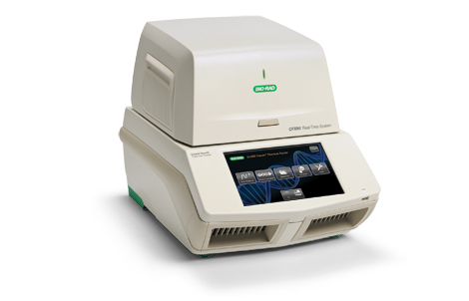
Molecular biology methods (qPCR)
Notes:
Culture methods are still a reference but presents some pitfalls. We used molecular biology to quantity the presence of pathogen

Slide 17
Domestic compost
Plant | Microbiological group | Background (no activity control) |  | Work area
 |  | Pos. samples | Genome / m³ | Pos. samples | Genome / m³
DOMESTIC CP | Total bacteria | 4/4 | 2.95x10⁵ - 3.58x10⁷ | 4/4 | 1.89x10⁶ - 2.8x10⁸
 | Penicillium/Aspergillus | 2/4 | ND - 3.27x10² | 4/4 | 8.61x10¹ - 9.91x10²
 | A. fumigatus | 1/4 | ND - 1.05x10² | 2/4 | ND – 1.53x10³
 | Legionella | 0/4 | ND | 0/4 | ND
 | L. pneumophila | 0/4 | ND | 0/4 | ND
 | Mycobacterium | 4/4 | 9.27x10³ - 1.17x10⁵ | 4/4 | 3.95x10⁴ - 5.12x10⁵
 | S. rectivirgula | 0/4 | ND | 2/4 | ND – 1.54x10³
Although the detection of bioaerosols is more important in working areas, there is still a natural emission of bioaerosols even with no handling activity
Presence of pathogens such as Mycobacterium and S. rectivirgula

Slide 18
Vegetal compost
Plant | Microbiological group | Background (no activity control) |  | Work area
 |  | Pos. samples | Genome / m³ | Pos. samples | Genome / m³
VEGETAL CP | Total bacteria | 6/8 | ND - 3.66x10⁶ | 8/8 | 5.65x10⁵ - 1.66x10¹¹
 | Penicillium/Aspergillus | 3/8 | ND – 2.68x10² | 3/8 | ND – 4.2x10²
 | A. fumigatus | 2/8 | ND - 9.85x10¹ | 5/8 | ND - 4.63x10²
 | Legionella | 0/8 | ND | 2/8 | ND - 9.82x10²
 | L. pneumophila | 0/8 | ND | 0/8 | ND
 | Mycobacterium | 4/8 | ND - 1.17x10⁵ | 6/8 | ND - 4.98x10⁵
 | S. rectivirgula | 1/8 | ND | 2/8 | ND - 1.34x10³
  The number of total bacteria detected increases significantly reaching up to 10¹¹
  which is the highest concentration compared to the other types of compost
  Presence of Legionella

Slide 19
Animal compost
Plant | Microbiological group | Background (no activity control) CFU/ m³ |  | Work area CFU/ m³
 |  | Pos. samples | Genome/ m³ | Pos. samples | Genome/ m³
ANIMAL CP | Total bacteria | 3/7 | ND - 3.58x10⁶ | 7/7 | 1.87x10⁵ - 2.13x10⁹
 | Penicillium/Aspergillus | 2/7 | ND - 9.98x10³ | 6/7 | ND - 5.24x10⁴
 | A. fumigatus | 2/7 | ND - 3.9x10² | 5/7 | ND - 2.09x10⁵
 | Legionella | 0/7 | ND - 2.92x10³ | 3/7 | ND - 1.85x10⁵
 | L. pneumophila | 1/7 | ND - 9.83x10³ | 3/7 | ND - 3.12x10⁴
 | Mycobacterium | 3/7 | ND - 3.8x10⁴ | 7/7 | 4.49x10² - 2.41x10⁷
 | S. rectivirgula | 0/7 | ND | 4/7 | ND - 3.26x10⁶
The most important concentrations of pathogens were observed in the animal compost as L.pneumophila, S.rectivirgula, A.fumigatus & Mycobacterium reached their highest concentration

Slide 20
Health impact on workers
Bioaerosols exposure found in 3 different CPs exceeded the suggested threshold limit for
  Mesophilic bacteria
  Mesophilic molds
  Thermophilic actinomycetes
The detection of pathogens as A. fumigatus, Mycobacterium and S. rectivirgula (all CPs) and L. pneumophila (2/3 CPs) could present a significant risk for workers, still underestimated

Slide 21
Conclusion & perspective
There is an underestimation of bioaerosols emission
There is a need for identifying the standards exposure to bioaerosols in composting plants for a better protection of worker’s health
Additional data and complete documentation is essential to establish safety standards to protect the health of workers
Preventive measures need to be proposed (Personal protective equipment)
The number of workers deem likely to increase, it is of primary importance to address their occupational health and safety

Slide 22
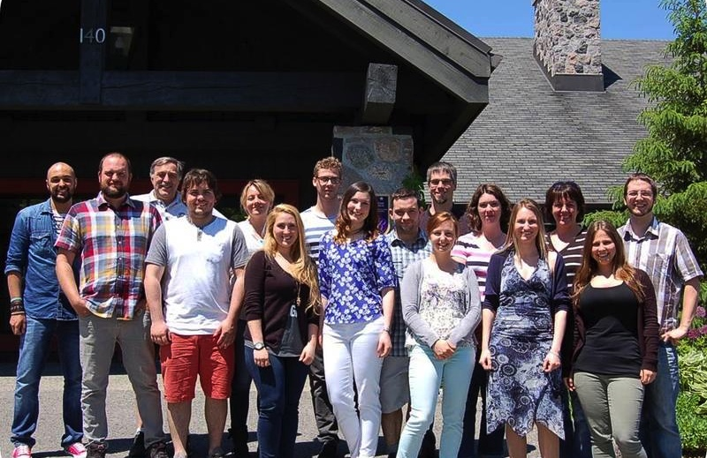


Acknowledgements
All workers and the composting facilities that participated at this study
IRSST : Carole Pépin, Yves Beaudet
CRIQ : Éric Légaré
Funding agencies (IRSST)
http://www.bioaerosols.ulaval.ca

Slide 23
Visit our website
http://www.bioaerosols.ulaval.ca

