Slide 1
Bioplastic Formulations for the Delivery of Beneficial Microbes to Control Agricultural Pests
Hamed K. Abbas, Research Plant Pathologist/Lead Scientist, Biological Control of Pests Research Unit, USDA-ARS, Stoneville, MS 38776
Cesare Accinelli, Dept of Agricultural Sciences, University of Bologna, V.Le Fanin 44, 40127 Bologna (Italy)
W. Thomas Shier, Dept of Medicinal Chemistry, College of Pharmacy, University of Minnesota, Minneapolis, MN 55455
2017 International Conference and
Exhibition on Biopolymers and Bioplastics
October 19-21, 2017
San Francisco, CA

Slide 2
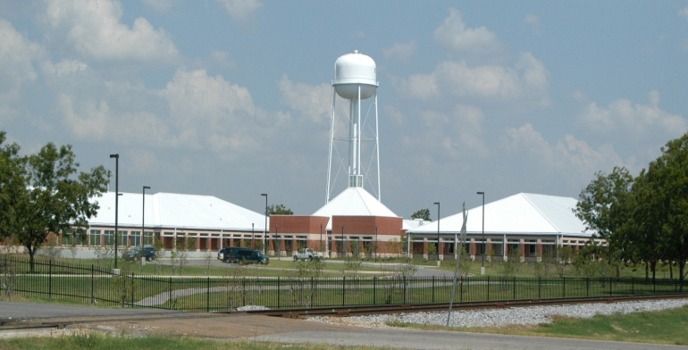
Biological Control of pests Research Unit
59 Lee Road, Stoneville MS 38776
Biocontrol of Aflatoxin and Other Mycotoxins in Maize Using Non-Toxigenic Strains of Aspergillus Flavus | NP 303
Mass Production of Biological Control Agents | NP 304
Biting and Stinging Pests: Ecology and Biologically-Base Control Improvement of Bioherbicide Strategies for Invasive Weeds in Southern Cropping Systems | NP 104 NP 304
Dr. Michael J. Grodowitz | Research Leader NP104 NP304
Dr. Walker Jones (retired) | Res. Entomologist NP304
Dr. Jian Chen | Res. Entomologist NP104
Dr. Juan Morales Ramos | Res. Entomologist NP304
Dr. Guadalupe Rojas | Res. Entomologist NP104 NP304
Dr. Eric W. Riddick | Res. Entomologist NP304
Dr. Margaret Allen | Res. Entomologist NP104
Dr. Doug Boyette | Res. Plant Pathologist NP304
Dr. Hamed Abbas | Res. Plant Pathologist NP303
Dr. Mark Weaver | Res. Plant Pathologist NP303

Slide 3
Outlines
Corn Starch-Based (BIOPLASTIC):
Background
Bioplastic Solid (granule) application
Bioplastic Liquid (sprayable) application
Bioplastic seed (coating) treatment
Conclusion

Slide 4
Patent D. N. 0013.13 Filed May 13, 2014 & it was issued in Dec. 27, 2016; Patent No. 9,526,240. Sprayable Dispersed Starch-Based Bioplastic Formulation to Control Pests
BIO-CONTROL | TARGET
Aspergillus flavus | --Toxigenic strains & aflatoxin Corn & soil, > 90% reduction
Beauveria bassiana | --European Corn Borer in corn, > 75% mortality --Tarnished Plant Bug in cotton, > 44% mortality
Bacillus thuringiens (Bt) | --European Corn Borer Larvae, 72% mortality
Seed treatment – Trichoderma harzianum | --Soil-borne pathogens, i.e. damping off in tomato, ~ 85% reduction

Slide 5
Aflatoxin Threat to Farmers and Customers
Seriously affects: Humans, Livestock, Poultry, pets, game birds, trout, deer, and other wildlife
Causes: Weight loss, impaired immune system, cancer, and death
Regulated: FDA and Global
Stable in Food Commodities: Cooking, Boiling, Autoclaving, Tortillas, etc.
Susceptible Host: Corn, Peanut, Cotton, Rice, Tree Nuts and Their Products
Global Economic Problems
No Current Method for Chemical Control: Biological Control, Breeding, Environmental Manipulation, Insect Management, Variety Testing, Molecular Approaches

Slide 6
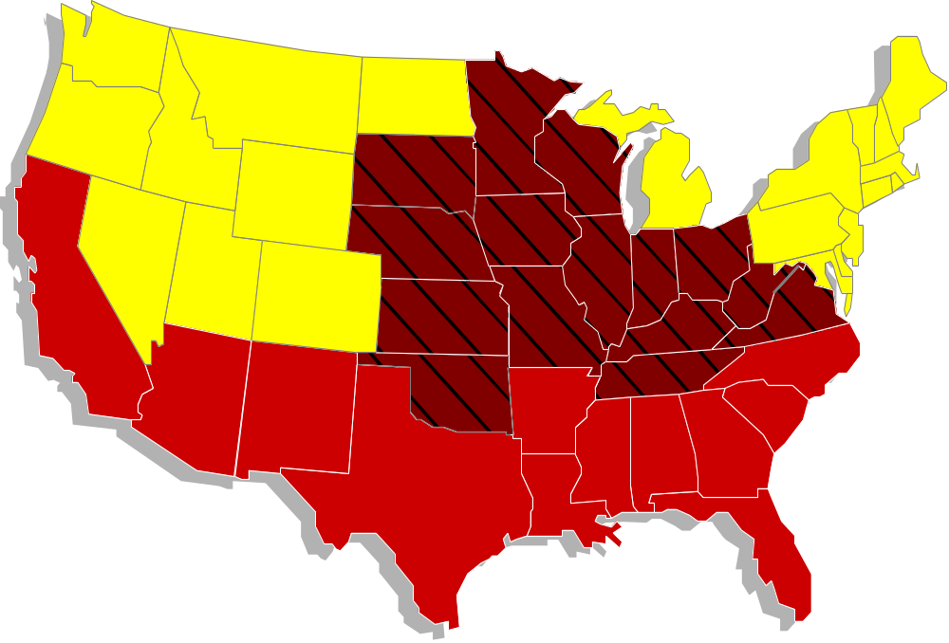
AFLATOXIN CONTAMINATION IS A NATIONAL PROBLEM

Slide 7
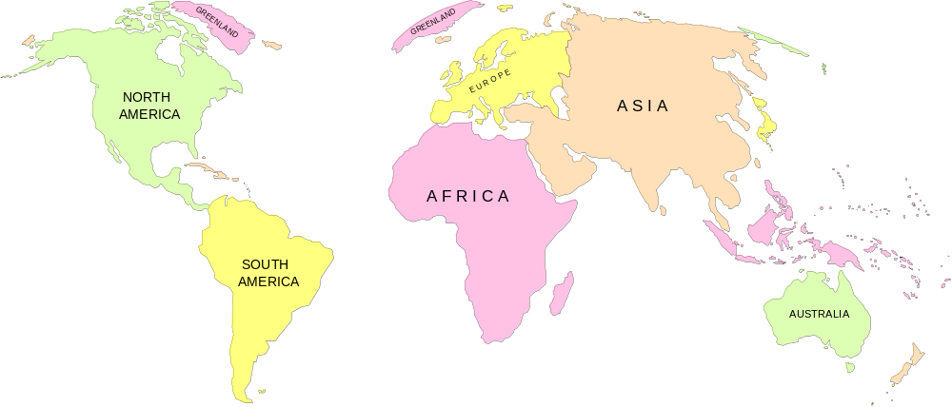
Aflatoxin Contamination:
A Perennial Concern in Warm Climates
Contamination is worse during dry periods; During
droughts the zone containing contaminated crops
enlarges and crops outside the zone are at risk.
35°N
35°S
Zone with Perennial
Contamination Risk

Slide 8
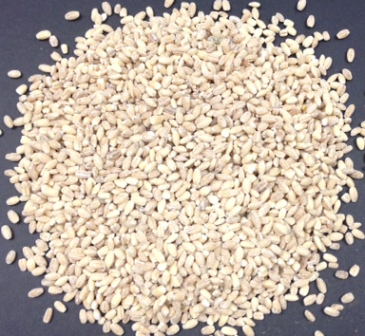
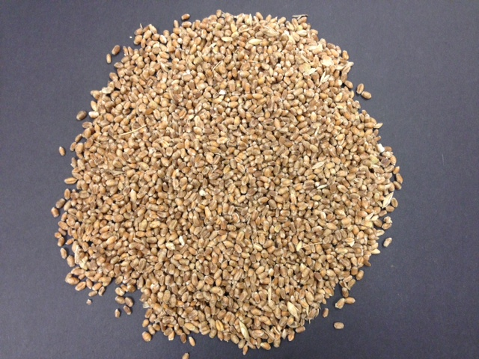
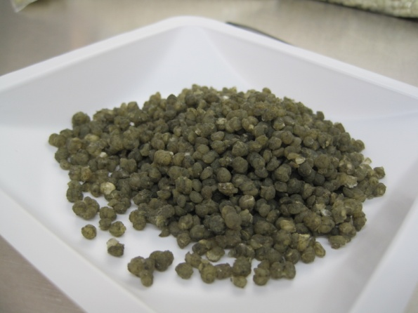
Bioplastics:
Starch-Based Bioplastic
Is a family of bioplastic materials obtained from corn starch and other biodegradable raw materials.
Rationale and Advantage
Traditionally biocontrol fungi was formulated on grains. Grain is not a uniform substrate.
Grain may be contaminated with undesirable materials.
Bioplastic has a longer shelf-life, it is pest-resistant, etc.
Bioplastic
Barley
Wheat
(AG)
(K49)

Slide 9
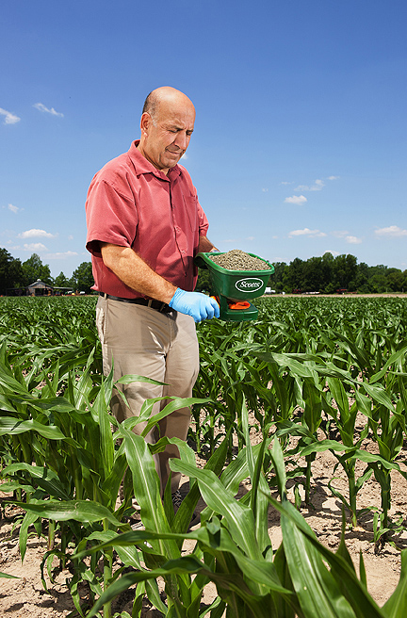
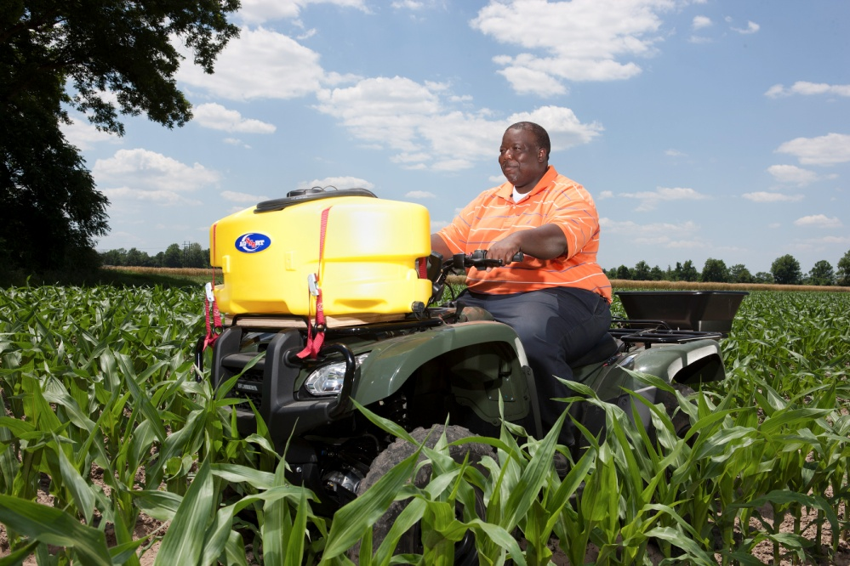
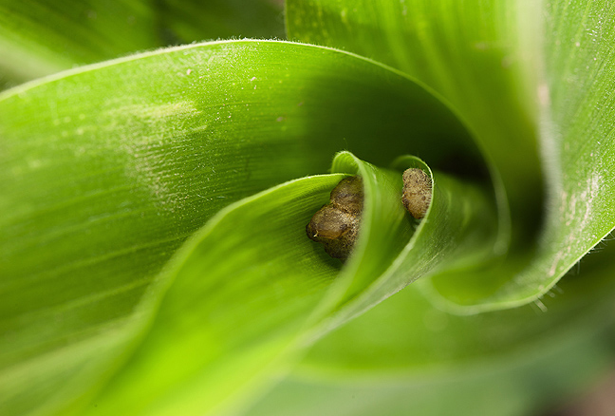
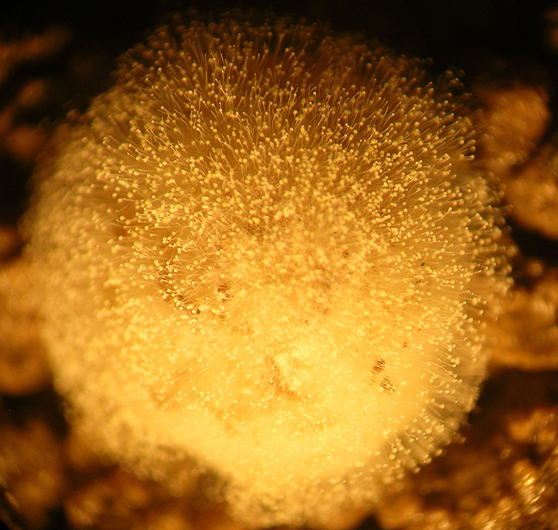
Granule Application

Slide 10
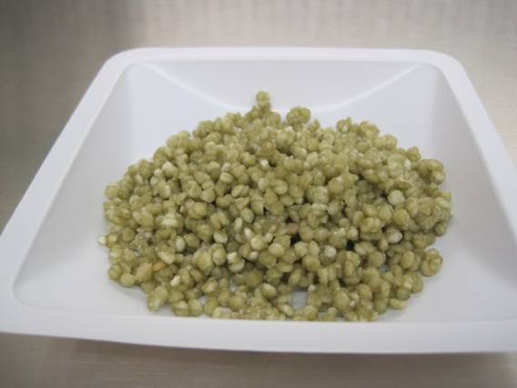
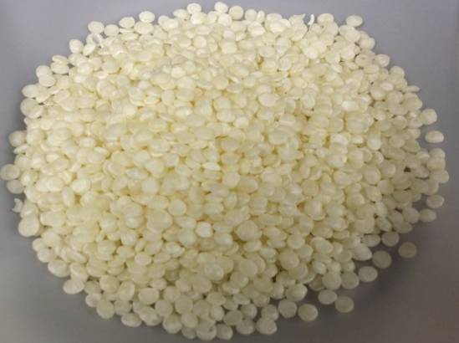
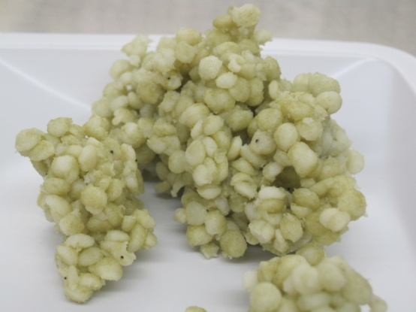
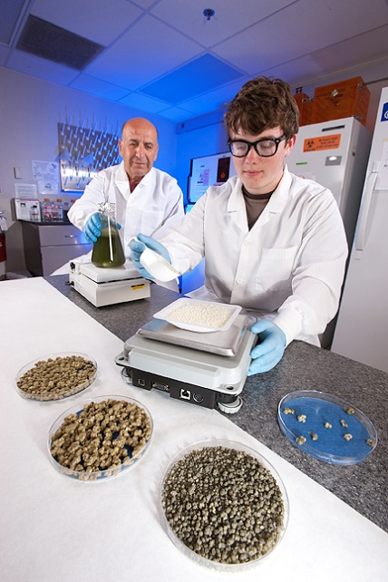
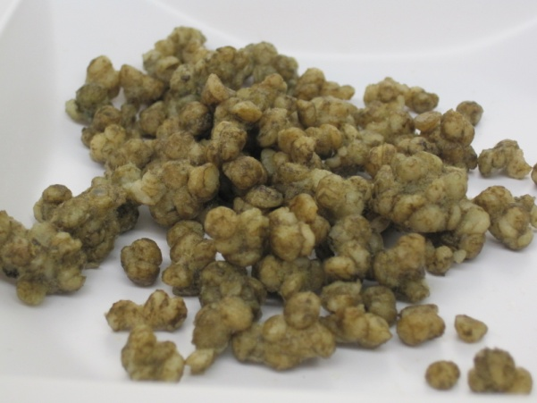
Bioplastic TrialS
Inoculated & Dried
Inoculated Bioplastic
Clean Bioplastic
Effect of Aflaguard and K-49 formulated in Bioplastic granules & Grain on Aflatoxin under field conditions in USA and Italy
Inoculated & Dried
Inoculated & Dried
Grown on Moist Plate

Slide 11
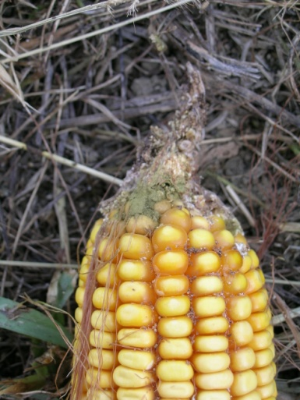
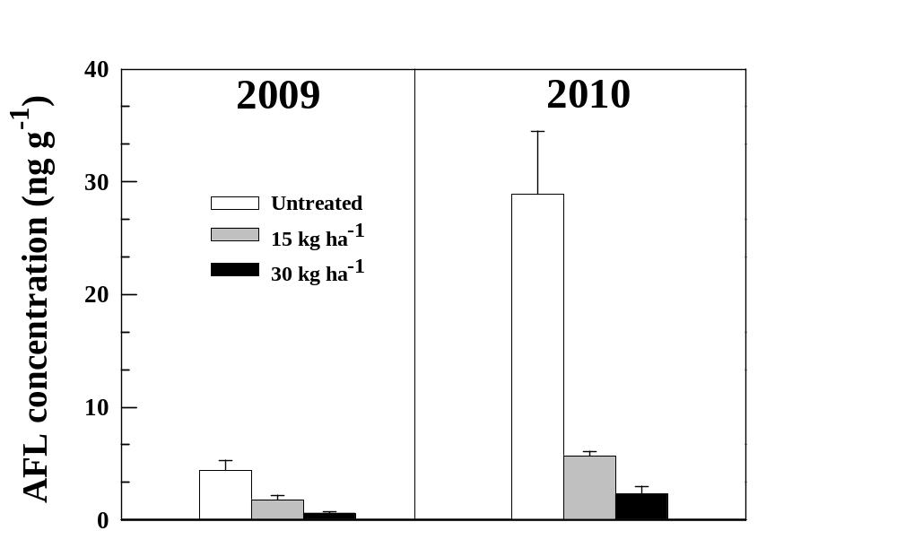
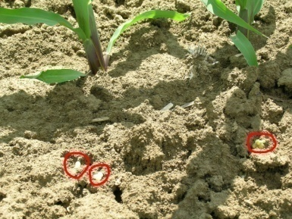
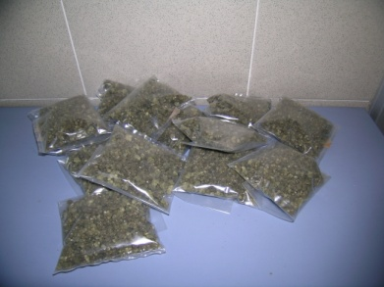
Bioplastic Granules (Italy)
Managing and monitoring of Aspergillus flavus in corn using bioplastic-based formulations.
Accinelli et al., 2011 Crop Protection
Biocontrol of A. flavus in corn
 | 2009 | 2010
15 kg/ha | 59% | 80%
30 kg/ha | 86% | 92%

Slide 12
Field 7 - Effect of Aflaguard and K-49 formulated in Bioplastic granules and Grain on Aflatoxin under field conditions, 2012 (USA)
Bioplastic - Field 7 | Aflatoxin (ppb)
Treatment | R1 | R2 | R3 | R4 | R5 | R6 | Total Aflatoxin (ppb) | Average + Std. Dev.
Control | 5.00 | 14.42 | 4.16 | 264.56 | 0.00 | 0.00 | 288.14 | 48.02 + 106.21
K-49 in Bioplastic | 0.00 | 0.00 | 12.40 | 0.00 | 0.00 | 0.00 | 12.40 | 2.07 + 5.06
Afla-Guard in Bioplastic | 37.36 | 0.00 | 0.00 | 0.00 | 0.00 | 0.00 | 37.36 | 6.23 + 15.25
Afla-Guard in Grain | 0.00 | 9.25 | 0.00 | 4.35 | 0.00 | 0.00 | 13.60 | 2.27 + 3.84
K-49 in Grain | 10.28 | 2.67 | 0.00 | 0.00 | 0.00 | 0.00 | 12.95 | 2.16 + 4.12

Slide 13
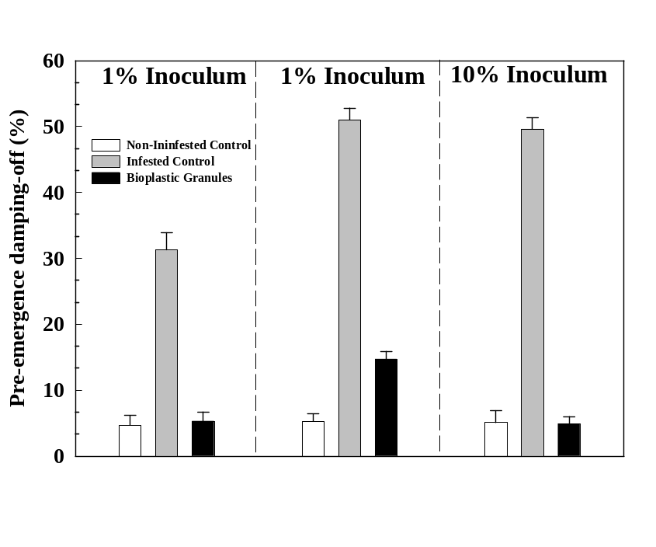
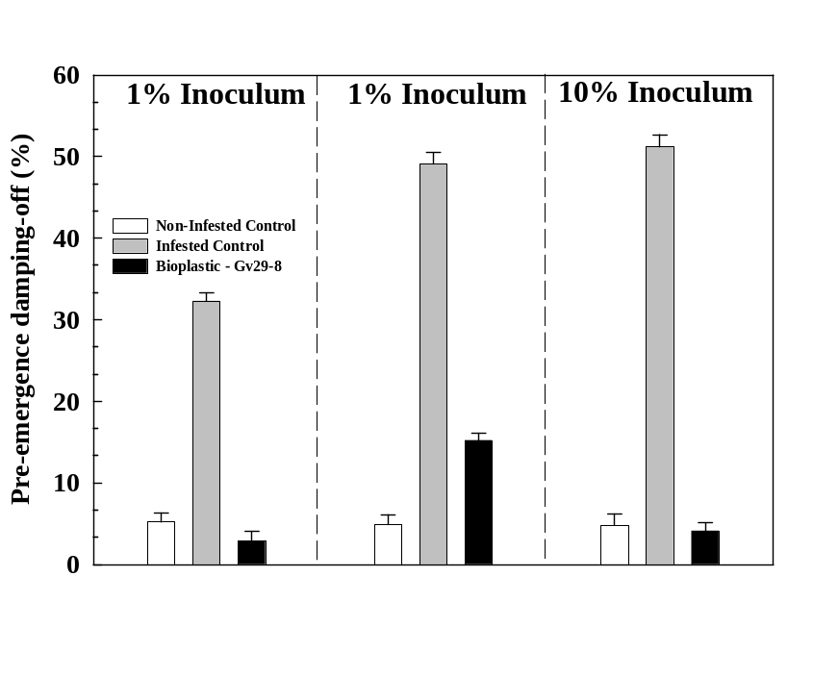
Extending the use of bioplastic granules for the application of Trichoderma biocontrol isolates in flori/horticulture and turfgrass
T. virens - Impatiens
T. virens - Tomato
Low R. solani infestation
High R. solani infestation
Low R. solani infestation
High R. solani infestation

Slide 14
Preparation of Liquid Bioplastic for Sprayable and Seed Coating Applications

Slide 15
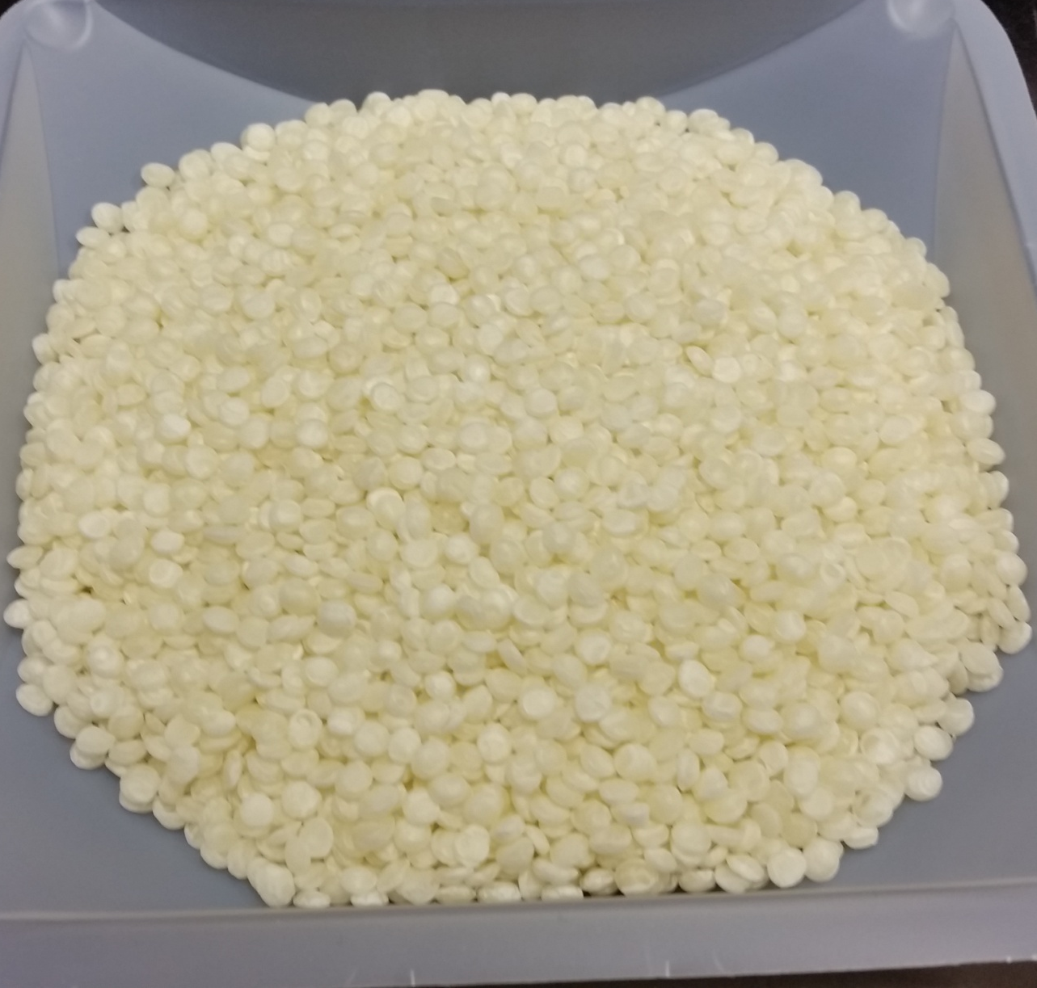
Weighed out 125g of bioplastic pellets and add to 1,250mL of water to make a 10% solution.

Slide 16
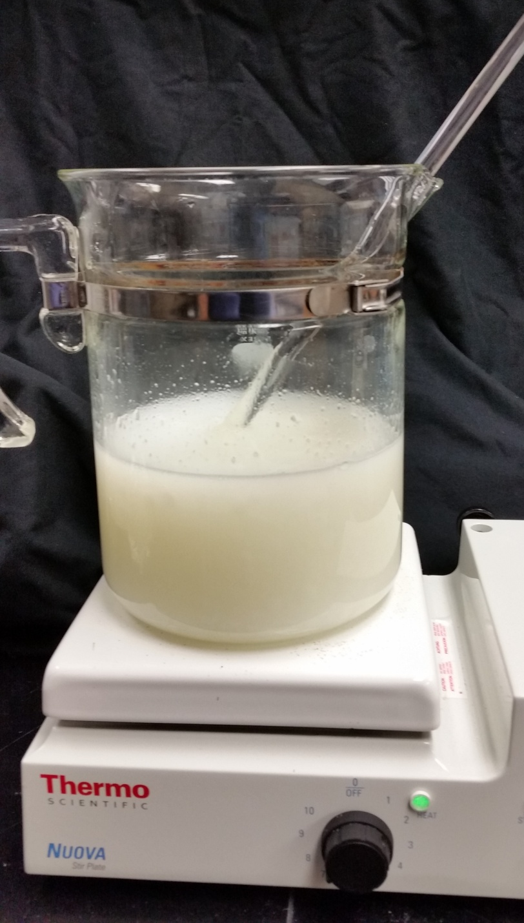
Heat @ 80-90°C for 2-3 hours while stirring.

Slide 17
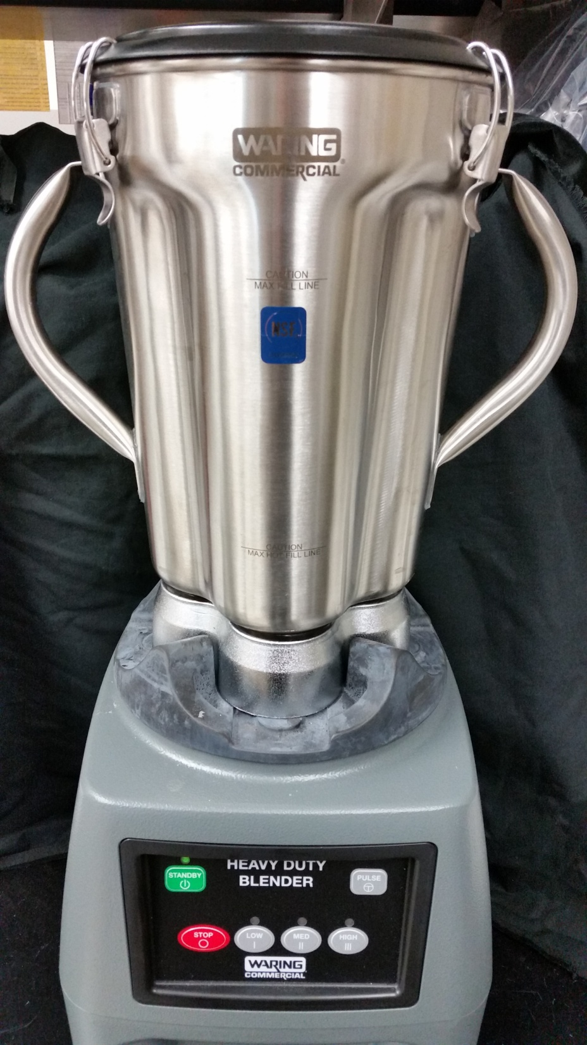
Commercial blender used to blend any remaining pellets into liquid.

Slide 18
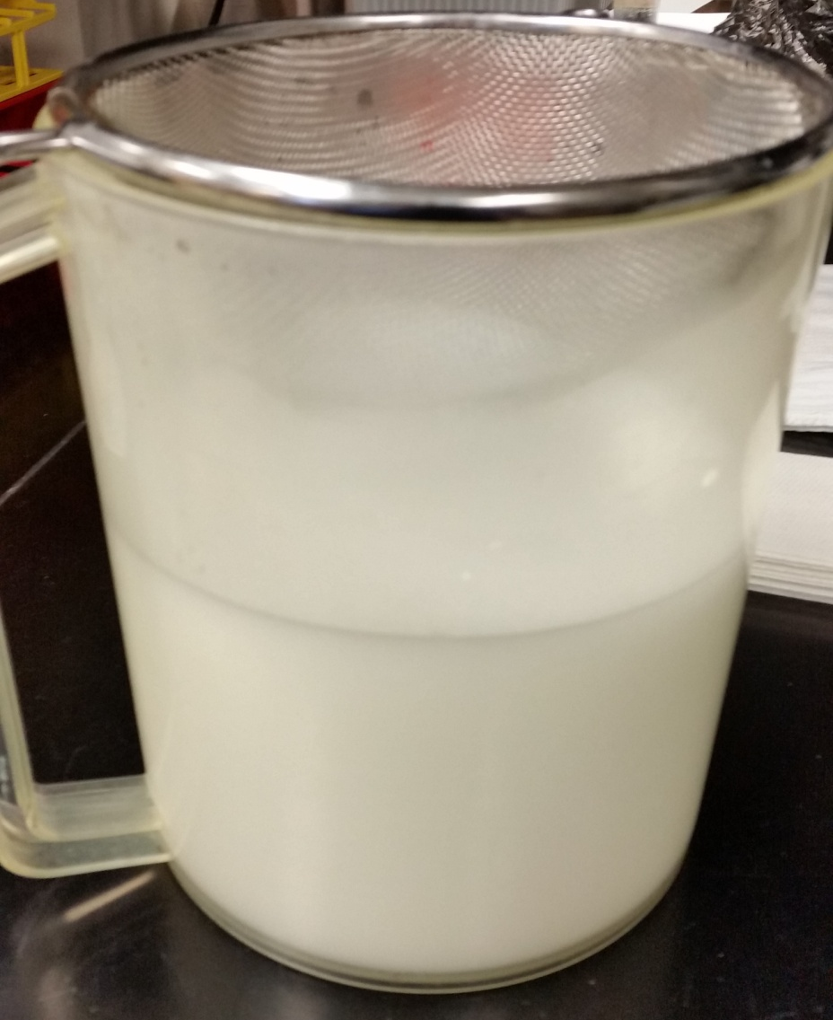
Straining the liquid mixture so that only liquid remains.

Slide 19
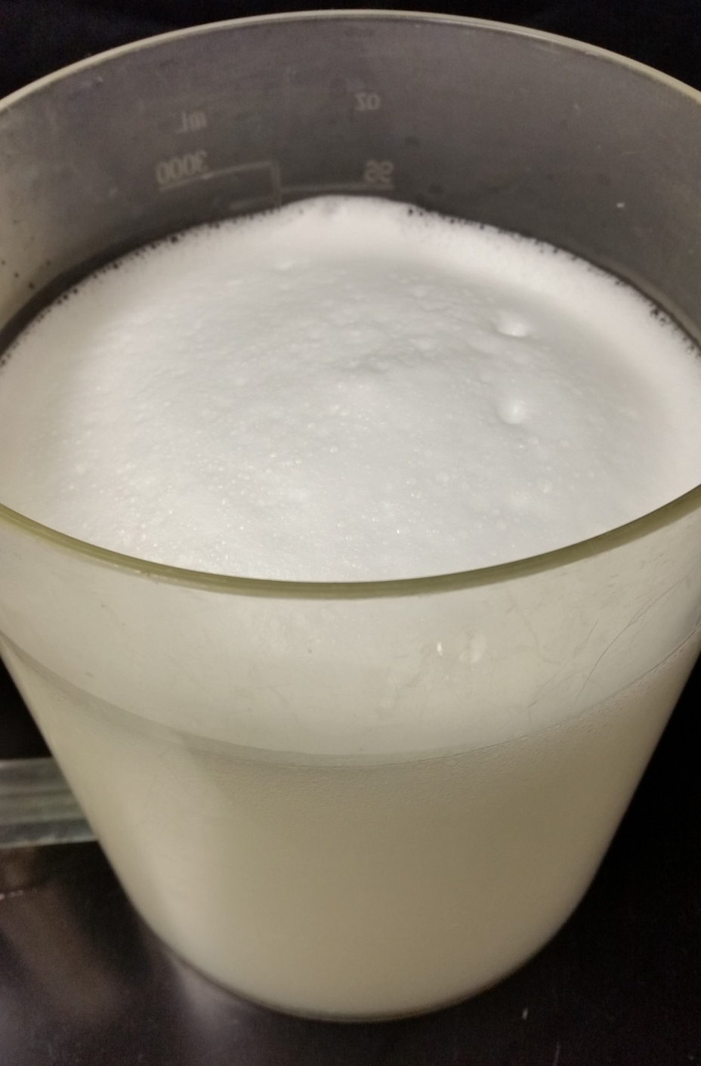
After straining the bioplastic is a little foamy.

Slide 20
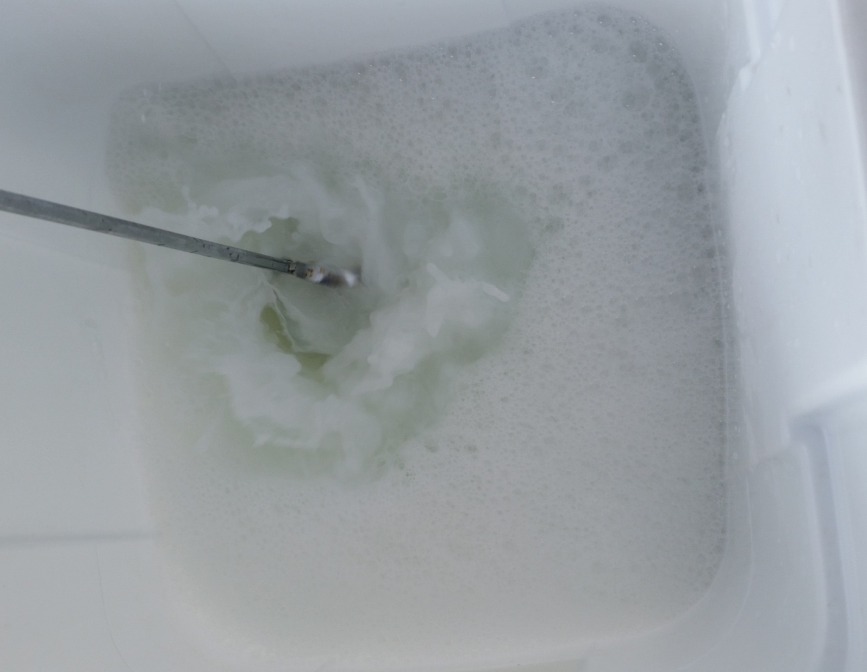
Add necessary amount of water to make 1.5% bioplastic solution and mix.

Slide 21
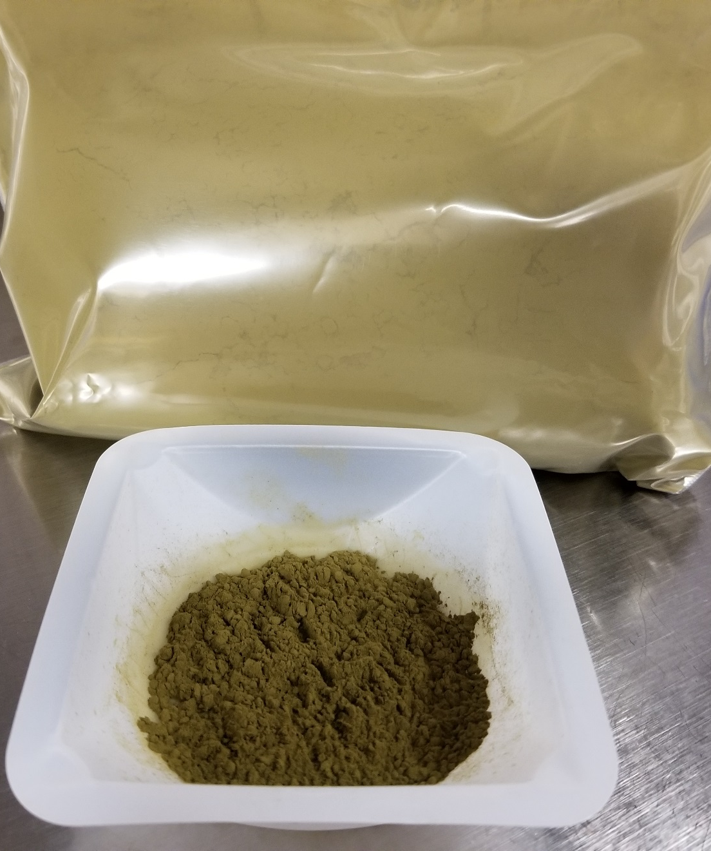
Non-toxigenic Aspergillus spores for biological control of aflatoxin

Slide 22
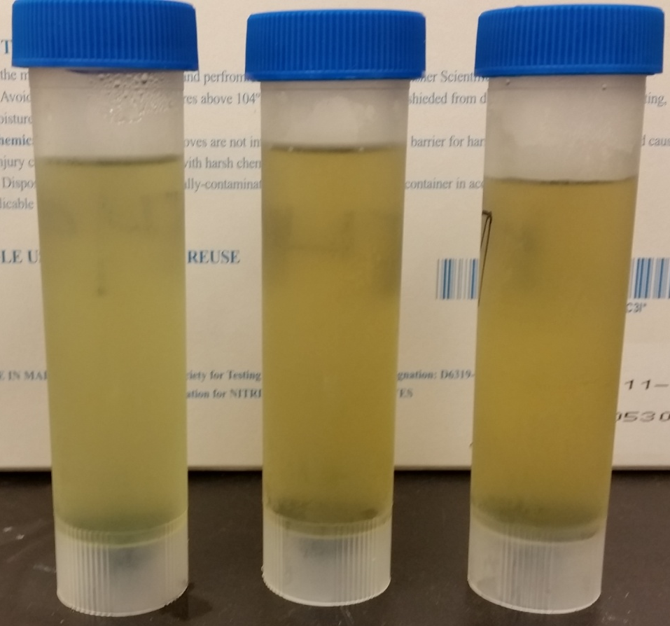
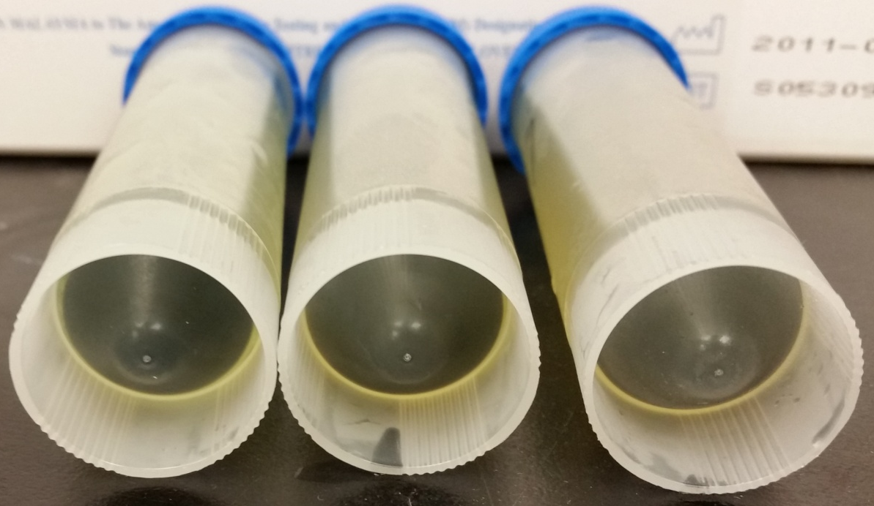
K49 spores to add to the 1.5% bioplastic solution.

Slide 23
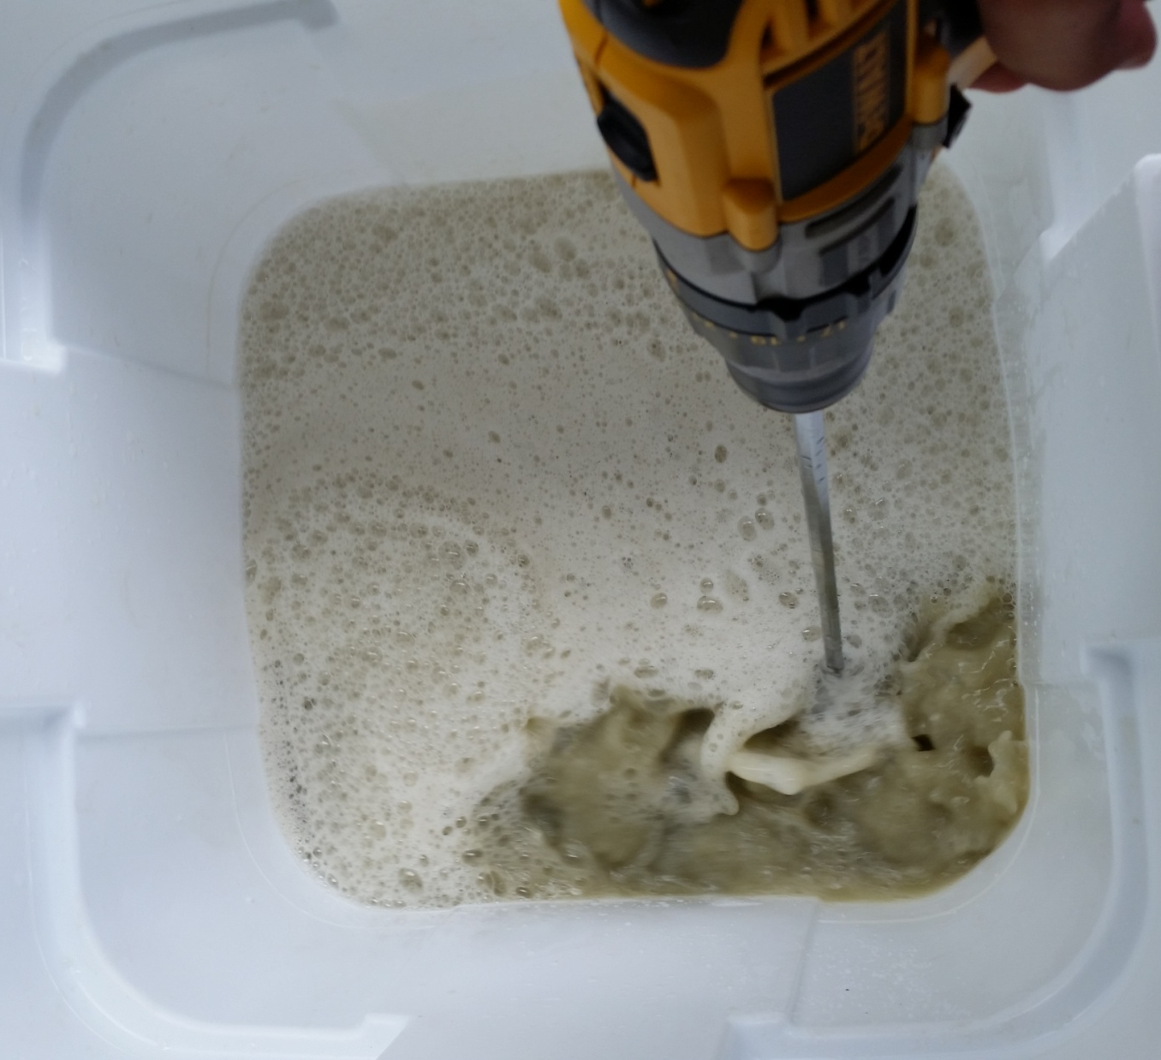
Mix in the spores to the 1.5% bioplastic solution.

Slide 24
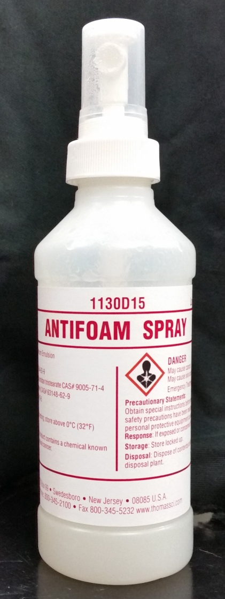
Antifoam spray to kill the foam after mixing.

Slide 25
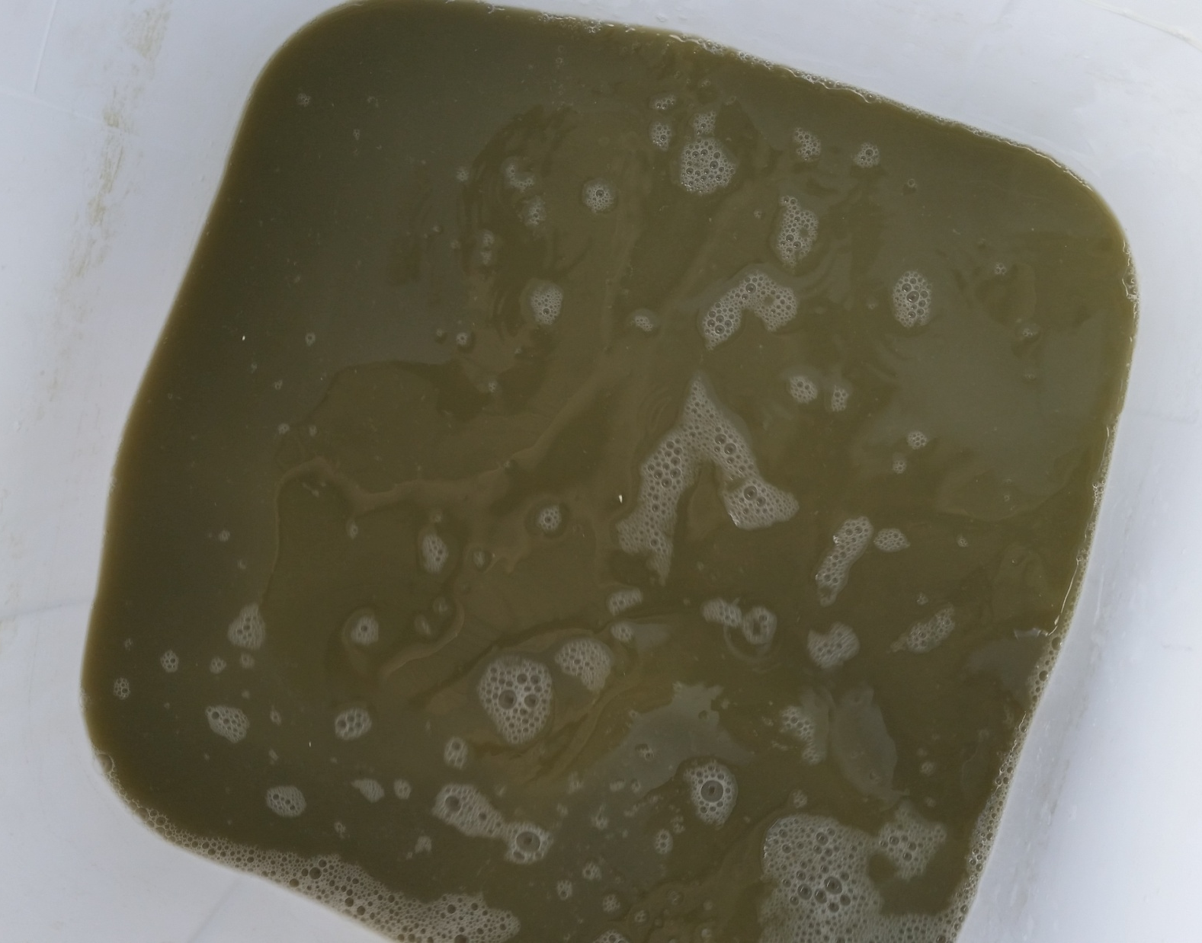
1.5% bioplastic solution with spores ready to spray the field.

Slide 26
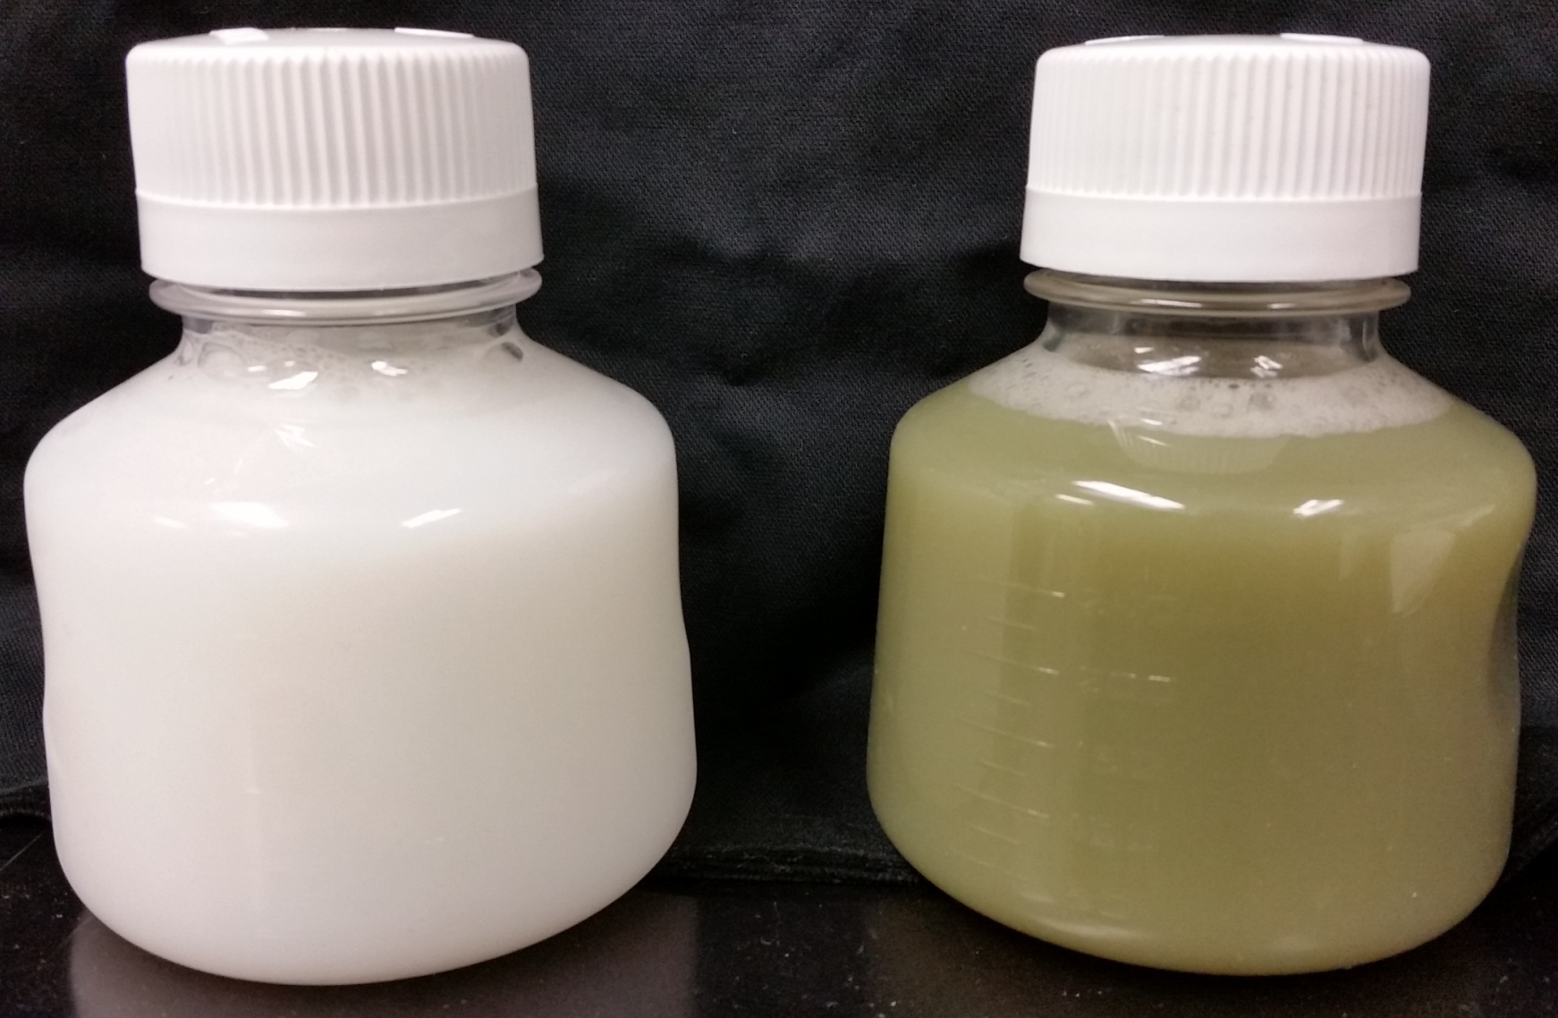
1.5% Bioplastic Solution
1.5% Bioplastic Solution w/ Spores

Slide 27
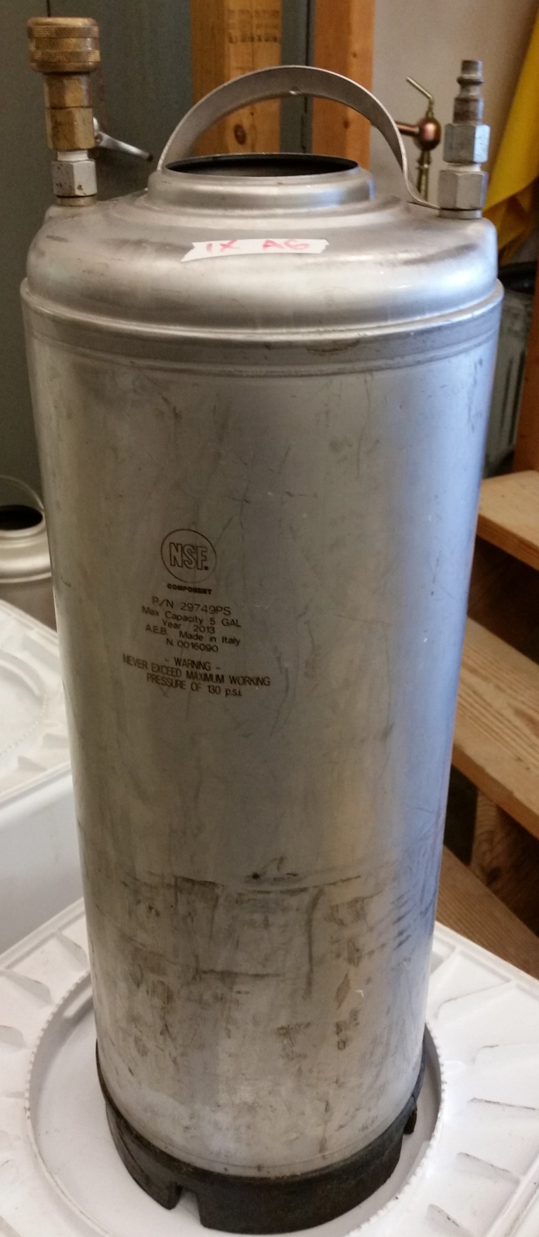
Pressurized container that holds the 1.5% bioplastic solution for spraying the field.

Slide 28
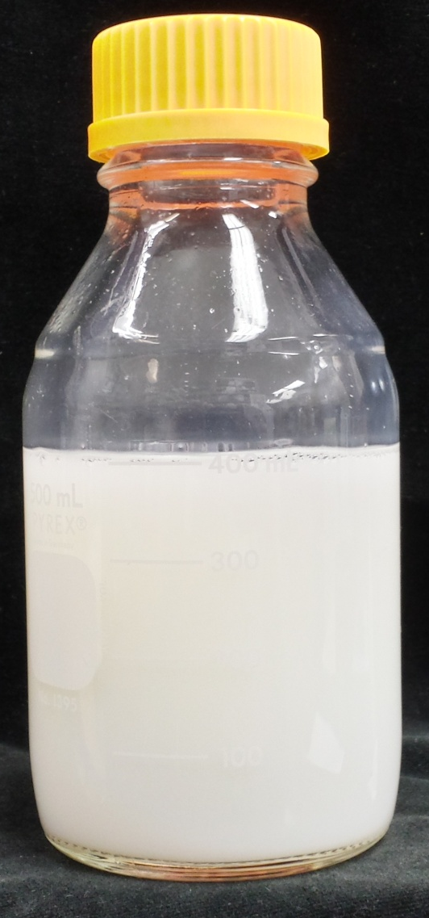
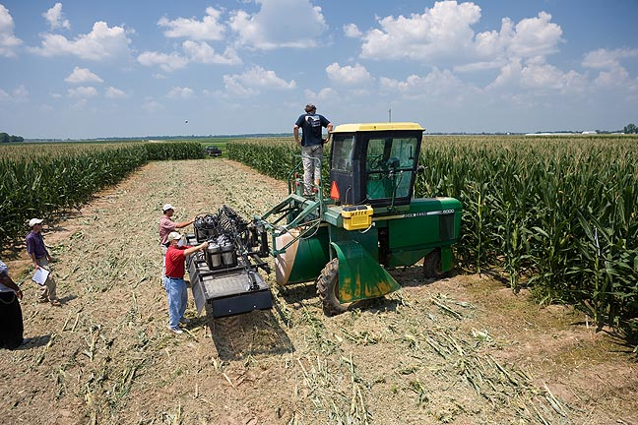
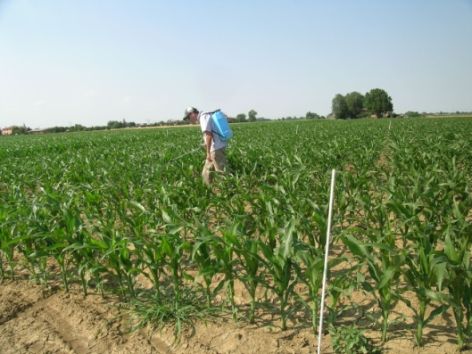
Bioplastic Spray (1.5-2%) Application
5% Liquid Bioplastic for spraying

Slide 29
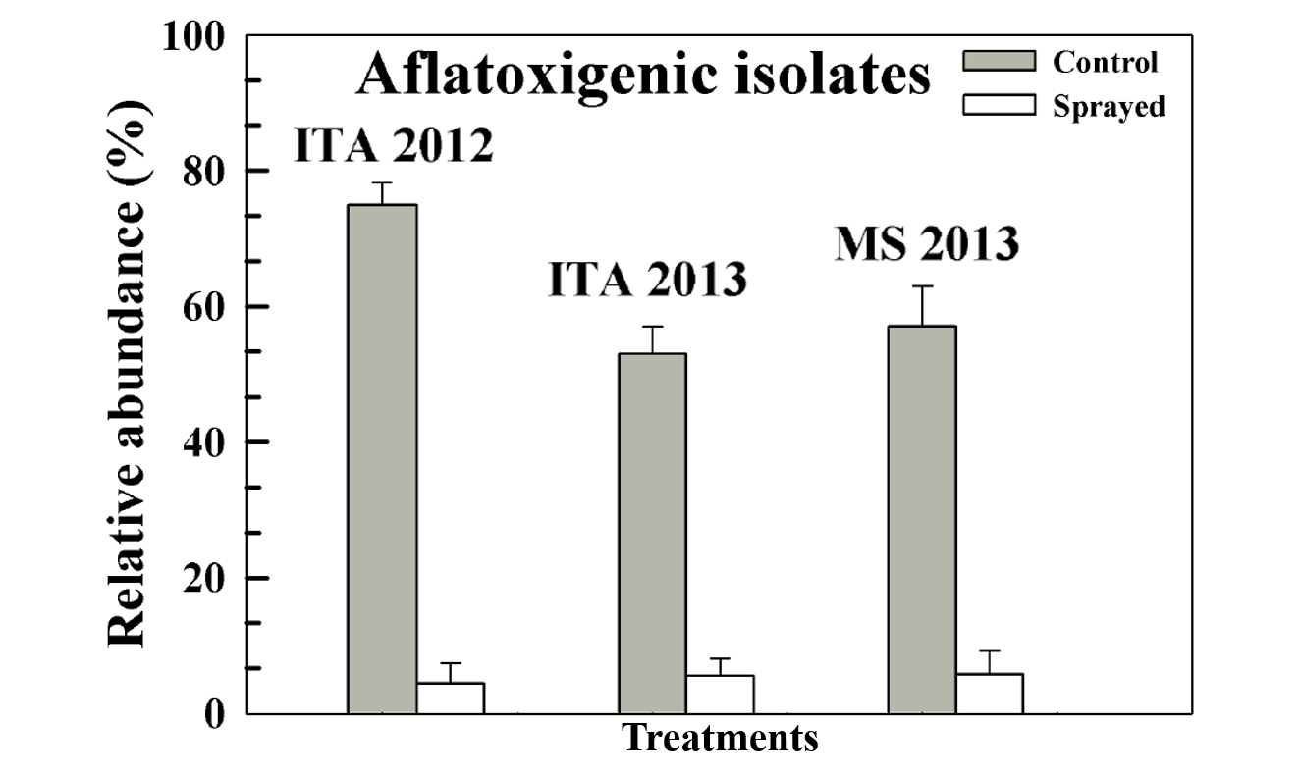

Slide 30
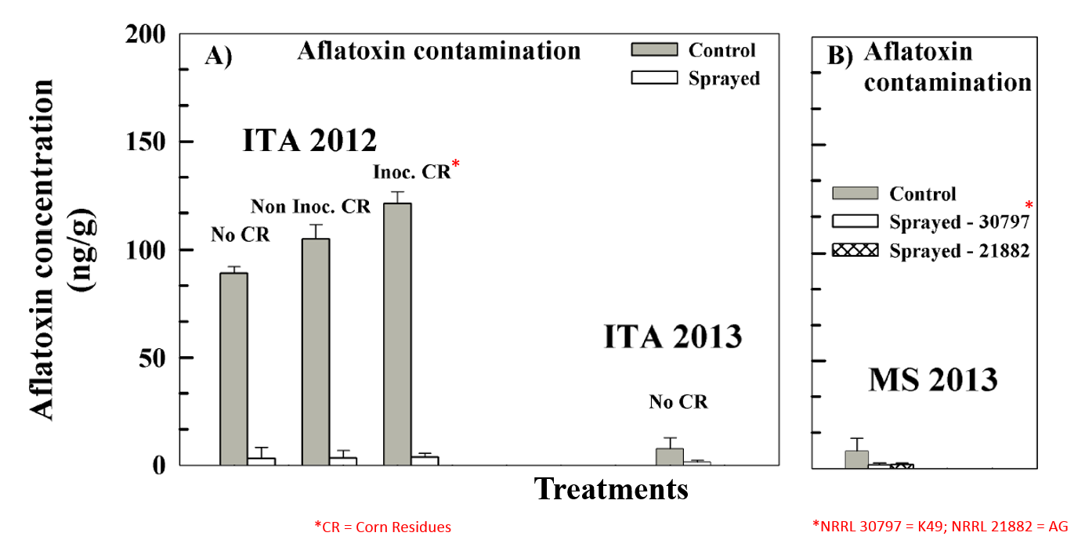

Slide 31
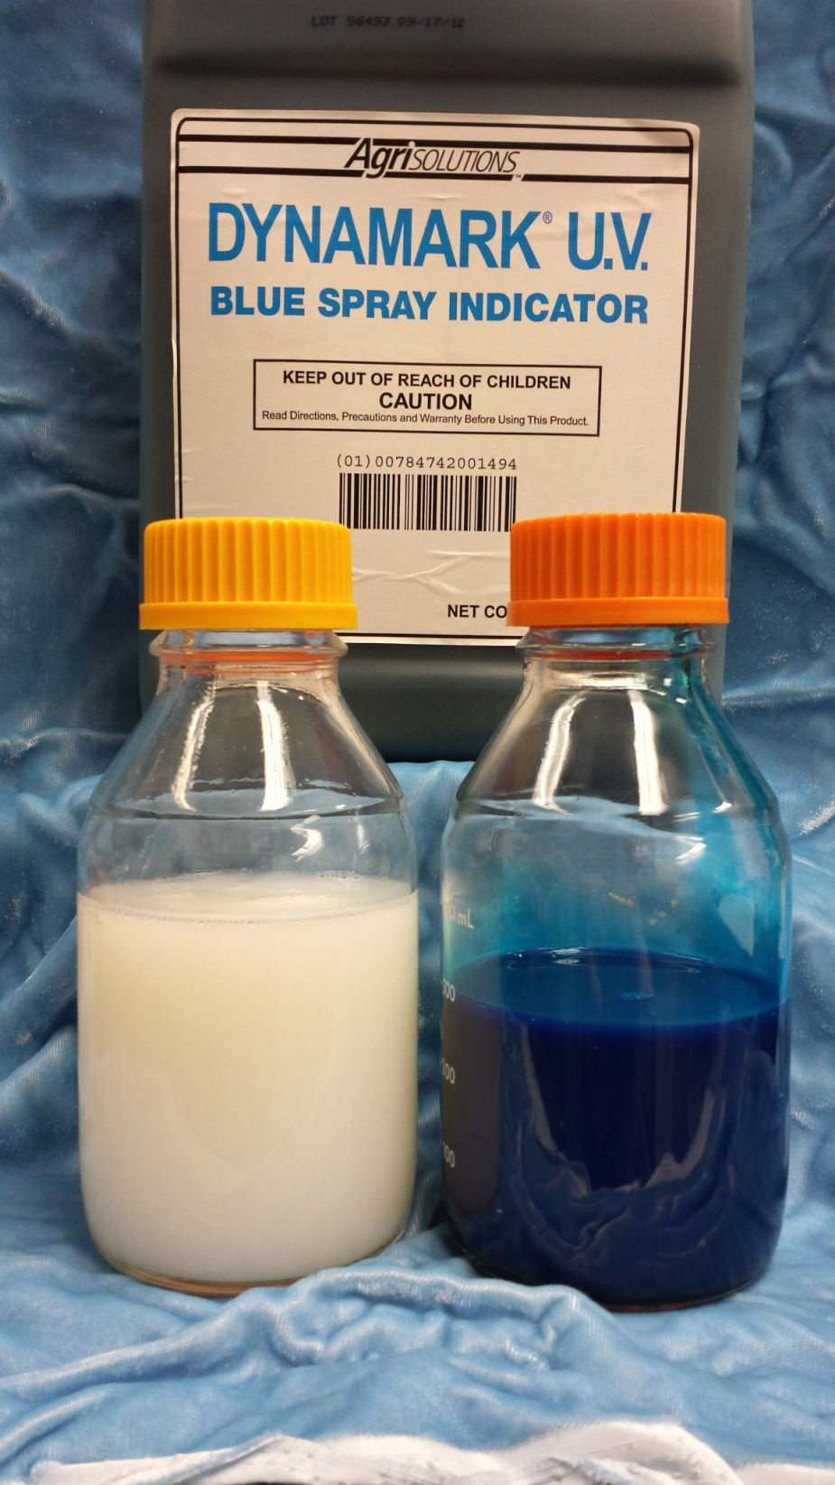
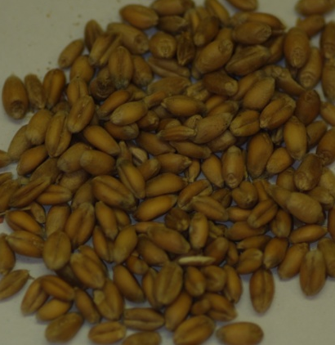
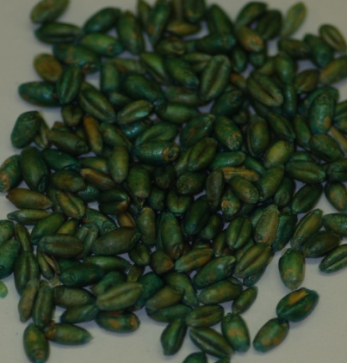
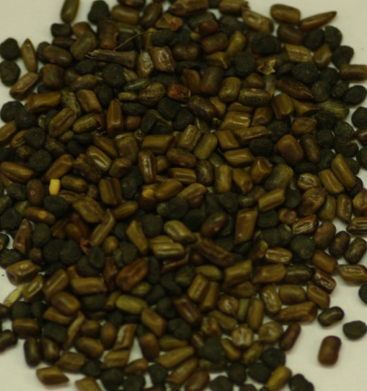
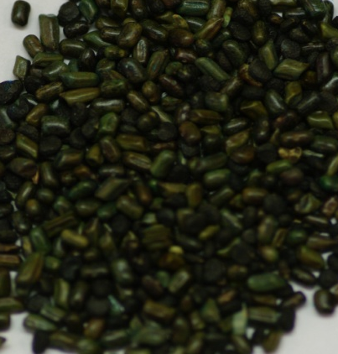
Seed Coating
--Left: Initial Liquid Product (ILP)
--Right: 5% Bioplastic with 1mL Dynamark U.V. per 600mL 5% ILP
--Seed coating using Fluid Bed Dryer
Untreated
Treated
Wheat
Mixed Small Weed Seeds
5% Liquid Bioplastic

Slide 32
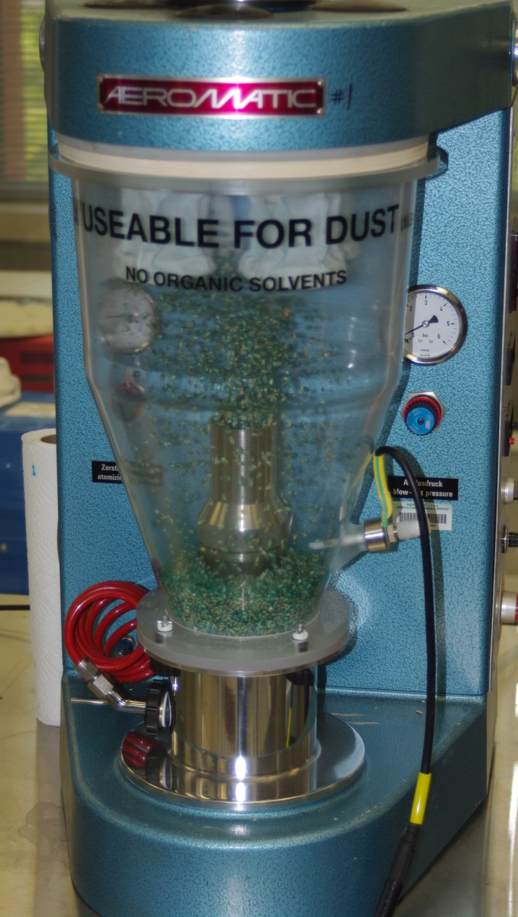
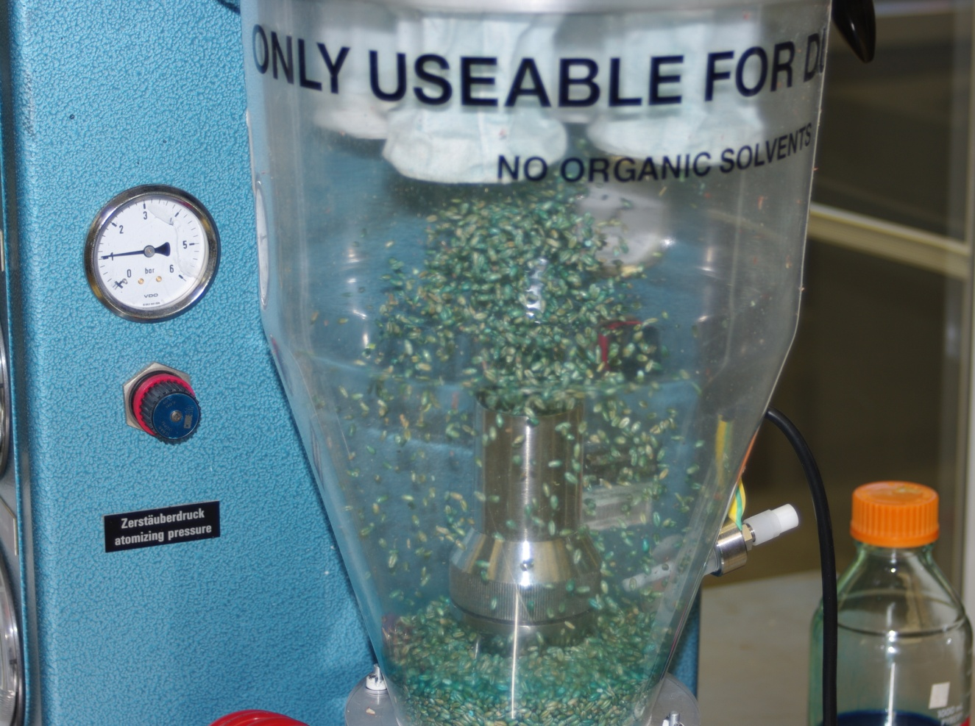
Fluid Bed Dryer
Bioplastic Seed Coating

Slide 33
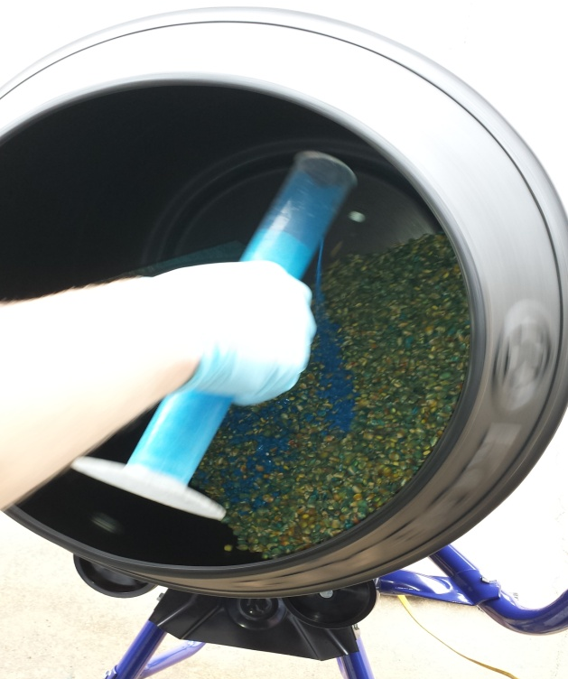
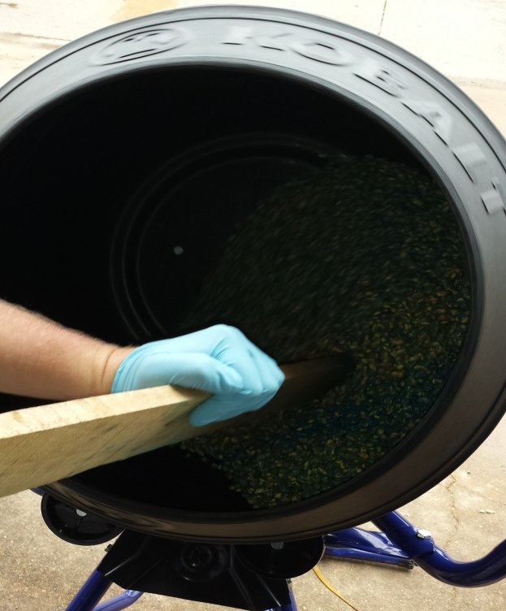
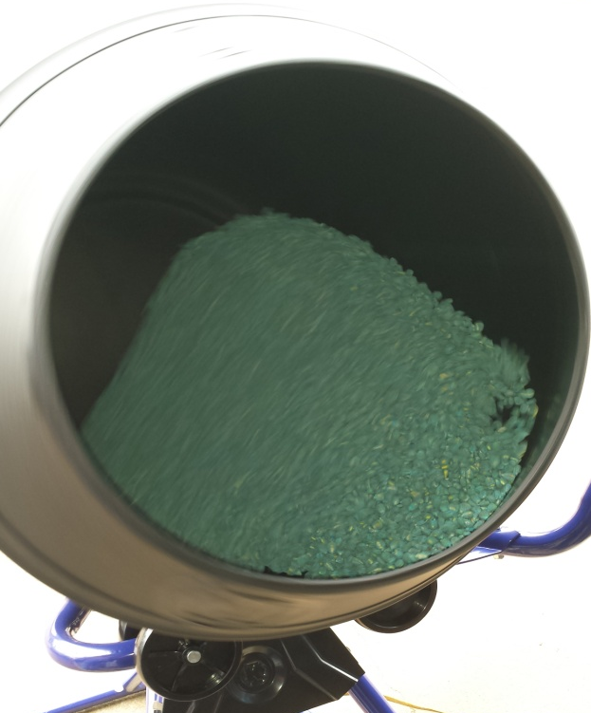

Seed treatment using cement mixer
Bottom Left: Seed treated with 222mL solution containing fungicide, insecticide, water, and dye (4mL) per 25lbs seed.
Bottom Right: Seed treated with 29mL solution containing 5% bioplastic and dye (1mL) per 5lbs seed.

Slide 34


Slide 35


Clean Bioplastic Granules
Beneficial Microbes in Bioplastic: Granule, Liquid & Seed Coating Formulation
Sprayable Bioplastic Formulation
This technology resulted in:
Patent serial no. 8,173,179 B1 was granted on May 8, 2012.
The Divisional patent DN: 0185.12; SN: 13/439,634 granted April 2014.
Patent serial no. 9,526,240 was granted on December 27, 2016.
Negotiations with industry partners in progress.
Inoculated & Dried Bioplastic Granules
Field Application
Seed coated w/ Bioplastic
These photos are demonstrating various methods of applications of bioplastic formulation.

Slide 36
Conclusions
New effective Biofungicides
Biofungicides from renewable sources
From agriculture to agriculture
Future research
  Seed Coating Field Trials
  Bacterial Seed Coating
  Weed Control
  Others

Slide 37
Acknowledgement
Collaborators
Drs. Nathan Little (entomologist), and Robert Zablotowicz (retired, deceased 2016)
Personal Supports
Jeremy Kotowicz, Brad Elliot, Rod Patterson, and Terry Johnson

