Slide 1
“Pain Management in Hail Region Hospitals”
By
Dr. Hamdan Albaqawi

Slide 2

overview
Introduction
Literature Review
Consequences of pain
Current study/ setting
Research questions
Research Methodology
Objectives
Results
Recommendations
References

Slide 3
Introduction:
Pain is associated with a wide range of injuries and diseases.
Pain assessment and management is the most fundamental part of the nurse’s responsibility (considered as the 5th vital signs).
Perception of pain is influenced by cultural, psychological, and emotional factors.
"Pain is one of the biggest health issues in Australia today – every bit as big as cancer, AIDS and coronary heart disease. Yet it remains one of the most neglected areas of health-care" Professor Michael Cousins, Chair National Pain Strategy.

Slide 4
Literature Review:
Undertreatment of pain has been reported for many decades as a major and persistent clinical problem.
Nurses have knowledge deficits and incorrect beliefs about pain assessment and management.
Patients continue to suffer from unnecessary pain.

Slide 5
Literature Review:
Study / setting | Method & sample | Results
Lui, So & Fong (2008). China 143 nurses working at medical units in a public hospital | Cross-sectional study Nurses’ knowledge and attitudes survey regarding pain | -Severe deficit in knowledge and attitudes related to pain management. -Overall mean score = 47.72% -Range = 20–76%
Matthews & Malcolm (2007). United Kingdom 113 nurses | Cross-sectional study Nurses' Knowledge and Attitudes Survey Regarding Pain | -Deficit in knowledge relating to non-pharmacological methods and opioid use in chronic pain. -Overall mean score = 73.8%
Moceri & Drevdahl (2012). United State 91 Emergency nurses | Descriptive study Nurses' Knowledge and Attitudes Survey Regarding Pain | - Inadequate knowledge about pain management. -Overall mean score = 76%
Yildirim, Cicek & Uyar (2008) Turkey 68 oncology nurses | Descriptive study Nurses' Knowledge and Attitudes Survey Regarding Pain | -Severe deficit in knowledge and attitudes related to pain management. -Overall mean score = 35.41% -Range= 5.13% to 56.41%

Slide 6
Consequences of pain
Pain can have physical, psychological and economical impacts on patients, their families and societies.
Pain impedes a patient’s recovery from trauma and surgery or prolong the period of healing (postoperative patients).
Untreated pain can cause depression, anxiety, impaired sleep, poor appetite, weight loss and social isolation.
↓ the quality of patients' lives and limit their activities.
Consumes large amounts of healthcare resources.

Slide 7

Current study/ setting:
Saudi Arabia’s population 29,994,272 million (99%) Muslims.
MOH hospitals are 268 with capacity of 38,970 beds.
Total number of nurses is 65،152 and Saudi nurses are (50.8%) and the remaining are expatriate nurses.

Slide 8
Research questions:
What knowledge and attitudes do nurses hold regarding pain management in Hail Region Hospitals?
Objectives:
Explore and identify nurses' knowledge and attitude regarding pain and pain management in Hail Region Hospitals.

Slide 9
Study methods:
Participants: local and expatriate nurses working in Hail Region Hospitals.
The inclusion criteria will be: Nurses aged 21-65 years old.
Participants are required to answer a survey (Knowledge and Attitudes Survey Regarding Pain) by Ferrell, B. & McCaffery, M.
303 nurses participated in this study.
Sampling: convenience sampling.
Setting: 5 Public hospitals
Response rate: 60%

Slide 10
Instruments:
Knowledge and Attitudes Survey Regarding Pain
Questionnaire Components | Items | Responses
Knowledge | 22 | True / False
Attitudes | 16 | Multiple choice including: -Pharmacological interventions -Nonpharmacological interventions -Pain assessment -Attitudes on managing pain -Two case study (scenarios)

Slide 11
Results:
Frequency Distribution of Participants by Nationality and Gender
Nationality | n | %
Saudi | 57 | 18.8%
Filipino | 112 | 37.0%
Indian | 124 | 40.9%
Indonesian and Chinese 3.4%
Gender | n | %
Male | 22 | 7.3%
Female | 281 | 92.7%
Total | 303 | 100.0%

Slide 12
Results:
Frequency Distribution of Participants by Academic Qualification
The correct answers ranged 5.0% - 87.5%
Overall mean score = 41.76% (SD = 9.83).
Qualification | n | %
Diploma | 139 | 45.8%
Bachelor's Degree | 159 | 52.5%
Master's Degree | 5 | 1.7%
Total | 303 | 100.0%

Slide 13
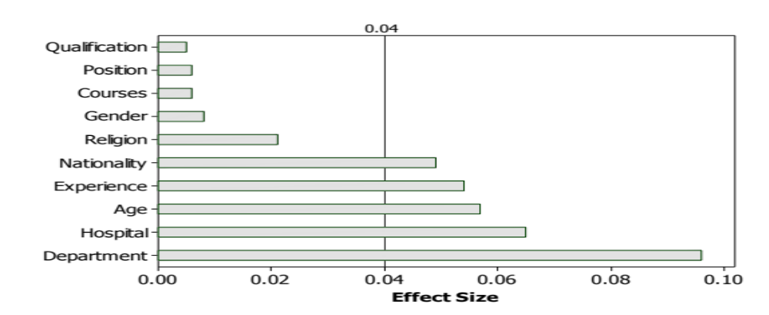
Effect of variables
Variables | Highest | Mean | Lowest | Mean
Nationality | Filipino | 44.44 | Saudi | 38.77
Experience | 15-20 y | 46.78 | 7-12 m | 31.43
Age | 41-60 | 47.73 | 21-30 | 40.25
Hospital | E | 46.85 | B | 38.86
Department | Education Department/Nursing Office | 50.00 | Pediatric Department | 37.50

Slide 14
Most Frequently Missed Items
Questions | Correct
38 B. Check the action you will take at this time: | 38 (12.5%)
37 A. Andrew is 25 years old and this is his first day following abdominal surgery. As you enter his room, he smiles at you and continues talking and joking with his visitor. Your assessment reveals the following information: BP = 120/80; HR = 80; R = 18; on a scale of 0 to 10 (0 = no pain/discomfort, 10 = worst pain/discomfort) he rates his pain as 8. On the patient’s record you must mark his pain on the scale below. Circle the number that represents your assessment of Andrew’s pain. | 28 (9.2%)
19. If the source of the patient’s pain is unknown, opioids should not be used during the pain evaluation period, as this could mask the ability to correctly diagnose the cause of pain. | 22 (7.3%)
37 B. Check the action you will take at this time. | 9 (3.0%)

Slide 15
Recommendations
Upgrade educational qualifications to a Bachelor for Diploma holder.
Continues assessment for nurses to assess their care.
Provide pain courses.
Assessment form should be implemented or charts to ensure documentation and assessment of pain.
Provide cultural orientation for newcomers.
Protocol or policy.
Encourage nurses to use non- pharmacological methods for patients with pain.

Slide 16
References:
Fosnocht, D. E., Swanson, E. R., & Barton, E. D. (2005). Changing attitudes about pain and pain control in emergency medicine. Emergency Medicine Clinics of North America, 23, 297-306.
Hughes, R., & Healthcare Research, U. S. A. for, Quality. (2008). Patient Safety and Quality: An Evidence- Based Handbook for Nurses. Agency for Healthcare Research and Quality, U.S. Dept. of Health and Human Services.
International Association for the Study of Pain. (1986) Pain terms: A current list with definitions and notes on usage. Pain, 3 (suppl): S216-S221.
Jones, K. R., Fink, R., Pepper, G., Hutt, E., Vojir, C. P., Scott, J., Clark, L., & Mellis, K. (2004). Improving nursing home staff knowledge and attitudes about pain. The Gerontologist, 44 (4), 469-478.
Martin, B. I., Deyo, R. a, Mirza, S. K., Turner, J. a, Comstock, B. a, Hollingworth, W., et al. (2008). Expenditures and health status among adults with back and neck problems. JAMA : the journal of the American Medical Association, 299 (6), 656-64.
Mezey, M. (2005). Assessing pain as the fifth vital sign in ling-term care facilities: Recommendations from the field. Journal of Nursing, 31 (3), 16-24.
Müller, A. (2010). Background information for consultation. Vaccinations in tropical and travel medicine. Pharmazie in unserer Zeit, 39(1), 54-61.
Pasero, C, & McCaffery, M. (2007). IV opioid range orders for acute pain management. American Journal of Nursing, 107(12), 52-60.
Solman, R., Wruble, A., Rosen, G., & Rom, M. (2006). Determination of clinically meaningful level of pain reduction in patients experiencing acute postoperative pain. Pain Management Nursing, 7 (4), 153- 158.
Wells, N., Pasero, C., & Mccaffery, M. (2004). Chapter 17. Improving the Quality of Care Through Pain Assessment and Management. Management.

Slide 17


We have the science, but are we making any progress?
Thank you for your attention
Any Questions?

