Slide 1
Obstructive sleep apnea in epilepsy: a preliminary Egyptian study
Hala A. Shaheen
Prof and head of neurology department, Faculty of medicine, Fayoum university

Slide 2

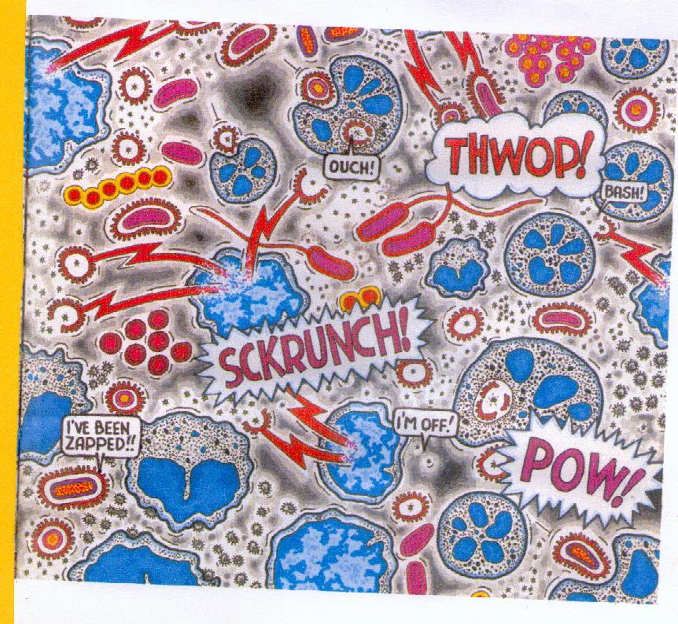
A preliminary Egyptian study
a preliminary Egyptian study

Slide 3

Hala A. Shaheen , Ann A. Abd El-Kader , Amira M. El Gohary , Neveen M. El-Fayoumy , Lamia M. Afifi
Faculty of medicine, Egypt

Slide 4
Introduction
Epilepsy and obstructive sleep apnea are two common disorders that coexist

Slide 5
Introduction
Epilepsy and obstructive sleep apnea profoundly exacerbate each other’s [Peppard etal 2000]

Slide 6
Introduction
Several mechanisms may contribute to the increased incidence of OSA in patients with epilepsy,

Slide 7
Introduction
The adverse effect of antiepileptic drugs
CNS depression,
Effect on upper airway tone,
Weight gain

Slide 8
Introduction
Reduced physical activity of patients with epilepsy
Also seizures prolonged REM
where OSA became worse
[Sharafkhaneh A, etal 2005)

Slide 9
Introduction
Appearance of OSA symptoms coincided with clear increase in seizure frequency or an emergence of status in patients with epilepsy [Nieto F, etal 2011]

Slide 10
Introduction
A variety of seizure-provoking mechanisms in OSA patients are postulated

Slide 11
Introduction
Obstructive sleep apnea (OSA) is due to intermittent blockage of the upper airway with Consequent reduction or cessation of airflow during sleep [Frucht M, etal 2000]

Slide 12
Introduction
It leads to
Cerebral hypoxemia,
cortical arousal,
Sleep fragmentation, and

Slide 13
Introduction
Decrease time spent in deep sleep, and
Sleep deprivation
[Wyler A, Weymuller E 2012].

Slide 14
Introduction
OSA with subsequent significant morbidity such as

Slide 15
Introduction
Morbidity
increased risk of cardiac,
respiratory, and
metabolic consequences
[Parra etal 2010]

Slide 16
Introduction
Mortality
OSA postulated as a cause of sudden unexpected death in patients with epilepsy
[Malow B, etal 2008]

Slide 17
Introduction
To make matters worse, obstructive sleep apnea is notoriously underdiagnosed particularly in patients with epilepsy [Decary A, etal 2000]

Slide 18
Introduction
The extent and clinical relevance of the association between epilepsy and sleep apnea are not previously studied in Egypt

Slide 19

What we wanted to know was the

Slide 20
Aim of work
This study aimed to look for the frequency of sleep apnea in Egyptian patients with epilepsy in comparison to a control group.

Slide 21
Aim of work
Try to find out sleep apnea relation to
Clinical data, Sleep complaint
Polysomnographic findings

Slide 22
Introduction
The identification and treatment of OSA may have far-reaching consequences in improving patient’s quality of life [Trupp R, etal 2004]

Slide 23
Introduction
Continuous positive airway pressure (CPAP) treatment was found to improve seizure control in those patients [Gami A, etal 2005]

Slide 24

Patients and methods:

Slide 25

““
Patients

Slide 26
Patients and methods:
This is a case control study of 26 patients with epilepsy
and
26 normal controls Patients

Slide 27
Patients and methods:
Inclusion criteria
Children with idiopathic epilepsy

Slide 28

Patients and methods:
Exclusion criteria

Slide 29
Patients with any neurological disease apart from epilepsy; patients with psychiatric illness; patients with history of hypnotics or sedatives intake; or those with liver or kidney failure were excluded from the study.

Slide 30
Patients and methods:
The patients were divided into two subgroups according to apnea/hypopnea index (AHI):
Group (1) patients without OSA
group (2) patients with OSA

Slide 31
Patients and methods: control group
Healthy children their age and sex matched to our patients were also studied

Slide 32
Methods
Clinical assessment
Epilepsy history and detailed neurological examination
Epilepsy history: Neurologist interviewed patients and one of their close relative to inquire about age of onset of epilepsy and disease duration

Slide 33
Methods
Clinical assessment
Seizures characteristics
such as
Seizure frequency,
status epilepticus,
Circadian rhythm, and
Dosage of medications

Slide 34
Methods
Clinical assessment
Type of epilepsy was determined according to International League against Epilepsy classification

Slide 35
Methods
Sleep history
They were asked about total nocturnal sleep time, repeated awakenings during sleep, history of excessive daytime sleepiness, insomnia, and nocturnal snoring

Slide 36
Methods
Electrophysiological assessment
Electroencephalogram(EEG) was done for all patients using a Schwarzer GmbH medical diagnostic equipment

Slide 37
Methods
Electrophysiological assessment
Video EEG monitoring was done for all patients using a Schwarzer GmbH medical diagnostic equipment and a digital video-camera Panasonic AG6040)

Slide 38
Methods
Electrophysiological assessment
Overnight polysomnography was performed for both patients and controls using a Schwarzer. Epos 32 GmbH, medical diagnostic polysomnogram, Germany
The software used was Somnologica version 3.1

Slide 39
Methods
The polysomnographic parameters were :
Total sleep time (TST),
Sleep efficiency,
Percentage of each stage
Number of awakenings,
Arousal index and
leg movements

Slide 40
Methods
Polysomnographic assessment
Apnea events were counted according to the criteria established by the American Academy of Sleep Medicine

Slide 41
Statistical analysis:
Statistical package for social science (SPSS) version 15 were used for data management. Chi square test was used for comparison between qualitative variables groups

Slide 42
Statistical analysis:
Independent sample T test was used for normally distributed quantitative variables as comparing age mean, seizure duration, and sleep efficiency among patient subgroups.

Slide 43
Statistical analysis:
Mann–Whitney test were used for non normally distributed quantitative variables as age of onset, number of awakening, sleep latency, PLM, and apnea and hypopnea index.

Slide 44
Statistical analysis:
Pearson’s correlation coefficient was calculated for the association between the apnea/hypopnea index and clinical and polysomnographic data.

Slide 45
Statistical analysis:
The logistic regression analysis was done to test for significant predictors of OSA among the patients.
P value 0.05 was considered significant

Slide 46

Results

Slide 47
Results
The patients’ age ranged from 4.5 to 18 years.
Ten (38.5%) of them were girls. Sixteen (61.5%) were boys.

Slide 48
Results
The control group were chosen to be age-and sex-matched to the patients group.
There were no obese children

Slide 49
Type of epilepsy

Slide 50
Results
Clinical
Mean age of onset of epilepsy was 7.49 ± 4.2 years.
Mean duration was 5.09± 4.57 minutes.

Slide 51
Results
Clinical
The seizure frequency ranged from once per month to six per day with mean of 47.6±53.2 seizures per month

Slide 52
Results
Clinical
Seizures were uncontrolled (more than once per month) in 24 patients (92.3%)
and three patients (11.5%) had history of status epilepticus.

Slide 53
Results
Clinical
Circadian distribution of the attacks was
diurnal in two patients (7.7%),
nocturnal in 12 (46.2%),
and both diurnal and nocturnal in 12 (46.2%).

Slide 54
Results
Clinical
Six patients (23.1%) diagnosed had not received medications yet,
Ten (38.5%) were on monotherapy,
and 10 (38.5%) were on polytherapy

Slide 55
Sleep clinical results
The patients’ sleep complaint
Repeated awakenings during sleep in 15 patients (57.7%)
Daytime sleepiness in 13 patients (50%).
Snoring was encountered in only two patients (7.7%).

Slide 56
Polysomnographic results
The patients had significantly
Higher arousal index and
percent of stage 2 from total sleep time but
lower SWS percent from TST and sleep efficiency,
in comparison to the control group.

Slide 57
Polysomnographic data | Patients group | Controls group | P-value
Sleep onset in min. | 18.73 ± 17.5 | 14.1 ± 12.16 | .53
Sleep efficiency % | 73.17 ± 7.33 | 83.12 ± 10.59 | .006
No. of awakenings | 12 ± 6.03 | 13.67 ± 5.1 | .449
Sleep latency to S1 | 102.01 ± 114.58 | 102.43 ± 176.07 | .530
Sleep latency to S2 | 51.7 ± 74.76 | 17.35 ± 13.21 | .157
Sleep latency SWS | 81.82± 78.9 | 74.6 ± 47.55 | .489
Sleep latency REM | 196.88 ± 108.38 | 224.08 ± 90.67 | .572
% of S1 from TST | 8.18 ± 7.18 | 7.22 ± 6.86 | .530
% of S2 from TST | 57.01 ± 17.12 | 44.05 ± 14.98 | .022
% of SWS from TST | 23.11 ± 10.27 | 36.08 ± 14.9 | .012
% of REM from TST | 12.57 ± 9.33 | 12.62 ± 6.28 | .706
Arousal index | 8.23 ± 10.88 | .89 ± .62 | .000
Periodic Leg Movement index | .82 ± 1.33 | .38 ± .35 | .545
Apnea index REM | .39 ± 1.10 | .00 ± .00 | .109
Apnea index in NREM | .31 ± .39 | .00 ± .1 | 1
Hypopnea index in REM | 1.75 ± 4.91 | .00 ± .00 | .255
Hypopnea index in NREM | .7 ± .97 | .00 ± .45 | .775
Apnea hypopnea index | 1.21 ± 1.46 | .00 ± .75 | .704

Slide 58
Results
Eleven patients with epilepsy(42.3%) have Obstructive sleep apnea

Slide 59
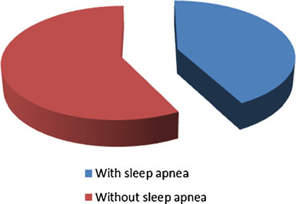
Frequency of sleep apnea in patients

Slide 60
Comparison between clinical variables in epilepsy patients’groups with and without OSA

Slide 61
Comparison
Results
Seizure frequency was significantly higher in the patients with OSA. All other clinical epilepsy, sleep, and EEG findings did not differ significantly

Slide 62
Results
If sleep deprivation is the assumed mechanism, one
might expect that seizures during both sleep and wakefulness would be facilitated as in our study.

Slide 63
Results
If sleep fragmentation and frequent stage shifts resulting from apneas are responsible for provoking seizures, then seizures during sleep may be facilitated preferentially
[Wyler A etal 1981]

Slide 64
Clinical variables | Group (1) Patients without OSA No. (%) | Group (2) Patients with OSA No. (%) | P-value
Age of onset | 7.97 ± 3.37 | 6.83 ± 5.27 | .310
Duration of illness | 5.23 ± 3.86 | 4.89 ± 5.6 | .435
Sex Female Male | 7 (46.7%) | 3 (27.3%) | .315
 | 8 (53.3%) | 8 (72.7%)
Type Generalized Focal Focal with secondary generalization | 3 (20%) | 1 (9%) | .305
 | 5 (33.3%) | 7 (63.6%)
 | 7 (46.7%) | 3 (27.3%)
Seizure frequency | 26.55 ± 36.18 | 63.07 ± 59.38 | .046
Status epilepticus | 2 (13.3%) | 1(9%) | .738
Circadian rhythm Diurnal Nocturnal Nocturnal and diurnal Treatment |  |  | .550
 | 2 (13.3%) | 0 (0%)
 | 7 (46.7%) 6 (40%) | 5 (45.4%) 6 (54.6%)
No Medication Monotherapy Polytherapy | 3 (20%) | 3 (27.3%) | .910
 | 6 (40%) | 4 (36.3%)
 | 6 (40%) | 4 (36.3%)

Slide 65
Results
Comparison
Results
Comparison of sleep parameters patients’ subgroup
Apart from apnea and hypopnea indices, all other polysomnographic sleep parameters did not differ between patients’ subgroups

Slide 66
Polysomnographic data | Group (1) patients without OSA Mean ± SD | Group (2) patients with OSA Mean ± SD | P value
Sleep onset in min. | 21.84 ± 21.46 | 14.49 ± 9.3 | .659
Sleep efficiency % | 85.3 ± 9.39 | 80.15 ± 11.83 | .227
No. of awakenings | 10.8 ± 5.02 | 13.64 ± 7.12 | .404
Sleep latency to S1 | 92.66 ± 128.12 | 114.76 ± 97.61 | .421
Sleep latency to S2 | 48.83 ± 69.57 | 55.63 ± 84.66 | .659
Sleep latency SWS | 79.23 ± 70.47 | 85.35 ± 92.67 | .697
Sleep latency REM | 182.69 ± 114.59 | 216.23 ± 101.34 | .516
% of S1 from TST | 8.53 ± 7.71 | 7.71 ± 6.72 | .795
% of S2 from TST | 57.81 ± 17.8 | 55.93 ± 16.94 | .697
% of SWS from TST | 22.07 ± 9 | 24.54 ± 12.08 | .406
% of REM from TST | 11.62 ± 9.88 | 13.87 ± 8.81 | .311
Arousal index | 5.57 ± 6.45 | 11.85 ± 14.57 | .233
Periodic Leg Movement index | .86 ± 1.28 | .75 ± 1.45 | .546
Apnea index REM | .00 ± .00 | .93 ± 1.58 | .005
Apnea index in NREM | .16 ± .21 | .51 ± .48 | .062
Hypopnea index in REM | .03 ± .13 | 4.1 ± 7.05 | .000
Hypopnea index in NREM | .23 ± .24 | 1.34 ± 1.22 | .006
Apnea hypopnea index | .36 ± .27 | 2.36 ± 1.63 | .000

Slide 67

Correlation between
apnea/hypopnea index,
Clinical and polysomnographic data

Slide 68
Correlation
Apnea index in REM positively correlates with latency to deep sleep

Slide 69
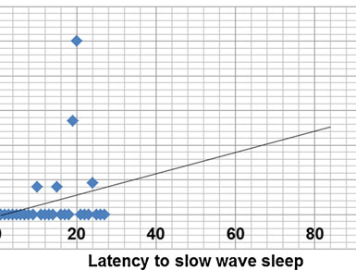
Correlation between Apnea index and latency to deep sleep
Correlation

Slide 70
Results
Correlation
Hypopnea index in REM positively correlates with number of awaking (r=0.393, P=0.047).

Slide 71
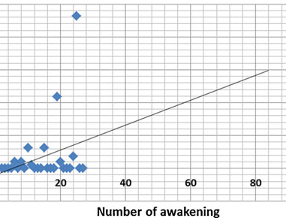
number of awakening and hypopnea index
Correlation

Slide 72
Discussions
It is well-known that sleep apnea is not the same throughout the course of the night. It tends to be worse in (REM) sleep

Slide 73
Discussions
Patients with epilepsy and OSA had significantly longer sleep latency and higher arousal index. A significant tendency towards light sleep than slow wave deep sleep

Slide 74
Discussions
In this study, no epilepsy or sleep data have been
found to be significant predictors of OSA in patients with epilepsy

Slide 75
Discussions
Contradictory to previous study that reported that older, heavier male, and sleepier epileptics are more prone to have
OSA [Raffaele M, etal 2003].

Slide 76
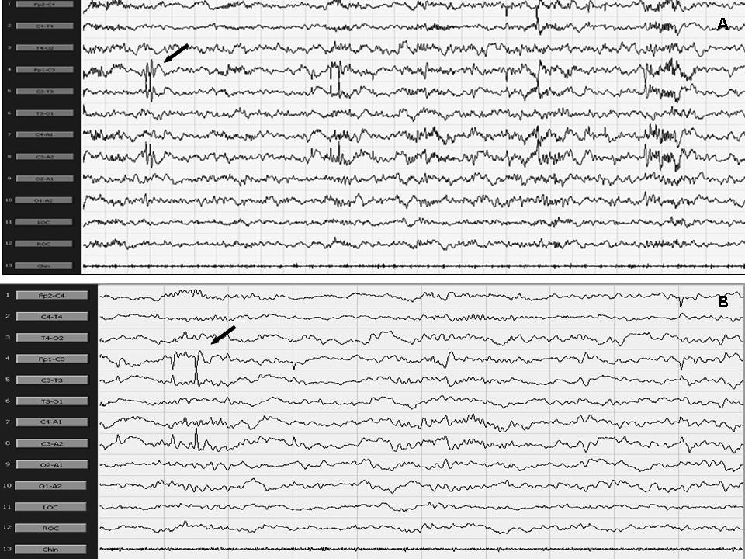
left centrotemporal sharp waves

Slide 77
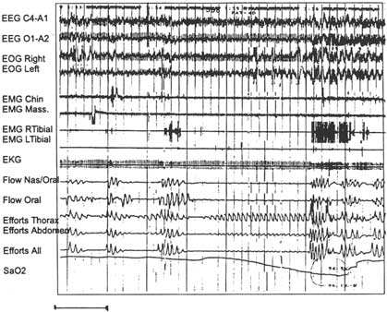
Obstructive sleep apnoea
Polysomnographic recording

Slide 78
Conclusions

Slide 79
Conclusions
Obstructive sleep apnea is frequent in patients with epilepsy.
Obstructive sleep apnea contribute to increase seizures frequency.

Slide 80
Recommendations
Investigating sleep apnea in all patients with epilepsy even those without sleep complaint

Slide 81




Finally
Egypt
Fayoum
neurology
Conference
10-12
November
2016
has01@
fayoum.edu.eg

Slide 82


Thank You

