Slide 1


Characteristics of the overflow pollution of storm drains with inappropriate sewage entry
Zuxin XU
Hailong YIN
College of Environmental Science and Engineering,
Tongji University
Notes:
1

Slide 2
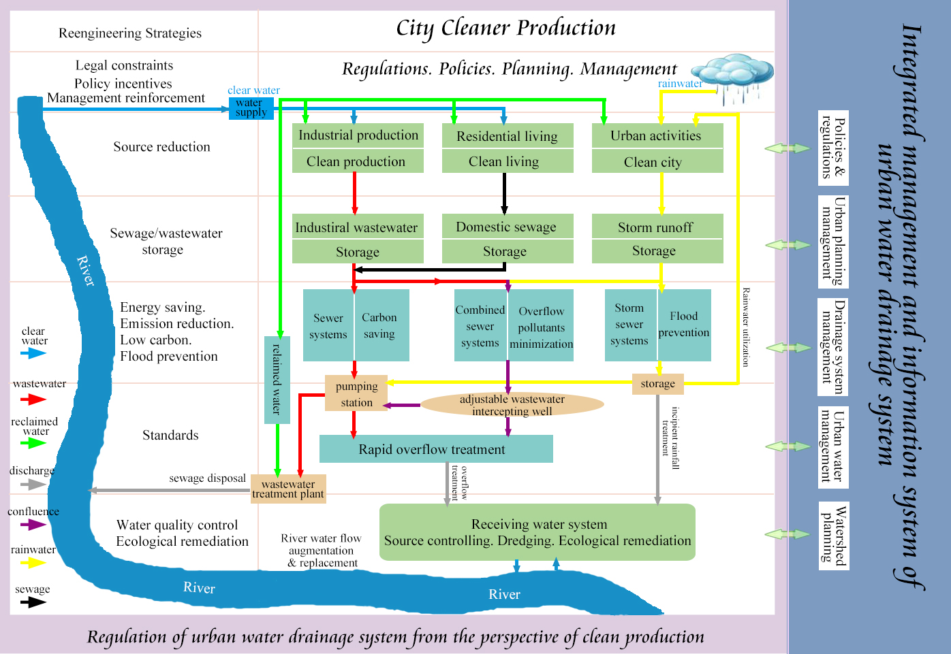
Framework of Integrated Urban Water system

Slide 3
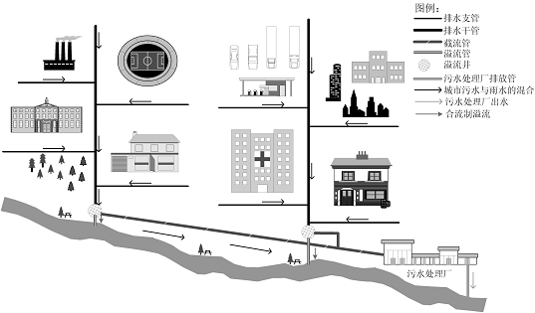
Urban drainage systems－Combined sewer system
A sewer designed for receiving surface (dry and wet weather) runoff, municipal (sanitary and industrial ) wastewater, and subsurface waters from infiltration. During wet weather, it acts as a sanitary sewer, but it also carries stormwater from wetweather runoff.
Notes:
3

Slide 4
Urban drainage systems－Combined sewer system
Combined sewer overflow-flow from an outfall of a combined sewer collection system, in excess of the interceptor capacity or due to a malfunctioning or improperly set flow regulator, that is discharged into a receiving water and/or an auxiliary CSO control storage-treatment system.
Notes:
4

Slide 5
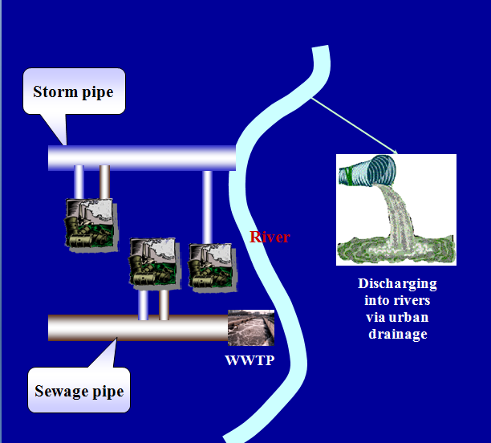
Urban drainage systems－Separate Storm and sewers
Issues: Ever since the introduction of separate sewer systems, the managers have been faced with non-storm water entries into storm drains.
Separate sewer systems have been widely introduced since the early 1970s to circumvent the drawbacks of combined sewer systems.
A separate sewer system consists of two parallel pipe networks. One is the sewer system, which transports household or industrial wastewater to a sewage treatment plant. The second is the storm drainage system, which delivers clean rain or storm water to the surface water system without treatment.
Notes:
5

Slide 6
Urban drainage systems－Separate Storm and sewers
These entries may originate from illicit connections of unintended sewer cross-connections that connect foul water outlets from residential or industrial premises to the storm drainage system, and extraneous water intrusion into storm drains.
Dry-weather overflow from storm pipes due to inappropriate pollution sources entry into storm drainage
Notes:
6

Slide 7
Urban drainage systems－Separate Storm and sewers
The contaminated non-stormwater entries into storm drains are much more problematic, as these result in the release of untreated sewage in the surface water system. If these pollutant sources are not identified and corrected, there would be little improvement in receiving water conditions.
Presentation title:
Characteristics of overflow pollution of storm drains with inappropriate sewage entry
Notes:
7

Slide 8
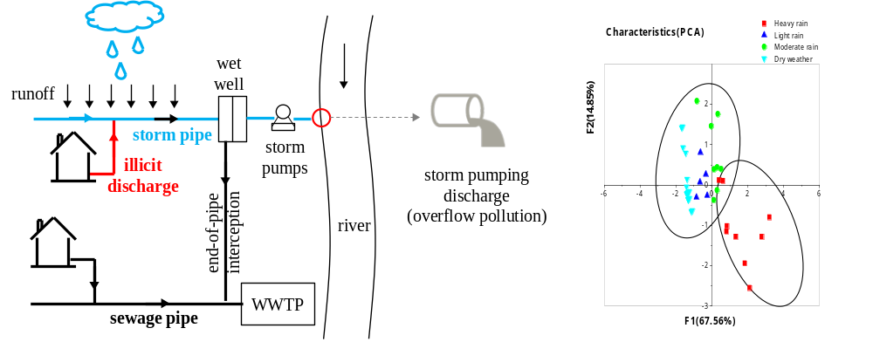
Highlights
1. Overflow pollution of storm drains on dry and wet weather days was probed.
2. Overflow pollution is highly related to sewage and sediments erosion in storm pipes.
3. First flush mostly occurs under heavy rain with early rainfall intensity peak.
4. Storm drains with serious sewage entry may not be better than combined sewers.
5. On-line treatment units could be better for storm drains with serious sewage entry.
Notes:
8

Slide 9
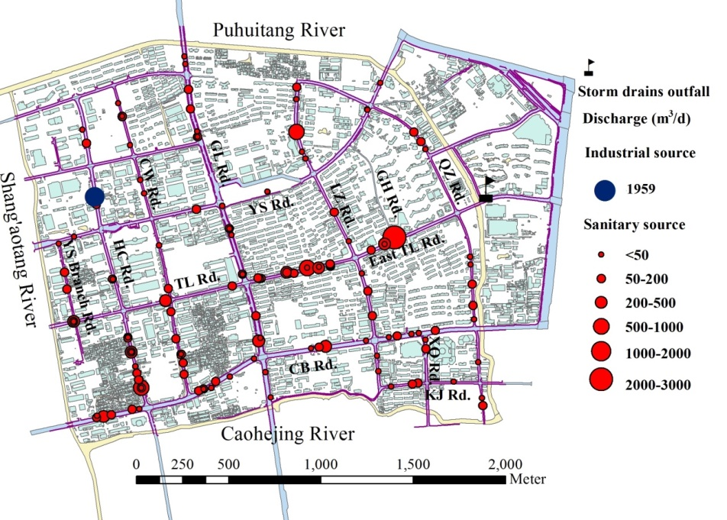
1. Site description
A typical high-density urbanized catchment (approximately 270 inhabitants/ha) in Shanghai’s downtown area, that is surrounded by three .
Completed in 1986, it is an area served by a separate sewer and storm drainage system covering 374 ha.
Non-storm water sources also found their way into storm drains and discharge in an untreated state into local watercourses, resulting in the receiving water bodies’ blackness and stench.
Notes:
9

Slide 10

1. Site description
Three ways of flows discharged from the storm drains:
Dry-weather discharge under gravity flow.
Sewage mixed with infiltrated groundwater flow from the storm drains on dry-weather days.
The sewage outflow was collected by end-of-storm pipe sewers and ultimately transported to the nearby wastewater treatment plant.
Notes:
10

Slide 11
1. Site description
2. Dry-weather discharge under storm pump operation
River water back flow into storm drains triggers storm pumps operation on dry-weather days. 28,593 m³ on average within duration of about 180 min per event.
The pumped non-storm water was discharged into the receiving watercourse, that is, storm drains overflow on dry-weather days.
Notes:
11

Slide 12
1. Site description
3. Wet-weather discharge under storm pump operation
The storm pumps are started to prevent the runoff from accumulating on the surface road and to drain the surface runoff into the nearby watercourse.
With an increase of rainfall intensity, the number of storm pumps put into operation increases. 13.8 m³/s to the maximum.
Notes:
12

Slide 13
2. Materials and methods
Samples were collected from the terminal wet well using an automatic vacuometric sampler (ISCO 6712, Teledyne, Lincoln, Nebraska, USA).
Dry-weather discharge under gravity flow: 11 events during the period Mar. 28, 2011 to May 7, 2012. Each monitoring event lasted 24 hours, with a fixed sampling time interval of 1 h.
Pumping discharge on dry-weather days: 10 events during the period May 4, 2011 to Mar. 27, 2012, with a sampling time interval of 20 min for each event.
Pumping discharge on wet-weather days: 23 rainfall events during the period Aug. 18, 2008 to Mar. 1, 2012, with a sampling time interval of 10–20 min for each event.
Notes:
13

Slide 14
2. Materials and methods
Water quality indicators:
Suspended solids (SS),
Chemical oxygen demand (COD)
Five-day biochemical oxygen demand (BOD₅)
Ammonia nitrogen (NH₃-N), total nitrogen (TN)
Total phosphorus (TP).
Dry-weather discharge under gravity flow: 11 events during the period Mar. 28, 2011 to May 7, 2012.
Pumping discharge on dry-weather days: 10 events during the period May 4, 2011 to Mar. 27, 2012.
Pumping discharge on wet-weather days: 23 rainfall events during the period Aug. 18, 2008 to Mar. 1, 2012.
Notes:
14

Slide 15
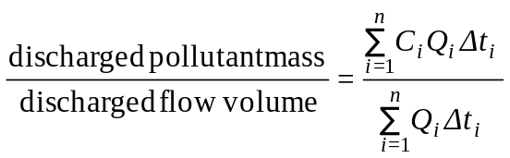
3. Results and discussions
(1) Event mean concentrations of storm drains discharges
EMCs=
Event mean concentrations (EMCs) of the study site and some combined sewers in Shanghai.
Discharge scenario | Statistical Parameters | SS | COD | BOD₅ | NH₃-N | TN | TP
Dry-weather discharge under gravity flow | EMC range | 61~175 | 117~284 | 40~85 | 20.3~29.0 | 24.8~32.4 | 2.8~4.7
 | EMC averaged | 135 | 188 | 61 | 25.6 | 29.4 | 3.76
 | SD | 31.4 | 47.2 | 13 | 2.86 | 2.40 | 0.56
 | CV | 0.23 | 0.25 | 0.1 | 0.11 | 0.08 | 0.15
Dry-weather discharge under pumping flow | EMC range | 117~319 | 195~807 | 82~145 | 18.9~29.3 | 27.6~37.2 | 2.08~10.3
 | EMC averaged | 194 | 327 | 110 | 24.8 | 31.0 | 4.64
 | SD | 91.7 | 175 | 25.7 | 3.41 | 3.02 | 2.42
 | CV | 0.47 | 0.54 | 0.23 | 0.14 | 0.10 | 0.48
Wet-weather discharge under pumping flow | EMC range | 80~336 | 47~714 | 16~126 | 1.4~33.6 | 5.9~42.2 | 0.60~8.16
 | EMC averaged | 172 | 290 | 96 | 15.0 | 20.8 | 3.32
 | SD | 81.2 | 169 | 35.1 | 8.05 | 7.64 | 1.67
 | CV | 0.47 | 0.58 | 0.53 | 0.54 | 0.37 | 0.50
Combined sewer overflows (Li, 2006) | EMC range | 30~140 | 113~436 | 40~184 | 6.4~14.1
 | EMC averaged | 110 | 268 | 101 | 9.5
 | SD | 39.6 | 131 | 56.6 | 3.14
 | CV | 0.36 | 0.49 | 0.56 | 0.33
Notes:
15

Slide 16
3. Results and discussions
Event mean concentrations (EMCs) of the study site and some combined sewers in Shanghai.
Discharge scenario | Statistical Parameters | SS | COD | BOD₅ | NH₃-N | TN | TP
Dry-weather discharge under gravity flow | EMC range | 61~175 | 117~284 | 40~85 | 20.3~29.0 | 24.8~32.4 | 2.8~4.7
 | EMC averaged | 135 | 188 | 61 | 25.6 | 29.4 | 3.76
 | SD | 31.4 | 47.2 | 13 | 2.86 | 2.40 | 0.56
 | CV | 0.23 | 0.25 | 0.1 | 0.11 | 0.08 | 0.15
Dry-weather discharge under pumping flow | EMC range | 117~319 | 195~807 | 82~145 | 18.9~29.3 | 27.6~37.2 | 2.08~10.3
 | EMC averaged | 194 | 327 | 110 | 24.8 | 31.0 | 4.64
 | SD | 91.7 | 175 | 25.7 | 3.41 | 3.02 | 2.42
 | CV | 0.47 | 0.54 | 0.23 | 0.14 | 0.10 | 0.48
Wet-weather discharge under pumping flow | EMC range | 80~336 | 47~714 | 16~126 | 1.4~33.6 | 5.9~42.2 | 0.60~8.16
 | EMC averaged | 172 | 290 | 96 | 15.0 | 20.8 | 3.32
 | SD | 81.2 | 169 | 35.1 | 8.05 | 7.64 | 1.67
 | CV | 0.47 | 0.58 | 0.53 | 0.54 | 0.37 | 0.50
The concentrations of pumping discharge are higher than those of gravity discharge, especially for SS and associated COD and BOD₅.
Phenomenon: when the storm pump starts, the water flowing velocity increases significantly; therefore sediments retained in the storm drains on dry-weather days would flush out, leading to an increased SS associated with COD and BOD₅.
The overflow concentration of COD could be up to 1000 mg/L or even higher.
Notes:
16

Slide 17
3. Results and discussions
Event mean concentrations (EMCs) of the study site and some combined sewers in Shanghai.
Discharge scenario | Statistical Parameters | SS | COD | BOD₅ | NH₃-N | TN | TP
Wet-weather discharge under pumping flow | EMC range | 80~336 | 47~714 | 16~126 | 1.4~33.6 | 5.9~42.2 | 0.60~8.16
 | EMC averaged | 172 | 290 | 96 | 15.0 | 20.8 | 3.32
 | SD | 81.2 | 169 | 35.1 | 8.05 | 7.64 | 1.67
 | CV | 0.47 | 0.58 | 0.53 | 0.54 | 0.37 | 0.50
Combined sewer overflows (Li, 2006) | EMC range | 30~140 | 113~436 | 40~184 | 6.4~14.1
 | EMC averaged | 110 | 268 | 101 | 9.5
 | SD | 39.6 | 131 | 56.6 | 3.14
 | CV | 0.36 | 0.49 | 0.56 | 0.33
The overflow concentration of storm drains was even worse than that of traditional combined sewers, especially for NH₃-N, due to the relatively in-line storage of the former case.
Retrospect: Separate sewer systems have been widely introduced since the early 1970s to circumvent the drawbacks of combined sewer systems.
Questionable!
Notes:
17

Slide 18
3. Results and discussions
(2) First flush effect
First flush effect does exist: best management practices are practical.
First flush effect doesn’t exist: best management practices are not practical.
  Definition: Storm water runoff typically contains significant amounts of anthropogenic pollutants as well as naturally occurring materials such as soil erosion. The early runoff in a storm event is often more contaminated than the later part of runoff, which may be due to several factors, including the mobilization of material accumulated during antecedent dry periods, a lack of dilution flow and a disproportionate runoff volume from the impervious surfaces, where pollutants may accumulate.
Notes:
18

Slide 19
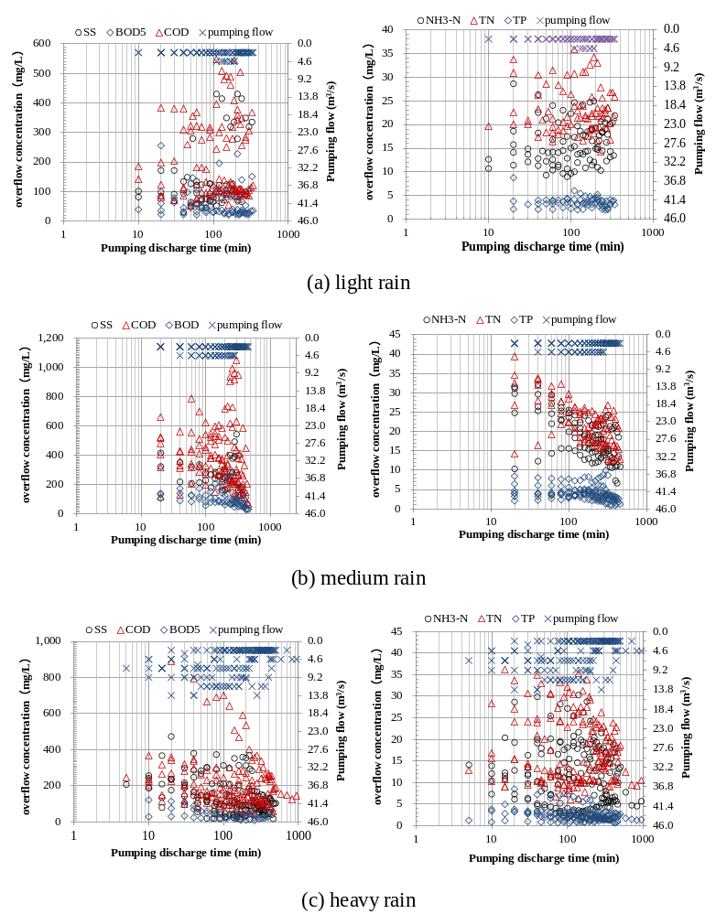
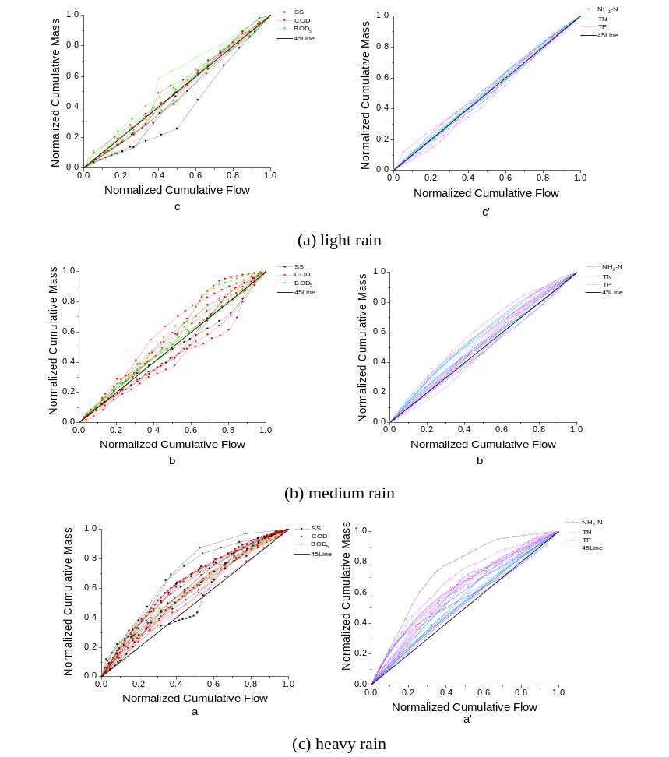
3. Results and discussions
(2) First flush effect
Monitored water quality data sets plotted with pumping discharge duration
M(v) curves for different water pollutant indicators during wet-weather pumping discharge.
Notes:
19

Slide 20
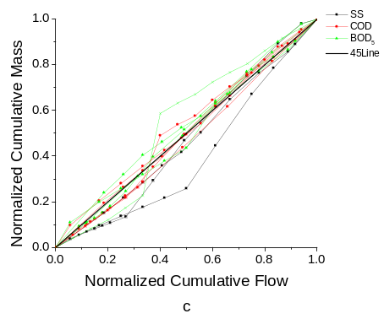
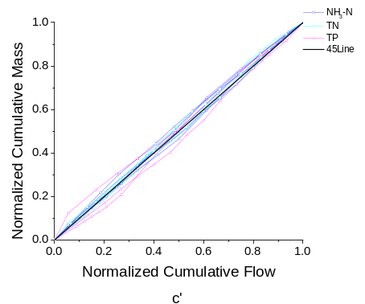
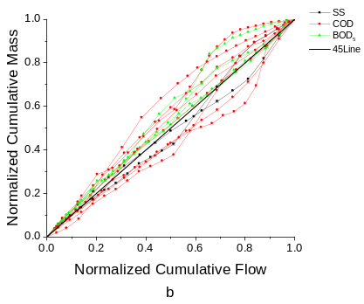
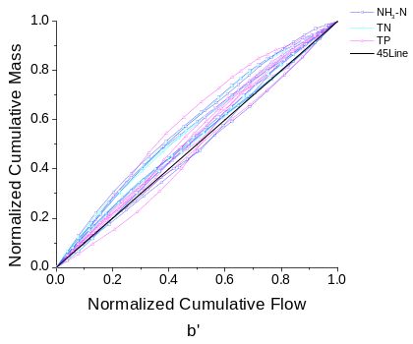
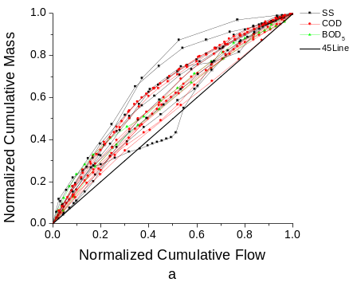
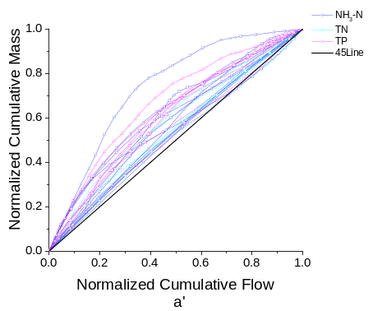




3. Results and discussions
(2) First flush effect and pollutant mass distributions
Light rain
Medium rain
High first flush
Medium first flush
Negligible first flush
Heavy rain
Notes:
20

Slide 21
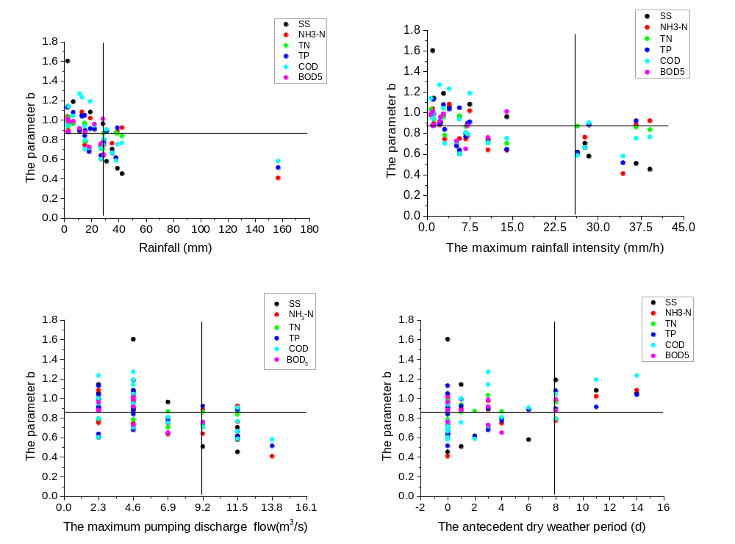
3. Results and discussions
(2) First flush effect and pollutant mass distributions
With the increase of rainfall, maximum rainfall intensity, and maximum pumping discharge flow, the first flush effect tended to be intensified.
Scenario: rainfall greater than 30mm, maximum rainfall intensity greater than 26.3 mm/h, and maximum pumping discharge flow greater than 9.2 m³/s.
Parameter b as a function of (a) rainfall, (b) maximum rainfall intensity, (c) maximum pumping discharge, and (d) antecedent dry weather period.
Notes:
21

Slide 22
3. Results and discussions
(2) First flush effect and pollutant mass distributions
with the increase of antecedent dry weather period, the first flush effect tended to be weakened. On condition that the antecedent dry weather period was above 8 days, the first flush didn’t occur.
For the storm drains with serious sewage entry, sediments deposition and the following sediments flush plays a more important role in weakening first flush effect as compared to that of combined sewers.
Parameter b as a function of (a) rainfall, (b) maximum rainfall intensity, (c) maximum pumping discharge, and (d) antecedent dry weather period.
Notes:
22

Slide 23
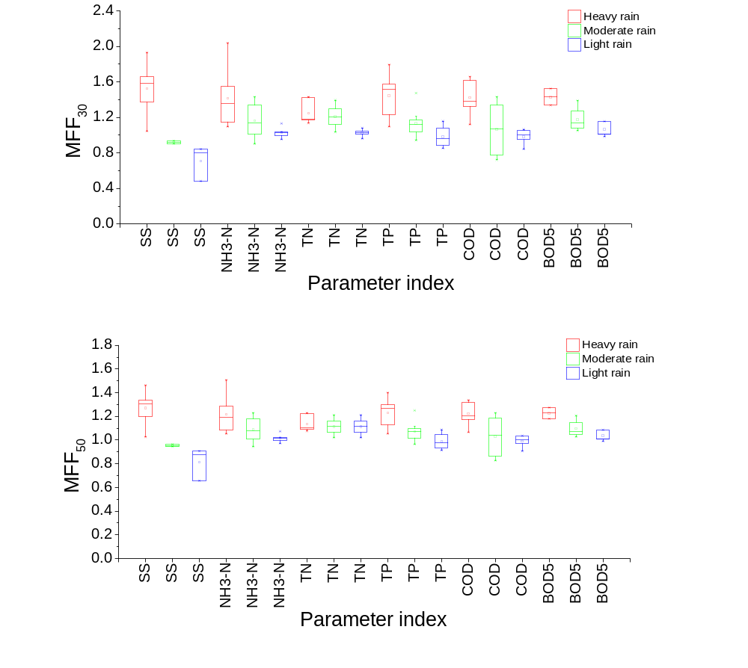
3. Results and discussions
(2) First flush effect and pollutant mass distributions
e.g. MFF₃₀ equal to 2.0 indicating 60% of the pollutant mass contained in the first 30% of the pumping discharge volume.
Reported catchments:
Typical of designed drainage system characterizing relatively high slopes that don’t allow sediments to accumulate, and a strong first flush may occur.
Our study site:
Exhibiting flat topography that don’t reduce sediment deposition by maintaining higher velocity, and severe sediment deposition within the storm drains would occur on dry-weather days.
MFF describes the fractional mass of pollutants emitted as a function of the pumping discharge process ranging from 0% to 100%
Notes:
23

Slide 24
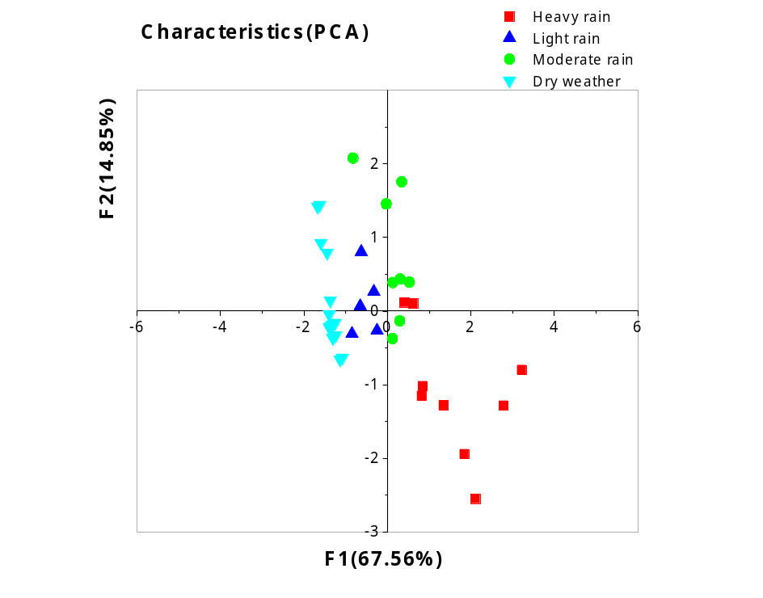
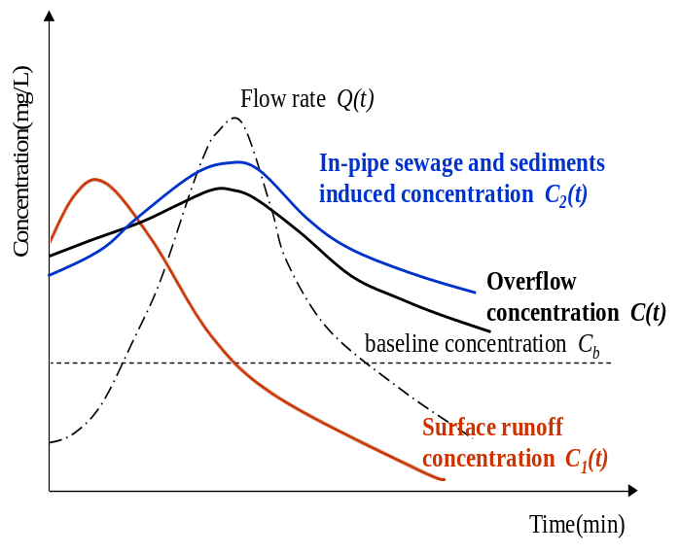
3. Results and discussions
(3) Overall pollution characteristics
The first cluster: the pumping events of dry-weather, light and medium rain.
The overflow concentration is predominantly decided by sewage and consistent sediments erosion within the storm pipes. No mass first flush or only weak first flush mostly occurs.
Notes:
24

Slide 25
3. Results and discussions
(3) Overall pollution characteristics
The second cluster: the pumping events of heavy rain.
The mass flush process is relatively slightly influenced by sewage and sediments erosion within the storm pipes.
The significantly increased pumping flow as well as surface road wash-off in the incipient rainfall, could trigger the mass first flush to some extent, especially for the rainstorm with early rainfall peak .
Notes:
25

Slide 26
4. Strategies
Strategy 1: Correcting the situation of sewage that illicitly enters the storm drains, especially the key entries featuring large amounts of wastewater discharge.
However, for widespread sewage connections to storm drains, point-by-point corrections may not be feasible in very busy downtown areas.
Notes:
26

Slide 27
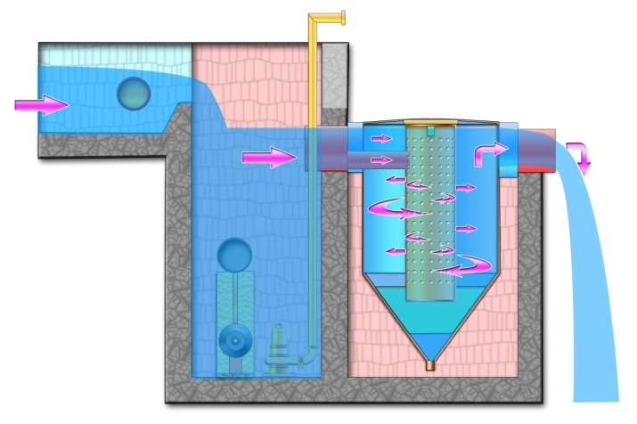
4. Strategies
Vortex separators
Treating a continuous overflow rate is a better strategy than treating the maximum amount of early part of the overflow.
On-line treatment-type units like water detention tanks combined with enhanced flocculation sedimentation tanks and vortex separators may be more effective to treat overflow pollutants continuously.
Notes:
27

Slide 28
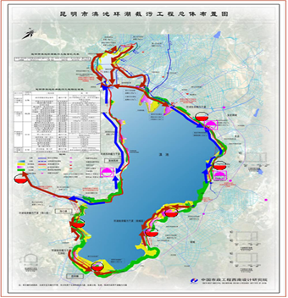
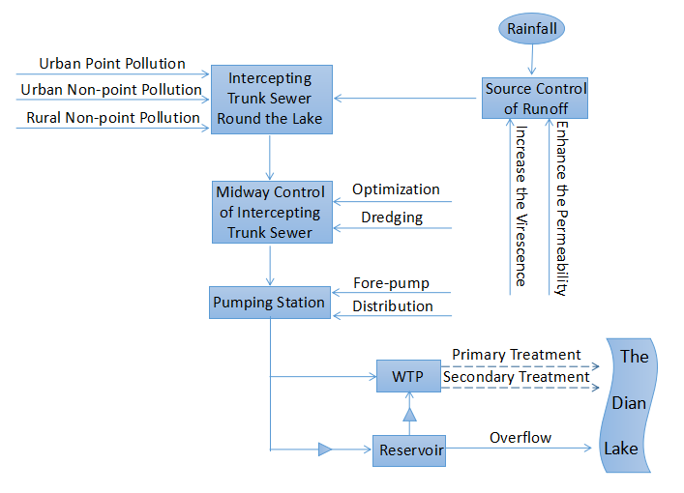
Supplementation: studies in Dianchi Lake, Yun’nan Province, China
(1) Source control. Reducing runoff coefficient will abate the overflow pollution by 24%;
(2) Midway control (wastewater interception system): Alleviating the sediments deposition within the sewer network, will abate the overflow by 45%;
(3) Midway Control (wastewater interception system): increasing the wet-weather interception capacity from one times of the dry-weather flow to three times of dry-weather flow, will abate the overflow pollution by 16%.
Notes:
28

Slide 29
Thanks for your attention!
xzx@stcsm.gov.cn
yinhailong@tongji.edu.cn
Notes:
29

