Slide 1


Small RNAs and Cross-Kingdom RNAi
in Plant-Microbial Interaction
Hailing Jin
Department of Plant Pathology & Microbiology
Institute for Integrative Genome Biology

Slide 2
Small RNAs
microRNAs
(miRNAs)
Small interfering RNAs
(siRNAs)
PolII
PolIV
RDR
DCL
DCL
AGO
AGO
M
M
M
M
M
RISC
RISC
Translation Inhibition
mRNA Degradation
Chromatin Modification

Slide 3
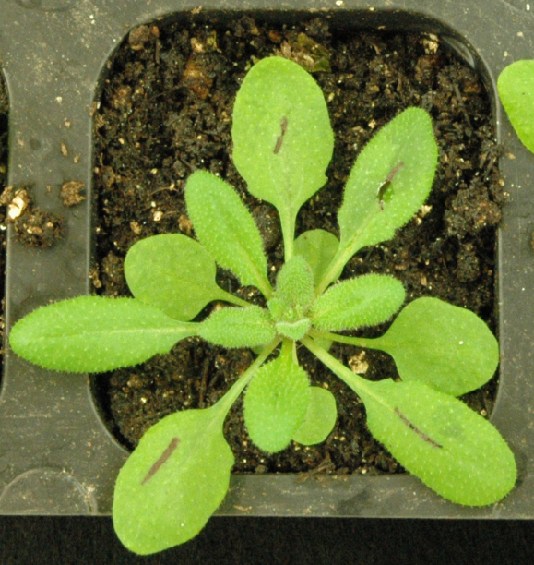
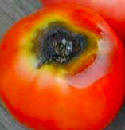
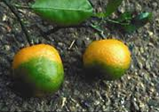
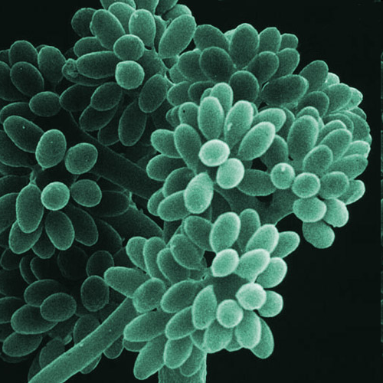
Small RNAs and Cross-Kingdom RNAi
in plant-pathogen interactions
Host endogenous small RNAs and RNAi machinery
Pathogen-derived small RNAs and Cross-Kingdom RNAi

Slide 4
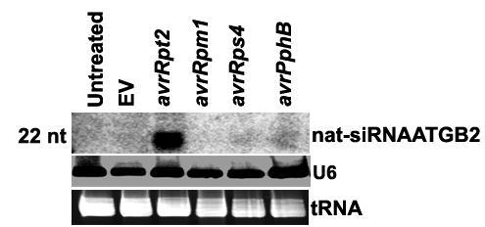
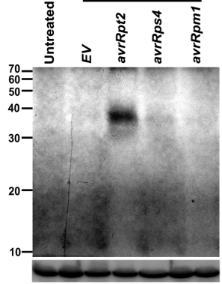
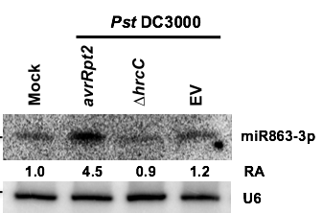
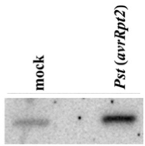

Pathogen-induced host small RNAs regulate immunity by suppressing negative regulators of plant defense
Pst
AtlsiRNA-1
U6
miR393b*
U6
PPRL
AtRAP
MEMB12
ARLPK1/2, SE
Negative Regulators of Plant Defense
Katiyar-Agawal et al.,
PNAS 2006
Katiyar-Agawal et al.,
Genes & Dev 2007
Zhang et al.,
Molecular Cell 2011
Niu et al.,
Nature Comm 2016

Slide 5
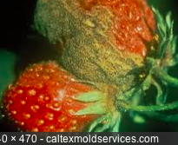

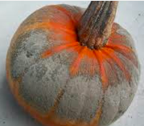
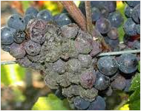

Fungal small RNAs in host pathogen interaction
Fungal Pathogen Plant Hosts
Botrytis cinerea
Gray mold disease
Super aggressive
Infect more than 200 species
including almost all the fruits
and vegetables
Has its own sRNA machinery

Slide 6
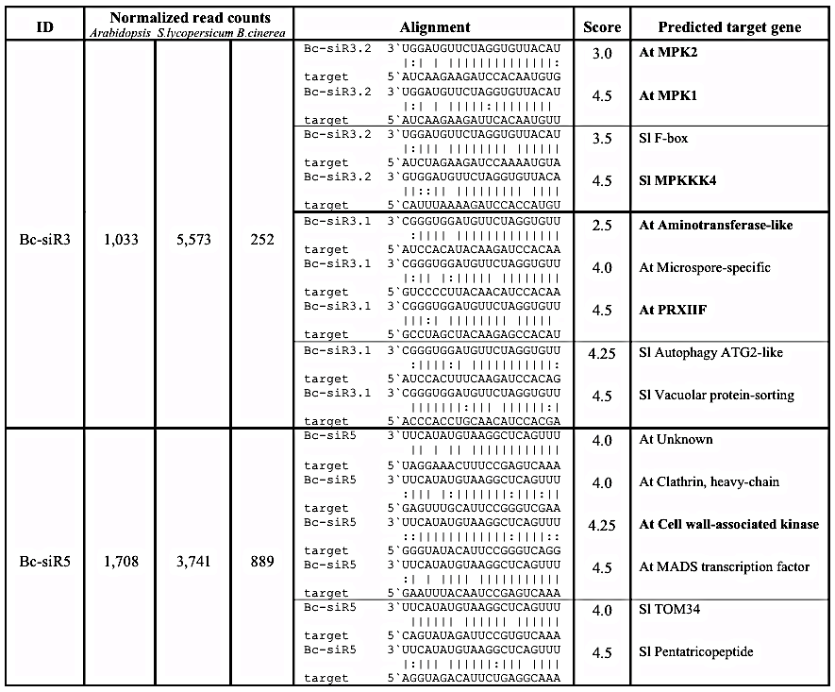
Some Bc-sRNAs have predicted targets in both Arabidopsis and tomato
73 Bc-sRNAs that present in both Arabidopsis- and tomato-infected libraries have predicted host targets in both hosts. (using stringent target prediction criteria)
12 out of 73 sRNAs have at least 2 targets belong to the same gene family, such as MPKs, NLRs, F-box proteins, WD-40, RLKs, etc.
Weiberg et al., Science 342, 118 (2013)

Slide 7
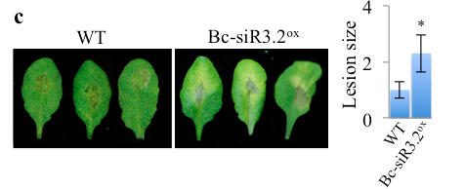
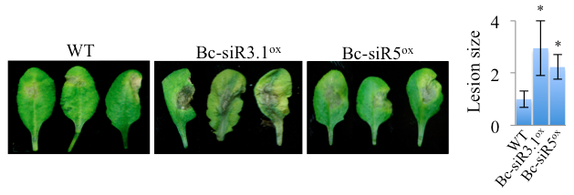
Transgenic plants expressing Bc-sRNAs display enhanced disease susceptibility to B. cinerea
Weiberg et al., Science 342, 118 (2013)

Slide 8
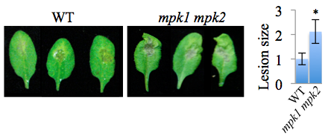
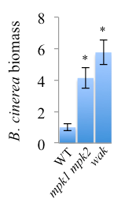
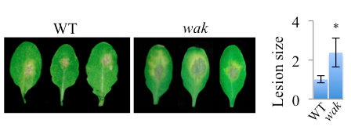
Arabidopsis target genes of Bc-sRNAs are important for host defense against Botrytis
Bc-siR3.2 Targets
MPK1 and MPK2
Bc-siR5 Target
WAK
Weiberg et al., Science 342, 118 (2013)

Slide 9
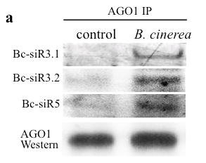
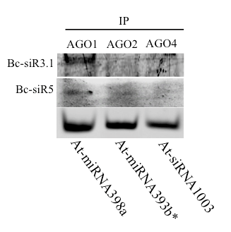
B. cinerea siRNAs hijack Arabidopsis AGO1 during infection to silence host genes
Bc-siR3.1 5`UUGUGGAUCUUGUAGGUGGGC
Bc-siR3.2 5`UACAUUGUGGAUCUUGUAGGU
Bc-siR5 5`UUUGACUCGGAAUGUAUACUU
AGO-IP
sRNA Analysis
Weiberg et al., Science 342, 118 (2013)

Slide 10
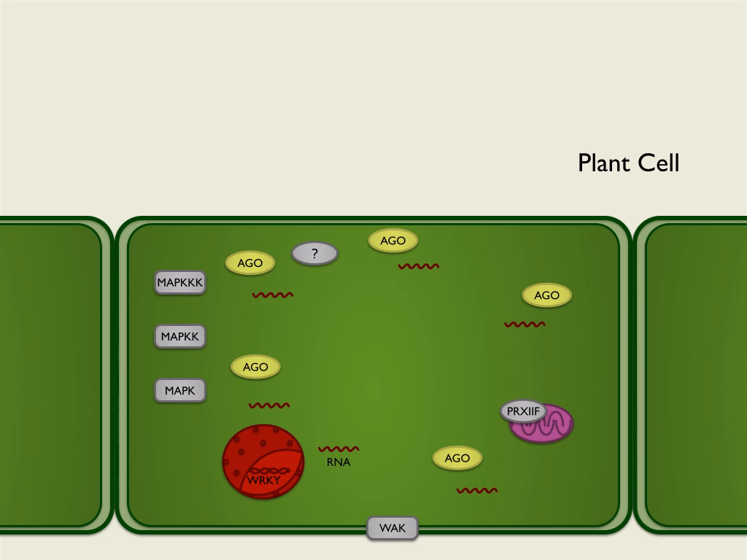
Naturally Occurring Cross-Kingdom RNAi
(as an Advanced Virulence Mechanism)
Weiberg et al., Science 342, 118 (2013)

Slide 11

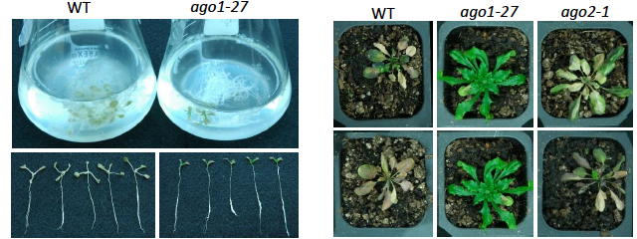
Is such cross-kingdom RNAi virulence mechanism present in other eukaryotic pathogens?
Another fungal plant pathogen, Verticllium dahliae, also depends on AGO1 function for its pathogenicity.
AGO1- and AGO2-IP
sRNA Analysis
We found more than 135 Vd-sRNAs have At Targets in AGO1-IP fraction, vs only 15 in AGO2-IP fraction
(using 100 rpm and 10 fold enrichment as cutoff)

Slide 12
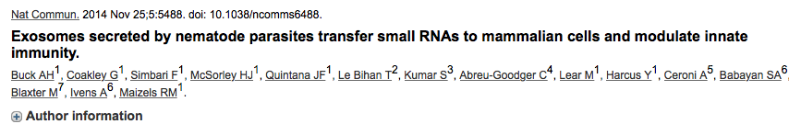
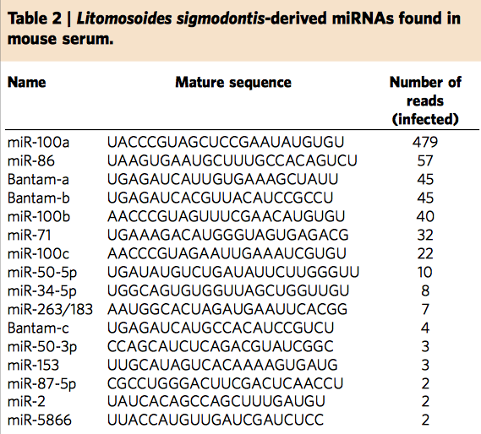
Similar Findings in Animal Systems
These parasite small RNAs suppress host genes involved in inflammation and immunity, including the receptor for the alarmin IL-33 and a key regulator of mitogen-activated protein kinase (MAPK) signaling

Slide 13
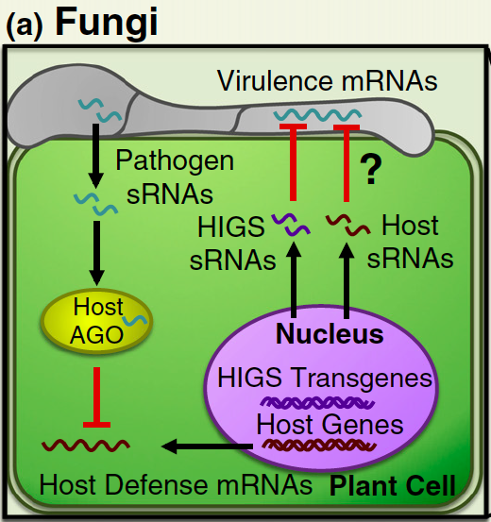
Can we develop an efficient way to control pathogens using small RNA effectors?
Is cross-kingdom RNAi bidirectional?

Slide 14
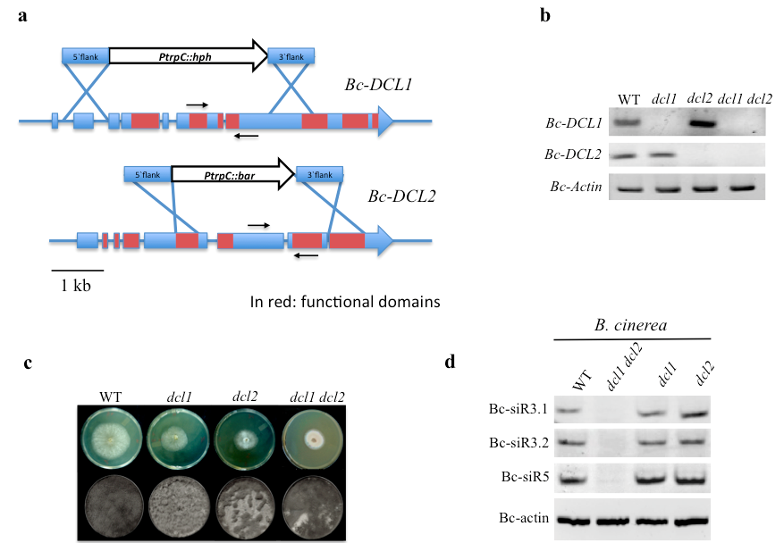
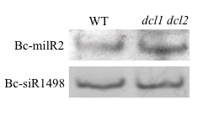
Bc-sRNA effectors are dependent on B. cinerea DCLs
Weiberg et al., Science 342, 118 (2013)

Slide 15
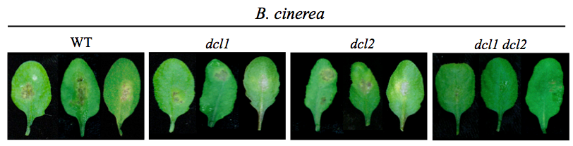
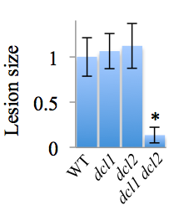
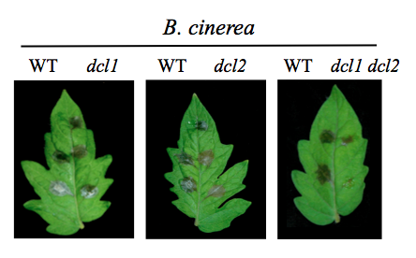
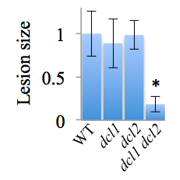
B. cinerea DCLs are essential for its pathogenicity
Weiberg et al., Science 342, 118 (2013)

Slide 16
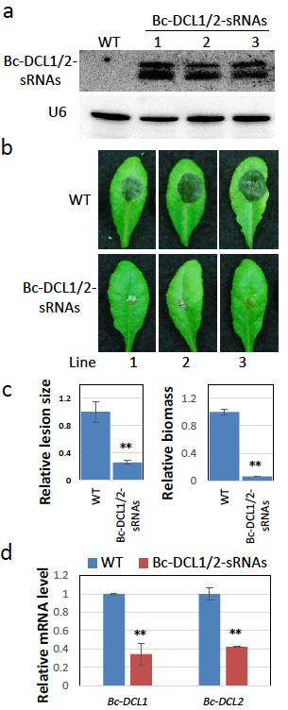
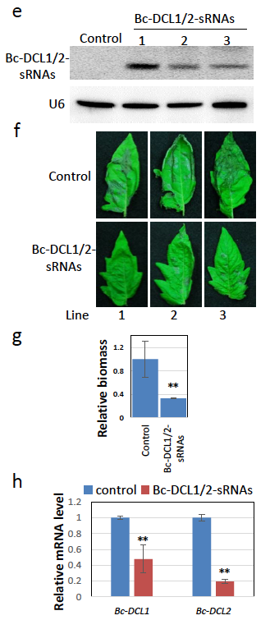
Plants expressing Bc-DCL1/2 targeting sRNAs are more resistance to B. cinerea infection
Cross-Kingdom RNAi is bidirectional

Slide 17
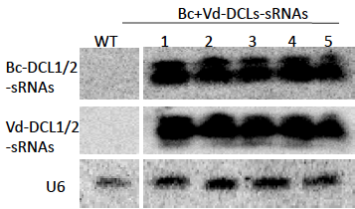
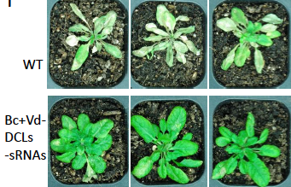
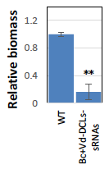
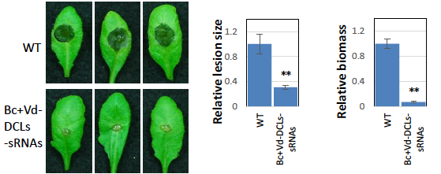
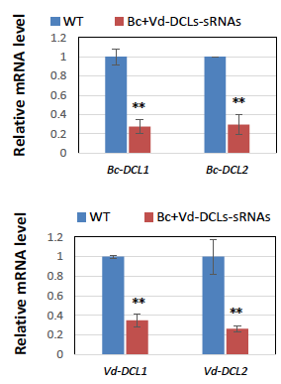
Cross-Kingdom RNAi-based disease control strategy allows targeting multiple pathogens
Verticillium resistance
Botrytis resistance

Slide 18
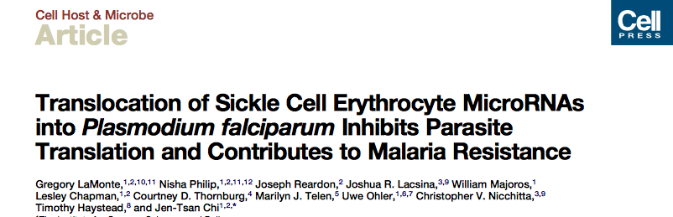
miR451 and let-7i are highly enriched in hemoglobin allele (HbS) heterozygous and homozygous erythrocytes, which contributes to resistance against P. falciparum.

Slide 19
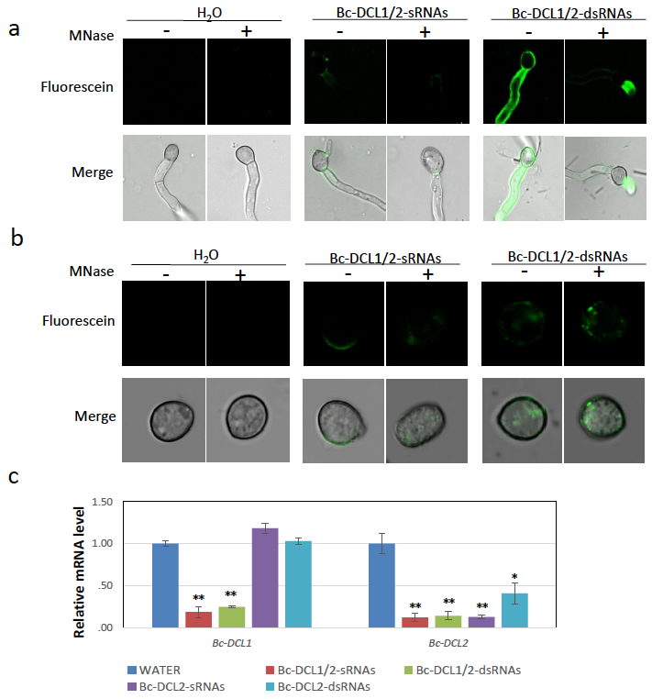
B. cinerea could uptake RNAs from environment

Slide 20
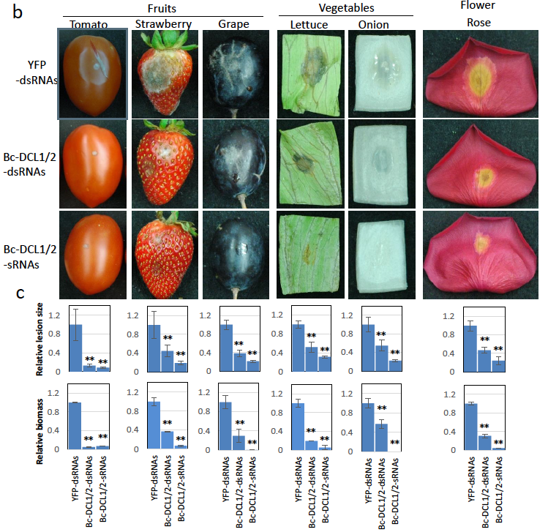
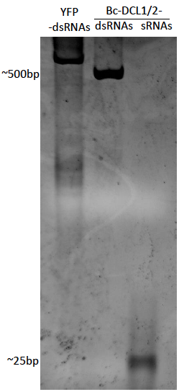
Spraying Bc-DCL1/2 dsRNAs or siRNAs inhibits infection
In vitro transcription

Slide 21
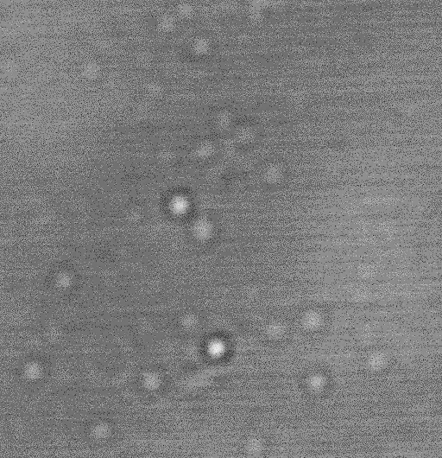
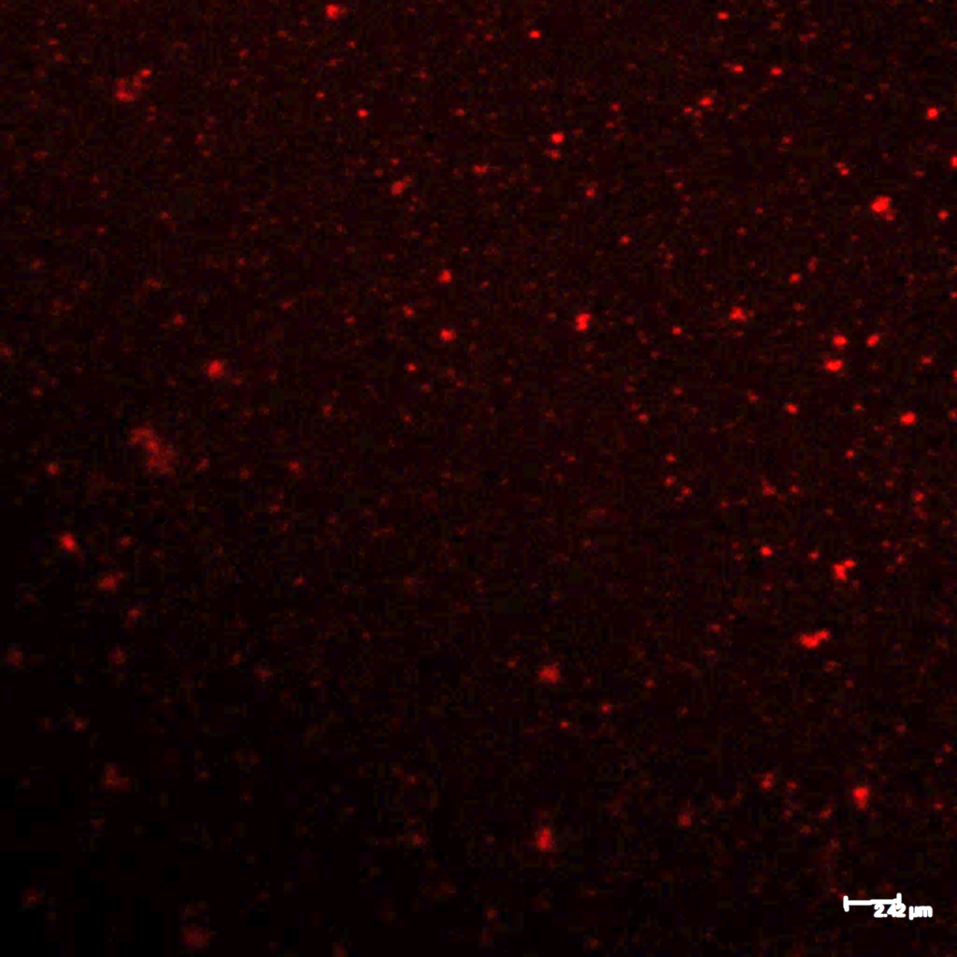
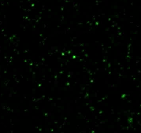
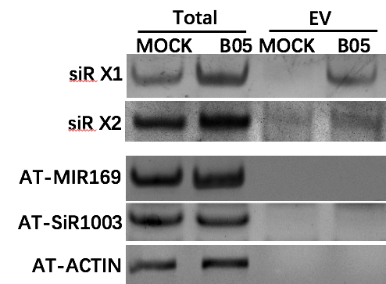
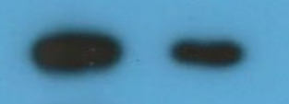


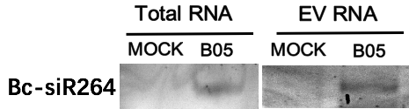
Plant and fungal sRNAs are present in extracellular vesicles
Bright field
FM-64 staining
35S:PEN1-GFP
0.5 μm
2 μm
2 μm
Total
EVs
PEN1-GFP
ARA6-GFP
WB: GFP
ARA7-YFP
Bc-siRY1

Slide 22
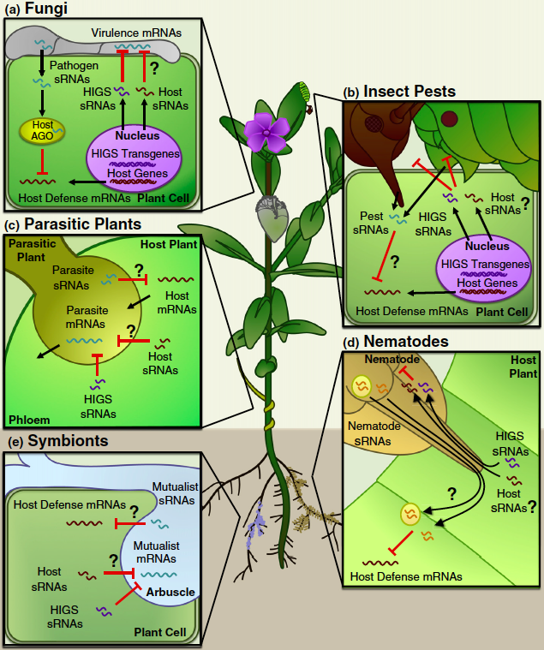
Cross-kingdom RNAi in host-pathogen/pest interaction
Weiberg et al., Curr. Opin. in Biotech. 2015

Slide 23
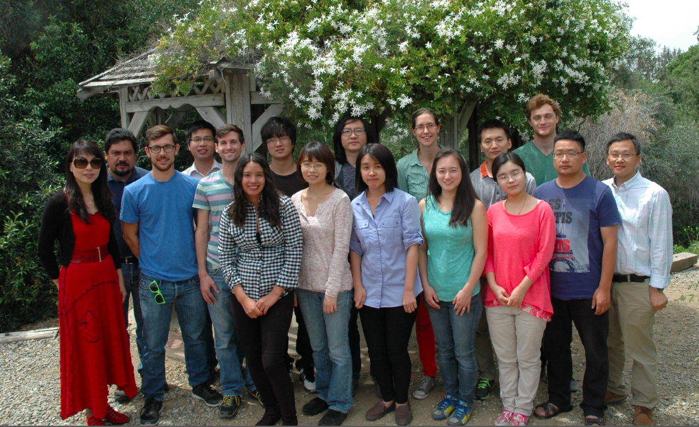



Acknowledgement
Arne Weiberg
Ming Wang
Yifan Lii
Dongdong Niu
Padmanabhan
Challeppan
Natasha Raikhel
Isgouhi Kaloshian
Bryan Huang
Feng-Mao Lin
Bart Thomma
Artur Jarmolowski
Sascha Laubinger
Mike Prigge
David Baulcombe
Herve Vaucheret
María Marcote
Petr Karlovsky
IOS
MCB
(CAREER)
NIH
(R01)
CRB

