Slide 1
Understanding the effects of steroid hormone exposure on regulation of P53 and Bcl-2 gene expression
T.S. WILEY
Wiley Compounding Systems
Genomics 2015

Slide 2
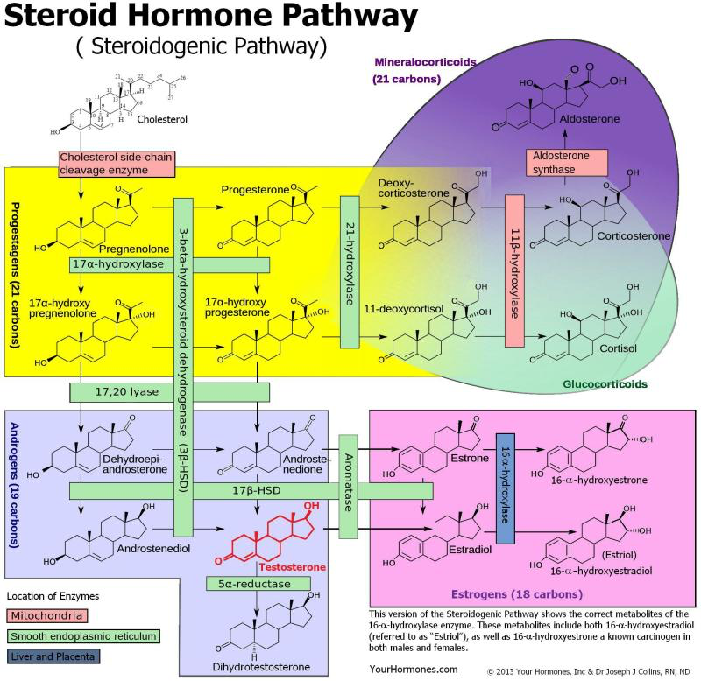
Steroid Hormones
Steroid hormones can be grouped into five groups by the receptors to which they bind: glucocorticoids, mineralocorticoids, androgens, estrogens, and progestogens.
Vitamin D derivatives are a sixth closely related hormone system with homologous receptors. They have some of the characteristics of true steroids as receptor ligands.
Adrenal Hormones
Cortisol
DHEA
Androstenediol
Sex Hormones
Progesterone
Testosterone
Estrogen

Slide 3
Steroid Hormones in Rhythmic Patterns
Control Gene Activation
Endocrine rhythms of all hormones control genetic regulation
In the womb – epigenetics
In the world – light, food, temperature, crowding
Genesis, fluorescence and decay (growth, stasis, death) in soft-tissue vs. nerve and skeletal tissue is controlled by steroid hormones in fetal development and throughout life

Slide 4
Regulatory Mechanisms of Steroid Hormones are Ancient and Ubiquitous.
450 Million years ago, estrogen receptors first appeared in jawless fish that do not have estrogen.
The human hormone progesterone has been document simple microscopic aquatic animals (rotifers) 100’s of millions of years ago.
The mechanisms of steroids from million of years ago are the same ones that govern the evolutionary changes we observe today.

Slide 5
Steroid Hormones and Homeostasis
Steroid Hormone Pathway
(Steroidogenic Pathway)
The expression of regulatory genes is critical for the sustainability of life. Through the production of protein complexes such as amino acids, enzymes, and steroid receptors, these regulatory pathways control how and when specific genes are expressed.
These cascades of steroid controlled gene activity can either enhance or diminish the level of functionality down stream of all other genes products throughout the body.

Slide 6
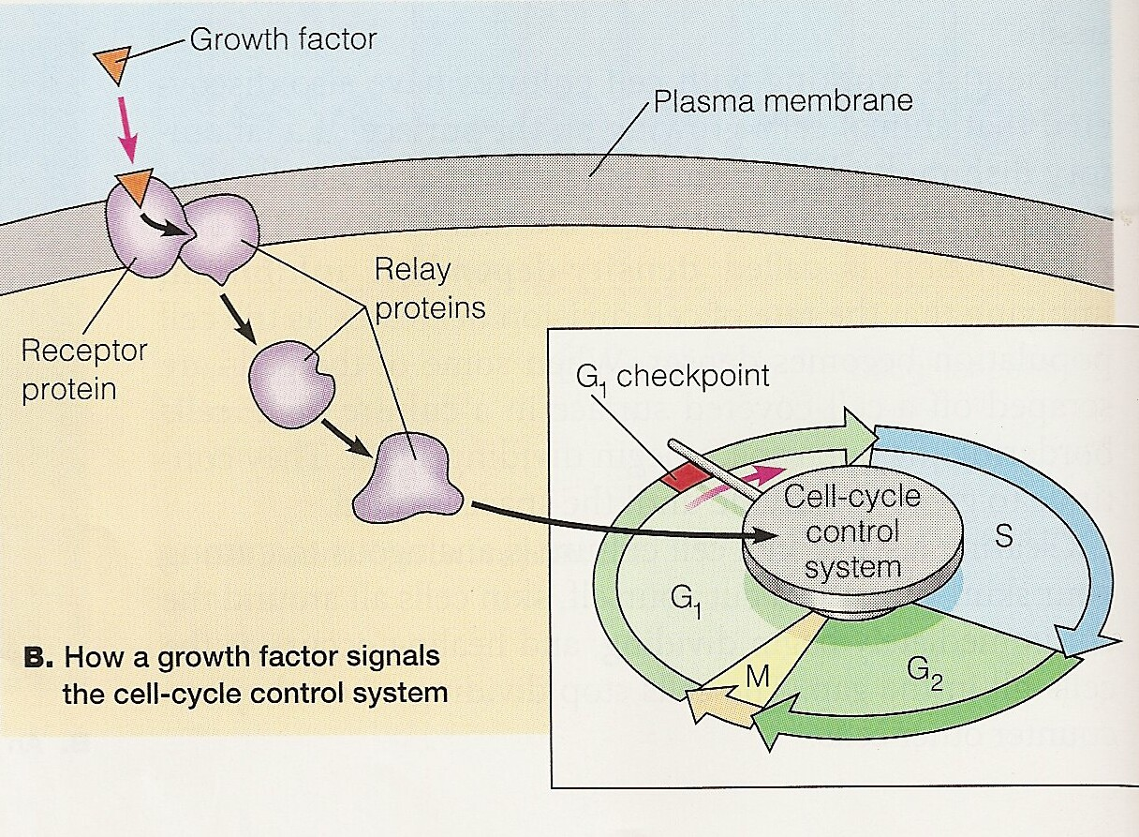
Steroid Hormones
Steroids exert a wide variety of effects, mediated by slow genomic as well as by rapid non-genomic mechanisms. They bind to nuclear receptors in the cell nucleus for genomic actions. Membrane-associated steroid receptors activate intracellular signaling cascades involved in non-genomic actions.

Slide 7
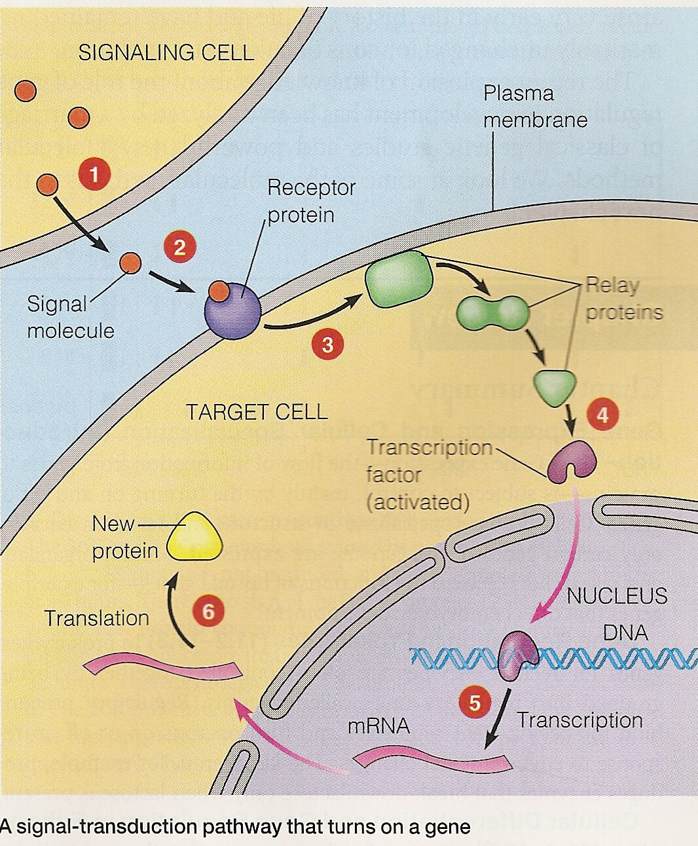
Steroid Hormones
Steroid hormones are critical to the natural development of multicellular organisms and complex cellular functions for all planets, animals, and insects by interpreting environmental cues.
Through the use of receptors and gene products, steroid hormones constantly control these regulatory systems using iterative hormone interactions. Since many diseases can be traced back to the amplified or silenced gene expression, understanding the mechanisms by which steroid hormones control or modify gene products is paramount for the medical community.

Slide 8
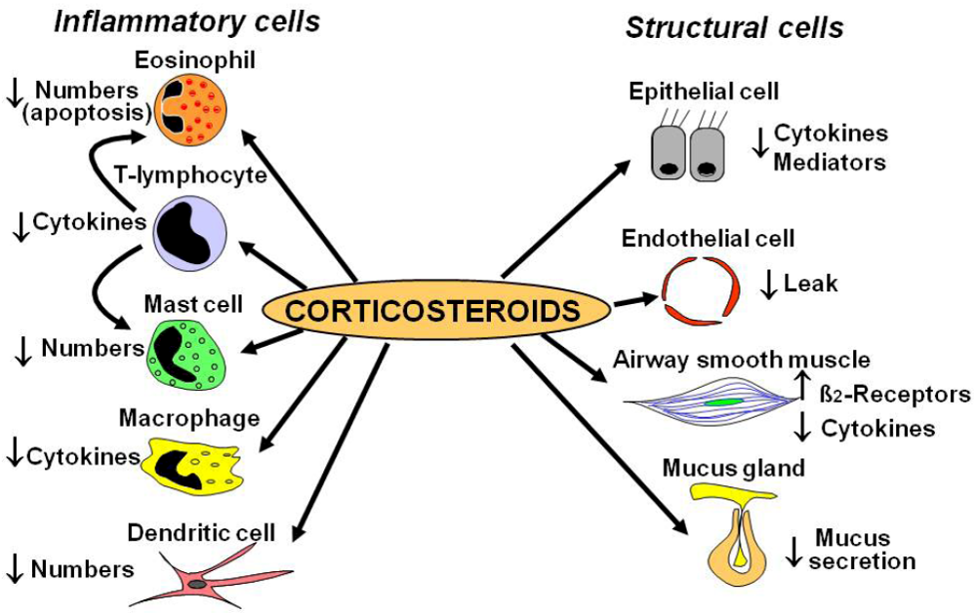
Example of Steroid Hormone Control
of Gene Expression
Glucocorticoids are one type of steroid whose method of controlling gene expression has been determined.
Works by controlling the mechanisms by which genes are regulated and control for expression.

Slide 9
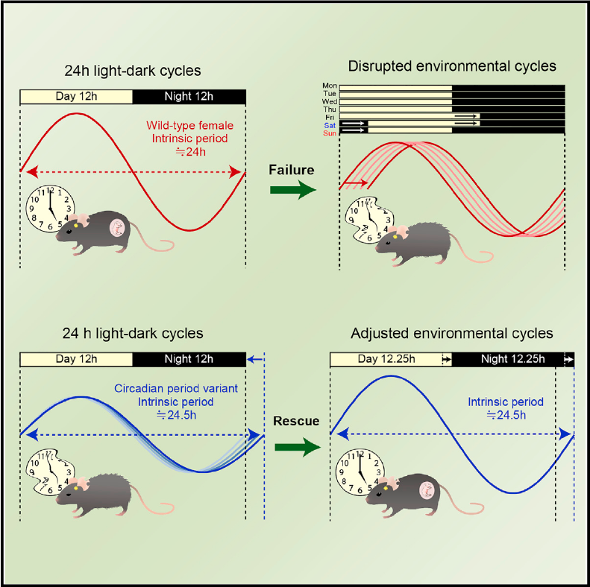
Daylight Control of Steroid Hormone
Regulation of Gene Expression
Takasu et al. show that weekly perturbation of the light-dark cycle disrupts estrous cycles in middle-aged female mice, and early infertility evident in female mice deficient in core circadian clock genes is improved by coordinating environmental and endogenous circadian rhythms. These findings suggest that an age-related decline in fertility may be rescued by control of environmental timing signals via Cortisol.

Slide 10
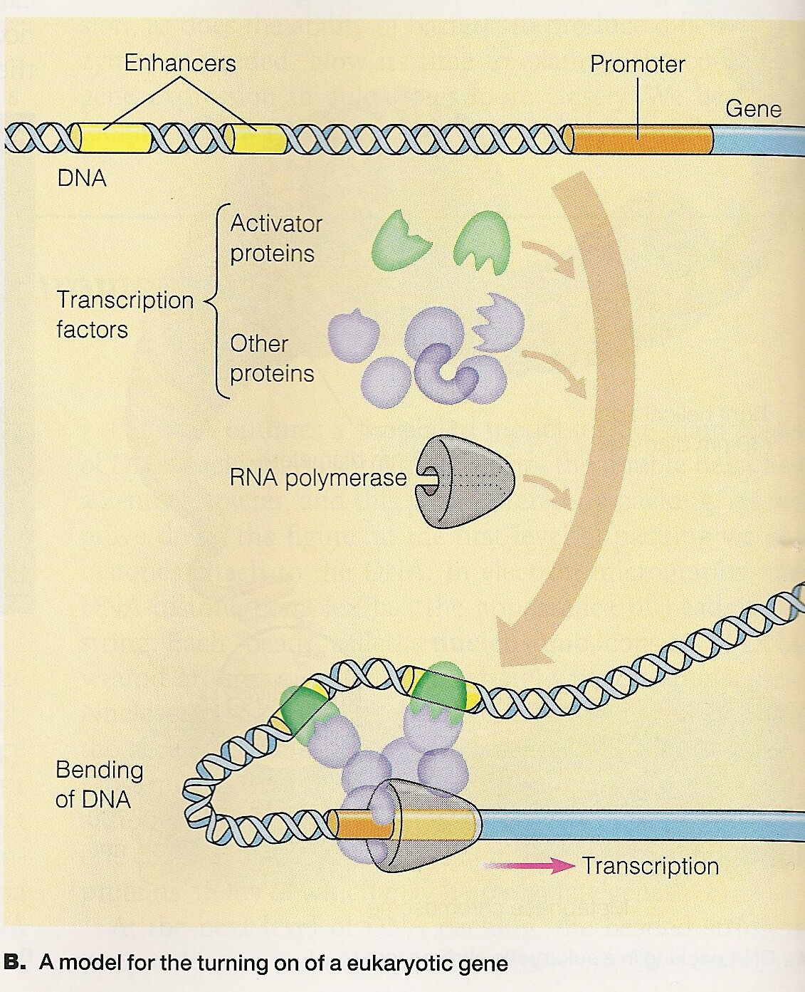
The Environment’s Effects on Genetic Transcription via Steroid Hormones
The environment communicates through steroid hormones to the nucleus of the cell to promoter regions and response elements.

Slide 11
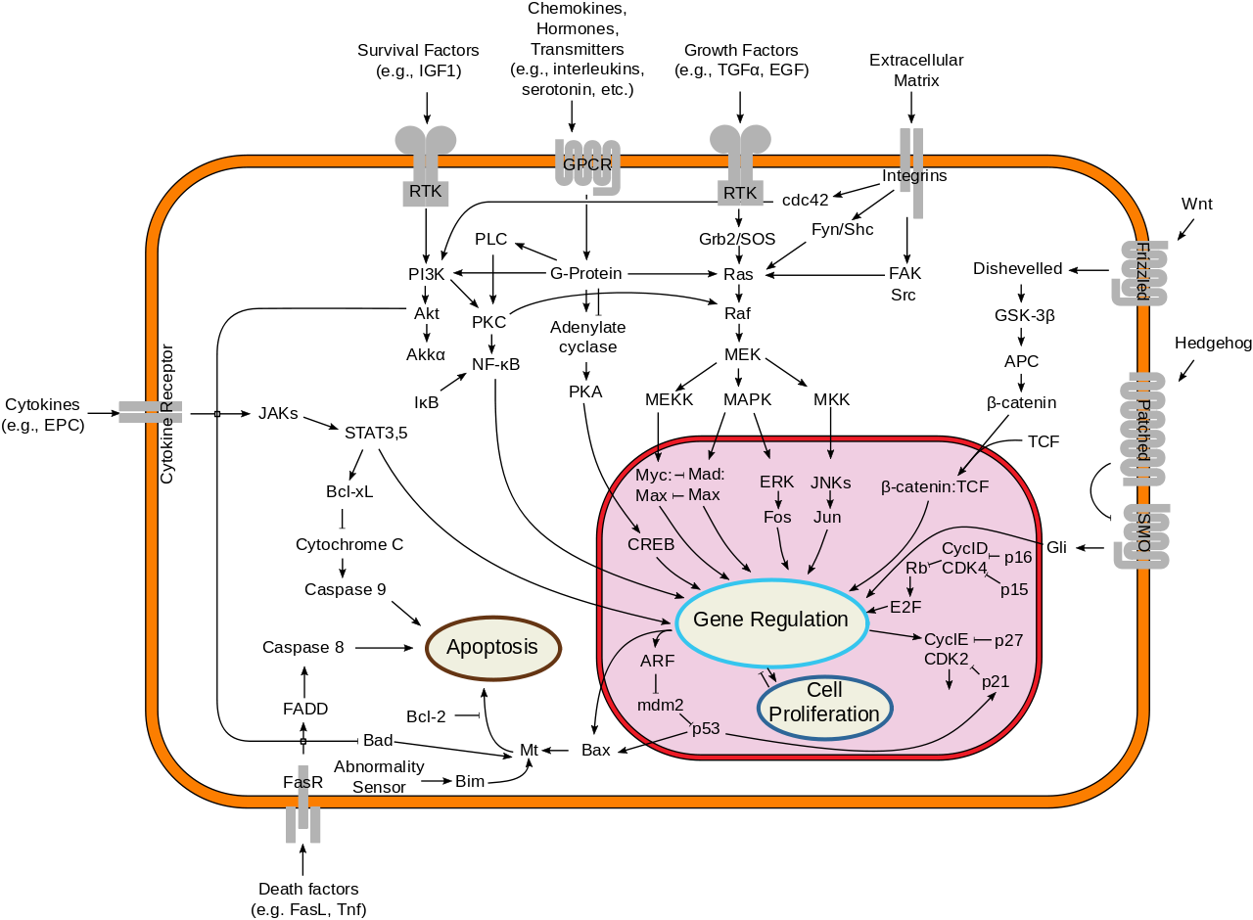

Slide 12
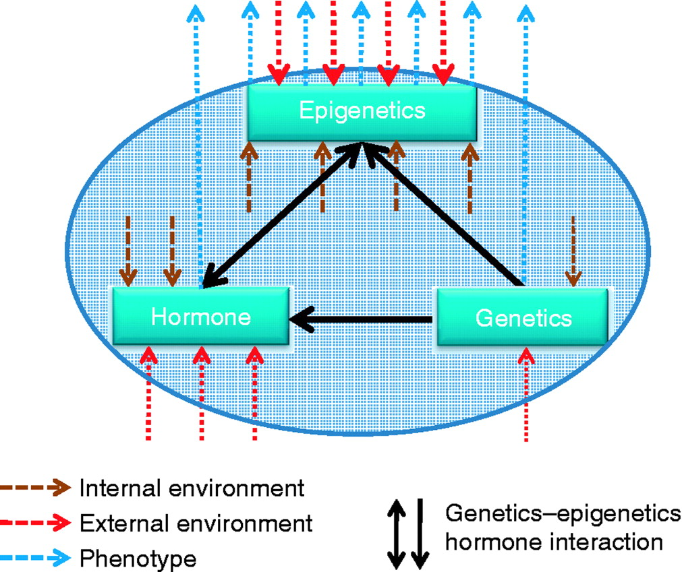

Epigenetic activity through methylation, histones, & RNAi links genetic changes to environmental adaptation via endocrine function
Transgenerational genetics

Slide 13
Epigenetic Steroid Driven Mechanisms

Slide 14
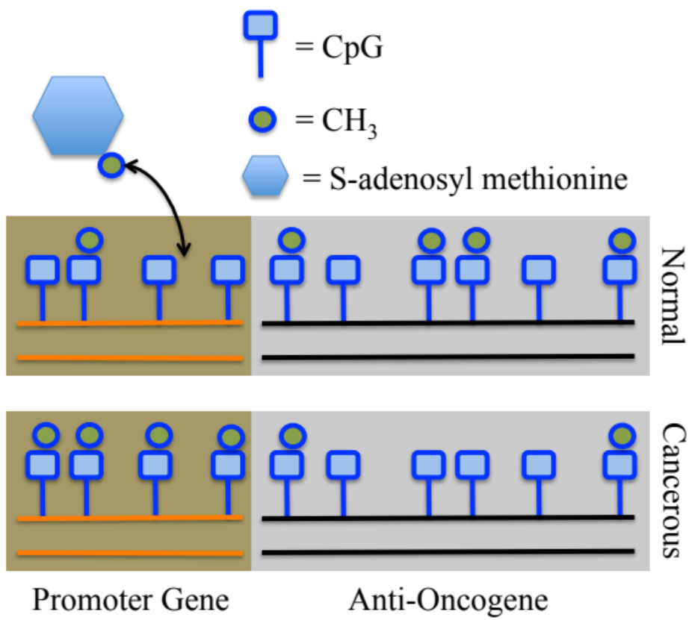
DNA Methylation
The methylation of DNA is a process in which a methyl group (CH3) bonds to the 5 position of cytosine (C) only. This process is critical for the development of organisms due to its control over cellular differentiation, and its ability to alter gene expression over evolution.
T.S. Wiley Med. Hypotheses (2014).

Slide 15
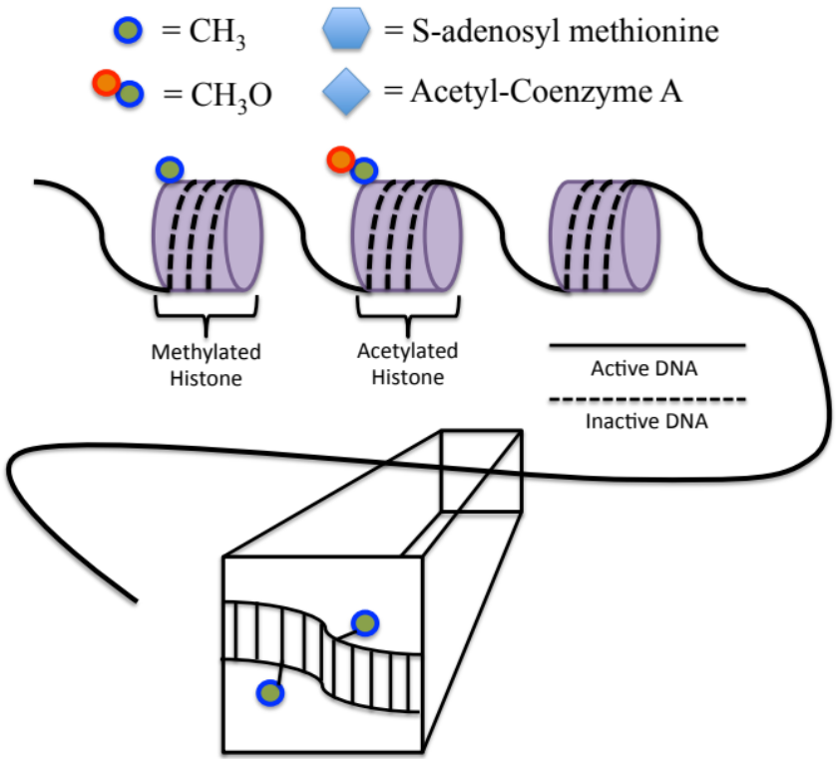
Histone Methylation
Histones are proteins that affect the compaction and contraction of DNA using tightly wound bundles called nucleosomes. Histones, through chromatin, control the winding and unwinding of DNA for transcription controlling the expression of the gene. When DNA needs to be transcribed, the histones unravel, allowing the DNA transcription process to occur.
T.S. Wiley Med. Hypotheses (2014).

Slide 16
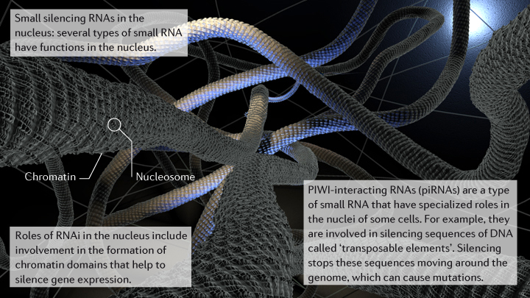
RNA interference
Nature Reviews Genetics
RNAi silencing is a critical process in eukaryotic cells (plants, animals, and fungi), because it can easily stop or enhance the production of vital gene products for functional or even evolutionary purposes. The silencing of gene products through RNAi is critical for an organism’s protection against viral infections or even cancer. The under or over expression of various gene products creates an instability in the cell.

Slide 17

learn.genetics.utah.edu/content/epigenetics/intro/

Slide 19
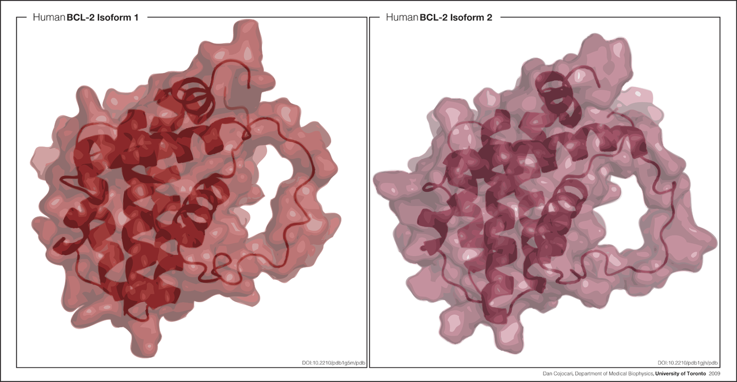
Bcl-2 – Cellular Protective protein
PNAS 98: 3012-3017 (2001)
The two isoforms of Bcl-2, Isoform 1, also known as 1G5M, and Isoform 2, also known as 1G5O/1GJH, exhibit similar fold. However, results in the ability of these isoforms to bind to the BAD and BAK proteins, as well as in the structural topology and electrostatic potential of the binding groove, suggest differences in anti-apoptotic activity for the two isoforms.

Slide 20
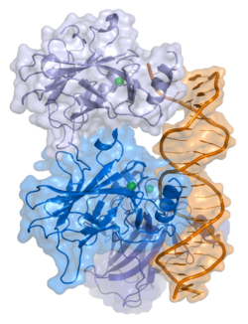
P53 – Tumor Suppressor Protein
It can activate DNA repair proteins when DNA has sustained damage. Thus, it may be an important factor in aging.
It can arrest growth by holding the cell cycle at the G1/S regulation point on DNA damage recognition (if it holds the cell here for long enough, the DNA repair proteins will have time to fix the damage and the cell will be allowed to continue the cell cycle).
It can initiate apoptosis – programmed cell death – if DNA damage proves to be irreparable.
Developmental Biology, 10th ed. USA: Sinauer Associates, Inc. Publishers

Slide 21
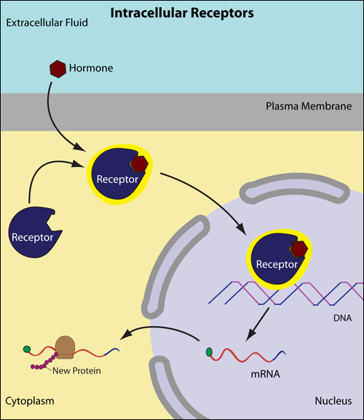
Steroid hormones: P53 and Bcl-2
The normal cycles of estrogen and progesterone manifest predictable regulatory gene expression through the repression or expression of genes like P53 and Bcl-2 and their gene products, which are timed throughout the cycle as well as initiating cascades of other functional gene products. The normal cycle consists of an estrogen peak on day 12. This produces an increase in Bcl-2 until day 12 and a decrease in P53. On day 21, the progesterone peaks and commands the cells to begin apoptosis and signals a decrease in Bcl-2 by blocking E2 and an increase in P53. This allows for regulation and control of the increase and decrease of cells all over the body.
Phosphorylation

Slide 22
For Example:
Steroid Hormone Effects on Regulatory Genes in Breast Cancer
Decrease in hormone levels in mid-life causes a decrease in the regulatory mechanisms of the body.
Lack of proper regulatory mechanisms increase the risk of cancerous growth.
Therefore, we want to look at the possibility of controlling these mechanism through external control of hormone levels.

Slide 23
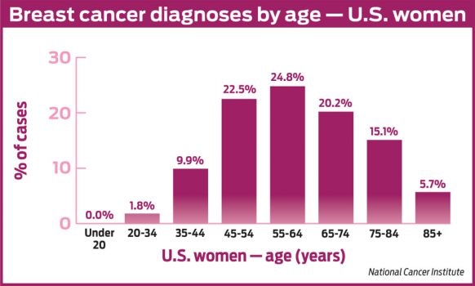
Breast cancer by age

Slide 24
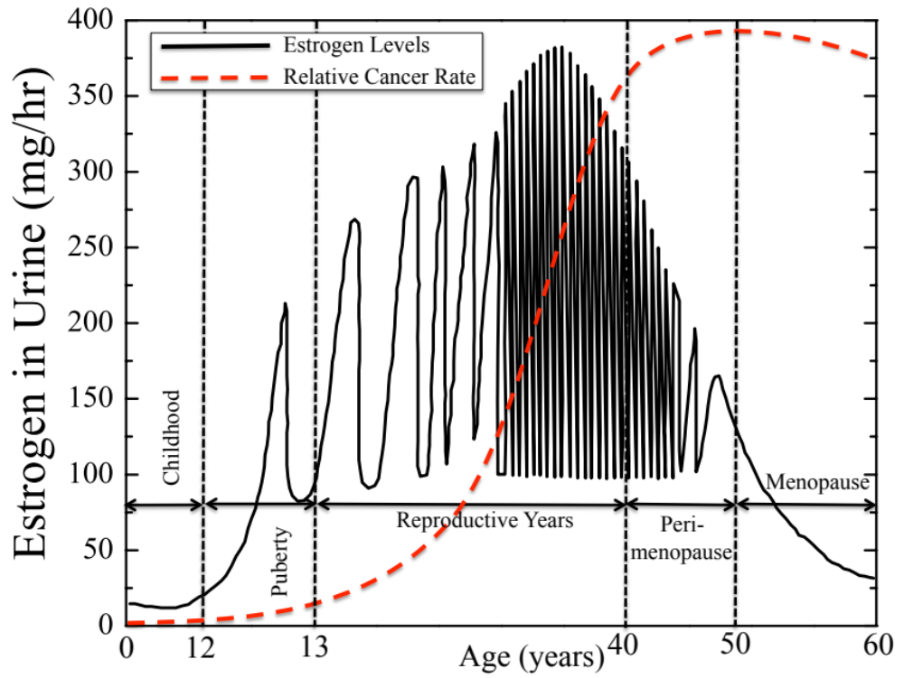
The Hormone Estrogen Over a Woman’s Lifetime
T.S. Wiley Med. Hypotheses (2014).

Slide 25
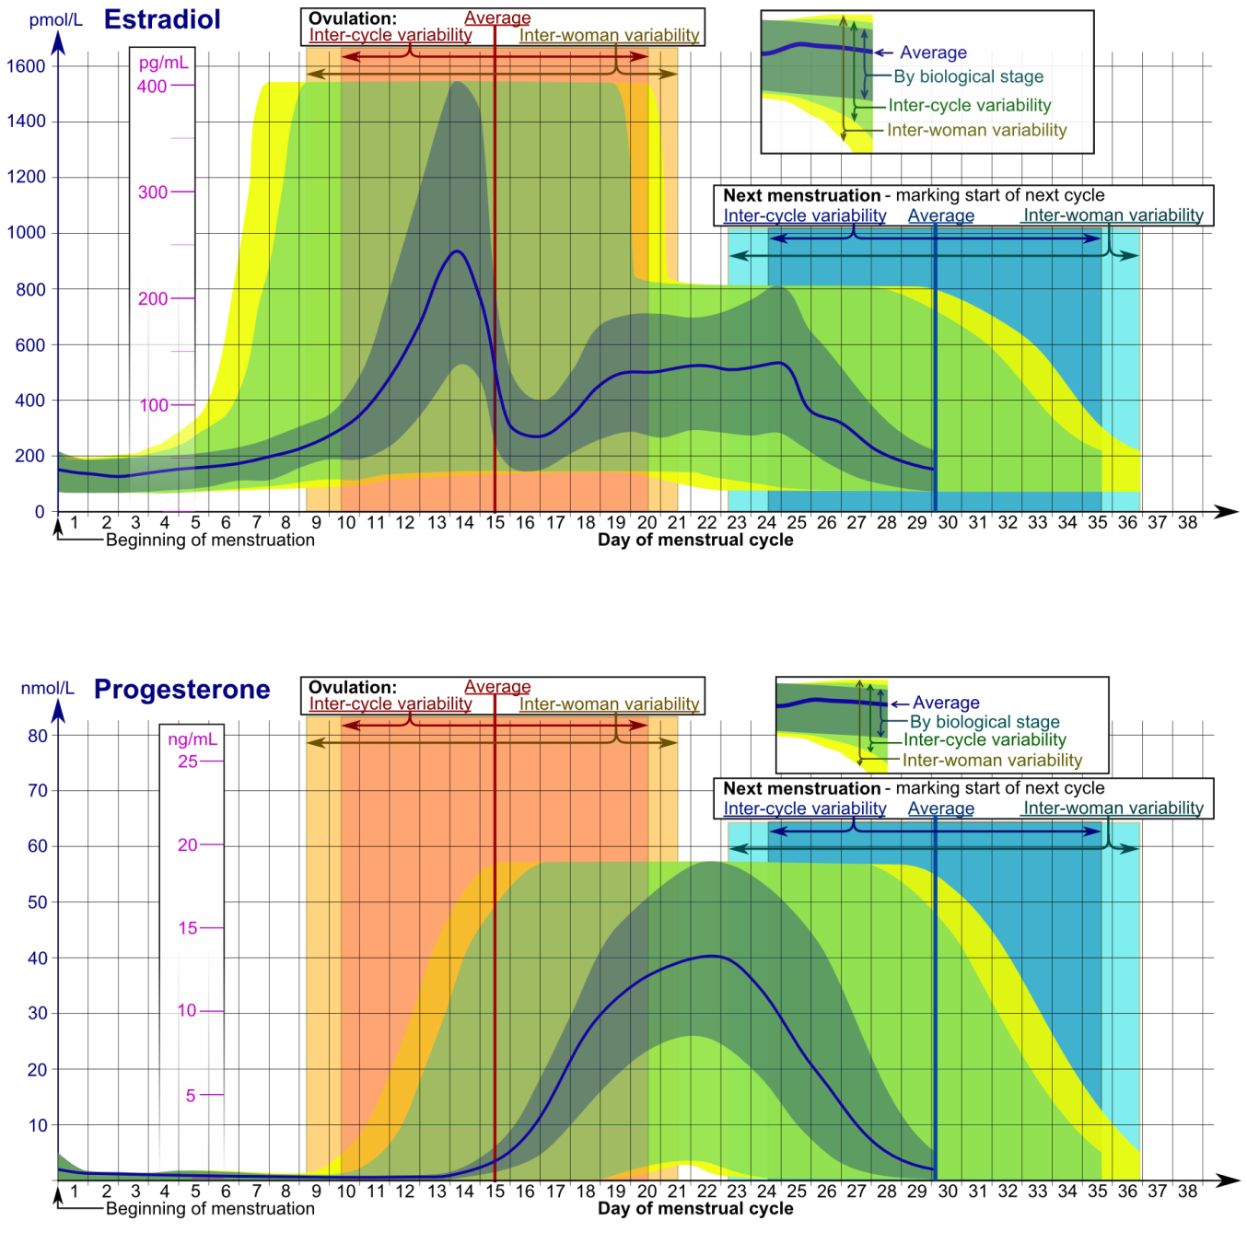
Estrogen & Progesterone
Over 28 Days

Slide 26
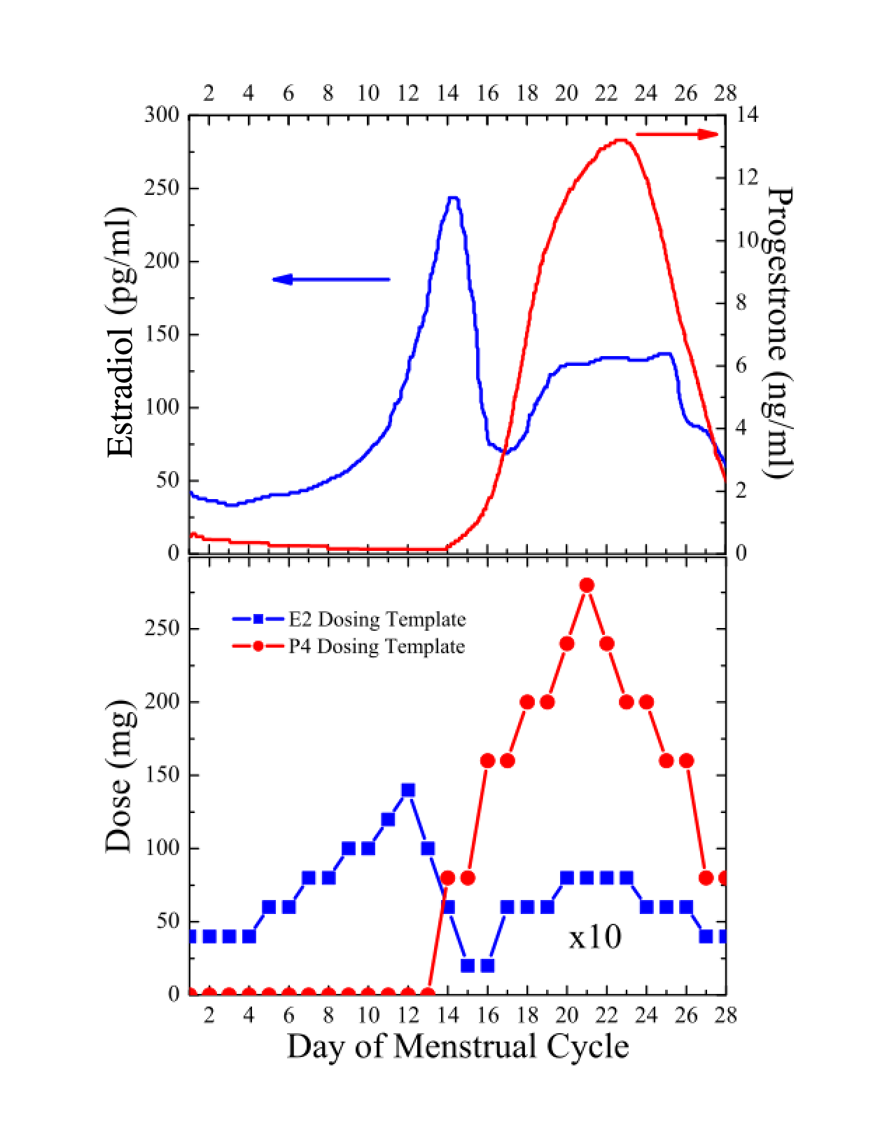
Control of P53 and Bcl-2 for Growth & Death
FSH
Day 12
G1 arrest & PR Provocation
LH
Day 21
Apoptosis
E2
P4
P53
Bcl-2
P53
Bcl-2
T.S. Wiley Med. Hypotheses (2014).

Slide 27
Bio-mimetic, Bio-identical
We refer to the only bio-mimetic, bio-identical hormone treatment available, because it is such a regimen that takes these normal templates of reproductive fitness into account. The reestablishment of this well-established template of hormone production may control gene expression as well. This therapy provides transdermal hormones that consist of estrogen and progesterone provided topically. Recent unpublished studies of this regimen have demonstrated that women have an increase in sleep, energy, bone growth and diminished uterine overgrowth and other tissue controls.
T.S. Wiley Med. Hypotheses (2014).

Slide 28
Proposed Clinical Experiment
Day 12
Day 21
Three groups: young, reproductive, post-menopausal women on Biomimetic E² & P⁴
Three study corridors: static,
bio-mimetic, and none
Test blood spots on days 12 and 21 for expression and repression of P53 and Bcl-2
Goal: Test if Bio-mimetic treatment restores normal youthful gene activity
E2
P4
P53
Bcl-2
P53
Bcl-2
?
?
?
?

Slide 29
Conclusion
Overall, we propose that steroid hormones affect gene expression through changes in both amplitude and frequency of dosing or exposure. A key example of this would be through the changing of hormones in women during a menstrual period. Advances in hormone replacement therapy provide a wide range of testable parameters for this claim. We suggest the investigation of the expression of P53 and Bcl-2 in both peri- and post-menopausal women.
T.S. Wiley Med. Hypotheses (2014).

Slide 30




Dynamic Damage
The basic dynamics of evolution includes creativity
Evolution is not just adaptation, it is an iterative process with a living environment
Evolution is an ongoing dance, a conversation
If you change the environment, it changes you… through hormone action

Slide 31
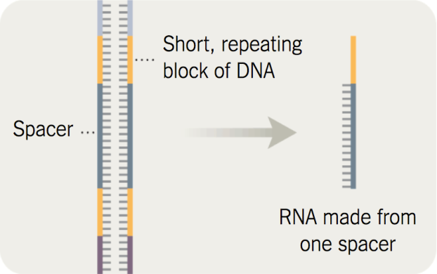
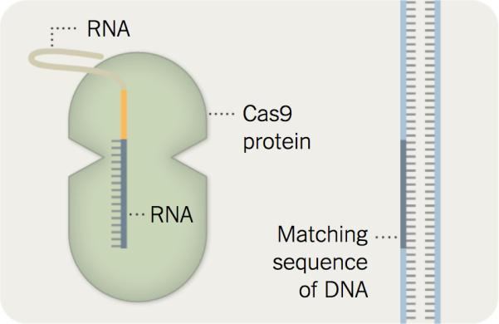
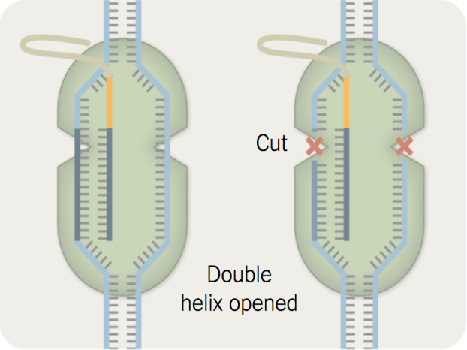
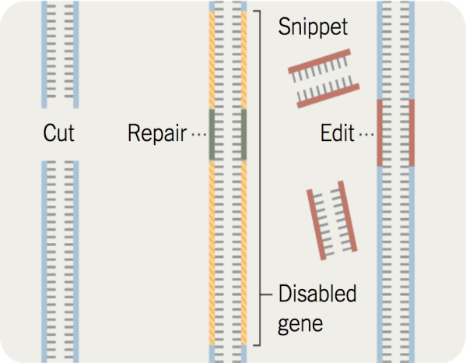
Using Steroids for Good, Not Evil
Dr. Doudna, Biochemist, University of California, Berkeley
Found a relatively easy way to alter any organism’s DNA, just as a computer user can edit a word in a document.
Doudna J. The new frontier of genome engineering with CRISPR-Cas9. Science. 2014 Nov 28; 346(6213)

Slide 32
Relevant Publications
Wiley TS, Haraldsen JT. The theory of modulated hormone therapy for the treatment of breast cancer in pre- and post-menopausal women. AIP Advances. 2012;2:011206.
Wiley TS, Haraldsen JT. The effects of steroid hormone exposure on direct gene regulation. Med. Hypotheses. 2014;83:436-440. http://dx.doi.org/10.1016/j.mehy.2014.07.010
Wiley TS, Odegard, Raden J. Haraldsen J.T. The standardization of non-sterile compounding: A study in quality control and assessment for hormone compounding. International Journal of Pharmaceutical Compounding. 2014;18(2):162.
Formby B, Wiley TS. Progesterone inhibits growth and induces apoptosis in breast cancer cells: inverse effects on Bcl-2 and p53. Ann Clin Lab Sci. 1998 Nov 1;28(6):360–9.
Taguchi J. Observational report of transdermal rhythmic bio-identical hormones in an oncology population. IRB # 07- 80

Slide 33
Relevant Publications
Takasu N. Recovery from Age-Related Infertility under Environmental Light-Dark Cycles Adjusted to the Intrinsic Circadian Period. Cell Reports. 2015 Sept 1; 12(9):1407-13
Waszak M. Population Variation and Genetic Control of Modular Chromatin Architecture in Humans. Cell. 2015 Aug 27; 162(4): 1039-50
Jinek M. A Programmable Dual-RNA–Guided DNA Endonuclease in Adaptive Bacterial Immunity. Science. 2012 Aug 17; 337(6096):816-21
Baltimore D. A prudent path forward for genomic engineering and germline gene modification. Science. 2015 Apr 3; 348(6230):36-8
Wiedenheft B. RNA-guided genetic silencing systems in bacteria and archaea. Nature. 2012 Feb 5; 482:331-8.
Jinek M. RNA-programmed genome editing in human cells. Elife. 2013 Jan 29; 2:e00471

Slide 34
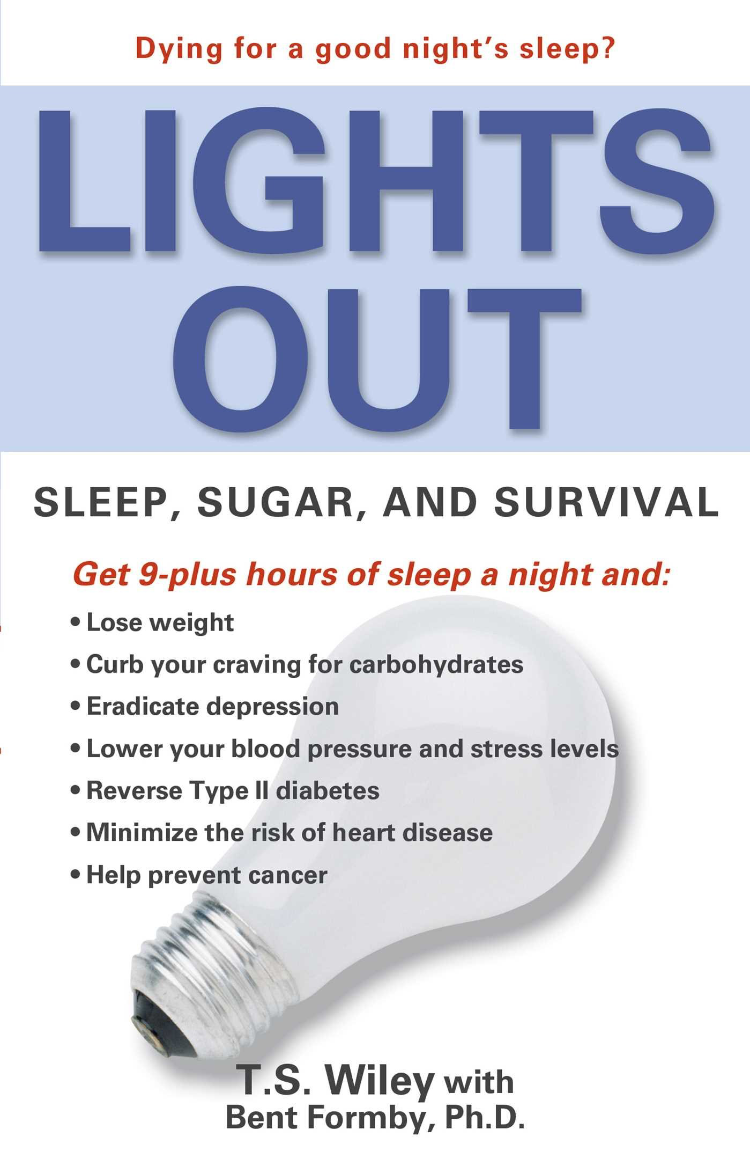
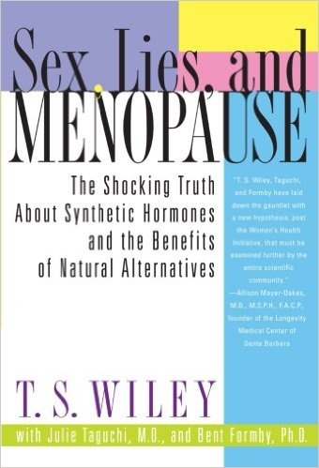
Relevant Publications

