Slide 1
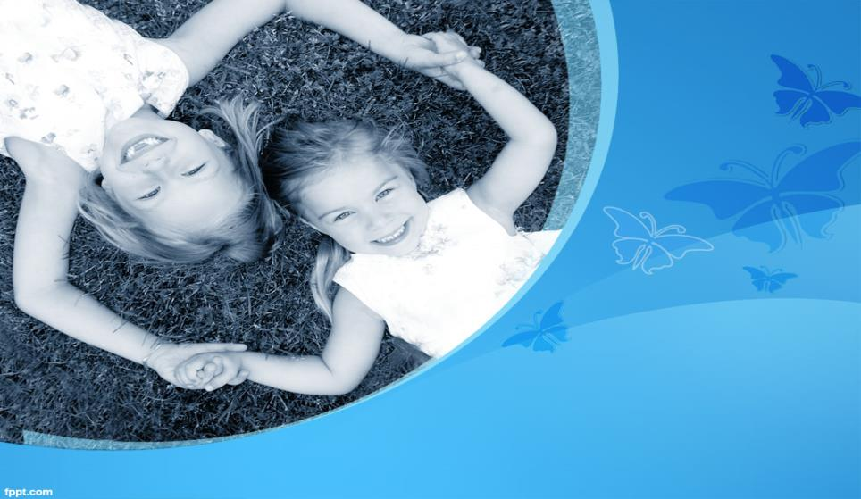
EFFECT OF LOW LEVEL LASER ON HEALING OF MODERATE SIZED INDUCED
SEPTAL DEFECTS ON RABBITS
By
Hady Atef Labib Mohamed

Slide 2
Authors
Hady Atef: Teacher assistant of Cardiovascular/Respiratory Disorder and Geriatrics
Faculty of Physical Therapy
Cairo University.
Prof. Dr. Zeinab Mohamed Helmy: Professor of Physical Therapy for Cardiovascular/Respiratory Disorder and Geriatrics
Faculty of Physical Therapy
Cairo University.
Prof. Dr. Mostafa Fadel: Professor of Vetrinary medicine
Faculty of Vetrinary medicine
Cairo University.
Dr.Heba Abdin: Lecturer of Cardiovascular/Respiratory Disorder and Geriatrics
Faculty of Physical Therapy
Cairo University.

Slide 3

Introduction
Help them to be what they dream to be…

Slide 4
About congenital shunts
A cardiac shunt is a pattern of blood flow in the heart that deviates from the normal circuit of the circulatory system. It may be described as right-left, left-right or bidirectional, or as systemic-to-pulmonary or pulmonary-to-systemic. The direction may be controlled by left and/or right heart pressure, a biological or artificial heart valve or both. The presence of a shunt may also affect left and/or right heart pressure either beneficially or detrimentally (Dugdale et al., 2012).

Slide 5
congenital heart defects (CHD)
Prevalence:
Congenital heart defects (CHDs) are the most common types of birth defects. They affect nearly 1% of―or about 40,000―births per year in the United States (Arroyo-Espliguero et al., 2004).
About 25% of babies with a CHD have a critical CHD. Infants with critical CHDs generally need surgery or other procedures in their first year of life (Schelbert, 2010).

Slide 6
How are pediatric congenital heart defects treated?
There are two main options: treatment with a catheter, or open heart surgery(Virani et al., 2012).
1. Catheter treatment
Treatment with a catheter is much easier for the child to go through than surgery.
The catheter places a small device into the septal defect to close it up by introduction into the vein. The catheter is then removed (Allen et al., 2012).

Slide 7
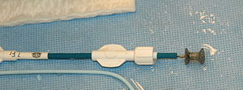
The Catheter

Slide 8
Surgical repair
Surgical Repair is via a median sternotomy incision with use of cardiopulmonary bypass. The septal wall may be closed directly with sutures, or with a pericardial patch (Paul,2012).
Postoperative Complications may include heart block and junctional ectopic tachycardia (in infants). Residual VSD’s may also remain (Dedieu,2012).
Surgery is generally performed electively at 3-4 years of age. Very few VSD’s close spontaneously after the 1st year of life (Zion,2006).

Slide 9
L.A.S.E.R
Definition
A laser is a device that emits light through a process of optical amplification based on the stimulated emission of electromagnetic radiation. The term "laser" originated as an acronym for "light amplification by stimulated emission of radiation (Chu et al.,2003).

Slide 10
Low level LASER therapy(LLLT)
Low level laser therapy (LLLT) is the application of light (usually a low power laser in the range of 1mW – 500mW) to a pathology to promote tissue regeneration, reduce inflammation and relieve pain. The light is typically of narrow spectral width in the red or near infrared (NIR) spectrum (600nm – 1000nm), with a power density (irradiance) between 1mw-5W/cm2. (Fillipin et al,2005).

Slide 11
Low level laser therapy( LLLT)
Low-level laser therapy (LLLT) is a form of laser medicine used in physical therapy and veterinary treatment that uses low-level (low-power) lasers or light-emitting diodes to alter cellular function. Other names for the therapy include low-power laser, soft laser, cold laser, biostimulation laser, therapeutic laser, and laser acupuncture. Whereas high-power lasers ablate tissue, low-power lasers are claimed to stimulate it and to encourage the cells to function( Brosseau et al., 2005).

Slide 12
Laser can heal
There have been a large number of both animal model and clinical studies that demonstrated highly beneficial LLLT effects on a variety of diseases, injuries, and has been widely used in both chronic and acute conditions .It may enhance neovascularisation, promote angiogenesis and increase collagen synthesis to promote healing of acute and chronic wounds. (Hopkins et al. 2004).

Slide 13
Statement of the problem:
Would Low level LASER therapy (LLLT) have an effect on the healing of moderate-sized induced ventricular septal defects of the heart on rabbits?.

Slide 14
Purpose of the study
1. To investigate whether low level Laser had any effect on the healing of moderate sized induced ventricular septal defects.
2. To investigate whether low level Laser had any side effects on the patient.
3. To investigate whether treatment with low level Laser could be an adjunctive method of treatment for the traditional surgical choices.

Slide 15
Significance of the study
There is no past studies conducted in that field but another studies were conducted on the thermal effect of argon laser in palliation of obstructive congenital lesions such as aortic stenosis and coartication of the aorta and it was found to be effective in that issue.
This study is the first of its type to conduct that method of treatment for induced ventricular septal defects.
This study would try to conduct a new non-surgical intervention that may lead to healing of moderate sized induced ventricular septal defects.

Slide 16
Null hypothesis
There would be no significant effect of low level Laser on the healing of induced ventricular septal defects.

Slide 17
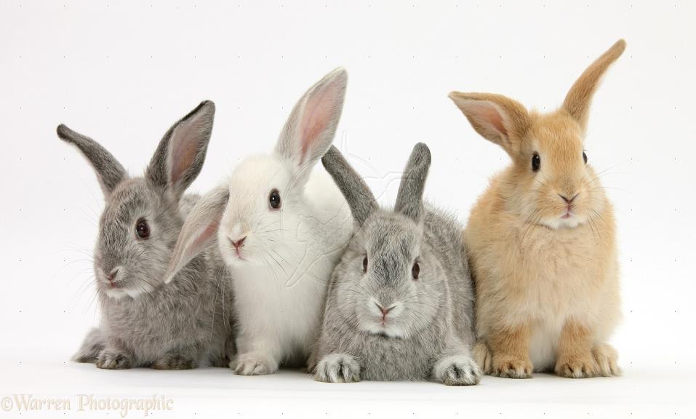
SUBJECTS AND METHODS

Slide 18
SUBJECTS AND METHODS
I- Subjects:
Twenty male rabbits who underwent surgical induction of moderate sized septal defects in their hearts via catheterization were included in the study, aged from 6-10 months and recruited from the Department of physiology at the faculty of veterinary medicine, Cairo University. All subjects of the study were hospitalized and received care in the animal house in Al kasr el Aini faculty of medicine. They were randomly assigned into two groups:

Slide 19
Subjects
Group (A):
The study group consisted of 10 rabbits, which received low level LASER therapy at the site of the induced shunt percutaneusly plus routine animal care (feeding, and psychological support).
Group (B):
The control group consisted of (10) rabbits, which received only routine animal care (feeding, and psychological support).

Slide 20
Inclusion criteria:
1-Male rabbits who underwent surgical induction of moderate sized septal defects in their hearts via catheterization.
2-Their age ranged from 6-10 months old.
3- Rabbits with clinically and medically stable conditions.

Slide 21
Exclusion criteria
Rabbits that are apparently not healthy or known to have any kind of illness

Slide 22
II- Instrumentations
A)Induction equipment:
1-surgical needle: its size is 24 guage used in the induction of the lesion within the heart whilst the heart is exposed.
b-Anesthesia protocol:
General anesthesia with ketamine hydrochloride and xylazine 0.1mg/kg (Hedenqvist P et al., 2001)
B) Evaluating equipment:
1-Echocardiography:

Slide 23
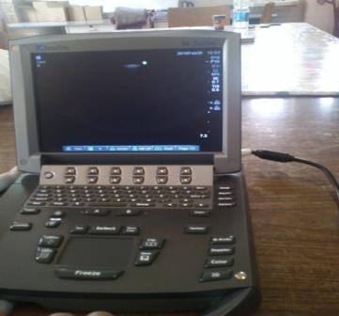
Echocardiography
(PHOX PLUS C 402103020, America)

Slide 24
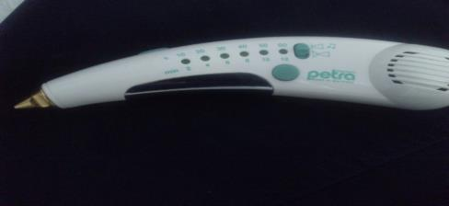
C) Therapeutic equipment:
The LASER device:
(laserklasse2M,EN60825-1,+A2:2002,w.l=635-670nm,p<6mW, German)

Slide 25
III- Procedures:
Demographic data, clinical characteristics and all medical history were collected from rabbits' file.
A- Induction procedure (induction of septal defects): has been done for all rabbits as follows:

Slide 26
III- Procedures:
For each rabbit before the study, the induction of the ventricular septal defects via opening of the chest via lateral thoracotomy incision and whilst the heart is exposed a needle is inserted directly into the heart with a cardiac puncture technique to induce moderate sized induced septal defects

Slide 27
III- Procedures:
It was defined as moderate sized when we measured the annulus of the aortic valve by the echocardiography and divided by 2, the diameter of the annulus of the aortic valve was 1.2+/-0.2cm, so the diameter of the induced shunt was 0.6+/-0.1cm ) in the hearts of the rabbits

Slide 28
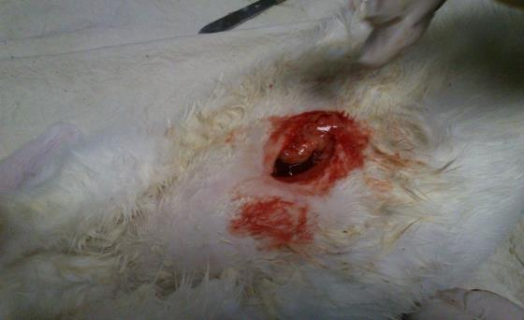
The induction of the shunt (exposed heart)

Slide 29
B- Evaluation procedure
Echocardiography: has been done for all rabbits as follows:
For each rabbit before and after the study, the echocardiography was used
Before the study, to investigate the exact site of the shunt to apply the laser therapy on it.

Slide 30
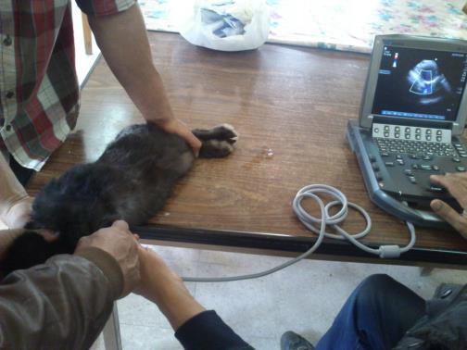
Echocardiography applied on the rabbit

Slide 31
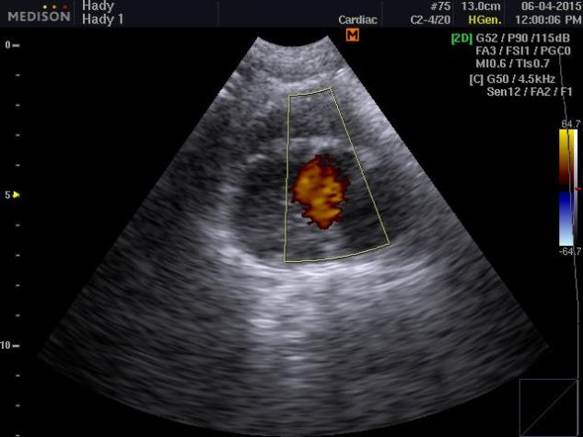
Echocardiography showing the mosaic appearance that happened after induction of the shunt at the beginning of the study

Slide 32
After the study, we investigated the differences happened to the shunt after the application of the laser therapy at the end of the study.

Slide 33
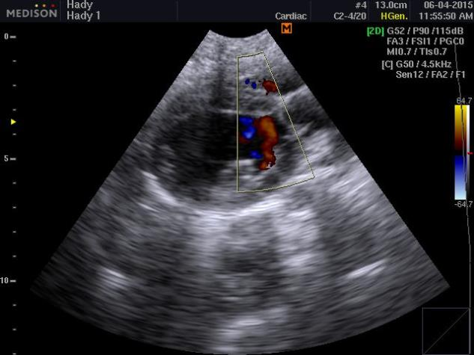
Echocardiography showing marked improvement and decrease in the amount of the mixed blood after laser therapy for the shunt (at the end of the study)

Slide 34
C)Treatment procedure
LASER device:
Each rabbit in the study group received laser therapy at the site of the shunt percutaneusly for 10 minutes (gradual increase up to 20 minutes) with two sessions daily for six consecutive weeks.

Slide 35
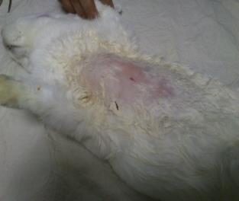
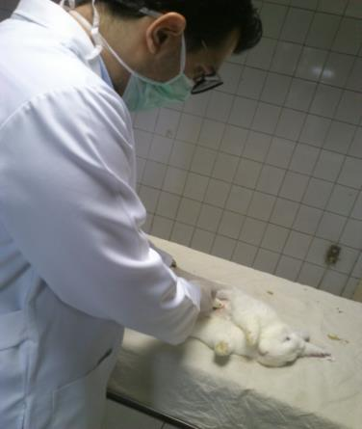

The steps of the application

Slide 36

RESULTS
They are waiting us to make a difference…

Slide 37
ANALYSIS OF RESULTS
1- Results of rabbits age and weight:
Mean values of rabbits age and weight.

Slide 38
2) Mean values of the diameter of VSD in control group Pre and Post study:

Slide 39
3) Results of laser on the diameter of the ventricular septal defects in study group:
Before and after application of laser on diameter of the ventricular septal defects means in study group

Slide 40
The improvement percentage of diameter of the ventricular septal defects in the study group.

Slide 41
C. Comparative analysis between control group and study group:
The mean values of the diameter of the VSD between control group and study group.

Slide 42

DISCUSSION

Slide 43
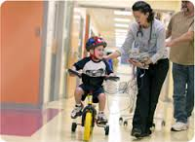

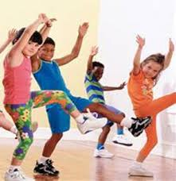

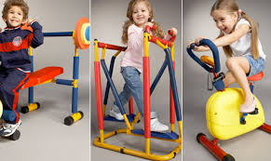
Why we do all of this ?!!!!
Simply for those

Slide 44
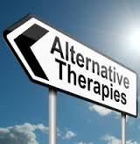
Aim of our work
This study aimed to find an alternative or even adjunctive non surgical method for some congenital heart defects like septal defects whether it is ventricular or atrial, in order to avoid or decrease -at least- open heart surgeries complications, which is still till now the only method for treatment of such cases.

Slide 45
What happened?
The current study reflected that improvement of healing process of the induced septal defect using pulsed LASER (Group A) which was better than routine animal care only (Group B) after one and half month due to the following possible explanations: LASER, 1)able to induce photobiological processes in cells by activation of mitochondria, increase ATP synthesis, 2)activate Cytochrome C oxidase and nitric oxide release, 3)increase DNA,RNA and protein synthesis, 4)activate Reactive oxygen species and gene transcription, 5)promote angiogenesis and neovascularisation and 6)increase collagen synthesis to promote healing.

Slide 46
By this we supposed that it healed!!
L.A.
nitric oxide (NO)
S
DNA, RNA and protein synthesis
Reactive oxygen species and gene transcription
.E.R
mitochondrial activity, ATP synthesis and cytochrome C oxidas
angiogenesis and neovascularisation:
collagen synthesis to promote healing:

Slide 47
Who confirmed that this LLLT can do this??
Activation of, mitochondrial activity, ATP synthesis and cytochrome C oxidase:
Activation of nitric oxide (NO) release
Houreld and his colleagues in 2013
Mitchell and Mack (2013)
Activation of DNA, RNA and protein synthesis
Fonesca et al (2014)

Slide 48
Who confirmed that this LLLT can do this??
activation of Reactive oxygen species and gene transcription
activation of angiogenesis and neovascularisation
activation of collagen synthesis to promote healing
Kushibiki et al (2013)
Coloumbo et al (2013)
Kana et al (2012)

Slide 49
Is it safe?
Several studies such as Pal et al., (2007) reported that continuous wave of laser but not pulsed laser angioplasty may be complicated by arterial spasm when applied laser percutaneously at New Zealand white rabbits . Such spasm presumably reflects the potent vasoconstrictor effects of heat generated during continuous wave laser irradiation; the absence of spasm during pulsed laser irradiation presumably reflects less marked rise in tissue temperature typical of pulsed lasers.
The current work reflects that pulsed LASER improves healing of cardiac and vascular structures and don’t lead to any vascular damage.

Slide 50
Contradictory opinions
In contrast, a study conducted by Bagis et al., (2003) on sciatic nerve healing in rats via laser application showed that low-energy GaAs irradiation did not have any effect on the injured rat sciatic nerve. The contradiction between the results of both studies was because of the very high dose of the study done by Bagis et al., (2003), which was 19 J/cm2 hence it is recommended not to exceed the dose to that extent and stick to the safe limits only.

Slide 51

Conclusion

Slide 52
Conclusion
It was concluded that low level LASER therapy can be considered as a promising therapy for congenital heart defects in animals and to be examined on children with similar congenital lesions after then.

Slide 53

RECOMMENDATIONS

Slide 54
RECOMMENDATIONS
Effect of LLLT on
Applications
Quality of life.
Healing of induced cardiac shunts.
Different animal models.
Congenital septal defects in children.
Long term.
Functional improvement in the cardiovascular measurements
Compare between application of low level LASER application percutaneusly or intracardiac.
LASER application combined with aerobic training
Compare between the effects of different physiotherapy modalities on healing process of cardiac shunts, and quality of life.

Slide 55




