Slide 1
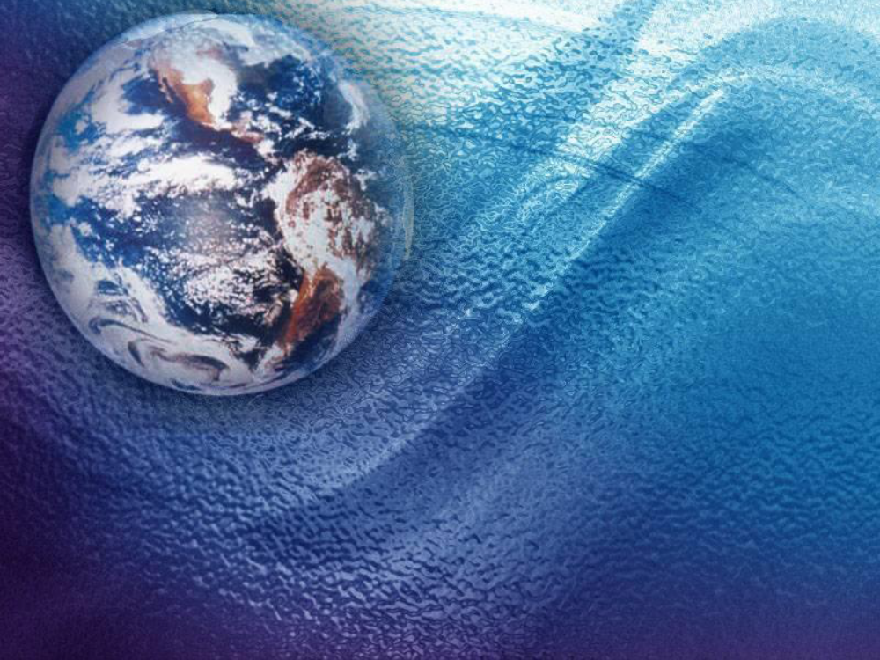
Information
Class
Location
Schedule
  M-W-F
  Lab Tues-Thurs
Office
Phone
Email
Book(s)
  Required Text
  Additional
Materials
  Item 1
  Item 2
  Item 3
Investigation of the physical parameters that cause to formation or expansion of Harmful Algae Bloom (HAB) and comparing worldwide records with the Persian Gulf
Dr. Mahmood Akhyani
Hadis Hosseinzadehnaseri
Notes:
Beginning course details and/or books/materials needed for a class/project.

Slide 2
Effects and problems caused by harmful algal blooms at different scales on various parts of human life and the environment are considerable. There are several reasons for the occurrence of this phenomenon.
in this article, data related to the red tide has been collected in different parts of the world and has been compared with the case of this phenomenon in 2008 in Iran.
Iran's southern waters are very prone to red tide crises due to all kinds of factors causing the creation and development of harmful algal blooms, including:
Waste water
marine currents
suitable winds
dust
ship’s ballast water
appropriate temperature and salinity
Global warming
Notes:
Presentation slide for courses, classes, lectures et al.

Slide 3
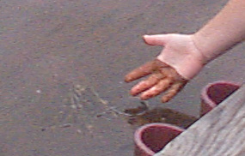
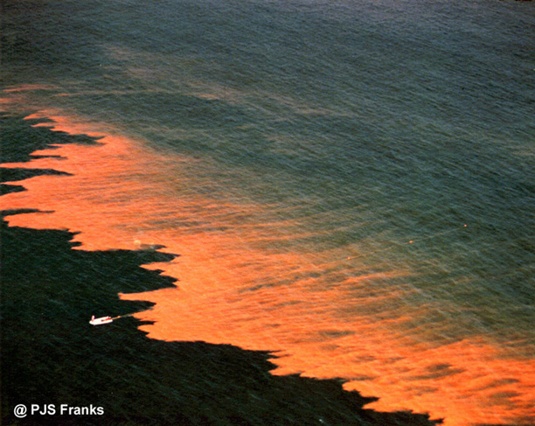
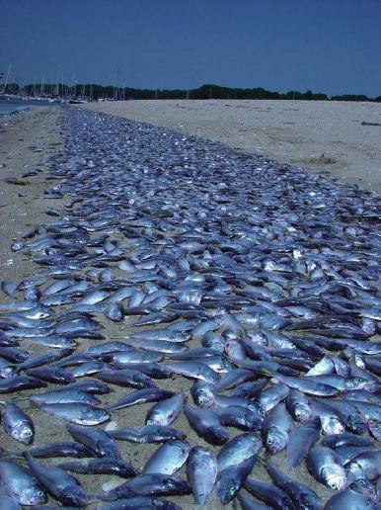
Introduction
The phenomenon occurs in sea water or fresh water, and builds up algal in the water column rapidly. This phenomenon is called the red tide, why seawater appears reddish to brown because of the proliferation of alga and the microscopic red pigments-containing phytoplankton cells.
The bloom is also accompanied by toxins production and dispersal of strong stench. Although there are some masses of certain types of low cell density, not changing in watercolor, but still damaging due to the toxins produced by the algal. The entered toxin can hurt the fishes, humans and other creatures. Syndromes made in fishes through harmful algal are including paralyzing (PSP), diarrhea (DSP), neurotoxin (nerve disorder or NSP), amnesia (ASP), and asthma (AZP). Human contact with poisoning fishes causes CFP disease [13].
Term of harmful algal can be devoted to many species of algal, but HAB share a unique feature that is toxic. These algal have an especial physical structure influencing on the food chain and causing death of other creatures. The rapid growth of the HAB is of other characteristics.
1 million phytoplankton algal cells on per liter of seawater, accompanying with the production of environmental toxins is considered algal blooms. Rezai and Senejani [12] have reported 2 to 8 million microorganisms in some areas contaminated by red tide in 2008 in Iran’s southern waters.
Notes:
A schedule design for optional periods of time/objectives.

Slide 4
Materials and Methods
In order to scientific prevention or controlling this phenomenon, studying the relevant records in the world and getting more information about the influencing factors is necessary.
This phenomenon can be reviewed in terms of biological, bioenvironmental and physical.
In this paper, we have collected data, including distribution and characteristics of various types of the phenomenon throughout the world using published articles and available scientific reports and have compared their revolution processes.
On the other side, the monthly and annual frequency of the red tide’s occurrence was examined that can be applied to investigate the effects of the environmental and climatic changes on this phenomenon.
The wind data, temperature satellite data, and salinity data have been used in the Persian gulf and sea of Oman.

Slide 5
Data Collection and Analysis
Published articles on the red tide are very low in Iran and the types and species of HABs have been considered mostly. These articles have identified 38 toxic samples on algal blooms of the Persian Gulf, which 18 of them to "types" and others to "species" have been studied [11].
According to official reports filed by IOC, 3480 cases of red tide have been recorded in the world from 1987 to 2012.
These reports, registered in different parts of the world, based on which several papers have been published containing information in the fields of red tide appearance reasons, start and end time, number of samples, the concentration of micro-organisms and the type of published toxins etc. which are used to draw distributed diagrams and examine the overall trend.
These reports and related articles, were examined in terms of the cited factors, so that the results are as below.

Slide 6
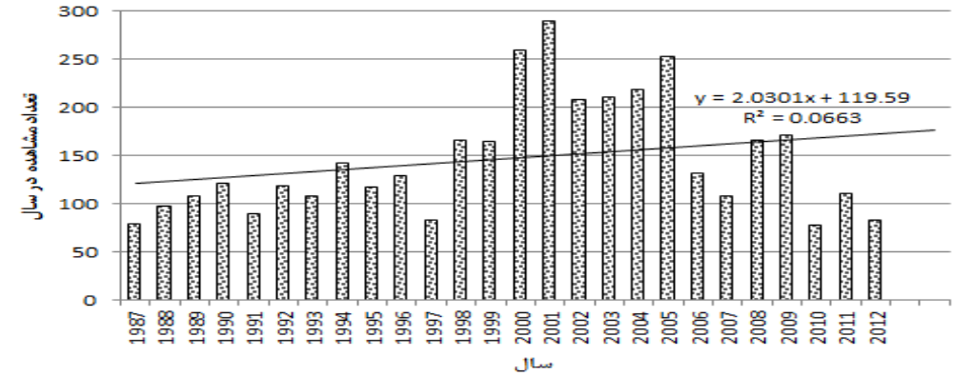
Results
Based on data gathered from 1987 to 2012, the annual curve of red tide occurrence was drawn indicating: the highest incidence of this phenomenon was in 2001, 2000, 2005. In 2001, the mortality of 2,500 tons fishes was reported in the Gulf of Kuwait with 850 square kilometers [9]. The annual distribution curve of HAB, demonstrates an ascending general trend to the occurrence of this phenomenon.
The number of HAB recorded annually, based on the IOC report

Slide 7
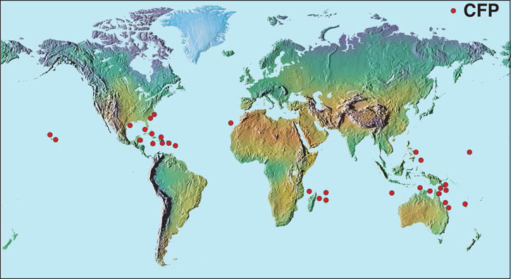
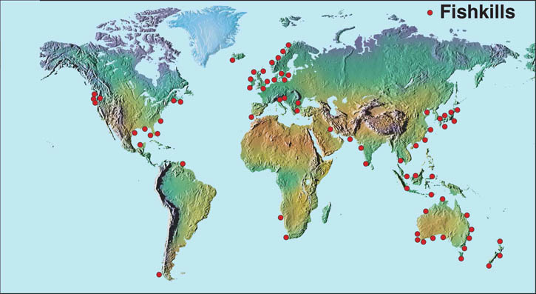
This Figure demonstrates the universal distribution of related reports of the fish deaths and human disease.
Long-term presence of algal mass causes a reduction of transparency and inputting light in the depth thus destroys the rich green seabed. HAB in Iran's waters causes death of marine animals through producing nerve toxin (NSP). The algal also have eliminated fish, zeoplanktons, and invertebrates by consuming dissolved oxygen in water [12].
Death of marine organisms until 2012 (right) [25] and CFP disease in humans (left) due to algal blooms phenomena [13]
Notes:
Conclusion to course, lecture, et al.

Slide 8
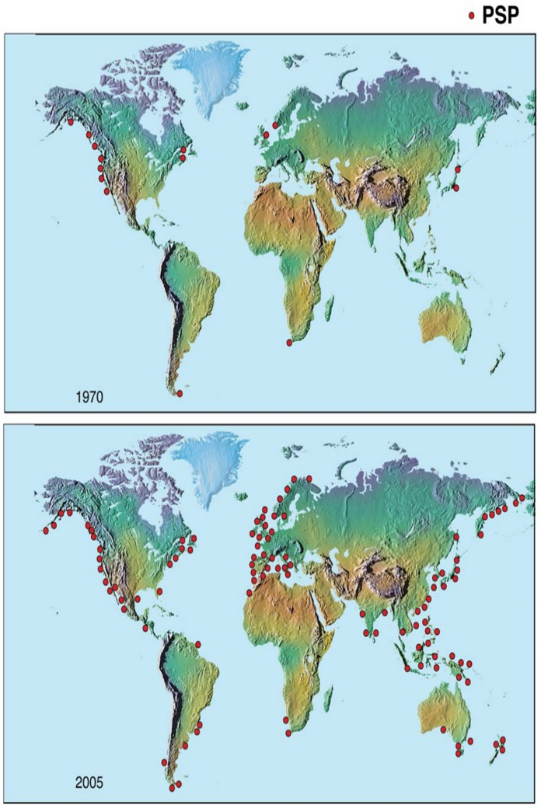

This Figure shows the global rise of this phenomenon and the confirmed presence of PSP toxins in fish.
The process of growing Harmful algal blooms from 1970 to 2005 [13]

Slide 9
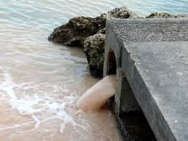
The published articles stating that there is not any agreement on the exact cause of spreading this phenomenon. The first hypothesis says that human activities and water pollution in some areas are the main reason behind this phenomenon.
Waste Water
Human activities may cause an area's water richer. In the past decades, the coastal waters have received the sheer large and growing size of industrial and agricultural effluents and domestic sewage in various ways. In many coastal areas around the cities, the entrances have changed the size and composition of the pool water so that can cause the broader and more diverse algal blooms. Therefore, domestic, industrial, and agricultural waters are full of such materials as nitrates and phosphates, which provide a rich platform and increase phytoplankton. In the Persian Gulf and Sea of Oman, there is enormous potential to appear red tide due to the entrance of cities and factory effluents, the oil industry etc. The presence of Iron in surface water controls the spread of algal development.

Slide 10
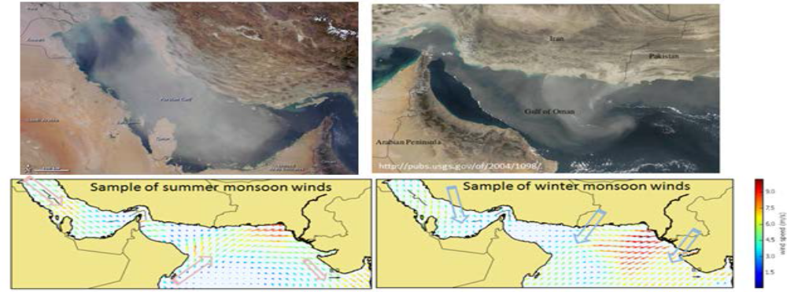
Dust
Windstorms can transfer the iron-containing dust to surface water. combination of iron-containing dust into the water is necessary to stimulate essential nitrogen for growth of toxic algal [15].
This Figure, showing the satellite images of dust storms in winter over the Sea of Oman and the Persian Gulf in upper part, indicate that the Persian Gulf and Sea of Oman have great potential in the field of creation or development of red tide, regarding to the current dust as sources of Iron. On below part of the shape, the wind patterns drawn in mid-August (summer monsoon) and mid-February (winter monsoon) are seen which are comparable with pictures of above storms.
Satellite Images of dust caused by storm over the Sea of Oman (November 2004) and the Persian Gulf (July) (top) and an example of Monson wind pattern (bottom)

Slide 11
Suitable Winds
Winds blow from different directions, cause to transfer the water mass from one point to another one. In a way that, the cold, or rather rich water, controls the algal blooms during upwelling [16]. The upwelling water flow increases the algal blooms rapidly. Entering cold and rich water into the warm water-containing areas and the presence of algal cause sudden growth and increasing of algal blooms. Restarting the upwelling winds, the algal blooms are expanded more and more due to the cold and rich water entrance.
HAB progress may also occur under the influence of wind on the boundary surface [17]. The wind also influences the characteristics of the mixed layer and circulation pattern of the continent plateau waters.

Slide 12
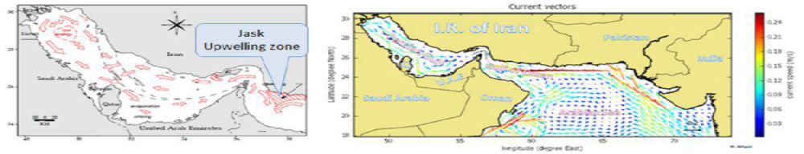
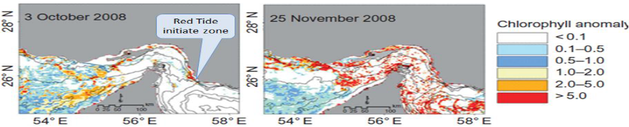
In Iran's southern waters, the domestic winds of the Saudi Arabia desert or the seasonal monsoon wind are the probable sources of dust transmission. The direction of monsoon wind changes in summer and winter, and upwelling areas have been identified near the Jask, where was one of the starting points of Red tide in 2008 in Persian Gulf [18]
In this Figure, an example of the surface flow produced by numerical simulation and pattern obtained by Reynolds is shown [19]. Comparing these images with below Figure showing the data from satellite associated with the red tide in early and late 2008 results in reliable role of upwelling and surface flowing in creating and publishing the phenomenon in the region.
Example of output of the surface flow model in Persian gulf and sea of oman and pattern obtained by Reynolds [18]
Analysis of satellite images of the red tide publication in 2008. [19]

Slide 13
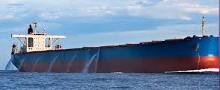
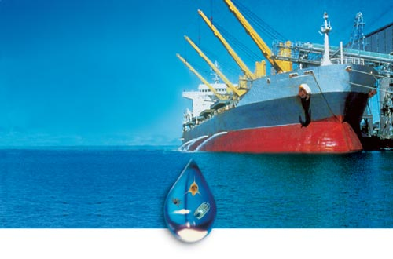
Ship’s Ballast Water
It is also likely that algal masses are transformed through the ships to different regions [8]. Data shows that approximately 57% of the world's oil reserves and 45 % of world's natural gas exist in the Persian Gulf and Sea of Oman, and more than 30 % of the world's demands for these resources are exported trough gigantic floats [20] and they are subsequently prone to be infected through the ships.

Slide 14
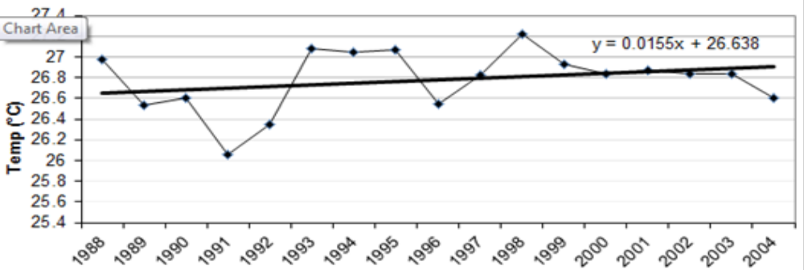
Global Warming
The algal blooms phenomenon may occur due to natural mechanisms such as climate change one of which is climate warming. Analysis of satellite data shows that the surface temperature of Iran's southern waters is genteelly increasing as seen in this Figure [21]. Although, based on detailed studies, there is algal blooms in areas where the water pollution - as a factor- is not seen. Organisms that are the main cause of the algal blooms have been existed, thousands or even millions of years ago on the planet chancing to disperse through climate change, the earth's layer movement, and the other world's changes.
Average surface temperature in the Arabian Sea and the Persian Gulf [20].

Slide 15
Marine Currents
Natural events and transmission through offshore flow can be mentioned as reason of the other expansions. For example, the expansion of NSP toxins in North Carolina in USA indicates that 1,500 km Florida algal masses was brought into the area by the Gulf Stream. There is approximately 750 km the development of this phenomenon along with input surface-water flow of the Indian Ocean to The Persian Gulf, from SIRIC port of Oman to the center of the Persian Gulf –Bushehr- [12].
The deep water of continent plateau usually provides a mosaic bed to transmit the deep stable water, which may contain the HAB Configuration changes. Orientation of coastal waters and seabed topography play significant role in determination of structure manner, the dispersal, and stability of HAB in water [8].

Slide 16
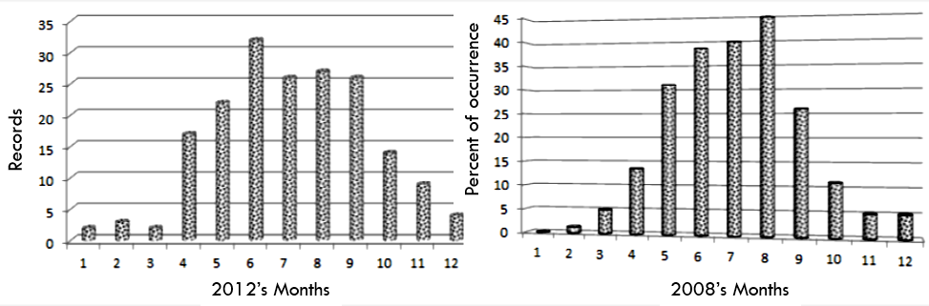
Appropriate Temperature and Salinity
Monthly distribution of the occurrence of red tide in the world depicted in this Figure, shows that the algal mass usually occurs in the summer when the water temperature is between 20 to 25 ° C and water salinity is 20 to 30 ppt [22]. The recorded events from November to March relates to the southern hemisphere's summer. The relevant Organisms achieve the fastest growing at temperatures above 20 ° C and salinity more than 20 ppt.
Water temperature in Iran has been 22.27 to 23.25 °c during this phenomenon.
The number of recorded HAB in the world, per month, in 2012 and the occurrence percent in 2008, according to IOC report

Slide 17
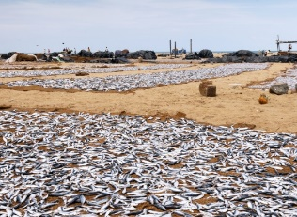
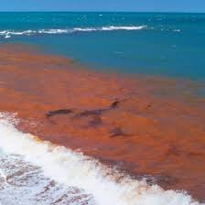
Some Of The Most Important Cases Of Harmful Algal Blooms Can Mention As Follows:
in 1793 and 2005 in Canada
in 1850 and 2012 on the Florida coast
in 1972 in England
in 1976 on the Malaysian coasts
in 2011 in the Gulf of Mexico.

Slide 18
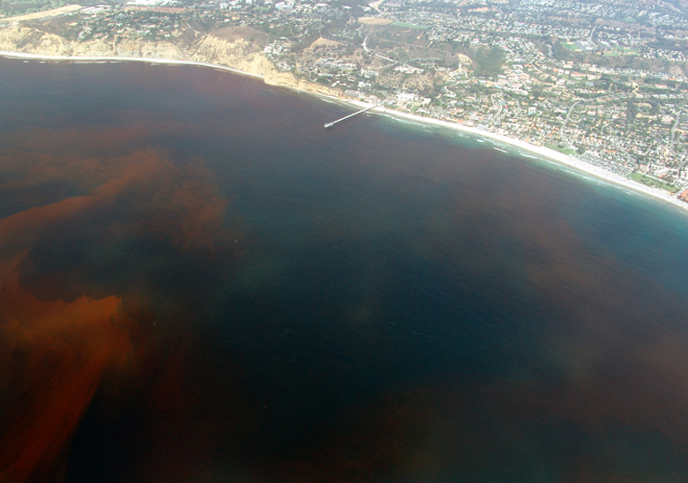
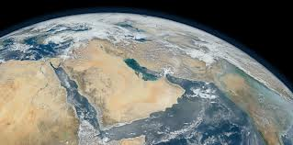
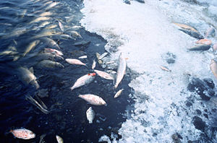
Harmful Algal Blooms
in the Persian Gulf and the Gulf of Oman:
Historical reports on the occurrence and frequency of HABs in the Persian Gulf and Gulf of Oman are scarce
Several taxa of potentially toxic phytoplankton have been documented in the Persian Gulf and nearby coastal waters, as have red tides resulting in significant fish kills and aquaculture losses
HABs, In 1999 cause a major fish kill occurred in Iranian coastal waters, which was immediately followed by fish kills in Kuwait Bay
A review of HAB occurrences in the coastal waters of Oman between 1976 and 2004 showed that about 66 red tide events have been recorded, 25 of which resulted in mass mortality of fish and marine organisms
2008–2009 bloom suspected to originate in the Gulf of Oman and was subsequently transported into the Persian Gulf though the Strait of Hormuz by currents

Slide 19
Conclusion
According to the above contents, the red tide in countries around the world like Iran has happened in the summer. Water temperature and salinity play a reliable role in any algal blooms that any type of algal reach the maximum rate of cell division in particular range of temperature - salinity.
Wastewater and other unnatural running waters provide the required food sources of the red tide algal. In order to prevent the hazard of red tide, detailed controlling should be done over this factor, especially in summer. In Iran Bushehr and Bandar-Abbas are the most pollutant places due to municipal and industrial waste and international vessels traffic.
The wind and marine currents are the most important emission factors of red tide. The surface water mass of the Indian Ocean enters through the Strait of Hormuz along the northern coasts of the Persian Gulf and progresses to Bushehr region. The overcoming wind pattern in the Persian Gulf is along with the red tide blooms in the North West.
Given the trend of earth warming, the evidence of which was mentioned with the analysis of the temperature of Iran's southern waters, each of the algal blooms phenomena occurring in different parts of the Persian Gulf continually, and have the prone to be a crisis.
Obviously, the only way to prevent this hazard is controlling and reducing pollution of input water caused by human activities. On the other side, according to the above contents, in order to optimal management of red tide disaster, studying and simulation of the pattern of sea currents, wind and high accuracy waves are necessary to more exact identify the publication velocity and orientation. In addition, sensitivity testing of the red tide algal should be taken place via the environmental ultra-measurement of temperature - salinity etc. which is being done in the world.

Slide 20
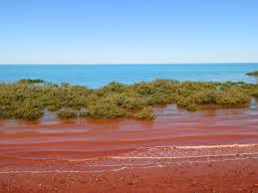
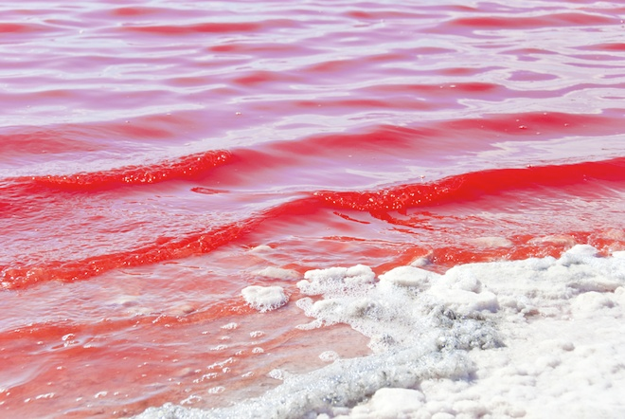
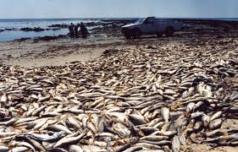
Thank you all for your attention

Slide 21
References
[1] Hallegraeff, G.M., “Harmful algal blooms: a global overview,” In Manual of Marine Microalgal. (Hallegraeff, G.M., Anderson, D.M. and Cembella, A., Eds.) pp. 1-22 Paris, UNESCO. 1995.
[2] MOORE, R.E.,” Toxins from blue-green algal,” J. Bioscience, Vol. 27, PP. 797-802. 1977.
[3] Anderson, D.M. turning back the harmful red tide. 1997.
[4] Kim, H., “Cochlodinium polykrikoides blooms in Korean coastal waters and their mitigation,” 8th International Conference on Harmful Algal, June 1997, pp. 227–228. 1998.
[5] Anderson, D.M., P.M. Gilbert, and Burkholder, J.M., “Harmful algal blooms and Eutrophication: Nutrient sources, composition, and consequences,” J. Estuaries, Vol. 25(4b), PP.562-584, 2002.
[6] Remy M., Thomas, A.C., and Hurst, J., "Relationships between satellite-measured thermal features and Alexandrium-imposed toxicity in the Gulf of Maine," J. Deep Sea Research Part II: Topical Studies in Oceanography Vol. 52(19–21), PP. 2656-2673, 2005.
[7] National Office for Marine Bio toxins and Harmful Algal Blooms. 1999.
[8] Boesch, D.F., Anderson, D.M., Horner, R.A., Shumway, S.E., Tester, P.A. and Whit ledge, T.E., “Harmful Algal Blooms in Coastal Waters: Options for Prevention, Control and Mitigation,” Science for Solutions. NOAA Coastal Ocean Program. 2010.
[9] Heil, C.A., Glibert, P.M., Al-Sarawl, M.A., Faraj, M., Behbehani, M., Husain, M., “First record of a fish-killing Gymnodinium sp bloom in Kuwait Bay, Arabian Sea: chronology and potential causes,” J. Mar. Ecol. Prog. Ser. 214, PP. 15–23, 2001.
[10] AL-HASAN, R.H., ALI, A.M. and RADWAN, S.S., “Lipids, and their constituent fatty acids, of Phaeocystis sp. from the Arabian Gulf,” J. Marine Biology, Vol. 105, pp. 9–14, 1990.
[11] Rezai, H., “Blooms of phytoplankton along the northeastern coast of the Persian Gulf,” In Iranian Fisheries Research and Training Organization Report, Vol. 1, pp. 1–55. 1995.
[12] Rezai, H., and Sanjani, S., “Red tide detection in the Hormuzgan coastal waters,” In Iranian National Center for Oceanography Report, Vol. 20, pp. 1–20. 2009.
[13] Anderson, D.M. “The Ecology and Oceanography of Harmful Algal Blooms: Multidisciplinary Approach to Research and Management,” Woods Hole Oceanographic Institute, MA USA, UNESCO, Paris, 2005.
Notes:
An opportunity for questions and discussions.

