Slide 1


FACTORS AFFECTING THE STATUS OF OBESITY IN SCHOOL-AGE CHILDREN
Nurcan YABANCI AYHAN, H.Omer YILMAZ, Nida TOKAC ER
Cagdas Salih MERIC
ANKARA UNIVERSITY HEALTH SCIENCES FACULTY
DEPARTMENT OF NUTRITION AND DIETETICS

Slide 2
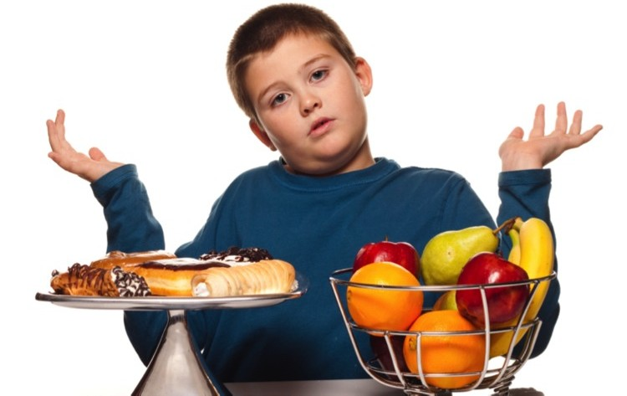
INTRODUCTION
Obesity occurs when the body consumes more calories than it burns through overeating and underexercising. Childhood obesity is caused by excessive food consumption and drinking of high-calorie sweetened beverages, no exercise or physical activity, as well as genetic factors.

Slide 3
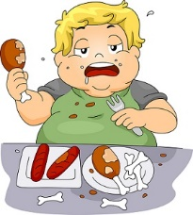
Pediatric or childhood obesity is a growing global epidemic that requires attention due to the burden placed on the healthcare system for children and adults.

Slide 4
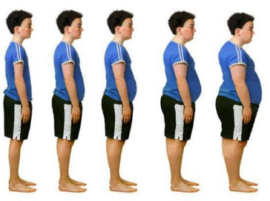
Consumption of fatty foods and a high sugar diet, as well as tobacco smoking, and no exercise qualify as the main reasons for obesity among children and adults.
Pediatric obesity affects all the organs in the body and has an increasing prevalence in young diabetic children.
Childhood obesity is connected with an increased risk of various diseases such as diabetes, cardiovascular, stroke, certain types of cancer later in life, social problems and depression among youth.

Slide 5
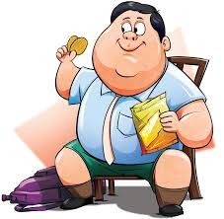
As an increasing number of children are becoming overweight, health professionals need to search for effective methods for the prevention and treatment of obesity.
In the past 30 years,
pediatric obesity has more than doubled in children and tripled
in adolescents worldwide.
Among children aged 6-11 years,
the rate of obesity has increased from 7% in 1980 to 18% in 2010.

Slide 6
CHILDHOD OBESITY in TURKEY
Ankara in Turkey, 7-14 aged children and adolescents (n:2049)
Obesity 6.9% [Boys 8.5%, Girl :5.3%],
Overweight 14.3 % [Boys %16.1, Girls 12.3%]
(Yabancı , 2004)
School children (n:12301) (6-10 aged) in Turkey
Obesity 6.5% [Boys 7.5%, Girl :5.4%],
Overweight 14.3 % [Boys %15.1, Girls 13.5% (TOCBİ, 2011)

Slide 7
MATERIAL AND METHODS
358 child
186 girls
172 boys
11-12 aged

Slide 8
MATERIAL AND METHODS
Anthropometric measurements were taken and genetic factors, eating habits, physical activity, television viewing time had been questioned.
For determining status of obesity; body weight, height, waist-hip circumference were measured.
In the study, body weight of students with electronic scales, height, waist and hip measurements were determined by the measuring cylinder. Body mass index; body weight, was calculated by dividing by the square of height measured.

Slide 9
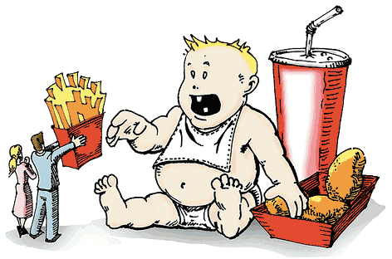
MATERIAL AND METHODS
According to WHO reference values, underweight, acceptable weight, normal weight, overweight and obesity were classified when the BMIs were less than 5., between 5-15., 15-85., 85-95., 95.percentile and over, respectively.
Data analysis was performed using SPSS for Windows 16.0 software package.

Slide 10
RESULTS
The values of anthropometric measurements of the students by gender
 | Boy (n:172) |  |  | Girl (n:186) |  |  | t | p
 | x ± SS | S | Min-Max | x ± SS | S | Min-Mx
Age (year) | 11.5±0.5 | 0.03 | 11.0-12.0 | 11.5±0.5 | 0.03 | 10.0-13.0 | 0.219 | 0.827
Weight(kg) | 41.9±9.7 | 0.74 | 24.0-90.0 | 40.4±9.1 | 0.67 | 24.0-78.0 | 1.512 | 0.131
Height (cm) | 140.0 ± 8.0 | 0.61 | 127.0-171.0 | 140.0±8.2 | 0.60 | 129.0-169.0 | 1.114 | 0.266
BMI (kg/m²) | 18.9 ±3.5 | 0.27 | 11.69-30.77 | 18.4±3.2 | 0.23 | 12.2-30.47 | 1.294 | 0.196
Waist circumference (cm) | 69.0±9.3 | 0.71 | 51.00-105.0 | 66.3±8.8 | 0.64 | 47.0-92.0 | 2.851 | 0.005
Hip circumference (cm) | 80.9±9.2 | 0.70 | 55.00-112.0 | 80.0±11.2 | 0.82 | 55.0-108.0 | 0.836 | 0.404
waist-hip circumference | 0.8±0.07 | 0.005 | 0.73-1.27 | 0.8±0.09 | 0.007 | 0.66-1.38 | 2.814 | 0.005

Slide 11
BMI classification by age
 | 11 age (n:177) |  | 12 age (n:181) |  | Total (n:358)
 | n | % | n | % | n | %
Underweight | 6 | 3.4 | 21 | 11.6 | 27 | 7.5
Acceptable | 19 | 10,7 | 20 | 11.0 | 39 | 10.9
Normal | 91 | 51.4 | 88 | 48.6 | 179 | 50.0
overweight | 31 | 17.5 | 27 | 14.9 | 58 | 16.2
Obese | 30 | 16.9 | 25 | 13.8 | 55 | 15.4
 | χ²= 9.096 p=0.059

Slide 12
Eating Habits
BMI | Pass the meal (n:43) |  | Don’t pass the meal (n:96) |  | Sometimes pass meal (n:219) |  | TOTAL (n:358)
 | n | % | n | % | n | % | n | %
Underweight | 2 | 4.7 | 8 | 8.3 | 17 | 7.8 | 27 | 7.5
Acceptable | 4 | 9.3 | 11 | 11.5 | 24 | 11.0 | 39 | 10.9
Normal | 21 | 48.8 | 49 | 51.0 | 109 | 49.8 | 179 | 50.0
Overweight | 9 | 20.9 | 17 | 17.7 | 32 | 14.6 | 58 | 16.2
Obese | 7 | 16.3 | 11 | 11.5 | 37 | 16.9 | 55 | 15.4
χ²=3.114 p=0.927

Slide 13
Eating Habits
BMI | Have breakfast (n:253) |  | Don’t have breakfast (n:104) |  | Total (n:357)
 | n | % | n | % | n | %
Underweight | 21 | 8.3 | 6 | 5.8 | 27 | 7.6
Acceptable | 31 | 12.3 | 8 | 7.7 | 39 | 10.9
Normal | 127 | 50.2 | 52 | 50.0 | 179 | 50.1
Overweight | 38 | 15.0 | 20 | 19.2 | 58 | 16.2
Obese | 36 | 14.2 | 18 | 17.3 | 54 | 15.1
 | χ²= 3.294 p= 0.510

Slide 14
Daily habits
BMI | More than 2 hours a day watch TV(n:162) |  | More than 2 hours a day don’t watch TV(n:195) |  | Total (n:358)
 | n | % | n | % | n | %
Underweight | 15 | 9.3 | 12 | 6.2 | 27 | 7.5
Acceptable | 16 | 9.9 | 22 | 11.3 | 38 | 10.9
Normal | 78 | 48.1 | 101 | 51.8 | 179 | 50.0
Overweight | 26 | 16.0 | 32 | 16.4 | 58 | 16.2
Obese | 27 | 16.7 | 28 | 14.4 | 55 | 15.4
 | χ²=1.840 p=0.765

Slide 15
The effect of family on BMI
 | Obese ones in the family(n:159) |  | Non-obese ones in family(n:198) |  | Total (n:358)
 | n | % | n | % | n | %
Underweight | 10 | 6.3 | 17 | 8.6 | 27 | 7.6
Acceptable | 13 | 8.2 | 26 | 13.1 | 39 | 10.9
Normal | 72 | 45.3 | 107 | 54.0 | 179 | 16.0
Overweight | 28 | 17.6 | 29 | 14.6 | 57 | 16.0
Obese | 36 | 22.6 | 19 | 9.6 | 55 | 15.4
 | χ²=14.172 p=0.007
The percent of obese individuals is 22.6% and there is obese people in family.
The percent of obese individuals is 9.6% and there is not obese people in family.
ACCORDING TO THESE RESULTS, WE BELIEVE THAT GENETIC FACTORS HAVE EFFECTS ON OBESITY.

Slide 16
Eating Habits Students
 | Boy Girl Total
 | n | % | n | % | n | %
Dinner eat with family | 161 | 93.6 | 167 | 90.3 | 328 | 91.9
Dinnet don’t eat with family | 11 | 6.4 | 18 | 9.7 | 29 | 8.1
 | χ²=1.328 p=0.249
Before sleep eat something | 103 | 59.9 | 130 | 69.9 | 233 | 65.1
Before sleep don’t eat something | 69 | 40.1 | 56 | 30.1 | 125 | 34.9
 | χ²=3.939 p=0.047

Slide 17
Eating Habits Students
Before sleep eat something Milk, yogurt | 26 | 25.0 | 20 | 15.2 | 46 | 19.5
Fruit | 48 | 46.2 | 87 | 65.9 | 135 | 57.2
Nuts | 5 | 4.8 | 6 | 4.5 | 11 | 4.7
Snacks | 20 | 19.2 | 17 | 12.9 | 37 | 15.7
Bread | 5 | 4.8 | 2 | 1.5 | 7 | 3.0
 | χ²=10.495 p=0.033
Eat outside | 45 | 26.3 | 35 | 19.0 | 80 | 22.5
Don’t eat outside | 126 | 73.7 | 149 | 81.0 | 275 | 77.5
 | χ²=2.701 p=0.100
Consume 5 portion of fruits and vegetables | 69 | 40.1 | 63 | 33.9 | 132 | 36.9
Don’t consume 5 portion of fruits and vegetables | 103 | 59.9 | 123 | 66.1 | 226 | 63.1
 | χ²=1.497 p=0.221

Slide 18
CONCLUSION
Nutrition education to ensure adequate and balanced diet is very important. Especially school-age children and adolescents to be given nutrition education, is the foundation of proper nutrition habits will be acquired throughout life.
Earned wrong eating habits at a young age, it will pave the individual's encounter with health problems in later life, nutrition education programs to children and parents in schools should be organized.
School-age should be taught amount food groups, to be taken daily potions and the nutrients contained. Especially, in this period of growth and development of the positive effect of milk and milk products must be emphasized.

Slide 19

Thank you for listening……
Contact
E-mail: hmcrylmz@hotmail.com
Tel: +00905422701975
Ankara/Türkiye

