Slide 1
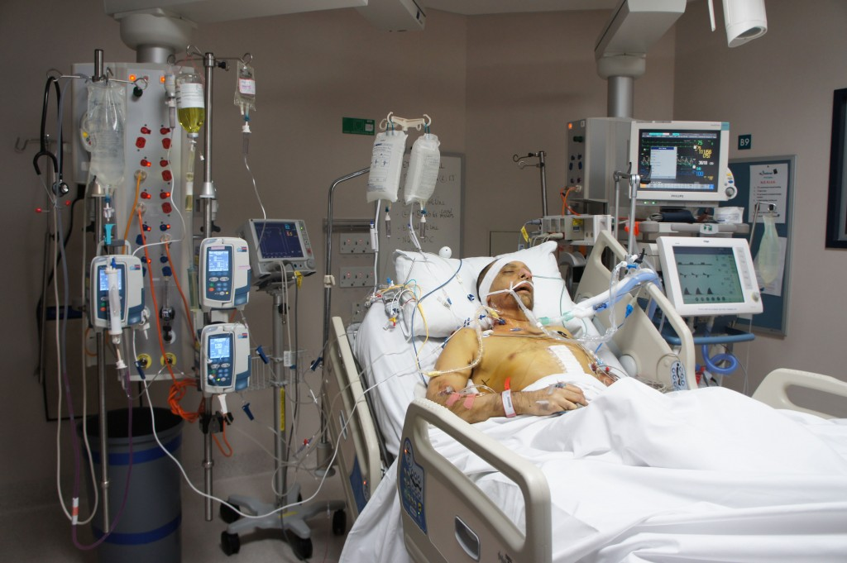
Renal Replacement therapy in the ICU
        Dr. H. Sudarshan Ballal. M.D.FRCP
        Chairman – Medical Advisory Board &
        Medical Director
        Manipal Health Enterprises Pvt Ltd
        Manipal Hospitals, Bangalore

Slide 2
Outline
AKI in the ICU
Principles of RRT
Modes of RRT
Indications for RRT
Optimal timing: When to start
Optimal modality: What Modality and Where ??
Optimal dosing- How Much?
Summary and Conclusions

Slide 3
AKI in the ICU

Slide 4
AKI in the ICU
AKI is common in the ICU
Depending on definition of AKI, up to 50-60% of patients in the ICU have AKI
Up to 70% of these will require RRT
Independent risk factor for mortality: 50 - 60% mortality in critically ill

Slide 5
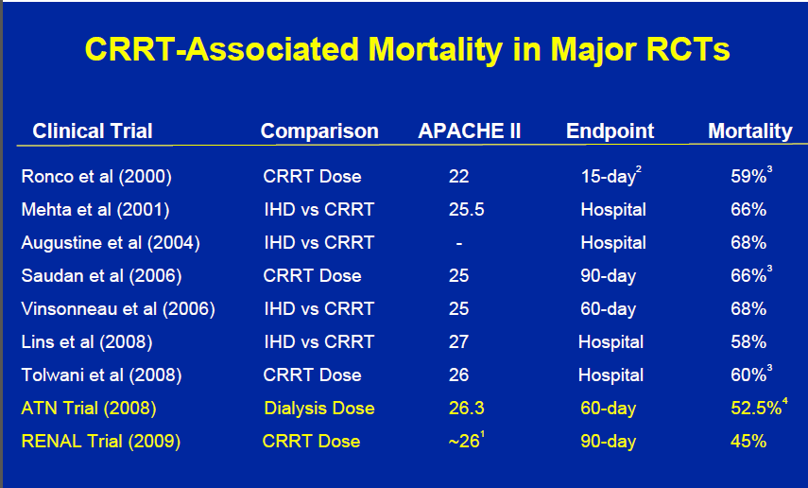
AKI in the ICU
Mortality remains unchanged

Slide 6
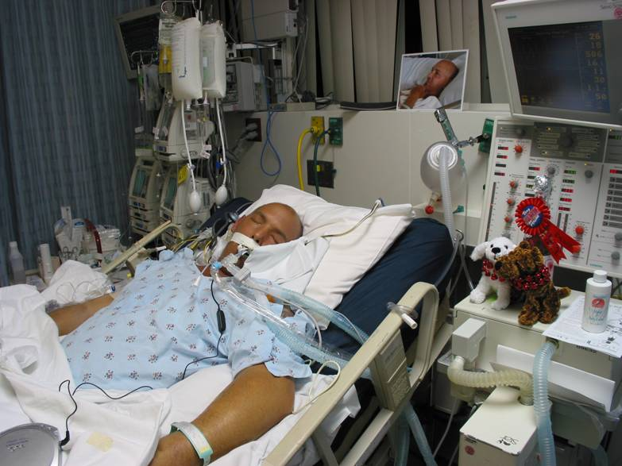
AKI in the ICU
Treatment success or Treatment failure ???

Slide 7
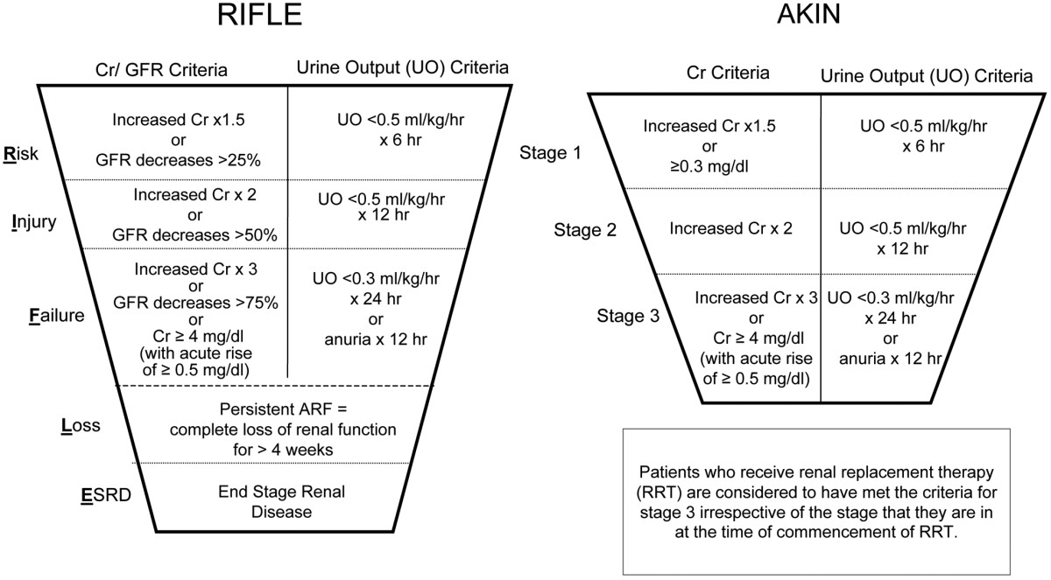
RIFLE and AKIN Classification for AKI

Slide 8
AKI in the ICU
Treatment of acute kidney injury (AKI) is principally supportive
Renal replacement therapy (RRT) indicated in patients with severe kidney injury.
Goal: optimization of fluid status ,maintain metabolic, nutritional & electrolyte balance
Multiple modalities of RRT :
  Intermittent hemodialysis (IHD),
  Continuous Renal Replacement Therapies (CRRTs)
  Peritoneal dialysis
  Hybrid therapies, ie Sustained Low-Efficiency Dialysis (SLED), Renal assist device ( RAD )

Slide 9
Principles of RRT

Slide 10

Diffusion
Movement of Solutes from an area of higher concentration to an area of lower concentration
Dialysis uses a semi permeable membrane for selected diffusion
Diffusion: The movement of solutes from a
higher to a lower solute concentration area.

Slide 11
Ultrafiltration
Movement of FLUIDS through a membrane caused by pressure gradient
Positive, negative and osmotic pressure from non-permeable solutes
positive pressure
negative pressure
Ultrafiltration: The movement of fluid through
a membrane caused by a pressure gradient.

Slide 12
Convection
Movement of SOLUTES with a water flow, “solvent drag”.
Convection: The movement of solutes with a water-flow,
“solvent drag”, e.g., the movement of membrane-permeable solutes with ultrafiltered water.

Slide 13
Modes of RRT

Slide 14
Modes of RRT
Intermittent hemodialysis (IHD)
Continuous renal replacement therapy (CRRT)
Peritoneal dialysis
Hybrid therapies, like SLED , Renal tubule Assist device ( RAD )

Slide 15
Intermittent hemodialysis (IHD)
Oldest and most common technique
Primarily diffusive treatment: blood and dialysate are circulated in countercurrent manner
  Also some fluid removal by ultrafiltration due to pressure driving through circuit
Best for removal of small molecules
Typically performed 4 hours 3x/wk or daily

Slide 16
Continuous Renal Replacement Therapy
Defined as
  “Any extracorporeal blood purification therapy intended to substitute for impaired renal function over an extended period of time and applied for
  or aimed at being applied for 24 hours /day.”
Bellomo R., Ronco C., Mehta R, Nomenclature for Continuous Renal
Replacement Therapies, AJKD, Vol 28, No. 5, Suppl 3, November 1996

Slide 17
Introduction to CRRT
Group of words
  Continuous
  Renal
  Replacement
  Therapy
Describes a group of Therapies
  SCUF
  CVVH
  CVVHD
  CVVHDF

Slide 18
Summary
Access
Access
Return
Return
Replacement
(pre or post
dilution)
SCUF
CVVH
Effluent
Effluent
Dialysate
Dialysate
Access
Access
Return
Return
I
CVVHDF
CVVHD
Replacement
(pre or
post dilution)
Effluent
Effluent

Slide 19
Sustained low-efficiency daily dialysis (SLEDD)
Extended daily dialysis (EDD) or slow continuous dialysis (SCD)
Hybrid therapy: IRRT at lower blood and dialysate flows for prolonged times (Usually ≥ 6 hrs)
Uses conventional dialysis machines
Flexibility of duration and intensity
Major advantages: flexibility, reduced costs, low or absent anticoagulation

Slide 20
Renal Tubule Assist Device (RAD)
Despite the ability of HD and PD to filter the blood of excess solutes and water, these therapies are unable to mimic the normal kidney's ability to secrete vital endocrine and immunologic factors, reabsorb and metabolize.
A bioartificial kidney - uses a patient's own cells in an artificial structure - would fulfil functions unaddressed by current dialysis.
Currently under the research of Dr. David Humes is in clinical trials for ACUTE renal failure. The Renal Assist Device (RAD) hopes to carry out those functions neglected by simple hemofiltration, and improve the current mortality rate.

Slide 21
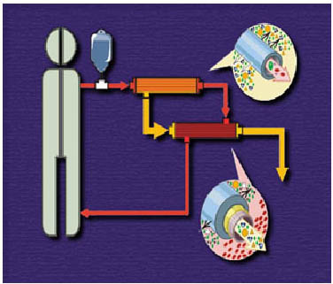
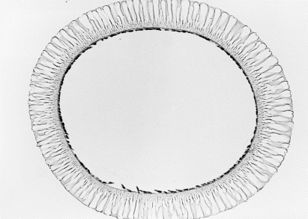
Renal Tubule Assist Device (RAD)
Light micrograph of a hematoxylin and eosin stained section of a hollow fiber with a confluent monolayer of porcine renal proximal tubule cells along the inner surface of the fiber.

Slide 22
Public Release: 4-Mar-2008
Renal Assist Device' reduces risk of death from acute kidney failure
Cell-filled device temporarily replaces renal tubule function
AMERICAN SOCIETY OF NEPHROLOGY
40 of 58 patients with AKI were randomly assigned to treatment with the RAD, in addition to standard renal replacement therapy.
Outcomes were significantly better for AKI patients treated with the RAD. After one month, 33 percent of patients in the RAD group had died, compared to 61 percent of those treated with renal replacement therapy only.
Patients who received the RAD were also more likely to be alive after six months. The risk of death was about 50 percent lower in the RAD group.
Patients in the RAD group also had a shorter time to return of kidney function. Overall, kidney function recovered in 53 percent of patients with RAD, compared to 28 percent without RAD. In both groups, about 20 percent of patients survived but never recovered kidney function, requiring chronic dialysis.

Slide 23
Indications for RRT

Slide 24
Indications for RRT
Renal Replacement :
  Acute management of life-threatening complications of AKI:
  A: Metabolic acidosis (pH less than 7.1)
  E: Electrolytes -- Hyperkalemia (K >6.5 meq/L) or rapidly rising K)
  I: Ingestion -- Certain alcohol and drug intoxications
  O: Refractory fluid overload
  U: Uremia, ie. pericarditis, neuropathy, decline in mental status
Renal Support: RRT even before any of the complications arise

Slide 25
Timing of initiation of RRT

Slide 26
Timing of CRRT
This is a very important issue and traditionally dialysis is started when standard indications for dialysis like volume overload or solute removal become necessary.
However recent data suggests that early initiation of CRRT improves patient outcome

Slide 27
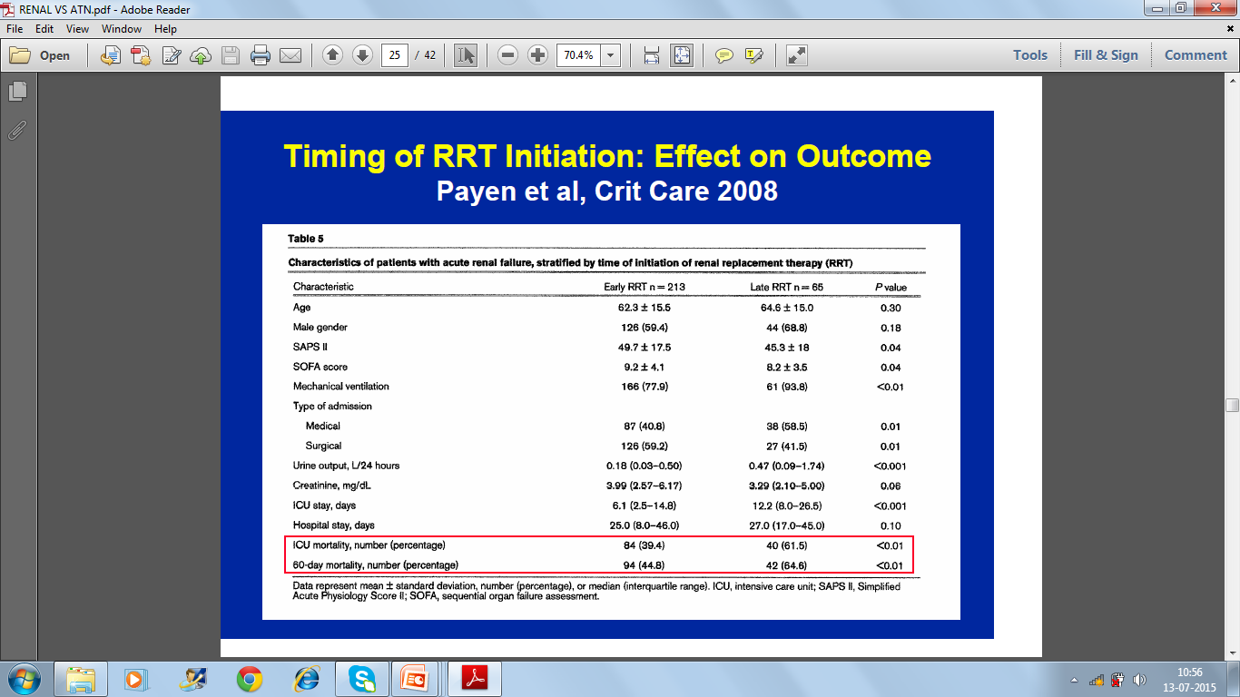

Slide 28
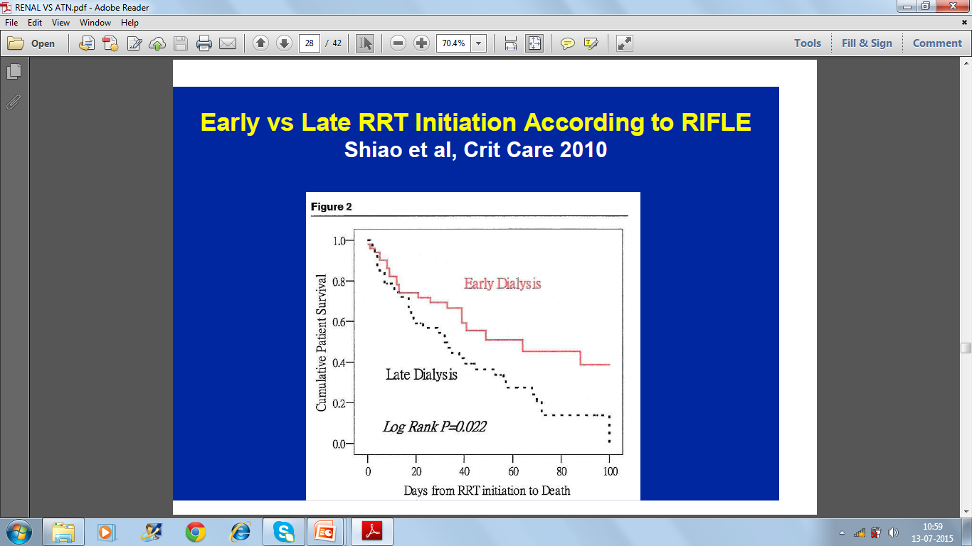

Slide 29
Optimum Modality
Continuous
vs
Intermittent dialysis

Slide 30
Continuous vs Intermittent dialysis
Ongoing debate
Theoretical benefits to both
At least 7 RCTs and 3 meta-analyses have not demonstrated difference in outcome
  Meta analysis of 9 randomized trials: No effect on mortality (OR 0.99) or recovery to RRT independence (OR 0.76). Bagshaw et al Crit Care Med 2008, 36:610-617
  Suggestion that continuous RRT had fewer episodes of hemodynamic instability and better control of fluid balance
May be preferable in specific subpopulations

Slide 31
Pro-continuous RRT
Better preservation of cardiovascular function and maintenance of hemodynamic stability
Prevents the surge in intracranial pressure associated with intermittent therapies- hence useful in neurosurgical patient and acute liver failure.
Effective in clearance of middle molecules
Useful in removal of immunomodulatory substances in sepsis like endotoxin, interleukin-1, etc
Permits protein rich nutritional support with a neutral nitrogen balance preventing protein malnutrition
Clinical benefits
  ? Better survival
  ? Better renal recovery

Slide 32
Pro-continuous RRT
Specific patient populations who may benefit from CRRT
  Hemodynamic instability
  Combined acute renal and hepatic failure
    Improved CV instability and intracranial pressure
  Acute brain injury
    Decreased cerebral edema

Slide 33
Pro-intermittent RRT
Practicality and flexibility
  Uses same machines as chronic HD
  Multiple pts per day
  Easier to mobilize pts
Less expensive than CRRT (by about ½)
Fewer bleeding complications
  CRRT requires continuous anticoagulation
Less filter clotting
Superior solute clearance, more rapid removal of toxins (due to higher flows)

Slide 34
Pro-intermittent RRT
Specific patient populations benefitting from IRRT:
  High bleeding risk
    ie. after recent surgery
  Acute treatment of hyperkalemia, rhabdomyolysis, poisoning, tumor lysis syndrome

Slide 35
Is SLEDD the answer?
Hybrid therapy with flexibility of duration and intensity
SLEDD vs CRRT
Major advantages: flexibility, reduced costs, low or absent anticoagulation
Similar adequacy and hemodynamics
  One small study showed slightly higher acidosis and lower BP (Baldwin et al 2007)
  VA/NIH ATN trial (Palevsky et al; NEJM 2008) suggests similar outcomes as CRRT and IRRT.
  Extended Daily Dialysis Versus Continuous Renal Replacement Therapy for Acute Kidney Injury: A Meta-analysis: Am J kidney Dis 2015 Aug;66(2):322-30: EDD is associated with similar outcomes to CRRT in RCTs

Slide 36
Optimal dosing of CRRT

Slide 37
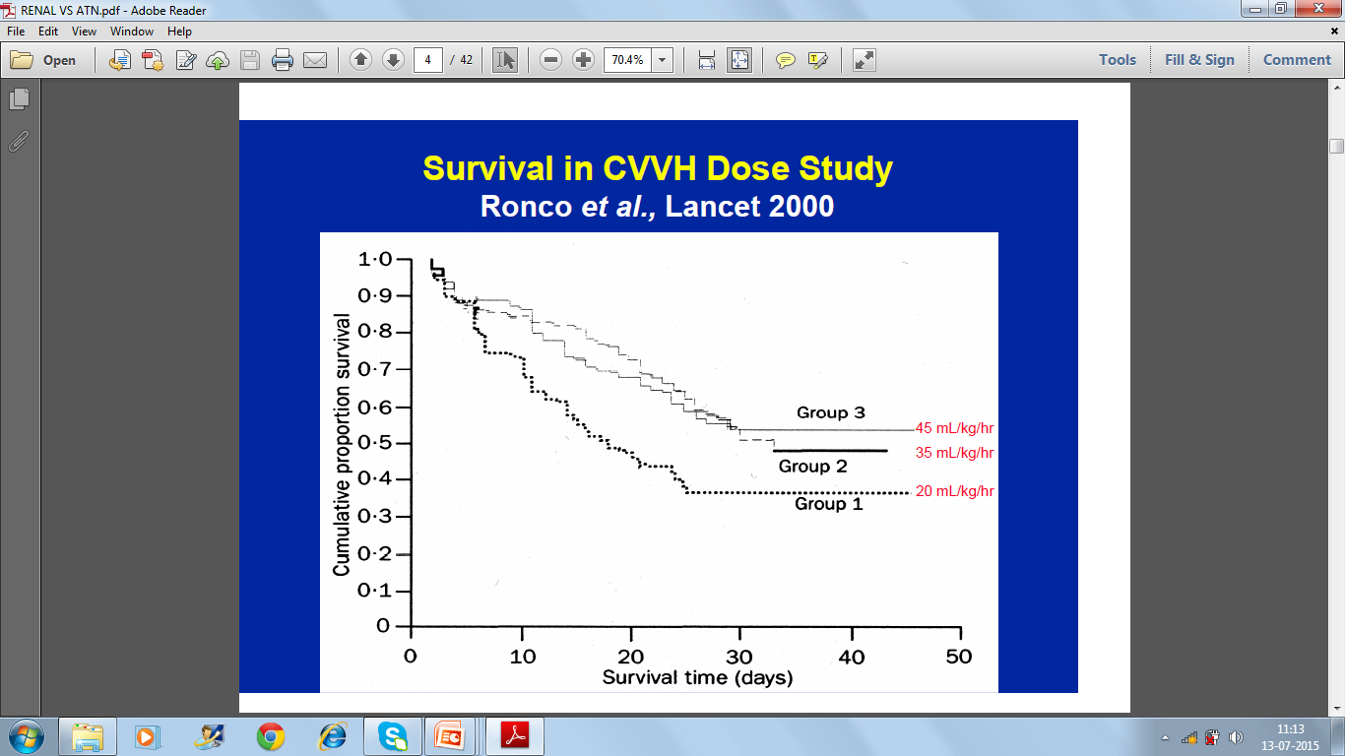

Slide 38
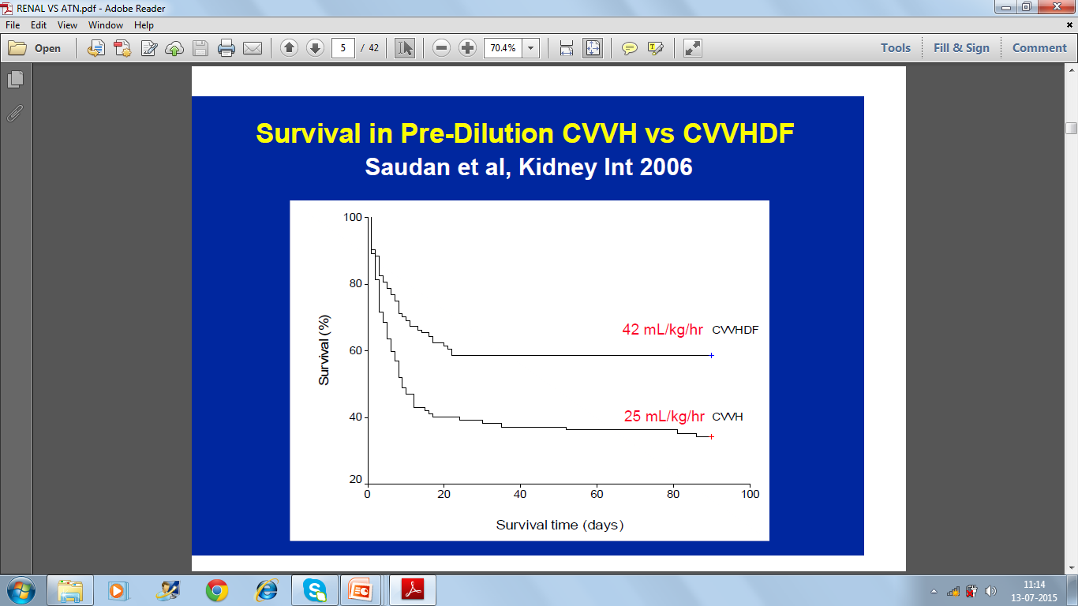

Slide 39
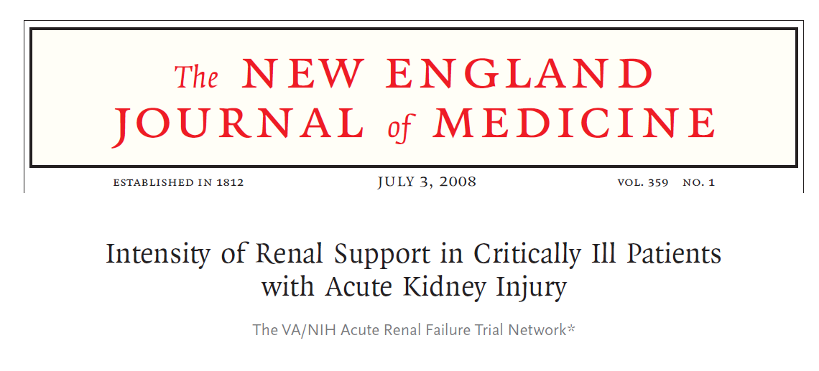
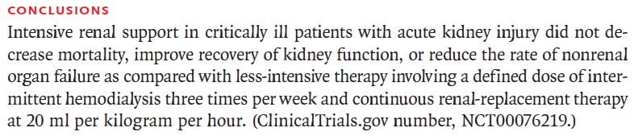

Slide 40
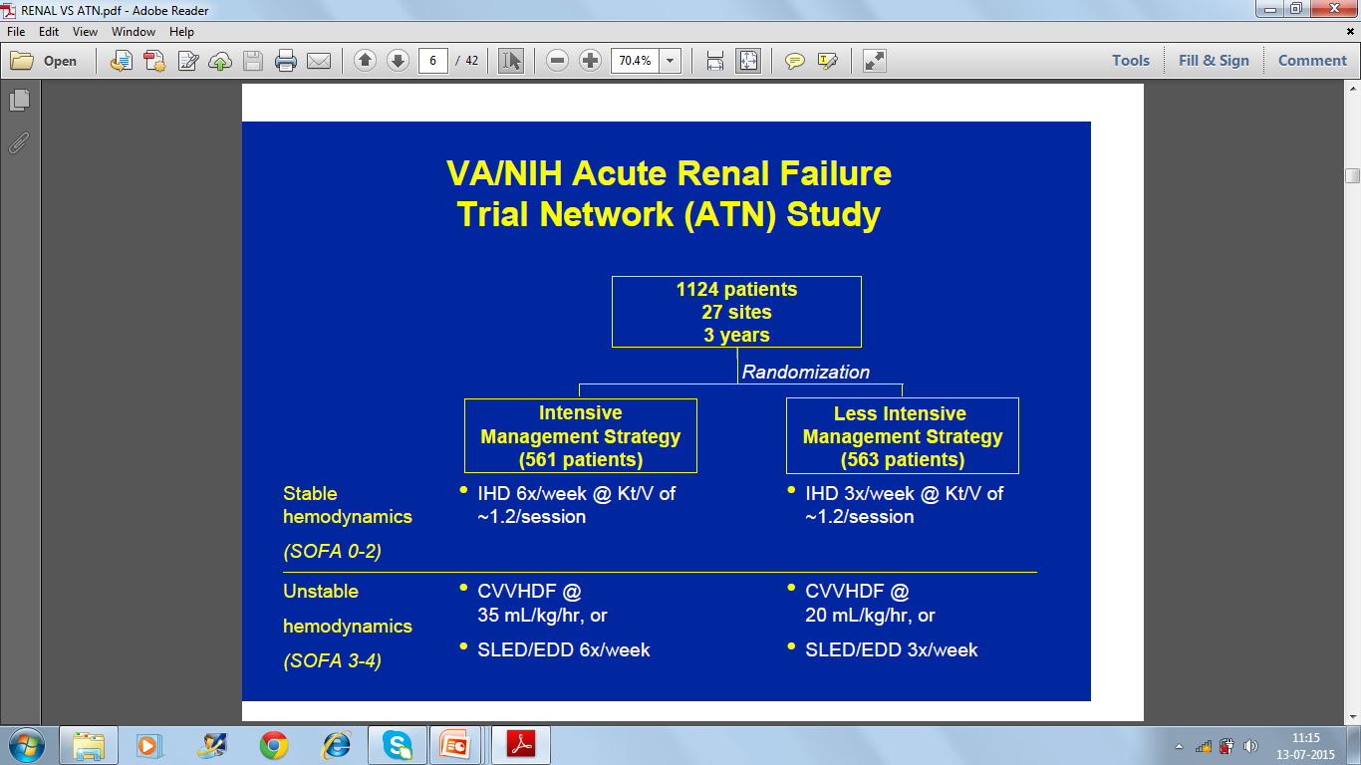

Slide 41
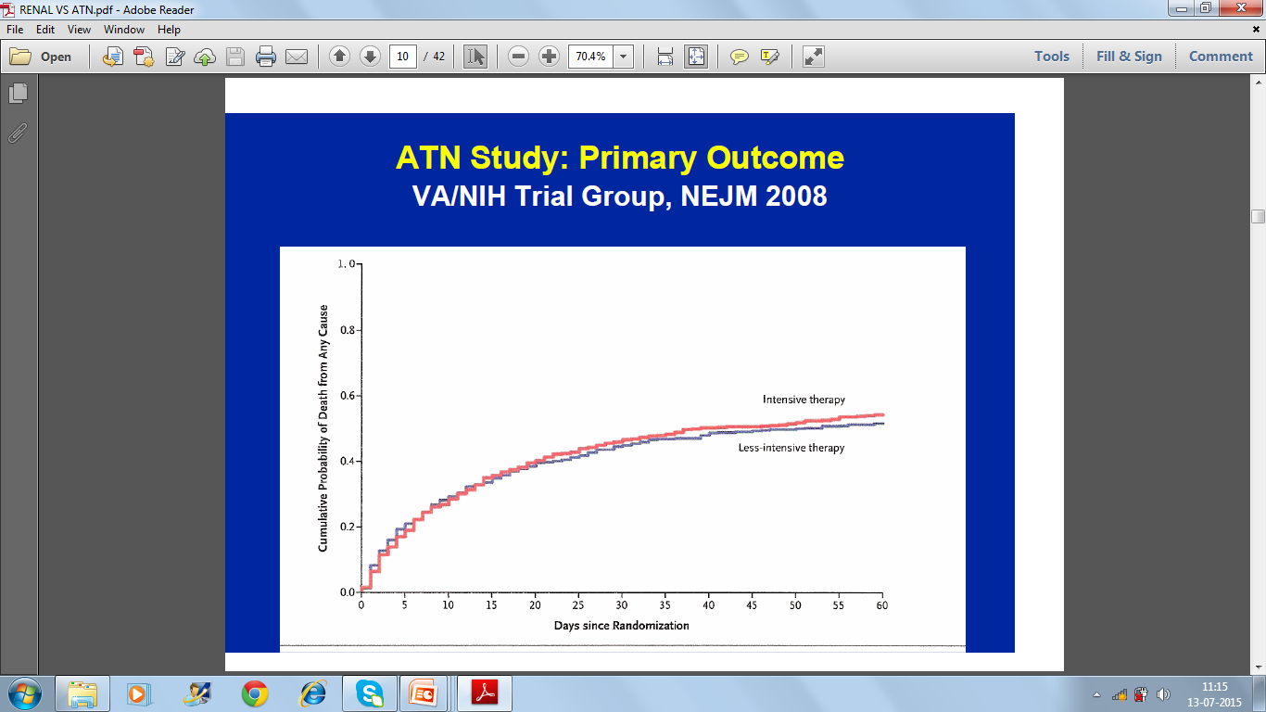

Slide 42
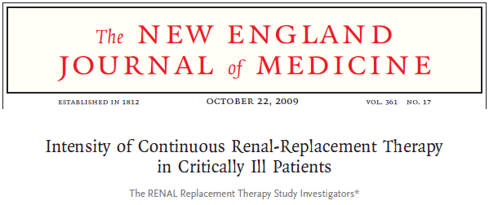


Slide 43
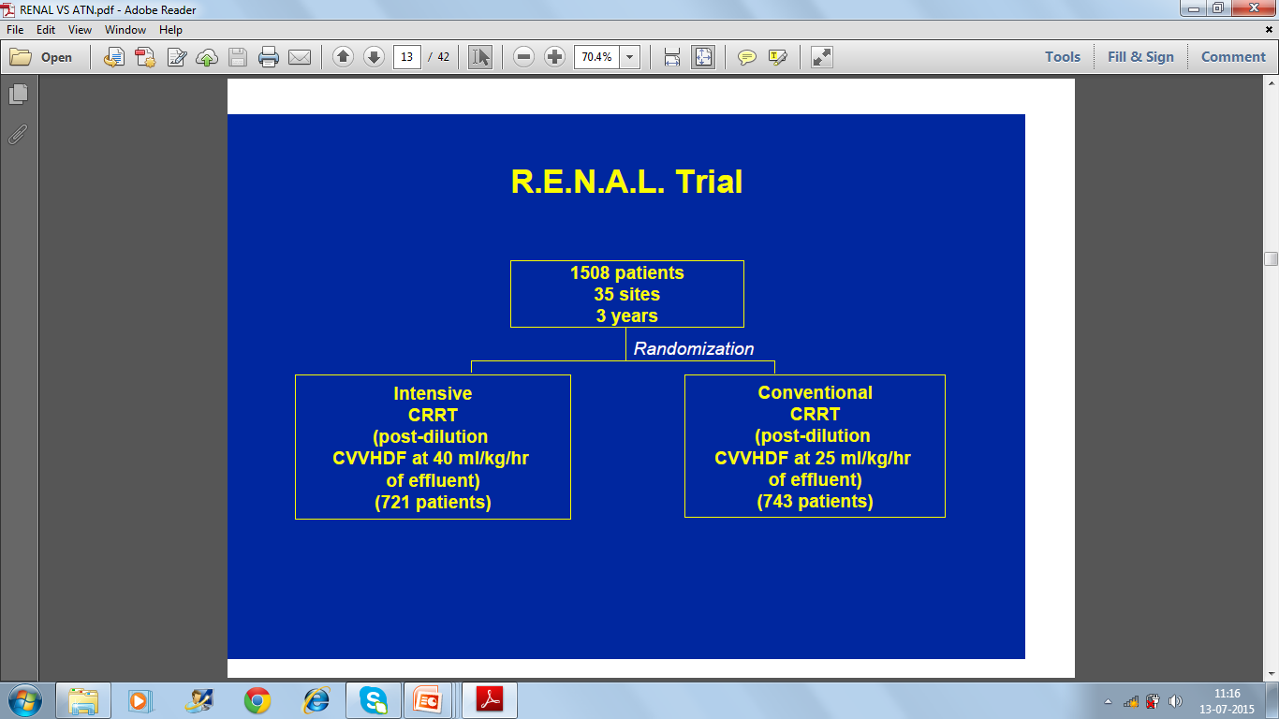

Slide 44
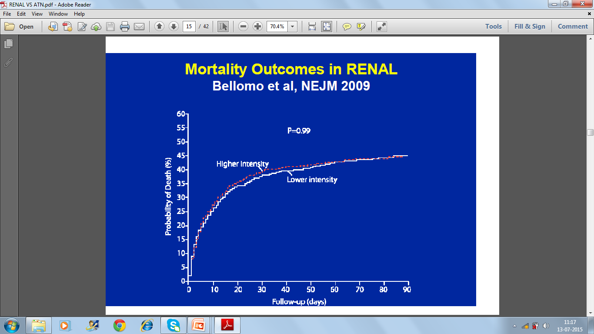

Slide 45
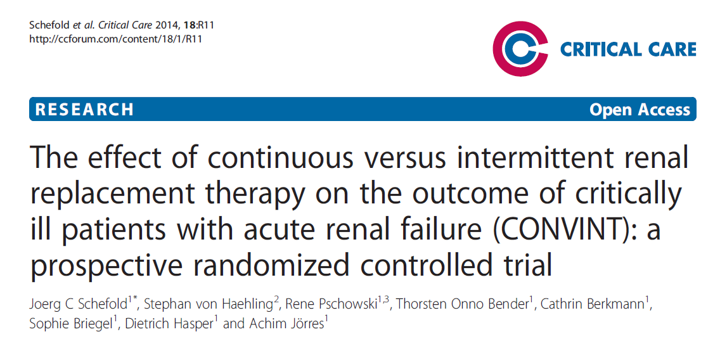
CONVINT TRIAL

Slide 46
CONVINT TRIAL
CONVINT TRIAL -Single-center prospective RCT including 252 critically ill patients with dialysis-dependent ARF . Patients were randomized to receive either daily IHD or CVVH.
The primary outcome measure was survival at 14 days .Secondary outcome measures included 30-day,ICU and intra hospital mortality, as well as course of disease severity/biomarkers and need for organ-support therapy.
Results: Survival rates at 14 days after RRT were 39.5% (IHD) versus 43.9% (CVVH).14-day-, 30-day, and all-cause intra hospital mortality rates were not different between the two groups (all P > 0.5).
Conclusions: No statistically significant differences was observed between the treatment modalities regarding mortality, renal-related outcome measures, or survival at 14 days after RRT.

Slide 47
AKI and CKD - Interplay
AKI
CKD

Slide 48
CRRT AND DIALYSIS DEPENDENCY
AFTER
ACUTE KIDNEY INJURY

Slide 49
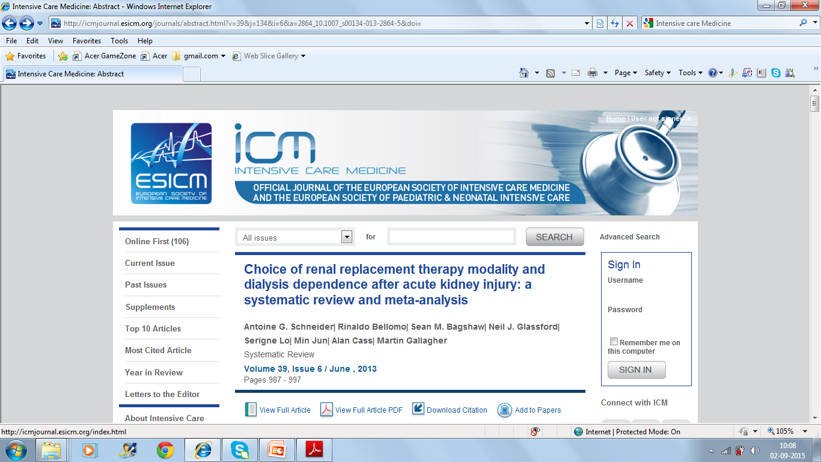
DOES CRRT Offers Better Acute Kidney Injury Outcomes????

Slide 50
Does CRRT Offers Better Acute Kidney Injury Outcomes???
Patients with AKI treated with IRRT rather than (CRRT) may be more likely to become dialysis dependent.
A systematic review and meta-analysis of 23 studies including 7 (RCTs) with 472 patients and 16 observational studies with3,499 patients concluded that Overall, initial treatment with IRRT was associated with a 1.7 times increased relative risk for dialysis dependence compared with CRRT.
Pooled analyses of the RCTs demonstrated no significant difference in dialysis dependent rates between the modalities, but pooled analyses of the observational studies showed that patients who initially received IRRT had a twofold increased risk of dialysis dependence compared with CRRT.

Slide 51
Summary
&
Conclusions

Slide 52
SUMMARY
Recent multicenter RCTs have failed to confirm earlier trials suggesting benefit of higher CRRT dose in critically ill
Several differences exist among the various CRRT dose/outcome trials ,effluent dose ,convective contribution , dilution mode and timing of initiation
A “One size fits All” approach makes it very difficult to establish a standard CRRT modality and dose in an individual patient

Slide 53
SUMMARY
May be its time to say good bye to any more CRRT- high dose versus low dose ; CRRT versus IHD trials because hundreds of studies, including multicentre RCT’s, meta-analysis have not shown a clear benefit of one over the other
The choice of RRT in the critically ill is best left to the clinicians handling these patients depending on the condition of the patients, infrastructure, expertise and funds available in a given situation.

Slide 54
Suggested Reading
Intensity of Renal Support in Critically Ill Patients with Acute Kidney Injury :The VA/NIH Acute Renal Failure Trial Network. N Engl J Med 2008; 359:7-20
Intensity of Continuous Renal-Replacement Therapy in Critically Ill Patients:The RENAL Replacement Therapy Study Investigators N Engl J Med 2009; 361:1627-1638
A comparison of early versus late initiation of renal replacement therapy in critically ill patients with acute kidney injury: a systematic review and meta-analysis : Karvellas et al. Critical Care 2011, 15:R72
Dialysis: Results of RENAL—what is the optimal CRRT target dose? John A. Kellum & Claudio Ronco: Nature Reviews Nephrology 6, 191-192 (April 2010)
The effect of continuous versus intermittent renal replacement therapy on the outcome of critically ill patients with acute renal failure (CONVINT): a prospective randomized controlled trial. Schefold JC, von Haehlin et al Crit Care. 2014 Jan 10;18(1):R11.
Extended Daily Dialysis Versus Continuous Renal Replacement Therapy for Acute Kidney Injury: A Meta-analysis. Am J Kidney Dis :2015 Aug;66(2):322-30

Slide 55
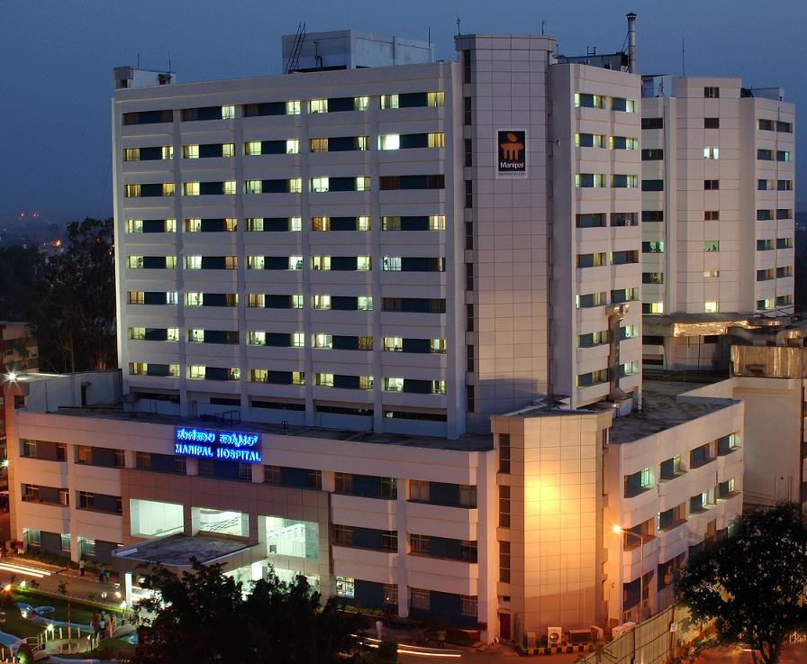
Thank You

