Slide 1

Influence of AM fungi on accumulation of Withaferin-A in micropropagated Withania somnifera (L.) Dunal
Dr. Raveesha, H.R
Assistant Professor
Dept. of Botany
Bangalore University
Bangalore - 560056

Slide 2
INTRODUCTION

Slide 3
Withania somnifera is under shrub of family Solanaceae, grows widely in subtropical and North Western parts of India.
It is popularly Known as Ashwagandha / Winter cherry / Indian Ginseng is used in Indian traditional system of medicine as an herbal tonic in the form of Medharasayana.
The roots are rich source of Steroidal lactones - Withanolides, withanones, Withaferin and several sitoindosides, alkaloids, flavonoids and tannins.
The plants are exploited for its varied medicinal properties by pharmaceutical industries.
Therefore, the present study was designed to investigate the effect of AM fungi on enhancement of secondary metabolites in micropropagated plants.

Slide 4
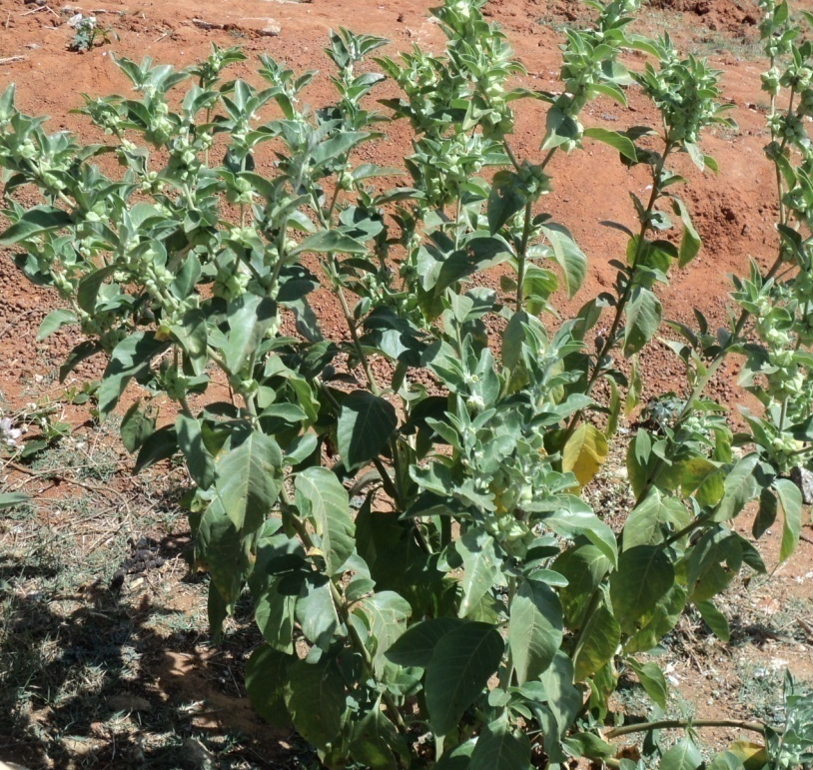
Systematic Position
Division : Magnoliophyta
Class : Magnoliopsida
Order : Solanales
Family : Solanaceae
Genus : Withania
Species : somnifera
Synonym : Physalis somnifera

Slide 5
Objectives
Establishment of in vitro cultures from various explants.
To evaluate the comparative studies between normal, regenerated and AM fungi treated plants
To assess the percent colonization and AM fungi spores in the root
To investigate the antioxidants and Withanolides
To study the potential AM fungal species influencing the amount of secondary metabolites

Slide 6
Need for conservation and cultivation
Large requirement for preparation & testing
Increasing
demand for
herbal products
Unscientific methods of collection
Disappearence of natural habitats
Large requirement for preparation & testing
Urgent need for conservation &
cultivation

Slide 7
MATERIAL AND METHODS

Slide 8
Collection of plant material
Seeds and seedlings - collected from Kolar hills
Standardization of the media
Whites media (1954), Murashige and Skoog (1962), Gamborg’s B5 (1968) and Nitsch (1969)
Growth regulators
Auxins - 2,4-D, NAA, IAA and IBA
Cytokinins – BA, KIN and 2ip
Gibberellins – GA₃
Establishment of aseptic cultures
Explants – washed in running tap water & subsequently with sterilants (chlorine water, HgCl2, NaoCl, ethanol etc.)

Slide 9
AM Fungal studies
Collection, Multiplication & maintenance of Glomus cultures
Experimental design
Control
T1- Normal plants
T2- Micropropagated plants
Plants raised from Shoot tip culture treated with Glomus species
T3- G. mosseae
T4- G. fasciculatum
T5-G. macrocarpum
Plants raised from Nodal culture treated with Glomus species
T6- G. mosseae
T7- G. fasciculatum
T8-G. macrocarpum
Plants raised from leaf culture treated with Glomus species
T9- G. mosseae
T10- G. fasciculatum
T11-G. macrocarpu

Slide 10
Parameters studied
Percent of root colonization (Philips and Hayman,1970)
Spore count (Gerdemann and Nicolson, 1963)
Morphological parameters and Biomass
Phytochemical studies
Primary metabolites
Chlorophyll content (Arnon, 1949)
Total Carbohydrates by Anthrone method (Sridhar and Mahadevan,1986)
Reducing sugars by DNS method (Sridhar and Mahadevan, 1986)
Total proteins (Lowry et al.,1951)
Free Amino acids (Moore and Stein, 1984)

Slide 11
Secondary metabolites
Phenolics ( Nitsch and Nitsch, 1962)
Antioxidant assay
DPPH (1,1-Diphenyl-2-picrylhydrazyl, Auddy, 2003)
ABTS (2, 2’-azinobis-ethyl-benzothiozoline-6-sulphonic acid, Rajkumar ,1994)
HPLC Analysis.
Quantification of Withaferin –A (Rathod et al., 2013)
Statistical analysis
The data was analyzed by one & two way analysis of variance (ANOVA) fallowed by least significant Diff using IBM SPSS Statistics software version 20.The statistical significance was set p< 0.05.

Slide 12
RESULTS

Slide 13
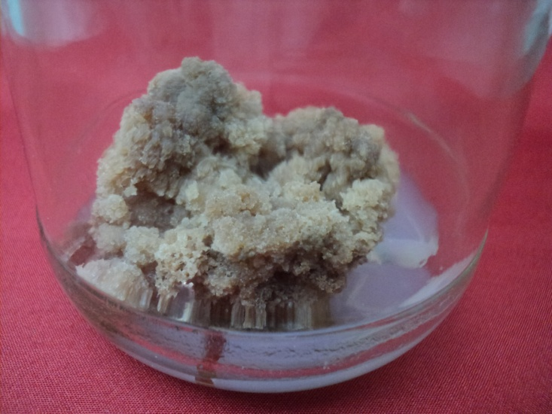
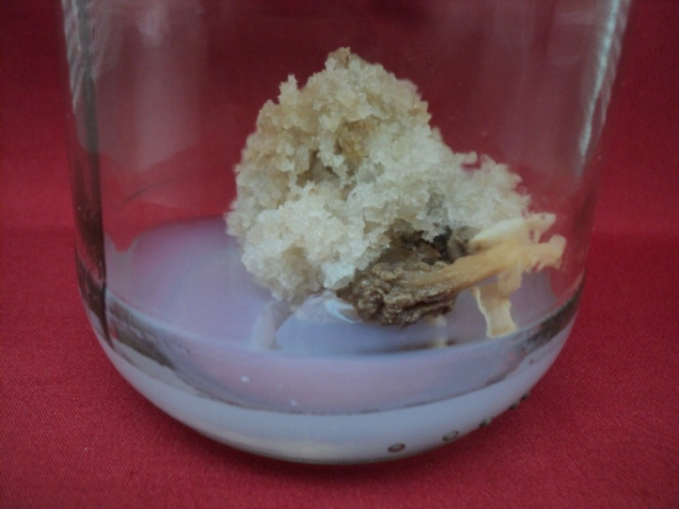
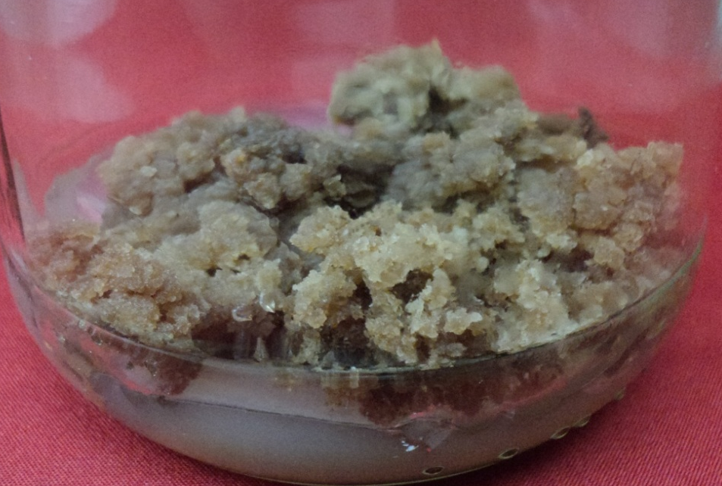
MS+IBA (2mgl⁻¹)
Plate-I
A
B
C
MS+ 2,4-D (0.5mgl⁻¹)

Slide 14
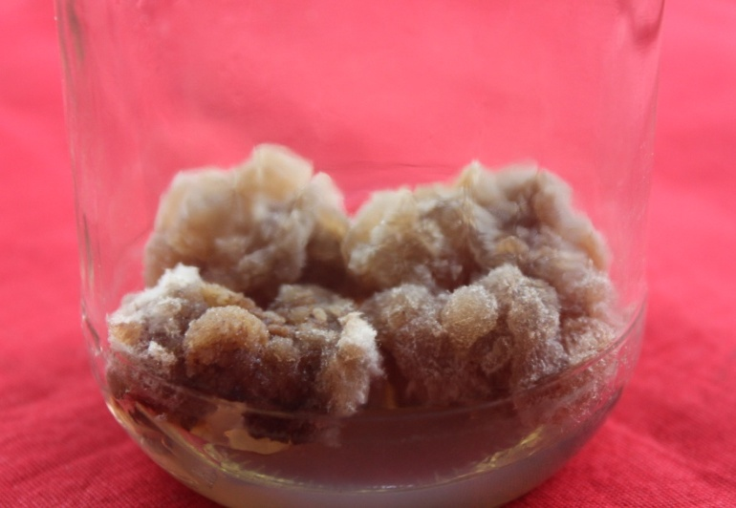
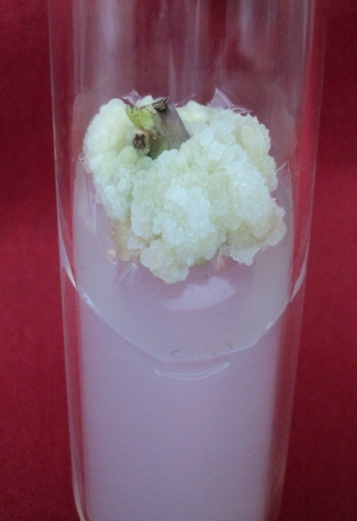
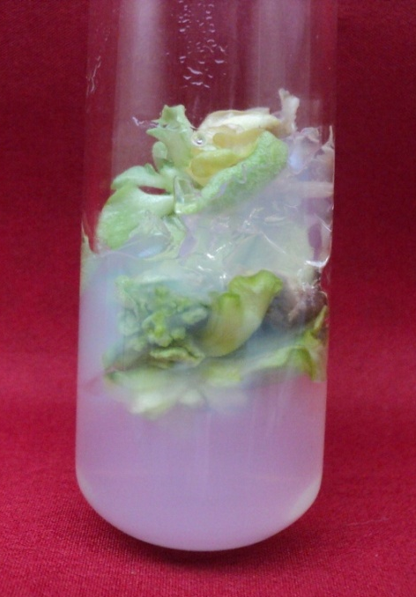
2,4-D (2mgl⁻¹)+ BA (0.5mgl⁻¹)
Plate-II
A
IBA (2mgl⁻¹ ) + KN (0.5mgl⁻¹)
B
C
IBA (2mgl⁻¹ )+BA (0.5mgl⁻¹ )

Slide 15
A- percent of explants responded B- No of shoots initiated/explants
Table-1: Effect of different concentrations of Auxins (0.5 mgl⁻¹) with Cytokinins (1 -4 mgl⁻¹) on shoot initiation (No of explants cultured- 15)
MS +PGRs+Conc. mgl⁻¹ | Shoot tip explants |  | Nodal explants |  | Leaf explants
 | A | B | A | B | A | B
BA+2,4-D, 1+0.5 | 39.99±3.84b | 2.33±0.33b | 68.88±5.87bc | 6.34±0.66b | 91.10±2.22a | 6.66±0.66a
2+0.5 | 53.33±3.85c | 3±0.57b | 82.22±2.22c | 10±1c | 64.44±2.22b | 5.32±0.33a
3+0.5 | 33.33±3.85b | 2±0.00b | 66.66±3.84b | 4±0.57a | 46.66±6.66c | 3.65±0.66b
4+0.5 | 0±0.00a | 0±0.00a | 48.88±4.44a | 3.66±0.33a | 31.10±4.44d | 3±0.00b
KN+2,4-D, 1+0.5 | 44.44±4.44b | 2.33±0.33b | 62.22±5.87bc | 7±1.00b | 68.88±2.22c | 5.67±0.66a
2+0.5 | 71.11±11.11c | 3.34±0.33c | 73.33±10.18c | 7.67±0.33b | 59.99±6.66c | 4.33±0.33a
3+0.5 | 28.88±9.68b | 2.34±0.33b | 48.88±4.44b | 3.66±0.33a | 42.22±2.22b | 2.34±0.33b
4+0.5 | 0±0.00a | 0±0.00a | 24.44±2.22a | 2.68±0.33a | 24.44±2.22a | 1.67±0.33b

Slide 16
Table-2: Effect of different concentrations of Auxins (0.5 mgl⁻¹) with Cytokinins (1 -4 mgl⁻¹) on shoot initiation. (No of explants cultured- 15)
MS+PGRs+Conc. mgl⁻¹ | Shoot tip explants |  | Nodal explants |  | Leaf explants
 | A | B | A | B | A | B
BA+IBA
1+0.5 | 46.66±3.84a | 2.33 ±0.33b | 77.77±2.22c | 7.33±0.33b | 62.22±2.22b | 5.66±0.33a
2+0.5 | 60±11.54a | 3.33±0.33c | 93.33±3.85d | 9.33±0.88c | 77.77±2.22a | 6.33±0.66a
3+0.5 | 57.77±15.55a | 2.33±0.33b | 64.44±2.22b | 4±0.57a | 44.44±4.43c | 4±0.57b
4+0.5 | 0±0.00b | 0±0.00a | 51.11±5.87a | 4.33±0.33a | 33.33±7.69c | 3.66±0.33b
KN+IBA
1+0.5 | 71.55±7.8bc | 2.66 ±0.33b | 75.55±4.44 | 6±0.57b | 53.33±3.85a | 4.33±0.33a
2+0.5 | 92.77±4.33c | 4.33±0.33c | 91.10±4.45 | 8.33±0.66c | 64.44±4.44a | 4.66±0.33a
3+0.5 | 64.44±11.7b | 2.66±0.33b | 64.44±4.44 | 5±0.57ab | 35.55±5.87b | 3.66±0.33ab
4+0.5 | 0±0.00a | 0±0.00a | 46.66±3.84 | 3.33±0.88a | 31.11±5.87b | 2.66±0.66b
A- No of explants responded B- No of shoots initiated/explants

Slide 17
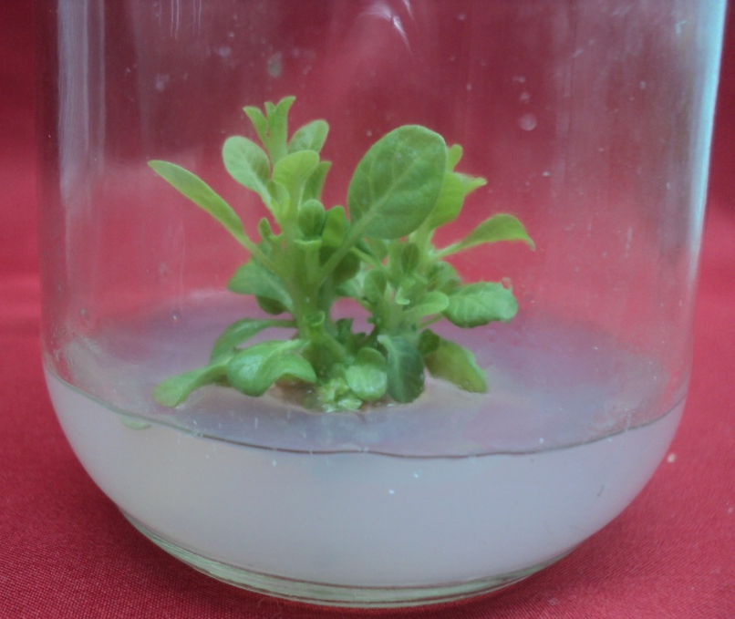
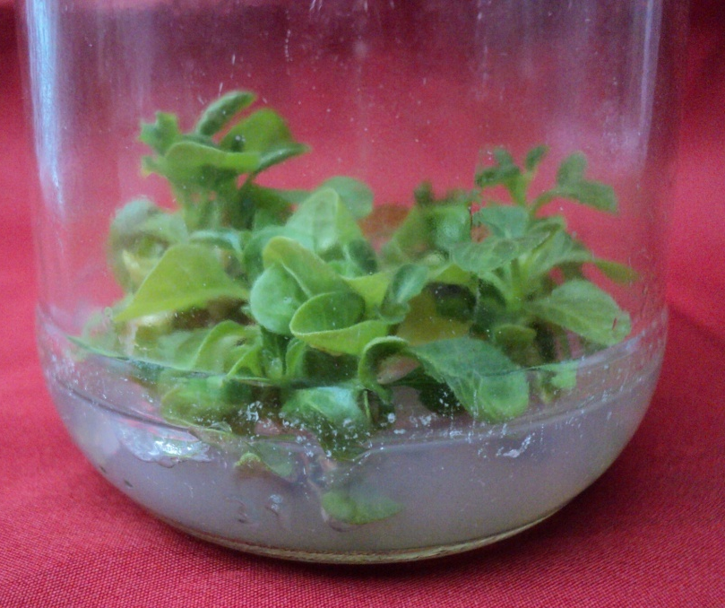
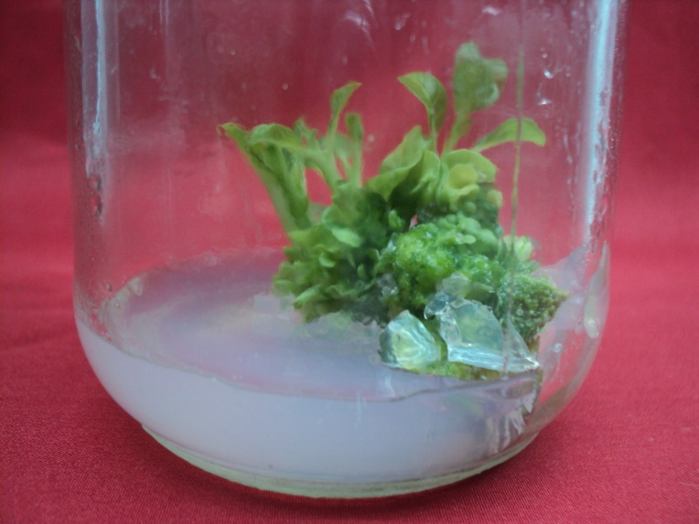
KN (2mgl⁻¹ )+IBA (0.5mgl⁻¹) BA (2mgl⁻¹ )+IBA (0.5mgl⁻¹)
Plate-III
A
B
C
BA (1mgl⁻¹) + 2, 4-D (0.5mgl⁻¹ )

Slide 18
Table-3: Effect of combination of cytokinins on rapid multiple shoot initiation/explant
 | Concn. mgl⁻¹ | BA+KN |  | KN+BA
 |  | A | B | A | B
 | 1+0.5 | 59.99±17.63bc | 3.33±0.33ª | 59.99±7.69b | 4.33±0.33^{b}
Shoot tip | 2+0.5 | 79.99±3.84c | 5.32±0.66^{b} | 97.77±2.22a | 7±0.57^{c}
 | 3+0.5 | 37.77±8.01ab | 3.65±0.33^{ab} | 59.99±15.39b | 3.66±0.33^{ab}
 | 4+0.5 | 24.44±2.22a | 2.32±0.33ª | 22.22±2.22c | 2.65±0.33ª
 | 1+0.5 | 71.11±5.87c | 6.33±0.33^{b} | 62.22±2.22c | 7.33±0.66ª
Node | 2+0.5 | 91.10±4.44d | 9±1.00ª | 53.33±3.85c | 5.65±0.66^{ab}
 | 3+0.5 | 55.55±2.22b | 5.32±0.33^{bc} | 37.77±2.22b | 4.66±0.66^{b}
 | 4+0.5 | 37.77±2.22a | 3.66±0.66^{c} | 19.99±3.84a | 2.64±0.33^{c}
 | 1+0.5 | 59.99±6.66b | 5.65±0.33ª | 46.66±3.84b | 4.66±0.33ª
Leaf | 2+0.5 | 77.77±2.22a | 7.66±0.33^{b} | 62.22±5.87a | 5±0.57ª
 | 3+0.5 | 37.77±2.22c | 4.33±0.33^{c} | 31.10±4.44c | 3.33±0.33^{b}
 | 4+0.5 | 17.77±2.22d | 3.32±0.33^{c} | 11.10±2.22d | 1.65±0.33^{c}
A- No of explants responded, B-No of shoots initiated/explant

Slide 19
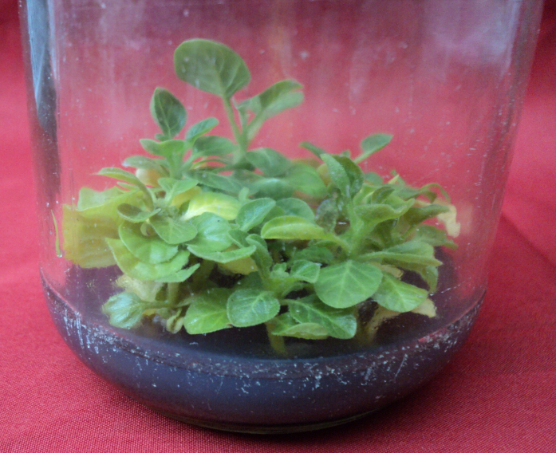

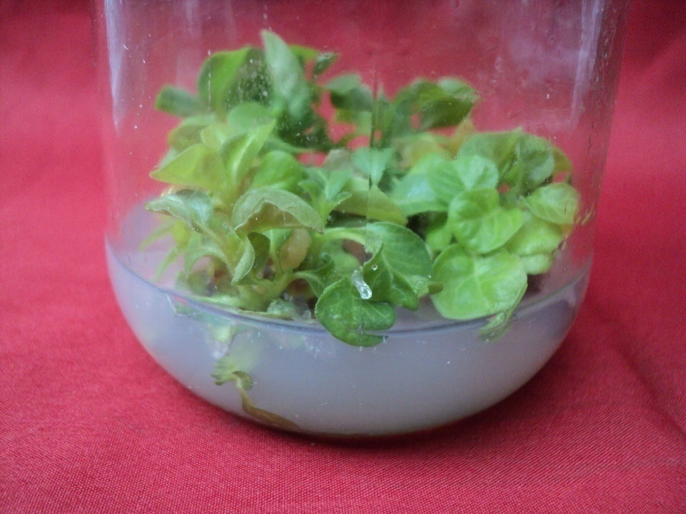
KN (2mgl⁻¹ )+ba (0.5mgl⁻¹ ) ba (2mgl⁻¹ )+kn (0.5mgl⁻¹ )
Plate-IV
A
B
C
BA (2mgl⁻¹ )+KN (0.5mgl⁻¹ )

Slide 20
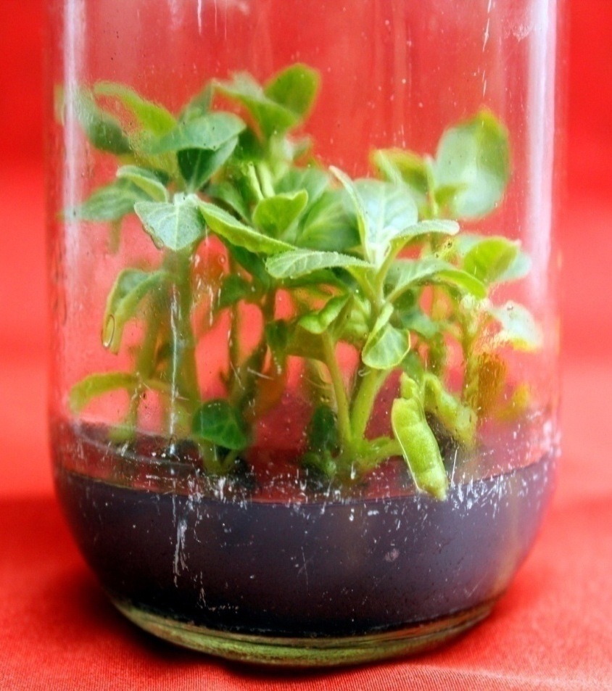
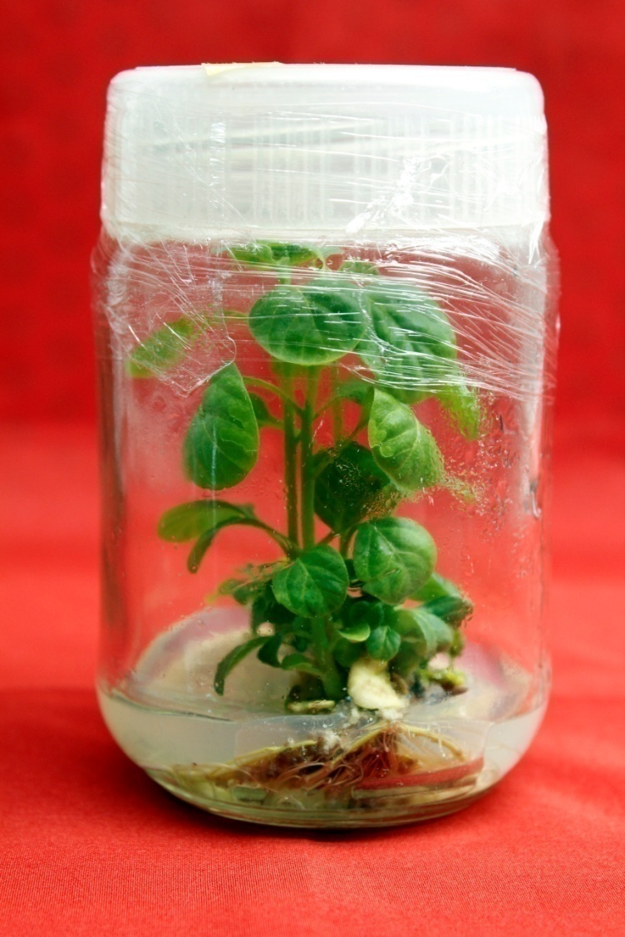
Root initiation
Plate-V
A
B
MS + IBA (0.5-1mgl⁻¹)

Slide 21
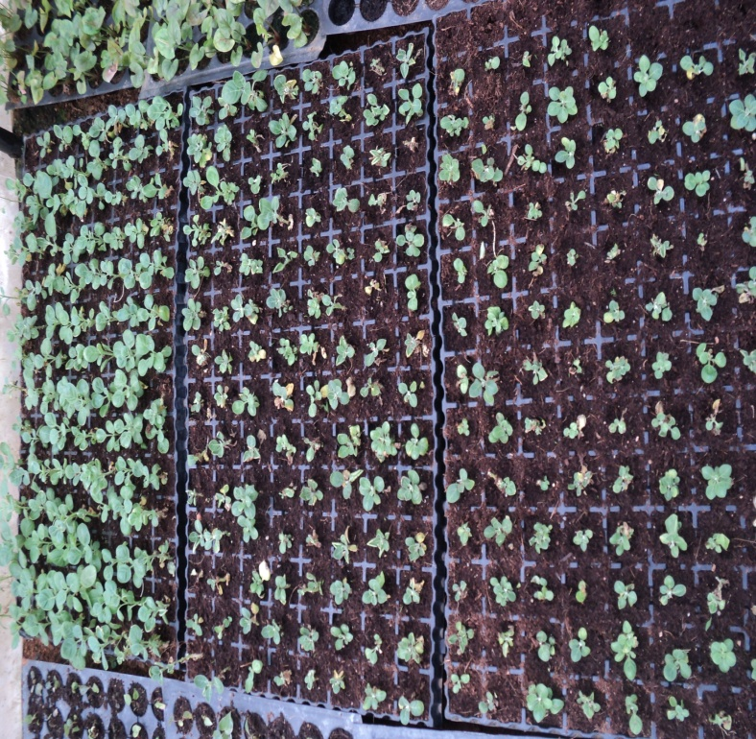
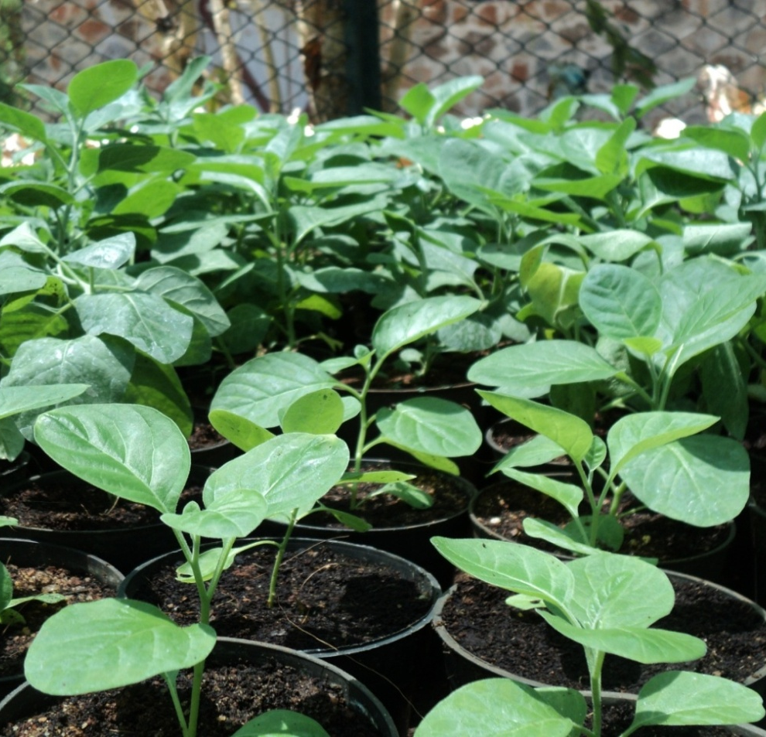
Hardening and Acclimatization
Plate-VI
A
B
Fig. A: Nursery bed mixture: Sterilized coconut peat mass.
Fig. B: Pot mixture: sterile soil, manure and sand (1:2:1)

Slide 22
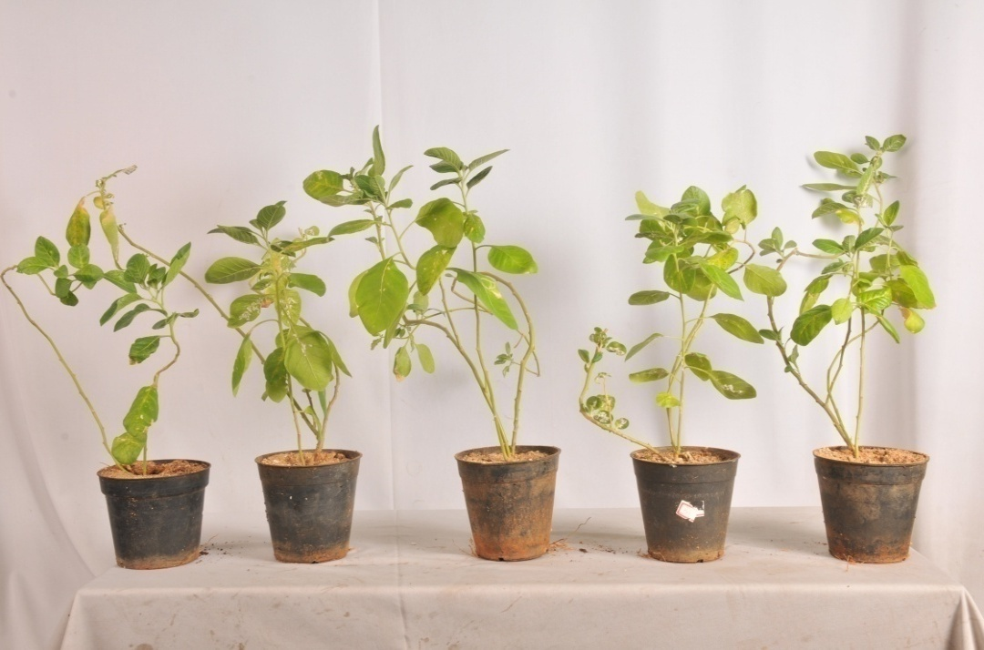
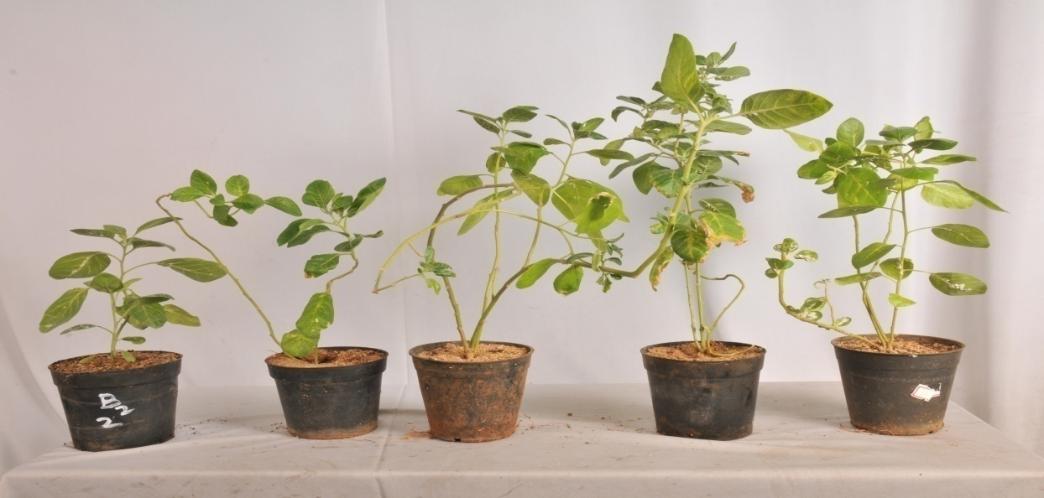
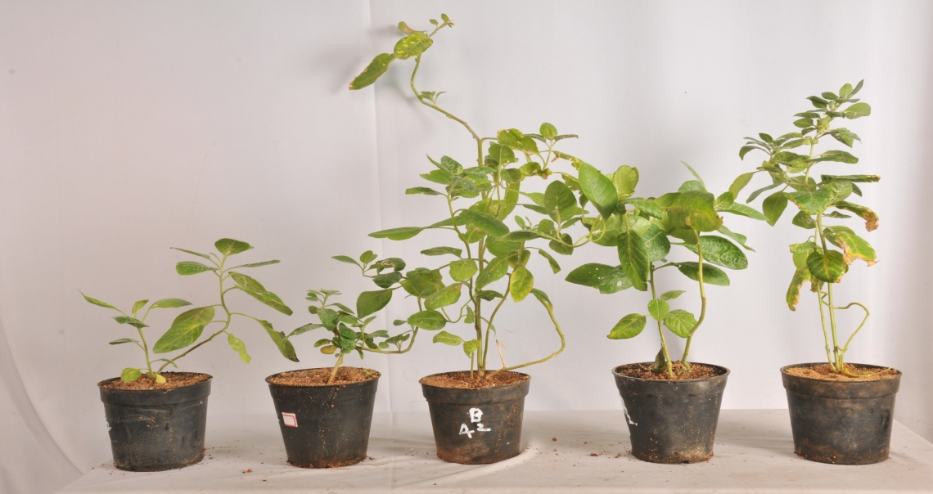
Plate-VII
A
B
T1
T2
T3
T4
T5
T1
T2
T6
T7
T8
C
T1
T2
T9
T10
T11
Hardened plants raised from A-Shoot tip explants, B-Nodal explants, C- Leaf explants.

Slide 23
Table- 4: Percentage of root colonization and spore count in 500mg of soil
Treatments | No of vesicles/root | No of arbuscles/root | No of spores
T1 | 0.00±0.00ª | 0.00±0.00ª | 0.00±0.00ª
T2 | 0.00±0.00ª | 0.00±0.00ª | 0.00±0.00ª
T3 | 7.33±0.33^{b} | 7.32±0.88^{b} | 232.66±2.33^{b}
T4 | 10.66±0.88^{c} | 11.33±1.76^{c} | 293.65±3.71^{c}
T5 | 11±1.15^{c} | 9.32±0.88^{bc} | 284.65±4.97^{c}
T6 | 9.66±1.20a | 8±0.57a | 255.66±3.75a
T7 | 13.33±1.45b | 10.33±0.88b | 296±4.00b
T8 | 5.65±0.66c | 4.66±0.33c | 279±5.03c
T9 | 249.66±1.20ª | 5.32±0.88ª | 7±1.15ª
T10 | 278.33±1.76^{b} | 7±1.00ª | 9.66±0.66^{b}
T11 | 261.32±1.45^{c} | 5.66±0.88ª | 6.67±0.33ª
T1- Normal, T2- Untreated micropropagated, T3,T6, T9-G. mosseae. T4,T7, T10- G. fasciculatum, T5, T8, T11- G. macrocarpum

Slide 24
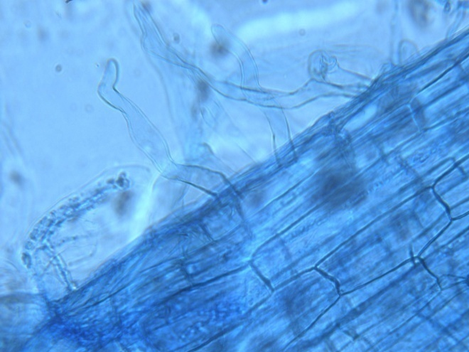
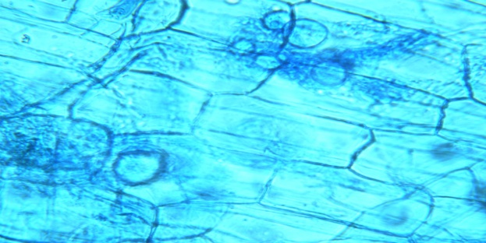
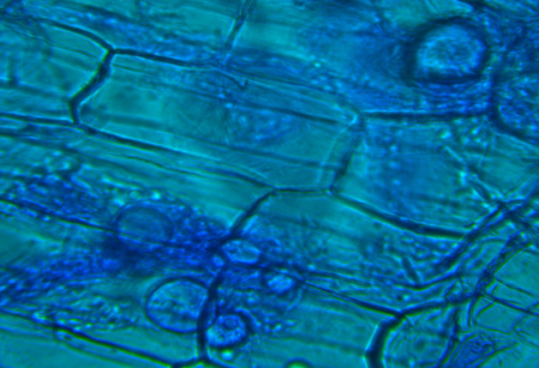
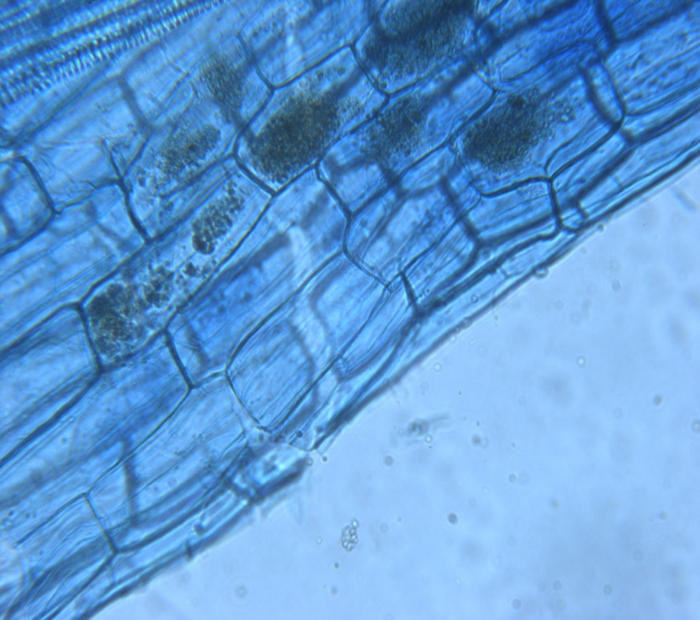
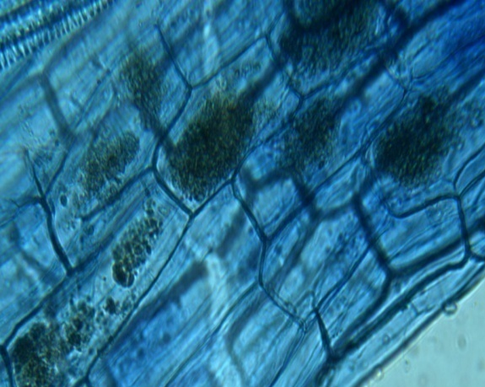
AMF colonization- Vesicles & arbuscles
Plate-VIII
A
B
c
D
E

Slide 25
Table-5: Influence of Glomus species on Fresh and Dry weight of plants at 120th day (Shoot tip explants)
 | Fresh weight (g) |  |  | Dry weight (g)
Treatments | Root | Stem | Leaves | Root | Stem | Leaves
T1 | 6.1±4.16ª | 9.23±0.24ª | 13.50±0.40ª | 1.6±0.61ª | 1.72±0.13ª | 1.33±0.06ª
T2 | 6.68±1.18^{b} | 11.53±0.18^{b} | 15.31±0.32^{b} | 1.44±0.19ª | 1.84±0.313ª | 1.24±0.25ª
T3 | 8.57±0.14e | 15.82±0.23^{d} | 33.30±0.32e | 1.86±0.40^{c} | 3.07±0.17^{c} | 2.83±0.27^{c}
T4 | 6.95±0.26d^{b} | 16.69±0.19e | 21.54±0.55^{d} | 1.51±0.37^{b} | 2.87±0.25^{b} | 1.92±0.23^{b}
T5 | 6.04±0.30^{c} | 13.91±0. 39^{c} | 15. 82±0.94^{c} | 1.59±0.21^{b} | 2.82±0.25^{b} | 1.7±0.44^{b}
T₁- Normal, T₂- Untreated micropropagated, T₃₋G. mosseae. T₄- G. fasciculatum, T₅- G. macrocarpum

Slide 26
Table-6: Influence of Glomus species on Fresh and Dry weight of plants at 120th day (Nodal explants)
Treatments | Fresh weight (g) |  |  | Dry weight (g)
 | Root | Stem | Leaves | Root | Stem | Leaves
T1 | 6.07±0.09a | 9.17±0.15a | 12.96±0.23a | 1.42±0.27a | 1.54±0.11a | 1.07±0.03a
T2 | 6.95±0.67b | 11.46±0.28b | 15.25±0.37b | 1.55±0.19c | 1.90±0.04b | 1.27±0.03b
T6 | 8.04±0.03d | 15.49±0.28d | 28.48±0.97d | 1.89±0.04b | 2.05±0.03c | 2.63±0.13c
T7 | 9.33±0.20d | 19.56±0.04d | 22.92±0.77d | 2.92±0.03e | 3.14±0.15e | 2.83±0.07d
T8 | 8.30±0.20c | 14.52±0.33c | 16.83±0.51c | 2.55±0.24d | 1.97±0.07d | 2.87±0.05e
T1-Normal, T2- Untreated micropropagated, T6-G. mosseae. T7- G. fasciculatum, T8- G. macrocarpum

Slide 27
Table-7: Influence of Glomus species on Fresh and Dry weight of plants at 120th day (Leaf explants)
 |  | Fresh weight (g) |  |  | Dry weight (g)
Treatements | Root | Stem | Leaves | Root | Stem | Leaves
T1 | 4.82±0.46a | 9.09±0.38a | 11.72±0.80a | 1.22±0.00a | 1.35±0.07a | 1.13±0.03a
T2 | 6.02±0.11b | 11.02±0.56b | 14.49±0.30b | 1.38±0.07ab | 1.61±0.04b | 1.20±0.05a
T9 | 6.63±0.49c | 17.58±0.11c | 22.85±0.67c | 1.46±0.03b | 1.98±0.07c | 2.56±0.34b
T10 | 9.14±0.11c | 16.39±0.10c | 22.85±0.67c | 1.70±0.00c | 1.88±0.05c | 2.97±0.36b
T11 | 6.81±0.17b | 11.85±1.00b | 16.12±0.49b | 1.76±0.10c | 1.97±0.01c | 2.41±0.30b
T1- Normal, T2- Untreated micropropagated, T9-G. mosseae. T10- G. fasciculatum, T11- G. macrocarpum

Slide 28
Phytochemical studies

Slide 29
Table-8: Chlorophyll content (shoot tip, nodal & leaf explants)
 | Chlorophyll-a |  | Chlorophyll-b |  | Total chlorophyll
Treatments | Stem | Leaves | Stem | Leaves | Stem | Leaves
T1 | 1±0.00ª | 1.21±0.00^{b} | 6.66±5.77^{ab} | 2.07±1.00^{b} | 8.36±5.77^{ab} | 1.35±1.75^{b}
T2 | 2.33±0.77^{b} | 0.952±0.44ª | 6±0.00ª | 1.58±0.81ª | 8.3±1.00ª | 1.27±1.20ª
T3 | 3±0.00^{bc} | 1.24±1.00^{c} | 7.33±5.77^{bc} | 2.19±0.107^{c} | 8.26±2.08ª | 1.41±1.75^{c}
T4 | 2.33±0.71^{b} | 1.51±1.05^{d} | 7.66±5.77^{c} | 2.66±1.85^{d} | 8.63±1.52^{b} | 1.61±1.52^{d}
T5 | 3.33±.72^{c} | 0.96±0.00ª | 7±0.00^{bc} | 2.14±1.95^{bc} | 8.13±2.51ª | 1.32±1.50^{b}
T1 | 1.07±0.02ª | 1.13±0.02ª | 5.94±0.04ª | 2.11±0.08ª | 8.21±0.03ª | 1.4±0.02ª
T2 | 2.38±0.07^{b} | 1.44±0.07^{b} | 6.58±0.02^{b} | 1.7±0.09^{b} | 8.24±0.04ª | 1.57±0.02^{b}
T6 | 2.98±0.30^{c} | 1.67±0.03^{bc} | 6.92±0.04^{c} | 2.35±0.05^{c} | 8.37±0.02^{b} | 1.85±0.07^{c}
T7 | 3.26±0.04^{c} | 1.85±0.08^{d} | 7.14±0.03^{d} | 2.74±0.04^{d} | 8.59±0.01^{c} | 2.05±0.05^{d}
T8 | 3±0.08^{c} | 1.72±0.13^{d} | 6.94±0.05^{c} | 2.48±0.05^{c} | 8.35±0.04^{b} | 2.23±0.06e
T1 | 1.12±0.07ª | 1.26±0.029^{b} | 6.13±0.05ª | 1.86±0.06ª | 8.1±0.02a | 1.61±0.02ª
T2 | 2.24±0.04^{b} | 1.12±0.04ª | 6.18±0.03^{b} | 1.92±0.02ª | 8.17±0.02a | 1.6±0.00^{b}
T9 | 3.07±0.02^{c} | 1.641±0.05^{c} | 7±0.10^{c} | 2.43±0.04^{b} | 8.33±0.02bc | 1.83±0.06^{b}
T10 | 3.83±0.06^{d} | 1.81±0.02^{d} | 7.21±0.03^{c} | 2.67±0.02^{c} | 8.41±0.04c | 2.09±0.11^{c}
T11 | 3.03±0.05^{c} | 1.77±0.06^{cd} | 7.09±0.13^{c} | 2.54±0.06^{bc} | 8.28±0.02b | 2.17±0.02^{c}
T1- Normal, T2- Untreated micropropagated, T3,T6, T9-G. mosseae. T4,T7, T10- G. fasciculatum, T5, T8, T11- G. macrocarpum

Slide 30
Table-9: Carbohydrates
Treatments | Root (mg/g) | Stem (mg/g) | Leaves (mg/g)
T1 | 4.87±6.34ª | 4.91±7.09b | 5.43±2.08ª
T2 | 6.405±6.57^{b} | 4.34±8.50a | 6.25±0.13^{b}
T3 | 7.97±1.36^{cd} | 6.43±2.00^{c} | 7.86±3^{d}
T4 | 8.65±0.16d | 6.58±2.51^{d} | 8.56±0.49e
T5 | 6.95±1.38b^{c} | 6.43±2.51^{c} | 7.19±6.08^{c}
T1 | 5.14±0.00a | 4.24±0.00a | 5.08±0.01d
T2 | 6.32±0.00b | 5.21±0.01b | 5.69±0.03c
T6 | 8.41±0.65cd | 8.17±0.26d | 7.04±0.09b
T7 | 9.26±0.34d | 8.69±0.37d | 8.44±0.29a
T8 | 7.48±0.32c | 7.26±0.35c | 6.68±0.09b
T1 | 4.85±0.03a | 4.35±0.06c | 5.46±0.02e
T2 | 5.49±0.02b | 5.63±0.02b | 5.99±0.07d
T9 | 7.47±0.02d | 6.82±0.02a | 7.05±0.09b
T10 | 8.31±0.29e | 7.25±0.55a | 8.01±0.04a
T11 | 7.32±0.15c | 6.45±0.006a | 6.6±0.15c
T1- Normal, T2- Untreated micropropagated, T3,T6, T9-G. mosseae. T4,T7, T10- G. fasciculatum, T5, T8, T11- G. macrocarpum

Slide 31
Table-10: Reducing sugars
Treatments | Root (mg/g) | Stem (mg/g) | Leaves (mg/g)
T1 | 3.04±6.92ª | 3.66±6.11ª | 3.22±0.10ª
T2 | 3.133±6.11ª | 3.61±2.30ª | 3.58±0.10^{b}
T3 | 4.4±4^{c} | 4.92±0.17^{bc} | 5.49±0.20e
T4 | 3.64±6.92^{b} | 5.33±0.46^{c} | 4.96±0.10^{d}
T5 | 4.8±0.10^{d} | 4.57±4.61^{b} | 4.58±6.11^{c}
T1 | 2.82±0.01a | 3.24±0.01e | 2.93±0.04a
T2 | 3.30±0.01b | 4.37±0.02d | 3.80±0.08b
T6 | 4.88±0.02d | 7.19±0.38b | 6.32±0.22d
T7 | 6.32±0.02e | 9.26±0.37a | 7.15±0.20e
T8 | 4.04±0.09c | 6.01±0.11c | 5.62±0.32c
T1 | 3.15±0.01a | 3.32±0.01d | 3.24±0.06a
T2 | 3.93±0.07b | 3.84±0.01c | 4.34±0.13b
T9 | 4.84±0.02c | 4.65±0.01ab | 5.82±0.03d
T10 | 5.25±0.35d | 4.88±0.09a | 5.65±0.10d
T11 | 4.53±0.01c | 4.35±0.33b | 5.08±0.02c
T1- Normal, T2- Untreated micropropagated, T3,T6, T9-G. mosseae. T4,T7, T10- G. fasciculatum, T5, T8, T11- G. macrocarpum

Slide 32
Table-11: Proteins
Treatments | Root (mg/g) | Stem (mg/g) | Leaves (mg/g)
T1 | 3.94±6.11ª | 5.21±0.10^{b} | 4.77±8.32ª
T2 | 4.18±8.32^{b} | 4.98±6.11ª | 4.98±0.12^{b}
T3 | 6.21±0.12^{d} | 5.86±6.11c | 7.36±6.92^{d}
T4 | 6.86±4.61e | 5.92±4.0^{c} | 6.65±0.11^{c}
T5 | 5.42±0.14^{c} | 4.92±8.00ª | 6.48±0.14^{c}
T1 | 1.07±0.01a | 1.24±0.03e | 1.34±0.04a
T2 | 1.96±0.00b | 1.65±0.03d | 1.97±0.07b
T6 | 3.94±0.02c | 2.86±0.06b | 3.91±0.04d
T7 | 5.24±0.29d | 3.95±0.01a | 4.90±0.04e
T8 | 3.7±0.09c | 2.63±0.01c | 3.1±0.03c
T1 | 1.27±0.02a | 1.12±0.02d | 1.71±0.03a
T2 | 1.47±0.02b | 1.43±0.06c | 1.96±0.05b
T9 | 2.37±0.02d | 2.57±0.04a | 2.88±0.06c
T10 | 2.91±0.03e | 2.75±0.10a | 3.06±0.06d
T11 | 2.18±0.10c | 2.38±0.01b | 2.74±0.03c
T1- Normal, T2- Untreated micropropagated, T3,T6, T9-G. mosseae. T4,T7, T10- G. fasciculatum, T5, T8, T11- G. macrocarpum

Slide 33
Table-12: Free amino acids
 | Root (mg/g) | Stem (mg/g) | Leaves (mg/g)
T1 | 368±8a | 518.66±10.06a | 484±8ab
T2 | 356±8a | 535.06±67.70a | 396±34.17a
T3 | 390.66±18.03b | 609.33±12.22b | 548±99.51b
T4 | 438.66±8.32c | 650.66±6.11b | 585.33±102.3b
T5 | 405.33±12.22b | 598.66±6.11b | 584±21.16b
T1 | 348.33±2.02a | 491.66±2.60a | 364.66±1.76a
T2 | 388.66±1.76b | 511.33±3.84b | 408.33±2.02b
T6 | 442.66±2.33d | 523.66±0.88c | 512±24d
T7 | 527.66±0.88e | 531.33±2.33d | 536.66±2.90d
T8 | 434.66±1.45c | 522.66±1.20c | 469.33±8.74c
T1 | 337.33±2.90a | 509±2.64e | 464±2.30a
T2 | 358±2.30b | 527.66±2.02d | 474±1.15b
T9 | 382.66±1.76d | 556±1.15b | 498.66±4.25d
T10 | 421.33±2.66e | 594.33±1.85a | 551.66±2.60e
T11 | 367±2.64c | 545.66±1.45c | 485.33±1.76c
T1- Normal, T2- Untreated micropropagated, T3,T6, T9-G. mosseae. T4,T7, T10- G. fasciculatum, T5, T8, T11- G. macrocarpum

Slide 34
Table-13: Phenolic content
Treatment | Root (µg) | Stem | Leaves
T1 | 11.42±0.11b | 7.06±6.11b | 16.85±3.05c
T2 | 10.42±0.34a | 7.28±5.29c | 15.7±3.05b
T3 | 11.74±0.34bc | 8.36±1.52d | 18.68±5.03d
T4 | 12.18±0.21c | 8.31±1.52d | 19.49±3.05e
T5 | 11.24±0.63b | 6.9±5.29a | 15.26±4a
T1 | 58.12±2.84a | 39.4±1.37a | 83.65±1.68a
T2 | 66.06±0.65b | 45.45±1.25b | 87.74±2.44ab
T6 | 75.73±1.92c | 52.09±1.87c | 98.25±0.86d
T7 | 81.65±0.64d | 55.4±0.28d | 96.22±1.07cd
T8 | 72.4±2.06c | 50.05±1.29c | 91.48±1.62bc
T1 | 47.58±1.98d | 33.37±1.69a | 75.51±2.08d
T2 | 56.85±1.66c | 43.12±1.05b | 82.6±0.36c
T9 | 62.64±1.23b | 49.54±1.65c | 94.09±0.69a
T10 | 75.81±1.62a | 54.78±0.40d | 97.01±0.78a
T11 | 65.56±1.55b | 48.95±1.64c | 88.37±1.80b
T1- Normal, T2- Untreated micropropagated, T3,T6, T9-G. mosseae. T4,T7, T10- G. fasciculatum, T5, T8, T11- G. macrocarpum

Slide 35
DPPH and ABTS Scavenging activity
 |  | IC50 samples
Assay | IC50 Std | T9 | T10 | T11
DPPH | 5.2 | 88 | 28 | 100
ABTS | 5.7 | 108 | 94 | 41

Slide 36
Table-14: Screening of Withaferin - A in normal, micropropagated and AM fungi treated micropropagated plants.
Sample Description | Area | Withaferin A (µg/g)
Standard | 2344064 | -
T1 | 1212023 | 51.7
T2 | 1482728 | 63.25
T3 | 1744205 | 74.4
T4 | 1913396 | 81.6
T5 | 1759586 | 75.06
T6 | 1679605 | 71.65
T7 | 1796501 | 76.64
T8 | 1630386 | 69.55
T9 | 1665762 | 71.06
T10 | 1721134 | 73.42
T11 | 1615005 | 68.89
Injected concentration:100µg (0.1mg)

Slide 37
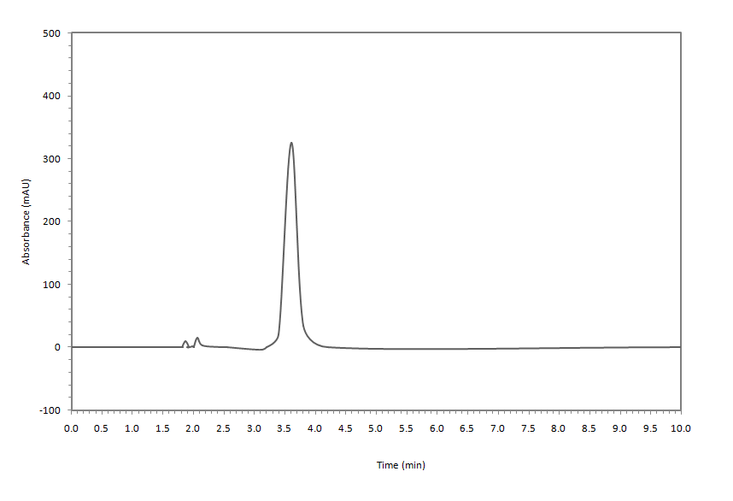
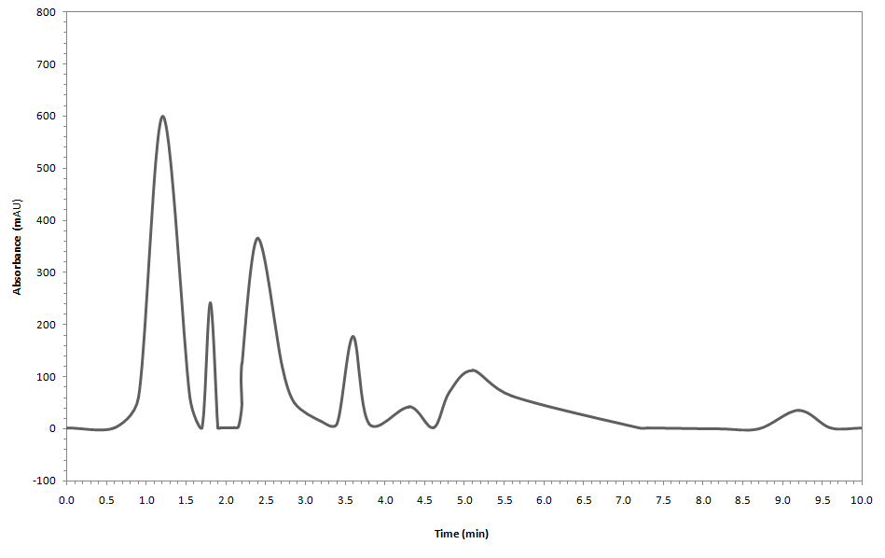
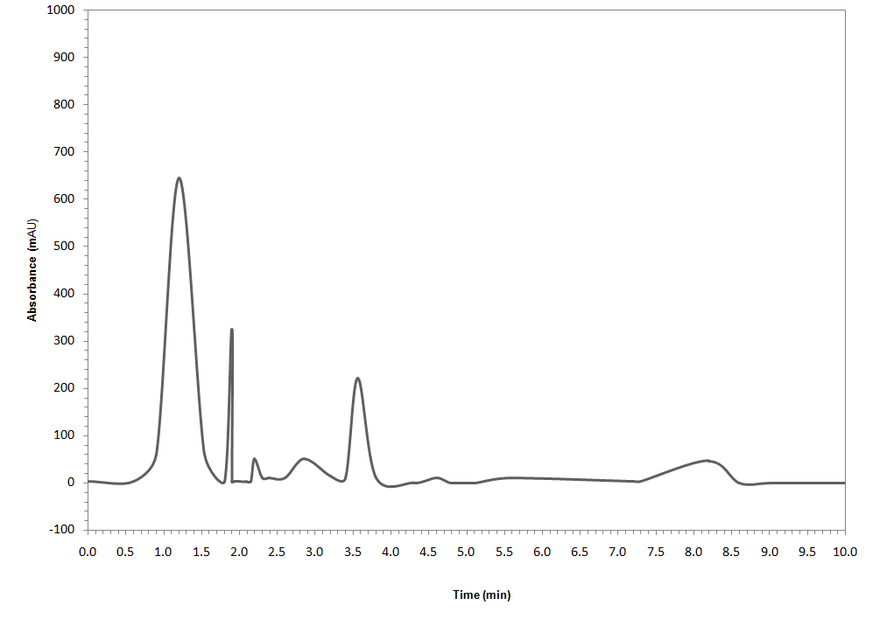
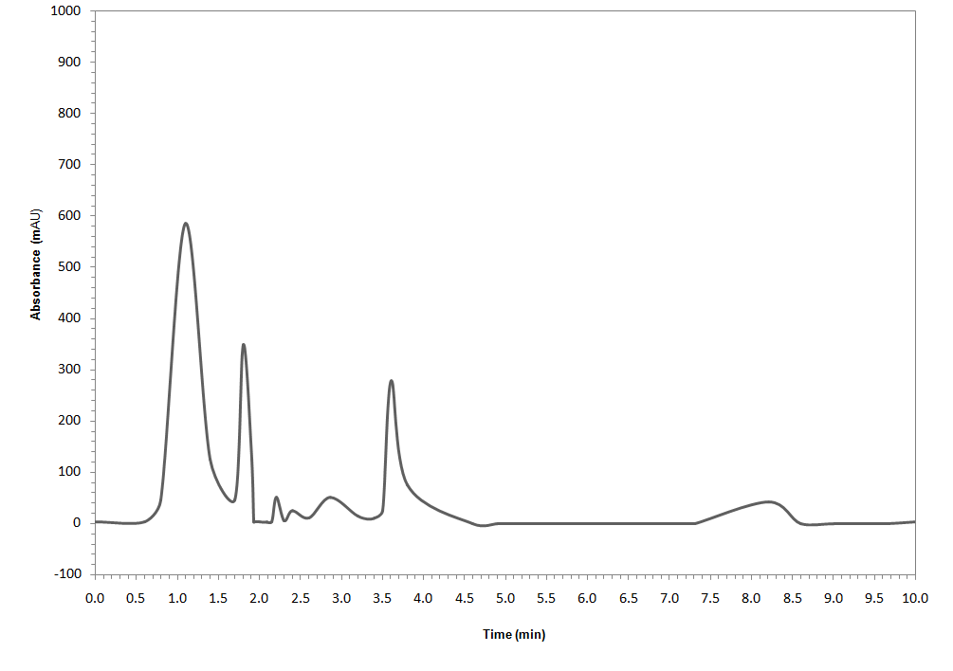
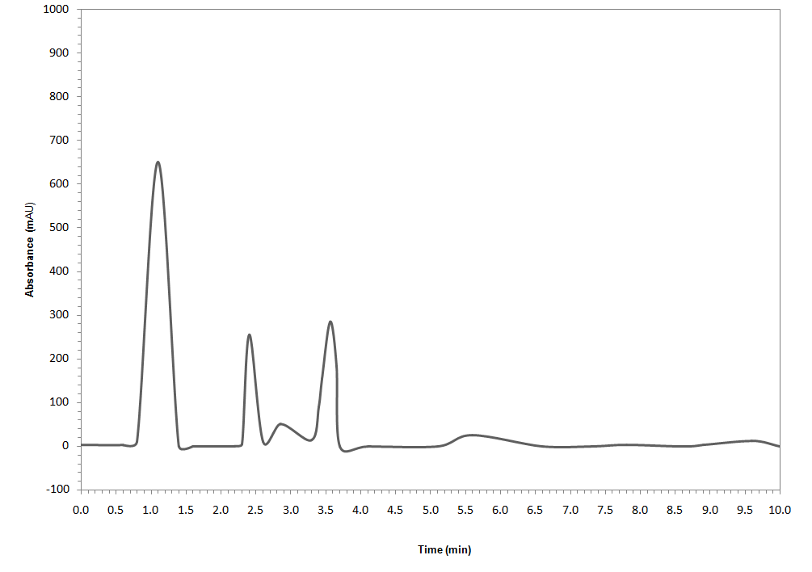
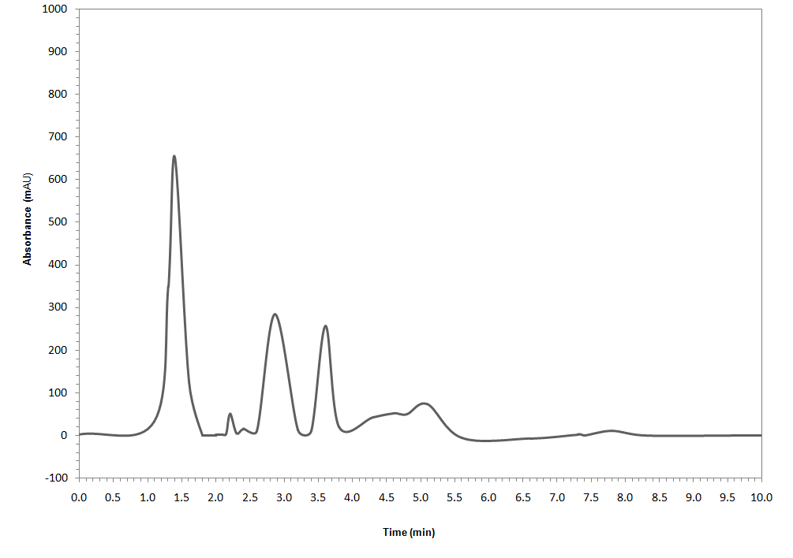
HPLC Chromatogram of different root samples
Standard
T1
T2
T3
T4
T5

Slide 38
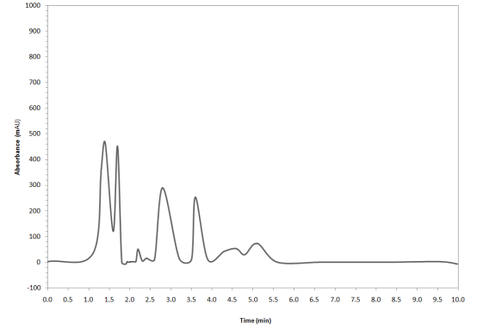
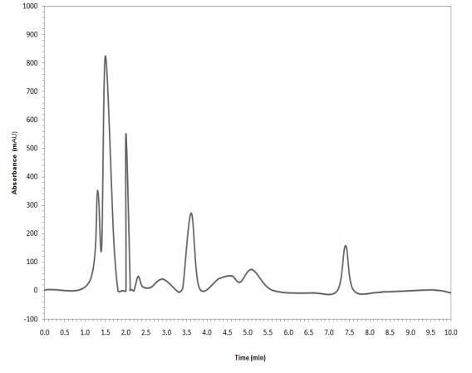
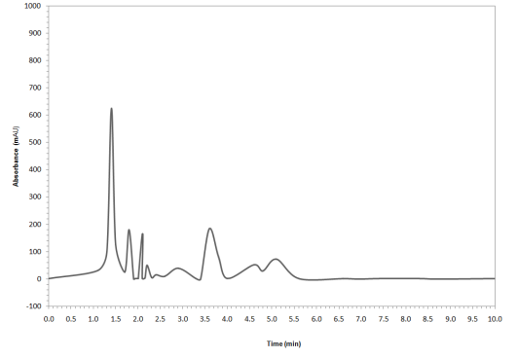
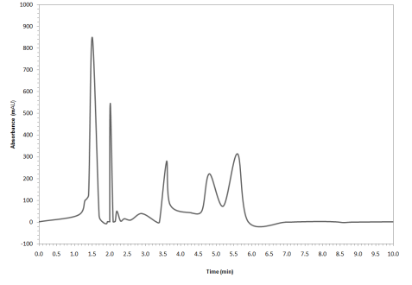
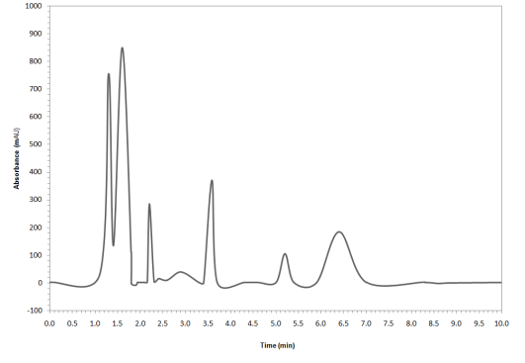
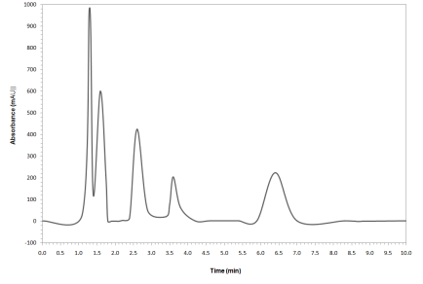
HPLC Chromatogram of different root samples
T6
T7
T8
T9
T10
T11

Slide 39
CONCLUSION

Slide 40
The induction of callus were better in MS supplemented with IBA & 2,4-D and the highest number of multiple shoots were observed in combination of cytokinins (BA and KIN, 1-2mg⁻¹)
Shoot tip and Nodal explants were found to be suitable for indirect organogenesis.
G. fasciculatum and G. mossae treated plants proved to be efficient in terms of root colonization, vesicles and arbuscles.
The biomass, Primary and secondary metabolites were significantly enhanced in AM inoculated micropropagated plants.
Withaferin A content quantified by HPLC also revealed significant elevation in Glomus treated plants.
AM fungi treated plants showed better antioxidant scavenging activities compared to control plants.
The study proves to be beneficial in rapid propagation of medicinally important plants through in vitro organogenesis and further enhancing their metabolites by using AM fungi.

Slide 41
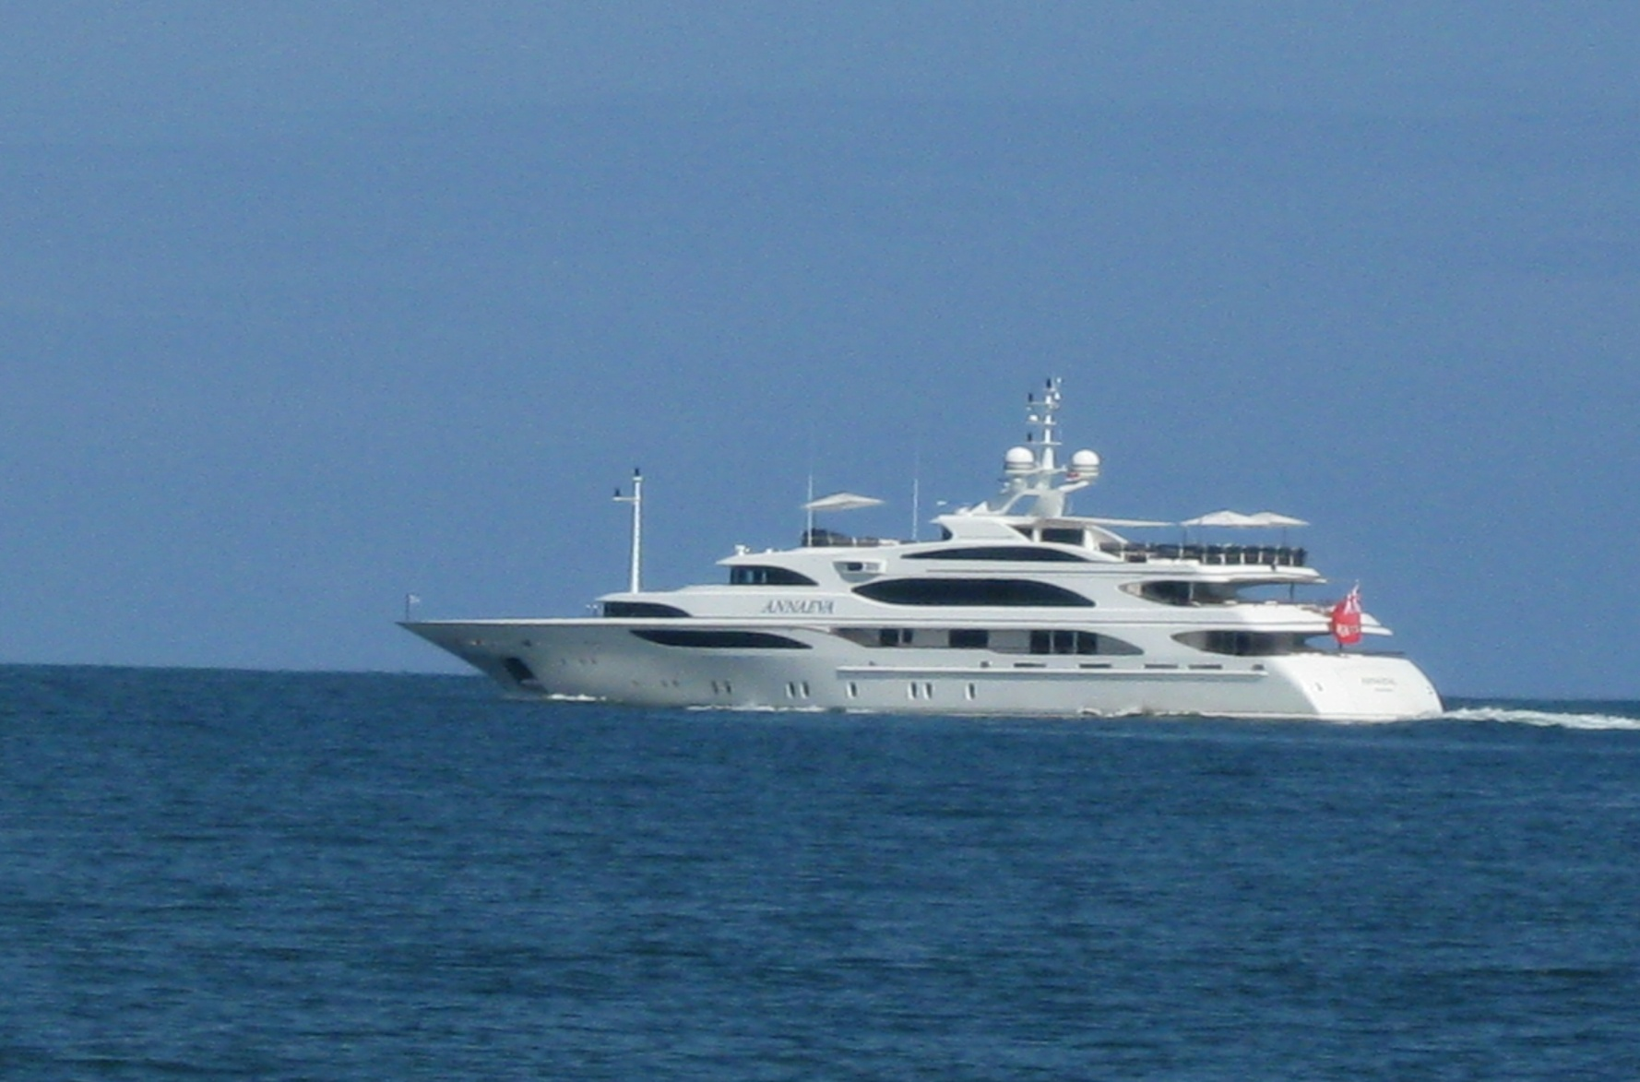
Thank you

