Slide 1


Innovation in Pediatric Medical Devices: Thinking Outside The Box
Gwenyth Fischer
University of Minnesota Masonic Children’s Hospital

Slide 2
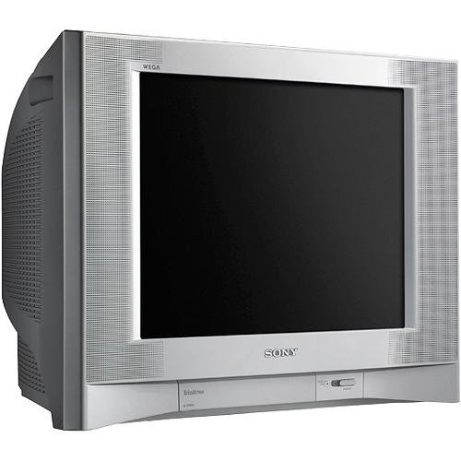

The Pediatric Device Lag
2005
2015
Notes:
But despite the need for pediatric specific products,
Unfortunately, the global market for pediatric devices is at least 5 years behind adults and in some fields it is more than 10 years behind.
So essentially, we are forced to practice medicine from the late 90’s.

Slide 3
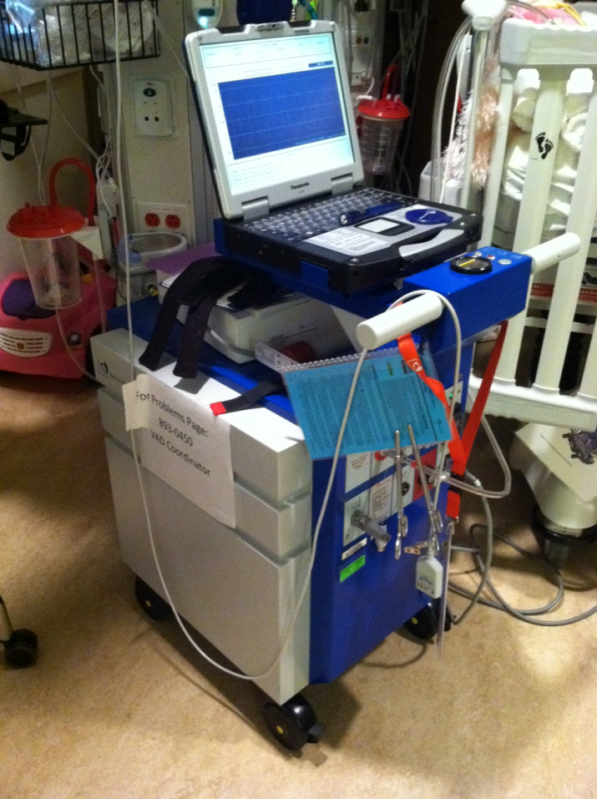
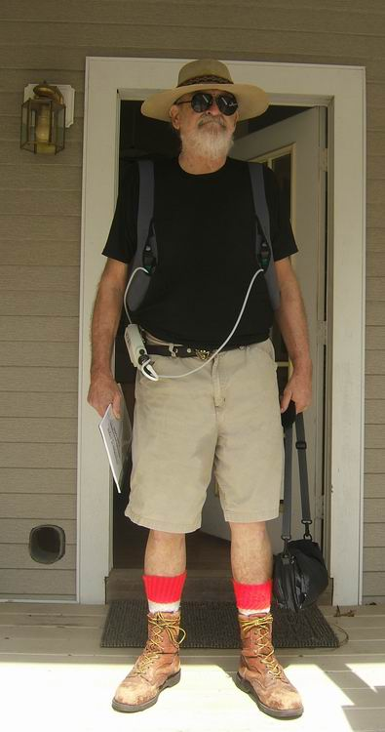
Pediatric Ventricular
Assist Device
Adult Ventricular
Assist Device
Notes:
Here is a prime example of the pediatric device lag: the ventricular assist device, used to help a failing heart
Example of the difference between where pediatric devices are versus adult devices-
Which would you rather be attached to??

Slide 4

Adult Ventricular Assist Device

Slide 5
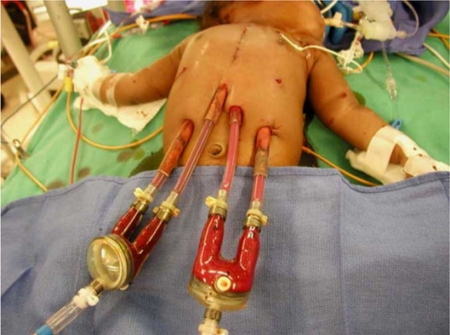
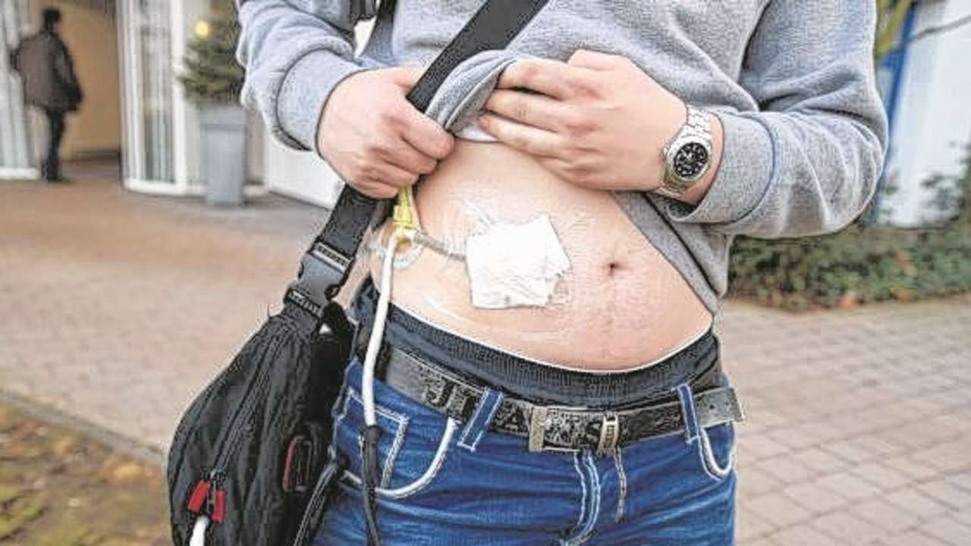
Notes:
The pediatric lvad is not only huge compared to the adult version, but it doesn’t provide for growth of the heart or the rest of the body, involves two giant pumps and cannulas to be outside of the body and exposed to the elements as opposed to just a small cord, and requires children to stay in an ICU for care due to the risk of bleeding and clotting.
The large laptop model I just showed you, called a berlin, is set to be approved for pediatric use by the fda in the very near future and will be the first pediatric approved device, as opposed to adult lvads which have been available since 1992 and many new iterations have appeared since that time.
So why the lag??

Slide 6
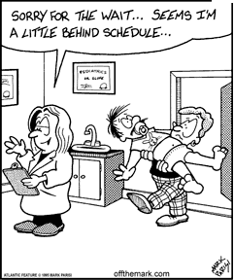
Why the Lag?
Funding
Testing
Regulation
Patient
Notes:
Smaller test population’
Difficult to get through the FDA
Kids have more complex needs

Slide 7

Funding-Venture Capital
Split Rock Criteria
for Investment:
  Significant market size
  “”typically greater than $500 million”
  “Rapid development timeline commercialization potential in less than 5 years”
http://www.splitrock.com
Notes:
The biggest reason that pediatric devices are created less than adult devices is because of the structure of the medical device community.
In europe and the US, where at this moment anyway most of the device innovation occurs, you have two different tiers of operation-
At one end you have a hand full of large medical device companies like medtronic or johnson and johnson.
These companies are too big to risk major innovation, but put out a solid number of device iterations every year.
At the other end, you have small scrappy start up companies-these companies

Slide 8
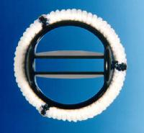
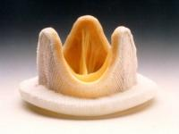
Peds versus Adult Device Market
Adult Global Heart Valve market:
$1.2billion
Pediatric Heart Valve Market:
$50-100 million
Circulation Research.2005; 97:
Notes:
Review
Heart Valve Tissue Engineering
Ivan Vesely
4 million people each year in the u.s.
60,000 people in us get heart valve replacement

Slide 9
Testing:
Smaller Test population
Cia.gov

Slide 10

Regulation:
Approval Through the FDA
Traditionally more stringent
requirements
Testing is difficult on a
pediatric population

Slide 11
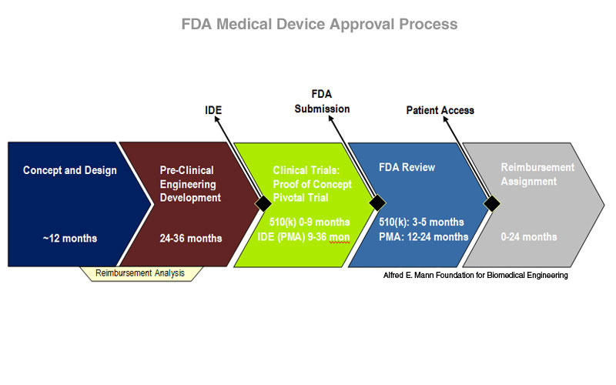
Traditional Device Pathway
The average ‘new’ device takes 100 million dollars and 10 years to get to U.S. market
Notes:
Pre market approval device-100 million dollars
About 40 devices a year apply to the FDA

Slide 12

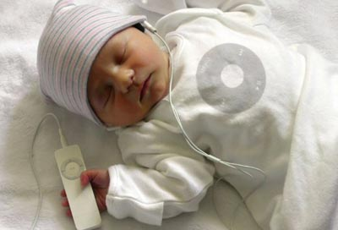
Medical Device Development Plan
Ideation
Engineering
Patent Submission
Protototyping
Bench Proof of Concept
Animal Model Proof of Concept
First in Man
Clinical Trials
Manufacturing Plan
FDA Submission
Reimbursement Plan
Marketing
Post Market Follow Up
Notes:
The process to getting a device to market is a long one-
Just to get to the point where you are ready to submit to the FDA can take 5+ years, depending on how new the device is, and how invasive

Slide 13
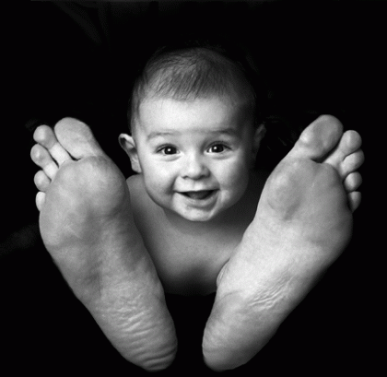
Device Shrink
Children are not
small adults
Threedonia.com
Notes:
Traditionally,
Medical devices for kids have developed in two ways-
An adult product has been jerry rigged and used off label-and I will admit to having used duct tape and cotton balls in the unit to make a device like a suction catheter or cpap mask work for a kid
OR
A company, as an after thought to an adult product, has shrunk an existing device, such as a pacemaker, to fit a smaller size
There are a number of reasons this isn’t optimal-The old adage that children are not small adults is true-
1)Kids grow
2) Kids have different metabolisms
3)Kids handle infection differently
4)Kids are more active
5) Kids have different diseases
6)Kids have longer life spans

Slide 14
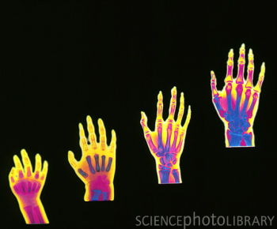
Kids are Complex
Age and Size variation
Growth
Immune Variation
Dependence on Caretakers
Notes:
1)Kids grow
2) Kids have different metabolisms
3)Kids handle infection differently
4)Kids are more active
5) Kids have different diseases
6)Kids have longer life spans

Slide 15
The Traditional Method of Making and Selling Medical Devices Doesn’t Work for Small Market Populations.
So What Now?

Slide 16
Pediatric Device Consortia
Some funded by FDA
Collaboration between
  University
  Industry
  Non-profits
  Private Inventors
University
Industry
Community
Notes:
Consortia
Non profit medical device companies
Incentives for bigger companies

Slide 17
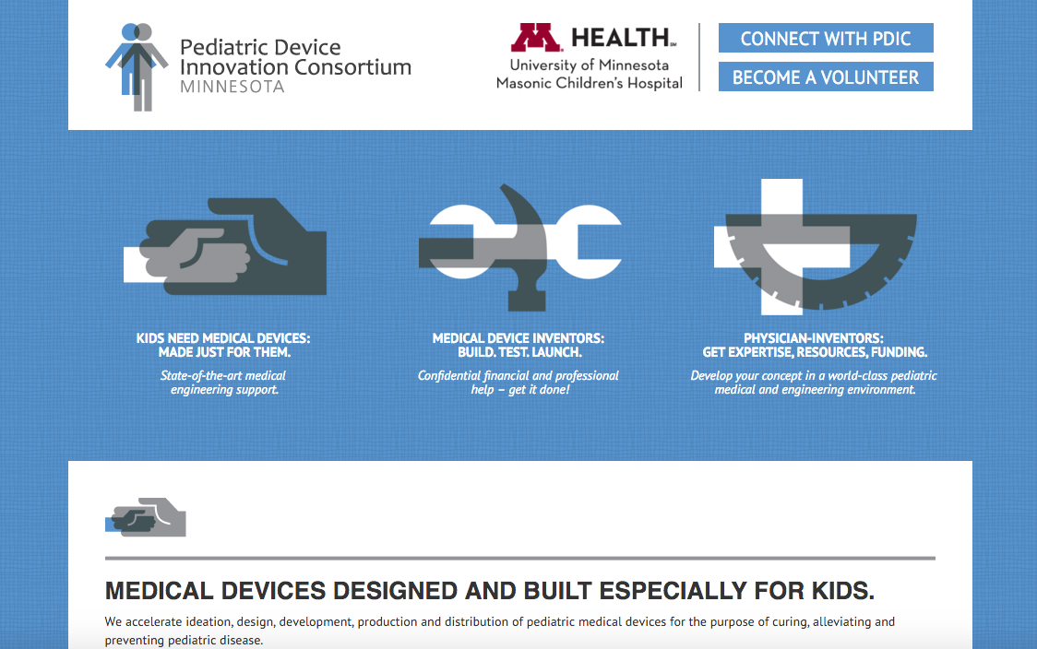
PDIC
Pediatric Device Innovation Consortium at the University of Minnesota: www.pdicmn.org

Slide 18
Humanitarian Use
Fast track for Devices Designed for Populations of <4,000 per year
Must prove benefit is more than risk
144 products with Humanitarian Use designation
44 Approved through Humanitarian Device Exemption
Notes:
The humanitarian use pathway that the fda has created continues to aid pediatric developers in getting peds product to market
Fast track for devies with populations under 4,000 per year, manyof which are pediatric
You need to prove that the benefit of using the device will be greater than the risk, but this is much less stringent than typical fda approval requirements
First must get approval as humanitarian use device
Second step fda approval as humanitarian device exemption
-stent for urinary tract obstruction in unborn babies
Titaniam rib for babies born with inadequate ribcage

Slide 19
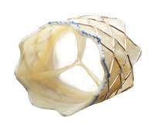
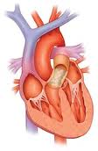
Example of Humanitarian Use-the Melody Valve
Made by Medtronic
First approved Transcatheter valve
Congenital heart disease
Humanitarian Use designation
Notes:
Tetralogy of fallot

Slide 20
Alternative Sources of Funding
SBIR/STTR
Crowdsourcing
University Clinical Translational Science Institutes (CTSI)
Student Engineering Projects (senior design classes)

Slide 21
Professional Help
On the FDA Webpage
Other Resources
Atlanta Pediatric Device Consortium
  http://atlanticpediatricdeviceconsortium.org/
Michigan Pediatric Device Consortium
  http://peddev.org/
National Capital Consortium
  Www.innovate4kids.org
New England Pediatric Consortium
  www.nepdc.org
Southern California Center
  www.scctip.com
Philadelphia Pediatric Consortium
  www.ppdc.org
UCSF Peds Consortium
  www.pediatricdeviceconsortium.org
PDIC
www.pdicmn.org
Pediaworks
www.pediaworks.org
Notes:
http://www.fda.gov/ForIndustry/DevelopingProductsforRareDiseasesConditions/PediatricDeviceConsortiaGrantsProgram/ucm337850.htm

Slide 22
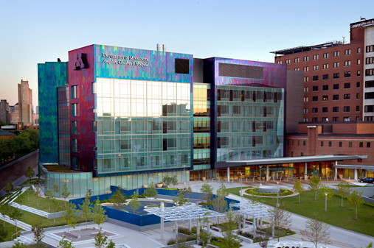
Thank you!
fisch662@umn.edu

