Slide 1
Life cycle assesment of the pyrometallurgical and hydrometallurgical routes used in rare earth recycling: A case study of NdFeB magnets
GWENDOLYN BAILEY
Gwendolyn.bailey@mtm.kuleuven.be

Slide 2
Agenda
Questions?
The context
Discussion
Assumptions/Conclusions
LCA results
Study & scope
Notes:
Why recycle NdFeB magnets
Scope includes only recycling or end of life and not entire life cycle
Main findings of the LCA
Discuss results and assumptions

Slide 3
Context
DIRTY
Mining and the processing of metals is
…but necessary!
There are options to help mitigate harmful emissions, but we must perform an assessment to find the best option.
Pyro vs hydro: which is the more environmentally friendly way to recycle these REE metals?
Notes:
Mining and the processing of metals is a dirty industry.
It’s impossible to mine a place while preserving the environment. But that said, it is absurd to suggest to do away with mining, it is a social and economic need, we do need to mine. But there are a few things we can do to mitigate. By calculating and weighing all the impacts and performing an LCA.
Question to the audience: There are many ways to recycle these magnets. But today we look at a purely Pyro and hydro method…which are the more environmentally friendly routes? So who thinks its hydro? And who thinks pyro? Who doesn’t know what pyrometallugry or hydrometallurgy means?
The decision whether to use hydrometallurgy or pyrometallurgy can be seen from various concerns including environment and economy. For instance, pyro recycling infrastructures are often more expensive than hydro ones. But today we will just focus on environment.

Slide 4


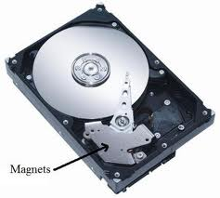
Case Study: NdFeB magnets
Applications with large amounts of rare earth elements (REE)
  1,5 MW wind turbine requires about 350 kg of REEs
  Computer hard disk drives
  Hybrid and electric vehicles
Critical to applications, but not REE rich
  - Electronics such as cell phones, the REEs make up less than 0,5 wt% of the device
Supply insecurity
- China is presently producing more than 90% of all rare earths
With limited supplies and increasing global demand, recycling of REE has become increasingly important
Notes:
Why recycle magnets? We seem like we have plenty of them right? You even have some in your pocket right now inside your cell phone. But their supply is much more criical than perceived. Rare Earths are listed at the top of the EU’s critical material list.
First, thera are some applications with large amounts of REEs required. And we simply don’t have that much in Europe. For example, wind turbines require about 350 kilograms of REEs and hybrid and electric vehicles require around 10kg.
Second, there are some which are important to technology because they allow for reduction of mass but there is not a large amount needed.
Third, Supply insecurity. Currently China is producing a large majority of REEs.
The EU is funding REE recycling projects such as my own to determine ways to keep the REEs that we already. There are many REE recycling techniques. Some of the recycling techniques for REES are purely pyrometallurgical.

Slide 5
Introduction to pyrometallurgical techniques for recycling
Pyrometallurgy, or the use of heat for the treatment of metals, often includes smelting and roasting.
Large energy input required
Generates large amount of solid waste
Results in hazardous wastes and strong gas emissions such as:
CO₂
SO₂
CO
Notes:
Read what pyrometallurgy is.
Then say that you can recycle REE metals in a similar way to their production, by directly melting them down to reform magnets or alloys. In general, the disadvantages of pyro methods for recycling are many. The basic operation is the direct introduction of magnet scrap into a high temperature furnace mixed with a reducer and smelting agent. This operation is accompanied with strong gas emissions including: -CO2 –CO coming from oxidation of carbon used as the reducer -dust of scrap metals and other components -green house effect gases like SO2 are also present.
Not only are these gas emissions damaging to the environment, but many of these gases are carcinogenic. So they are also damaging to human health.

Slide 6
Introduction to metallurgical techniques
hydro
Hydrometallurgy, sometimes called leaching, involves the selective dissolution of metals from their waste.
Large amount of polluting chemicals down the sink
Results in the generation of hazardous wastewater, which includes emissions such as:
H_{CN}
HCl
HNO3
Notes:
Read what hydrometallurgy is
The way to recycle these magnets are very similar to the method used for the extraction of REEs from minerals. The main disadvantages of the hydrometallurgical routes are that large amounts of chemicals are required and often the chemicals are not reused in the lab.
Results in the generation of hazardous waste water which includes emissions such as: Hydrogen cyanide, Hydrogen Chloride, Nitric acid

Slide 7

Which is better?
One must use LCA to find out!
Notes:
So which is better? On the one hand you are using large amounts of toxic chemicals to recycle metals and on the other hand you are using large amounts of energy and fuel?

Slide 8
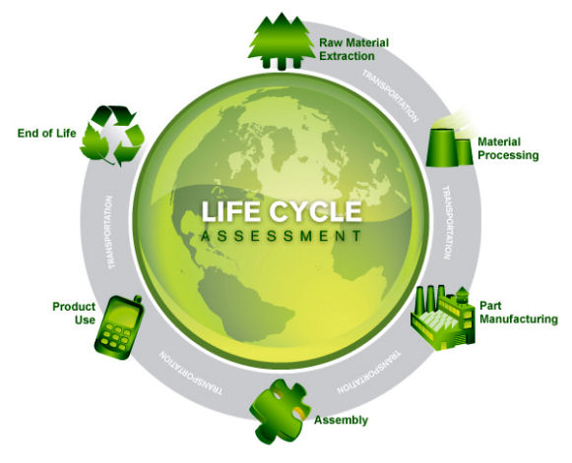
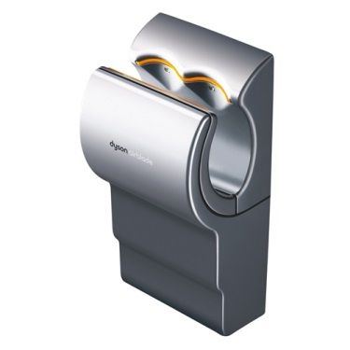

What is Life Cycle Assessment?
VS
Hand Dryer
Cotton roll
Notes:
What is life cycle assesment? It’s a methodology to evaluate environmental impacts, over the life cycle of a product. It is used mostly to compare two products. For example, it can tell you what is the more sustainble solution between a hand dryer and a cotton roll.

Slide 9
Study Goal
and
Scope
Impact Assessment
Ozone depletion
Human Health
(Daly)
Human toxicity
Radiation
Particules form.
Inventory
Analysis
Climate change
Terr. ecotox
The LCA framework
Terr. acidif.
Ecosystems
(Species yr.)
Agr. land occ.
Urban. land occ.
Nat. land transf
Marine ecotox.
Marine eutr.
Impact
Assessment
Freshwater eutr.
Freshw. Ecotox.
Resources
(Cost)
Fossil fuel cons
Mineral cons.
Water cons.
Notes:
While LCA is not a precision science, there is somewhat of a scientific method to it. I promise! Shown here—the LCA framework. One must create a goal and scope and collect data in an inventory analysis and do the calculations using an impact assesment method.
These are the three main areas of impacts., these are the three endpoints.
A typical structure of the different categories included in the impact assessment method is shown here as an example. Depending on our emission we assign a value to each of these categories, and these categories contribute to one of the three areas of impacts which can be related to human health for example.

Slide 10
Agenda
Questions?
The context
Discussion
LCA results
Assumptions/Conclusion
Study & Scope

Slide 11
What is Functional unit?
The amount of energy and material needed to produce enough neodymium oxide for 1 kg of NdFeB recycled magnetic material.
Notes:
First step in setting goal and scope is defining the FU. One of the biggest concepts in LCA to understand. Functional unit is the unit of analysis. The functional unit qualitatively and quantitatively describes the function(s) and duration of the product.
The primary purpose of a functional unit is to provide a reference to which the inputs and outputs are related. This reference is necessary to ensure comparability of LCA results
Read functional unit
It is important to note that the entire life cycle of these magnets is not being taken into account, just the impacts related to these two different EoL recycling routes. This includes upstream and downstream activities associated with going from an EoL magnet to an oxidized powder or liquid that you can use to remake a magnet.

Slide 12
Comparative LCA of NdFeB
LCIA method chosen: ReCiPe 1.08 H Midpoint
Economic allocation applied
Binnemans Routes –
  Traditional hydro recycling process
  Procedure for direct melting
  Sources: Binnemans, 2013. Recycling of rare earths: a critical review . Asabe, K., Saguchi, A., Takahashi, W., Suzuki, R., Ono, K., 2001. Recycling of rare earth magnet scraps: Part I carbon removal by high temperature oxidation. Mater. Trans. 42, 2487e2491.
Notes:
More details about the LCA study. The life cycle impact assesment method chosen was Recipe. A life-cycle impact assessment method aims to address, as accurately and as consistently as possible, a large set of impact categories. Explain that ReCiPe is just one of the many different LCIAs to choose from. Recipe uses certain characterization factors (CF) that express “impacts” per “amount” of inventory. Like how impactful 1kg of CO2 is on human health.
Economic allocation
The two routes analyzed were mentioned in Koen Binnemans’ rare earth recycling review published in 2013
My model for the hydro recycling is a quite traditional one, it came from one of Binnemans researchers. I will explain the flowsheet shortly but first I will go over the direct melting procedure.

Slide 13
Direct melting recycling route
O2
Thermal energy
Electricity Hydrogen
Ca Metal Electricity
Decarburization
Reduction
Deoxidization
Magnet
CaO slag Nd2O3
CO2 REE containing slag
H2 Fe H20 vapor
Source: Schulze, Rita and Onai, Mehmet, EREAN, 2016
Notes:
The procedure for direct melting is pretty straightforward: it includes decarburization, calcium reduction, and then deoxidization and then melt spinning back into magnets. I didn’t include however the melt spinning in my LCA because there wasn’t reliable data available.
Decarburization - Ni coated NdFeB scraps packed into a crucible and heated to 1373 K
Hydrogen reduction - After decarburizing, the powders are to be heated in the hydrogen atmosphere
3. Deoxidation - The remaining powders are oxidized in air at 1273 K and then reduced using a calcium metal

Slide 14
Hydrometallurgical recycling route
Electricity HCl H20
Electricity NaOH
NH5CO3
Electricity
Leaching
Solvent Extraction
Calcination
Magnet
Transition metals
Nd(OH)3
Waste water
Nd oxide
Sludges Nd Dy Solution
Source: Van der Hoogerstraete, T. Wellens, S. Veractert, K., Binnemans, K. “Removal of transition metals from rare earths by solvent extraction 2013
Notes:
The traditional route for recovery of rare earths from permanent magnets is via hydrometallurgy. The first step is to dissolve magnets in strong mineral acids. Selective leaching with acids (HCl, HNO3) to leave iron behind in the precipitate.
Second step is to precipitate REEs and extract remaining transition metals using a solvent extraction process.
Final step is to calcinate these precipitated compounds to produce marketable rare earth oxides

Slide 15
Agenda
Questions?
The context
Discussion
Assumptions/Conclusions
LCA results
Study & scope

Slide 16
Results - Hydrometallurgical

Slide 17
Results - hydro recycling process

Slide 18
Results – Pyrometallurgical

Slide 19
Results – Pyro recycling process

Slide 20
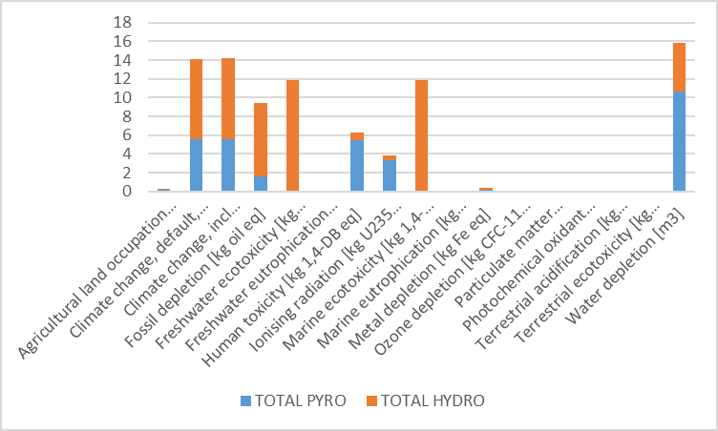
Pyro is the winner!
Notes:
Americans like competition so we have to declare a winner. Although it’s not really a winner if you reside in a country that doesn’t receive much rainfall, then the hydro process would be the winner for you…but in terms of overall impacts pyro has less.

Slide 21
Agenda
Questions?
The context
Discussion
Assumptions/Conclusions
LCA results
Study & scope

Slide 22
Discussion of Results
Hydro impacts are found mostly within the marine and freshwater ecotoxicity categories.
  This is due to the sodium hydroxide which could contaminate the water table harmfully affecting aquatic life
  This is due to the heavy metals which are being leached and polluting freshwater
Pyro impacts dominate the water depletion category.
  This is due to the large amounts of water lost in the water vapor in the reduction
  Climate change category is also affected due to the high temperature heating used in the direct melting

Slide 23
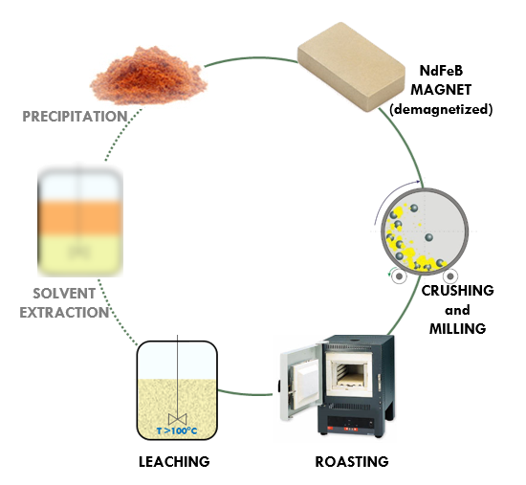
Limitations to the Study
Common route for NdFeB recyling
Assumptions:
  MAP instead of ammonium bicarbonate
  Deoxidization process modelled is worst case conditions
All processes done on lab scale
Does not accurtately reflect industry practice
  Neither pure pyro techniques nor pure hydro techniques practiced soley in industry
Notes:
Limitations – incredible lack of data. Only access to lab scale data. In the Pe international Gabi database Monoammonium phosphate

Slide 24
Agenda
Questions?
The context
Discussion
Assumptions/Conclusions
LCA results
Study & scope

Slide 25


Summary
Hydrometallurgical processes operate at lower temperatures and if organic chemicals are reused (like in industry) then it has the potential to be the more sustainable solution.
Pyrometallurgical recycling could be a real sustainable process considering the small amount of impacts at lab scale.
LCA displays potential hot spots despite uncertainties
Acknowledgments: This project has received funding from the European Union's EU Framework Programme for Research and Innovation Horizon 2020 under Grant Agreement No 674973

Slide 26

Conclusion
There’s no way to reflect reality…
But with LCA you are on your way!
LCA
Reality
Notes:
To bring home the idea that comparing two products is not easy and you will never be able to model a product or process involving all of its emissions! You will never reach Penelope Cruz status. But with LCA you can get pretty close.

Slide 27
Questions? Contact me
Gwendolyn.bailey@mtm.kuleuven.be
Questions?
The context
Discussion
Assumptions/Conclusions
LCA results
Study & scope

