Slide 1

The Surface Activity of Polymers in Cosolvated Systems Determined from Computational Simulation
Presented by:
Guy Francis Mongelli, F.E.

Slide 2
Overview
Background
Motivation
Surface activity of polyalkanes
Future Work
Summary

Slide 3
Overview
Background
Motivation
Surface activity of polyalkanes
Future Work
Summary

Slide 4
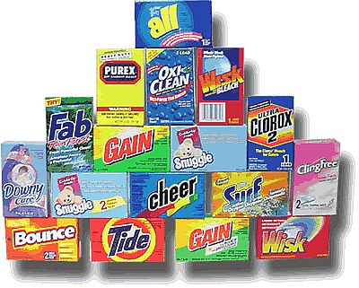
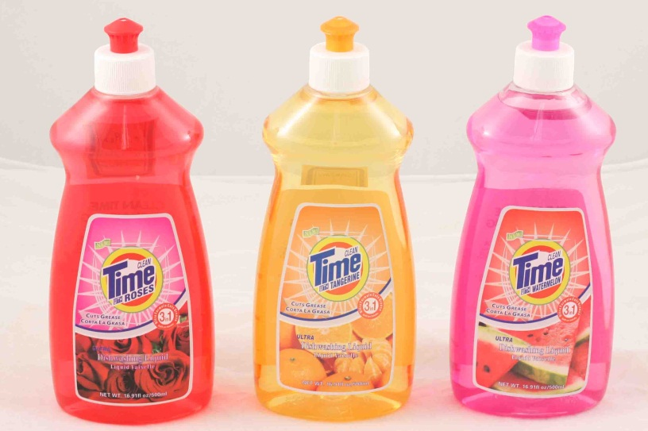
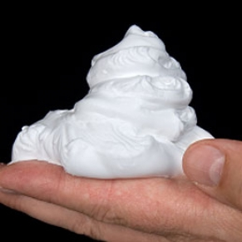
Background
Surfactants
Applications: Soaps, Detergents, Cosmetics, Pharmaceuticals
Notes:
Surface active agents
Decrease surface tension of H₂O
“Specialty surfactants industry is expected to reach USD 29.2 Billion Globally in 2017.”
“Nonionic surfactants are expected to be the fastest growing of these.”
–Transparency Market Research

Slide 5
Honing in
Focus on the polyalkane portion of the surfactants
Consider model systems of alcohol solvated solutions: Ethanol

Slide 6
Overview
Background & Prior Work
Motivation
Surface activity of polyalkanes
Future Work
Summary

Slide 7
Goal
Polymer Structure Aqueous Solubility:
PMO (-O-CH₂-)_{m} insoluble
PEO (-O-CH₂-CH₂-)_{m} soluble
P3MO (-O-CH₂-CH₂-CH₂-)_{m} insoluble
PPO (-O-CHCH₃-CH₂-)_{m} insoluble
PDMS (-O-Si(CH₃)₂-)_{m} insoluble
Polymer Structure Aqueous Solubility: X-OH Solubility
PE (-CH₂-)_{m} insoluble sparingly
PP (-CH₂CH₃-CH₂-)_{m} insoluble sparingly
PIB (-C(CH₃)₂-CH₂-)_{m} insoluble sparingly
Address the questions:
  Do molecular simulations with GROMACS accurately predict the solubility of polyalkanes in aqueous and mixed solvent solutions?
  How can we explain any differences there might be in the simulated surface activity?
Notes:
Write about determining the properties of alcohol systems and simulation of polymer materials
Come up with a metric to determine solubility of a molecule from computer simulation
1. How does the volumetric hydrogen bond density change with alcohol content? How are hydrogen bonds between different types of molecules impacted?

Slide 8
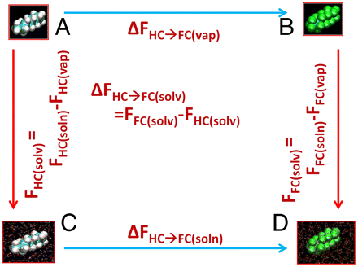
Downstream Computations from MD simulation
Surface partitioning constant, f from <x_{n}(t),y_{n} (t),z_{n} (t)> for various polymers as a function of molecular weight
Define the surface partitioning constant aka surface parameter
  Recently developed FORTRAN code for use with GROMACS. 521 lines.
  Published in Polymer 82 133-139 (2015)

Slide 9
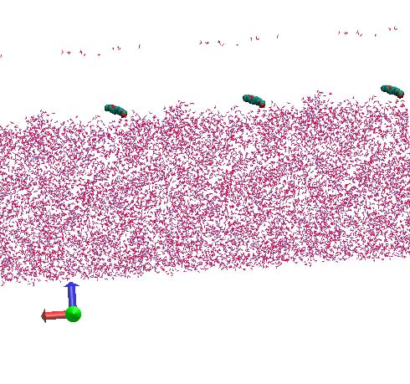
I. Surface activity of Poly-alkane series in mixed solvents
Surface parameter value: simulation-time-average fraction of the polymer atoms which have no solvent molecules, alcohol nor water, above them.

Slide 10
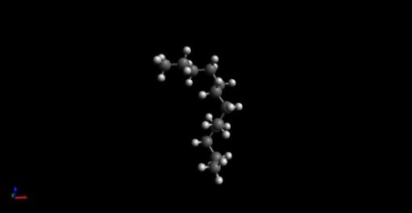
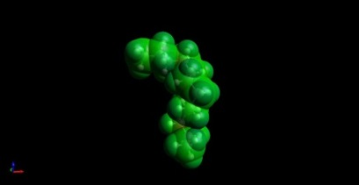
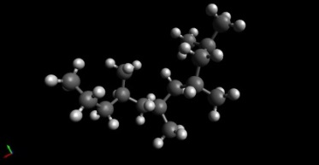
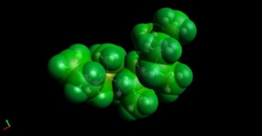
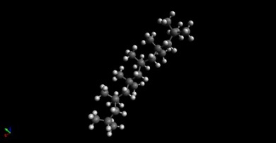
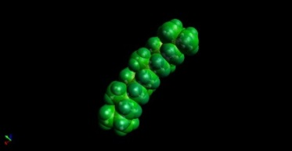
Structures of Interest:
Alkane Series
            PE
PP
PIB
green: average e⁻ density

Slide 11
Consider structures
PMO | 1 | 0 | 1 | 1 | 0 | 2
PEO | 2 | 0 | 2 | 1 | 0 | 3
P3MO | 3 | 0 | 3 | 1 | 0 | 6
PPO | 2 | 1 | 3 | 1 | 0 | 5
PDMS | 0 | 2 | 2 | 1 | 1 | 6
 | # Backbone C per monomer | # Side C per monomer | Total #C per monomer | # H per monomer
PE | 2 | 0 | 2 | 4
PP | 3 | 1 | 4 | 6
PIB | 2 | 2 | 4 | 8
 | # Backbone C per monomer | # Side C per monomer | Total #C per monomer | Backbone O per monomer | Backbone Si per monomer | # H per monomer
PE | 2 | 0 | 2 | 0 | 0 | 4
PP | 3 | 1 | 4 | 0 | 0 | 6
PIB | 2 | 2 | 4 | 0 | 0 | 6
Why differentiate between backbone and side chain carbons here?
Notes:
Remove the lines which don’t address polyalkane materials

Slide 12
Overview
Background & Prior Work
Motivation
Surface activity of polyalkanes
Future Work
Summary

Slide 13
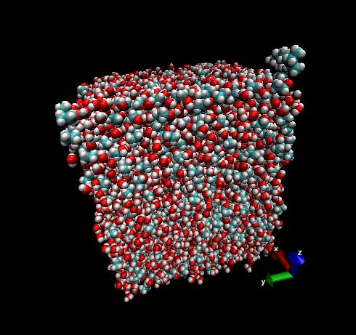
Simulation Studies
I. Alkanes in pure HOH, in 50%, 70%,
80% & 100% mass EtOH

Slide 17
Overview
Background & Prior Work
Motivation
Surface activity of polyalkanes
Future Work
Summary

Slide 18
Future Work
Polyether and polysilicone input models generated. Simulation and surface parameter analysis to be performed.
Notes:
Perform a similar study on polyether and polysilicone materials

Slide 19
Publications
“The Surface Activity of Polymeric Materials as determined from Computational Simulation” Polymer 82, Nov. 2015.
“Counting the Relative Number of Hydrogen Bonds in several Alcohol Co-solvated Systems as a function of Mass Content via GROMACS” (In Submission)

Slide 20
Summary
Higher alcohol content reduces the surface parameter of polyalkanes, more strongly in PIB and PP than PE.
There is not a strong correlation between molecular weight and surface parameter for polyalkanes with less than 25 carbons.
The cause of the variations in surface activity.
Notes:
C vs. H in input models and contribution to ΔH, ΔS, ΔG of solvation

Slide 21
























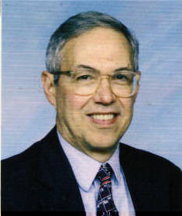

Acknowledgements
Thank you for your attention.
CWRU Dept. of Chemical Engineering
Prof. Daniel J. Lacks
Second Proposal Committee: Prof. R. F. Savinell,
Prof. C.C. Liu, Prof. A. Anderson, Prof. H. Baskaran
Prof. Landau, Prof. Martin, First Proposal Committee
Lacks Group: Greg Chung, Mihai, Debarstuthi, Xiaoshou Shen, Andrew Wang
National Science Foundation
UofRochester Dept. of Chemical Engineering
  Master’s Thesis Advisers: Ching W. Tang, Lewis J. Rothberg
  Title: “Studies of Silver Spheroidal Particles for the Improvement of OLED Light Extraction”
  Department of Energy funded work

Slide 22
Presentations
  2014 Research ShowCASE Cleveland
  2014 Chemical Engineering Open House Cleveland
  2013 Chemical Engineering Open House Cleveland
  2012 Center for Integrated Research Computing Symposium Rochester
  2012 Rochester Research Symposium Rochester
  2011 University of Rochester Graduate Student Research Conference Rochester
  2008 AIChE National Convention Philadelphia
  2008 Eisenberg Research Symposium Rochester
  2007 NSF REU Presentations Rochester

Slide 23
Large Scale Problems in Molecular Dynamics
Expansion of OPLS-AA force field
New ways to characterize bulk and gas states
Multi-polymer simulations which poly-dispersity and antimicrobial materials
Simulation of polymers whose structures are not available synthetically
Adding chemical reactivity to molecular dynamics

Slide 24
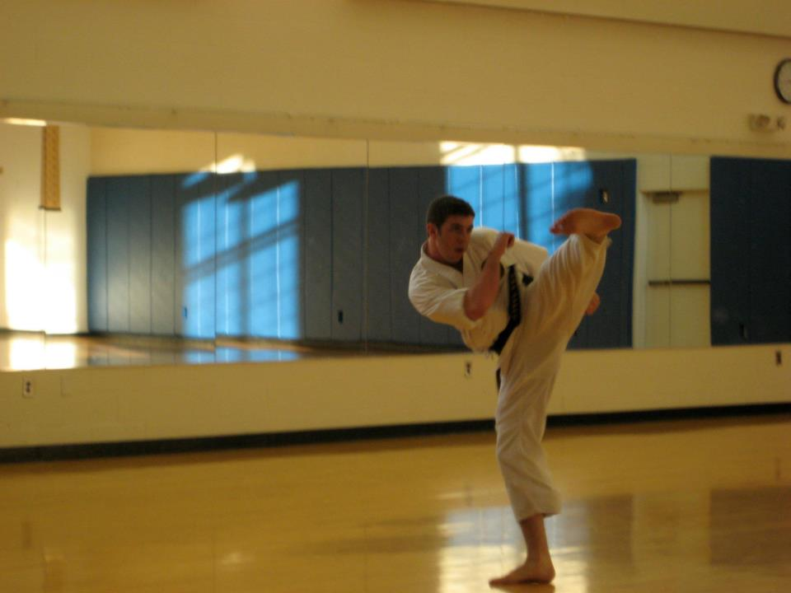
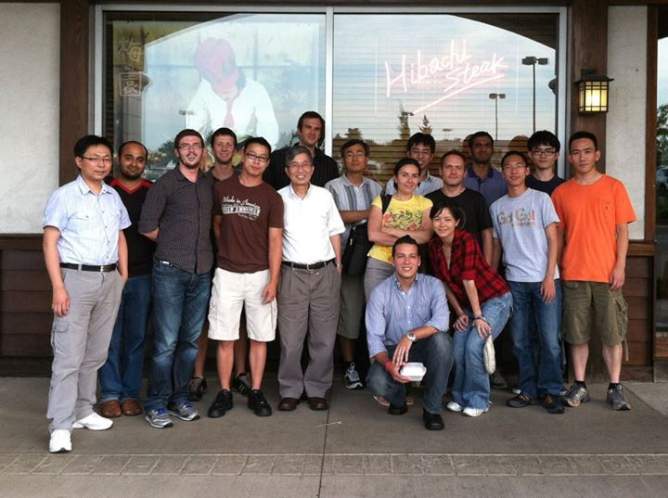
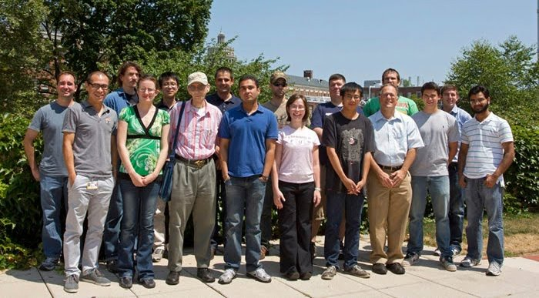
Life, New York City and The Past Two Years
November 2011- Second Degree Black Belt
July 2012 – Defended M.S. Thesis

Slide 25

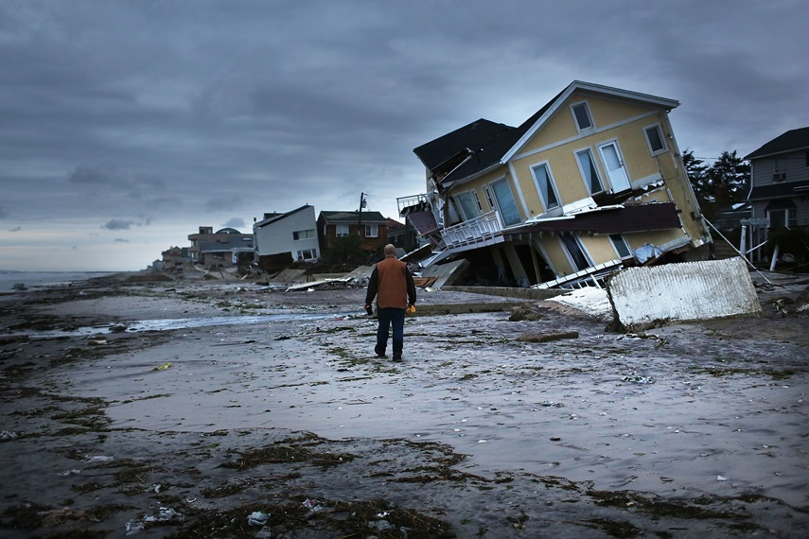
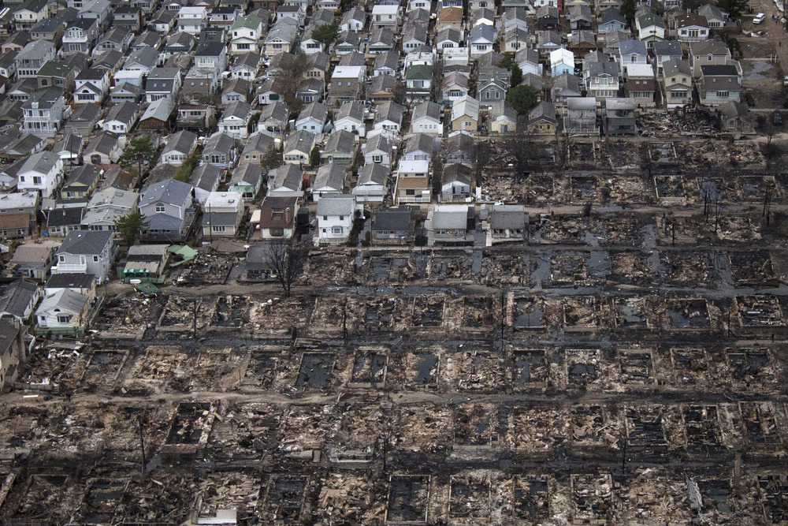
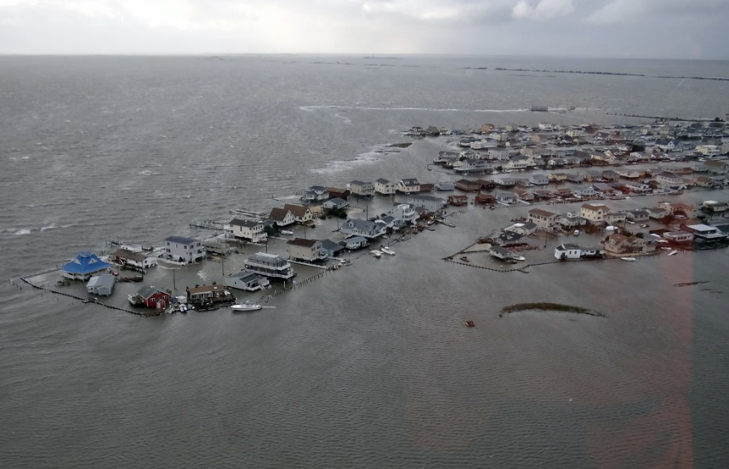
Life, New York City and The Past Two Years
August 2012- Vacationed in Yellowstone
October 2012 - Hurricane Sandy

Slide 26

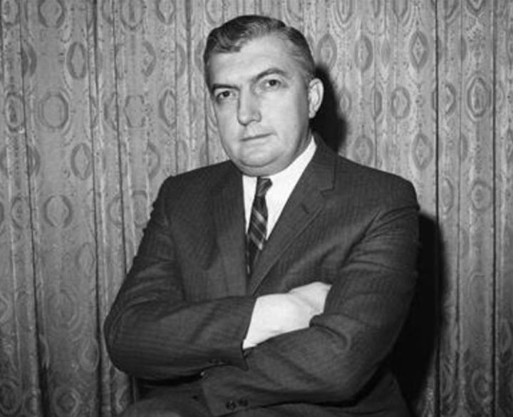

Life, New York City and The Past Two Years
December 2012 – Best Friend got Married
February 2013 - Lost my grandfather

Slide 27
Quotes from Heritage & Advisers’ Heritage
Italian:
  A chi vuole, non mancano modi.
  "If you are sufficiently determined to achieve something, then you will find a way of doing so.“
Irish:
  "Some cause happiness wherever they go; others whenever they go."
  -Oscar Wilde
German:
  Das Auge sieht weit, der Verstand noch weiter
  The eye looks far, the brains looks even farther.
Yiddish:
  Don't look for more honor than your learning merits.
Chinese Sayings:
  師傅領進門，修行在個人
  Teachers open the door. You enter by yourself.

Slide 28











Slide 29
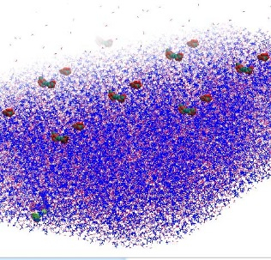
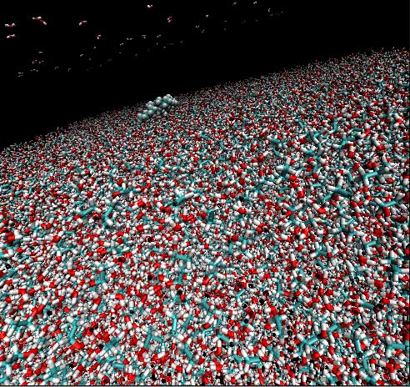


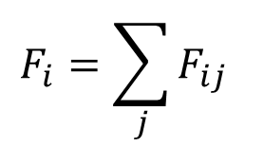
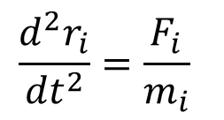
Simulation Methods
Gromacs
  Solves newton's equations of motion
Statistical Mechanics ensemble approach
  T=20°C, 10-100 ns
  6x6x15nm region (7nm slab in z)
  2783 molecules – ca. 3*10⁴ atoms
  ODE systems solved at 1 fs intervals
$$\frac{d^{2}r_{i}}{{dt}^{2}}=\frac{F_{i}}{m_{i}}$$
$$F_{i}=\sum_{j}{F_{ij}}$$
Simulation of an insoluble
polyether in 50% EtOH
(Source: Lacks group)

Slide 30
Surfactant Structure
Amphiphilic molecules
Di-block copolymers
Polyethers can be:
  hydrophilic
  hydrophobic
Advantages over other surfactant classes:
  Not as sensitive to electrolyte or pH
  Low or no toxicity
AAAAABBBBB
A_{x}B_{y}
A- hydrophilic
B- hydrophobic
Simulation of triblock copolymers:
D. Bedrov, C. Ayyagari, G.D. Smith “Multiscale Modeling of Poly(ethylene oxide)-Poly(propylene oxide)-Poly(ethylene oxide) Triblock Copolymer Micelles in Aqueous Solution” J. Chem. Theory Comput. 2, 598-606 (2006).
Industrial Surfactants
Ernest W. Flick, William Andrew (1994)

Slide 31
Motivation
Intellectual Merit
  No molecular dynamics simulations exist that evaluate the phase behavior of the polysilicones or explain the unique pattern in the hydrophobicity of polyethers
  Experimental surface tension data is not available in literature
Broader Impacts
  Possibility of improved or less expensive surfactant products
Low hanging fruit
  Only two simulations of polymer in mixed solvents (no solutes overlap with this study):
P.P Shah, C.J. Roberts “Molecular solvation in water-methanol and water-sorbitol mixtures: the roles of preferential hydration, hydrophobicity, and equation of state”
P.P. Shah, C.J. Roberts “Solvation in mixed aqueous solvents from a thermodynamic cycle approach” J. Phys. Chem. Lett. 112, 1049 (2008).
  Simulation of liquid PDMS:
S.W. Sides, J. Curro, G.S. Grest, M. J. Stevens, T. Soddemann, A. Habenschuss, J.D. Londono “Structure of PDMS melts: Theory, simulation and experiment”
Notes:
If we can demonstrate we can simulate ploy(silicones) correctly, then perhaps we can use the simulations to predict new properties of polymers. Or perhaps, we can design structures that have the same properties.
CMD=computational molecular dynamics
If we know when the surface tension is optimal and then use appropriate alcohol concentrations, improve surfactants
If we know why silicones are insoluble, then perhaps we can translate that newly determined property into other molecules
Possibility of improved surfactant produces- especially at high alcohol content.

Slide 32
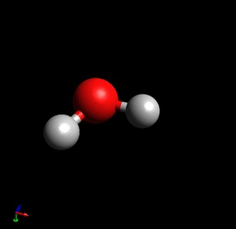
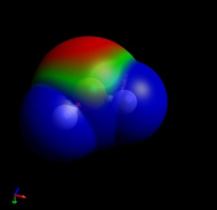
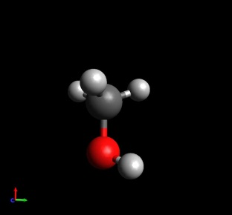
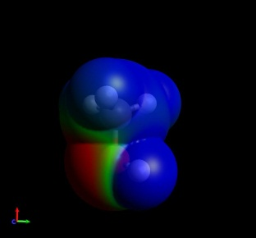
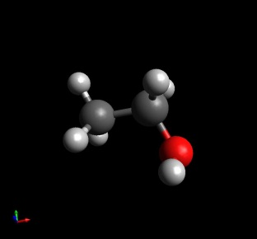
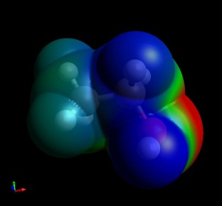
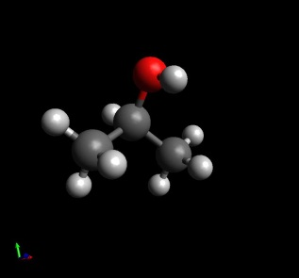
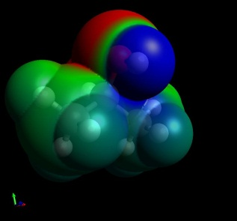
  Model systems
  Solvents of Dipole
Interest moment¹ (D)
  Water 1.8
  Methanol 1.7
  Ethanol 1.69
  Isopropanol 1.66
  All polar and protic.
  Like dissolves like does not explain solubility in these systems.
  Explores 1◦ & 2◦ -OH
  Acetone 2.91
  Acetoin 3.61
1) E.V. Anslyn, D.A. Dougherty “Modern Physical Organic Chemistry” University Science Books, Sausolito, CA (2004).
red: high e⁻ density
green: average e⁻ density
blue: low e⁻ density
VDW surfaces calculated via:
J. Gasteiger, M. Marsili, Tetrahedron Lett., 1978, 3181
J. Gasteiger, M. Marsili, Tetrahedron, 1980, 36, 3219-3228

Slide 33
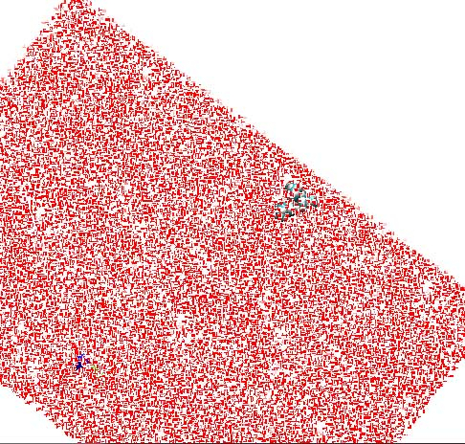
Proposition to Test the Hypothesis
Start with a simple poly-alkane structures.
Compare the poly-ethers and polysilicones
Observe f-value
See what affects f
  Explore entropy and constrained charge spacing; Turn off dihedrals
Simulation of a soluble molecule
In a typical Lacks group
MD simulation

Slide 34
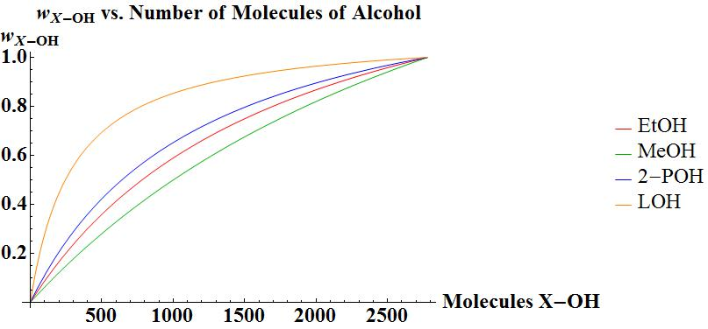
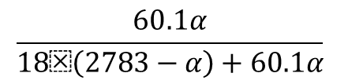
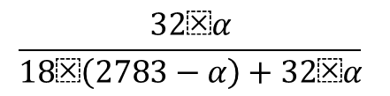
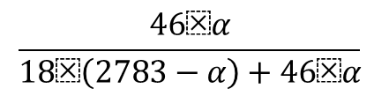
The force field parameters for PDMS:
J.S. Smith, O. Borodin, G.D. Smith “A Quantum Chemistry Based Force Field for Poly(dimethylsiloxane)” J. Phys. Chem. B, 108, 20340-20350 (2004).
A.L. Frischknecht, J.G. Curro “Improved united atom force field for poly(dimethylsiloxane)” Macromolecules 36, 2122 (2003).
Inputs:
  Polymer Structure: atom-atom connectivity
  Topology: interactions
  Simulation variables:
  Weight % of alcohol (implies # molecules/box) Alcohol structure (MeOH, EtOH, 2-POH, AMC, DMK)
Outputs:
  Time dependent position, velocity of each atom
$$\frac{46⁢α}{18⁢\left(2783−α\right)+46⁢α}$$
$$\frac{32⁢α}{18⁢\left(2783−α\right)+32⁢α}$$
$$\frac{60.1α}{18⁢\left(2783−α\right)+60.1α}$$

Slide 35
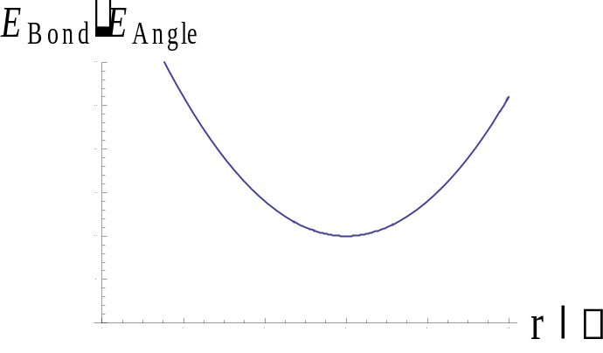
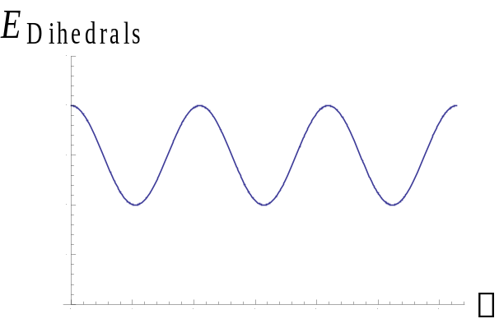

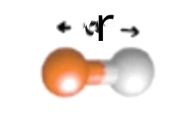
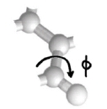
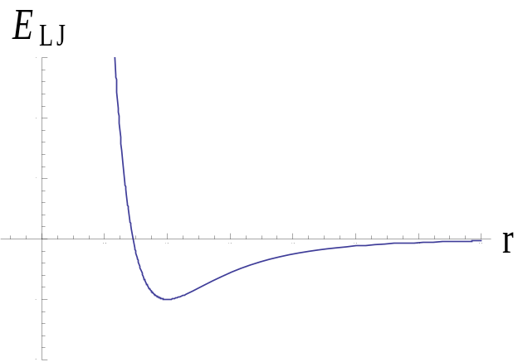
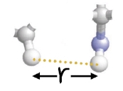
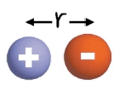
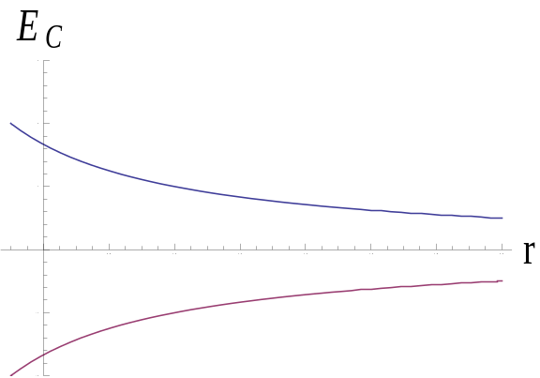
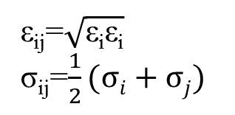
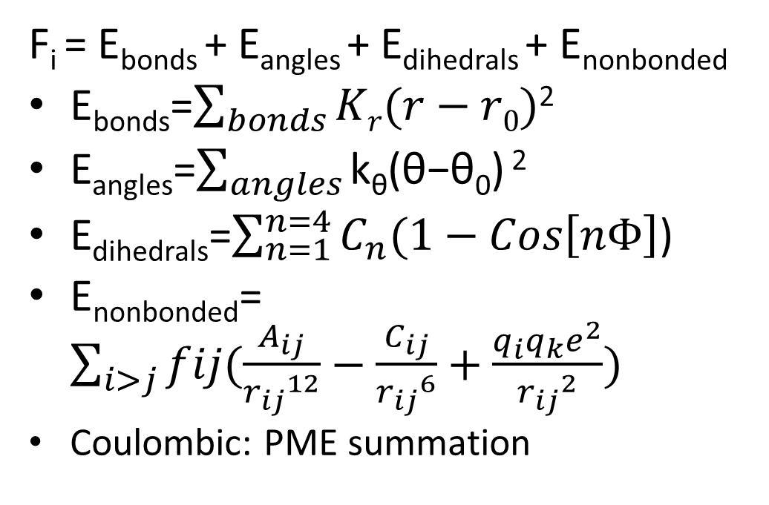
Theory
F_{i} = E_{bonds} + E_{angles} + E_{dihedrals} + E_{nonbonded}
E_{bonds}=$\sum_{bonds}{Kr(r−r0)}$²
E_{angles}=$\sum_{angles}{\text{k}\text{θ}\text{(}\text{θ}\text{−}\text{θ}\text{0}\text{)}\text{ 2}}$
E_{dihedrals}=$\sum_{n=1}^{n=4}{C_{n}(1−Cos\left[nΦ\right]}$)
E_{nonbonded}=$\sum_{i>j}{fij(\frac{A_{ij}}{{r_{ij}}^{12}}−\frac{C_{ij}}{{r_{ij}}^{6}}+\frac{q_{i}q_{k}e^{2}}{{r_{ij}}^{2}})}$
  Coulombic: PME summation
A_{ij}=4ε_{ij}σ_{ij}¹²
C_{ij}=4ε_{ij}σ_{ij}⁶
T. Darden, D. York, L. Pedersen; “Particle Mesh Ewald: An N⋅log(N) method for Ewald sums in large systems” J. Chem. Phys. 98, 10089 (1993)
ε_{ij}=$\sqrt{\text{ε}\text{i}\text{ε}\text{i}}$
σ_{ij}=$\frac{1}{2}(σi+σj)$

Slide 36
Polymer Topology: Mapping by Atomic Substitution
PPO
OC(CH₃)HCH₂
PE
CH2CH2
CH₂C(CH₃)HCH₂
PP
CH₂C(CH₃)H₂
OC(CH2CH3)H
PVC
CH₂CClH
PMO
CH₂O
OC(CH₃)H
PTFE
CF₂CF₂
P2B
C(CH₃)HC(CH₃)H
OC(CH₃)₂
P3MO
OCH₂CH₂CH₂
P1B
C(CH₂CH₂)HCH₂
PIB
CH₂C(CH₃)₂
OC(CH₂CH₂)
H₂CCH₂CH₂CH₂
PDMS
OSi(CH₃)₂
CH₂Si(CH₃)₂
CH₂C(CH₂CH₂)HO
CH₂SiH₂
CH2Si(CH₂CH₃)H

Slide 37
Polymer Topology: Mapping by Atomic Addition
PE
CH2CH2
Ether Series
PVC
CH₂CClH
Alkane Series
PMO
CH₂O
OC(CH3)H₂
PTFE
CF₂CF₂
PP
CH₂C(CH₃)H₂
PEO
CH₂CH₂O
P1B
C(CH₂CH₂)H₂CH₂
P2B
C(CH₃)HC(CH₃)H
PIB
CH₂C(CH₃)₂
PPO
OC(CH₃)HCH₂
CH₂SiH₂
CH₂C(CH₂CH₂)HO
CH₂C(CH₃)HCH₂
Silicone Series
CH₂Si(CH₃)₂
PDMS
OSi(CH₃)₂
CH₂Si(CH₃)H
CH2Si(CH₂CH₃)H

Slide 38
Consider base alkane structure
Examine strict carbon chains (no ether oxygens nor Si)
Vary branching and #C
Polymers of interest: PE, PP, PIB
C
C
C
C
C
C
C
C
PE
PP
PIB
 | # Backbone C per monomer | Total #C per monomer
PE | 2 | 2
PP | 3 | 4
PIB | 2 | 4
C

Slide 39
Vary number of carbons in each branching type: All polymers in alkane series insoluble
Least common multiples strategy:
 | # Backbone C | # Total C
PE 6-mer | 12 | 12
PE 12-mer | 24 | 24
PIB 6-mer | 12 | 24
PP 5-mer | 15 | 20
PP 6-mer | 18 | 24
PP 8-mer | 24 | 32

Slide 40
Some noteworthy polyalkanes
Polymer Number of monomers | # Backbone C | # Side Group C | # Total C
PE 6-mer | 12 | 0 | 12
PE 12-mer | 24 | 0 | 24
PIB 6-mer | 12 | 12 | 24
PP 5-mer | 15 | 5 | 20
PP 6-mer | 18 | 6 | 24
PP 8-mer | 24 | 8 | 32

Slide 41



Why does PDMS lack regions of high/low e- density distribution?
Net dipole: Vector sum definition
4 substituents on Si:
  -2O and 2C
  -individual bond dipoles cancel
C
Si
C
$$δ+$$
O-> H-attractive
or
C-> O-attractive
O
Atom | Pauling electronegativity | Atomic radius (pm)
C | 2.4 | 70
O | 3.4 | 152
Si | 1.9 | 210
$$δ−$$
Si
O
$$δ−$$
Si -> O attractive
or
C -> H attractive
Notes:
Put this into a figure
Cite the texts (anslyn), the one from high school.
Smaller e- density acquired from electronegativity and then diluted into a larger volume creates an average e- VDW surface when solving “” equation (get it from the paper I cited).

Slide 42
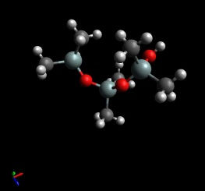
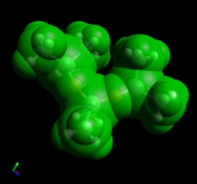
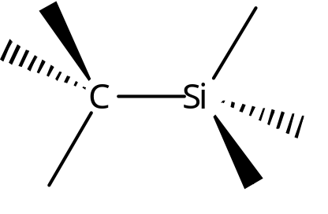








Structures of Interest:
Ether Series
Unexplained pattern in
water solubility vs. #C.
δ+
HOH solubility
PDMS insoluble
(-O-Si(CH₃)₂-)_{m}
PMO insoluble
(-O-CH₂-)_{m}
PEO soluble
(-O-CH₂-CH₂-)_{m}
P3MO insoluble
(-O-CH₂-CH₂-CH₂-)_{m}
PPO insoluble
(-O-CHCH₃-CH₂-)_{m}
δ-
red: high e⁻ density
blue: low e⁻ density
1) P.R. Wells “Group Electronegativities”
Prog. Phys. Org. 6, 111 (1968)
2) G. Fritz, E. Matern “Carbosilanes:
Synthesis and Reactions”
Springer, Belin (2011)

Slide 43
Definition of a Hydrogen Bond
GROMACS manual (ftp://ftp.gromacs.org/pub/manual/manual-5.0.7.pdf) p. 246
r ≤ rHB = 0.35 nm
α ≤ αHB = 30º
The value of rHB = 0.35 nm corresponds to the first minimum of the RDF of SPC water

Slide 44
Geometrical Hydrogen Bond Criterion
A
H
r
α
D

Slide 45
Insertion of Water into an H Bond
H
(2)
A
A
H
O
H
r
(1)
α
(2)
H
D
D
Normal H-bond between 2 molecules
H-bonding bridge via a water molecule

Slide 46
Total Hydrogen Bonding
Total H bonds decrease in number AND relative ordering significantly changes

Slide 50
Number of hydrogen bonds
H bond length in HOH
197 pm
Net molecular dipole of water
1.84 D
Energy of a single H bond
5-30 kJ/mol
Decreased hydrogen bonding
decreases destabilizations for
polyalkane polymer placement
in the bulk

Slide 51
Number of hydrogen bonds (2)

Slide 52
Orientation of solvents & hydrogen bonds (2)

Slide 53
HOH ordering
z-axis parallel
dipole parallel
z=15 nm
z=0
Solvent HOH ordering does not
change across alcohol contents
does not explain alcohol-dependent
solvophilicity
Intend to study X-OH ordering

Slide 54
EtOH Ordering

Slide 55
Summary of HOH-HOH Hydrogen Bonding
HOH bonds
decrease in number but relative ordering does not change

Slide 56
Summary of XOH-XOH Hydrogen Bonding
XOH-XOH bonds
increase in number but relative ordering nearly never changes

Slide 57
Summary of XOH-HOH Hydrogen Bonding
XOH-HOH bonds
increase then decrease in number AND relative ordering significantly changes

Slide 58
OPLS-AA Atom Types in Each Solvent
MeOH- 154, 135, 140
EtOH- 154, 135, 140, 157, 155
2POH- 154, 135, 140, 157, 155
DMK- 236, 135, 140, 235
AMC- 154, 236, 135, 140, 157, 155, 235
Sorted from most negative to most positive Colombically

Slide 59

Initial State of System: Gibb’s Surface Formalism
Bilayer system- half water, half vacuum
Start with polymer above
interface and watch
where it goes
Analysis:
Calculate surface parameter (f)
utilizing Fortran code
vacuum/air
polymer
solvents

Slide 60
Surface Parameter: 50% Mass EtOH

Slide 61
Surface Parameter: Aqueous System
f value: simulation-time-average fraction of the polymer atoms which have no solvent molecule above them
 | Dihedrals Off Surface Parameter, f | Dihedrals On Surface Parameter, f
PE_12C | 0.935 | 0.956
PE_18C | 0.983 | 0.984
PIB_24C | 0.988 | 0.988
PP_15C | 0.974 | 0.971
PP_18C | 0.977 | 0.969
PP_24C | 0.935 | 0.97

Slide 62

Radius of Gyration
$$R_{g}=\sqrt{\frac{\sum_{i}{m_{i}}(r−r_{cm})}{\sum_{i}{m_{i}}}}$$
 | Rg | RgX | RgY | RgZ
Average | 0.354515 | 0.269073 | 0.261025 | 0.312194
STDEV | 0.016298 | 0.074068 | 0.075436 | 0.052139

Slide 63

Diffusion constant (k_{D})
Stokes-Einstein relationship:
$$6Dt=\lim_{t→∞}{{\left(r−r_{0}\right)}^{}}$$

Slide 64

Radial distribution function (rdf)

Slide 65

Interfacial Tension Calculation
water 73 dynes/cm
52.
mercury 480 dynes/cm3.benzene 28 dynes/cm
4.
ethanol 22 dynes/cm
Derived from pressure tensor
$γ=\frac{1}{2} (P_{N}−P_{T})$*Lz
$P_{N}=p_{zz}(z)$
Isotropic interface:
$P_{T}=(p_{xx}+p_{yy})/2$=$p_{xx}$
Gromacs outputs $p_{xx}$, $p_{zz}$
G. Jimenez-Serratos, C. Vega, A. Gil-Villegas “Evaluation of the pressure tensor and
surface tension for molecular fluids with discontinuous potentials”

Slide 66
Ensemble potentials
 | kJ/mol | kJ/mol | kJ/mol | kJ/mol | kJ/mol
Average | Ryckaert-Bell. | LJ-14 | Coulomb-14 | LJ (SR) | Coulomb (SR)
00% EtOH | -29.51 | -29.58 | 1.20 | 1456.58 | -4788.12
50% EtOH | -25.47 | -29.56 | -550.20 | 826.33 | -3874.63
70% EtOH | -22.31 | -29.55 | -934.77 | 340.34 | -3110.41
 | bar | bar | bar
Average | Pres-XX | Pres-YY | Pres-ZZ
00% EtOH | -78.12 | -59.37 | 281.56
50% EtOH | -37.73 | -28.27 | 140.67
70% EtOH | -22.32 | -16.96 | 80.45

Slide 67
Surface Parameter: Demonstrating equilibration

Slide 68
Insights on which molecular characteristics impact surface activity
Translate this knowledge polyalkane knowledge into polyethers
By counting the relative number of LJ and Coulombics in poly-ethers of various mol. wt. we can se that only Coulombics alter the surface parameter.

Slide 69
Conclusions
Pure water simulations demonstrate that the PP, PIB and PE chains are insoluble in such systems as determined by the f value.
For the PP, PE and PIB series, dihedral interactions do not prevent water solvation.
Adding EtOH decreases the surface parameter of some of the polymers.

Slide 70
Overview
Background & Prior Work
Motivation
Solvent properties impact on surface activity
Critical Polyalkane, Polyether and Polysilicone Structure Differences
Solute properties impact on surface activity
Surface Excess & Free Energy impact on solvophilicity: Relationship to Surface Parameter
Summary

Slide 71







Surface excess is to free energy of hydration what enthalpy of vaporization is to fugacity.
$$a=\frac{1∗{10}^{20}}{N∗Γ}$$
$$dG=\sum_{α,β,S}{\left(\begin{aligned}dU+PdV+VdP−TdS−SdT+ \\ \sum_{i=1}^{k}{μ_{i}dn_{i}}+\sum_{i=1}^{k}{n_{i}dμ_{i}}\end{aligned}\right)+Adγ+γA}$$
$$−dγ=Γ_{1}dμ1+Γ_{2}dμ2$$
$\sum_{i=1}^{k}{{n_{i}}^{S}dμ_{i}}+Adγ$=0
$$Γ_{i}=\frac{{n_{i}}^{TOTAL}−{n_{i}}^{α}−{n_{i}}^{β}}{A}$$
Γ is surface tension
Γi is the surface excess of component i
μ_{i} is the chemical potential of component i
Species α is water, β is alcohol, δ is polymer and so on
$$Γ_{S}=−\frac{1}{2RT}{(\frac{∂γ}{∂C})}_{T,P}$$
$${Γ_{i}}^{1}=Γ_{i}−Γ_{1}(\frac{{C_{i}}^{α}−{C_{i}}^{β}}{{C_{1}}^{α}−{C_{1}}^{β}})$$

Slide 72
Free energy landscapes as a function of distance from liquid surface, P(z)=f(G)=g(z)
Force polymer along a specific trajectory constant x,y and steps in z
Calculate the ensemble Gibbs free energy at each position with respect to initial state

Slide 73

Downstream Computations
The Helmoltz-free energy along
trajectory
Free energy of solvation, ΔA
Interfacial tension, γ
Free energy as a
function of distance from
liquid surface, P(z)=f(G)=g(z)
Polymer A
(vap)
Polymer B
(vap)
ΔA_{A→B(vap)}
ΔA_{A(vap)→A(soln)}
ΔA_{B(vap)→B(soln)}
Polymer A
(aqueous)
Polymer B
(aqueous)
ΔA_{A→B(soln)}
ΔA_{A(soln)→B(soln)}=ΔA_{B(vap)→B(soln)}-ΔA_{A(vap)→A(soln})+ ΔA_{B(vap)→B(vap)}
$$P\left(z\right)=e^{\frac{−G(z)}{k_{B}∗T}}$$
λ=0, vapor
λ=1, soln
10 state (λ) interpolation
1) V.H. Dalvi, P.J. Rossky; “Molecular origins of fluorocarbon hydrophobicity”
Proc. Antl. Acad. Sci. USA 107, 13603 (2010)
2)Free energy of hydration computation method:
V.H. Dalvi, P.J. Rossky “Molecular origins of fluorocarbon hydrophobicity” Proc. Natl. Acad. Sci. USA 107, 13603 (2010).

Slide 74
OPLS-AA Atom Types in Each Polymer
PE- 135, 136, 140
PP- 135, 136, 137, 140
PIB- 135, 136, 137, 139, 140
PMO- 180, 140, 181, 182
PEO- 180, 140, 181, 182, 157
PPO- 180, 135, 136, 140, 157, 182
P3MO- 180, 135, 136, 137, 140, 182
Sorted from most negative to most positive Colombically
Notes:
Show the various forces constants

Slide 75
Coulombic charge on different Types of Carbon

Slide 76
Coulombic charge on different types of Oxygen

Slide 77
Coulombic Charge on different types of Hydrogen

