Slide 1

Cost-Effectiveness of Colorectal Cancer Screening Protocols in Chinese Urban Populations
Guoxiang Liu PhD, Professor
Harbin Medical University, P.R.China

Slide 2
Contents
Background
1
Materials and Methods
2
Results
3
Conclusion
4
Prospect
5

Slide 3
1
Background

Slide 4
Colorectal cancer (CRC) is one of the most prevalent cancers in the world. With high levels of incidence and mortality, CRC imposes a significant and potentially avoidable public health burden in most industrialized countries.
There is a population of 1.34 billion, of which the urban population accounts for 51.27% in China.
In China, CRC has attracted increasing attention over recent years, taking a second and fourth position in the incidence and mortality lists respectively among all malignant tumors in urban populations.
The National Plan for Cancer Prevention and Control in China
(2004–2010) identified CRC as one of the highest priorities for
Intervention(See Figure 1) .

Slide 5
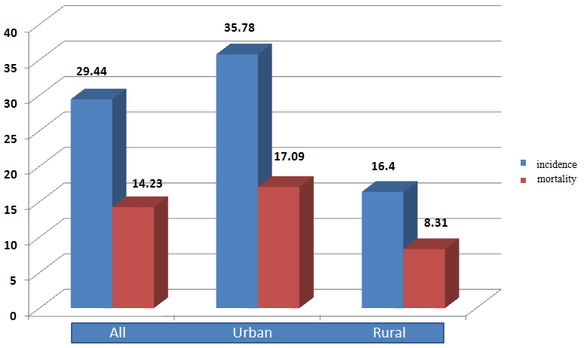
(1)
Colorectal cancer (CRC) has become one of the major malignant tumors in urban populations in China
Fig-1. The incidence and mortality of CRC in China, 2009(1/10⁵)

Slide 6
CRC is characterized by high prevalence, a long asymptomatic period and eminently treatable precancerous lesions, which together suggests that screening is a prudent option.
It has been reported in the literature that CRC screening can reduce mortality effectively and even curb incidence as a consequence of polyp Removal .
There are several protocols already in existence regarding population CRC screening(see Fig. 2).

Slide 7
(2)
Fig. 2 There are several protocols already in existence regarding population CRC screening
iFOBT
sDNA
PillCam COLON 2
gFOBT
Screening
protocols
MR-colonography
FSIG(flexible sigmoidoscopy)
Colonoscopy
CT colonography
colon capsule endoscopy
double contrast barium enema

Slide 8
Question:
How to choose suitable schemes
in various effective protocols?
:

Slide 9
Answer:
Input-Output analysis, i.e.
Economic Evaluation / Cost-Effectiveness analysis

Slide 10
(3)
※ Cost-effectiveness analysis is a decision-making assistance tool.
It identifies the economically most efficient way to fulfill an objective (see table 1).

Slide 11
(4)
Background---Some countries have sought economic evaluation of their chosen screening protocols for CRC , but few in mainland China
Table 1 The literature of economic evaluation in CRC screening
continent | country | quantity | composition
North America | USA | 11 | 26.19%
 | Canada | 3 | 7.14%
Europe | France | 6 | 14.29%
 | UK | 5 | 11.90%
 | Netherlands | 2 | 4.76%
 | Italy | 2 | 4.76%
 | Ireland | 1 | 2.38%
 | Germany | 1 | 2.38%
 | Norway | 1 | 2.38%
Asia | Taiwan(China) | 2 | 4.76%
 | Singapore | 2 | 4.76%
 | Iran | 1 | 2.38%
 | Israel | 1 | 2.38%
 | Hong Kong(China) | 1 | 2.38%
 | Taiwan(China) | 2 | 4.76%
 | Australia | 1 | 2.38%
 |  | 42 | 100.00%
14（33.33%）
18（42.86%）
9（21.43%）
Australia 1（2.38%）

Slide 12
(5)
Background--The Ministry of Health of China proposed a two-step protocol for population-based CRC screening
Based on a series of CRC screening efficacy, the Ministry of Health of China proposed a two-step protocol for population-based CRC screening:
S1: an initial FOBT and high risk factors questionnaire (HRFQ*) for population followed by
S2: a full colonoscopy for those suspected cases identified from the initial screening

Slide 13
(6)
HRFQ --- High Risk Factors Questionnaire
Individuals having one or more of the following features were
identified as ‘‘risk positive’’ by the HRFQ:
(1) first-degree relative(s) with CRC;
(2) a personal history of cancers or intestinal polyps;
(3) two or more of the symptoms/histories: (3a) chronic diarrhea;
(3b) chronic constipation; (3c) mucous and bloody stool;
(3d) history of appendicitis or appendectomy;
(3e) history of chronic cholecystitis or cholecystectomy;
(3f) history of psychological trauma (e.g. divorce, death of relatives).
The participants with either a positive FOBT or a positive HRFQ were offered colonoscopic examination.

Slide 14
In this study, we evaluated the cost-effectiveness of two different CRC initial screening strategies (FOBT vs FOBT+HRFQ) using the Markov model.

Slide 15
Materials and Methods
2

Slide 16
2
Materials and Methods
(1)Comparison and Evaluation of Screening Programs for Colorectal Cancer in Urban Communities in China (CESP)
The CESP project was undertaken from 2006 to 2008.
A total of 400,000 urban residents aged from 40 to 74 years inHangzhou, Shanghai and Harbin were approached by their local CDC (Center for Disease Control and Prevention) officials, who explained the study to them in detail.
Those who agreed to participate in the study were asked to take a FOBT test and fill in a HRFQ.
Data for this study came from the CESP and published literature.

Slide 17
(1)
Comparison and Evaluation of Screening Programs for Colorectal Cancer in Urban Communities in China (CESP)
urban residents aged from 40 to 74 years
First step
The process of CRC screening in CESP
Signed informed consent
FOBT+HRFQ
Negative
Positive
high-risk population
Colonoscopy
Second step
Negative
Positive
Routine surveillance
polyp
CRC

Slide 18
(2)
CRC screening protocols tested
We compared two initial screening protocols:
FOBT alone and (2) FOBT plus HRFQ.
In both protocols, individuals who were considered of interest were
offered a colonoscopic examination.
Four scenarios were developed for protocol one(FOBT alone ):
Scenario A1; Scenario A2; Scenario A3; Scenario A4
Four scenarios were developed for another protocol(FOBT plus HRFQ) :
Scenario B1; Scenario B2; Scenario B3; Scenario B4

Slide 19
(2)
CRC screening protocols tested
Screening
protocols
protocol B
（FOBT+HRFQ）
Scenario B₁
Scenario B₂
Scenario B₃
Scenario B₄
protocol A
（FOBT）
Scenario A₁
Scenario A₂
Scenario A₃
Scenario A₄
*You can view it at the web ‘http://journals.plos.org/plosone/article?id=10.1371/journal.pone.0109150’ if you are interested in protocol A and protocol B

Slide 20
(3)
Markov Model
We estimated costs and effectiveness of these eight scenarios using the Markov model, a transitional probability model. We developed the Markov model to simulate the progression of a cohort of 100,000 average-risk asymptomatic individuals moving through a defined series of states from 40 to 74 years old.
In this simulation, the health states of individuals were categorized either as normal, polyp, CRC or death.
After successive iterations, the model estimated the cumulative costs and effectiveness for the entire cohort over a35 years period.
Each resultant simulation was compared with that of a scenario in which no screening is involved.

Slide 21
(4)
Cost
The initial screening costs comprised expenses in marketing, materials and reagents for FOBT and HRFQ, and distribution and return of FOBT and HRFQ.
These were calculated using the CESP data.
All other costs were calculated based on the claim data of the Bureau of National Health Insurance (BNHI).
All costs are expressed in Chinese Yuan in this paper and are inflated to the 2008 price level.

Slide 22
(5)
Effectiveness
Life year saved--- LYS
The effectiveness of CRC screening was presented in terms of ‘‘Life Years’’ saved by the screening.
It was calculated through estimating premature deaths (from 40 to 74 years old) as a result of CRC using an age-dependent formula for each age group.
The‘‘Life Years’’ saved under each screening scenario equals to the
difference in life years lost between the tested screening scenario
and the scenario without any screening.

Slide 23
(6)
Markov model for CRC
Transition
probabilities
Markov state
Markov cycle
Model
● Normal
Polyp
CRC
Death
● 1 year
● CESP
● Lliteratures
● 100000 persons
● age 40-74
● 35 cycles
● Microsoft Excel 2003

Slide 24
(7)
Discount
discount
Cost
Discount rate ：3%
Effectiveness

Slide 25
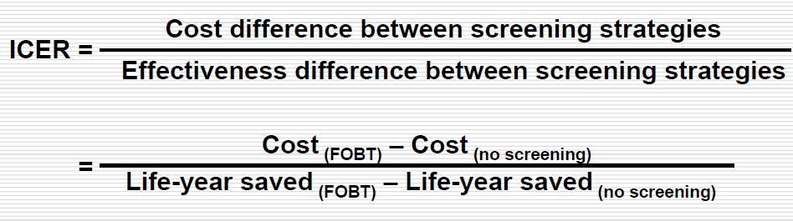
(8)
Incremental Cost Effectiveness Ratio
We used an Incremental cost-effectiveness ratio (ICER) to measure the cost-effectiveness of the tested screening protocols, defined as the ‘‘difference in costs divided by the corresponding difference in effectiveness’’.
A smaller ICER indicates lower cost for saving one life year, reflecting improved cost-effectiveness.

Slide 26
(9)
Sensitivity analysis
The range of key variables in sensitivity analysis
Variable | baseline（%） | Range（%）
Sensitivity of FOBT | 42.90 | 20-60
Sensitivity of FOBT+HRFQ | 88.90 | 75-90
Specificity of FOBT | 86.10 | 50-90
Specificity of FOBT+HRFQ | 71.70 | 50-90
Coverage of FOBT | 53.22 | 30-100
Compliance with colonoscopy request after initial screening by FOBT | 46.78 | 30-100
Coverage of FOBT plus HRFQ | 45.37 | 30-100
Compliance with colonoscopy request after initial screening by FOBT+HRFQ | 37.32 | 30-100
Discount rate | 3 | 0-7

Slide 27
3
Result

Slide 28
3
Result—(1). Cost analysis
The cost of each screening scenario
 | No Screening | Scenario A₁ | Scenario A₂ | Scenario A₃ | Scenario A₄ | Scenario B₁ | Scenario B₂ | Scenario B₃ | Scenario B₄
Marketing(thounds, Yuan) | 0 | 790 | 446 | 889 | 448 | 777 | 532 | 1025 | 54
Distribution and return of FOBT or FOBT+HRFQ(thounds, Yuan) | 0 | 2371 | 223 | 267 | 224 | 2371 | 160 | 3075 | 162
Material of FOBT(thounds, Yuan) | 0 | 3952 | 134 | 4447 | 134 | 0 | 0 | 0 | 0
Material of FOBT+HRFQ(thounds, Yuan) | 0 | 0 | 0 | 0 | 0 | 5441 | 373 | 7176 | 378
Pathology(thounds, Yuan) | 0 | 2201 | 125 | 2476 | 126 | 3362 | 231 | 4433 | 234
Colonoscopy(thounds, Yuan) | 0 | 13270 | 753 | 14927 | 757 | 24876 | 1711 | 32798 | 1734
Polypectomy(thounds, Yuan) | 0 | 7337 | 416 | 8254 | 419 | 11207 | 771 | 14776 | 781
Treatment of CRC(thounds, Yuan) | 44734 | 35999 | 44344 | 39542 | 44676 | 26797 | 44104 | 32733 | 44502
Total(thounds, Yuan) | 44734 | 65921 | 46039 | 73203 | 46381 | 74792 | 47402 | 96016 | 47844

Slide 29
3
Result—(2). Effectiveness analysis
The effectiveness of each screening scenario
Effectiveness | No Screening | Scenario A₁ | Scenario A₂ | Scenario A₃ | Scenario A₄ | Scenario B₁ | Scenario B₂ | Scenario B₃ | Scenario B₄
Discounted life years lost, Yr | 9918 | 8033 | 9847 | 8765 | 9890 | 6030 | 9754 | 7251 | 9851
Life years saved, Yr | 0 | 1885 | 71 | 1153 | 28 | 3888 | 164 | 2667 | 67
Life years saved, % | 0 | 19.01 | 0.71 | 11.63 | 0.28 | 39.20 | 1.66 | 26.89 | 0.68
CRC accumulated cases, N | 2131 | 1710 | 2123 | 1884 | 2129 | 1269 | 2115 | 1560 | 2127
CRC deaths, N | 1984 | 1593 | 1977 | 1754 | 1983 | 1182 | 1969 | 1452 | 1981
CRC prevented, N | 0 | 421 | 7 | 247 | 1 | 862 | 16 | 571 | 3
CRC prevented, % | 0 | 19.74 | 0.35 | 11.60 | 0.07 | 40.47 | 0.75 | 26.80 | 0.16

Slide 30
3
Result—(3). Incremental cost-effectiveness ratio
Table 5 Incremental cost-effectiveness ratio
 | No Screening | Scenario A₁ | Scenario A₂ | Scenario A₃ | Scenario A₄ | Scenario B₁ | Scenario B₂ | Scenario B₃ | Scenario B₄
Total(thounds,Yuan) | 44734 | 65921 | 46039 | 73203 | 46381 | 74792 | 47402 | 96016 | 47844
△Cost(thounds, Yuan) | 0 | 21187 | 1305 | 28470 | 1647 | 30058 | 2668 | 51282 | 3111
Discounted life years lost, Yr | 9918 | 8033 | 9847 | 8765 | 9890 | 6030 | 9754 | 7251 | 9851
△Effectiveness | 0 | 1885 | 71 | 1153 | 28 | 3888 | 164 | 2667 | 67
ICER(Yuan/life year saved) | 0 | 11236 | 18404 | 24689 | 59272 | 7732 | 16223 | 19227 | 46347

Slide 31
3
Result ---(4)Sensitivity analysis
Impact of compliance of initial screening and colonoscopy request on ICER
Compliance with Colonoscopy | Range of coverage of initial screening | Scenario A₁ | Scenario A₂ | Scenario A₃ | Scenario A₄ | Scenario B₁ | Scenario B₂ | Scenario B₃ | Scenario B₄
30% | 30%-100% | 41307- 41320 | 16843- 16893 | 16238- 16290 | 7504- 7156 | 10819- 10558 | 18794- 18748 | 21654- 21696 | 52882- 52890
50% | 30%-100% | 57240- 57138 | 24319- 24449 | 15510- 16044 | 8636- 7916 | 11984- 11247 | 17324- 17501 | 29289- 29395 | 68978- 68923
70% | 30%-100% | 69725- 69141 | 30271- 30511 | 14177- 15253 | 9071- 8370 | 12599- 11309 | 15396- 15799 | 35276- 35476 | 81265- 80960
100% | 30%-100% | 83269- 80430 | 37171- 37631 | 12208- 14167 | 9105- 9518 | 13035- 10883 | 12846- 13562 | 42065- 42467 | 93806- 92387

Slide 32
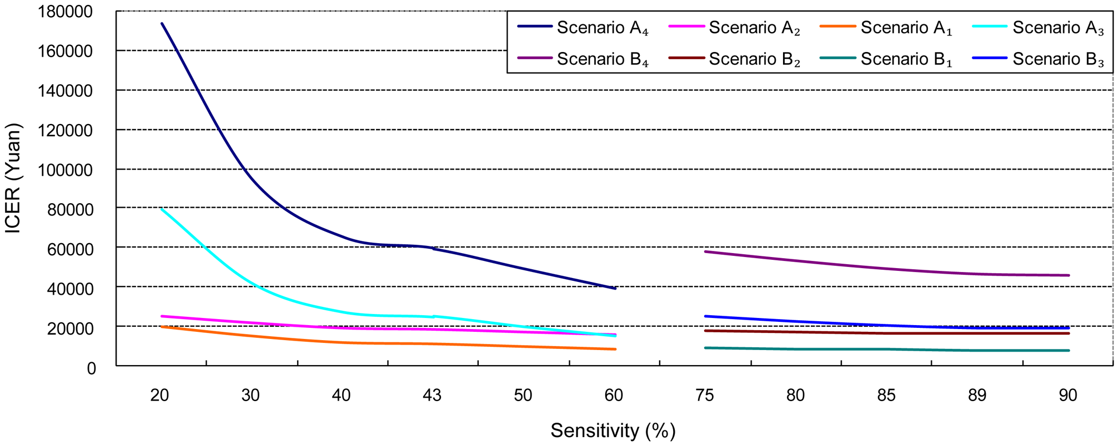
3
Result ---(4)Sensitivity analysis
ICER decreases with rising sensitivity of FOBT or FOBT+HRFQ: One-way sensitivity analysis

Slide 33
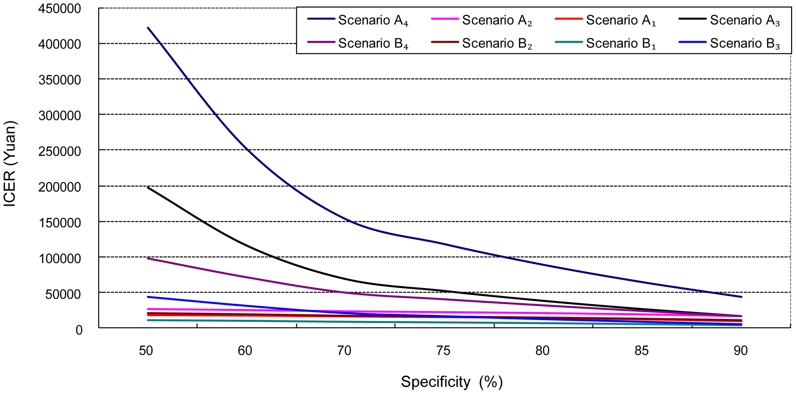
3
Result ---(4)Sensitivity analysis
ICER decreases with rising specificity of FOBT or FOBT+HRFQ: One-way sensitivity analysis

Slide 34
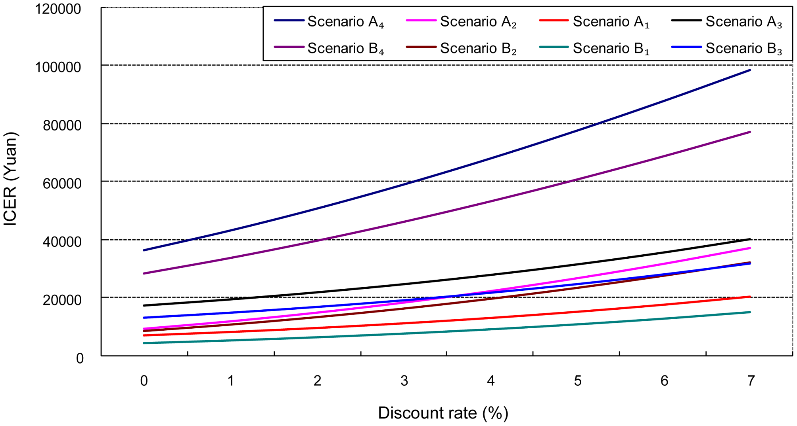
3
Result ---(4)Sensitivity analysis
Fig. ICER increases with discount rate: One-way sensitivity analysis

Slide 35
4
Conclusion

Slide 36
4
Conclusion
A combined use of FOBT and HRFQ as an initial step for CRC screening is a better strategy than FOBT alone
1
2
Compliance rates have a significantly impact on the total cost and effectiveness of CRC screening programs
The current Chinese Trial Version for CRC Screening Strategy falls into Scenario B₄, which is one of the least cost-effective options and should be revised in line with Scenario B₁
3

Slide 37
Scenario A1: The participants take a FOBT. Those with a FOBT positive result are offered a colonoscopy.
-Polyps (if found) are removed during the colonoscopic examination and follow-up colonoscopy is undertaken every three years for those with polyps removed.
-Those participants without polyps are offered another FOBT in ten years.
-Participants with an initial negative FOBT result or those having an initial positive FOBT but for whatever reasons elect not to comply with the recommended procedures were offered an annual follow-up FOBT.
Scenario B1: Participants are offered a FOBT and a HRFQ.
Those resulting in a positive outcome (either FOBT or HRFQ) areoffered a colonoscopic examination.
The follow-up procedures are similar to those of Scenario A1.

Slide 38
Scenario B4 :This is the scenario implemented in China.
--Participants are offered a FOBT and a HRFQ. Those with a positive result (either FOBT or HRFQ) are offered a colonoscopic examination.
-Polyps (if present) are removed during the colonoscopic examination
and follow-up colonoscopy is undertaken every three years.
Those without polyps take part in annual follow-up FOBT and HRFQ. The participants with a negative result(both FOBT and HRFQ)initially and those having a positive result initially but for whatever reasons elect not to comply with the recommended procedures were monitored through a routine cancer registry system.

Slide 39
5
Prospect

Slide 40
5
Prospect
Introduction of Cancer Screening Program in Urban China
Time since 2012
Funds sources: Ministry of Finance of the People’ s Republic of China
Types of cancer: lung cancer, colorectal cancer, esophagus cancer,
gastric cancer, liver cancer, breast cancer
Target population:urban population;
Range of age:40—70
Now, the program is running quite well and smoothly.
Notes:
时间 主管单位 经费来源

Slide 41
Acknowledgments
1.Dr. Wei dong Huang make the contributions to the paper
2.The members of China National Committee on Early Detection and Treatment for Cancers.
3.The general practitioners from participating communities, and the doctors and nurses from the local hospitals who supported the trial.
Mr. Adamm Ferrier provided language editing and proofreading on the manuscript.

Slide 42
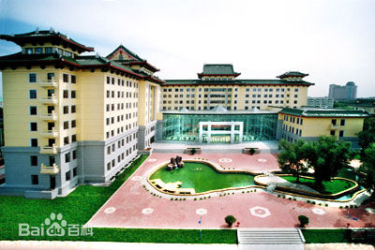
‘http://journals.plos.org/plosone/article?id=10.1371/journal.pone.0109150’ if you are interested in protocol A and protocol B
Thank You !
Guoxiang Liu
E-mail:lgx6301@163.com

