Slide 1
A Culturally-sensitive Approach to Elderly Care
gunn-tove.minde@uit.no

Slide 2
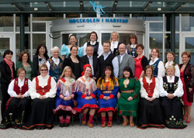
Aim
To describe the outcome of social and health care students’ experiences with person-centered care in nursing homes during 10 weeks in practice.

Slide 3
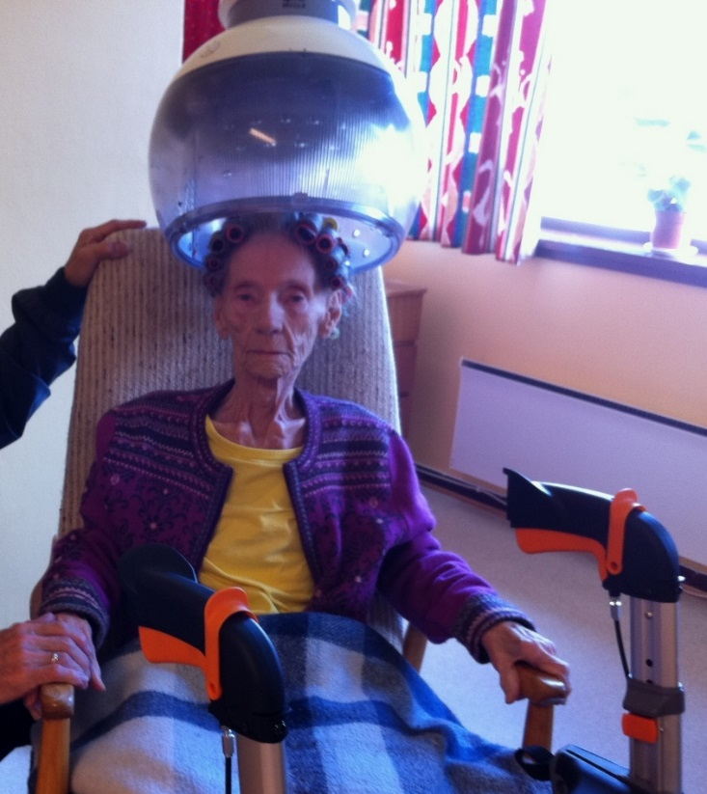
Method
Case studies of 10 practical reports of elderly living in nursing homes
In this presentation: Rachel, Jürgen and Aida

Slide 4
Sociatal stories about the older Arctic people of Norway (Scandinavia)
The Arctic region; colonization areas
Include the Nordic people, Sami Indigenous people (live there for ages) and the Kven/finish minorities moving to Norway during the 1700- and 1800 century
Communications problems and stigma from the Colonization period is still there and can appear in different ways when illness and disability occurs
Even if the majority of the Sami elders in the rural Sami districts have lost their Sami language, they have a strong Sami identity or they define themselves as ethnic Norwegians
Mostly have a traditional lifestyle

Slide 5
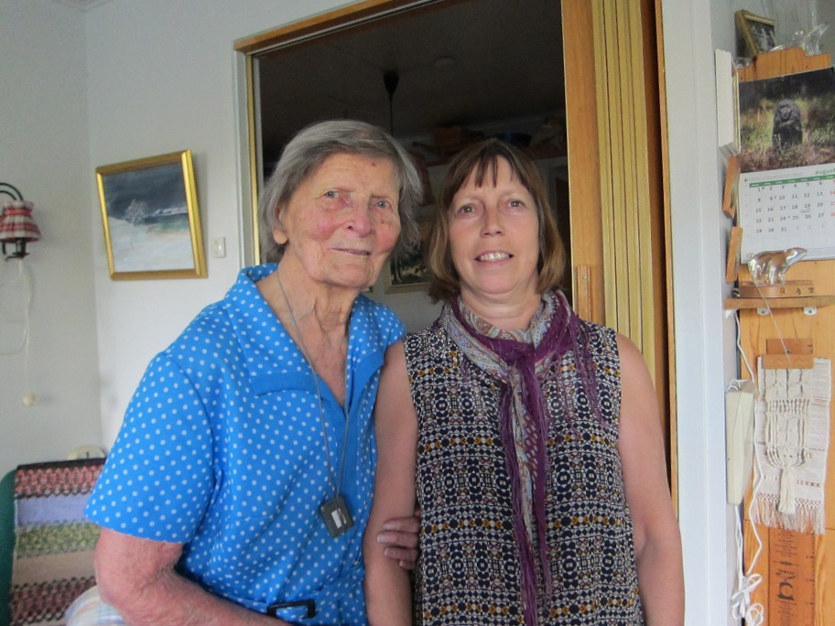
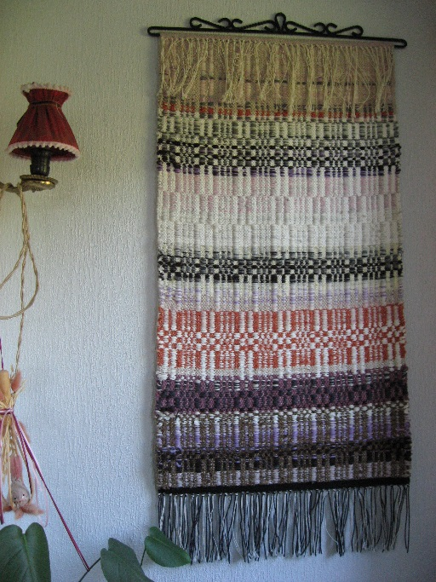
Elders from Kven heritage
Nanna 100 years
«Her untold story»

Slide 6
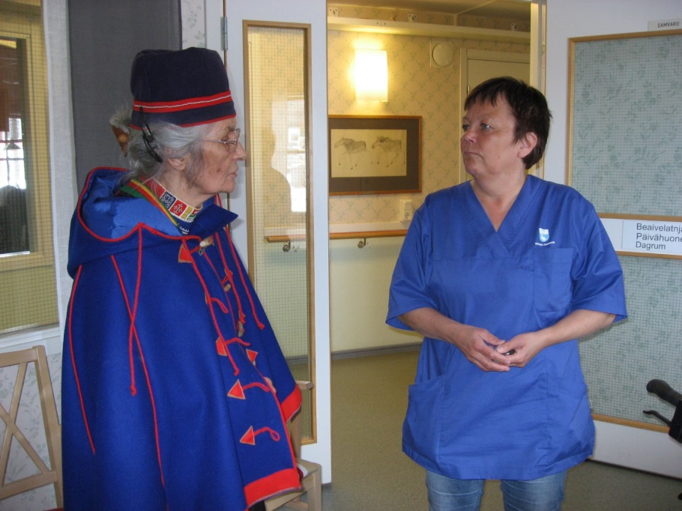
Sami Elders
Inga- leader of the Sami parliament organisation for Sami elders visiting a nursing home for Sami people in Sweden
A short film
Reidun 91 years old

Slide 7
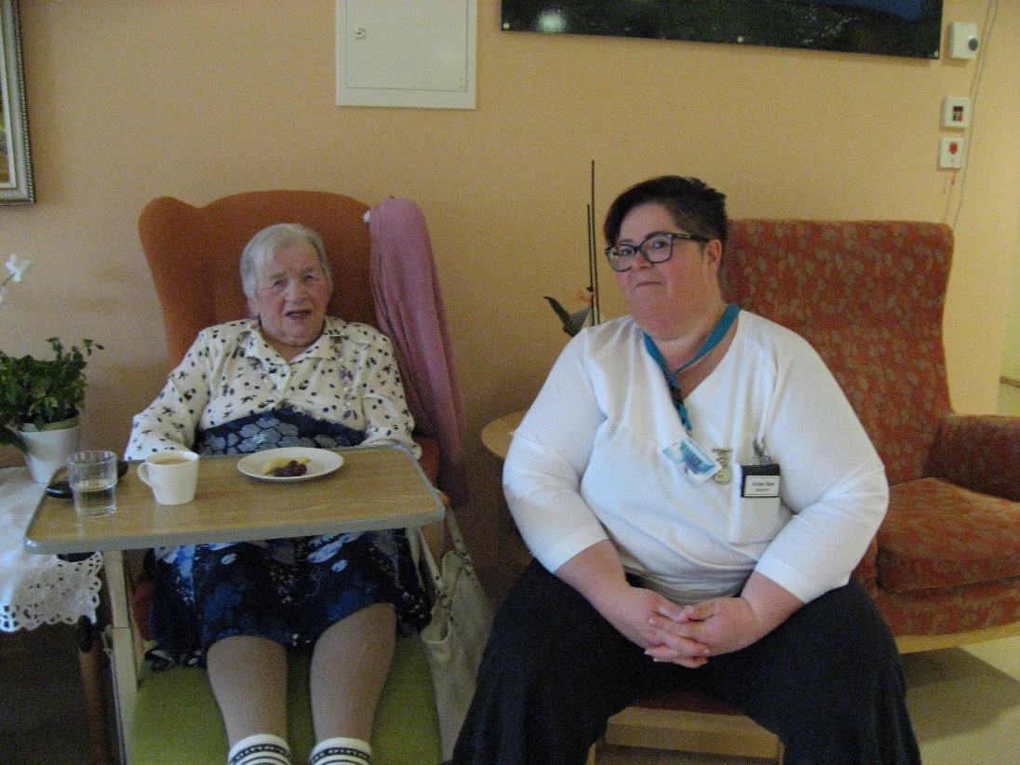
Person-centered Care
The life-story
Lifestyle and preferences
Health condition
Cognitive and practical function
Social relation
The life here and now
(Kitwood, 1999, Rokstad 2014)

Slide 8
Findings1
Aida
Rachel
The student used her cultural competence in order to connect with her. She used her cultural awareness to understand the whole picture i.e seeing that Aida has a Sami identity
Aida reacted negatively when the student spoke Sami to her.
But in some weeks Ida change attitude and started to speak her mother tongue- i.e. sami with the student
The story of Rachel shows a person with challenging behavior.
The student managed to cooperate and communicate with Rachel in order to understand the old woman’s need.
The student choose to take Rachel back home to her castle (matriark)
Rachel was delighted and no more depressed

Slide 9
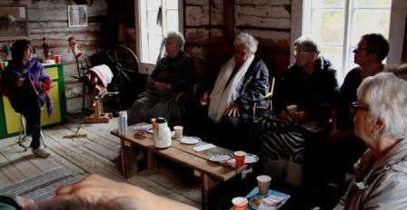
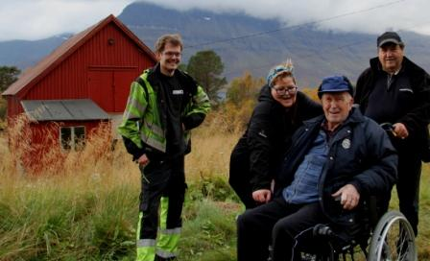
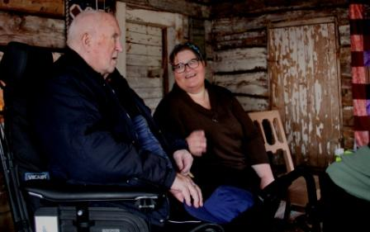
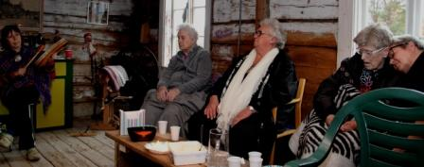
Mental health care - a short film

Slide 10
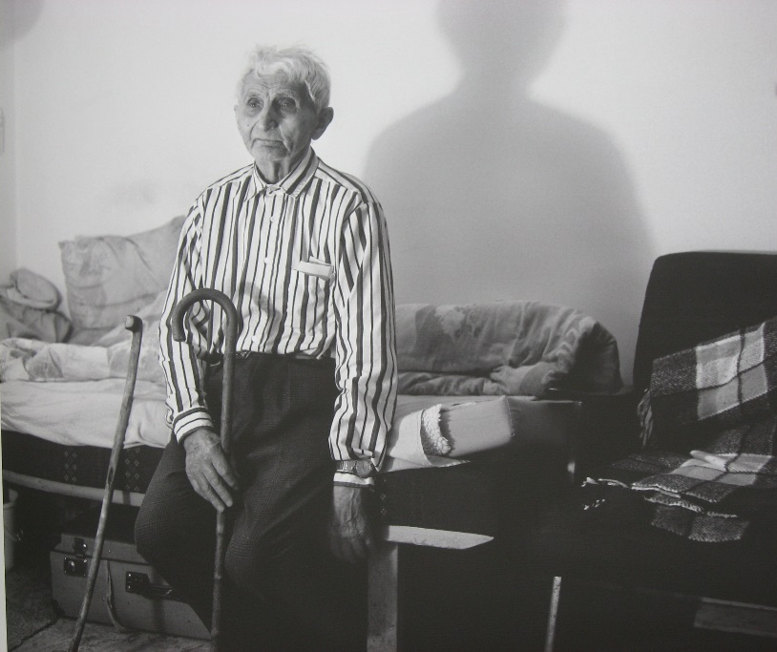
Jürgen
Jürgen is married and was hospitalized because suffering from dementia
The students organized a reminiscence group of men
After some weeks; no aggressive behavior against his spouse and the other female residents

Slide 11
Findings2
During the student`s fieldwork the students’ changed their attitudes during the ten-week practice to a more culturally-sensitive approach (a shift in focus from “the older” to myself).
During the process they keep in touch with their inner sensations. That was the turning point to understand and recognized the underlying values, beliefs and identities of Aida, Rachel and Jürgen.
They recognized , absorbed, interpreted and were moved by the older adult`s stories,
they also understood the underlying controlling lifestyles Aida, Rachel and Jürgen lived in the nursing home.

Slide 12
Conclusion
The growing older population in Western societies is a challenge for many countries, including Norway (Scandinavia)
Europe has a special responsibility to take care of their Older Indigenous people
A culturally-sensitive approach to elderly care helps to promote independence and strengthens the health strategies among the older adults
Taking them back to the cultural landscape is a mental well being-treatment.
To feel connected to their home and land is essential for nursing homes residents who have lived close to nature (jf. Indigenous people, Arctic people)

Slide 13
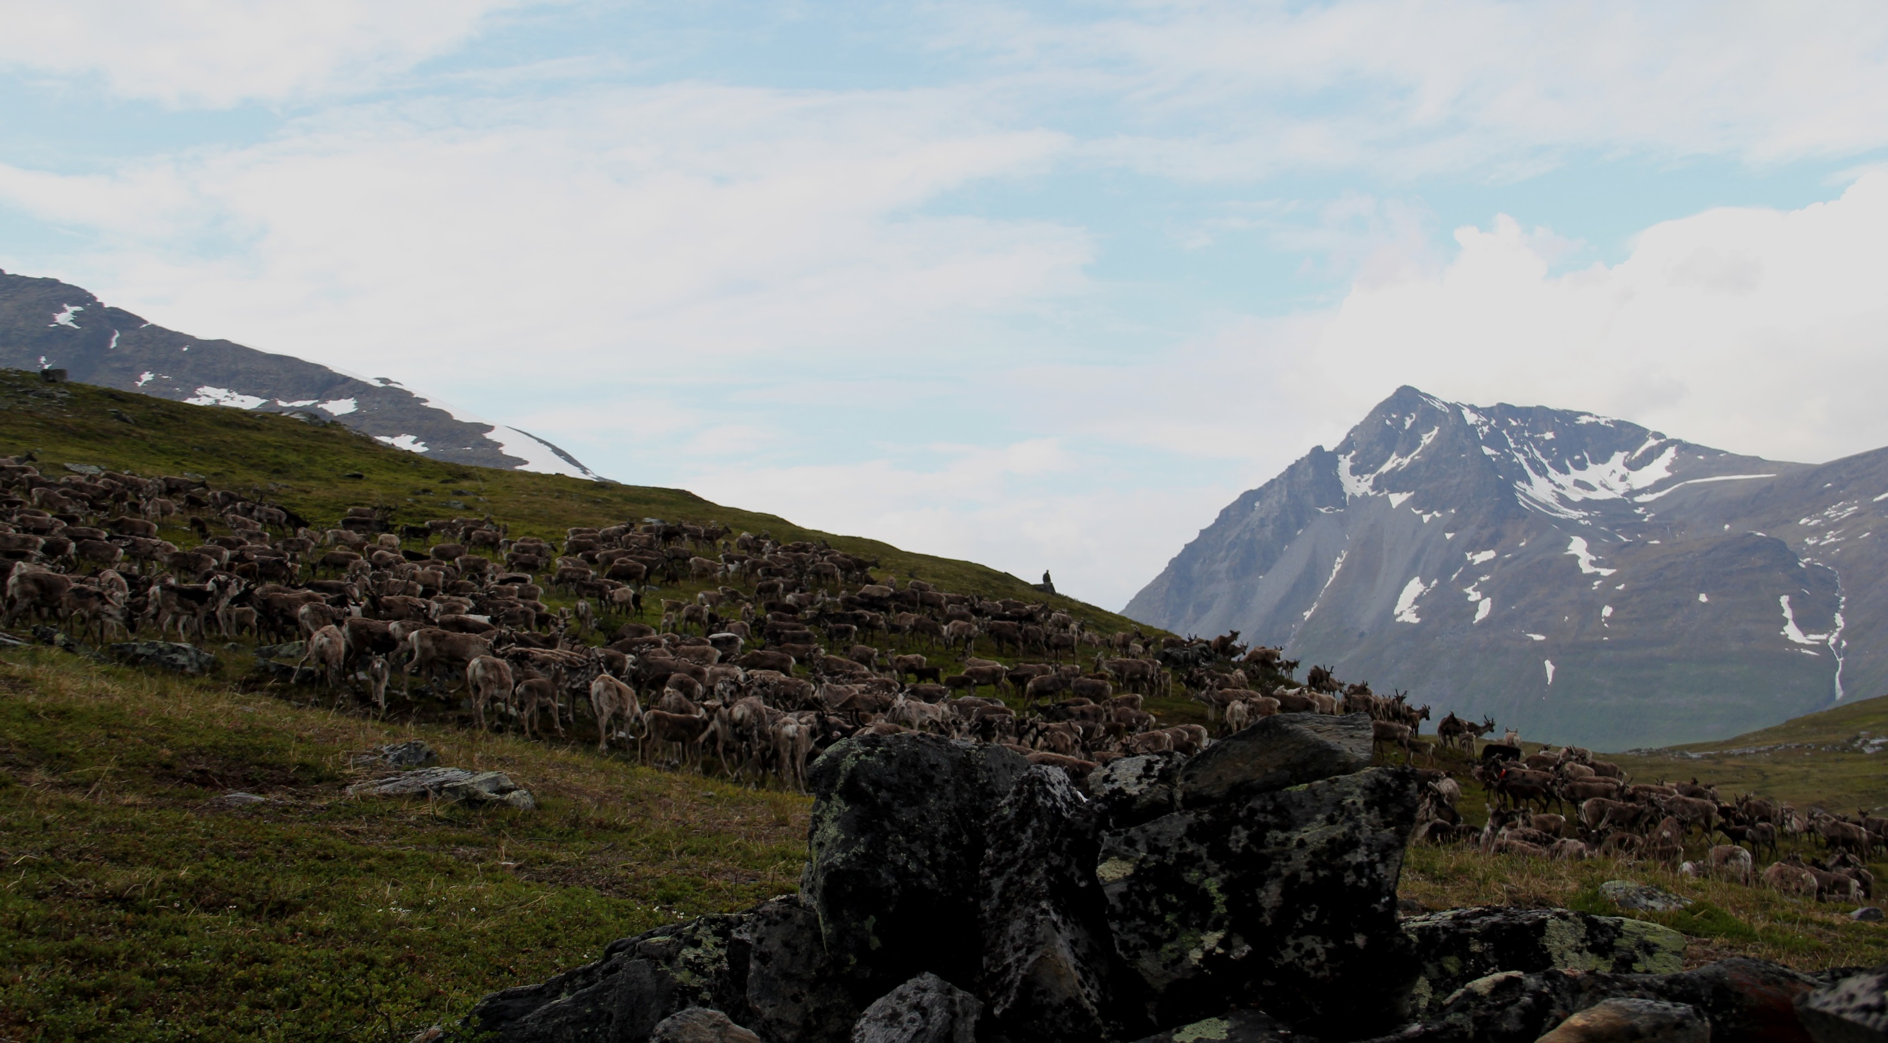

Slide 14
References
Minde, GT (2014) A Culturally-sensitive Approach to Elderly Care. Gerontol Geriatr Res 2015, 4:5
Rokstad AMM (2014) See who I am! Person-sentered care with dementia. Oslo: Universitetsforlaget.
Kitwood T (1999) Dementia reconsidered. Fredrikshavn: Dafolo Forlag.
McKenna, Iris (2011) A person`s connection to the land could be the secret to mental well being. ABC Kimberly 131011

