Slide 1

Gulsan Ara Parvin
Researcher, DPRI, Kyoto University
niruurp@yahoo.com
Date: July 26, 2018

Slide 2
Cyclone Warning and People`s Expectation-
A case study of Cyclone Aila Affected Area, Bangladesh
Gulsan Ara Parvin¹, Masashi Sakamoto², Shaw Rajib³, Hajime Nakagawa⁴, Anisul Haque ⁵
¹ Researcher, Disaster Prevention Research Institute (DPRI), Kyoto University, Japan
² Project Officer, Pacific Consultant, Tokyo, Japan
³ Professor, Keio University, Japan
⁴Professor and Director, Disaster Prevention Research Institution (DPRI), Kyoto University, Japan
^{5.} Institute of Water and Flood Management (IWFM), Bangladesh University of Engineering and Technology (BUET), Bangladesh

Slide 3
Outline of the Presentation
Part 1: Bangladesh and Cyclone
Part 2: Cyclone Warning in Bangladesh
Part 3: Modification in Cyclone Warning and Problems
Part 4: Cyclone Warning Scenario during Cyclone Aila

Slide 4
Part 1:
Bangladesh and Cyclone

Slide 5


Where is Bangladesh ???
Bangladesh

Slide 6
Cyclone in Bangladesh ???
Tropical cyclones with high winds and storm surges hit Bangladesh every three years on average (Saha, and James, 2017).
About 6-10% of the world’s tropical cyclones generate at the Bay of Bengal.
Due to the geo-physical and topographical condition Bangladesh is one of the most disaster prone countries in the world. Especially, climate related disasters like flood and cyclone are most common in Bangladesh.
Amon all disasters cyclones impose the most severe impacts in Bangladesh considering the loss of lives.
According to Nicholls et al. (1995) during the past two centuries 42% of tropical cyclone-associated deaths have occurred in Bangladesh.
How was the Loss of of Lives due to Cyclone ????

Slide 7
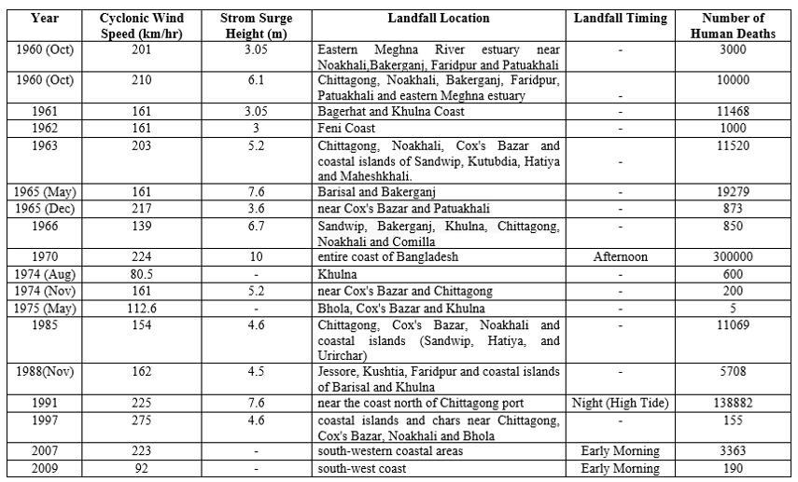
Cyclone Intensity and Human Casualty
Source : Department of Disaster Management, 2014

Slide 8
WHY Cyclone Warning ???
Cyclone Warning to reduce Human Casualty
Cyclone warning is a non-structural mitigation measure that can reduce human casualty, loss and damage.
If a cyclone warning can be issued timely with adequate information to the local people, it is possible to save life and property.
Success of evacuation depends on the level of information given in the warning and how much ‘believes’ people have on this information.
The most important issue is – whether the information given in the warning is ‘useful’ for the people.

Slide 9
Part 2:
Cyclone Warning in Bangladesh

Slide 10
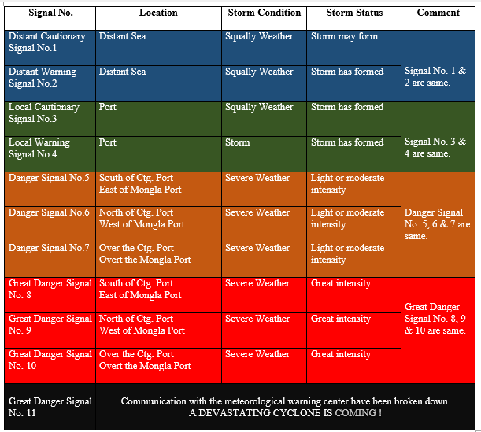
How is Present Cyclone Warning System in Bangladesh ?
Related to Sea Ports

Slide 11
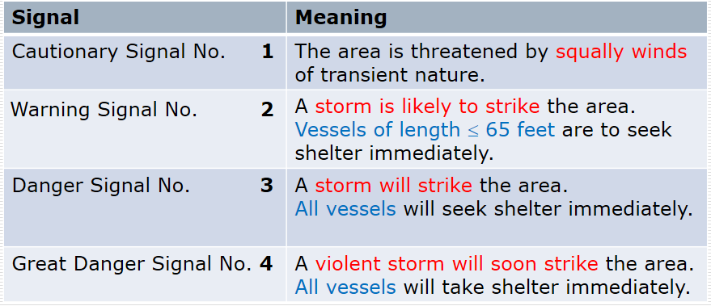
Present Cyclone Warning System in Bangladesh
Related to River Ports

Slide 12

Present Cyclone Warning System in Bangladesh
Present Cyclone Signal Dissemination Time
Stages of Cyclone Warning | Signal No. | Time to Forecast in Advance
Cyclone Alert Stage | Signal No. 1 , 2 , 3 | 36 Hrs
Cyclone Warning Stage | Signal No. 4 | 24 Hrs
Cyclone Danger Stage | Signal No. 5, 6, 7 | 18 Hrs
Cyclone Great Danger Stage | Signal No. 8, 9, 10 | 10 Hrs

Slide 13
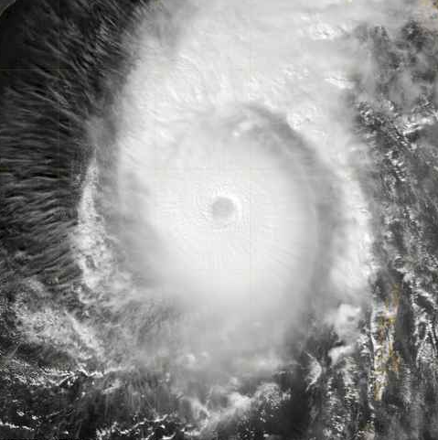
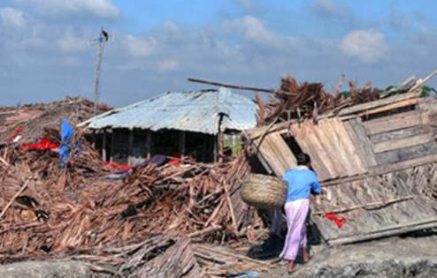
Problems in Present Cyclone Warning System in Bangladesh
Sidr November 15 2007
BMD warning for Cyclone ‘Sidr’
November 15, 2007: Met office sounded great danger signal No. 10 for Mongla port and great danger signal 9 for Chittagong and Cox's Bazar as a severe storm in the Bay of Bengal is estimated to make landfall Thursday.
Only port names are mentioned – nothing is mentioned about the districts or upazilas

Slide 14
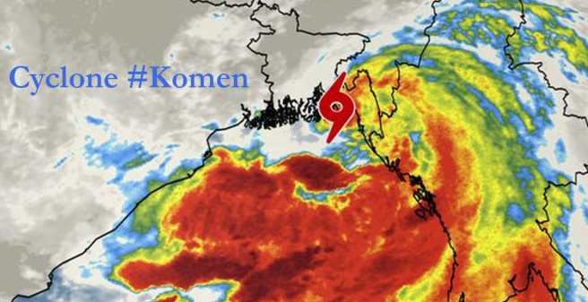
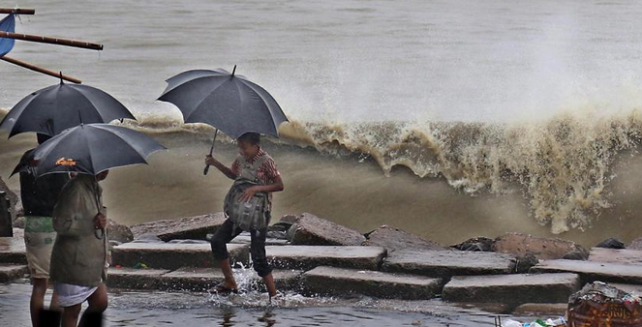
Problems in Present Cyclone Warning System in Bangladesh
Komen July 30 2015
BMD warning for Cyclone ‘Komen’ (July 30, 2015)
Chittagong and Cox’s Bazar ports asked to maintain cautionary signal no. 7. Mongla and Payra ports to maintain cautionary danger signal no. 7. Coastal districts of Cox’s Bazar, Chittagong, Noakhali, Laxmipur, Feni, Chandpur, Bhola, and their offshore islands and chars under danger signal no. 7. Coastal districts of Borguna, Patuakhali, Barisal, Pirozpur, Jhalokathi, Bagherhat, Khulna, Satkhira and their offshore islands under danger signal no. 5.
District names are mentioned in addition to port names but No Local Area Specific Information about Storm Surge Height or Cyclone Intensity

Slide 15
Problems in Present Cyclone Warning System in Bangladesh
This cyclone warning is generally criticized as
Warnings are basically sea port oriented not local area specific
Too much qualitative
Language of the warning is not familiar to the local people

Slide 16
Part 3:
Modification in Cyclone Warning and Problems

Slide 17
Modification made by BMD in Present Warning System
BMD is very sincere in this issue
After two major cyclonic events of 1991 (1991 Chittagong cyclone) and 2007 (SIDR) several improvement measures are taken by BMD
District specific signal numbers are issued with some quantification of surge depths and wind speed
In a warning message, the coastal districts located to the west of the Meghna estuary lie in the command area of Mongla maritime port, while the districts located to the east lie in the command area of Chittagong maritime port

Slide 18
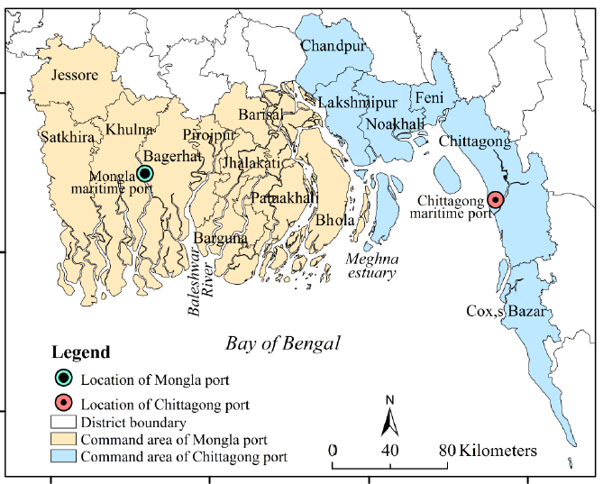
Modification made by BMD in Present Warning System

Slide 19
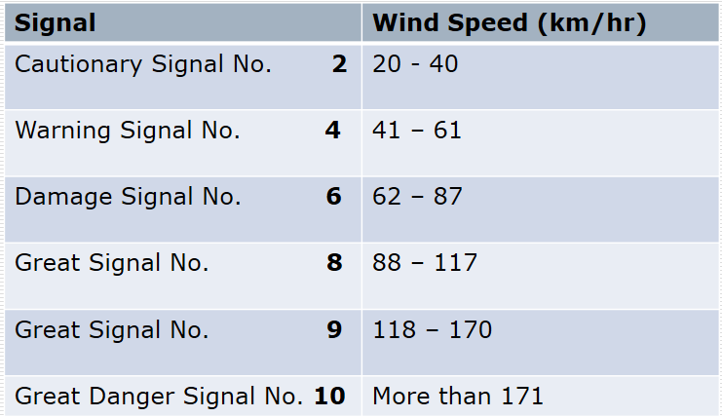
Modification made by BMD in Present Warning System

Slide 20
Modification made by BMD in Present Warning System
The Bangladesh Department of Disaster Management (DDM) has recently developed three mobile-network-based warning message dissemination methods
Cell Broadcasting System can be used to send warning messages to a targeted population group that is, residents in the coastal areas.
2. Interactive Voice Response is a method where residents can listen to a recorded warning message by calling a number.
3. Short Message Service is a text messaging service, which is specially designed for field-level disaster management committees. Members of these committees continuously receive updated information about the approaching TC on their mobile phones in cyclone emergencies.
Source:
Roy, C., S. K. Sarkar, J. Åberg and R. Kovordanyi. 2015. The current cyclone early warning system in Bangladesh: Providers' and receivers' views. International journal of disaster risk reduction 12: 285-299.

Slide 21
Doppler Radars–Grant of JICA
Since 1988, Japan has been contributing to improving the weather forecast service in Bangladesh through establishment of meteorological radars, improvement of weather analysis & forecasting system and capacity buildings.
All radars will be equipped with S-band Doppler radars.
Doppler radars can collect 3 dimensional meteorological data on atmospheric moisture, intensity of rain and wind velocity distribution much faster as well as in a more accurate manner than the previous radars.
https://www.google.com/url?sa=i&rct=j&q=&esrc=s&source=images&cd=&cad=rja&uact=8&ved=2ahUKEwiswPv62ZPcAhXE7GEKHa2BAQgQjRx6BAgBEAU&url=https%3A%2F%2Fwww.jica.go.jp%2Fbangladesh%2Fenglish%2Foffice%2Ftopics%2Fpress150624.html&psig=AOvVaw3lJ8zb7lBMYZkG_iuOAMYz&ust=1531283561351488

Slide 22
Problem Remains after Modification made by BMD in Present Warning System
Problem remains…………..
Concept of the command areas for district level warning are based on two ports and are very general.
Wind speed and surge depth information are not local area specific
Sometime signal numbers are confusing
Damage information is not mentioned
Language of warning are still difficult to understand for local people (people only take the ‘warning number’ and apply their own judgement to interpret it. e.g what is the difference between wind speed 50km/hr and 100km/hr)
Difference between Danger Signal No, Great Danger Signal No.

Slide 23
Problem Remains after Modification made by BMD in Present Warning System
Mallick (et al. 2017) has argued that in spite of improvement in early warning systems in Bangladesh, many people still do not know how to interpret the warnings.
He has found though 78% received a warning 6 hour before the cyclone Aila, one third of them were not able to understand the early warning message.
Present cyclone warning system in Bangladesh is related to sea port and river port.
Different terms that are used are confusing to the local people.
Sometimes when the warning signal No. change there is lack of adequate information, such as, change in intensity, height of tidal surges.
Sometimes change of cyclone warning signal no. indicates the change of cyclone track.

Slide 24
Part 4:
Cyclone Warning Scenario during Cyclone Aila

Slide 25
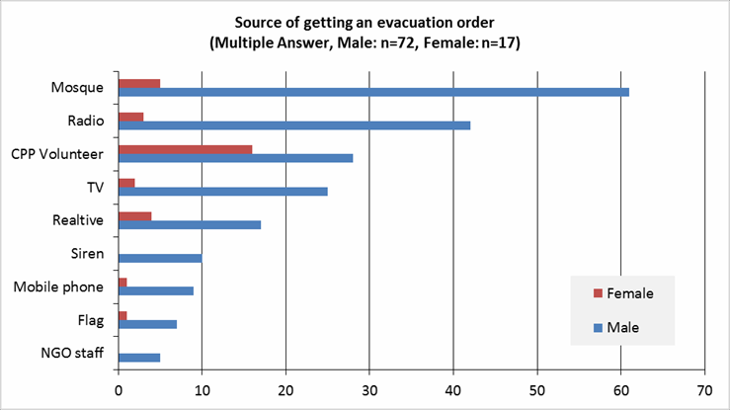
Cyclone Warning Scenarios During Cyclone Aila:
Cyclone Warning
Most of the men got warning and evacuation order from mosque.
Mass media such as radio and TV were also relatively useful tool.
CPP volunteer also played an important role; especially, most of women got evacuation order from CPP volunteer.
It is claimed that during cyclone Aila CPP volunteers were late to disseminate evacuation order.
Siren and flag, which are the main tools of warning and evacuation order dissemination were identified as not so effective.
People claimed that the sound of siren could not be heard and flag could not be seen from their house.
Source of Receiving Cyclone warning

Slide 26
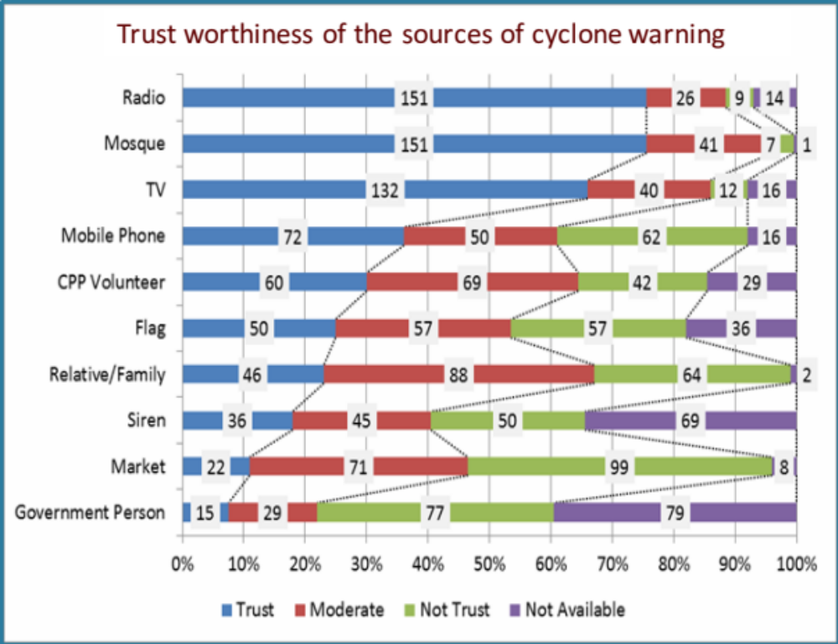
Sources and Trust worthiness of Cyclone warning
People basically trust the information broadcasted by mass media such as radio and TV.
Mosque is one of the most trusted source.
CPP volunteer is recognized as effective source of disseminate warning.
However, the result shows that some people do not have high trust to the information received from CPP volunteers.
It can be considered that cyclone warnings were disseminated many times but cyclone did not affect. Many mistakes of disseminating cyclone warning lead people not to trust CPP volunteers.

Slide 27
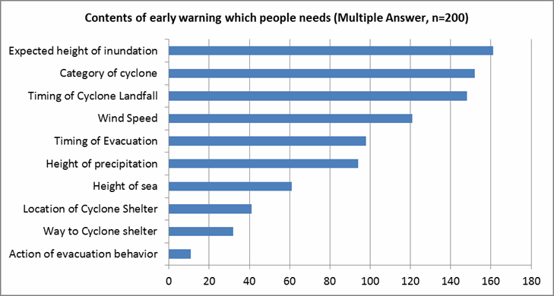
Expected Content of Cyclone warning in Bangladesh

Slide 28
Expected Content of Cyclone warning in Bangladesh
Main information which people need are
locality specific expected height of storm surge and probable inundation
Cyclone intensity or wind speed,
time of landfall, time of evacuation
location of cyclone shelter and safe way to cyclone shelter
when they should start preparation for evacuation, where they should evacuate and
how to reach there.

Slide 29
Concluding Remark
Content of Cyclone Warning needs to be adjusted with the People`s Expected Information
Language of the Warning should be easily understandable for the local and rural community
Rather being port oriented, cyclone warning has to be districts and Upazila oriented. Local community specific information should be prioritized.
Each Warning No. should be composed of a set of detail information, like wind speed, intensity, height of storm surge, probable damage, track
Time of cyclone landfall
Distance of nearest cyclone shelter, evacuation route,

Slide 30




Acknowledgements
This research was a part of a collaborative research project of Science and Technology Research Partnership for Sustainable Development (SATREP) between Bangladesh and the Japan Government funded by JST-JICA for whose support the authors wish to express their thanks and appreciation. Project title is `Disaster Prevention/Mitigation Measures against Floods and Storm Surges in Bangladesh` . Heartfelt thanks to Prof. Hajime Nakagawa and Prof Munsur Rahman for leading such an important project. Guidance of the Head of Component 5 Prof. Rajib Shaw and Head of Component 2 Prof. Anisul Haque are highly appreciated. Authors are thankful to the contribution of all members of Component 2 and Component 5.
Thank you very much for Your Kind Attention

