Slide 1





The Comparison of Applied Breathing Technique Before OSCE on the Effect of State Anxiety Level and Vital Signs on the Nursing Students
Gülşah KÖRPE*, Demet İNANGİL**, Pınar IRMAK VURAL
gulsahkorpe@outlook.com
*Istanbul Medipol University, Istanbul, TURKEY
**Saglik Bilimleri University, Istanbul, TURKEY

Slide 2

Introduction
The exam anxiety, being one of the forms of situational anxiety, is an important biopsychological factor negatively affecting the well-being and academic performance of students throughout their education.
This study was carried out to determine the effect of breathing technique on situational anxiety and vital signs in nursing students planning to take the OSCE (Objective Structured Clinical Exam)

Slide 3
Methods
This study was conducted with 60 volunteer students studying at the Nursing Department of the Health Sciences Faculty at a foundation university in Istanbul. The data was collected prior to the OSCE on May 31, 2017. Students included in the study were required to meet the eligibility criteria of being 18 years old or above, taking the theoretical course of Nursing Principles I and II, and entering the OSCE on May 31 as part of the Nursing Principles course.
A randomly ordered class list was prepared with the student numbers in the classroom list using the random.org program. According to the newly created list, students were notified in writing one day before about what time to arrive before the exam.

Slide 4
Methods
Students who arrived on the day of the exam were assigned to the breathing technique (B1 and B2) and the control group (C1 and C2). Each group consisted of 15 students for more efficiency due to an insufficient number of supervisors to monitor them.
Data collection was carried out using the Student Identification Form prepared by the authors, the Situational Anxiety Scale, and the Vital Signs Form.

Slide 5
Methods
The students were taken to a 90 m² practice room with 15 seats.
Each group was briefed for five minutes before obtaining their consent.
The students had their vital signs measured by the investigators. They were asked to fill out the Student Identification Form and the Situational Anxiety Scale.
Afterwards, the breathing tecnique were applied for 20 minutes. The tecnique were applied by the investigators who are experts in their fields.
After the methods were applied, the students had their vital signs remeasured by the investigators and were asked to fill out the Situational Anxiety Scale.
For the control group, pre-measurements were taken, 20 minutes of free time was given, and then post-measurements were taken.
At the end of the application of each technique, the students were taken immediately to the OSCE exam rooms. There were no disruptions to the exam flow. No interaction was allowed between students leaving the exam and entering the exam.

Slide 6
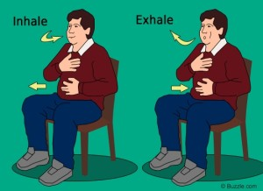
Methods
Implementation of the breathing technique
The breathing technique was performed in the application room.
Once the students were seated comfortably, they were asked to put their hand (left or right) on their diaphragm. They were asked to take a deep breath while counting from 1 to 8, and then to hold their breath while counting from 1 to 8, and then breathe out while counting from 1 to 8 again. They were told that when breathing, they needed to feel the abdominal cavity beneath the diaphragm muscle rising. While breathing, they were told to focus on the tip of their nose, their lungs rising, and imagine blowing up a balloon inside their stomach. They were also asked to think back to a nice memory or place to help replace any anxious thoughts about the exam occupying their minds.
The breathing technique was repeated 20 times on average, corresponding to one application every minute for 20 minutes.

Slide 7
Methods
Licensed SPSS 22.0 (Statistical Package for the Social Sciences for Windows, Version 22.0) was used for the data analysis. The results were evaluated within 95% confidence intervals, at a significance level of p<0.05.
The Shapiro-Wilk Test was used to examine the normal distribution. Due to the non-normal distribution, the Kruskal Wallis Test and the Mann-Whitney U Test were used for comparison between descriptive analyses (frequency, percentage, mean ± SD) and variables.
After the study, a power analysis was conducted with the G*Power 3.1.9.2 program and the power of the study was 89%.

Slide 8
Results
The mean age of the participants was 19.17 (min. = 18, max. = 22) and 16% were male.
The majority of students lived with their families and their economic situation was moderate-good.
There were no statistically significant differences between the groups in terms of the descriptive characteristics of the students randomly assigned to the groups.

Slide 9
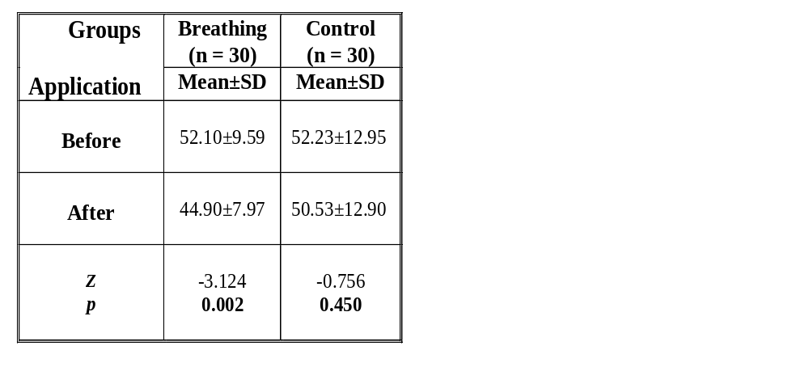
Results
Malinski and Todaro-Franceschi (2011) argued that meditation practice for nursing students, including the implementation of breathing techniques, is effective in reducing students’ anxieties.
Breathing deeply for 10-15 minutes before exams is reported to be useful in preventing anxiety symptoms (Oakley and Evans, 2014).
There was a statistically significant difference between the groups after the application and it was seen that this difference was caused by the control group (p<0.05). However, the application caused a statistically significant difference in anxiety levels before and after each application (p<0.05).
Z = Mann-Whitney U Test, p<0,05

Slide 10
A study by Paul et al.(2007) on 64 students reported that regular deep breathing meditation reduces levels of anxiety, nervousness, and self-doubt in students whilst increasing concentration skills.
Aritzeta et al.(2017) study reported that 152 psychology students who participated in a biofeedback program, including the deep breathing technique, showing better academic performance and lower levels of anxiety than those who did not participate in the program.
The study results correlate with the literature.

Slide 11
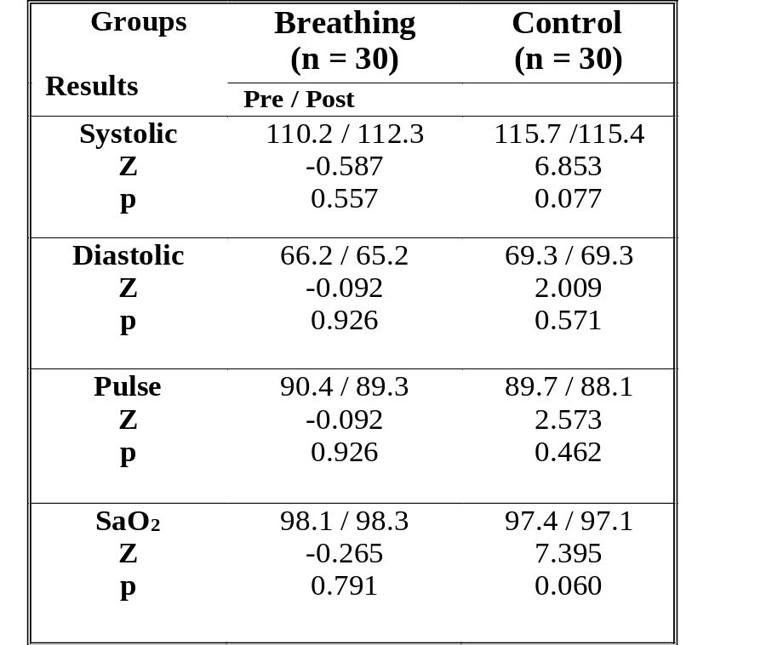
Results
In the breathing technique group, there was an increase in mean systolic blood pressure and oxygen saturation levels after the sessions, and a decrease in diastolic blood pressure and pulse rate. However, these differences were not statistically significant (p>0,05).
Z = Mann-Whitney U Test

Slide 12
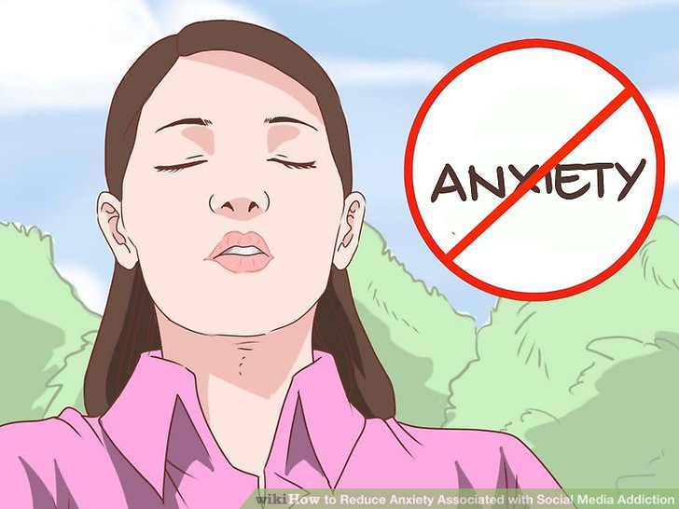
Conclusion
It was shown that the application of this method before an exam, which are easy and safe to apply, can reduce test anxiety.
We believe that the results of this study will contribute to the determination of effective methods for reducing test anxiety and recommend that nursing educators acquire competency in complementary and alternative treatment methods, and apply these methods for students suffering from situational anxiety.

Slide 13
References
Aritzeta, A., Soroa, G., Balluerka, N., Muela, A., Gorostiaga, A., Aliri, J., 2017. Reducing anxiety and improving academic performance through a biofeedback relaxation training program. Applied Psychophysiology and Biofeedback, 42(3), 193-202.
Oakley, S., Evans, E., 2014. The role of yoga: breathing, meditation and optimal fetal positioning. Pract. Midwife, 17, 30-32.
Malinski, V. M., Todaro-Franceschi, V., 2011. Exploring co-meditation as a means of reducing anxiety and facilitating relaxation in a nursing school setting. Journal of Holistic Nursing, 29(4), 242-248.
Paul, G., Elam, B., Verhulst, S. J., 2007. A longitudinal study of students' perceptions of using deep breathing meditation to reduce testing stresses. Teaching and Learning in Medicine, 19(3), 287-292

Slide 14
You can see here my e-mail. If you need some more information or question about my study, you can arrive me by this way;
gulsahkorpe@outlook.com

Slide 15
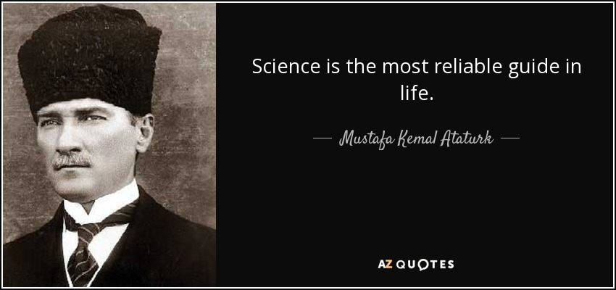
Thank you for listening...

