Slide 1


CLIMATE CHANGE AND CURRENT MEASURES TAKEN IN TURKEY
AS A MEDITERRANEAN COUNTRY
Guleda ONKAL ENGIN
Yildiz Technical University
Dept. of Environmental Engineering
Meltem CELEN
Remzi Anil YAVUZ
Ahmet ADILLER

Slide 2

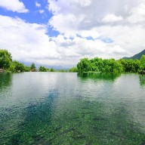
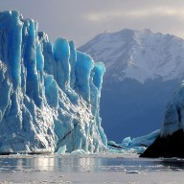

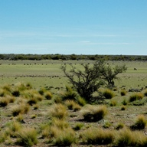
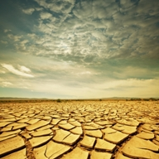

Outline
Problem
Impacts, Results and Reasons
Action Plans taken in Turkey
The EU Project CLIMB
Last words…
Yildiz Technical University Dept. Of Env. Engineering

Slide 3
Motivation
According to current climate projections, the Mediterranean countries are at high risk for an even pronounced susceptibility to changes in the hydrological budget and extremes.
These changes are expected to have severe direct impacts on the management of
  water resources,
  agricultural productivity and
  drinking water supply.
The different regions of the Mediterranean landscape are already experiencing and expecting a broad range of natural and man-made threats to water security.
Yildiz Technical University Dept. of Env. Engineering

Slide 4
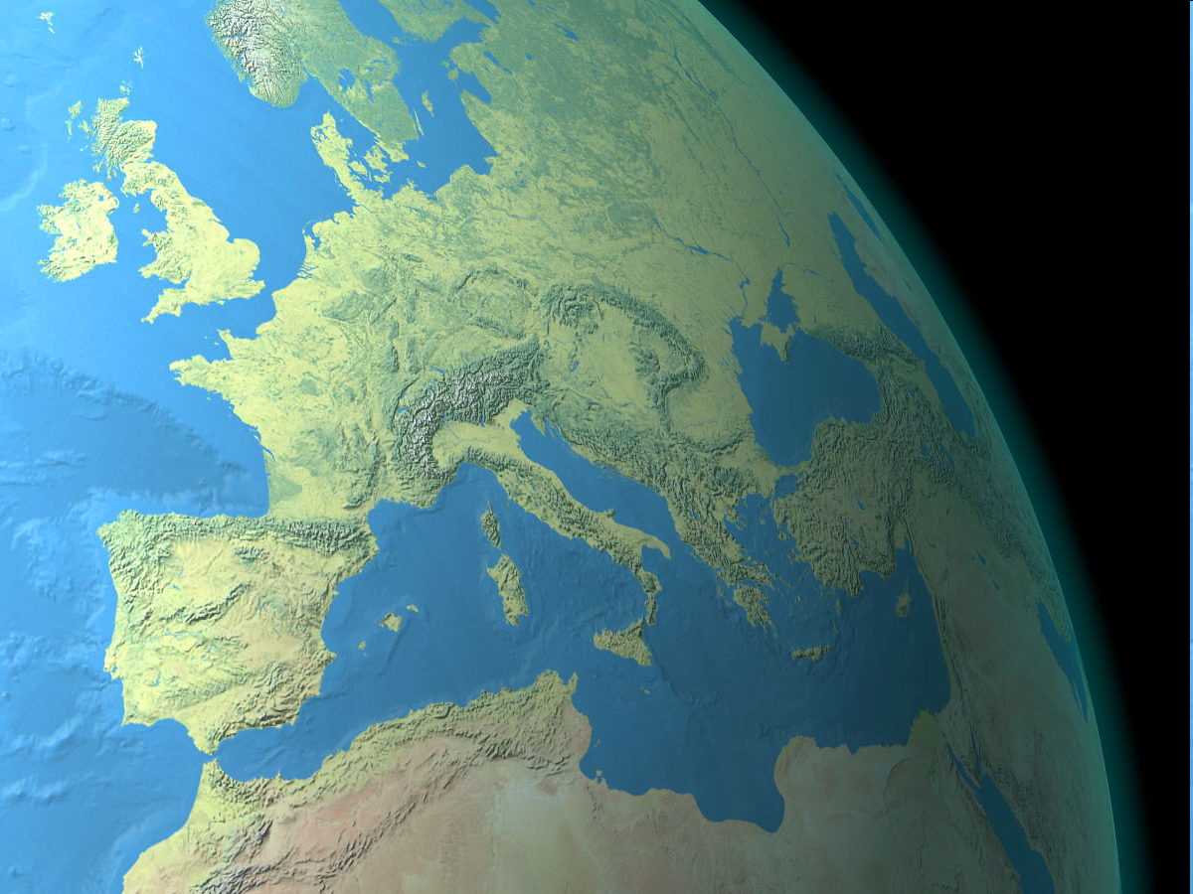
Glacier
melting
Pollution
Heat
waves
Droughts
Coastal
erosion
Flash
floods
Sea
level
rise
Environmental
migration
Salinization
Source: http://www.shadedrelief.com/natural/images/italy.jpg
Notes:
4
Climate change results in significant variations in water resources spatially, temporally, quantitatively and qualitatively. The adverse effects of climate change are particularly effective in the south Mediterranean countries. Threats include severe droughts and extreme flooding, salinization of coastal aquifers, degradation of fertile soils and desertification due to poor and unsustainable management practices. It can be foreseen that, unless appropriate adaptation measures are undertaken, the changes in the hydrologic cycle will give rise to an increasing potential for tensions and conflict among the political and economic actors in this vulnerable region.

Slide 5
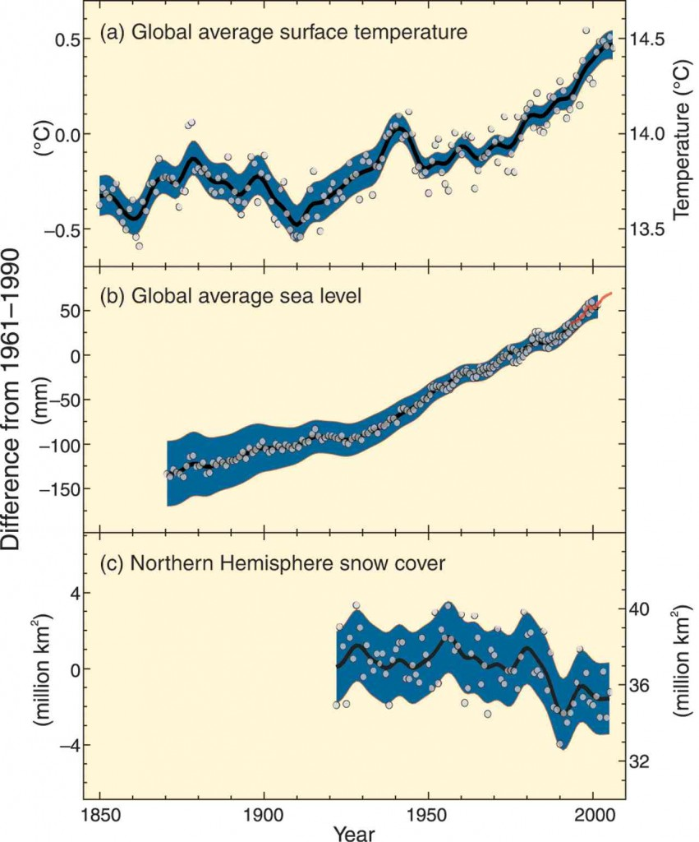
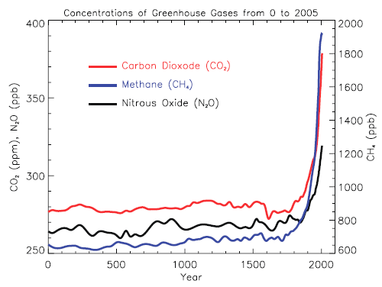
Impacts
The surface temparature increased 0.8 ºC since 1950s.
Global sea level rise was found to be 17.5 cm.
Glacier decrease in the northern hemisphere was around 7.5%.
Greenhouse emissions increased by 25-170%.
IPPC, 2007
Yildiz Technical University Dept. of Env. Engineering

Slide 6
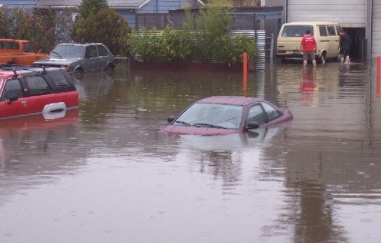
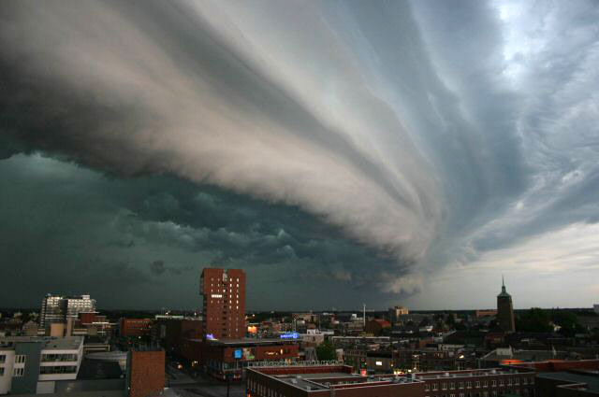
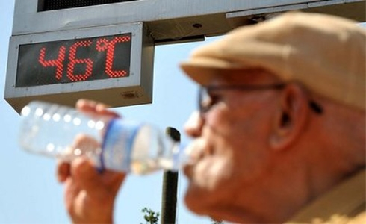
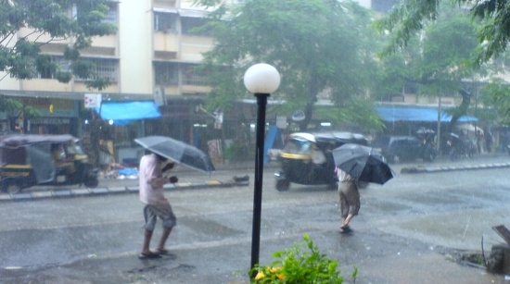
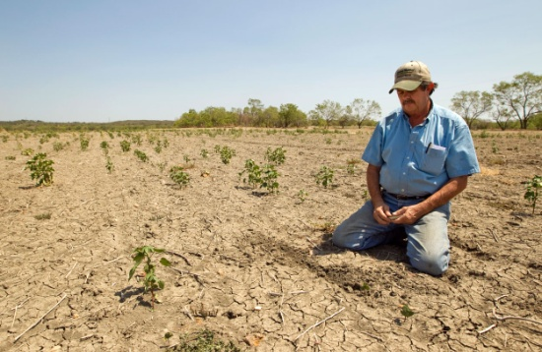
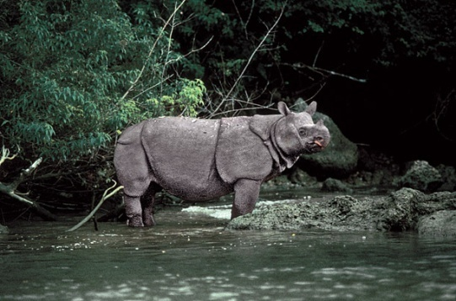
Results
Unexpected and destructive meteorological events
Decrease in water resources
Decline in food stocks and rise in food prices
Adverse effects on human health
…
Flooding
Storms
Overtemperature
Excessive precipitations
Droughts
Species extinction
Yildiz Technical University Dept. of Env. Engineering

Slide 7
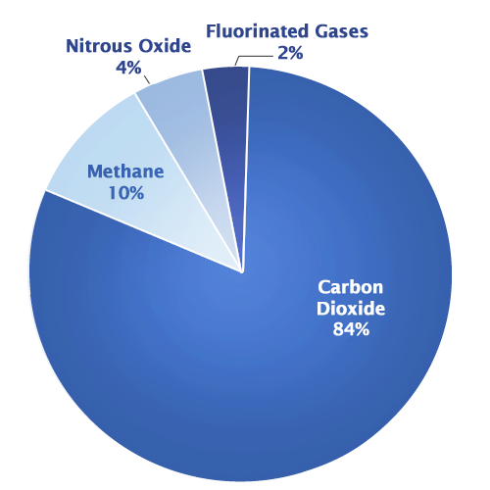
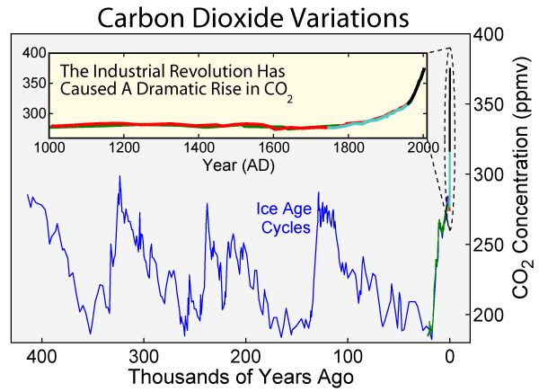
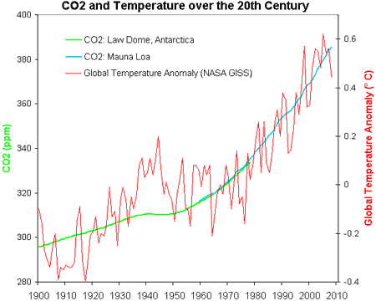
Reason: CO₂ conc. increase
In the last century, the CO₂ concentration increased by 25%.
A relationship was found between the CO₂ concentration increase and global warming.
Kaynak: EPA
Yildiz Technical University Dept. of Env. Engineering

Slide 8
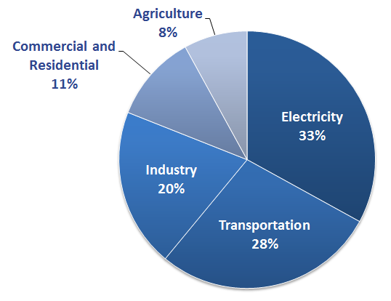
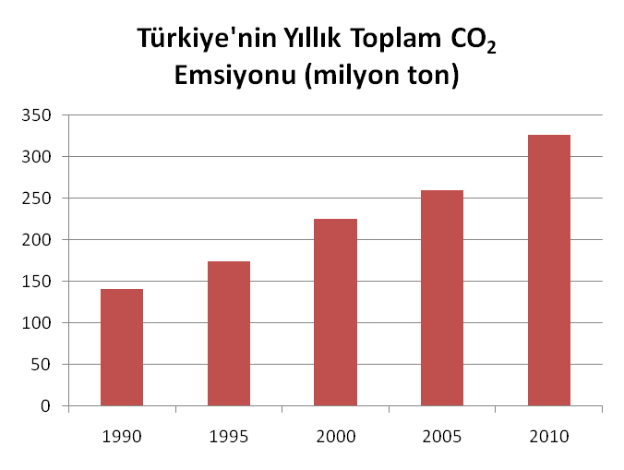
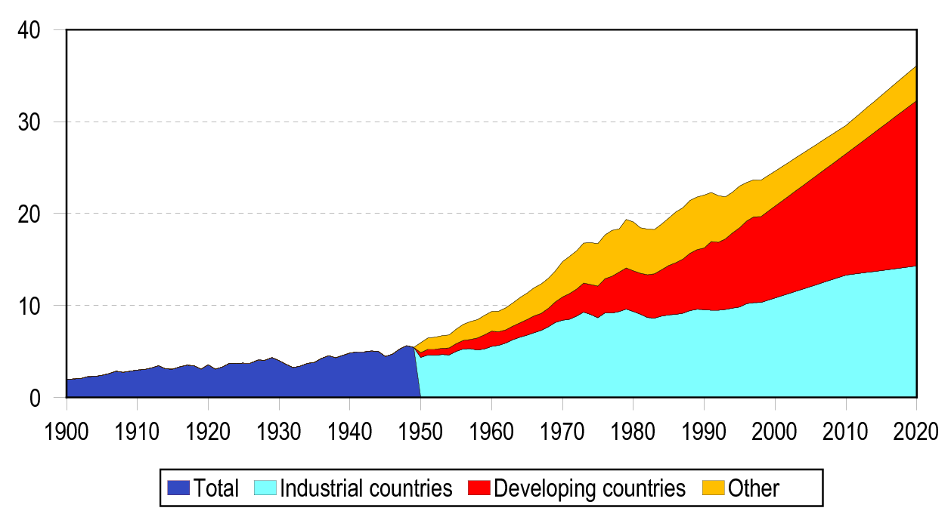
CO₂ emissions
Global CO₂ emissions increase by 2.1% each year (32 billion tonnes/year)
The CO₂ emission of Turkey have increased by 130% in the last 20 years.
Total CO₂ emission produced (%61) comes from energy-transportation sector.
Annual Total CO₂ Emissions - Turkey (million tonnes)
Global CO₂ emissions and projection (billion tonnes)
Yildiz Technical University Dept. of Env. Engineering

Slide 9
Important issue: Uncertainty
The effects of climate change have varying degrees of uncertainty.
Therefore, a thorough and integrated investigation should be considered including
      hydrological,
      climatological,
      socio-economical dimensions
to determine
      water scarcity,
      vulnerability of water resources,
      pronounced climatic variability
      social stress caused by all these effects.
Yildiz Technical University Dept. of Env. Engineering

Slide 10
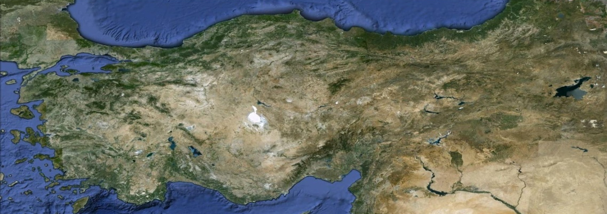
The situation in Turkey
Source: Google Earth
Being surrounded with water on three sides and having a fragmented topographical structure, different regions of Turkey will be affected in different ways and at different degrees.
The increase in temperature would affect semi-arid regions more that are under the threat of desertification and sub-humid regions that do not have adequate water such as the Southeast Anatolia, Central Anatolia, Aegean and Mediterranean regions.
These effects will be in the form of reduced regional water supply and increased levels of water demand.
Yildiz Technical University Dept. of Env. Engineering

Slide 11
The situation in Turkey
Source: Google Earth
Metropolitan municipalities have an important mission within their territorial borders to ensure the protection of water basins in harmony with the principle of sustainable development.
Other important legal entities related are:
  the Ministry of Forestry and Water Works
  the Ministry of Environment and Urbanization
  the Ministry of Food, Agriculture and Livestock
These Ministries are responsible for the protection and improvement of the resources of water, soil, plants, animals and fisheries.
Yildiz Technical University Dept. of Env. Engineering

Slide 12
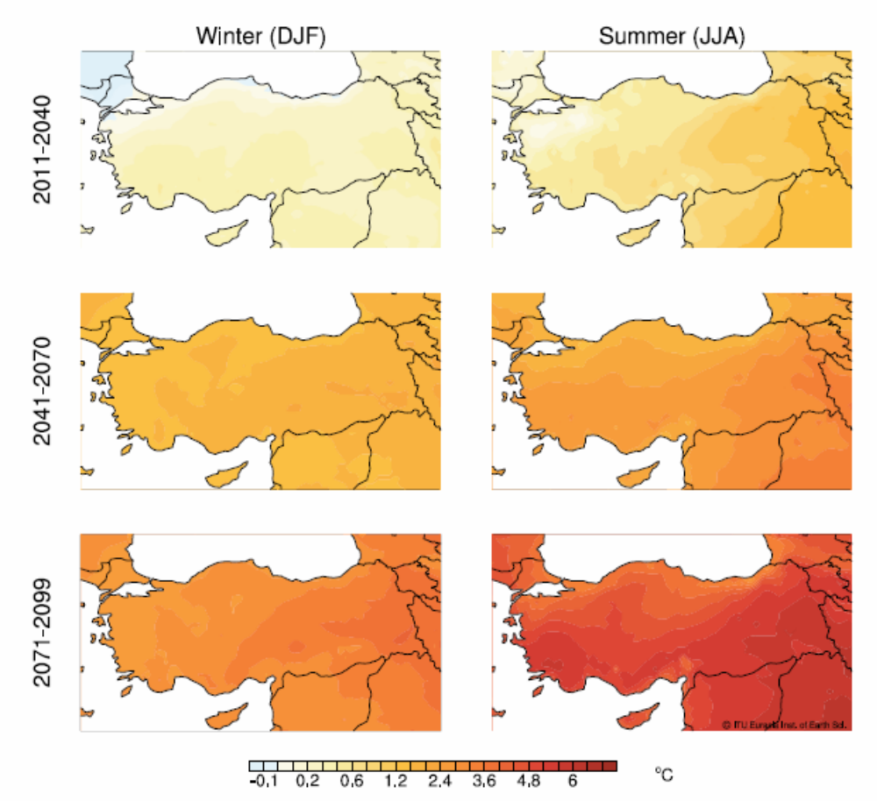
Climate Projections
Changes in Temperature
Yildiz Technical University Dept. of Env. Engineering

Slide 13
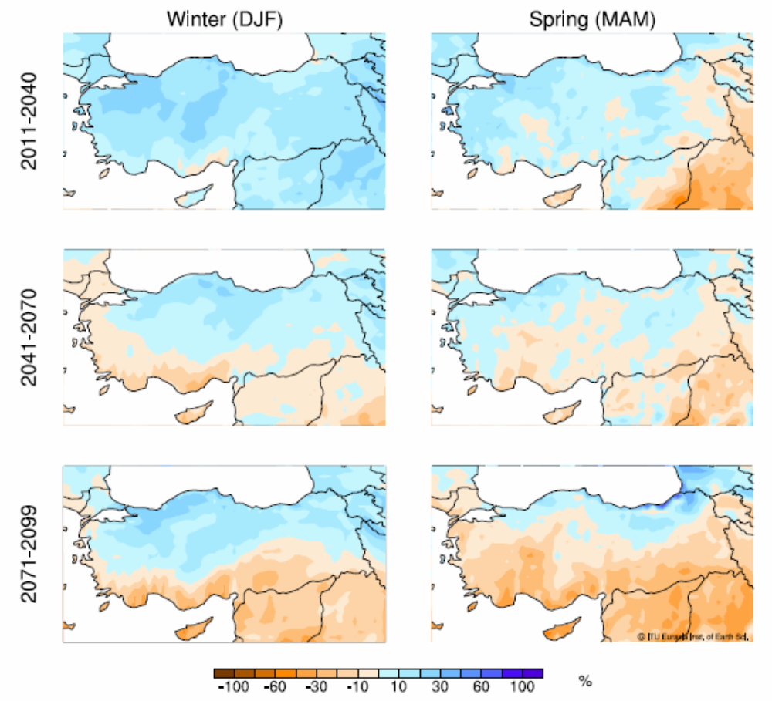
Climate Projections
Changes in Precipitation
Yildiz Technical University Dept. of Env. Engineering

Slide 14
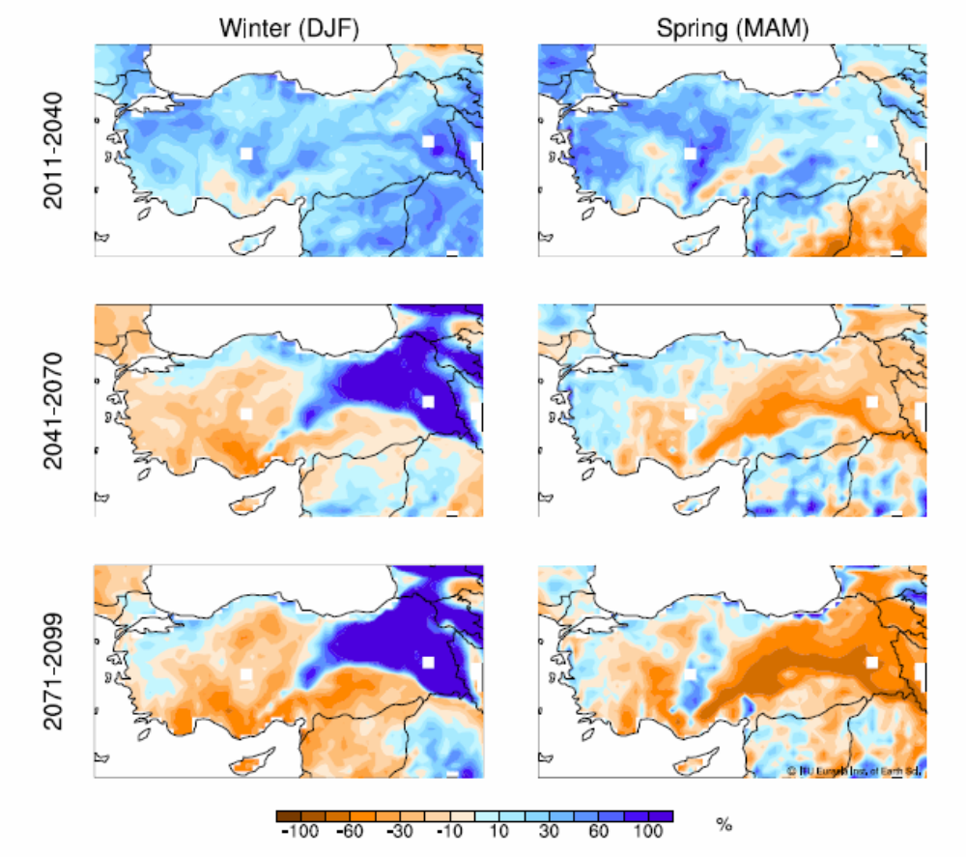
Climate Projections
Changes in surface runoff
Yildiz Technical University Dept. of Env. Engineering

Slide 15
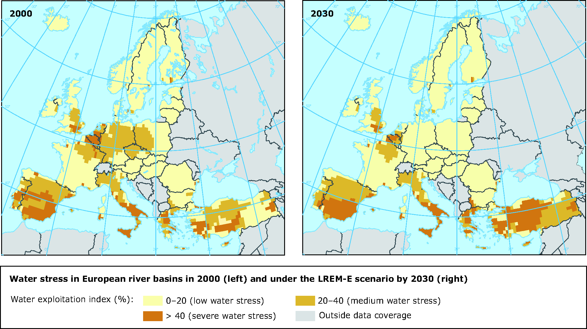
Water Stress in European River Basins
Water stress due to existing growth rate and water consumption trends (Source: EuPA, 2009)
Yildiz Technical University Dept. of Env. Engineering

Slide 16
Studies Conducted in Turkey
Water Scenarios for Neighbouring Countries - EU-FP6 project – Middle East Technical University
The Effects of Climate Change on Euphrates Regimes – Turkish Research Council project – Istanbul Technical University
The Effect of Climate Change on Supply Reliability of the Dam Reservoirs - Turkish Research Council project – Istanbul Technical University
Climate Change Effects on Water Resources of Istanbul – Istanbul Water and Sewarage Administration project
Climate Scenarios for Konya Closed Basin and East Mediteraanean Regions – WWF-Turkey project

Slide 17
Adaptation Studies – Water Resources
Adaptation to CC in Seyhan Basin
DSI (State Water Works) and UNDP
Anatolia Water Basins Rehabilitation
World Bank, and Global Eenvironmental Fund (carried out in 28 micro basins around Anatolia)
Capacity Building for Water Sector
EU – Establisment of Water Framework Directive
Yildiz Technical University Dept. of Env. Engineering

Slide 18
National climate change adaptation strategy & action plans
  National Adaptation Strategy prepared under the coordination of the Ministry of Environment & Urbanization
  5 main sectors:
  Water Resources Management
  Agriculture and Food Security
  Ecosystem Services & Biodiversity
  Disaster Risk Management
  Health
541 Action

Slide 19
National climate change adaptation strategy & action plans
Integrating adaptation to the impacts of climate change into water resource management policies
Strengthening water resources management capacity, interagency cooperation and coordination with regard to adaptation to climate change
Develop and expand R&D and scientific studies to ensure adaptation to the impacts of climate change in water resources management
Integrated management of water resources in water basins for adaptation to climate change
Yildiz Technical University Dept. of Env. Engineering

Slide 20
Climate change impacts on water resources project
Calculation of the water budget and budget deficits in river basins
Analysis of water impacts to sectors
Strategy documentation on adaptation activities tailored for each basin to support decision makers
Yildiz Technical University Dept. of Env. Engineering

Slide 21
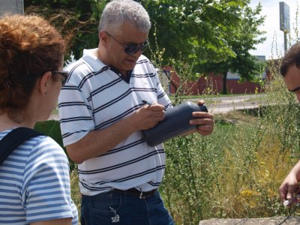
Strategy Development
In the strategy establishment procedure, the first challenge is to collect information and data and to share the information systematically among stakeholders.
gf
For the developing countries, collection of information can be a complex process, as coordination among water sectors is most of the time is not well-established.
The second challenge of strategy establishment is to develop policies that are specifically inclusive of all the water related issues.
One of the most important problems within this second challenge is financing of adaptive measures.
Yildiz Technical University Dept. of Env. Engineering

Slide 22
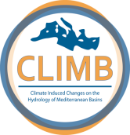
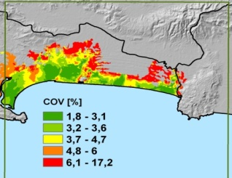
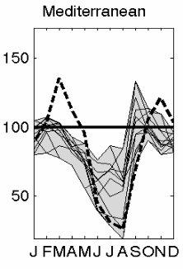
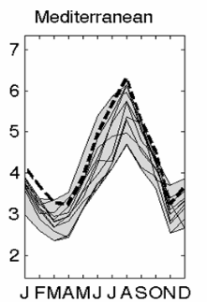
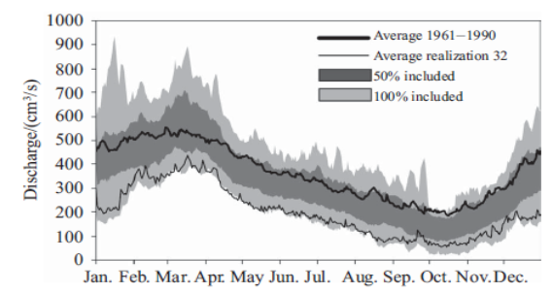

EU Project: CLIMB
FP7-Topic: ENV.2009.1.1.5.2
Funding period: 01/2010 – 12/2013
Project full title: Climate Induced Changes on the Hydrology of Mediterranean Basins – Reducing Uncertainty and Quantifying Risk through an Integrated Monitoring and Modeling System
Co-ordinator: Ludwig-Maximilians-Universität München
Partner countries: Germany, Italy, Austria, France, Tunisia, Turkey, Egypt, Palestinian administered areas, Canada. (9)
Partners: 20
EC contribution: 3.15 Mio €
Climate Change
Scenarios Uncertainty
Hydrological Modelling
Uncertainty
Risk & Vulnerability
Assessment Uncertainty
propagation
propagation
Decision making under
(quantified) uncertainty
Uncertainty reduction
Yildiz Technical University Dept. of Env. Engineering

Slide 23
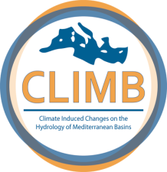
The EU Project CLIMB
Thau – 280 km² - Coastal Lagoon Southern France
Noce – 1367 km²
Southern Alps - Italy
Rio Mannu di San Sperate 473 km² - Sardinia - Italy
Izmit Bay - 2255 km²
Kocaeli - Turkey
Chiba – 286 km²
Cap Bon - Tunisia
Nile Delta – 1000 km²
Nile - Egypt
Gaza Aquifer – 365 km²
Gaza – Palestanian Administrated Area
The study sites, locations and surface areas
Yildiz Technical University Dept. of Env. Engineering

Slide 24
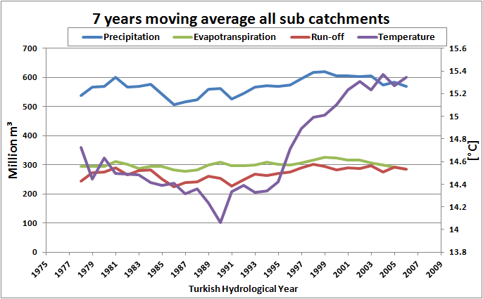

Climate Data
Meteorological data (1975-2010) shows that,
Mean annual temperature is increasing,
Mean annual precipitation in comparatively increasing,
Runoff and Evapotranspiration have no significant change.
Yildiz Technical University Dept. of Env. Engineering

Slide 25
Summary of results
an ensemble of 4 regional climate models has been applied to drive the hydrological models PROMET and mGROWA.
based on these simulation setups which comprise two hydrological periods from 1971-2000 (reference period) and 2041-2070 (future period) respectively, a bandwidth of possible future development paths of the regional water balance was determined.
increasing precipitation during the winter months
decreasing precipitation during the summer months
groundwater recharge within the hydrological winter half year seems to remain stable
extensive depletion of the soil water storage
increasing irrigation demand on agricultural land
pronounced change in sea level rise after year 2050.
Yildiz Technical University Dept. of Env. Engineering

Slide 26
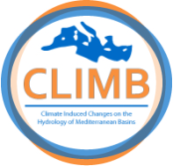
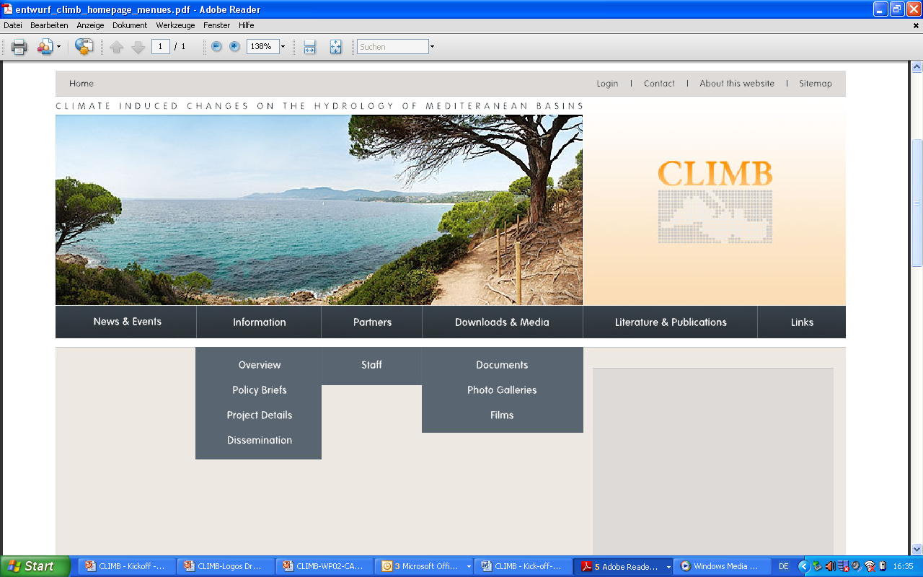
The EU Project CLIMB
www.climb-fp7.eu
Yildiz Technical University Dept. of Env. Engineering

Slide 27
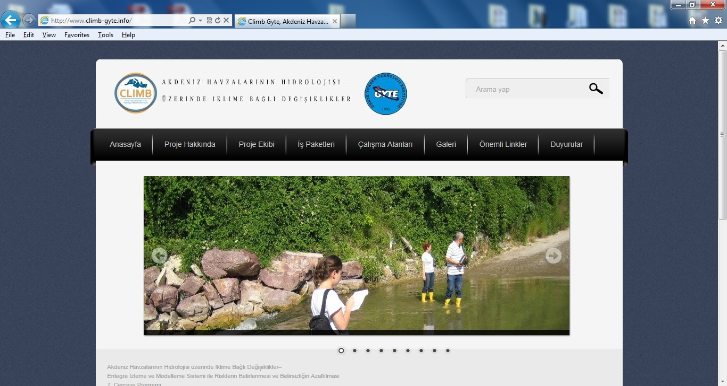
http://www.climb-gyte.info
Yildiz Technical University Dept. of Env. Engineering

Slide 28
Last words…
The pressure on water resources is ever increasing with overgrowing population and climate change, especially in the arid and semi arid regions. This calls for new approaches and strategies in water planning and management.
Existing uncertainties in climate change impact analysis is another dimension that should be taken into consideration in IWRM strategy development.
Integrated models (including climate and hydrology) should therefore be developed represent climate change conditions at catchment and sub-catchment level.
Regional climate models must be run to reflect different levels of effects. Moreover, the outcome of these scenarios should be supported by accurate data.
Yildiz Technical University Dept. of Env. Engineering

Slide 29

Thank you...

