Slide 1
TEACHING ON DIABETES MELLITUS MANAGEMENT WITH SIMULATION
Gulcan BAKAN, Arife AZAK, Umran OZDEMIR
Pamukkale University Faculty of Health Sciences

Slide 2
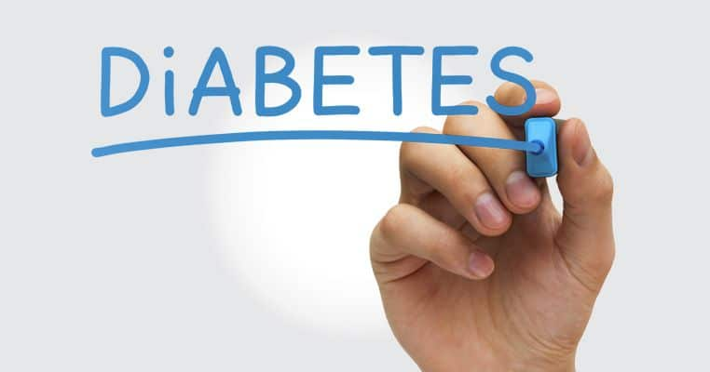
Diabetes mellitus (DM) is characterized by high level of blood glucose resulting from defects in insulin production, insulin action, or both.

Slide 3
INTRODUCTION
Diabetes is one of the largest global health emergencies of the 21st century
It is among the top 10 causes of death globally
Refence: International Diabetes Federation. IDF DIABETES ATLAS Eight Edition 2017

Slide 4
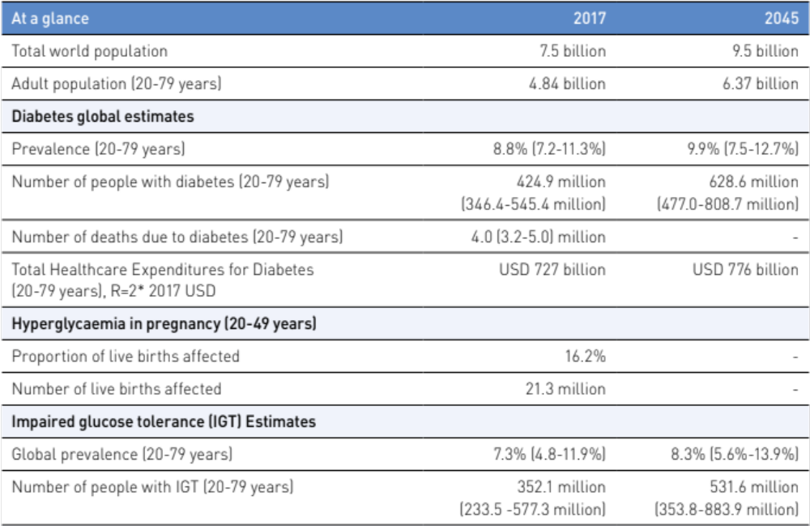
Prevalence of Diabetes (20-79 years) by IDF, 2017 and 2045
Refence: International Diabetes Federation. IDF DIABETES ATLAS Eight Edition 2017

Slide 5
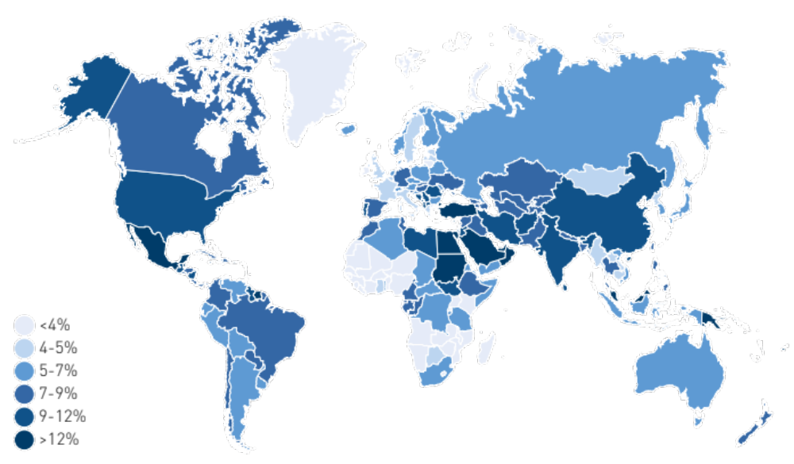
Estimated Total Number of Adults (20-79 years) Living with Diabetes, 2017
According to study of Turkey Diabetes Epidemiology (TURDEP-II) , the rate of type 2 diabetes in Turkish adults was found to be 13.7%
(Reference: Satman İ. TURDEP-II Results 2011 )
Refence: International Diabetes Federation. IDF DIABETES ATLAS Eight Edition 2017

Slide 6
INTRODUCTION
An interdisciplinary and multidisciplinary team approach should be used in diabetes management
Nurses have a vital role in the diabetes team
In traditional nursing education system, it is not possible for students to gain cognitive, affective and psycho-motor skills only by observing clinical practice
Notes:
which enable the student to participate actively in the learning process
Diyabetin yönetiminde interdisipliner ve multidisipliner ekip yaklaşımı uygulanmalıdır
Hemşireler diyabet ekibinde önemli bir role sahiptir
Hemşirelik öğrencilerinin, mezuniyet sonrası dönemde diyabetes mellitus yönetiminde bilişsel, duyuşsal ve psiko-motor beceriler açısından çok boyutlu becerilerini sergilemeleri beklenmektedir
Günümüzde geleneksel eğitim yöntemleri ile eğitim alan öğrencilerin, yanlızca klinik uygulamada gözlem yaparak bu becerileri kazanmaları mümkün olmamaktadır.

Slide 7
INTRODUCTION
Therefore, interactive methods like simulation should be used in nursing education
Simulation is a practice of imitating real life situations, events or conditions and it helps to improve patient care and provides patient security

Slide 8
INTRODUCTION
Simulation-based education (SBE) improves;
the linkage between theory and clinic,
the use of decision making,
critical thinking,
self-confidence
therapeutic communication in nursing education
Reference: Foronda C., Liu S., Bauman E.B. (2013). Evaluation of Simulation in Undergraduate Nurse Education: An Integrative Review. Clinical Simulation in Nursing 9, e409-e416

Slide 9
INTRODUCTION
Since 2003, the use of simulations has been supported by the National Nurses Association in the United States to prepare students for a complex clinical environment
The International Nursing Association for Clinical Simulation and Learning (INACSL) Standards Committee prepared the standards for best SBE
Reference: International Nursing Association for Clinical Simulation and Learning (INACSL) Standards 2016

Slide 10
INACSL Standards
Needs assessment
Measurable objectives
Format of simulation
Clinical scenario or case
Fidelity
Facilitator/Facilitative approach
Briefing
Debriefing and/or feedback
Evaluation
Participant preparation
Pilot test
Reference: International Nursing Association for Clinical Simulation and Learning (INACSL) Standards 2016

Slide 11
AIM
In this study, it was aimed
to test DM simulation method by preparing according to the Standards of Best Practice: Simulation Design IX (SBP:SD-IX)
to evaluate the success of the students who have taken the lesson of internal medicine nursing by using simulation-based training of DM

Slide 12
Methodology
This study was planned in a methodological type
214 students who took Internal Medicine Nursing class during the school year 2016-2017 formed the population and sampling
It was completed by 169 students
Student's opinions, final grade and skills checklist score were used to evaluate the research results

Slide 13
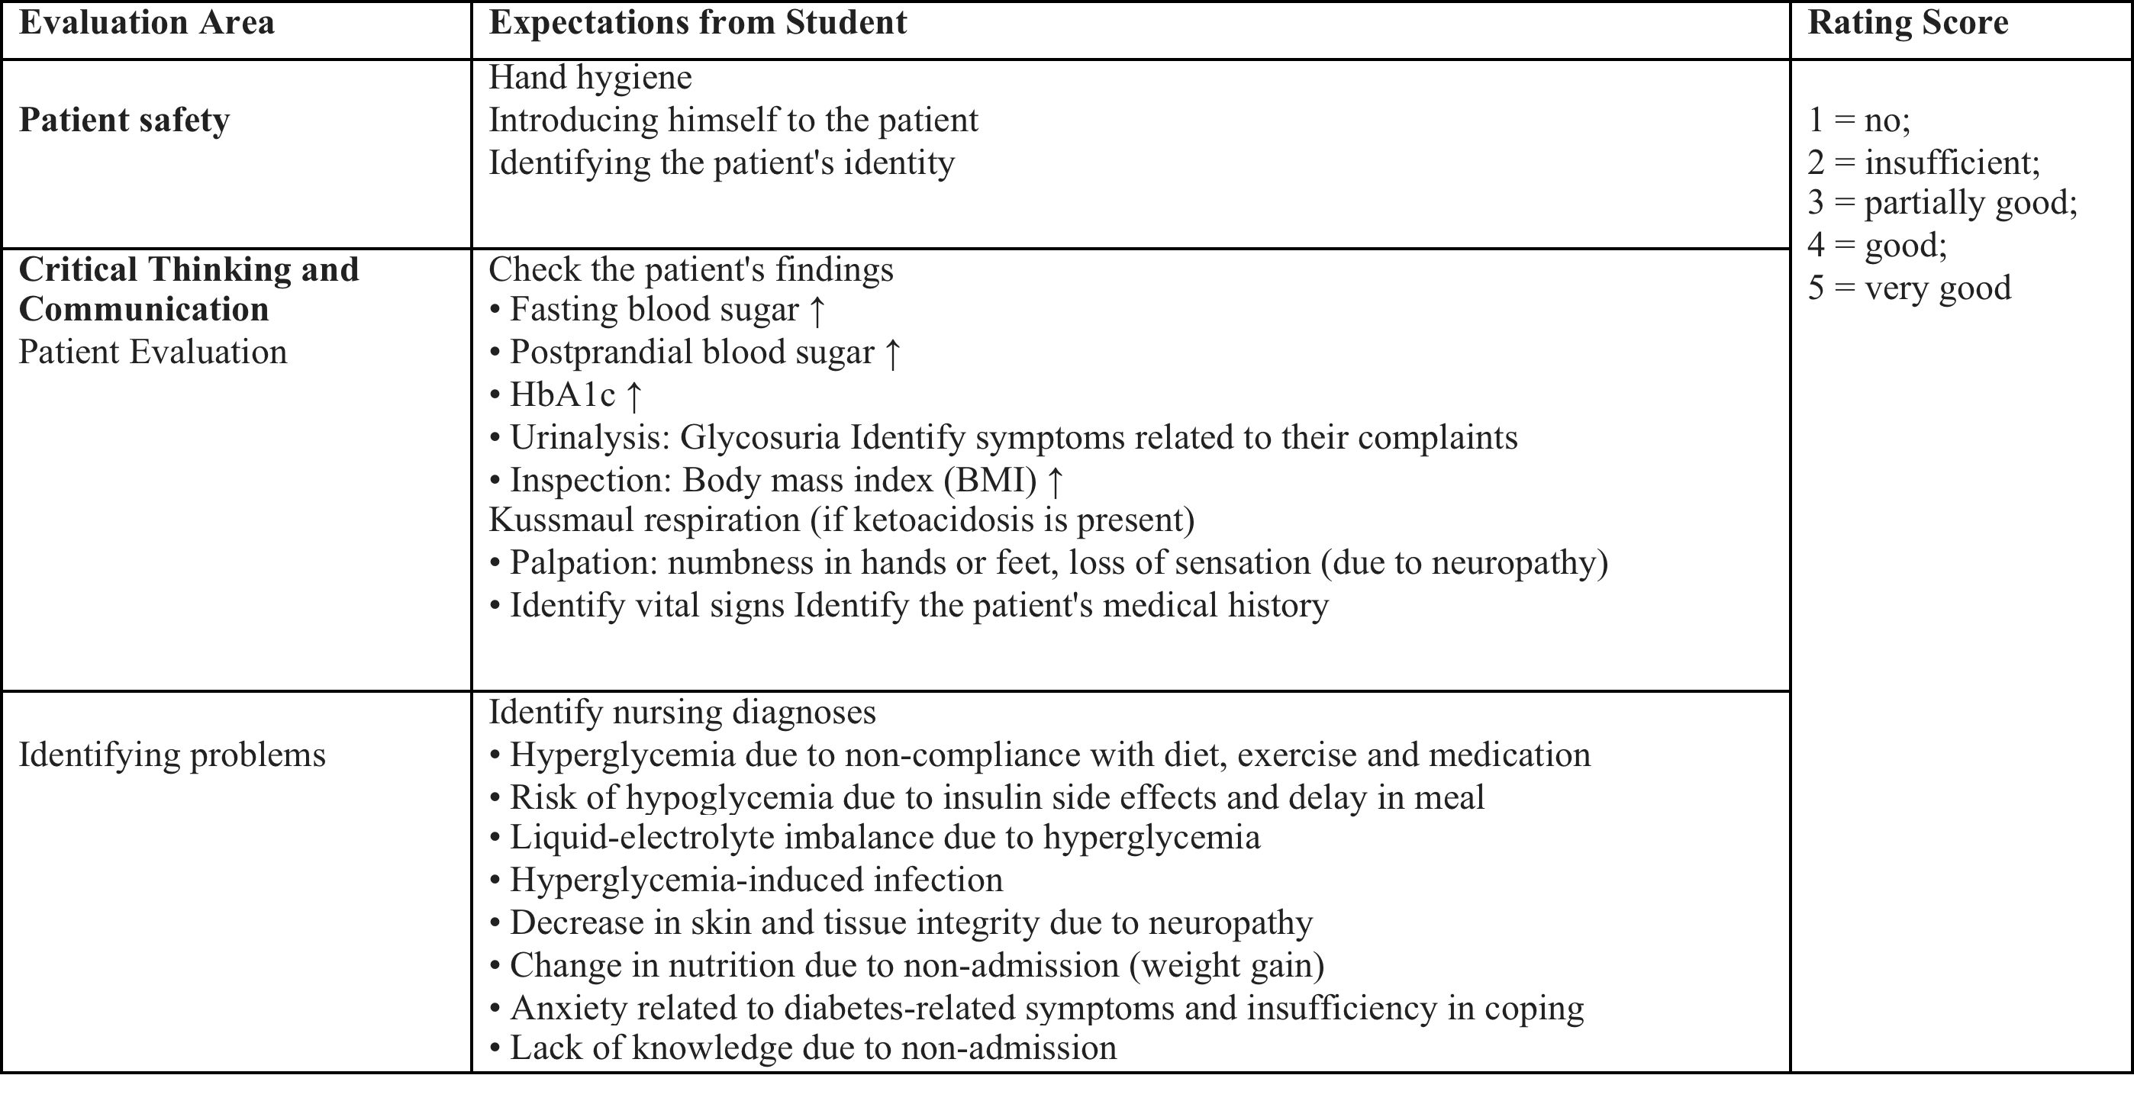
Table I. Skills Checklist for DM Management

Slide 14
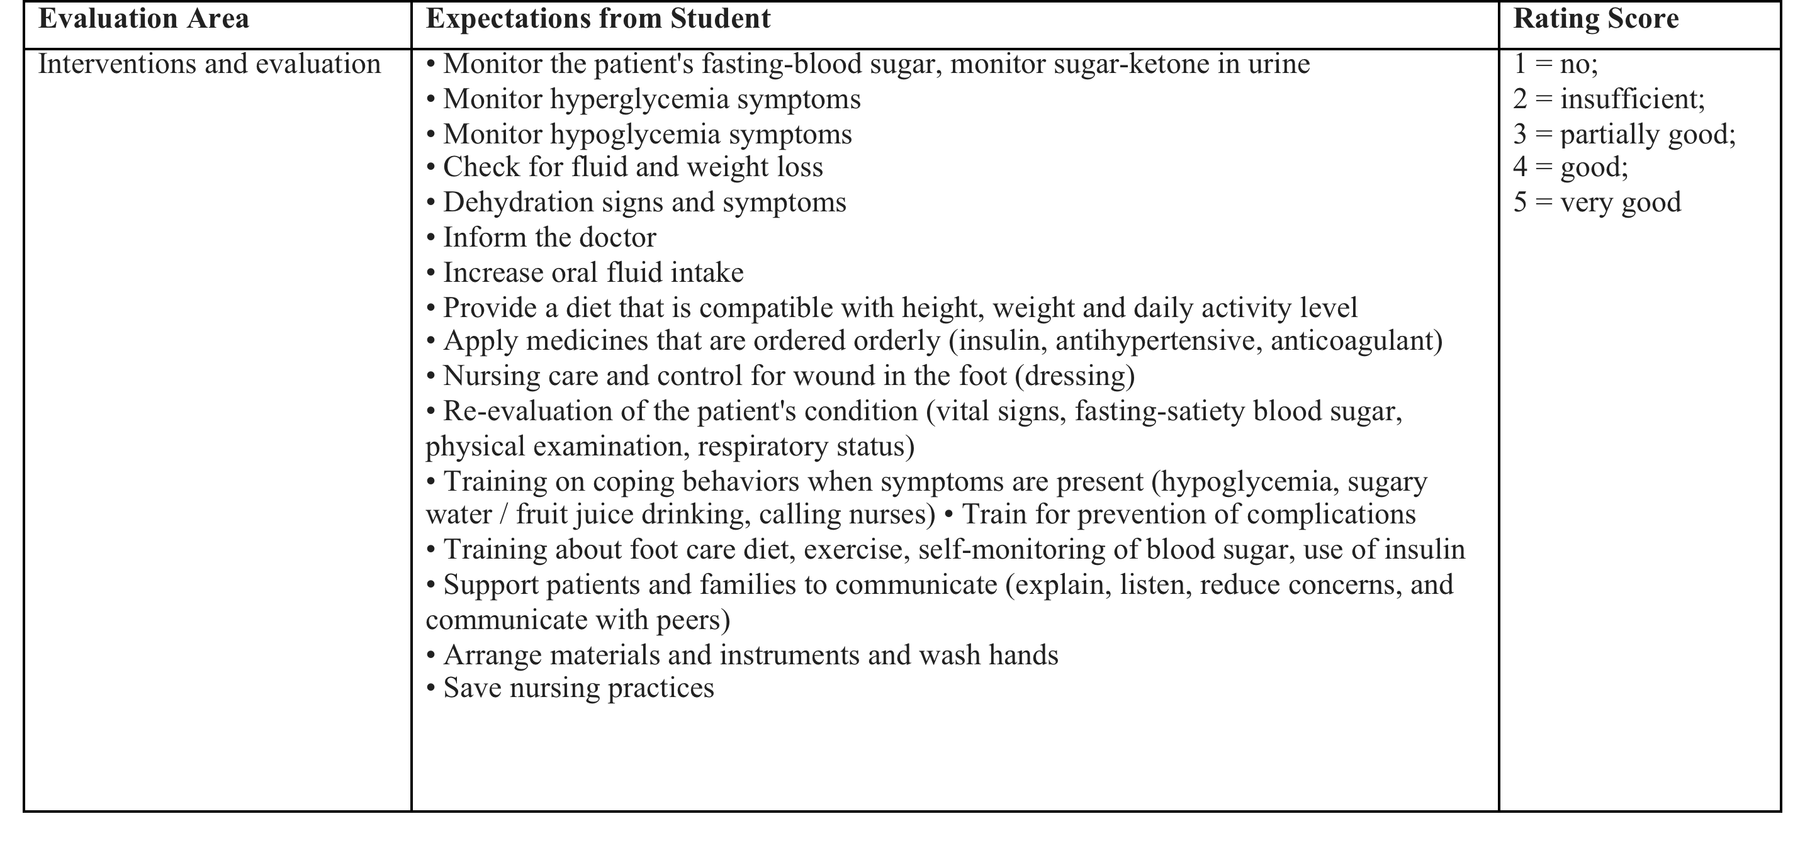
Table I. Skills Checklist for DM Management

Slide 15
Methodology
Students were separated into 32 groups of 5 and 6 students
Simulation training was applied alternatively in the management of an educator

Slide 16
Methodology
A standardized patient simulation method was used to form the simulation scenario
In this simulation method, a simile patient role is being played by a selected and trained student

Slide 17
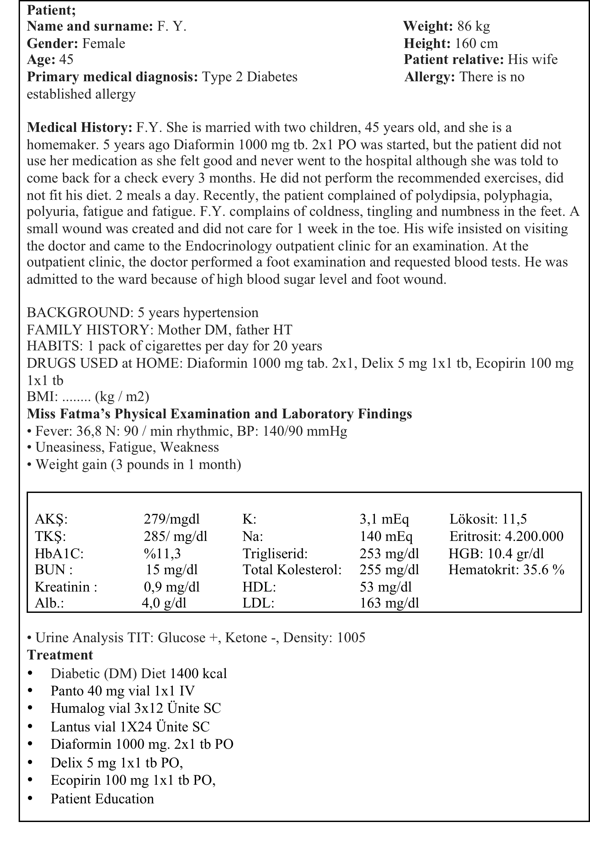
Methodology
In the simulation process, students were given a scenario
A brief information was explained about the case
Table II. Scenario

Slide 18
Methodology
Expectations about the scenario were shared with the students;
Doing the physical examination of the patient,
Explanation of laboratory findings,
Application of drugs in the treatment,
Doing nursing practices for management of DM in order of priority,
Evaluating the results of nursing care given to the patient,
Recording all the interventions

Slide 19
Methodology
The following additional resources were proposed to the students
They were asked to be prepared before the simulation
Books:
Akdemir N., Birol L., İç Hastalıkları ve Hemşirelik Bakımı, Sistem Ofset, Ankara, 3. Baskı, Eylül-2011
Durna Z., Akın S., Özdilli K., Ed.: Durna Z., İç Hastalıkları Hemşireliği Uygulama Rehberi, Nobel Tıp Kitebevleri, 2. Baskı, İstanbul, Eylül 2011
Articles:
Bulucu-Böyüksoy GD., Demi̇r G., Durmuş H. Daziroğlu N. (2016) Tip II Diyabetli Hastaya Klinikte Bütüncül Yaklaşımla Sunulan Hemşirelik Bakımı: Olgu Sunumu, Hacettepe Üniversitesi Hemşirelik Fakültesi Dergisi, 3(3), 77-82
Özdemir Alkanat H. (2015) Diyabetik Ayak Bakımı Ve Korunma, TOTBİD Dergisi, 14:470–474
Internet sources:
http://www.turkendokrin.org/files/DIYABET2017_web.pdf
http://www.tdhd.org/
http://www.turkdiab.org/
Videos:
Blood sugar measurement and insulin injection application.https://www.youtube.com/watch?v=pBhIa-msF30
Insulin pen.https://www.youtube.com/watch?v=T8mYybrvxQI

Slide 20
LIMITATIONS
Because of the financial limitations, the patient role in the simulation scenario was not played by a professional actor
The students taking the internal medicine course have been trained and played the role of the patient

Slide 21
RESULTS and DISCUSSION
30.2% of the participants were male and 69.8% were females
DM simulation grade-point average was found 2,7929 ± 1,05715 with a 5 point Likert scale
The practice grade-point average was 79,3195 ± 7,31386
By the end of the term the final grade-point average was 65,2959 ± 8,60482

Slide 22
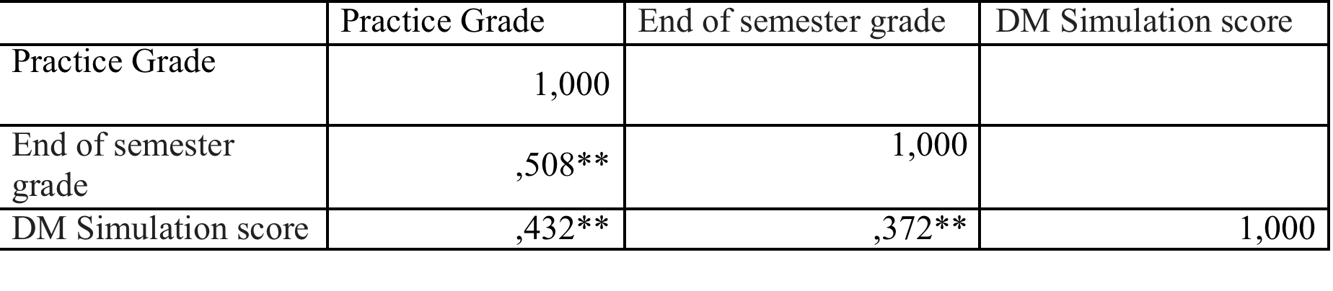
Table III. Relationship between students' practice grade, end-of-term grade and DM simulation score (n=169)
When we look at correlation, there is a moderate correlation in the positive direction
As the DM simulation scores increase, the practice grade and the end-of-term grade increase

Slide 23
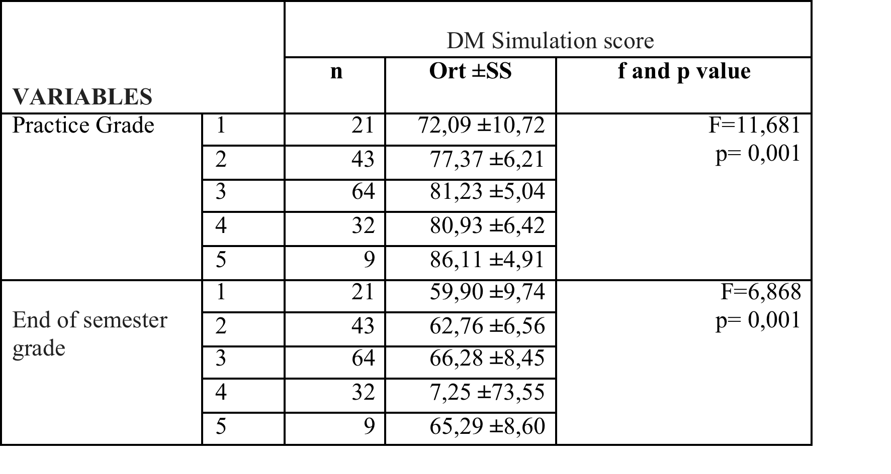
Table IV. Comparison of simulation score of students according to the end-of-term grade and practice grade (n = 169)
It was determined that the difference was caused by two groups taking 1 and 2 points
It was found that the students who had low simulation score had low practice grade and final grade

Slide 24
RESULTS and DISCUSSION
In our study, students' opinions about simulation;
‘I got rid of concern before the internship’
‘I learned to interpret the disease’
‘Very enjoyable and instructive’
‘I adapted to the hospital more quickly’

Slide 25
RESULTS and DISCUSSION
In recent years, the number of studies to evaluate the simulation results are limited although simulation began to be used widely in Turkey
There are no simulation based training studies about care of patients with diabetes mellitus in the literature
In this study, an example of assisting the students to transfer their theoretical knowledge to the practice during the intervention to the patients with diabetes mellitus is presented

Slide 26
RESULTS and DISCUSSION
In our study, it was determined that the simulation method was designed in accordance with SBP:SD-IX prepared by INACSL
increased the practice grades and end-of-semester grades
increased their confidence according to the student expressions
reduced pre-clinical concerns
was effective in learning

Slide 27
RESULTS and DISCUSSION
In the review studies, the simulation provided the students with knowledge and skills, critical thinking, self efficacy and self-confidence
In a study, a simulation palliative care training, increases communication skills of students and it is a low cost method in skill development
Reference: D‘Souza M.S., Arjunan P., Venkatesaperumal R. (2017). High Fidelity Simulation in Nursing Education, International Journal of Health Sciences and Research, 7(7), 340-353
Reference: Sarabia-Cobo C.M., Alconero-Camarero A.R., Lavín-Alconero L., Ibáñez-Rementería I. (2016). Assessment of a learning intervention in palliative care based on clinical simulations for nursing students, Nurse Education Today, 45 219–224

Slide 28
RESULTS and DISCUSSION
In conclusion, the use of the simulation-based training in nursing education increases the students' clinical practice achievements
Students can evaluate proper clinical problems and plan nursing care

Slide 29
REFERENCES
Cantrell M.A. (2008). The importance of debriefing in clinical simulations. Clinical Simulation in Nursing, 4(2), e19-e23. doi:10.1016/j.ecns.2008 .06.006
Chronister C., Brown D. (2012). Comparison of simulation debriefing methods. Clinical Simulation in Nursing; 8(7):281-88.
D‘Souza M.S., Arjunan P., Venkatesaperumal R. (2017). High Fidelity Simulation in Nursing Education, International Journal of Health Sciences and Research, 7(7), 340-353
Dobbs C., Sweitzer V., Jeffries P. (2006). Testing Simulation Design Features using an Insulin Management Simulation in Nursing Education. Clinical Simulation in Nursing Education 2, e17-e22.doi:10.1016/j.ecns.2009.05.012
Foronda C., Liu S., Bauman E.B. (2013). Evaluation of Simulation in Undergraduate Nurse Education: An Integrative Review. Clinical Simulation in Nursing 9, e409-e416.https://doi.org/10.1016/j.ecns.2012.11.003
Fowler-Durham C., Alden K. (2008). Enhancing patient safety in nursing education through patient simulation. Hughes, RG. (Ed.). Patient Safety and Quality: An Evidence-Based Handbook for Nurses, Rockville MD., US, Vol. 3:221-225.
International Diabetes Federation. IDF DIABETES ATLAS Eight Edition 2017. Available at: http://www.idf.org/. Date of access: 15 September 2018.
International Nursing Association for Clinical Simulation and Learning (INACSL). (2016). Repository of instruments used in simulation research. Retrieved from http://www.inacsl.org/i4a/pages/index.cfm?pageid1⁄43297.
Lee UJ., Jeong H.C., Kang K.A., Kim Y.J., Lee M. (2015). Development of a Simulation Scenario and Evaluation Checklist For Patients With Asthma In Emergency Care, Cin: Computers, Informatics, Nursing, 33(12), 546–554
Liani B., Alinier G. (2015). Standards of best practice: Simulation standard IX: Simulation design. Clinical Simulation in Nursing;11(6):309-15.
Limoges J. (2010). An exploration of ruling relations and how they organize and regulate nursing education in the high-fidelity patient simulation laboratory. Nursing İnquiry;17(1): 57-63.
Sarabia-Cobo C.M., Alconero-Camarero A.R., Lavín-Alconero L., Ibáñez-Rementería I. (2016). Assessment of a learning intervention in palliative care based on clinical simulations for nursing students, Nurse Education Today, 45 219–224
Satman İ. TURDEP-II Sonuçları. Available at: http://www. turkendokrin.org/ files/file/ TURDEP_II_2011. pdf. Erişim Tarihi 16 Ocak 2018.
Sperl-Hillen et al., (2013). Using Simulation Technology to Teach Diabetes Care Management Skills to Resident Physicians, Journal of Diabetes Science and Technology, 7,(5), 1243-1254

