Slide 1
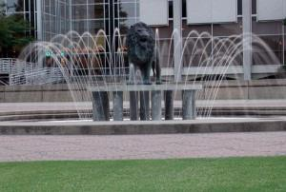
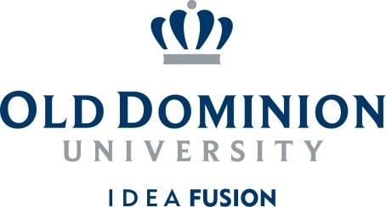
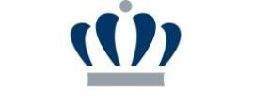
Design, Synthesis and
Characterization of Glycolipids and
Glycoclusters as Molecular Gelators
Guijun Wang, Ph.D. Professor
Department of Chemistry and Biochemistry, Old Dominion University, 4541 Hampton Boulevard, Norfolk, VA 23529-
0126, g1wang@odu.edu, 757 683-3781
1

Slide 2
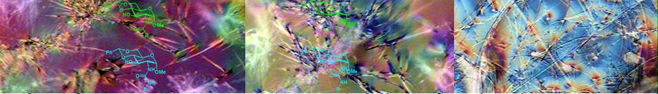
What are Molecular Gelators?
Glycolipids and Other Carbohydrate Based Self-
Assembling Systems
D-Glucose based molecular gelators
D-Glucosamine derivatives
Photo-responsive functional gelators
Other studies of glycoconjugates
Conclusions and Future Studies

Slide 3
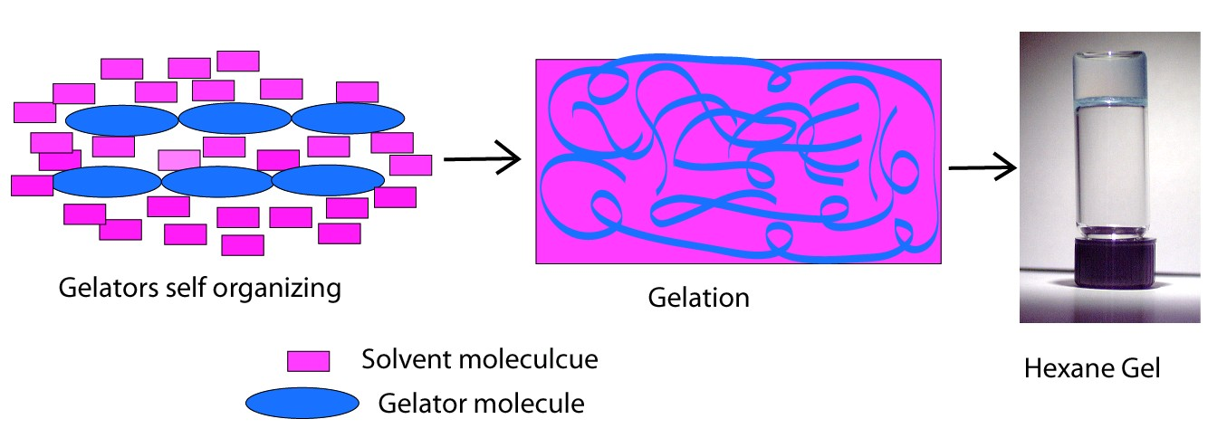
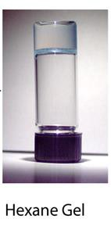
Low Molecular Weight Gelators (LMWGs)
A class of small molecules that can form gels in organic solvents
or water, MW typically <1000.
The driving forces are non-covalent forces such as hydrogen bonding, π-π stacking and van der Waals interactions.
Preparations: dissolve compound (gelator) in a solvent, heat and/or sonicate to solution, leave at rt for 15 minutes.

Slide 4
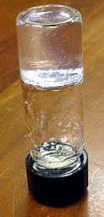
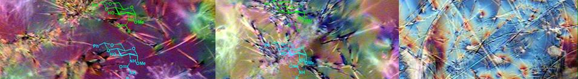
Carbohydrate Based Molecular Gelators
Gels of biological and natural product origins are
materials with potential biomedical applications.
Hydrogelators can produce scaffolds for tissue engineering, drug delivery carriers, protein immobilization and separation.
Carbohydrate based hydrogelators have intrinsic chirality, and the hydrogels thus formed are biocompatible and biodegradable

Slide 5
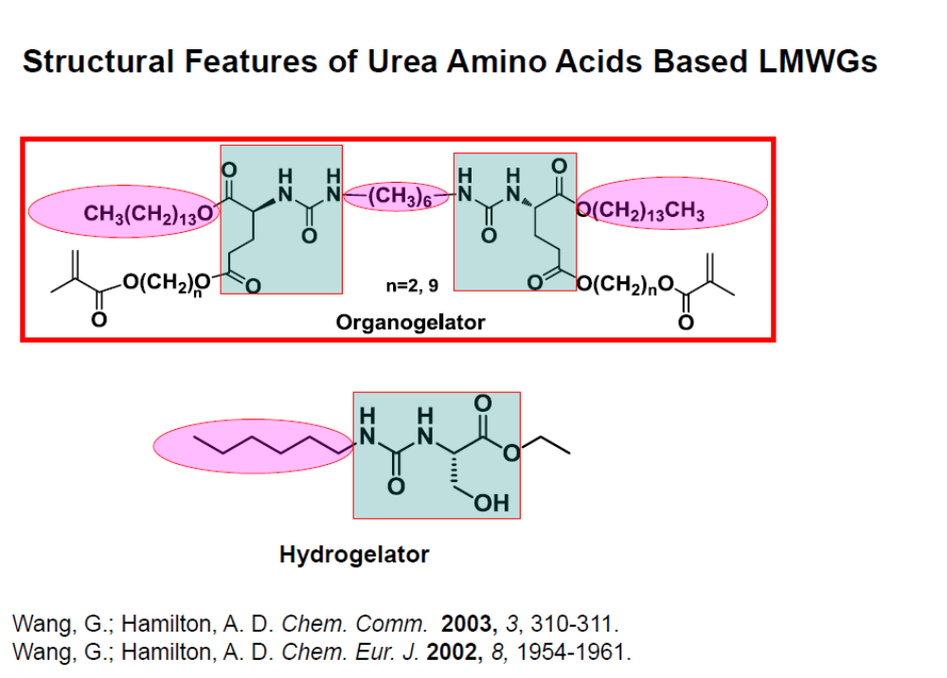

Slide 6
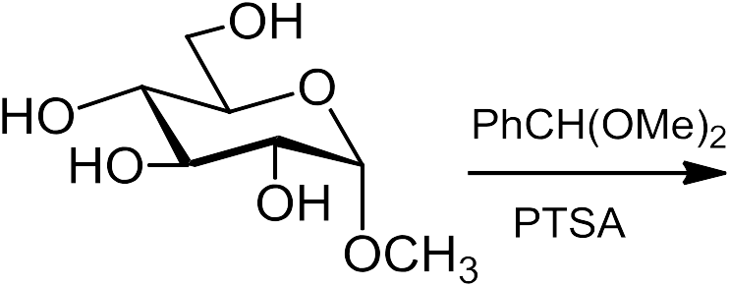
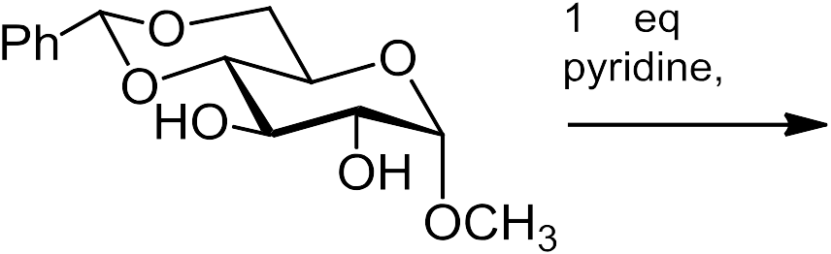
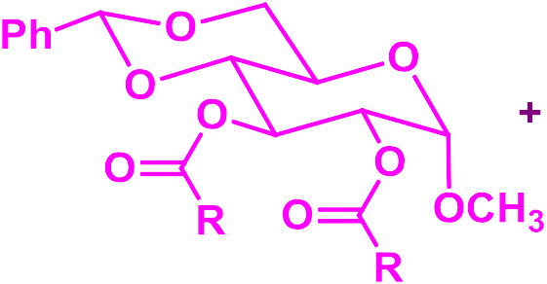
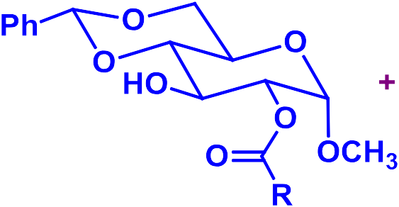
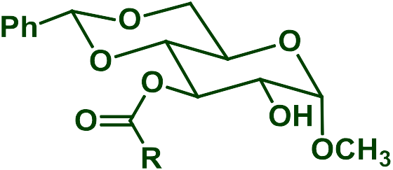
1. D-Glucose Based LMWGs: Esters and
Carbamates
R = alkyl, aryl, total 68 compounds synthesized and tested

Slide 7
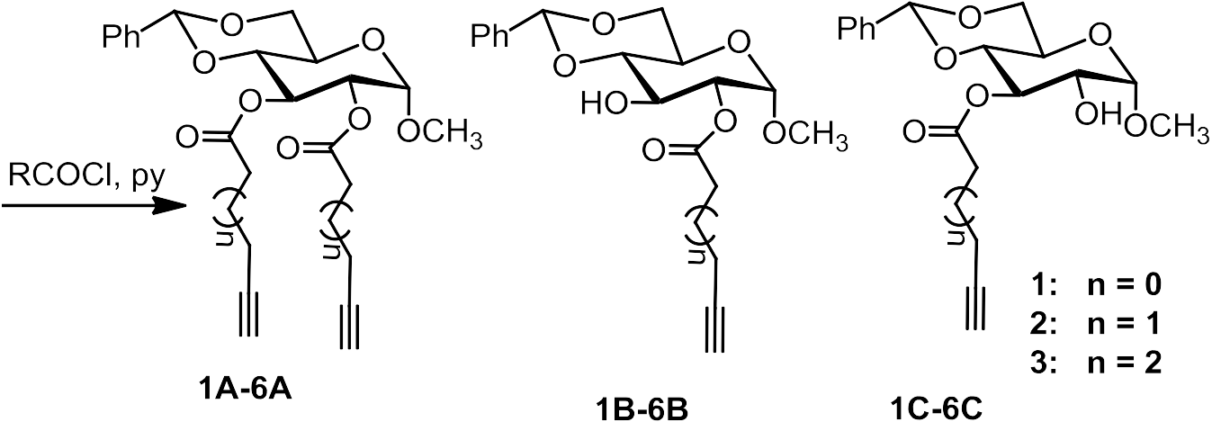
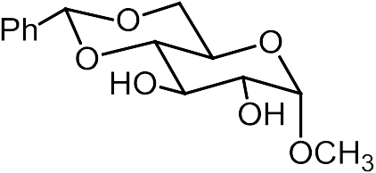

D-Glucose Derived Esters as Hydrogelators and Organogelators
A: form gels in hexane and ethanol B: form gels in hexane and water C: form gels in hexane and water
Wang, G.; Sharma, V.; Cheuk, S.; Williams, K.; Dakessian, L.; Thorton, Z.
Carbohydrate Res. 2006, 341, 705-716.

Slide 8
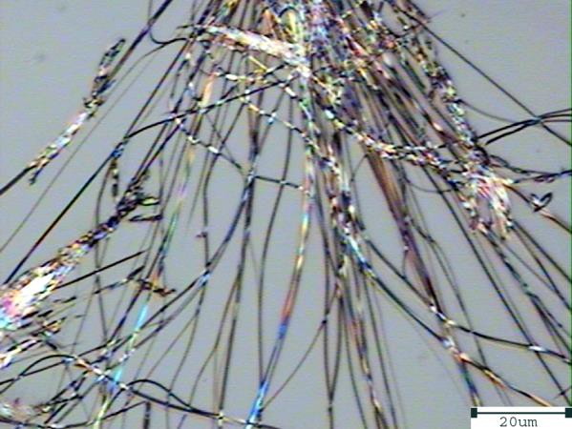
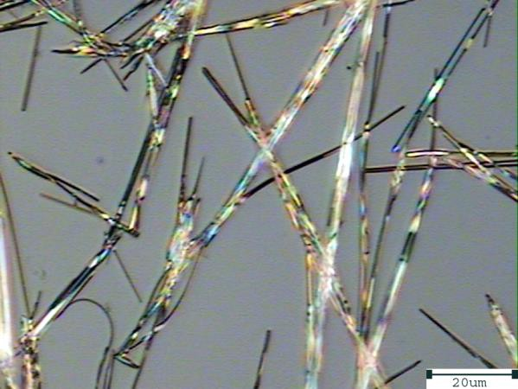
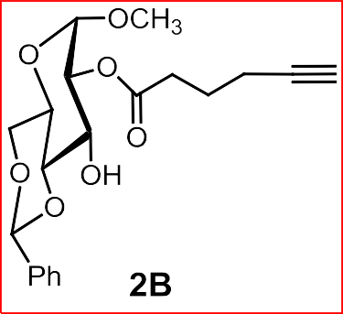
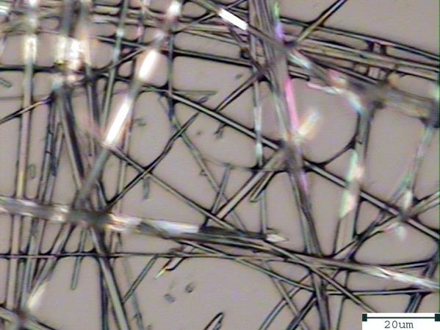
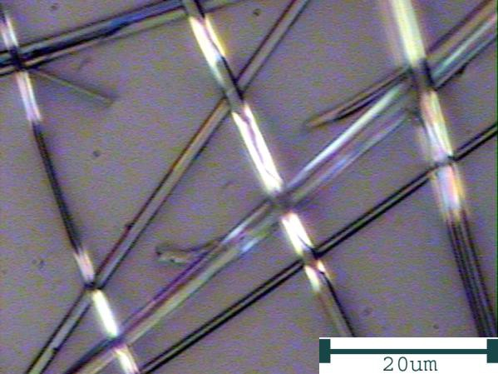
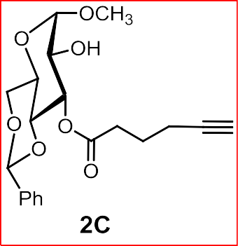
Optical Micrographs of the Gels in Water and Hexane
water
2B, 10mg/mL
2C, 10mg/mL
hexane
2C, 5 mg/mL 2C, 5 mg/mL
Wang, G.; Sharma, V.; Cheuk, S.; Williams, K.; Dakessian, L.; Thorton, Z.
Carbohydrate Res. 2006, 341, 705-716.

Slide 9
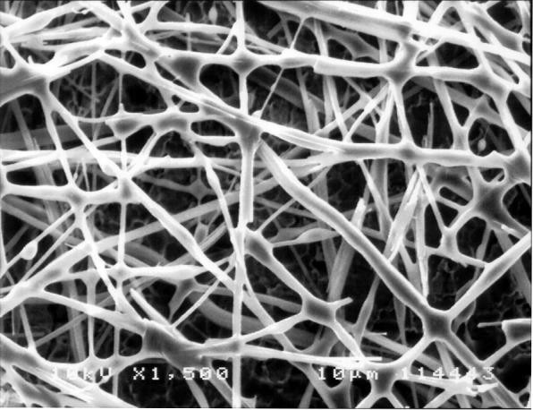
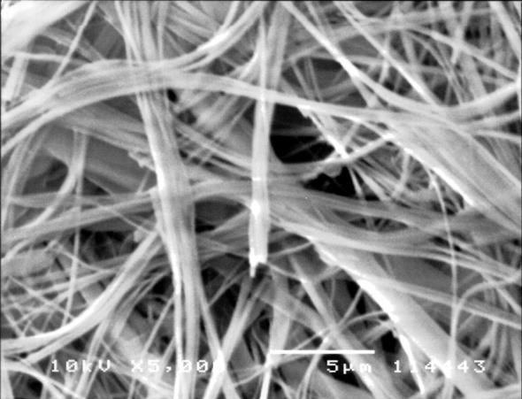
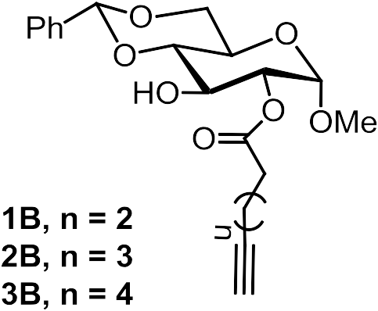
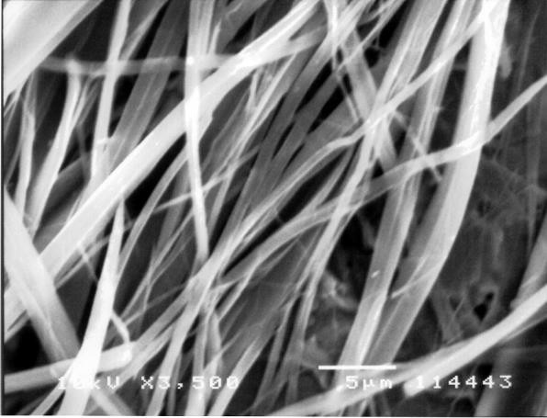
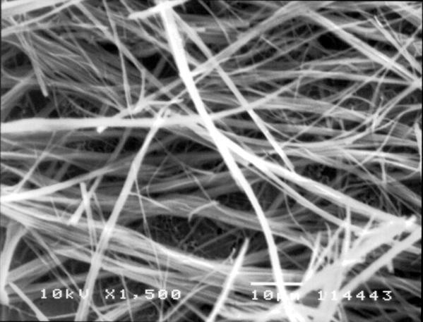
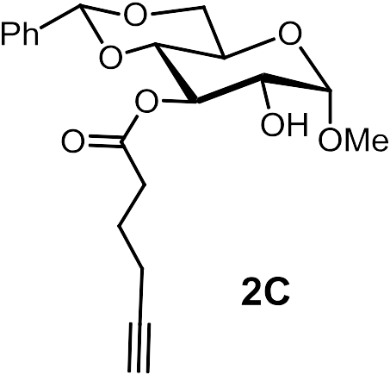
Scanning Electron Micrographs of the Hydrogels.
1B 5 mg/mL
2B 10 mg/mL
3B 10 mg/mL 2C 10 mg/mL
Wang, G.; Sharma, V.; Cheuk, S.; Williams, K.; Dakessian, L.; Thorton, Z.
Carbohydrate Res. 2006, 341, 705-716.

Slide 10
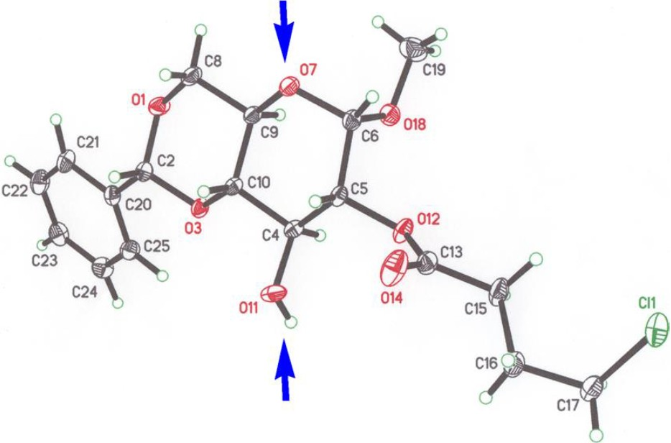
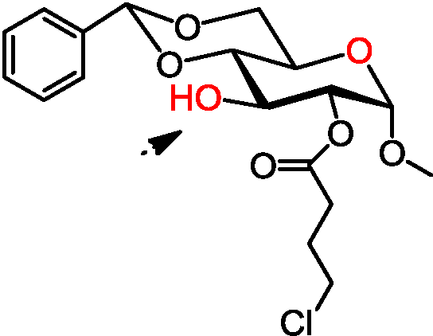

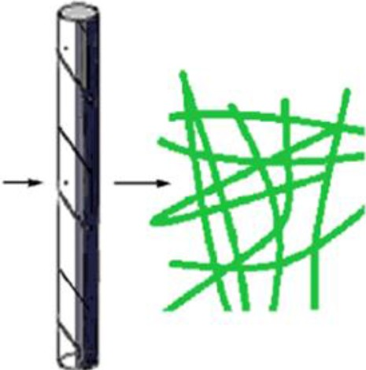
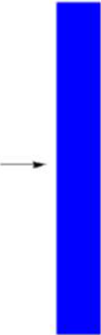
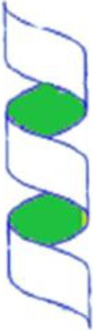
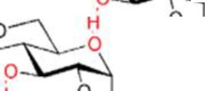

X-Ray Crystal Structure of 4-Chlorobutanoate.
Hydrogen bond acceptor
•
•
'
Hydrogen bond donor
en ⁰ -"]o'' ?fT
O
HO 01° OMe Cl
Cl
OMe
·--
bJS

Slide 11
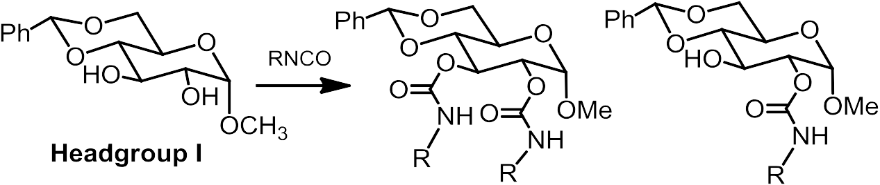
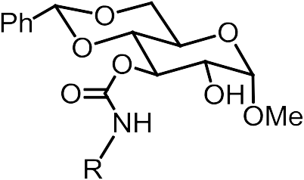

Effect of Additional Hydrogen Bond Donors
Synthesis of O-Linked Carbamates

Slide 12
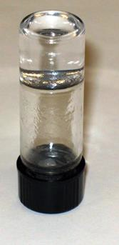
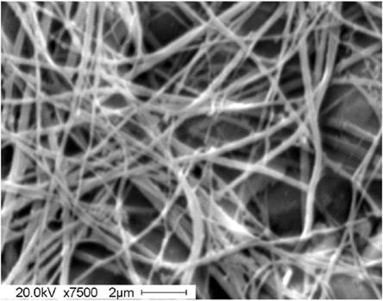
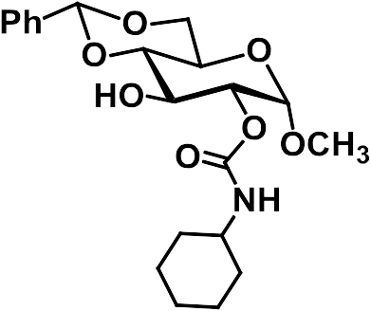
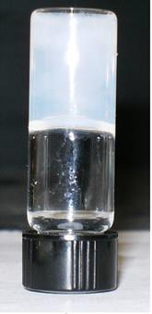
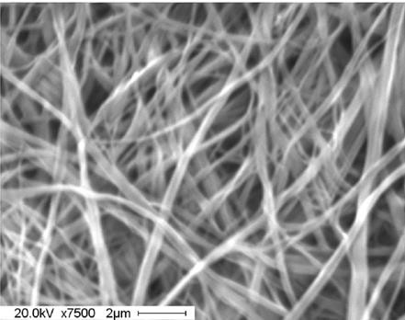
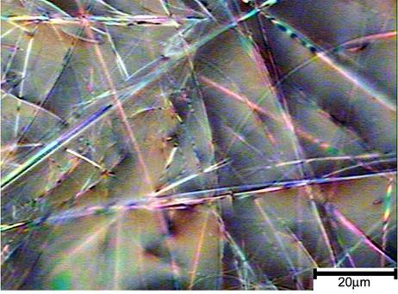
Characterization of Gels Formed by a Carbamate.
DMSO/H₂O (1:2) at 1.1 mg/mL
EtOH/H₂O (1:2) at 1.0 mg/mL
Wang, G.; Cheuk, S.; Yang, H.; Goyal, N.; Reddy, P. V. N. Langmuir, 2009, 25, 8696-8705.

Slide 13
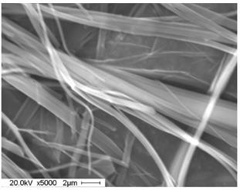
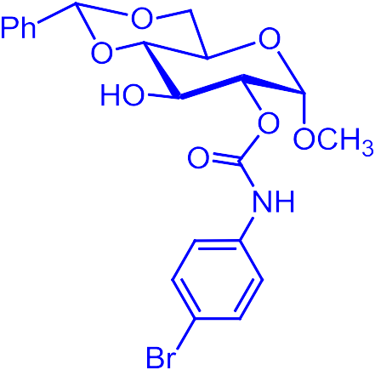
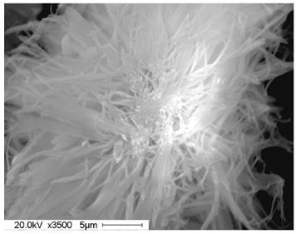
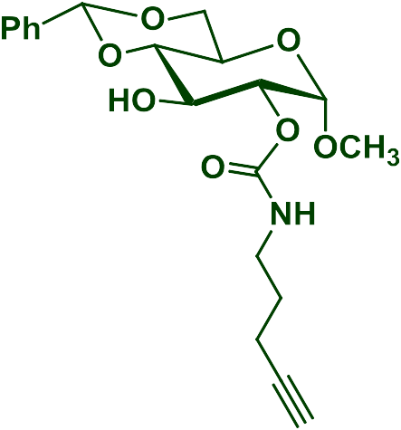
Scanning Electronic Micrographs of O-carbmate Gels
EtOH/H₂O (1:2) at 2 mg/mL
EtOH/H₂O (1:2) at 10 mg/mL
Wang, G.; Cheuk, S.; Yang, H.; Goyal, N.; Reddy, P. V. N. Langmuir 2009, 25, 8696-8705.

Slide 14
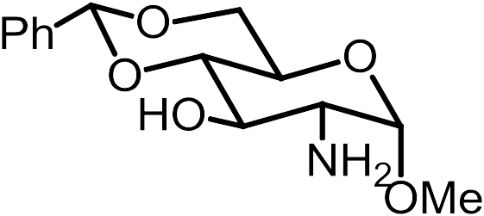
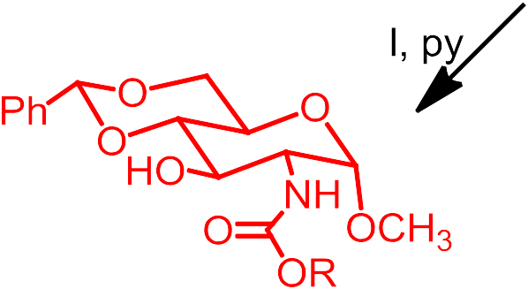

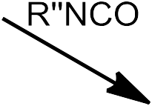
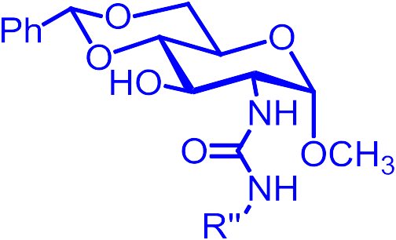


2. D-Glucosamine Derivatives as Low
Molecular Weight Gelators

Slide 15







A General Synthesis of Headgroup II
Goyal, N.; Cheuk, S.; Wang, G. Tetrahedron 2010, 66, 5962-5971.

Slide 16




Scanning Electronic Micrographs of N-carbamate Gels
EtOH/H₂O (1:2) at 10 mg/mL
EtOH/H₂O (1:2) at 2.5 mg/mL
H₂O at 4.0 mg/mL

Slide 17



Optical Micrographs of the Gels of an Amide
EtOH/H₂O (1:2) at 3 mg/mL
DMSO/H₂O (1:2) at 2 mg/mL.
Goyal, N.; Cheuk, S.; Wang, G. Tetrahedron. 2010, 66, 5962-5971.

Slide 18






3. Diacetylene Containing Polymerizable Systems
Polydiacetylenes (PDAs) exhibit a unique blue to red color transition in the presence of heat, mechanical stress, pH change and binding to biological agents. PDA containing gels are useful as biosensors or chemosensors.
The topochemical polymerization and the color transition mechanism.
Wang, G.; Hollingsworth, R. I. Langmuir 1999, 15, 3062-3069.

Slide 19
Synthesis of Diacetylene Containing Lipids Types A-C
O
O
Ph
O
O
Ph
O
O
Ph
O
O
HO
O
RCOCl
O
+ OCH₃
O
+
O
OH
O
O
O
O
OCH₃
O
OCH₃
Ph
O
O
O
HO
DCM, Py
n
n
n
n
^{OH} OCH₃
I
R
R
R
Type B
R
Type A
Type C
n = 2, 5, 7
R = H, Ph, Et, CH₂CH₂Ph, (CH₂)₇CH₃, (CH₂)₅CH₃
Nie, X; Wang, G. J. Org. Chem. 2006, 71, 4734-4741.

Slide 20
Structures of Diacetylene Compounds Synthesized
OCH₃
O O
OCH₃ O
O
O
H
O
O
O
O
O
O
H
O
7A
O
O
Ph
Ph
11A
OCH₃ O
OCH₃ O
O
O
O
Si(Et)₃
O
O
O
O
O
O
Si(Et)₃
O
O
O
Ph
8A
Ph
12A
OCH₃ O
O
OCH
3
O
O
O
O
O
O
O
O
O
O
O
Ph
9A
O
13A
OCH₃ O
Ph
OCH₃ O
O
O
O
O
O
O
O
O
O
O
O
10A
O
14A
Ph
Ph
Type B and C are analogs with only one fatty acyl chains

Slide 21




Polymerization of a Gel Formed by Compound 7C.
At r.t.
UV 3 min
Heat < 70 °C
Ethanol 10 mg/mL
Nie, X; Wang, G. J. Org. Chem. 2006, 71, 4734-4741.

Slide 22


Optical Micrographs of Two Gels
OCH₃ OH
OCH₃ O
O
O
O
O
O
O
O
O
O
O
9C
O
7A
Ph
Ph
Partially polymerized
TLC lamp didn’t cross link
Nie, X; Wang, G. J. Org. Chem. 2006, 71, 4734-4741.

Slide 23



A Deoxy Sugar Diacetylene Lipid
O
O
O
O
O
O
O
Ph
15A
Ethanol gel, 10 mg/mL
Optical micrograph Scanning electron micrograph
Wang, G., Hao, Y., Cheuk, S. Beilstein J. Org. Chem. 2011, 7, 234-242.

Slide 24



Field Emission SEM of compound 10, ethanol gel 1.2 mg/mL
Wang, G.; Goyal, N.; Reddy, P. V. N. J. Org. Chem. 2015, 80, 733-743.

Slide 25

4. Other Studies of Glycoconjugates
Glycopeptoids Synthesized by Ugi Reaction
Ugi one-pot four component reaction
modular approach for structure diversity

Slide 26


Optical Micrographs of DMSO/Water Gels
Mangunuru, H. P. R.; Yang, H.; Wang, G. Chem. Commun. 2013, 49, 4489-4491.

Slide 27

Release Profile of Naproxen at Neutral Conditions
5
4.5
4
3.5
Naproxen 1 h
h
h
h
h
h
9 h
3
2.5
2
1.5
1
0.5
0
250 270 290 310 330 350 370
The UV-spectra of the gel in presence of water.
Compound (6mg) and Naproxen sodium salt (1.5 mg) were dissolved in 3 mL DMSO:H₂O (1:2).
Goyal, N.; Mangunuru, H.P.R.; Parikh, B.; Shrestha, S.; Wang, G. Beilstein J. Org. Chem. 2014, 10, 3111-3121.

Slide 28

Release Profile of Naproxen at Acidic Conditions
3
2.5
2
Naproxen 1 h
h
h
h
h
h 9h
1.5
1
0.5
0
310 320 330 340 350 360 370
The UV-spectra of the gel in presence of 0.1 M of HCl solution.
Goyal, N.; Mangunuru, H.P.R.; Parikh, B.; Shrestha, S.; Wang, G. Beilstein J. Org. Chem. 2014, 10, 3111-3121.

Slide 29
Summary
A systematic structure and gelation relationship study has been carried out for monosaccharide templates.
Obtained functional diacetylene containing sugar gelators that
can polymerize and exhibit desirable optical properties.
Synthesis and characterization of stimuli responsive hydrogelators and organogelators, including light sensitive and pH sensitive systems.
Future Research
Synthesis of glycomimetics and study of their biological applications.
Applications of the LMWGs as stimuli responsive smart materials in controlled release of drugs or biomolecules through collaborations.

Slide 30

Brief Overview of Other Projects
Synthesis of chiral small molecules
Synthesis of chiral small molecules by chiral pool approach
Asymmetric synthesis and synthetic methodology development and catalytic reactions
Target compounds: chiral amino alcohols and
heterocycles, unusual amino acids
HO
P₂
Ar'
N
O O
HN
O
OH
N
N
P₁
O
NH
P
R
O
H
N NH₂
NH
3
HO
Small molecule libraries
OH
Aeruginosin analogs

Slide 31
Acknowledgements
Current and former Wang group members:
Undergraduate
Students
Lousi Dakessian Branden Hopkinson Jennifer Vu Sherman Coleman Corey Hampton Zeus Thornton William Taylor Andrew Allain
Sonu Shrestha Sadia Akram Kellie Mays Angelo Espirito
Total 32 undergraduate students
Graduate Students Sherwin Cheuk Kristopher Williams Navneet Goyal
Michal St. Martin Hao Yang
Hari P. R. Mangunuru Ifeanyi Okafor Kristen Bashaw
Anji Chen Consuelo Garcia
Postdoctoral Associates
Xiaoping Nie PVN Reddy
Jayasudahan Yerabolu
Financial Support
National Science Foundation Boehringer Ingelheim, Inc Old Dominion University University of New Orleans

Slide 32

Professor Wang’s Research Group, August 2014, Norfolk, VA http://www.odu.edu/directory/people/g/g1wang

Slide 33


