Slide 1
Overview of Mercury Measurements in East Asia and over the North Pacific Ocean
Guey-Rong Sheu
Department of Atmospheric Sciences
National Central University
Jhong-Li, Taiwan

Slide 2
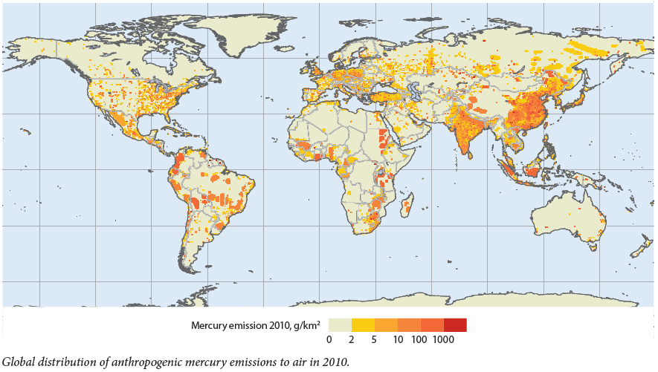
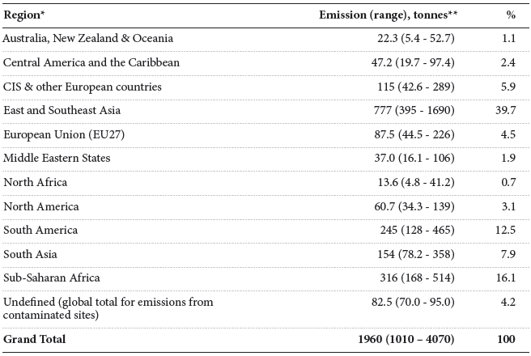
Anthropogenic Hg Emissions in 2010
Country | Emission (tonnes)
Cambodia | 3.9
China | 575.2
Indonesia | 78.2
Japan | 17.2
Korea | 7.1
Laos | 1.3
Malaysia | 6.1
Mongolia | 6.9
Philippines | 33.1
Singapore | 0.9
Taiwan | 5.5
Thailand | 14.9
Vietnam | 11.6
(UNEP, 2013)

Slide 3
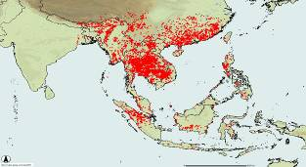
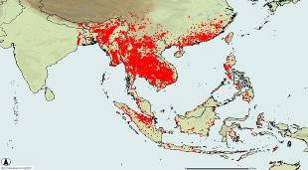
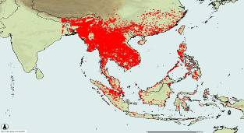
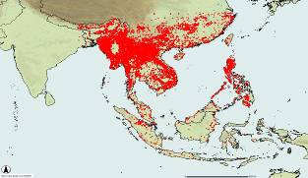
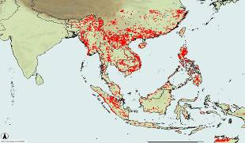
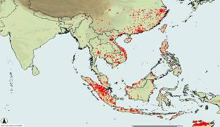
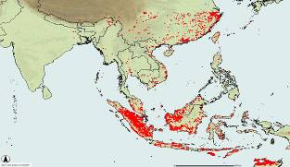
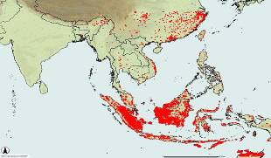
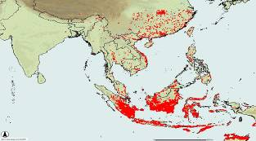
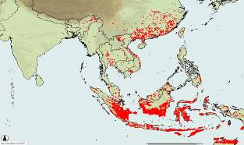
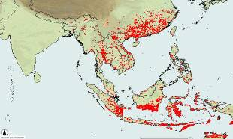
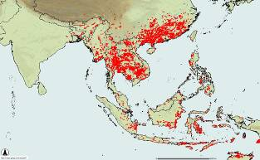
Jan
Feb
Mar
Apr
May
Jun
Jul
Aug
Sep
Oct
Nov
Dec
http://maps.geog.umd.edu/activefire_html/

Slide 4
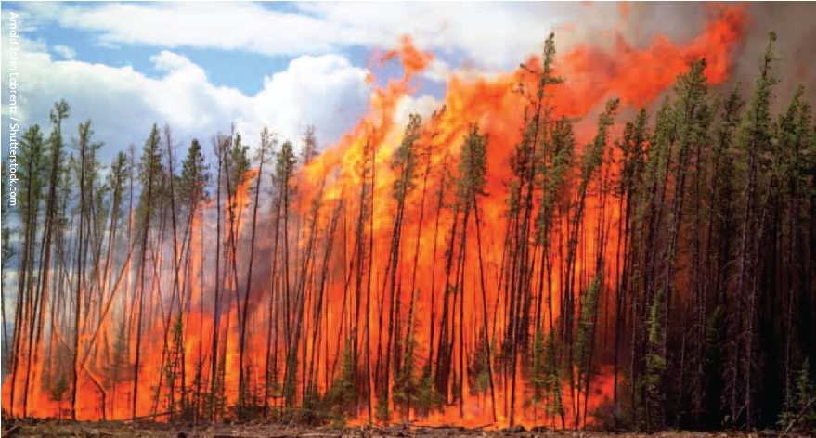
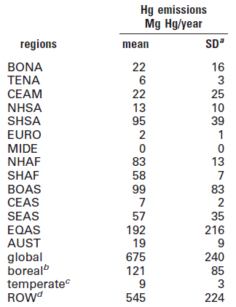
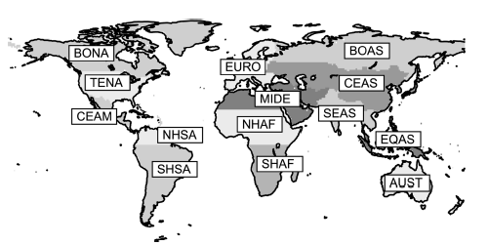
Biomass Burning Hg Emissions in 2005
SEAS + EQAS = 249 Mg Hg/year
Friedli et al., 2009
Notes:
先解釋圖代表什麼，在講橫軸，縱軸的代表。

Slide 5
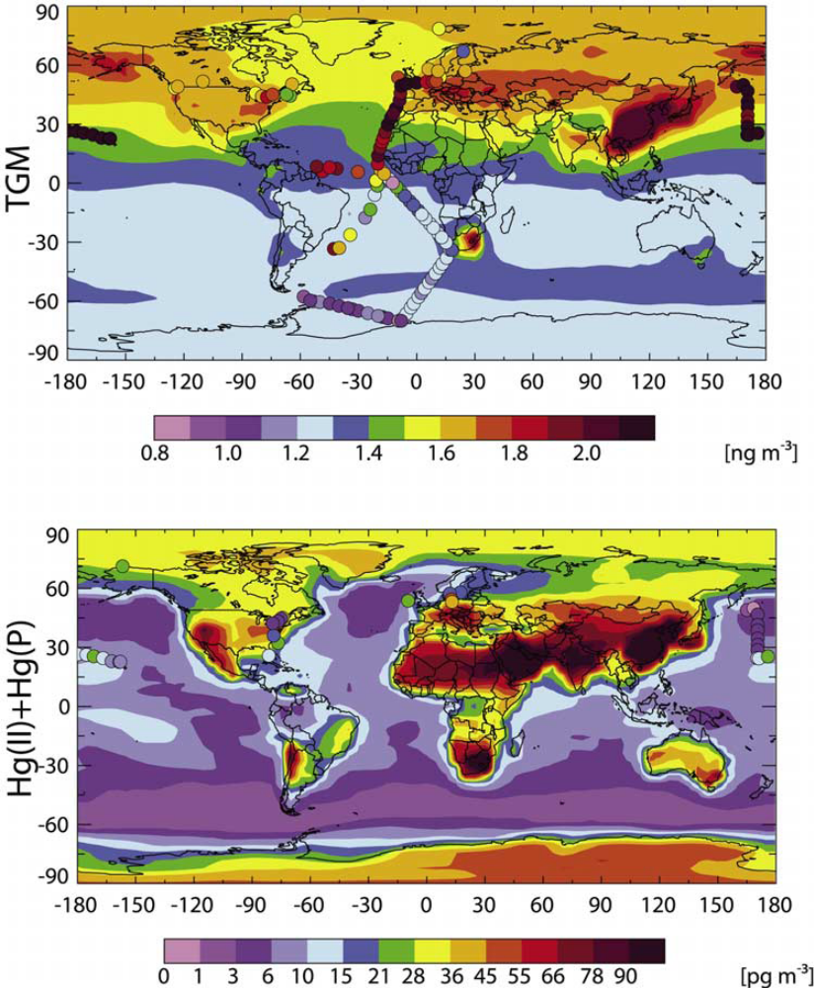
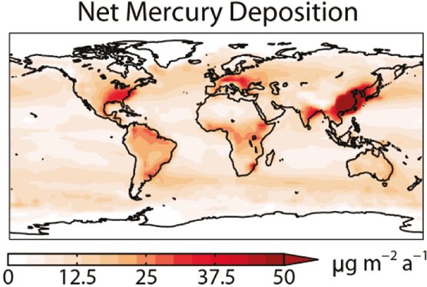
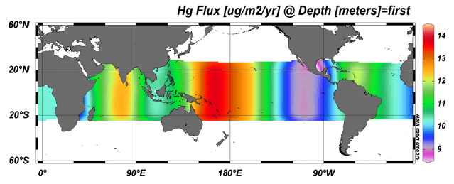
Distribution of Atmospheric Hg Concentrations and Deposition Fluxes: Modeling Results
Corbitt et al., 2011
Costa et al., 2012
Selin et al., 2007

Slide 6
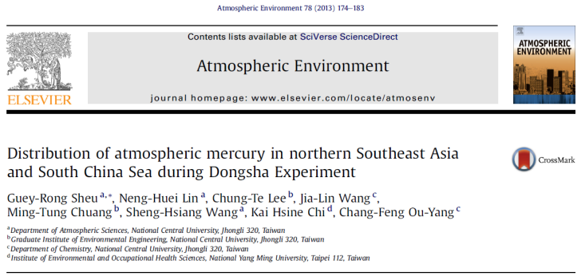
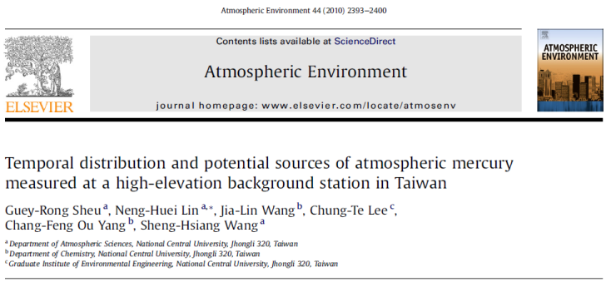
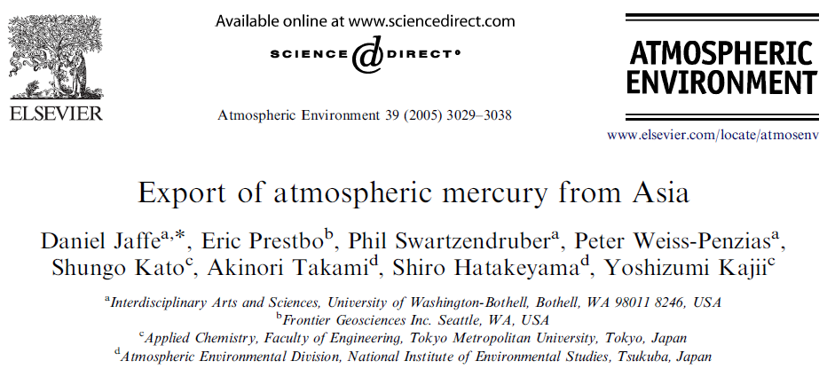
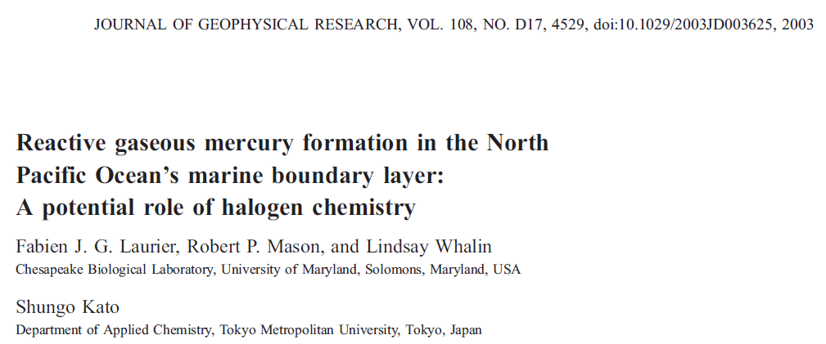
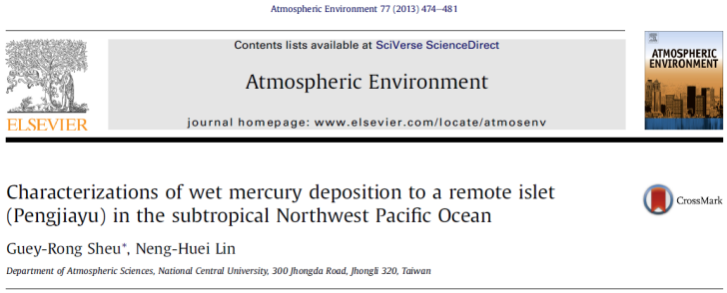
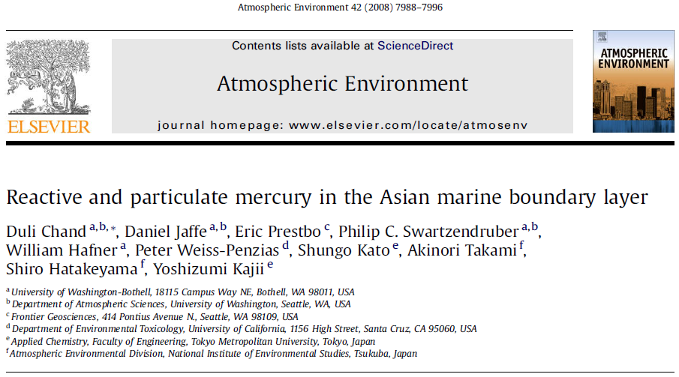
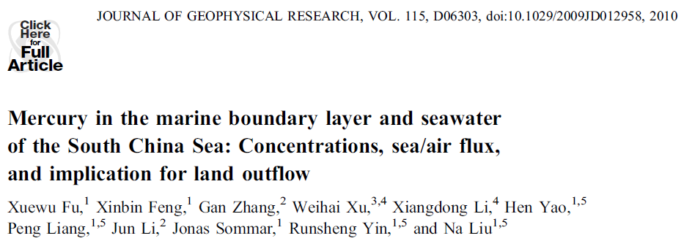
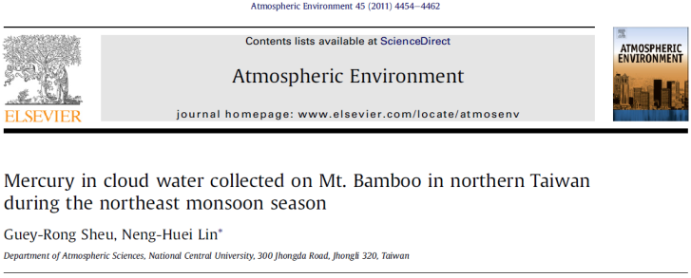
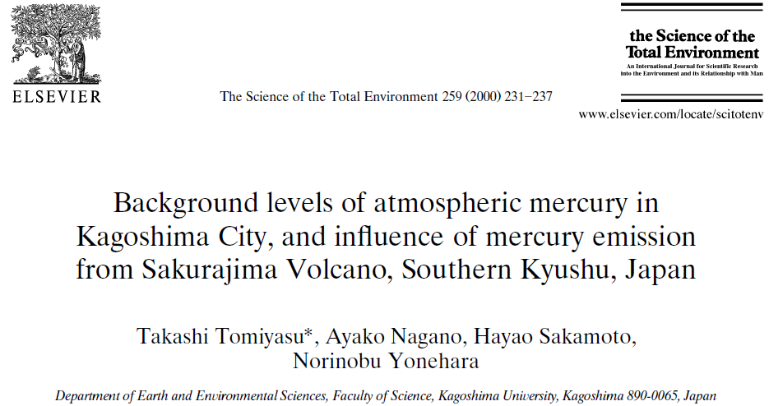
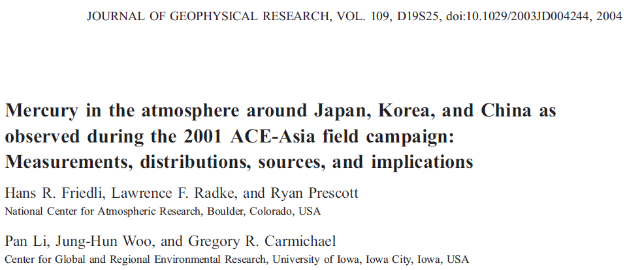
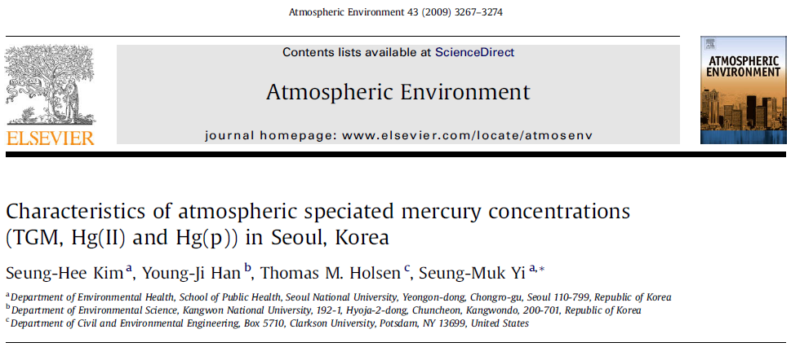
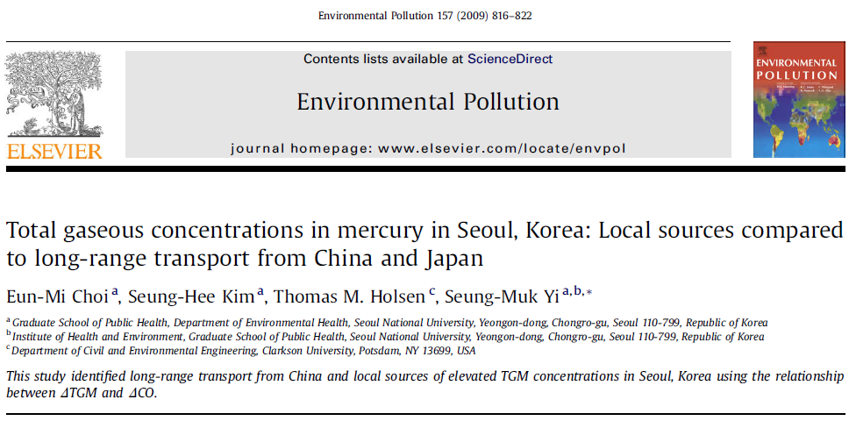
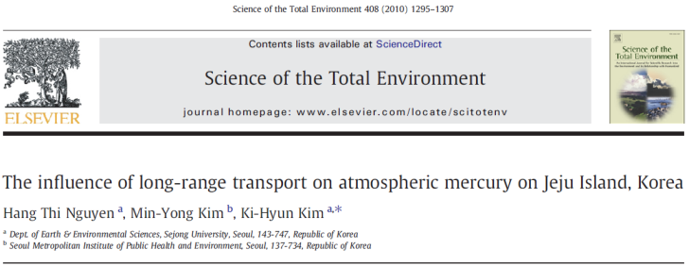
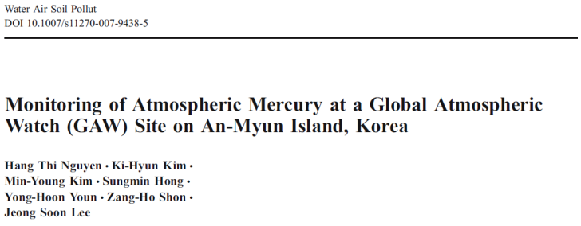

Slide 7
Mercury Speciation in the Marine Boundary over the North Pacific Ocean
(Laurier et al., 2003)

Slide 8
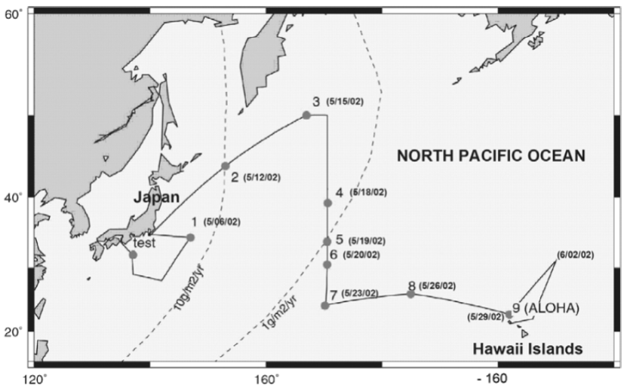
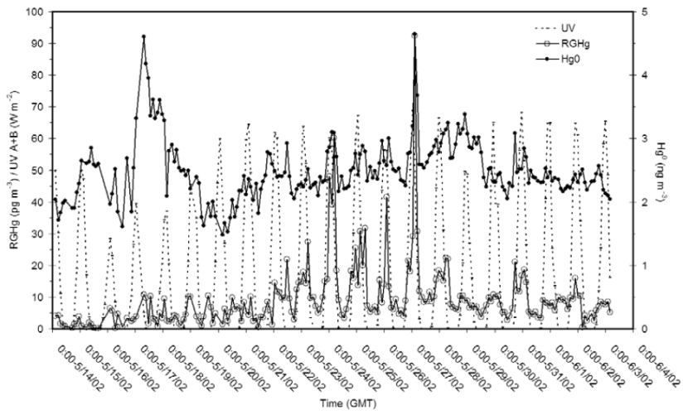
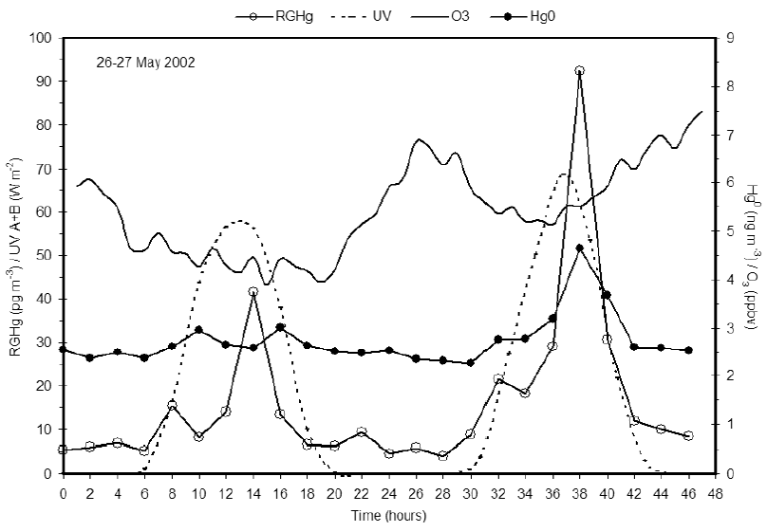
GEM and RGM were measured using Tekran 2537A/1130 aboard a cruise from Osaka, Japan to Honolulu, Hawaii between May 1 and June 4, 2002.
GEM ranged between 1.6 and 4.7 ng m⁻³ with an average of 2.5 ng m⁻³.
RGM ranged between 0.15 and 92.4 pg m⁻³ with an average of 9.5 pg m⁻³.
A distinct diurnal variation in RGM concentrations with maxima at midday suggests a photochemically driven oxidation of GEM in the marine boundary layer over the North Pacific Ocean.
Enhanced RGM formation could be related to halogen chemistry.

Slide 9
Mercury Speciation at Cape Hedo, Okinawa, Japan
(Chand et al., 2008)

Slide 10
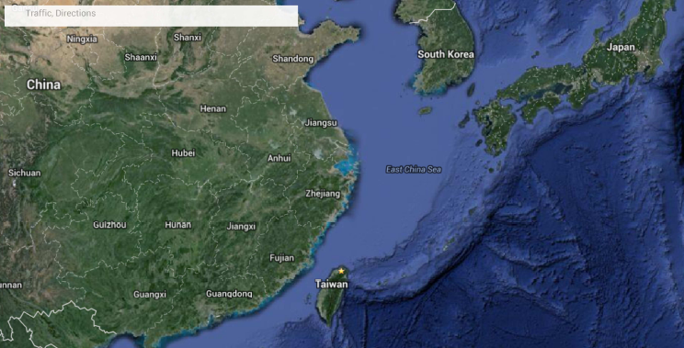
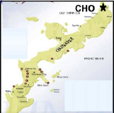
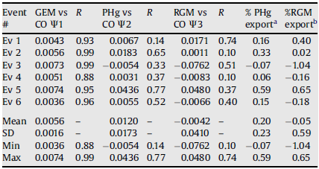
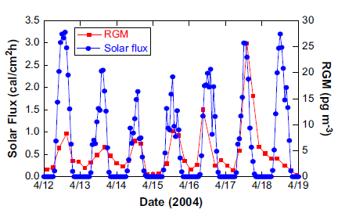
GEM, RGM and PHg were measured using Tekran 2537A/1130/1135 at the Cape Hedo Observatory between March 23 and May 2, 2004.
Mean values of GEM, RGM and PHg were 2.04 ng m⁻³, 4.5 pg m⁻³, and 3.0 pg m⁻³, respectively.
In Asian outflow, most mercury export in the MBL is due to the GEM form, and direct outflow of RGM and PHg is low.
RGM showed a diurnal cycle with a peak near local noon, suggesting photochemically driven oxidation of GEM.
Air from China has a higher GEM concentration compared to the air coming from southern Japan.

Slide 11
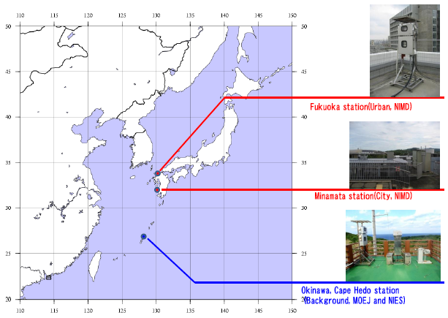
On-going Hg Monitoring Sites in Japan
Sites | Organizations | Hg speciation (GEM, GOM, PHg) In air | TGM | Hg in precipitation
Cape Hedo (Background) | MOEJ and NIES | Continuous ( by Tekran ) |  | Wet-only Weekly
Minamata (City) | NIMD | Manual sampling 1 week a month | Continuous | Wet-only Weekly
Fukuoka (Urban) | NIMD | Continuous ( by Tekran ) |  | Wet-only Weekly Since, Jun. 2013
(Courtesy of Dr. Kohji Marumoto)

Slide 12
Mercury Speciation in Seoul, Korea
(Kim et al., 2009)

Slide 13
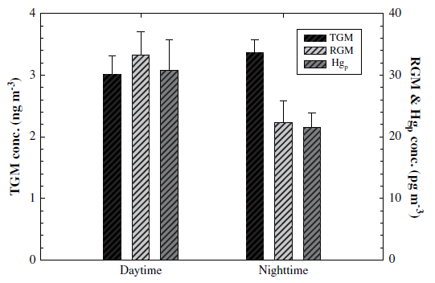
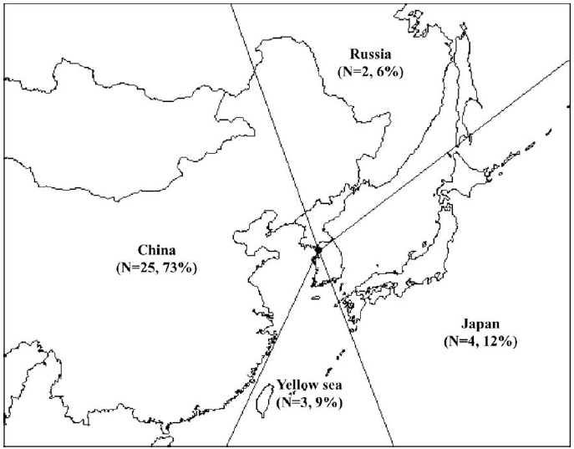
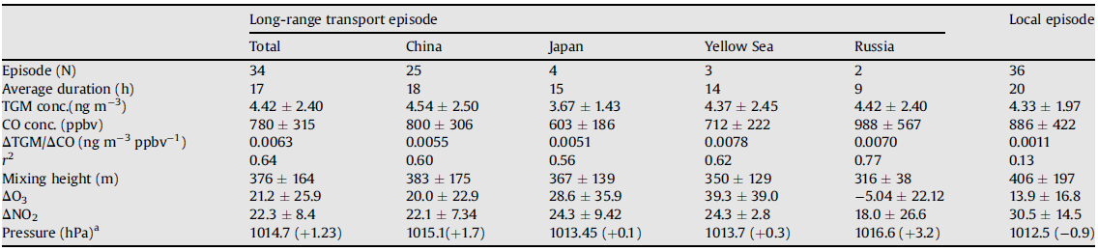
TGM was measured using Tekran 2537A, whereas RGM and PHg were measured manually, in Seoul between Feb. 2005 and Feb. 2006.
Mean values of TGM, RGM and PHg were 3.22 ng m⁻³, 27.2 pg m⁻³, and 23.9 pg m⁻³, respectively.
RGM and PHg were higher in daytime than at because of high photochemical activity.
Long-range transport episodes with air from China has a higher TGM concentration compared to that of local episodes.

Slide 14
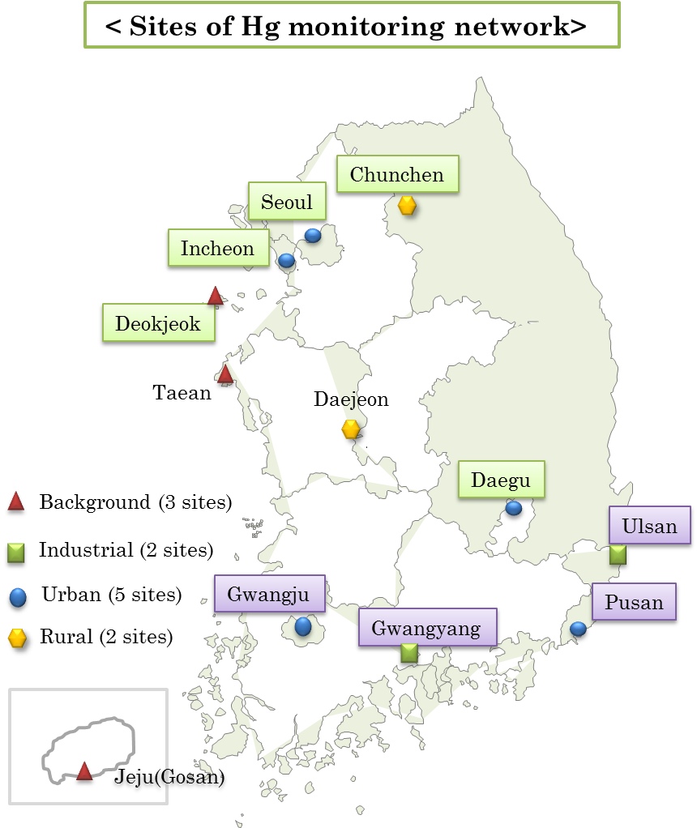
Atmospheric Mercury Monitoring Network of Korea
Objective
To monitor the atmospheric mercury concentration levels in Korea
To evaluate the long-range transports of mercury between nations
Status
Started from 2009 and currently operated at 12 sites to monitor TGM.
Operated by KECO (Korean Environmental Cooperation) and data are reported to NIER
Extended to the monitoring of wet mercury deposition at all sites and the monitoring of speciated mercury at 4 sites until 2015.
TGM monitoring methods
Instrument : Teckran 2537
Sampling frequency : Every 5 mins.
Frequency of data report : Every 2 hours
(Courtesy of Dr. Young-Hee Kim)

Slide 15
Mercury Speciation at the Lulin Atmospheric Background Station in Taiwan
(Sheu et al., 2010)

Slide 16
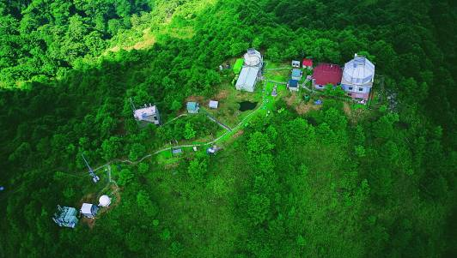
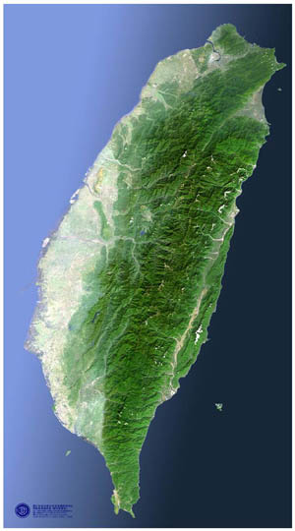
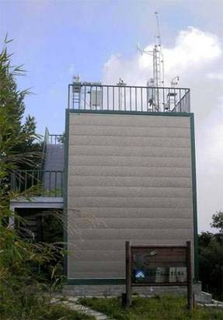
Lulin Atmospheric Background Station (LABS)
LABS is located atop Mt. Front Lulin in central Taiwan, with an elevation of 2862 m above sea level.
GEM, RGM and PHg have been measured using Tekran 2537A/1130/1135 at the LABS since April 13, 2006.
LABS

Slide 17
Summary of Atmospheric Hg in 2006/04-2013/11
 | GEM (ng m⁻³) | RGM (pg m⁻³) | PHg (pg m⁻³)
Mean | 1.6 | 18.2 | 2.6
S.D. | 0.4 | 14.8 | 4.0
GEM is the dominant atmospheric Hg species measured at LABS, constituting on average 98.7% of the total atmospheric Hg.
Average GEM (1.6 ng m⁻³) is within the Northern Hemisphere background value of 1.5-1.7 ng m⁻³ at sea level.
However, about 30% of the GEM is greater than 2 ng m⁻³, suggesting sources other than the background atmosphere are influencing the background station.

Slide 18
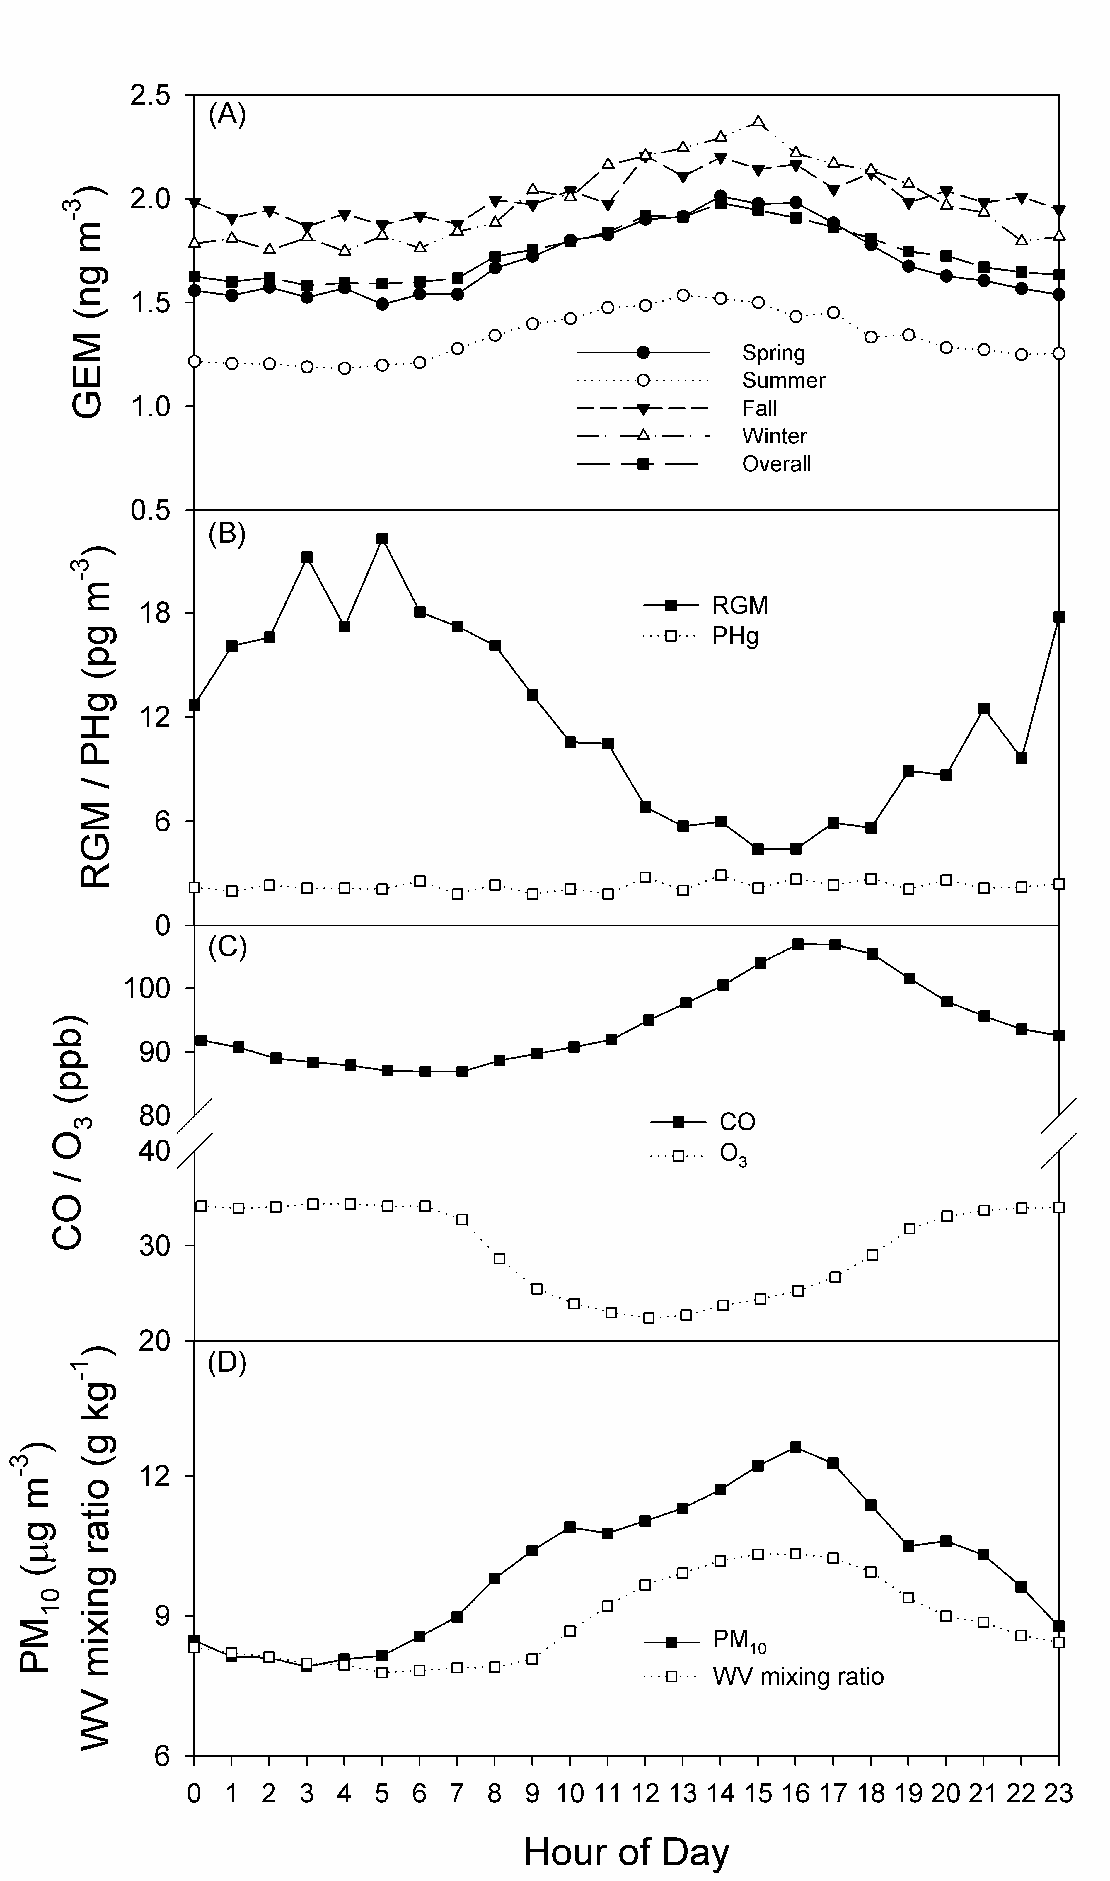

Diurnal Distribution of Hg and Other Chemicals
Concentrations of CO, PM₁₀ and WV mixing ratio all exhibited diurnal patterns similar to that of GEM.
On the other hand, O₃ concentrations showed diurnal pattern similar to that of RGM.
Upslope movement of boundary layer air in daytime and subsidence of free tropospheric air at night resulted in these diurnal patterns.
Notes:
先解釋圖代表什麼，在講橫軸，縱軸的代表。

Slide 19


RGM and Humidity
07/14-21/2014
2013
Notes:
先解釋圖代表什麼，在講橫軸，縱軸的代表。

Slide 20







Seasonal Pattern of Nighttime GEM
Spring
Summer
Fall
Winter
2007/03 MODIS fire detection
LABS is the only site to observe Hg from anthropogenic emissions from China and biomass burning from Indochina Peninsula.
Notes:
先解釋圖代表什麼，在講橫軸，縱軸的代表。

Slide 21

Correlation between GEM and CO
April 2007
Good GEM/CO correlations were observed in non-summer months, indicating influence of anthropogenic emission sources.
GEM seasonal pattern, backward trajectory analysis and GEM/CO correlations indicated that air mass origins plays an important role in determining the GEM levels.
These results also demonstrate the significance of East Asian Hg emissions and their long-range transport to downwind regions.
July 2007
Oct. 2007
Notes:
先解釋圖代表什麼，在講橫軸，縱軸的代表。

Slide 22

Source-Receptor Relatioship: Concentration-Weighted Trajectory

Slide 23

Wet and Dry Deposition Fluxes in 2010
Location | Site Type | GEM | RGM | PHg | Wet | Reference
LABS, Taiwan | Mountain | 58.8 | 10.6 | 0.1 | 33.7 | This study
AMNet, USA | Rural/urban | 13-35 | 0.3-7.8 | 0.1-0.8 | 6-12.6 | Zhang et al. 2012
Unit: µg m⁻²
Notes:
先解釋圖代表什麼，在講橫軸，縱軸的代表。

Slide 24
Summary
Location | Site Type | GEM (ng m⁻³) | RGM (pg m⁻³) | PHg (pg m⁻³)
Cruise over NPO | Ocean | 2.5 | 9.5
Cape Hedo, Japan | Ocean | 2.0 | 4.5 | 3.0
Seoul, Korea | Urban | 3.2 | 27.2 | 23.9
LABS, Taiwan | Mountain | 1.6 | 18.2 | 2.6
Higher atmospheric mercury concentrations at urban sites than in the marine boundary layer and free troposphere.
RGM levels peak at noon at surface sites, likely due to in situ photochemical production. However, RGM peaks at night or in the early morning at high-elevation sites as a result of transport from higher altitudes.
Lack of atmospheric mercury measurements in SE Asia.

Slide 25


Contact:
grsheu@atm.ncu.edu.tw

