Slide 1
What Landauer Limit? Ultra-low power electronics, and the minimum energy for computation
Gregory Snider, Alexei Orlov, and Craig Lent
Department of Electrical Engineering
University of Notre Dame

Slide 2
Outline
The power dilemma and resulting limits
The Landauer Principle
A word about state variables
Experiments
Possible ways forward

Slide 3
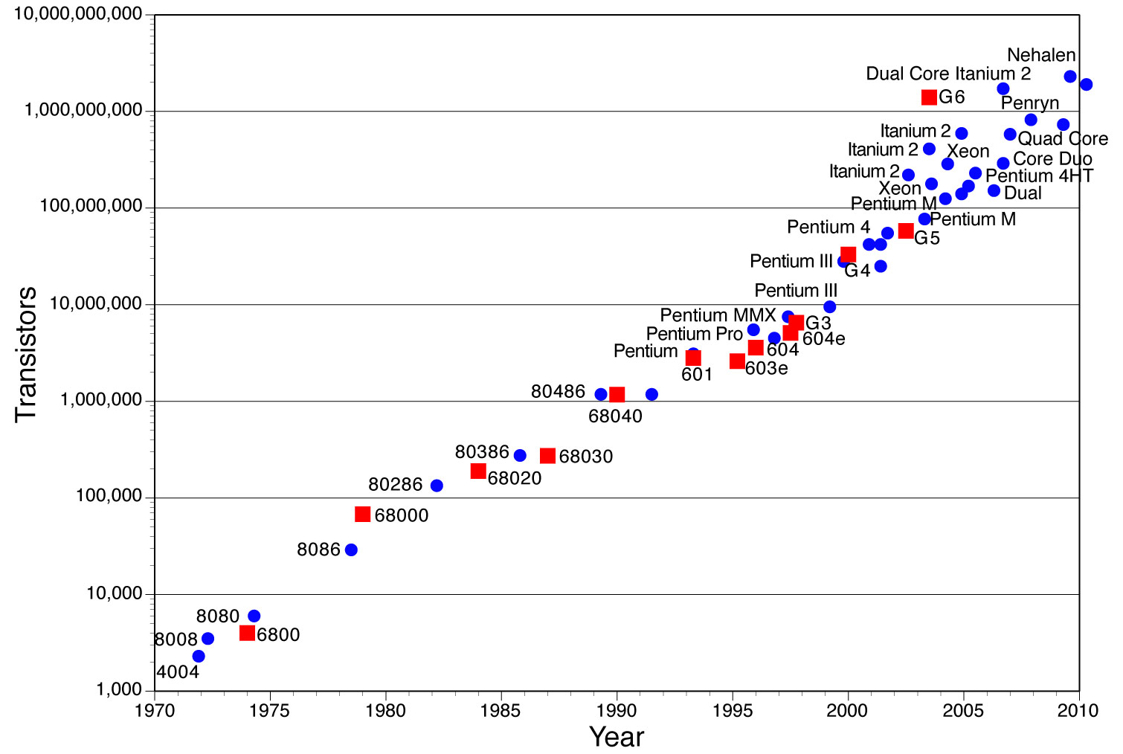
Moore’s Law
The number of transistors per chip doubles every 18 months

Slide 4
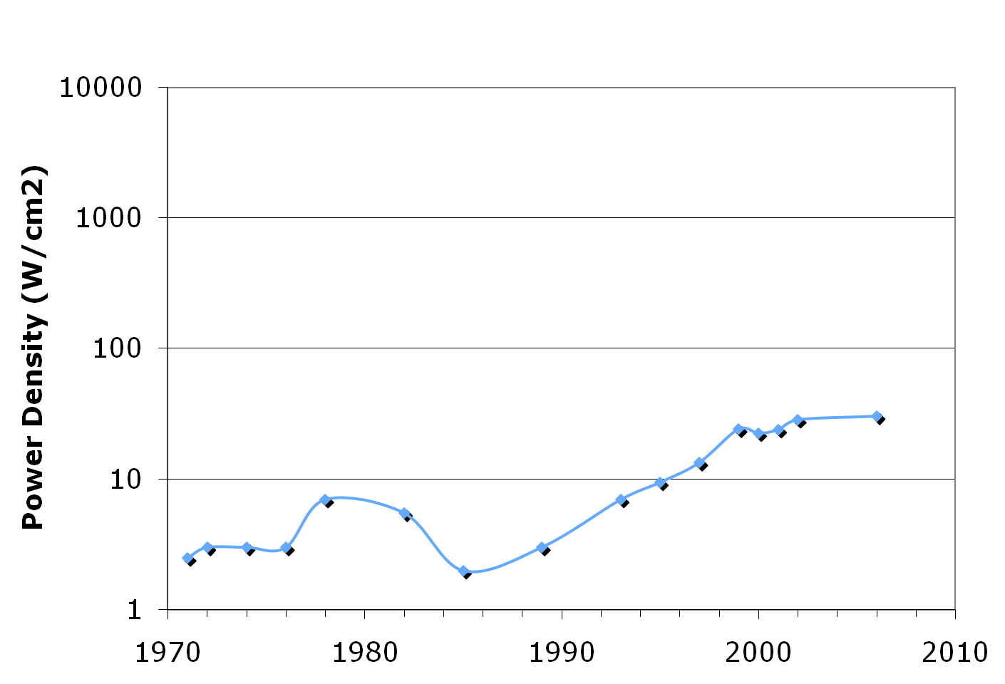
Power Density
Sun’s Surface
Rocket Nozzle
Nuclear Reactor
Hot Plate
III
Itanium
Core 2 Duo
Pentium Pro
4
Itanium 2
Pentium II
8086
286
Pentium
8008
8085
486
4004
8080
386
Multi-core processors necessary to keep chips from melting

Slide 5


Is Heat Really a Problem?
Every Problem is an opportunity:
Applications for waste heat:
Home heating, Global warming, etc.

Slide 6
Power in Conventional Logic
Conventional CMOS
P = N(αCV² f + Passive Dissipation)
{
2E_{Bit}
V
How to reduce power?
Reduce V
Reduce C
Reduce f (multi-core)
Turn off parts of the circuit (α)
Reduce passive power
V_{in}
V_{out}
C
Notes:
6

Slide 7
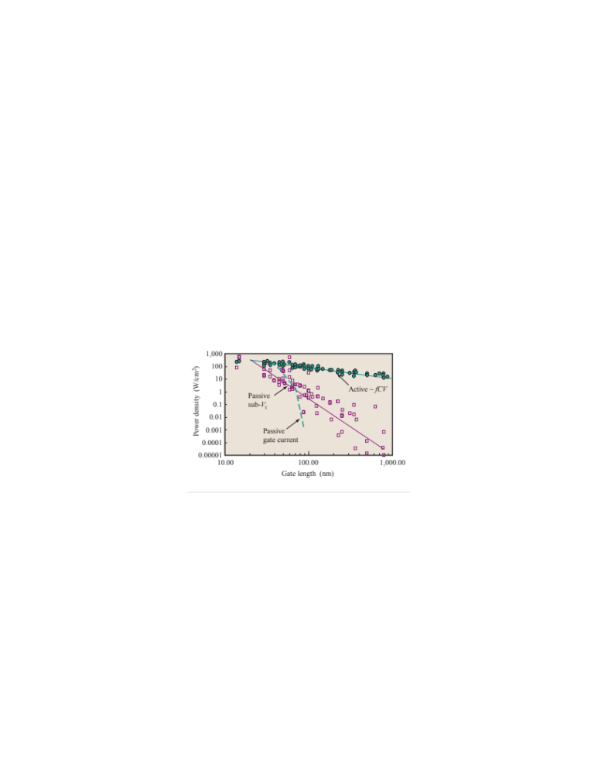
Focus on Active or Passive Power?
Passive Power seems the most threatening!
Solution: Improve the switch!
From Haensch
IBM J. Res. Dev. 2006
The Perfect Switch
You’ve fixed Static Power issue, but not the active power!
V
V_{in}
V_{out}
If E_{Bit} =100 k_{B}T, f=100 GHz, N=10¹¹ cm⁻²
P = 4 kW/cm²
C

Slide 8
Fundamental limits for computation?
Is there a fundamental lower limit on energy dissipation per bit?
i.e. is there a minimum amount of heat that must be generated to compute a bit?
Notes:
8

Slide 9
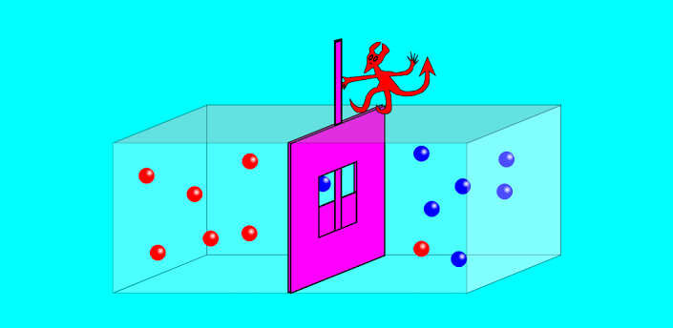
Minimum energy for computation
Maxwell’s demon (1875) – by first measuring states, could perform reversible processes to lower entropy
Szilard (1929), Brillouin (1962): measurement causes
k_{B}T ln(2) dissipation per bit.
Landauer (1961,1970): only destruction of information must cause dissipation of k_{B}T ln(2) per bit (Landauer’s Principle)
Bennett (1982): full computation can be done without erasure.
logical reversibility ⬄ physical reversibility
Still somewhat controversial.
Maxwell’s Demon
Notes:
9

Slide 10
The Debate
Exorcist XIV: The wrath of Maxwell’s demon. Part I: From Maxwell to Szilard, Earman, J., & Norton, J. D., Studies in History and Philosophy of Modern Physics, 29, 435 (1998).
Exorcist XIV: The wrath of Maxwell’s demon. Part II: From Szilard to Landauer and beyond, Earman, J., & Norton, J. D., Studies in History and Philosophy of Modern Physics, 30, 1 (1999).
Eaters of the lotus: Landauer’s principle and the return of Maxwell’s demon, Norton, J. D., Studies in History and Philosophy of Modern Physics, 36, 375 (2005).
The (absence of a) relationship between thermodynamic and logical reversibility, Maroney, O. J. E. Studies in History and Philosophy of Modern Physics, 36, 355 (2005)
The connection between logical and thermodynamic irreversibility, James Ladyman, Stuart Presnell, Anthony J. Short, Berry Groisman, Studies in History and Philosophy of Modern Physics, 38, 58 (2007).
Notes:
10

Slide 11
Analysis of erasure process
Helpful to examine and contrast two cases:
Erasure with a copy
  Reversible logical operation (No Data Destroyed)
  Key feature:
    The copy biases the system toward the state it’s in
Erasure without a copy
  Irreversible logical operation (Data Destroyed)
  Key feature:
    The system cannot be biased toward the state it’s in, so there’s an uncontrolled step

Slide 12
What About State Variables?
Does the choice of a state variable affect this analysis?
Isn’t using charge as the state variable the real problem?
If we use a different state variable like spin, the problem goes away, right?

Slide 13
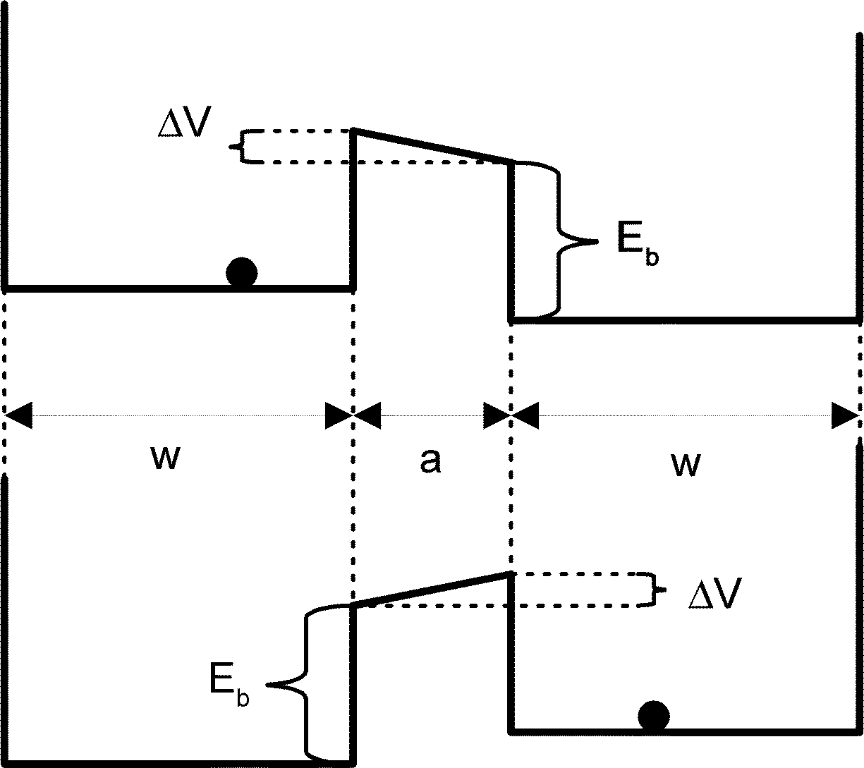
A Little History
Beginning in 2003 Zhirnov, Cavin, and Hutchby from SRC have published a series of highly influential papers indicting charge as a state variable.
Their conclusions:
At least k_{B}T ln2 must be dissipated at each transition
This result was generalized to all charge-based devices
This is true for CMOS, but what about other charge based devices?
Fig. 1. Energy model for limiting device: w = width of left-hand well (LHW) and right-hand well (RHW); a = barrier width; E = barrier energy
V.V. Zhirnov, et al., Proceedings of the IEEE, 91, p. 1934-39, 2003.

Slide 14
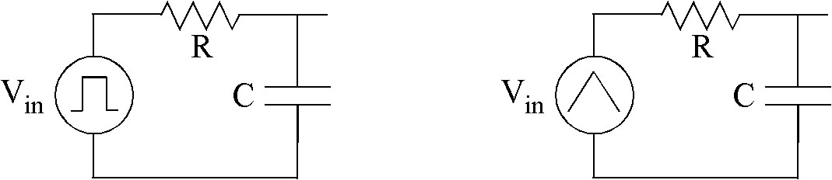
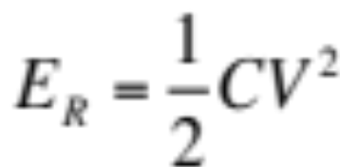
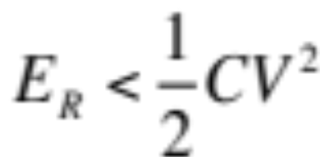
What About “Reversible” Computing?
Following Landauer, the idea is to avoid erasure of information.
A key technology in reversible computing is adiabatic charging and discharging of capacitors: recycle charge rather than throwing it to ground.
The SRC critique: Cavin’s Demon

Slide 15
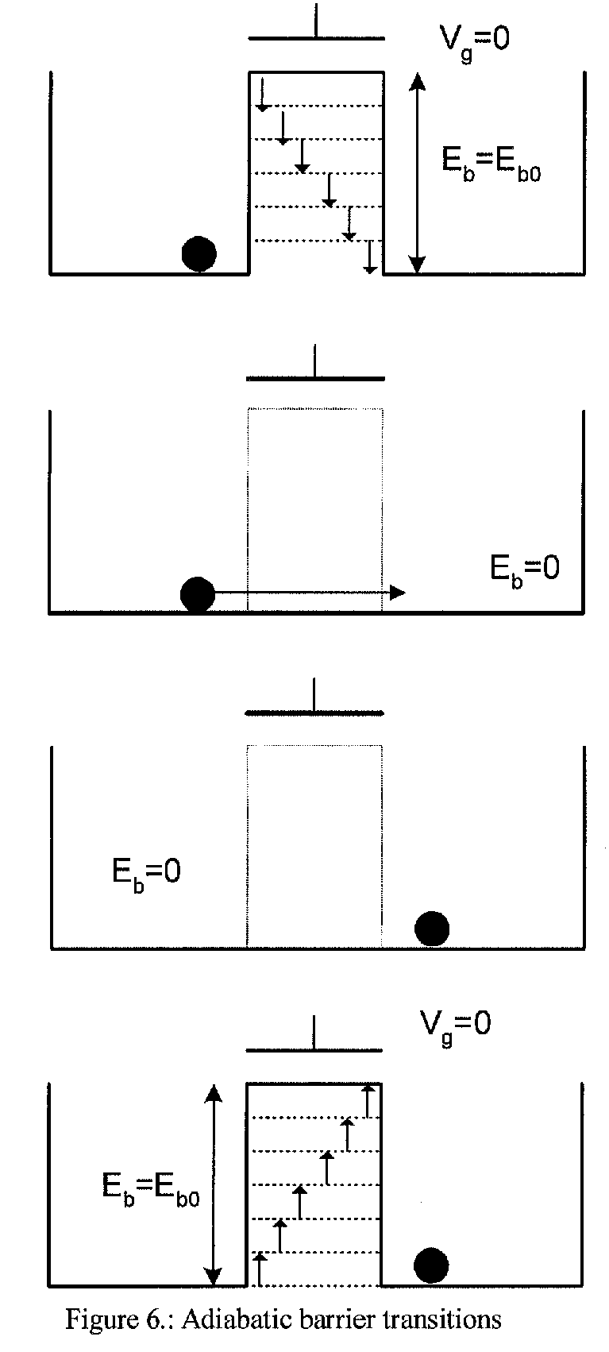
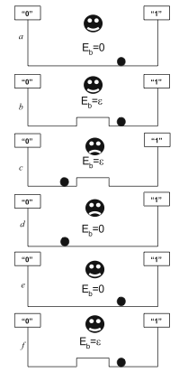
Cavin’s Demon
Assertion 1. Energy must be dissipated to make logic transitions.
Energy spent by the demon must be > k_{B}T ln2
Problem: Since there is no input this is really just creating a bit of information.
Fluct. and Noise Letters, Vol. 5, pp. C29, 2005.
Proc. SPIE Vol. 5844, pp. 1, 2005

Slide 16
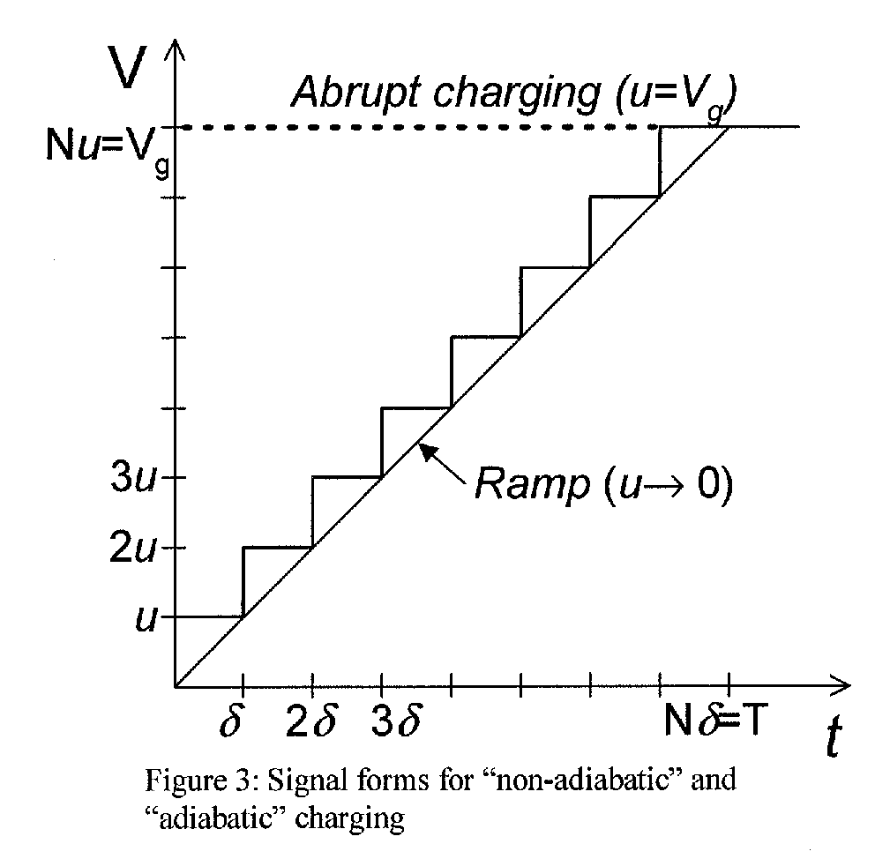
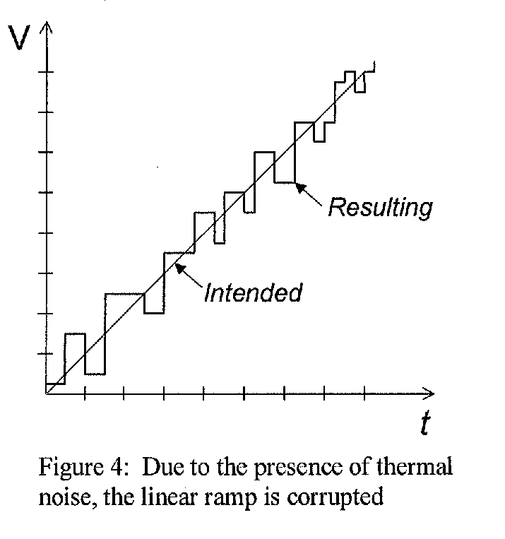
Cavin’s Demon
Assertion 2: Charging a capacitor requires at least k_{B}T ln2 of energy

Slide 17
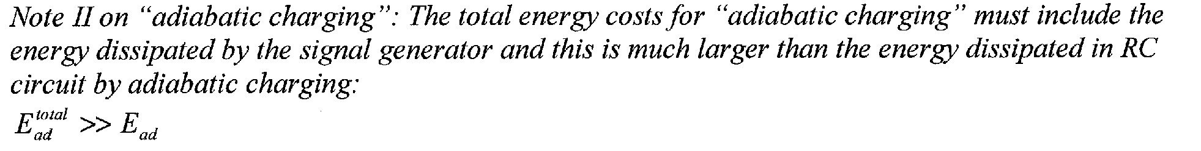
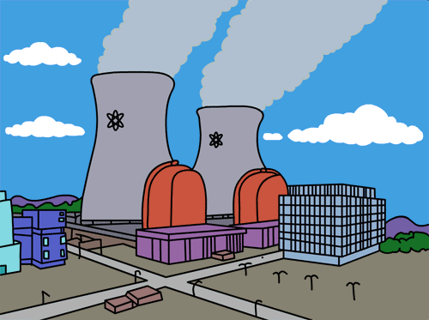
Cavin’s Demon
Assertion 3:
This is a systems level assertion that depends on the signal generator. However, signal generators can scale differently than integrated circuits!
Worst case: Signal generator more easily cooled than and IC!
Sig.
Gen.
IC
Less than 200 W/cm²
Signal generator concerns apply equally to the control signals for every state variable
SRC’s Conclusion: Charge is dead!

Slide 18
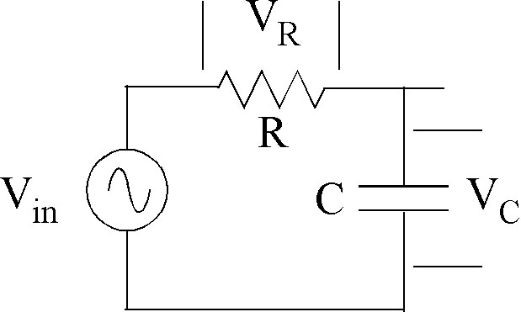
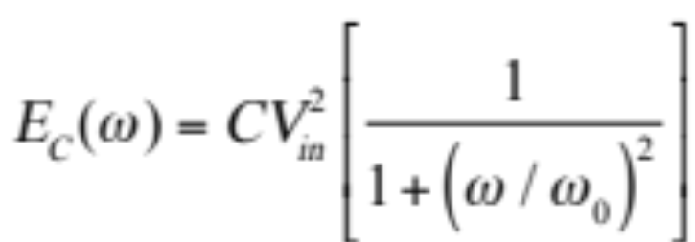
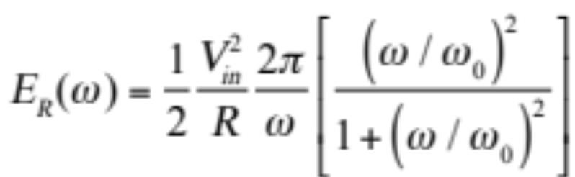
Is this Conclusion Correct?
Let’s find out!
The challenge: k_{B}T ln2 at RT = 3 zJ!

Slide 19
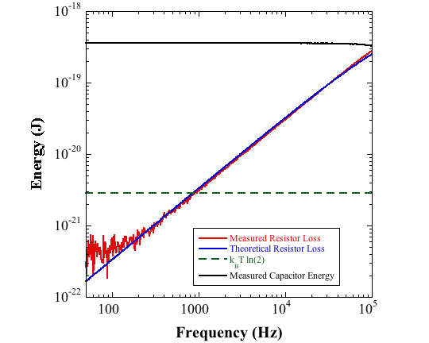
Sanity Check

Slide 20
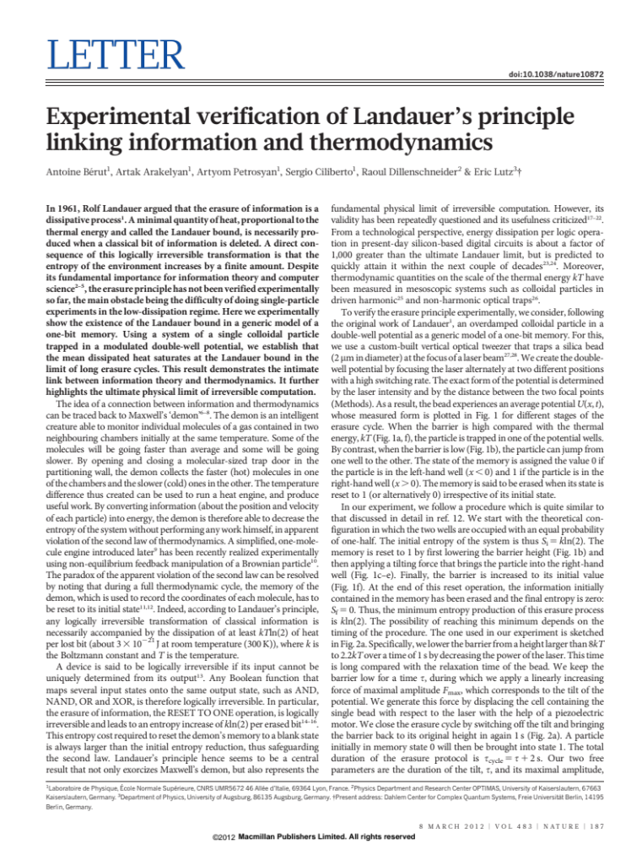
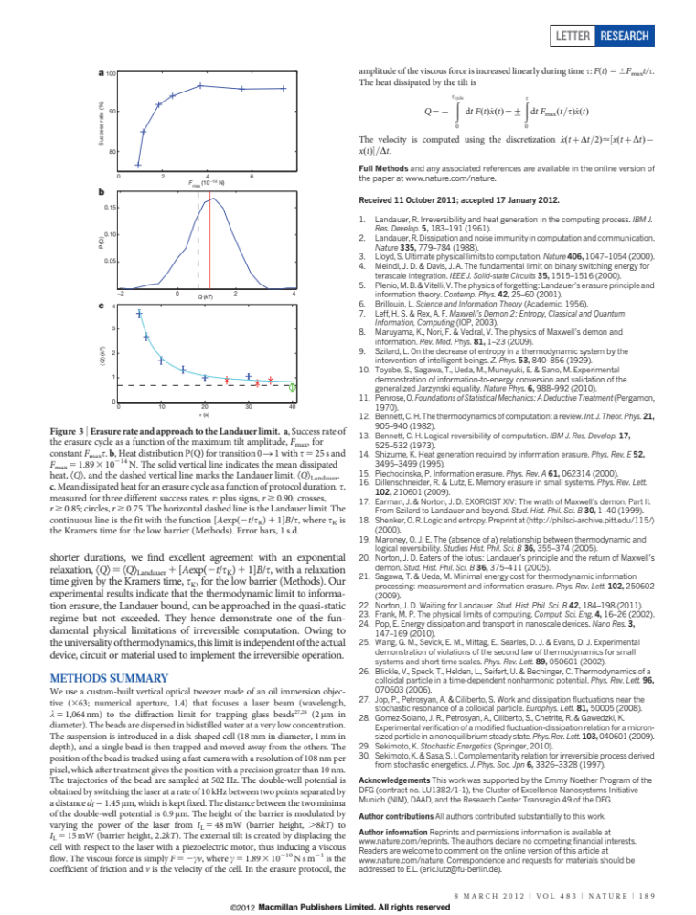
The Landauer Principle
Nature 483, p189, 2012

Slide 21
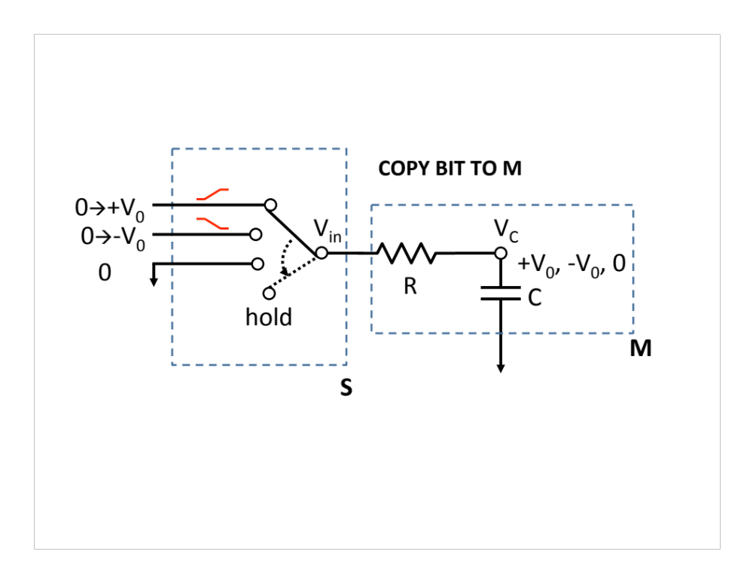
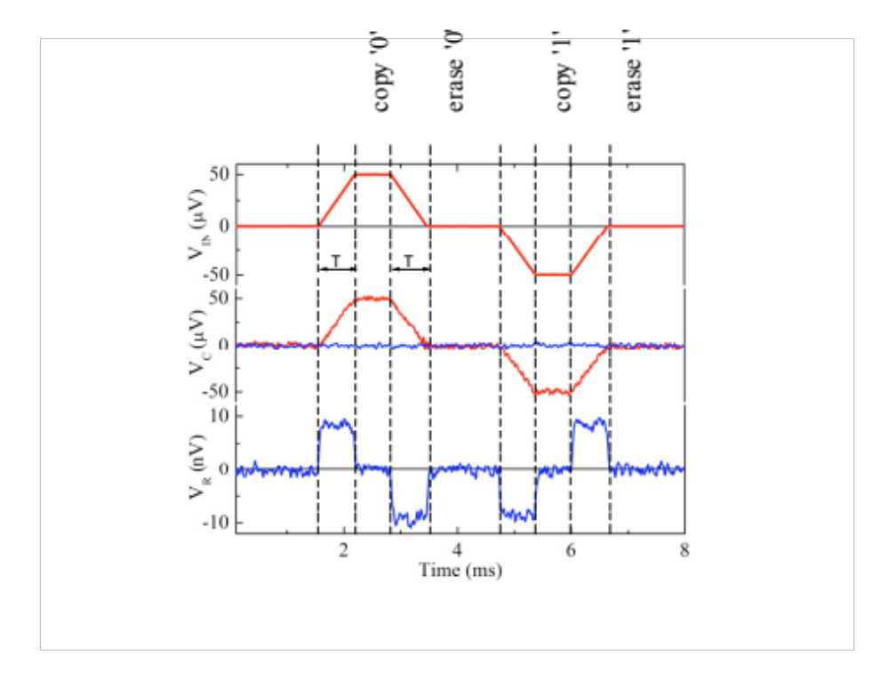
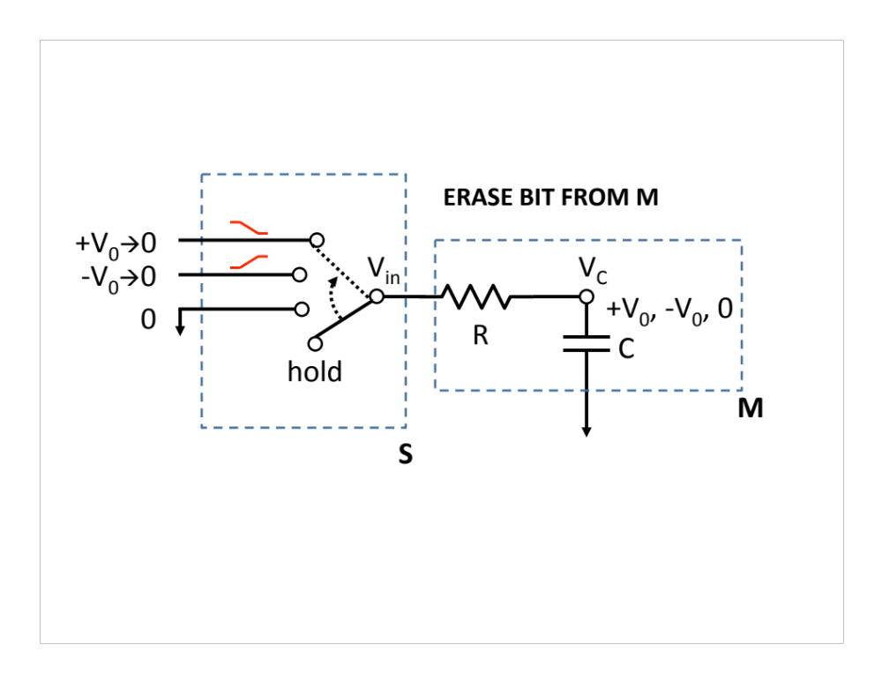
The Landauer Principle
The SRC group rejects the Landauer Principle, but can it be tested?
Room temperature operations on a 30 k_{B}T bit of information
Dissipation was measured as low as 0.01 k_{B}T, confirming the Landauer Principle.
JJAP, 51, pp. 06FE10, 2012.

Slide 22
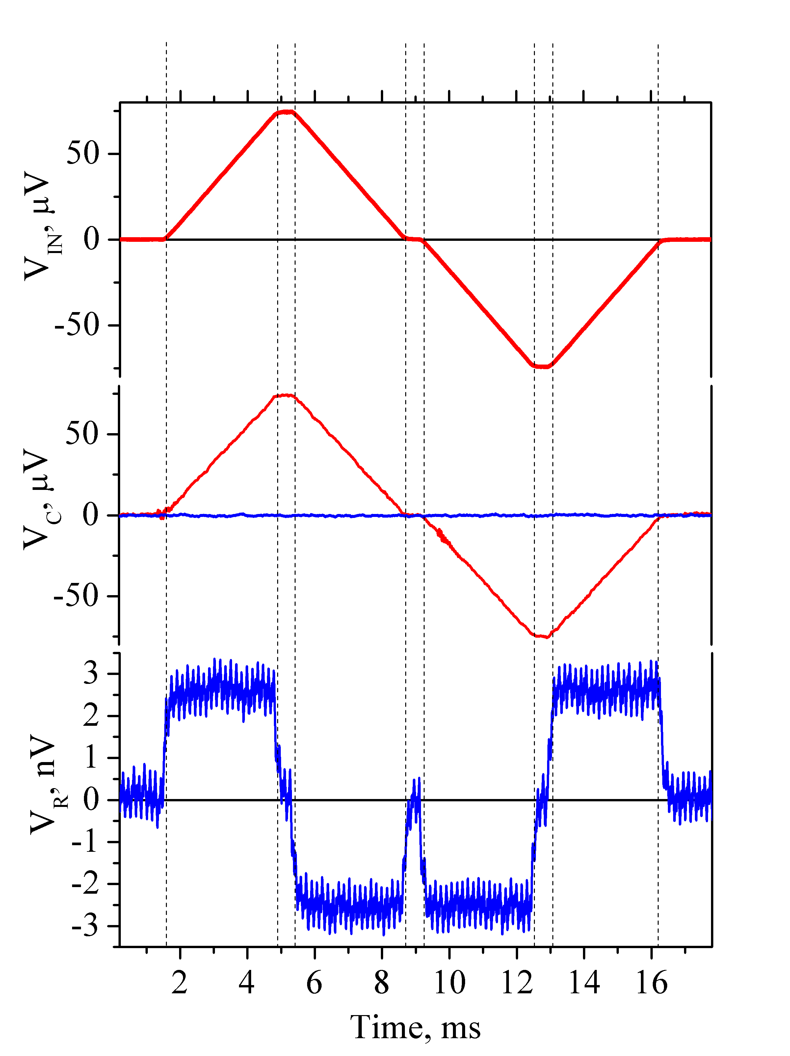
The Landauer Principle
Room temperature operations on a 73 k_{B}T bit of information
Copy 0
Erase 0
Copy 1
Erase 1
Measured dissipation was 0.005 k_{B}T (15 yJ).

Slide 23
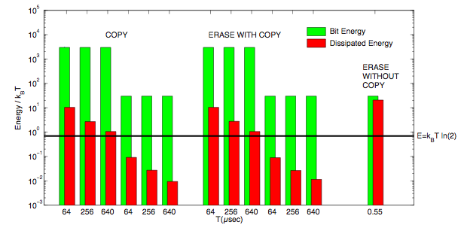
Experimental Summary
Notes:
23

Slide 24
Is There Any Hope?
Yes, but transistors may not be the best way!
It is time to do something different.
Represent binary information by charge configuration!
Quantum-dot Cellular Automata
A cell with 4 dots
2 extra electrons
Developed in the early 90s by
Craig Lent
Wolfgang Porod
Gary Bernstein
Tunneling between dots
Polarization P = -1
Bit value “0”

Slide 25
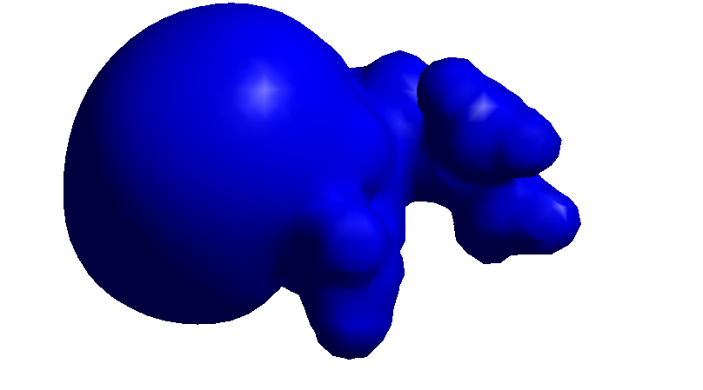
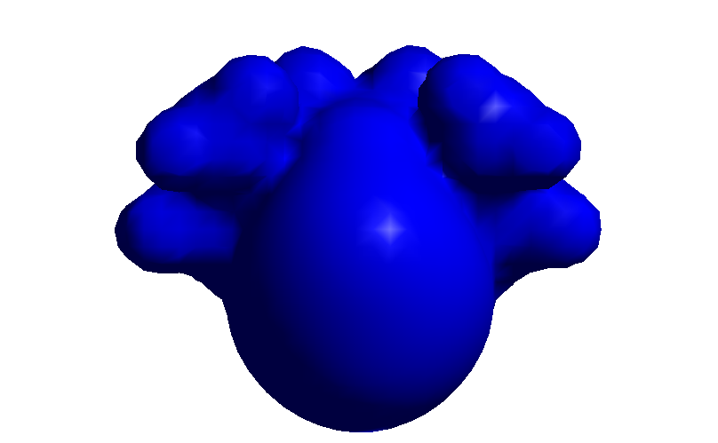
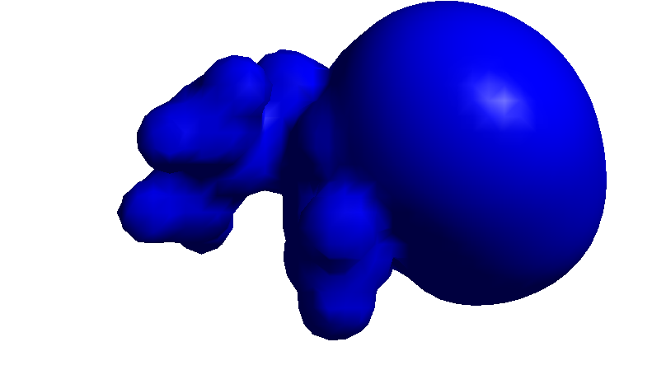
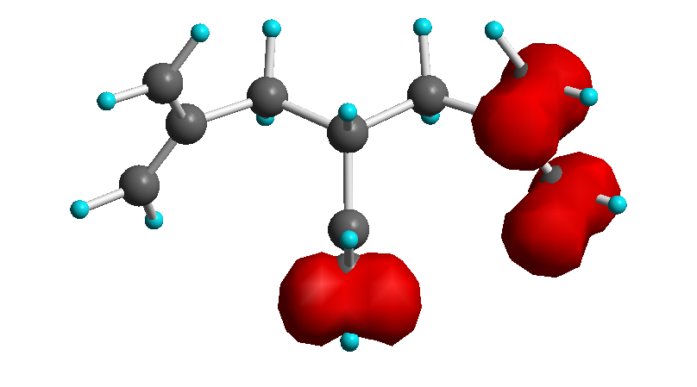
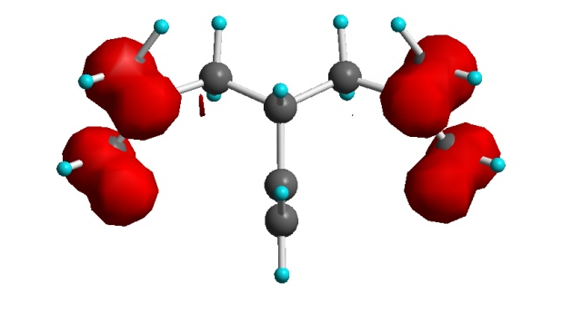
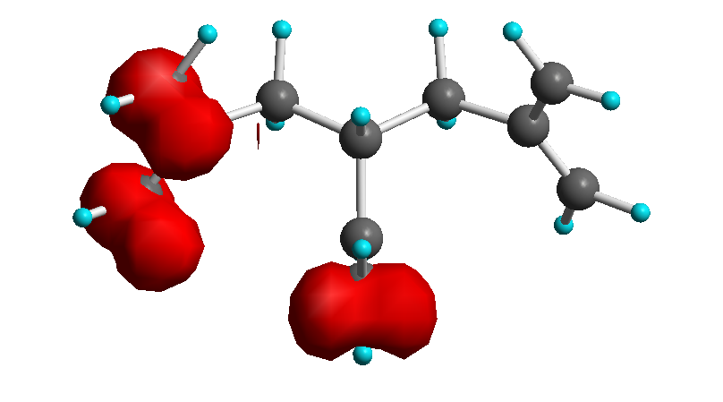
Charge configuration represents bit
isopotential surfaces
+
“0”
“null”
“1”

Slide 26
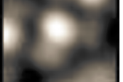
Neutral mixed-valence zwitterion (self-doped)
Synthesis:
John Christie, Kenneth Henderson
Imaging:
Alex Kandel, Natalie Wasio,
Rebecca Quardokas
Awitterionic mixed-valent nido-1,2-diferrocenyl-undecacarborane.

Slide 27
Conclusions
Energy recycling can enable power reduction
Charge is a viable state variable
Alternative state variables face the same limits as charge
There is no fundamental lower limit on the energy needed for computation – only practical ones
The key is to trade speed for power, a trade-off that is already being made.
Low energy dissipation key to implantable applications.

