Slide 1


Integrating the Technical and Human Dimensions of Climate Change: Culture, Communication, Conflict, and Collaboration
Gregg B. Walker, Ph.D.
Member, Faculties of Communication, Environmental Sciences, Forest Ecosystems & Society, Public Policy, and Water Resource Management Programs
Oregon State University, USA
gwalker@oregonstate.edu
The World Conference on Climate Change
24-26 October 2016
Valencia, Spain

Slide 2
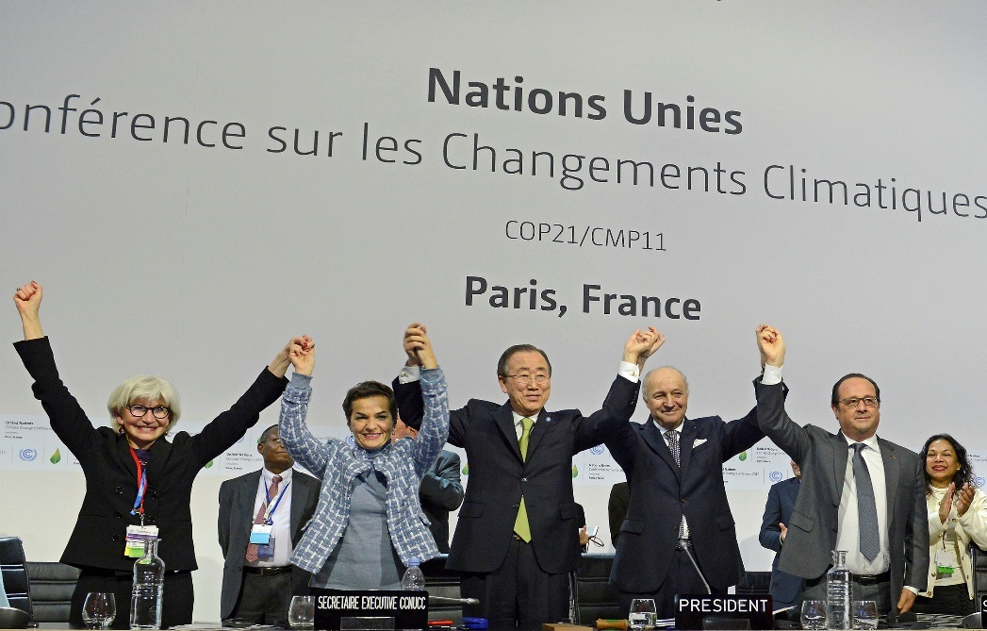
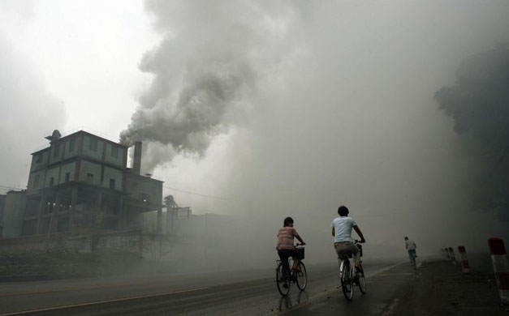
The Preview
Background - The MBB Project (research access)
Technical dimensions and human dimensions of climate change policy
Beyond Paris – Human dimensions and implementation

Slide 3
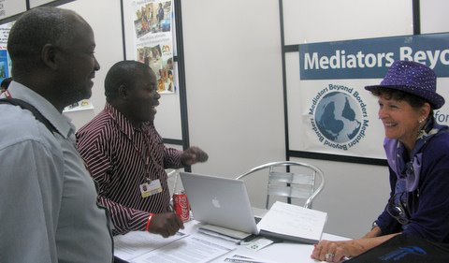

The MBBI Climate Change Policy Project
Started in 2009 - Team members at 23 of the last 27 meetings and last seven Conference of the Parties (COPs).
Walker at 21…heading to Marrakesh later this year…and buying carbon offsets

Slide 4


And…
I chair the Climate Change Negotiations Working Group of the International Environmental Communication Association (IECA)
I am a member of the Steering Committee of RINGO – the Research and Independent Non-government organization constituency, one of nine Civil Society Organization (CSO) constituencies (others are ENGO, BINGO, YOUNGO…)

Slide 5
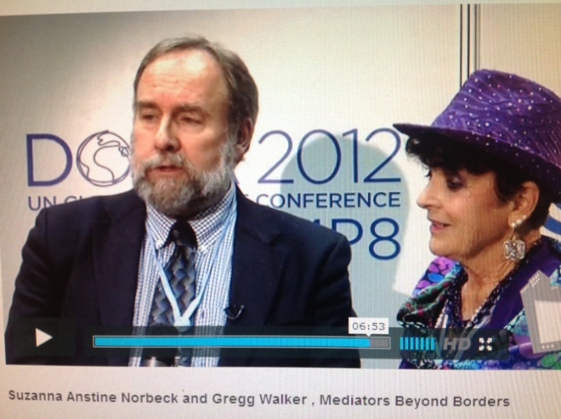

As a UNFCCC observer
I advocate for “conflict resolution capacity building” and treaty language that features peaceful means for resolving conflicts…
I participate in the UNFCCC process as an “in-situ” researcher…
I observe negotiations and talk with parties…
I study the negotiation “discourse(s)”
http://climatechange-tv.rtcc.org/cop18-co-chairs-could-help-aid-lca-track-of-climate-talks/

Slide 6
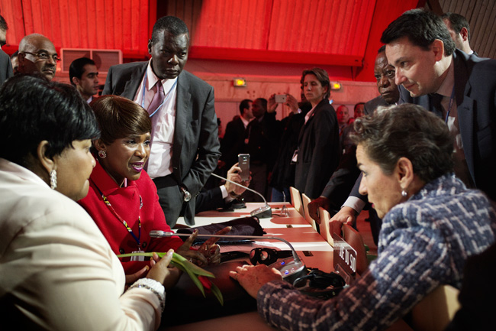
UNFCCC Negotiations
The “Big Four” Issues
Over two decades of negotiations on:
Mitigation
Adaptation
Finance
Technology

Slide 7

The Big Four Issues
Although human dimensions have been discussed in relationship to the four major issues (particularly adaptation)…
Much of the work has come from civil society
Progress has been made on some specific matters, such as REDD+ and the Doha Work Programme on Article 6
The IPCC has increasingly recognized human dimensionsLet’s look at the Paris Agreement

Slide 8
Mitigation in the Paris Agreement
Holding the increase in the global average temperature to well below 2°C above pre-industrial levels and pursuing efforts to limit the temperature increase to 1.5°C above pre-industrial levels… [Article 2]
Parties…undertake rapid reductions thereafter in accordance with best available science, so as to achieve a balance between anthropogenic emissions by sources and removals by sinks of greenhouse gases in the second half of this century…[Article 4]
Parties should take action to conserve and enhance, as appropriate, sinks and reservoirs of greenhouse gases as referred to in Article 4, paragraph 1 (d), of the Convention, including forests. [Article 5]

Slide 9
Adaptation in the Paris Agreement
Parties hereby establish the global goal on adaptation of enhancing adaptive capacity, strengthening resilience and reducing vulnerability to climate change… [Article 7]
[Parties should] assess climate change impacts and vulnerability, with a view to formulating nationally determined prioritized actions, taking into account vulnerable people, places and ecosystems…[and include] monitoring and evaluating and learning from adaptation plans… [Article 7]

Slide 10
Climate Finance in the Paris Agreement
Developed country Parties shall provide financial resources to assist developing country Parties with respect to both mitigation and adaptation…[Article 9]
The Financial Mechanism of the Convention, shall aim to ensure efficient access to financial resources through simplified approval procedures and enhanced readiness support for developing country Parties…[Article 9]

Slide 11
Technology in the Paris Agreement
Parties share a long-term vision on the importance of fully realizing technology development and transfer in order to improve resilience to climate change and to reduce greenhouse gas emissions. [Article 10]
Accelerating, encouraging and enabling innovation is critical for an effective, long-term global response to climate change and promoting economic growth and sustainable development. [Article 10]

Slide 12
UNFCCC negotiations and the Paris Agreement
Have emphasized the technical dimensions of climate change policy
Relied on the IPCC reports as a foundation
Have created institutions that relate to technical, regulatory, and legal matters
Post-Paris, implementation and improvement are key
Implementation and improvement elevate the human dimensions

Slide 13
Technical and Human Dimensions
High
Technical
(incl. legal,
regulatory)
Low
Low High
Human (cultural, social, economic)

Slide 14
Technical and Human Dimensions
High X - Kyoto Protocol/CDM
Technical
(incl. legal,
regulatory)
Low
Low High
Human (cultural, social, economic)

Slide 15
Technical and Human Dimensions
High X – The Paris Agreement
Technical X - Implementing
(incl. legal, The Paris
regulatory) Agreement
Low
Low High
Human (cultural, social, economic)

Slide 16


Key Human Dimensions
Culture
Communication
Conflict
Collaboration
Key Point: some of these appear in the Paris Agreement, but HDs need greater attention during implementation.

Slide 17
Culture
In the Paris Agreement Preamble and Article 7 (Adaptation)
Parties should, when taking action to address climate change, respect, promote and consider their respective obligations on human rights, the right to health, the rights of indigenous peoples, local communities, migrants, children, persons with disabilities and people in vulnerable situations and the right to development, as well as gender equality, empowerment of women and intergenerational equity.

Slide 18
Implementing Culture
Climate change policies need to be culturally appropriate.
Members of relevant cultural communities need to be engaged as partners and leaders throughout the implementation process.
Traditional knowledge (indigenous, local) should be incorporated into implementation and monitoring activities.

Slide 19
Communication
In the Paris Agreement – communication is formal and institutional
Parties are to undertake and communicate ambitious efforts…[Article 3]
Each Party shall prepare, communicate and maintain successive nationally determined contributions [Article 4]
All Parties should strive to formulate and communicate long-term low greenhouse gas emission development strategies…[Article 4]
Each Party should, as appropriate, submit and update periodically an adaptation communication [Article 7]
Developed country Parties shall biennially communicate indicative quantitative and qualitative information (about climate finance)…[Article 9]

Slide 20
Implementing Communication
Communication needs and competencies need to be addressed in every climate context and scale
Parties and non-party actors should develop climate communication strategies that account for audiences and address messages, methods (e.g., media and face-to-face) and meanings
Climate communication activity should be both informal and formal; vertical and horizontal

Slide 21
Conflict (and Conflict Management)
In the Paris Agreement
Climate change-related conflicts are not acknowledged
Methods for managing climate chang-related conflicts are not addressed
The Paris Agreement does establish facilitation as an aspect of implementation and compliance: “A committee that shall be expert-based and facilitative in nature and function in a manner that is transparent, non-adversarial and non-punitive.” [Article 15]

Slide 22
Implementing Conflict Management
Parties should acknowledge the potential for climate change-related conflicts – at every scale, both vertically and horizontally
Committees (e.g., the Adaptation Committee) and Mechanisms (e.g., Loss and Damage) should address conflict and conflict management
The UNFCCC should link its work to the UN mediation efforts and resources
Conflict management training should be encouraged

Slide 23
Collaboration
(cooperation, pluralism, partnerships, governance)
In the Paris Agreement
Parties shall, where engaging on a voluntary basis in cooperative approaches that involve the use of internationally transferred mitigation outcomes towards nationally determined contributions, promote sustainable development and ensure environmental integrity and transparency, including in governance [Article 6]
Parties recognize the importance of support for and international cooperation on adaptation efforts… [Article 7]
The Warsaw International Mechanism shall collaborate with existing bodies and expert groups under the Agreement…[Article 8]

Slide 24
Implementing Collaboration
Parties and civil society working together – collaboratively – is essential to implementation
Committees, mechanisms, negotiating bodies (e.g., SBI), civil society, and affected communities should locate opportunities for diverse stakeholder participation, joint decision-making, and shared implementation (collaborative governance)
Like other HDs, work together vertically and horizontally
Bring technical and human dimensions communities together

Slide 25
Beyond Paris
Human dimensions need to be integrated and operationalized throughout the Paris Agreement implementation plans
UNFCCC committees and mechanisms need to address human dimensions – through “expert panels” and community engagement
Article 6 or “ACE – Action for Climate Empowerment” features human dimensions
Civil society – non state actors – can play an important role
Continue the connection to sustainable development efforts (the Sustainable Development Goals)

Slide 26
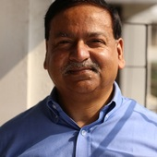

Integrating Technical
& Human Dimensions
Capacity Building provides the confluence
As Saleemal Huq and Naznin Nasir of the Independent University, Bangladesh, wrote recently:
In Bangladesh, we need more local ability to both prevent catastrophic climate change…and also to deal with its effects… Local people need the skills to use important climate-related technologies. Improved planning and access to climate information, for instance, can allow farmers to better prepare for disasters and cope with climatic variability… Article 11 of (The Paris Agreement) reaffirmed that capacity building and climate education are essential to climate action …It is now time for developing real capacity building approaches, instead of mindless spending on presentations and seminars.
(www.theconversation.com; 03 October 2016)

Slide 27
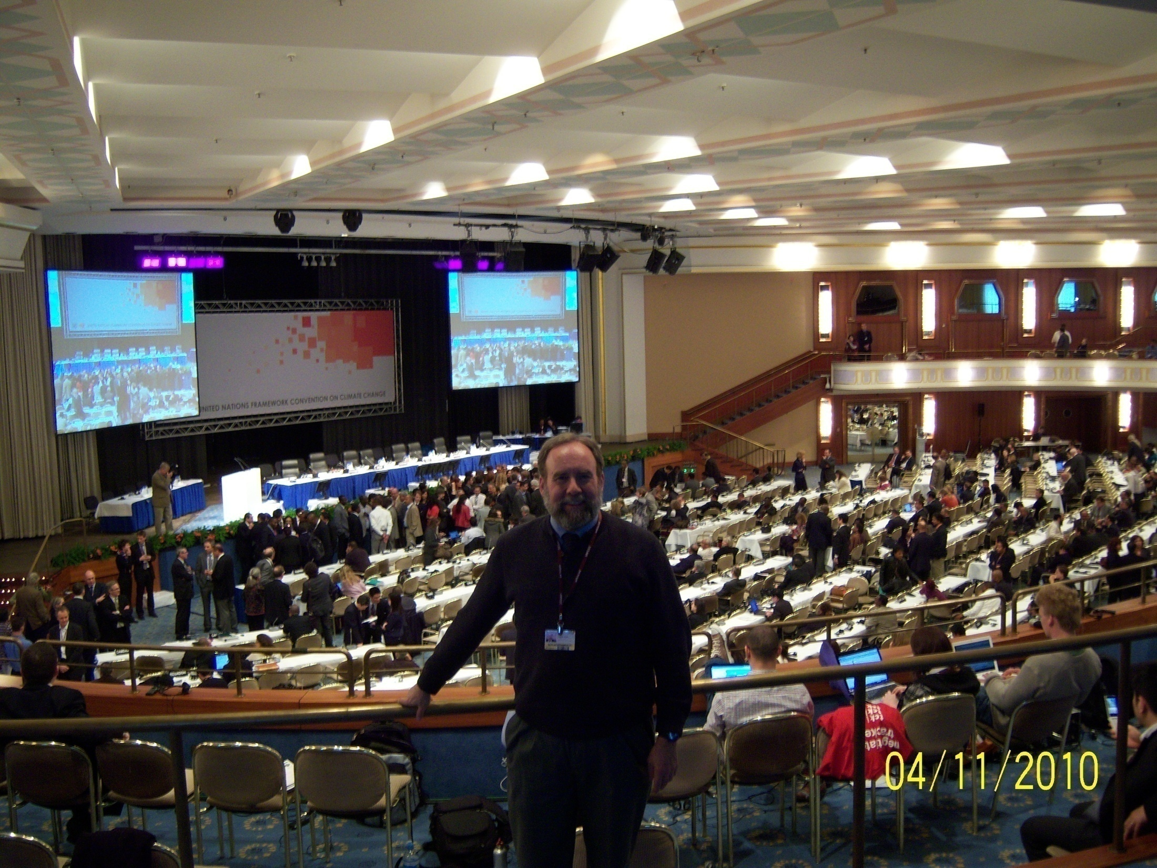
Thank you for interest!
I welcome your comments, questions, concerns…
-- Gregg

