Slide 1
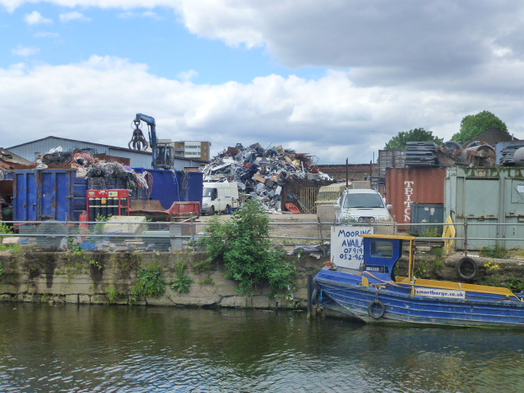


SmArt Cities and Waste:
Developing an interdisciplinary Network for Waste Management & Treatment Innovation
Professor Graeme Evans

Slide 2

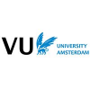


SmArt Cities and Waste:
Developing an interdisciplinary network for waste management and treatment innovation
UK-Dutch partnership [AHRC-funded] 2016-18
Research-practitioner workshops in 4 cities (Amsterdam, Maastricht, London, Bangor-Wales)
Demonstration / Citizen Science projects
Knowledge exchange and network development through website/social media/workshops

Slide 3
Aims of the Waste network
Primary aim: Interdisciplinary Knowledge Exchange and capacity building: arts/science/policy/practitioners/ ‘the public’
Secondary aim: Identify key ‘intervention points’ most suitable for developing interdisciplinary, ‘participatory design’ approaches through demonstration projects:
e.g. site-based - London Olympic Park, IBA Limburg/Chemelot Campus;
EU projects: BioMoP LIFE, Eutropolis H2020

Slide 4
Sustainable waste management: on the policy agenda across Europe…
We need to develop further the concept of a circular economy, where one person's waste becomes another's valuable resource…Making the changes requires innovation and creative thinking and community/public/stakeholder-led approaches (Prevention is better than cure: The role of waste prevention in moving to a more resource efficient economy , UK Govt. 2013)
the construction and organic waste chains have plenty of potential to become circular. A chain is the process of production, transport, consumption and waste; in the various steps of the process, value is either added or lost…. (Circular Amsterdam, 2016)

Slide 5
City Waste Challenge
In Europe total waste production amounts to over 2.5 billion tonnes, but only a limited share (36%) is recycled, with the rest landfilled or burned
Of the 600m tonnes of products and materials that enter the UK each year, only 115m is recycled - 60% of all waste generated in London is currently exported for treatment or disposal outside of the city - UK Govt’s Waste Strategy states that waste should be managed as close as possible to the point of production…
The total volume of waste generated globally is expected to increase by nearly 50% over the next decade, however there are major variations in landfill disposal - Copenhagen (2%), Paris (11%), to New York (64%)
European Water Framework Directive (2000) Water Quality targets were not met by 2015…

Slide 6
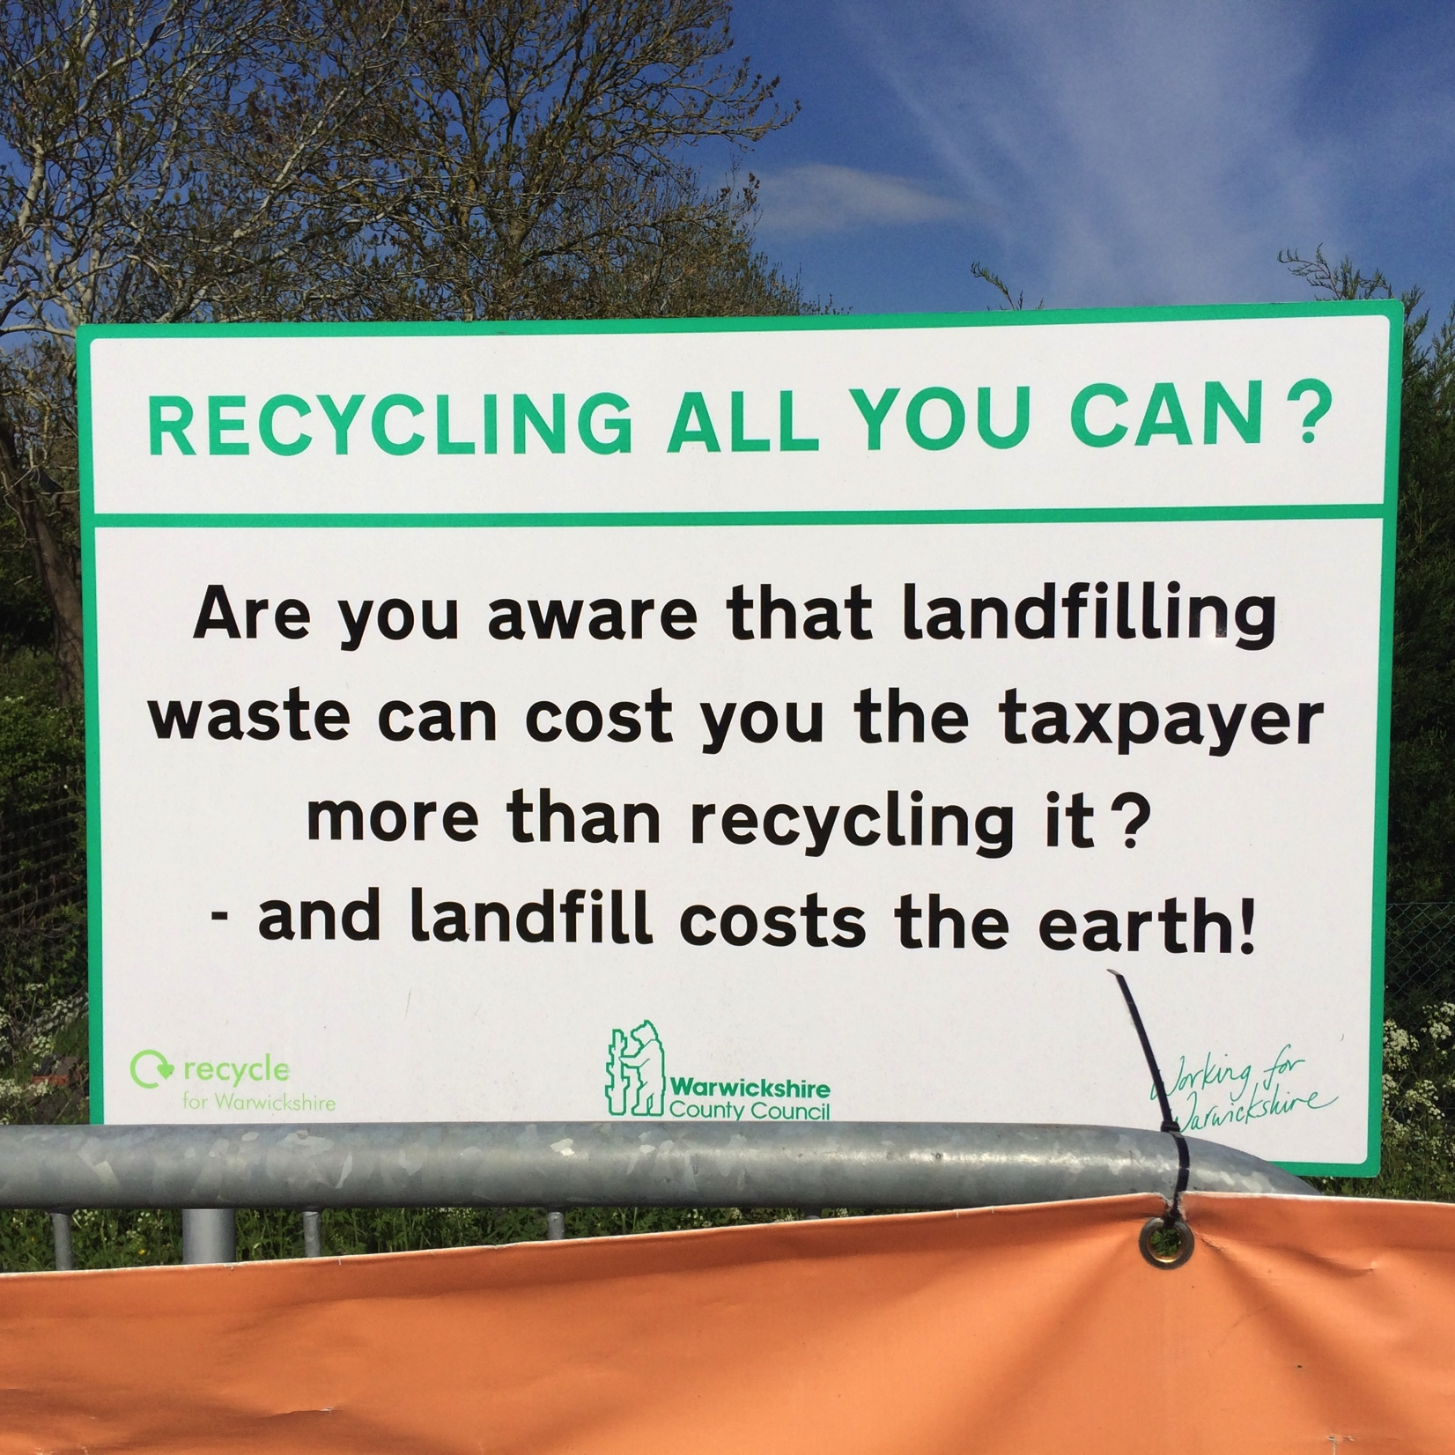
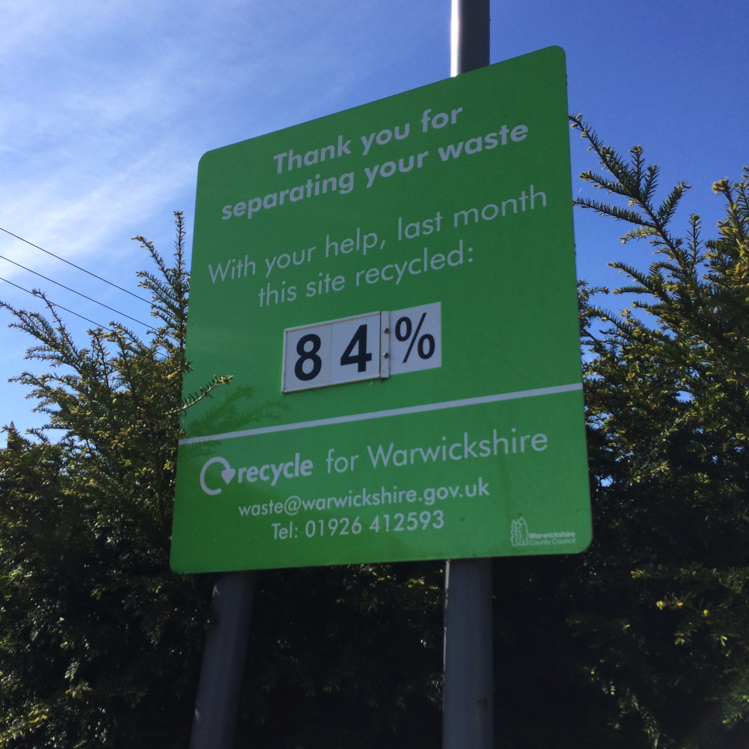
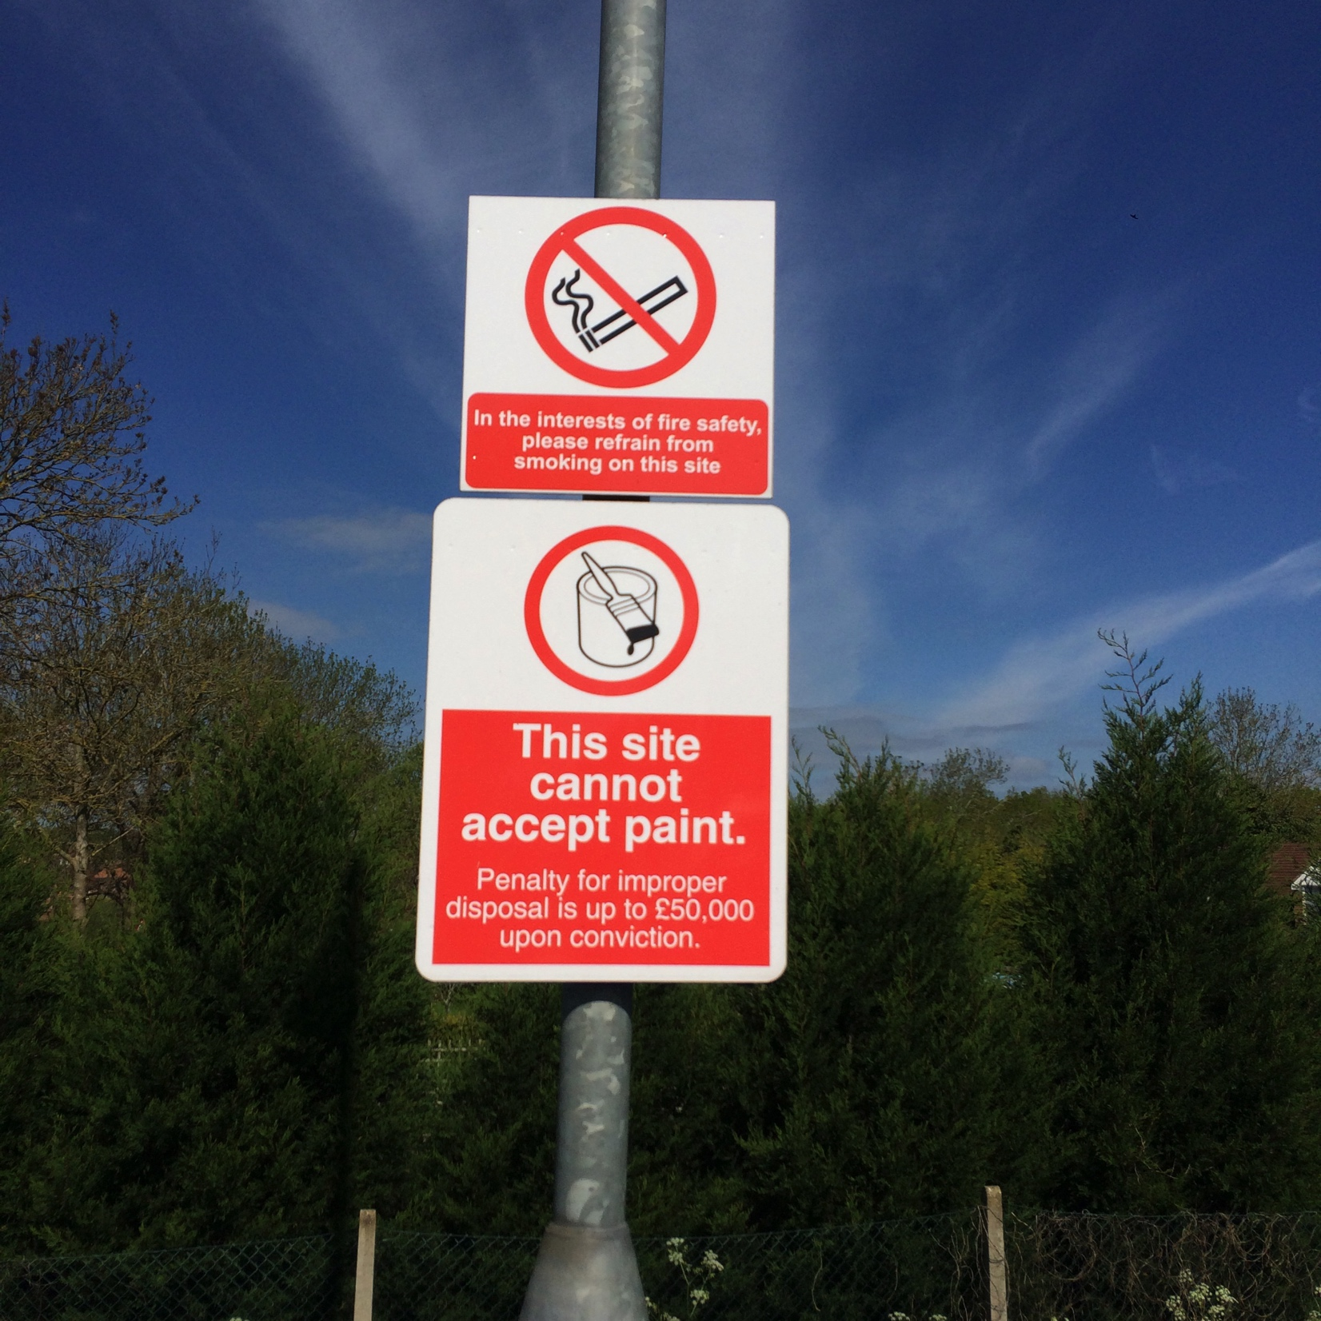
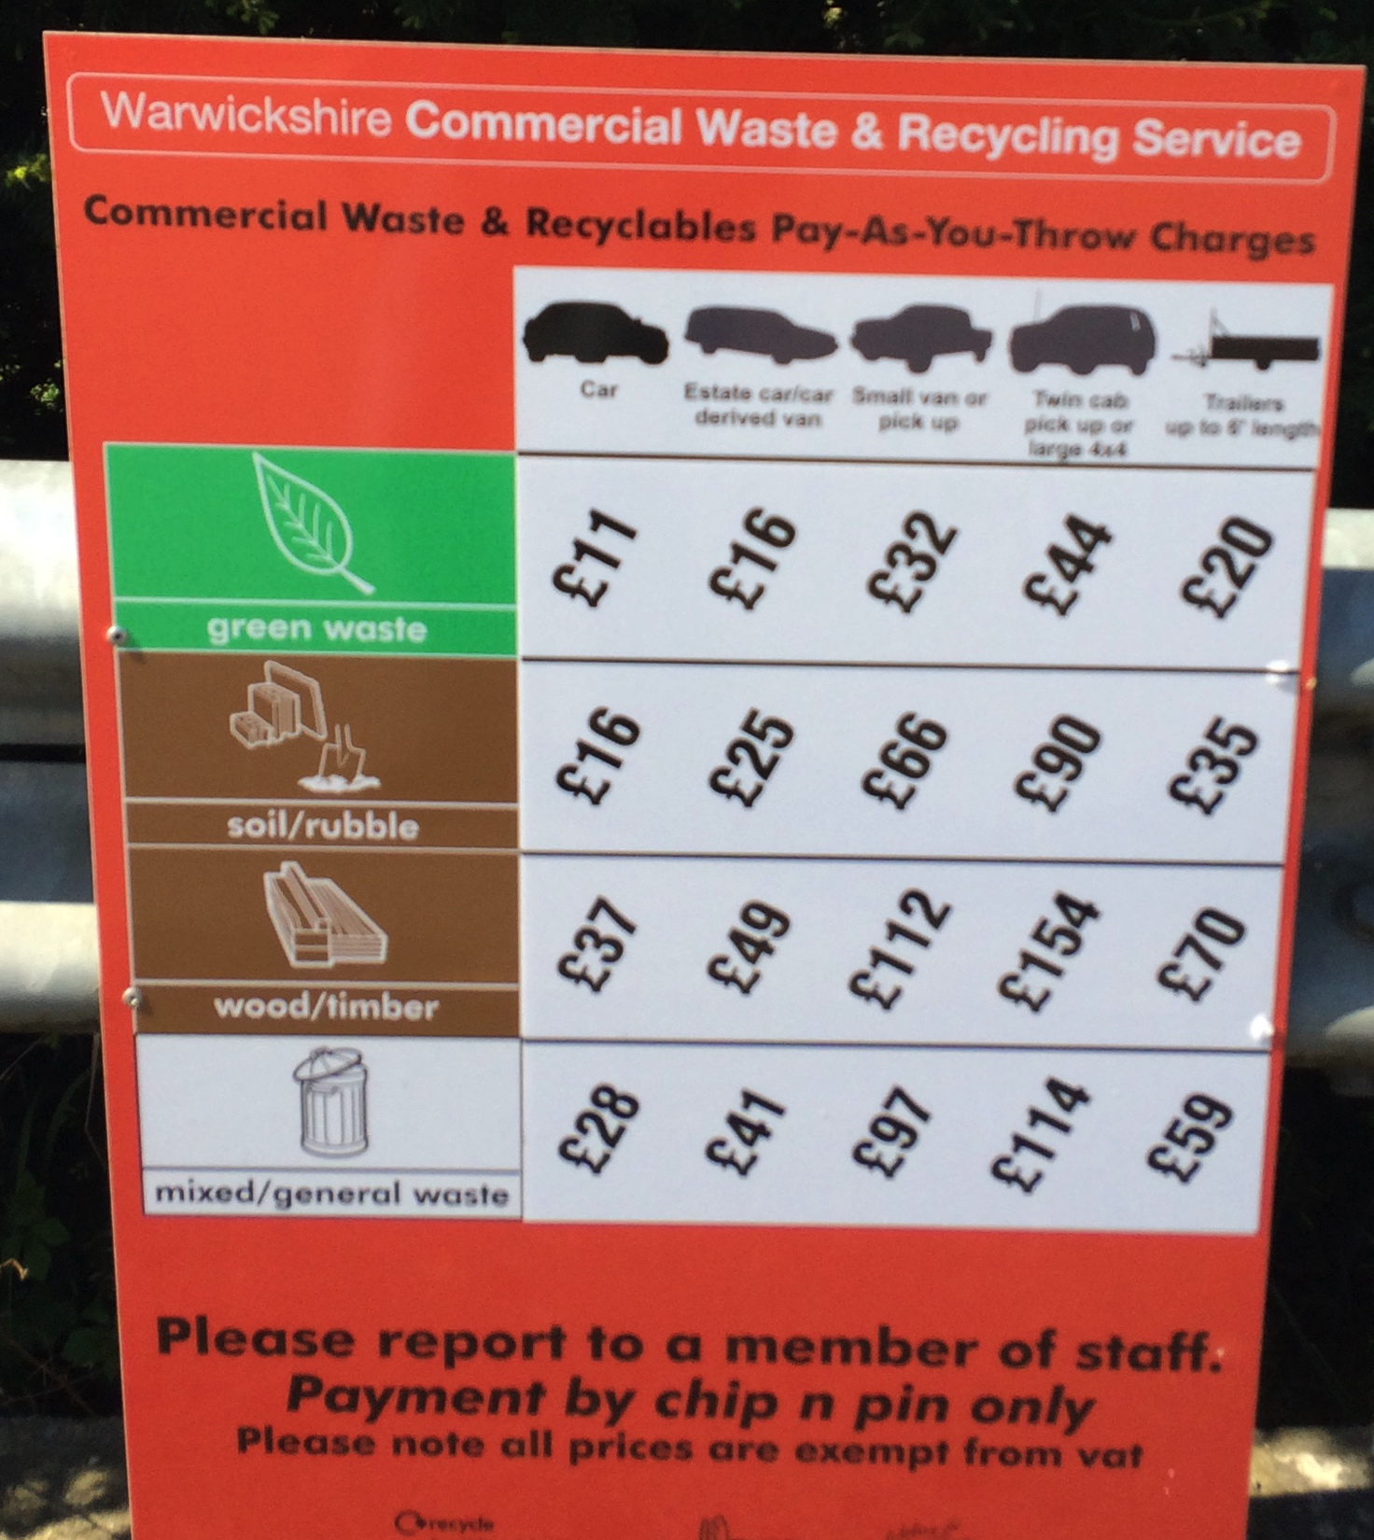
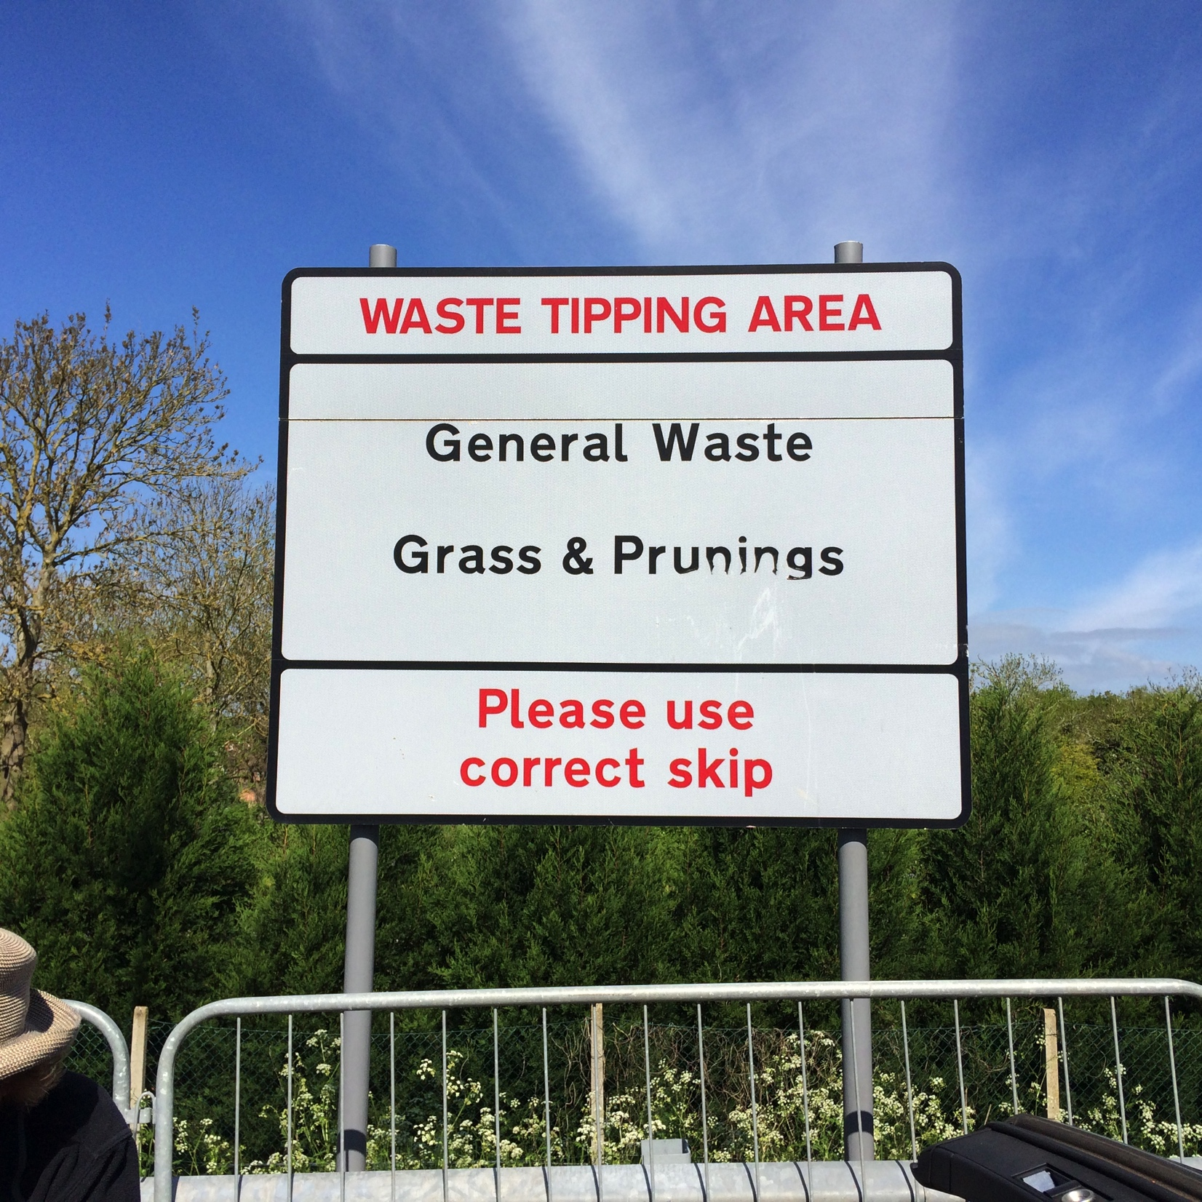
Municipal Waste Challenge

Slide 7
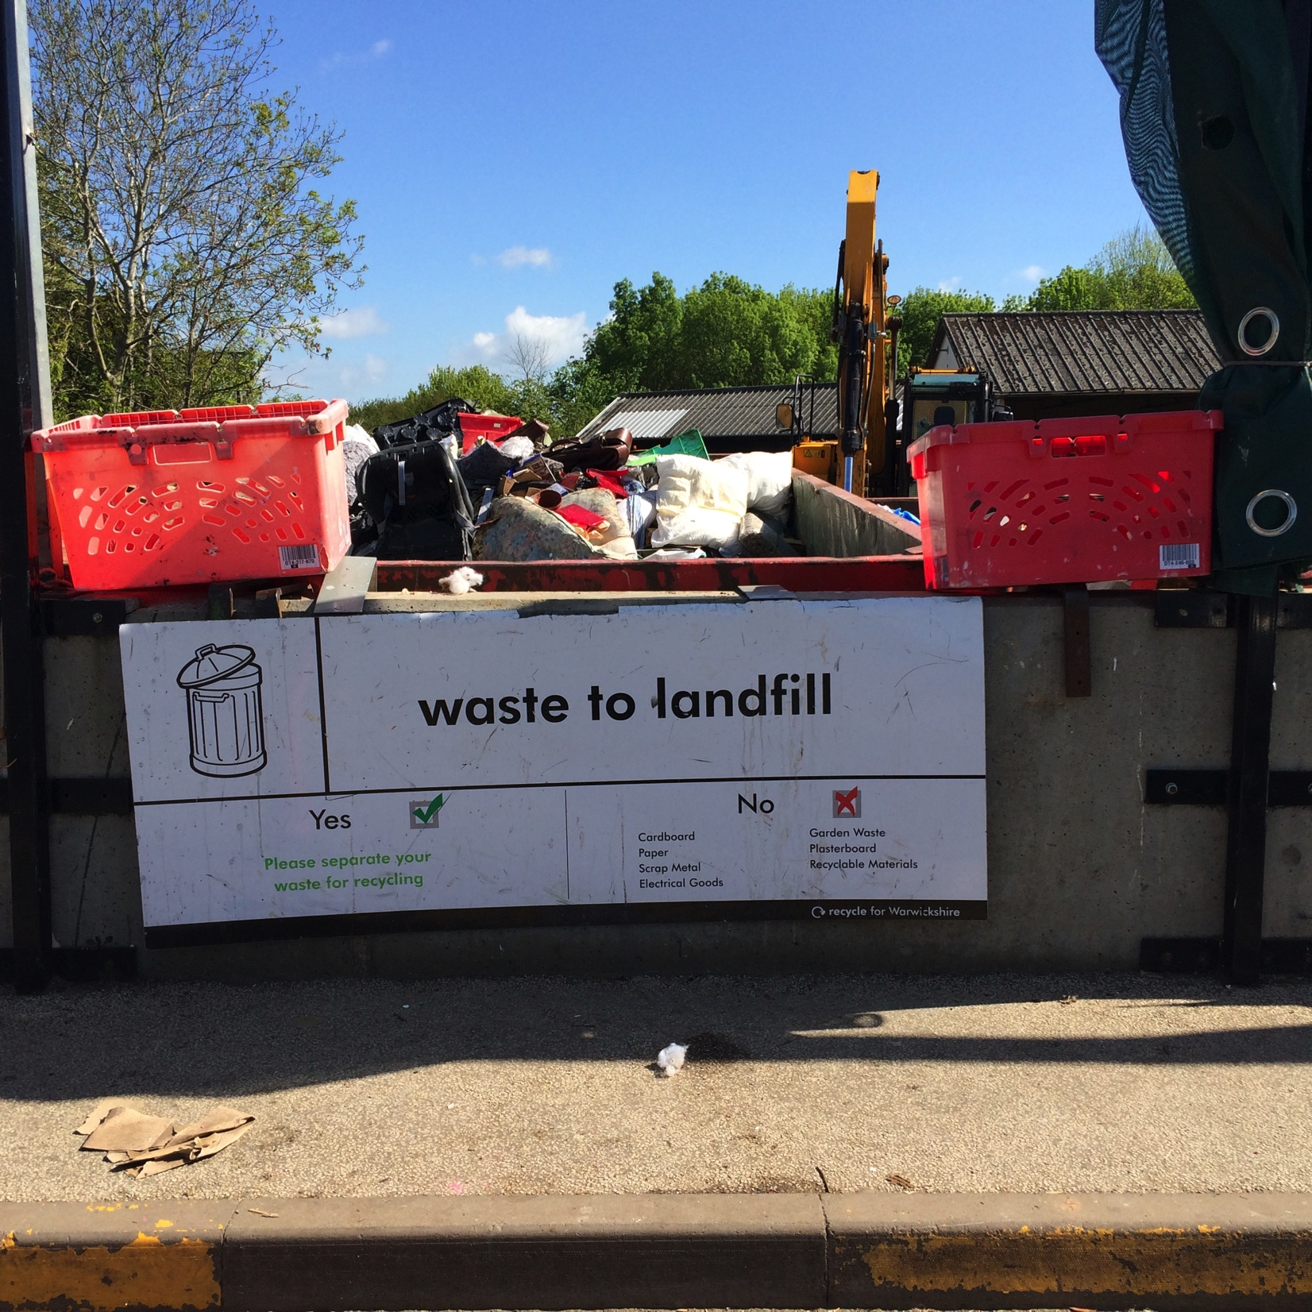
Waste Hierarchy (DEFRA, UK 2011)
Prevention
Preparing for Re-Use
Recycling
Disposal
Other recovery
Using less material in design and manufacture; Keeping products for longer; Using less hazardous material; Re-use
Checking, cleaning, repairing, refurbishing, repair, whole items or spare parts
Turning waste into a new substance or product. Includes composting if it meets quality protocols
Including anaerobic digestion, incineration with energy recovery, gasification and pyrolysis which produce energy (fuels, heat and power) and materials from waste; some back filling operations
Land fill and incineration without energy recovery

Slide 8
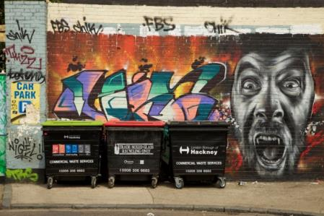
Waste is a social/cultural product
Techno/scientific waste innovation needs to have input from intermediary and end users
Participatory design
Scientific citizenship
Local knowledge
Behavioural Change
→ Role of art & design and social sciences/Society Technology Studies (STS)

Slide 9
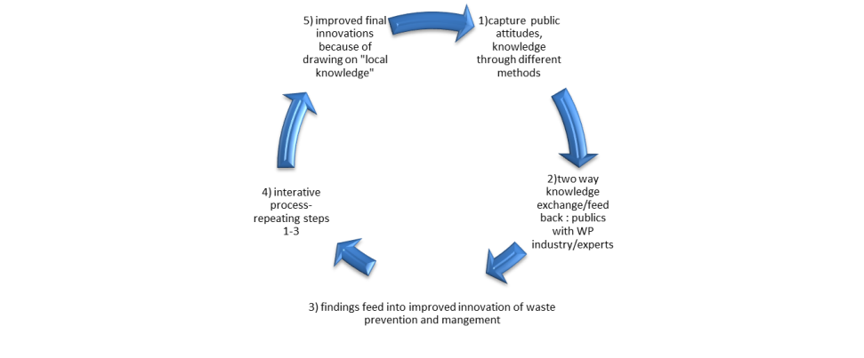
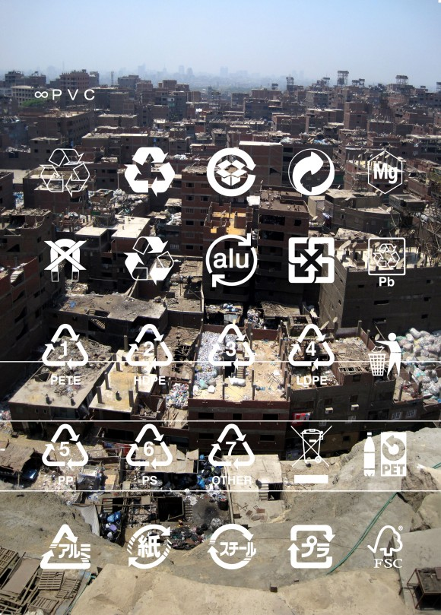

Slide 10
Network Waste themes
Construction (re-use, recycling)
Water recycling (grey/black water)
Water sampling, tracing pollution sources
Anaerobic digestion-energy (biogas, solar)
Bioplastics: bio-inspired monomers & polymers
Biomining: biological and bioelectrochemical recovery of critical and scarce metals
Municipal recycling design (home, ‘dumps’)
Artists pop-ups and waste installations

Slide 11
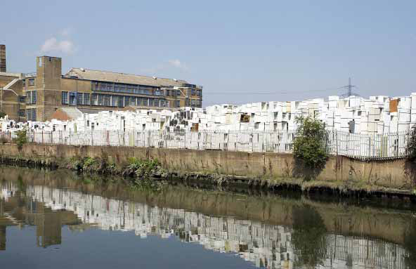
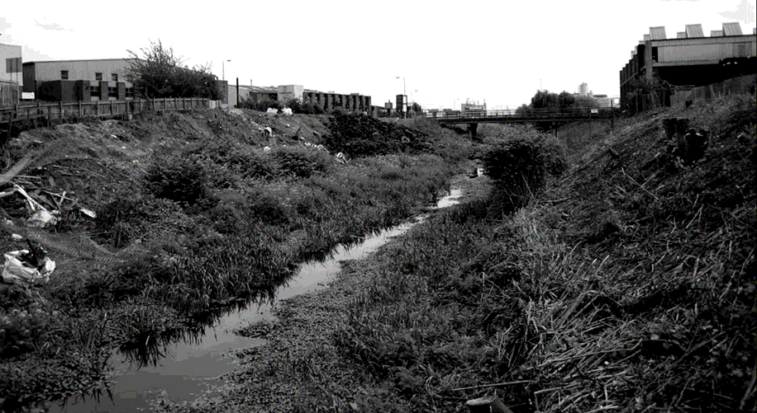
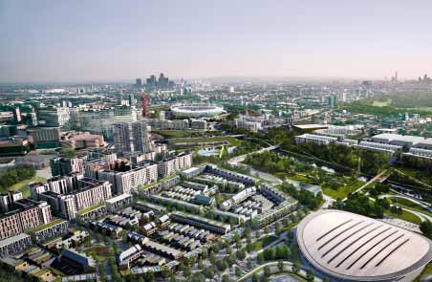
One Planet Olympics, London 2012
The original Summer Olympics bid focused on five sustainability themes:
Climate change
Waste
Biodiversity
Inclusion
Healthy living
Green building measures included:
water recycling - recycled water is any water that has been recovered from disposal and redirected back into use, most commonly after some processing
halving the carbon footprint of all construction projects
sourcing 25% of project materials from recycled sources

Slide 12
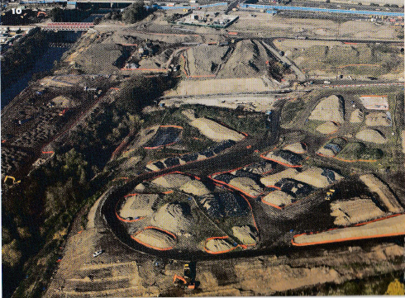
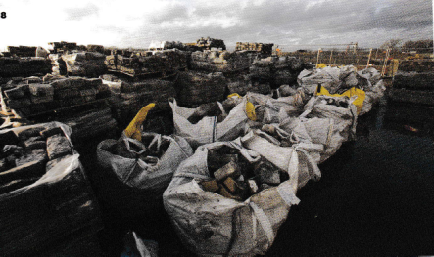
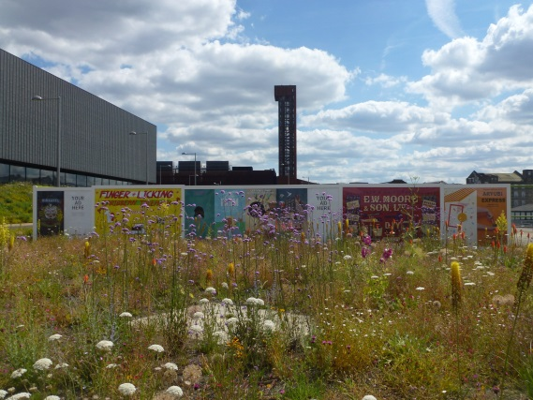
Recycling and reuse of materials
1.4 million cubic metres of soil were treated
80% of the excavated soil was re-used on site (vs. 50% industry standard)
A ‘soil hospital’ used industrial cleaning machines to remove contaminants e.g. oil, petrol, tar and toxic heavy metals including arsenic, lead and zinc from soil
4,000 tonnes of crushed concrete was salvaged 10,000m³ crushed into gabion walls, 25% was reused in foundations, the rest offsite
98% of demolition material was reused or the majority recycled

Slide 13
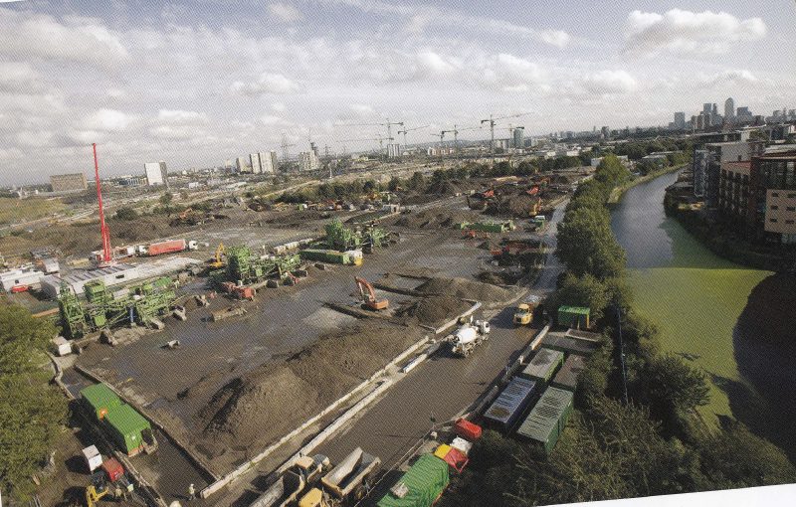
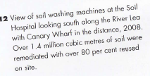
The majority of soil was washed and the remainder treated by complex sorting, chemical stabilisation or bioremediation
Over 80,000 cubic metres of soil were treated by this method not previously used in the UK on this scale

Slide 14
Waste Management
NEW CONSTRUCTION
• Zero municipal waste directly to landfill by 2025.
• All new buildings to have adequate internal/external storage space for recyclable household waste
• Promote on-site compost facilities to reduce the amount of household waste sent to landfill
VENUES & PARKLANDS
• Recycle or compost 70% of commercial waste by 2015
• 100% provision of recycling facilities in public areas
• Zero parklands waste to landfill by 2030
CORPORATE
• Develop education programmes for visitors, workers, and residents about reduction and management of waste, e.g. blackwater recycled non-potable water
• Integrate sustainability requirements into supplier contracts & rules
• Monitor performance, publish data to set benchmarks, and report on sustainability targets

Slide 15
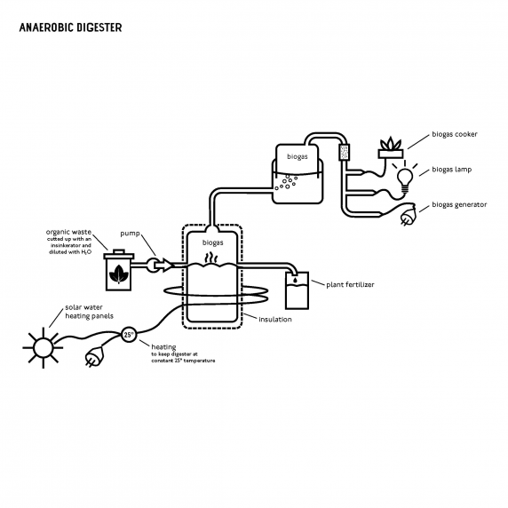
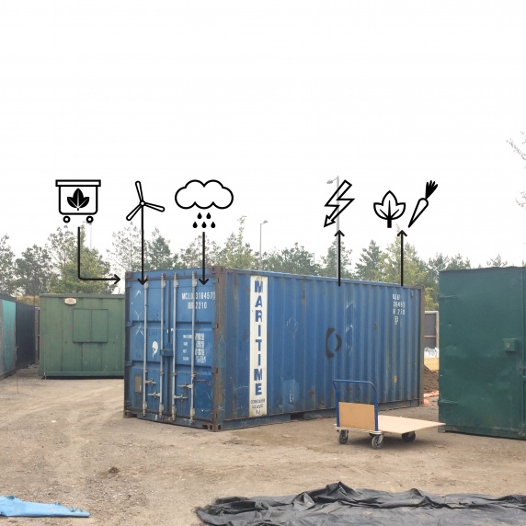
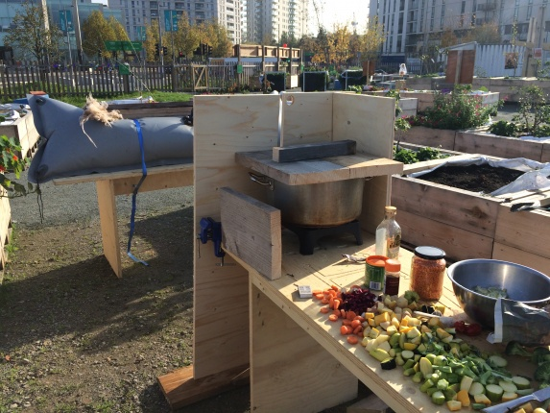
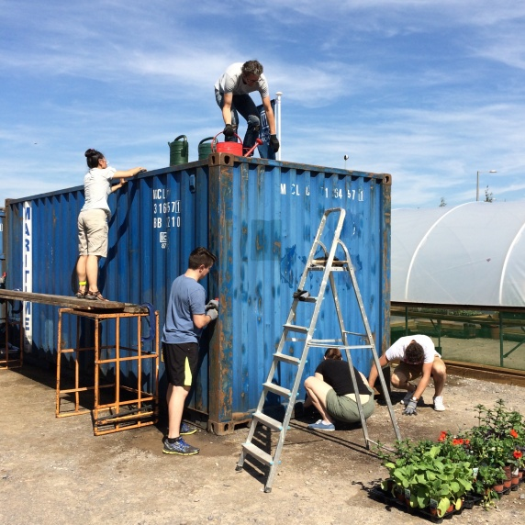
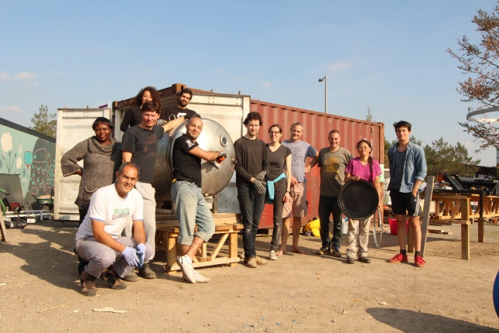
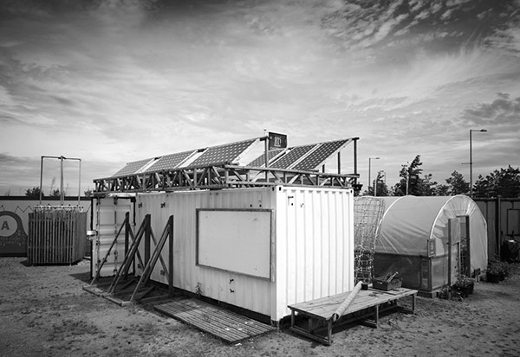
Anaerobic Digestion self-build

Slide 16
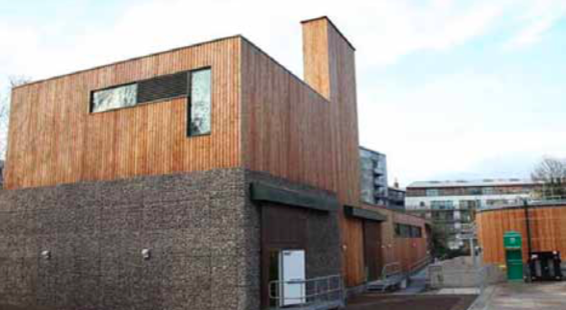
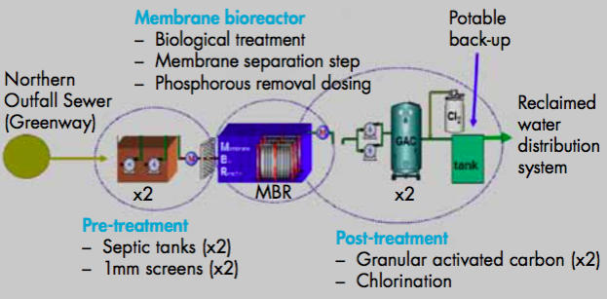
Water Recycling Centre
Greywater is wastewater from wash basins, showers/baths, which can be recycled for uses such as toilet flushing and landscape irrigation and often includes waste water from laundry, dishwashers and kitchen sinks. It differs from the waste water of toilets which is designated sewage or blackwater to indicate it contains human waste.
New homes incorporate water
efficient taps, toilets & shower
heads, and plants requiring less
water meeting a standard of
90lppd, vs. 125lppd outlined
under Building Regulations, and
below the national average water
use of 142lppd. Additional savings
made through the Old Ford Water
Recycling Plant (above), which uses
advanced treatment processes to turn blackwater (sewage waste water) into non-potable water for irrigation and toilet flushing. (lppd=litres per person and day)

Slide 17









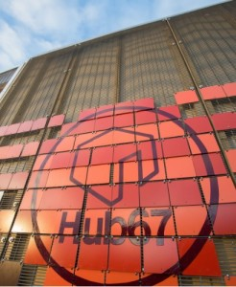


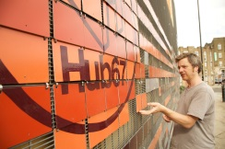
Cre8 ARC
The Cre8 Arc is an eco hub, permaculture gardens and sporting facility built using reused and recycled material from the Olympic Park.
The Cre8 Arc is a passive, off grid out-house and permaculture garden designed and built by a pioneering project team using materials from the London 2012 Games and local organisations to showcase a sustainable legacy of London 2012.
Built by the community, for the community, the Cre8 Arc is a template for innovation in sustainable design and community engagement. A voluntary project supported by professionals from local companies and universities.
Hub67 Community Centre, built with recycled materials -(timber, steel, ceramics, wire…)

Slide 18
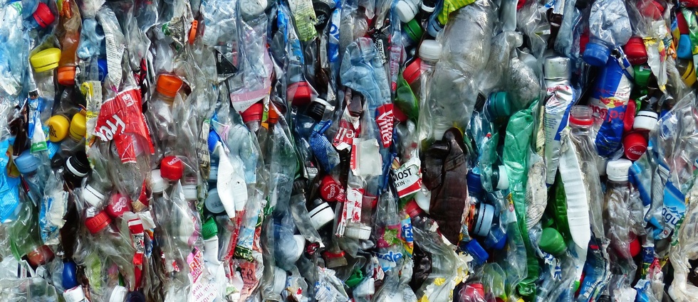
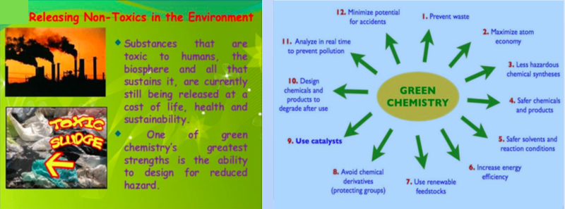
BioInspired Monomers and Polymers (BIMoP)
IA (itaconic acid)-based monomers and polymers are used to produce bio-based adhesives, inks and paints to ensure that the most common bioplastics used for food-packaging, such as polylactic acid (PLA), maintain the biodegradable and compostable properties required by the EU standard EN 13432

Slide 19
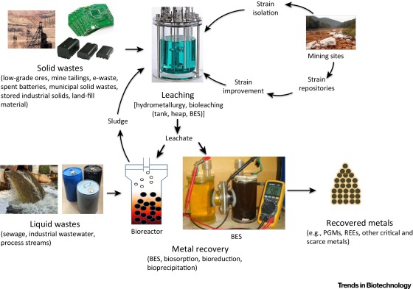
Biomining (Eutropolis)
Techno scientific waste innovation example
Biological and Bioelectrochemical Recovery of Critical and Scarce Metals
Nancharaiah, Y.V. et al. Trends in Biotechnology , 34 (2 ), 137-155, 2016

Slide 20
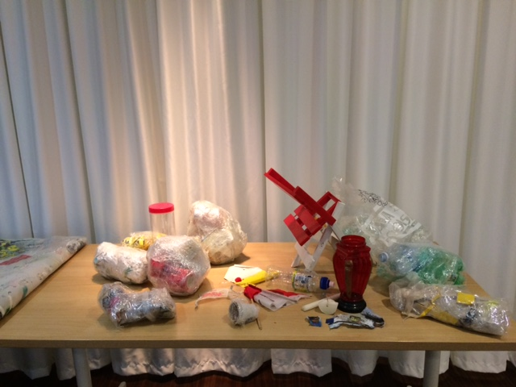
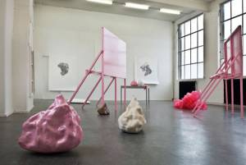
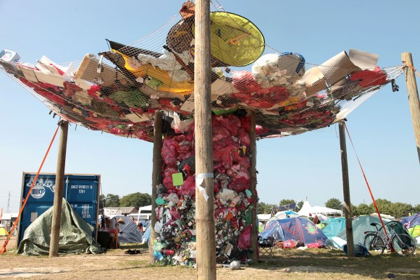
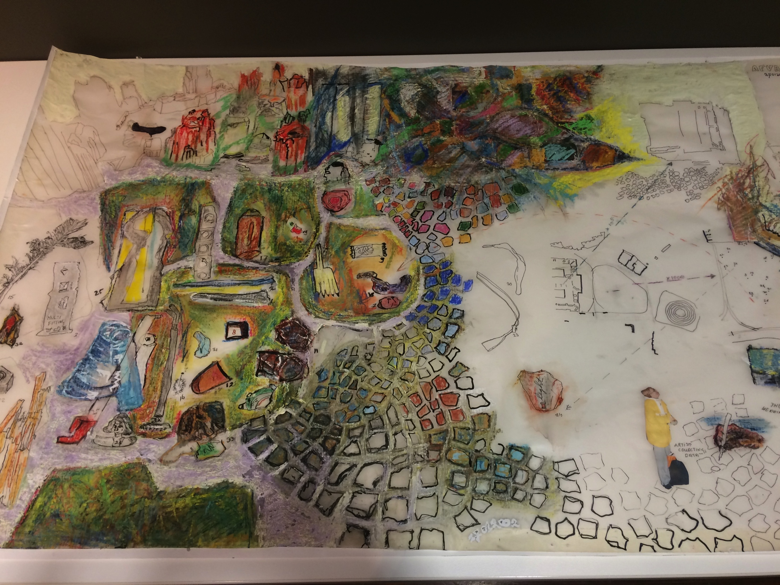
Artists interventions and installations

Slide 21
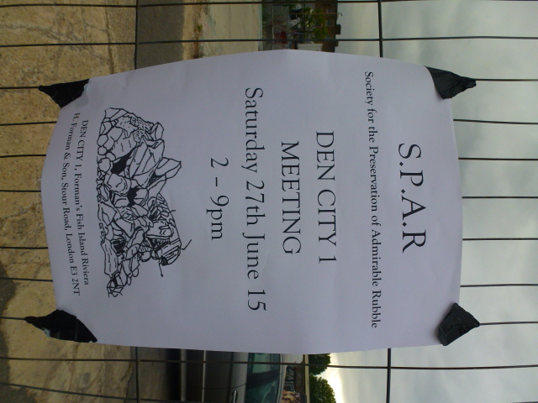
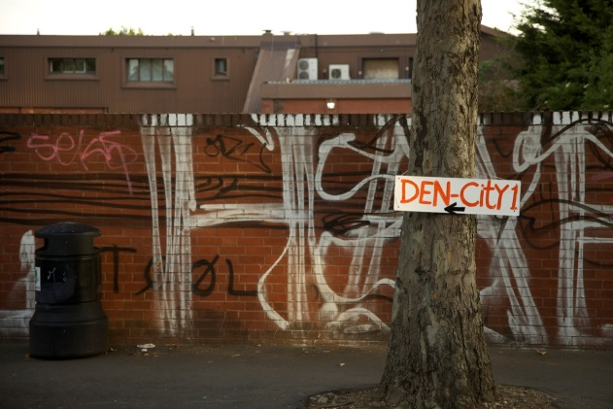
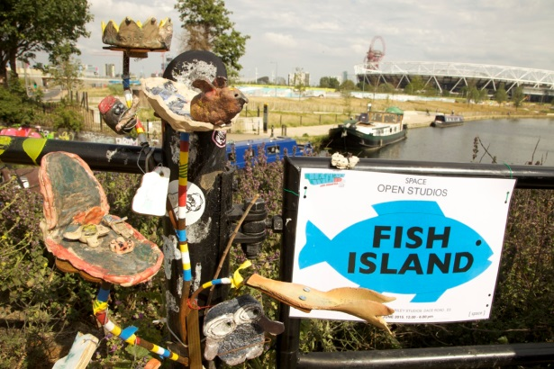
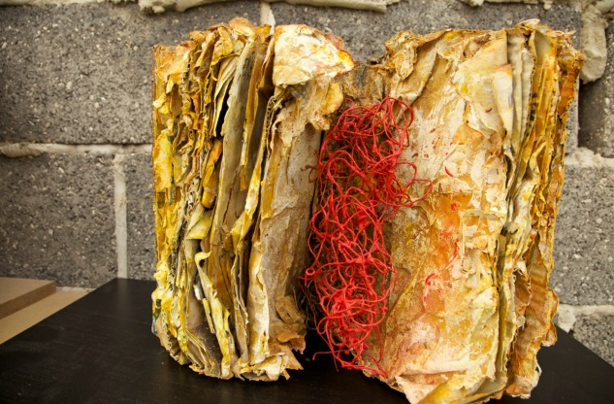
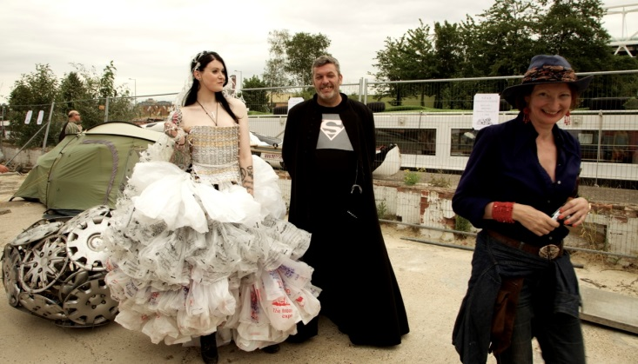
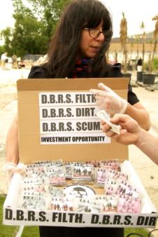
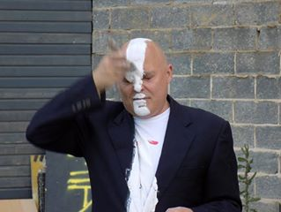
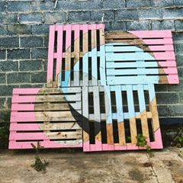

DEN-City - a temporary utopian city of installations, dens and assemblages. Colourfully, repurposing, and recycling on the theme ‘Work in Progress’ . DEN- City is mushrooming on a prime piece of land by the Olympic site
S.P.A.R - The Society for the Preservation of Admirable Rubble meeting at DEN-CITY discussing the campaign to keep the rubble formed by demolishing homes and buildings in the fabric and foyers of all new developments

Slide 22
Network Outcomes
Improved awareness and knowledge of waste options, processes and impacts by public, local government and industry and artists & designers
Greater understanding and value placed on local knowledge and co-design/co-production of solutions
Creative and Design thinking in waste innovation and management
Creative collaboration between scientists, technologists, social scientists and ‘creatives’
Scale-up local demonstration projects

Slide 23
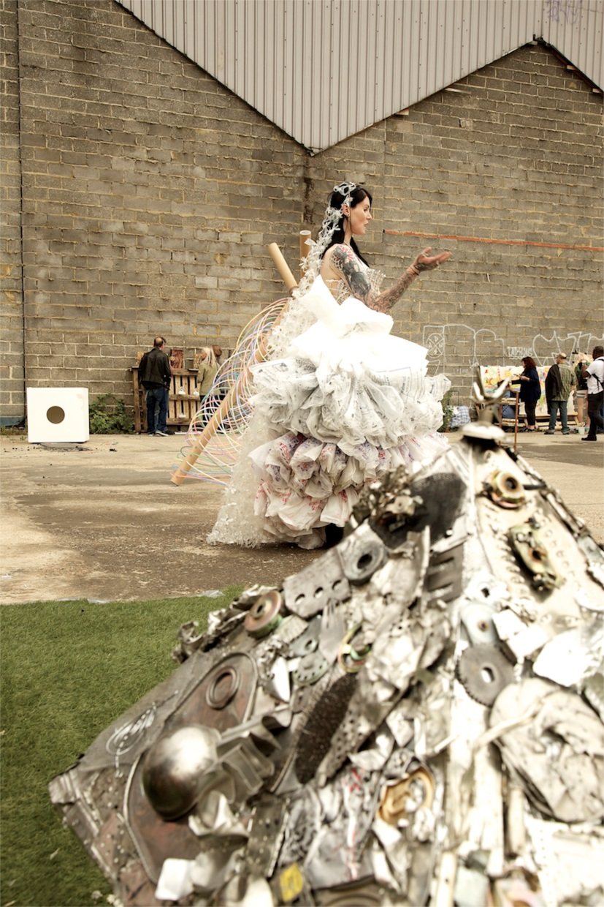
Danke!
Please sign up to the Waste Network: www.smartcitiesandwaste.org
Next workshop in Maastricht, Netherlands
9 December 2016
+ London 2017

