Slide 1
The Nexus of Energy Supply and Human Health
Govinda R. Timilsina
The World Bank, Washington, DC
Global Health Economics Summit
Berlin, Germany
July 25-26 2016

Slide 2
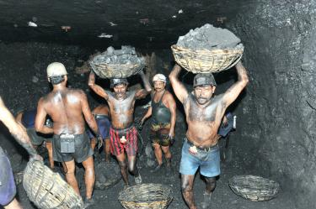
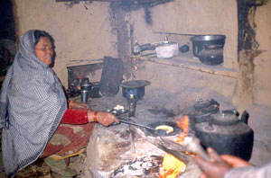
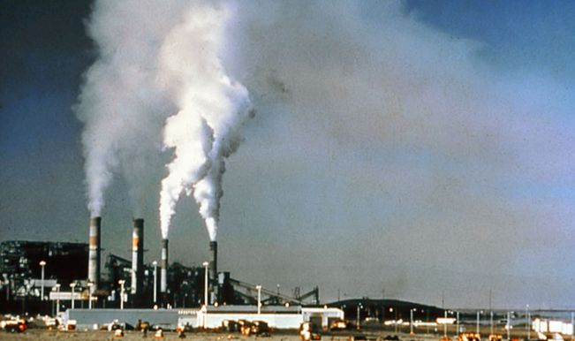
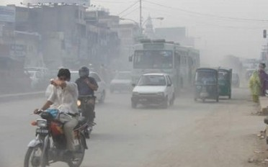
Every activity in energy supply chains affects human health
Mining
Utilization -- Cooking with fuelwood
Transformation -- Air pollution from power plants
Utilization - Air pollution from transportation

Slide 3
Each activity in the energy supply chain can affect human health through three mediums
Exploration, mining, production
Exploration, Mining, production
Transportation/transformation/transmission
Utilization/consumption
Accidental
Occupational
Air Pollution
Outdoor air pollution
Indoor air pollution

Slide 4
Energy activities impacts health through various means
Surface and ground water pollution (e.g., acid mine drainage, sediments, dissolved solids, and toxic substances); exposure to toxic substances; dust and particulate air pollution; high mortality and morbidity
Mining
Transportation
Major accidents (oil tanker blasts, oil and gas pipeline explosions), air
pollution (railway or truck transportation)
Oil and gas
drilling
Toxic substances from drilling liquids and muds (e.g., Polycyclic aromatic hydrocarbons, cadmium, chromium, lead, mercury, chromate and barite)
Transformation
(power
generation),
and consumption
at end-use
(e.g., cooking)
Particulate Matters (PM), carbon monoxide (CO), methane (CH4), carcinogenic PAH, oxides of sulfur and nitrogen, volatile organic compounds (VOC), toxic substances (e.g., benzene, formaldehyde, sulfur mercury, arsenic, fluorine, selenium)
All these pollutants are harmful to human health at varying ways and degrees
Radiation
Nuclear radiation, radiation from coal fly ash

Slide 5
Pollutants from energy activities have several
health impacts
Sulphur dioxide
and nitrous oxides
Asthma; chronic obstructive pulmonary disease (COPD); cardiac
disease; ischemic stroke
Particular matter
(PM10, PM2.5)
Asthma, COPD, lung cancer, cardiac arrhythmias; acute myocardial infarction, congestive heart failure, ischemic stroke
Polycyclic Aromatic
Hydrocarbons (PAHs)
Adverse effects on liver, kidney, and testes; may impair the reproductive system
Volatile Organic Compounds (VOCs)
Impaired lung functions, impaired memory, respiratory symptoms, effects to the liver and kidneys, probable carcinogen
Heavy metals
(Lead, Arsenic,
Cadmium, Nickel,
Selenium, Mercury
Chromium, etc.)
Damages the nervous systems, kidneys; cardiovascular disease, carcinogens (lung, bladder, kidney, and skin cancers), impacts on respiratory and immune systems

Slide 6
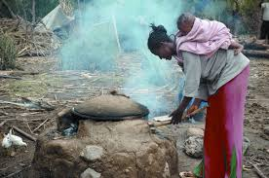
The scale of health impacts from energy supply activities
Household air pollution (HAP) from cooking causes 4.3 million premature deaths each year (WHO, 2016); equivalent to 7.7% of global mortality and more than the toll from malaria, tuberculosis and HIV/AIDS combined; it causes 1/4th of all global deaths from stroke, 17% of adult lung cancer deaths, and 15% of deaths from ischemic heart diseases and 1/3rd of all deaths from COPD in low and middle income countries; more than 60% of all premature deaths from HAP are among women and children
Outdoor air pollution causes about 4 million deaths (6.5% of all deaths) worldwide (2012 data); due mainly to exposure to SPM (PM10 or less); 88% in developing countries; 80% of deaths - ischemic heart disease and strokes, 14% - COPD and 6% - lung cancer

Slide 7
Coal (power generation), oil (transportation) and biomass (cooking) are the main source of health impacts
Fossil and biomass
fuel use in 2012
Total: 12,073 MTOE
Global Primary Energy
Supply in 2012
Total: 13,444 MTOE
Source: IEA

Slide 8
Energy mining is the main source of occupational health impacts
A strong association between occupational exposure to coal dust and disabling respiratory and cardiovascular dysfunction in coal miners, such as pneumoconiosis and chronic obstructive pulmonary disease, has been well established (Coggon and Taylor, 1998).
In a study of coal miners who had been exposed to high concentrations of coal dust, 96% had Coal Workers’ Pneumoconiosis (an inflammation of the alveoli resulting in irreversible lung damage) and 0.5% suffered an advanced form of lung disease (Laney et al. (2012); CWP continues to occur in modern miners despite the recommended safety standards.

Slide 9
Air pollution from energy mining is also a source of health impacts
Using a survey of 16,493 people in West Virginia, USA, Hendryx and Ahern (2008) finds that high levels of coal production is associated with higher rates of cardiopulmonary disease, chronic obstructive pulmonary disease, hypertension, lung disease, and kidney disease.
Using 2006 BRFSS (Behavioral Risk Factor Surveillance System data) on HRQOL (health-related quality of life) in the 4 central Appalachian states in US, where mountain top coal mining occurs, Keith and Hendryx (2011), shows that mountaintop mining areas are associated with the greatest reductions in health-related life quality compared with non-mining counties and also compared with counties with other forms of coal mining.

Slide 10
Air pollution from coal fired power generation is the primary culprit for human health impacts
The US Clean Air Task Force estimates that air pollution caused by US power plants caused 24,000 deaths in 2004, 13,000 in 2010 and 7,500 in 2004; although the number deaths reduced significantly due to strong regulations, it is still high (CITF, 2015)
A Greenpeace study (Greenpeace, 2013) reports that PM2.5 pollution from power plants in Beijing and the Jingjinji region (the worst-hit region by air pollution in China) caused almost 10,000 deaths, 11,000 cases of asthma, 12,000 cases of chronic bronchitis, 1,000 cases of hospital admission and 60,000 outpatient visits
Existing coal plants in Indonesia cause an estimated 7,100 premature deaths every year (Greenpeace , 2015)

Slide 11
Among the fuels used for electricity generation, coal and lignite cause the highest mortality rate in Europe
Number of deaths per billion unit (kWh) of electricity generation in Europe
Source: Markandya and Wilkinson (2007)

Slide 12
Among the fuels used for electricity generation, coal and lignite cause the highest morbidity rate in Europe
Major illness
Number of illness per billion unit (kWh) of electricity generation in Europe
Minor illness
Source: Markandya and Wilkinson (2007)

Slide 13
Fatalities from accidents related to energy supply chain is also a concern
Includes immediate fatalities only
Accidents with fatalities > 5
Data is for the 2069-2000 period
Coal data for China includes 1994-2000 period only
Hydro fatalities are from a single major accident in China in 1975 (Banqiao dam, Huai river in Southeast China)
Data source: OECD (2010)

Slide 14
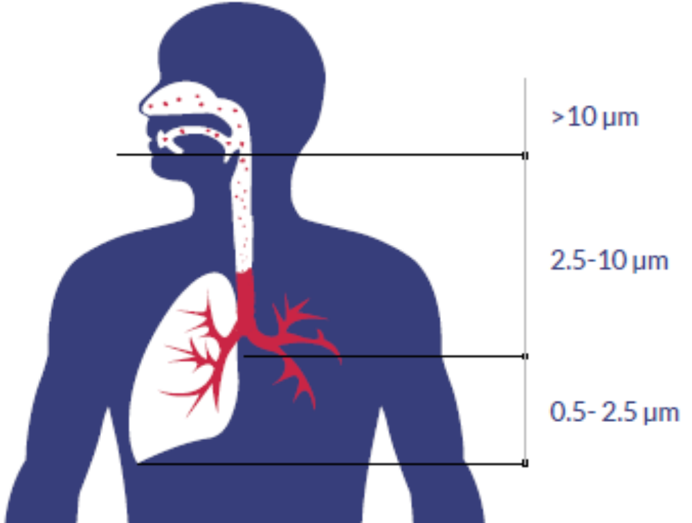
Air Pollution – the biggest source of health damage
PM are the most adverse to human health:
Large PM (PM10 or higher), such as dust or pollen, get congested in the nasal and thoracic cavities.
Smaller particles (PM2.5 µm or smaller) reach tiny sacs in the lungs
Outdoor or Ambient Air Pollution
Outdoor air pollution causes about 4 million deaths (6.5% of all deaths) worldwide (2012 data); due mainly to exposure to SPM (PM10 or less); 88% in developing countries)
80% of deaths - ischemic heart disease and strokes, 14% - chronic obstructive pulmonary (COP) disease and 6% - lung cancer
Indoor (household) Air Pollution
HAP causes 4.3 million deaths annually; it is responsible for 25% of all deaths from stroke, 15% of deaths from ischaemic heart disease, 17% of deaths from lung cancer, and more than 33% COP.

Slide 15
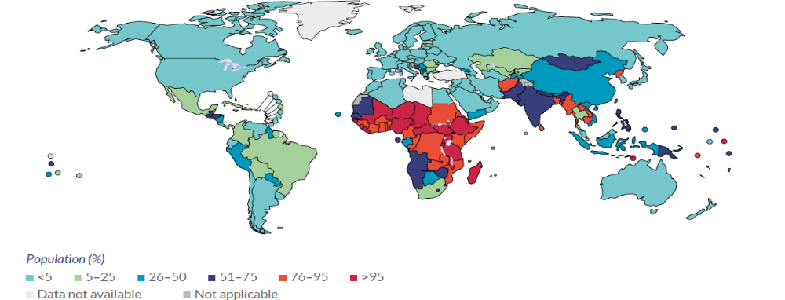
Household cooking is the main source of in-door air pollution
Global use of polluting fuels for cooking in 2014
Source: WHO
Around 3.1 billion people still use biomass and coal for cooking. Biomass is used as
main cooking fuel in:
- More than 50% of HHs in 128 countries
- 95% of HHs in 18 Sub-Saharan countries
- 62% HHs in Southeast Asia
- Over 20% HHs in urban areas
About one third of HH in LMICs depend mainly on kerosene for lighting (53% of HH in SSA and 32% HH in South East Asia). In India alone, almost 400 million people use kerosene for lighting.

Slide 16
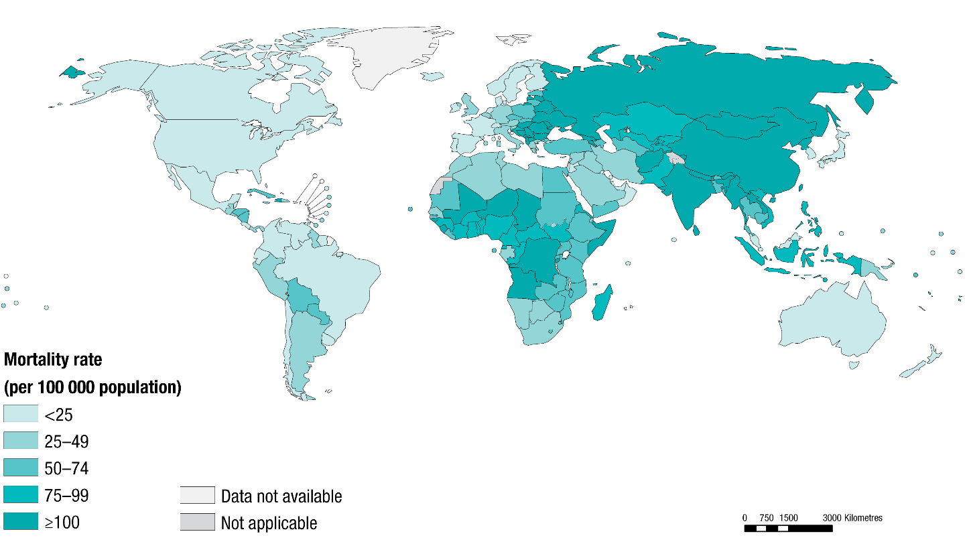
Mortality related to outdoor air pollution is concentrated in low and middle income countries
Source: WHO

Slide 17
Millions of people have been exposed to outdoor air pollution around the world
Ambient Air Quality Index 2014 (PM10)
Population (million)
exceeding PM10
concentration
PM10 Concentration (µg/m3)
Pakistan
PM10 Concentration (µg/m3)
Bangladesh
India
Mexico
Turkey
Korea
WHO Standards for PM10: 20μg/m3 (annual mean)
50 μg/m3 (24-hour mean)
China
Philippines
Population (million)

Slide 18
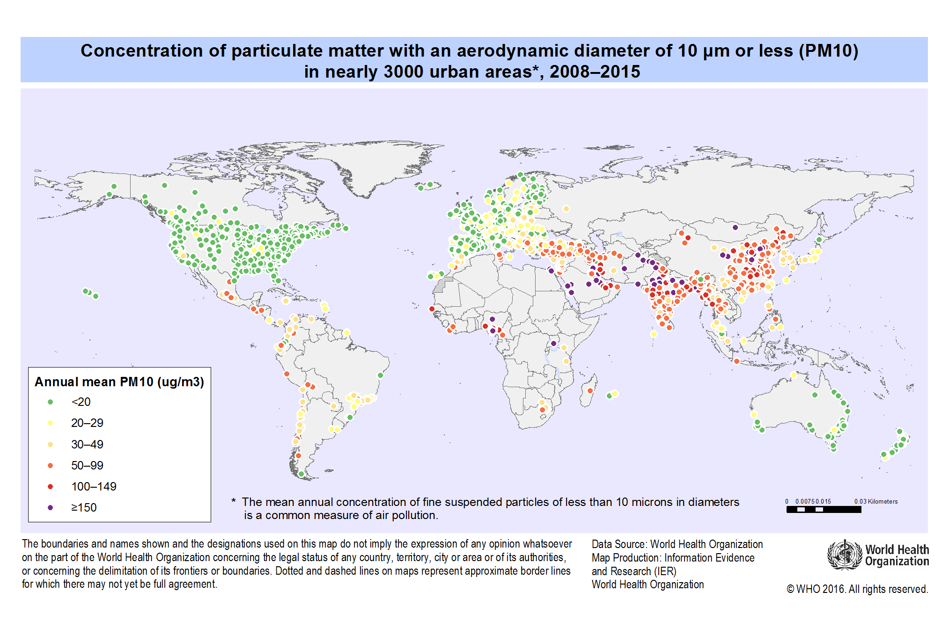
A large number of cities have air pollution levels much higher than WHO standards
Concentration of 10 µm or less (PM10 or less) in nearly 3000 urban areas, 2008–2015
WHO Standards 20μg/m3 (annual mean)
Source: WHO
WHO -- http://gamapserver.who.int/mapLibrary/Files/Maps/Global_pm10_cities_2008_2015.png:

Slide 19
Key Conclusions
Coal accounts for one of the highest shares in the total energy supply, and at the same time it is associated with the highest human health impacts among energy commodities.
Air pollution is the main medium for human health impacts from energy supply activities, causing millions of premature deaths; mostly women and children in the developing world.
Energy transformation (mainly power generation) and consumption (e.g., cooking, transportation) are the main energy activities impacting human health.

Slide 20
References
Anil Markandya, Paul Wilkinson (2007). Electricity generation and health. Lancet, Vol. 370, pp. 979–90.
Stephens C, Ahern M. (2001). Worker and community health impacts related to mining operations internationally. A rapid review of the literature. London: Mining and Minerals for Sustainable Development Project
Clean Air Task Force (CATF) (2016). http://www.catf.us/fossil/problems/power_plants/
Michael Hendryx and Melissa M. Ahern (2008). Relations between Health Indicators and Residential Proximity to Coal Mining in West Virginia. American Journal of Public Health: Vol. 98, No. 4, pp. 669-671.
Keith J. Zullig, and Michael Hendryx, (2011). Health-Related Quality of Life among Central Appalachian Residents in Mountaintop Mining Counties. American Journal of Public Health, Vol 101, No. 5, pp. 848-853.
Coggon and Taylor (1998). ‘Coal mining and chronic obstructive pulmonary disease: a review of the evidence’ Thorax 398.
Laney et al. (2012). ‘Pneumoconiosis and advanced occupational lung disease among surface coal miners in 16 states, 2010-2011. 16 MMWR 431, 431. Morbidity and Mortality Weekly Report, Center for Diseases Prevention and Control. https://www.cdc.gov/mmwr/preview/mmwrhtml/mm6123a2.htm
Liu Guijian, Zheng Liugen, Nurdan S. Duzgoren-Aydin, Gao Lianfen, Liu Junhua, and Peng Zicheng (2007). Health Effects of Arsenic, Fluorine, and Selenium from Indoor Burning of Chinese Coal. Reviews of Environmental Contamination and Toxicology, Vol. 189, pp. 89-106.
P.C. Mishra (2004). Environmental impact of coal industry and thermal power plants in India. Journal of Environmental Radioactivity, Vol. 72, pp. 35–40
OECD (2010). Comparing Nuclear Accident Risks with Those from Other Energy Sources, Paris.
Greenpeace (2013). The health impact from coal power plants in Beijing, Tianjin and Hebei. http://www.greenpeace.org/eastasia/publications/reports/climate-energy/2013/health-impacts-coal-power/
Greenpeace, Indonesia (2015). Human cost of coal power. http://www.greenpeace.org/seasia/Press-Centre/Press-Releases/Research-from-Harvard-reveals-health-impacts-of-Indonesias-coal-plants/

Slide 21
Photo Sources
Coal mining in India
https://www.google.com/search?q=pictures+of+underground+coal+mining+in+India&biw=1093&bih=461&tbm=isch&imgil=JQ45uayBU3LiRM%253A%253BjJCA3RIOQJBf0M%253Bhttp%25253A%25252F%25252Fwww.thehindubusinessline.com%25252Fcompanies%25252Fwith-new-technologies-coal-india-to-step-up-underground-output%25252Farticle7834196.ece&source=iu&pf=m&fir=JQ45uayBU3LiRM%253A%252CjJCA3RIOQJBf0M%252C_&usg=___UULq05ja5agvO5o4Lqhsyc5Xmg%3D&ved=0ahUKEwirrun_ltrNAhVDGR4KHQq6AhYQyjcINQ&ei=Joh6V6uDEsOyeIr0irAB#imgdii=JQ45uayBU3LiRM%3A%3BJQ45uayBU3LiRM%3A%3Bg6bw-qFSMBTjGM%3A&imgrc=JQ45uayBU3LiRM%3A
Fuelwood Burning in Nepal
https://www.google.com/search?q=pictures+of+smoking+from+fuel+wood+burning+in+Nepal&biw=1093&bih=461&tbm=isch&imgil=Wd-hR8mE-k7KUM%253A%253BRtHfPpAb9Z79aM%253Bhttp%25253A%25252F%25252Fnepalitimes.com%25252Fnews.php%25253Fid%2525253D19406&source=iu&pf=m&fir=Wd-hR8mE-k7KUM%253A%252CRtHfPpAb9Z79aM%252C_&usg=__Rjgahc0d1ftX4WqFH0WUYL9ajTM%3D&ved=0ahUKEwiB7quzmNrNAhUJWx4KHdMQDaMQyjcINQ&ei=nol6V4GnL4m2edOhtJgK#imgrc=Wd-hR8mE-k7KUM%3A
Air pollution from coal fired plant and transport
https://www.google.com/search?q=picture+of+nuclear+power+disaster+in+japan&biw=1093&bih=461&tbm=isch&imgil=EGRYzyxnqqrPZM%253A%253BMdF_s8_If2r_wM%253Bhttp%25253A%25252F%25252Fwww.myfox47.com%25252Fstory%25252F14239090%25252Fexplosion-at-japan-nuke-plant-disaster-toll-rises&source=iu&pf=m&fir=EGRYzyxnqqrPZM%253A%252CMdF_s8_If2r_wM%252C_&usg=__pIfp4dKMJuaRmrfo5XAX2A62rHA%3D&ved=0ahUKEwiRmIvumdrNAhWFqh4KHTQPAZAQyjcIOA&ei=Jot6V5HtGIXVerSehIAJ#imgdii=EGRYzyxnqqrPZM%3A%3BEGRYzyxnqqrPZM%3A%3BsYQhUEkd6h8y1M%3A&imgrc=EGRYzyxnqqrPZM%3A

Slide 22
THANK YOU
Govinda R. Timilsina
Sr. Research Economist (Climate Change & Clean Energy)
Development Research Group
The World Bank
1818 H Street, NW
Washington, DC 20433, USA
Tel: 1 202 473 2767
Fax: 1 202 522 1151
E-mail: gtimilsina@worldbank.org

