Slide 1
Glenn S Tillotson PhD, FIDSA, FCCP
Cempra Inc.
Burden of AntiMicrobial Resistance (AMR)

Slide 2
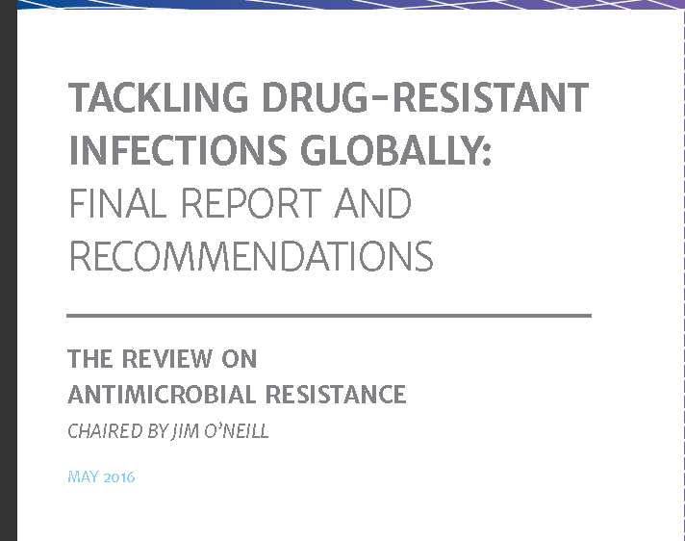
The O’Neil Report May 2016

Slide 3


Slide 4
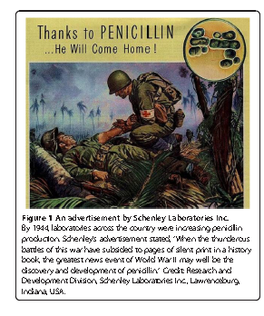

Slide 5
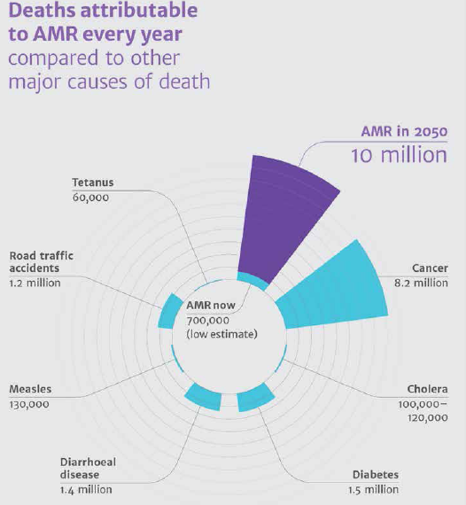

Slide 6
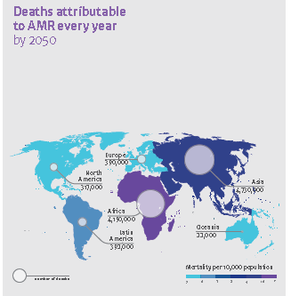

Slide 7
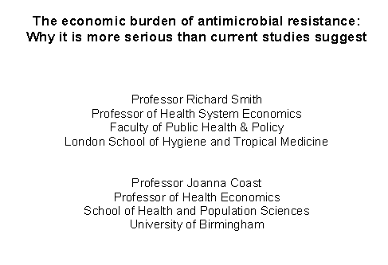

Slide 8
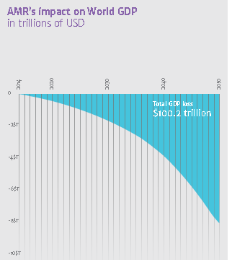
Negative impact of AMR on global productivity by 2050

Slide 9
WHO Antimicrobial Resistance Report 2014:
The Effect of Drug Resistance on Patient Outcomes
Patients with drug-resistant infections have an increased risk of worse clinical outcomes and death, and consume more healthcare resources, than patients infected with the same bacteria not demonstrating resistance
Is there evidence in the scientific literature that there is a difference in patient outcomes for antimicrobial resistant vs nonresistant infections?
 | Escherichia coli |  | Klebsiella pneumoniae
 | Third-generation cephalosporins | Fluoroquinolones | Third-generation cephalosporins | Carbapenems
Bacterium attributable mortality | ✓ | ✗ | ✓ | ✗
30-day mortality | ✓ | ✓ | ✓ | ✓
Hospital LOS | ✗ | ✗ | ✗ | Unclear
Admission to ICU | ✗ | ✓ | ✓ | ND
Post-infection LOS | ✗ | ND | ✓ | ✗
LOS, length of stay; ND, no data.
WHO. Antimicrobial Resistance. Global Report on Surveillance. 2014. Accessed at: http://apps.who.int/iris/bitstream/10665/112642/1/9789241564748_eng.pdf?ua=1

Slide 10
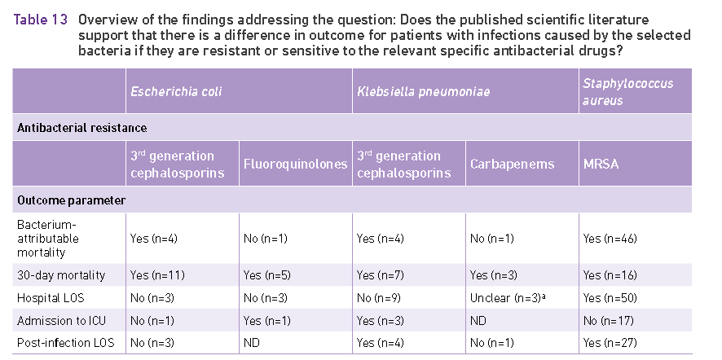

Slide 11
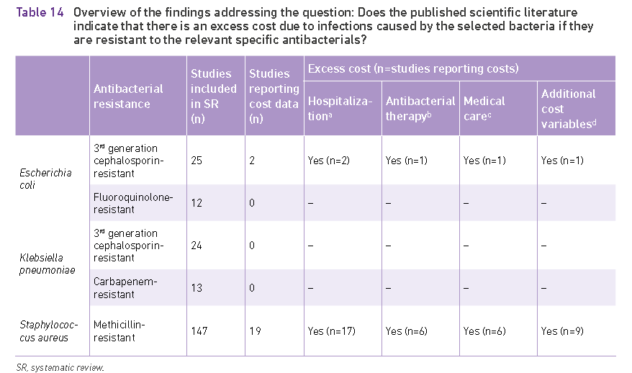

Slide 12
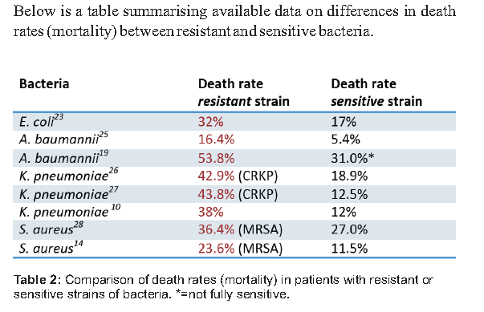
ReACT synopsis of Impact of AMR

Slide 13
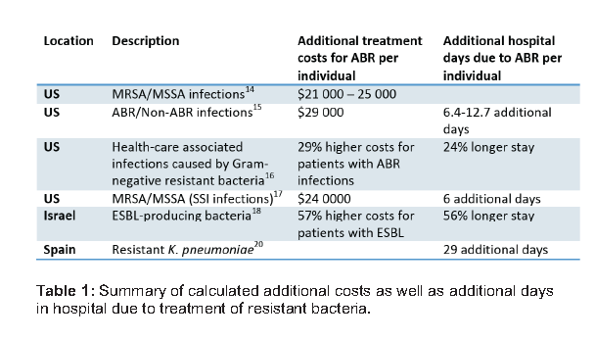

Slide 14
Globally, Majority of ICU Infections Are Due to
Gram-negative Bacteria
62% of ICU infections are Gram-negative
Top 3 Gram-negative pathogens are Pseudomonas spp., E. coli, and Klebsiella spp.
Pseudomonas spp.
Escherichia
coli
Klebsiella
spp.
Acinetobacter
spp.
Enterobacter
spp.
Other
Data from the Extended Prevalence of Infection in Intensive Care (EPIC II) Study, a global, 1-day point prevalence study of 13,796 patients from 1265 ICUs in 75 countries in 2007. ICU, intensive care unit. Gram-negative isolates (%) are calculated as % of all patients with Gram-negative infections
Vincent et al. JAMA. 2009;302:2323-9.
Notes:
The Extended Prevalence of Infection in Intensive Care (EPIC II) Study, a global 1-day, prospective, point prevalence study of 13,796 patients from 1265 intensive care units (ICUs) from 75 countries in 2007, reported that 62% of ICU infections were due to Gram-negative bacteria.
The top 3 Gram-negative pathogens, calculated as a percentage of all patients with Gram-negative infections, were Pseudomonas spp. (31%), Escherichia coli (26%), and Klebsiella spp. (20%).
Reference
Vincent et al. JAMA. 2009;302:2323-9.

Slide 15
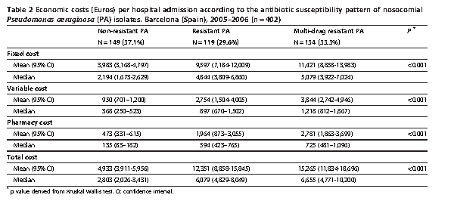

Slide 16
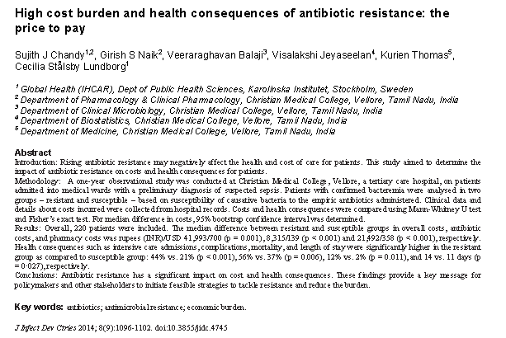

Slide 17
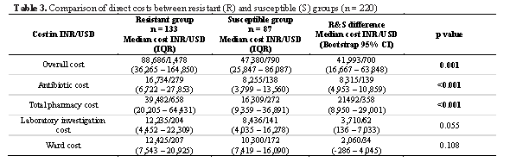

Slide 18
There Is a High Burden of Healthcare-Associated Infections in the US
In a survey of 11,290 inpatients from 183 US hospitals, 4% had at least 1 healthcare-associated infection
Top 5 Highest Ranking Healthcare-Associated Infections in the US
Type | Rank | All healthcare-associated infections, % (95% CI)
Pneumonia | 1 (tie) | 21.8 (18.4–25.6)
Surgical site infection | 1 (tie) | 21.8 (18.4–25.6)
Gastrointestinal infection | 3 | 17.1 (14.0–20.5)
Urinary tract infection | 4 | 12.9 (10.2–16.0)
Bloodstream infection | 5 | 9.9 (7.5–12.8)
Magill et al. N Engl J Med 2014;370:1198-208.

Slide 19
Hospital Costs Increase With Drug Resistance
Hartford, USA, 2006 (n = 240)¹
Barcelona, Spain, 2005-2006 (n = 402)²
Meropenem-
susceptible
P. aeruginosa
P. aeruginosa
P. aeruginosa
P. aeruginosa
P. aeruginosa
P. aeruginosa
Multidrug resistant (MDR) for strains resistant to carbapenems, β-lactams, quinolones, tobramycin, and gentamicin.
1. Eagye et al. Infect Control Hosp Epidemiol. 2009;30:746-52. 2. Morales et al. BMC Health Serv Res. 2012;12:122.
Notes:
Hospital costs due to Pseudomonas aeruginosa drug resistance were evaluated in teaching hospitals in Hartford, US and Barcelona, Spain.
In Hartford, the hospital costs associated with meropenem-resistant P. aeruginosa (n = 58), meropenem-susceptible P. aeruginosa (n = 125) and without P. aeruginosa (n = 57) were evaluated. Costs were significantly higher for patients with meropenem-resistant P. aeruginosa vs meropenem-susceptible P. aeruginosa patients and patients without P. aeruginosa: $88,425 vs $28,620 vs $22,605 (P < 0.01).¹
In Barcelona, the hospital costs associated with multidrug-resistant (MDR) P. aeruginosa (n = 134), resistant P. aeruginosa (n = 119), and nonresistant P. aeruginosa (n = 149) were evaluated. The total mean economic cost per hospital admission of patients with a MDR P. aeruginosa strain increased more than 3-fold compared with with nonresistant strains (€15,265 vs €4933).²
In both cases, hospital costs increased with drug resistance.
References
Eagye et al. Infect Control Hosp Epidemiol. 2009;30:746-52.
Morales et al. BMC Health Serv Res. 2012;12:122.

Slide 20
Worse Clinical Outcomes May Be Associated With MDR Pseudomonas aeruginosa Infections Due to Limited Effective Antimicrobials¹
Inappropriate empirical therapy has been associated with increased mortality in P. aeruginosa infections¹⁻⁵
Delays in starting appropriate therapy may contribute to increased length of hospital stay, persistence of infection, and mortality^{1,3,4,6}
There is:
  Increased mortality with MDR P. aeruginosa infections^{1,7-10}
  Increased morbidity with MDR P. aeruginosa infections,¹ including invasive procedures,⁸ discharge to a long-term acute care facility,⁸ increased length of stay,^{4,8} and persistence of infection⁶
MDR, multidrug resistant.
1. Hirsch and Tam. Expert Rev Pharmacoecon Outcomes Res. 2010;10:441-51. 2. Kang et al. Clin Infect Dis. 2003; 37:745-51. 3. Lodise et al. Antimicrob Agents Chemother. 2007;51:3510-5. 4. Micek et al. Antimicrob Agents Chemother. 2005;49:1306-11. 5. Osih et al. Antimicrob Agents Chemother. 2007;51:839-44. 6. Carmeli et al. Arch Intern Med. 1999;159:1127-32. 7. Cao et al. J Hosp Infect. 2004;57:112-8. 8. Aloush et al. Antimicrob Agents Chemother.
2006;50:43-8. 9. Gasink et al. Am J Med. 2006;119:526, e519-25. 10. Lautenbach et al. Infect Control Hosp Epidemiol. 2010;31:47-53.

Slide 21
Multidrug-resistant (MDR) Pseudomonas aeruginosa Is Associated With Increased Morbidity and Mortality
Retrospective study at Tel-Aviv Sourasky Medical Center, Israel
82 patients with MDR P. aeruginosa and 82 controls
More severe outcomes with MDR P. aeruginosa
P = 0.02
P = 0.015
P = 0.001
P = 0.04
P = 0.001
P = 0.05
Aloush et al. Antimicrob Agents Chemother. 2006;50:43-6.

Slide 22
Hospital Costs Increase With Multidrug-resistant (MDR) Pseudomonas aeruginosa
Studies have quantified the direct costs attributable to MDR P. aeruginosa infections¹
Type of MDR resistance | No of pts | Difference in cost of drug-resistant vs drug-susceptible P. aeruginosa | Reference
Ceftazidime, ciprofloxacin, imipenem, and piperacillin resistant | 22 | $33,965 | Harris 1999²
Fluoroquinolone resistant | 847 | $13,592 | Gasink 2006³
Imipenem resistant | 1616 | $32,949 | Lautenbach 2006⁴
Resistant to all drugs in ≥1 class | 120 | $26,491 | Evans 2007⁵
Not stated | 17 | €55,266 | Bou 2009 (Spain)⁶
Imipenem resistant | 253 | $85,299 | Lautenbach 2010⁷
Meropenem resistant | 183 | $59,805 | Eagye 2009⁸
Resistant to ≥1 carbapenem, β-lactam, quinolone, tobramycin, or gentamicin | 402 | €10,332 | Morales 2012 (Spain)⁹
1. Hirsch and Tam. Expert Rev Pharmacoecon Outcomes Res. 2010;10:441-51. 2. Harris et al. Clin Infect Dis. 1999;28:1128-33. 3. Gasink et al. Am J Med. 2006;119:526, e519-25. 4. Lautenbach et al. Infect Control Hosp Epidemiol. 2006;27:893-900. 5. Evans et al. Crit Care Med. 2007;35:89-95. 6. Bou et al. J Hosp Infect. 2009;71:138-42. 7. Lautenbach et al. Infect Control Hosp Epidemiol. 2010;31:47-53. 8. Eagye et al. Infect Control Hosp Epidemiol. 2009;30:746-52.
9. Morales et al. BMC Health Serv Res. 2012;12:122.
Notes:
The following 8 studies have quantified the direct costs attributed to multidrug-resistant (MDR) Pseudomonas aeruginosa infections.¹ In all instances, MDR P. aeruginosa was associated with higher hospital costs then susceptible P. aeruginosa.
Harris: Harris and colleagues published a case series of 22 patients with MDR P. aeruginosa recovered from any clinical culture hospitalized from August 1994 to December 1997. An MDR isolate was classified as one with resistance to ceftazidime, ciprofloxacin, imipenem, and piperacillin. The mean cost of hospitalization due to MDR P. aeruginosa compared to susceptible P. aeruginosa infections was $54,081 vs $22,116.²
Gasink: In the cohort of patients with fluoroquinolone-resistant P. aeruginosa infections, median hospital charges were significantly higher compared with patients with fluoroquinolone-susceptible infections ($62,325 vs $48,733; P = 0.008).³
Lautenbach 2006: In the third study, patients with imipenem-resistant P. aeruginosa isolates, median hospital costs were $81,330 for imipenem-resistant strains compared with $48,381 for imipenem-susceptible strains (P < 0.001).⁴
Evans: Resistant P. aeruginosa infections were associated with higher median hospital costs ($87,519 vs $61,028; P = 0.015). Antibiotic resistance was defined as resistance to all the drugs in one or more of the following antibiotic classes: aminoglycosides, cephalosporins, carbapenems, and fluoroquinolones.⁵
Bou: In Spain, Bou and colleagues reported a significantly higher median economic burden with antibiotic multi-resistance in P. aeruginosa infections (€72,356 vs €17,090; P = 0.004).⁶
Lautenbach 2010: For imipenem-resistant P. aeruginosa infections, mean hospital costs were significantly higher compared with imipenem-susceptible infections ($251,495 vs $166,196; P < 0.001).⁷
Eagye and Morales: As discussed on the previous slide, higher hospital costs were associated with meropenem-resistant and MDR P. aeruginosa infections.^{8,9}
References
Hirsch and Tam. Expert Rev Pharmacoecon Outcomes Res. 2010;10:441-51.
Harris et al. Clin Infect Dis. 1999;28:1128-33.
Gasink et al. Am J Med. 2006;119:526, e519-25.
Lautenbach et al. Infect Control Hosp Epidemiol. 2006;27:893-900.
Evans et al. Crit Care Med. 2007;35:89-95.
Bou et al. J Hosp Infect. 2009;71:138-42.
Lautenbach et al. Infect Control Hosp Epidemiol. 2010;31:47-53.
Eagye et al. Infect Control Hosp Epidemiol. 2009;30:746-52.
Morales et al. BMC Health Serv Res. 2012;12:122.

Slide 23
Summary
Pseudomonas Infections
Pseudomonas aeruginosa is a major cause of infection in hospitalized patients¹⁻⁵
  Second most common cause of ventilator-associated pneumonia²
  Second most common cause of catheter-associated urinary tract infection²
  Fifth most common cause of healthcare-associated infections overall²
Pseudomonas drug resistance has remained stable in Europe and the United States, and remains at concerning levels^{1,5}
Infections due to multidrug-resistant P. aeruginosa are associated with increased morbidity, mortality, and economic impact^{3,4}
European Centre for Disease Prevention and Control. 2012. http://www.ecdc.europa.eu/en/publications/Publications/
antimicrobial-resistance-surveillance-europe-2011.pdf. 2. Sievert et al. Infect Control Hosp Epidemiol. 2013;34:1-14. 3. Hirsch et al. Expert Rev Pharmacoecon Outcomes Res. 2010;10:441-51. 4. Lambert et al. Lancet Infect Dis. 2011;11:30-8. 5. Zilberberg and Shorr. J Hosp Med. 2013;10:559-63.

Slide 24
MDR Gram-negative Infections Associated With Higher Mean Length of Stay and Hospital Costs (US)
A US study of 662 patients admitted from 2000-2008 who developed hospital-acquired infections (HAIs) caused by multidrug-resistantª Gram-negative pathogens versus those caused by susceptible pathogens showed that
  Additional length of stay was 24% higher
  Hospital costs was 29% higher
ªNonsusceptible to 1 of the following antibiotic groups: fluoroquinolones (ciprofloxacin, levofloxacin, ofloxacin, moxifloxacin, or gatifloxacin), piperacillin (piperacillin or piperacillin/tazobactam), carbapenems (imipenem or meropenem), or extended-spectrum cephalosporins (ceftriaxone, ceftazidime, cefotaxime, or cefepime).
Mauldin et al. Antimicrob Agents Chemother. 2010;54:109-15.
Notes:
Antibiotic resistance is a growing clinical problem and infections caused by antibiotic resistant pathogens usually result in a significantly longer hospitalization rate and excess health care costs compared with antibiotic-susceptible pathogens.^{1,2} Determination of the attributable length of stay and hospital cost are of critical importance for patients, providers, and payers who must make rational and informed decisions about patient care and the allocation of resources.³
Mauldin et al investigated the additional length of stay and hospital cost attributable to hospital-acquired infections (HAIs) caused by multidrug-resistant (MDR) Gram-negative pathogens vs those caused by susceptible pathogens in 662 patients, admitted from 2000 to 2008, who developed HAIs caused by Acinetobacter spp., Enterobacter spp., Escherichia coli, Klebsiella spp., or Pseudomonas spp.³
Multivariate analysis revealed that infection due to MDR Gram-negative pathogens resulted in an increase in length of stay of 24% (P = 0.0003) and an increase of hospital costs of 29% (P < 0.0001) compared with susceptible Gram-negative pathogens.³
Bacteria were considered resistant if they were not susceptible to one of the following antibiotic groups: fluoroquinolones (ciprofloxacin, levofloxacin, ofloxacin, moxifloxacin, or gatifloxacin), piperacillin (piperacillin or piperacillin/tazobactam), carbapenems (imipenem or meropenem), or extended-spectrum cephalosporins (ceftriaxone, ceftazidime, cefotaxime, or cefepime). Organisms were considered MDR if they were resistant to antibiotics in 2 or more of these same groups.³
References
Morales et al. BMC Health Serv Res. 2012;12:12.
Tansarli et al. Expert Rev Anti Infect Ther. 2013;11:321-31.
Mauldin et al. Antimicrob Agents Chemother. 2010;54:109-15.

Slide 25
Gram-negative‒resistant Infections Are Associated With Higher Mean Hospital Costs (US)
In 253 patients with imipenem-resistant Pseudomonas aeruginosa
  Mean hospital cost was $251,495 (95% CI, $205,755-$297,236), compared with $166,196
  (95% CI, $151,404-$180,989) for patients with imipenem-sensitive P. aeruginosa¹
In 89 patients with imipenem-resistant Acinetobacter baumannii
  Mean hospital cost was $334,516 (95% CI, $235,417-$433,615), compared with $276,059
  (95% CI, $215,120-$336,998) for patients with imipenem-sensitive A. baumannii²
P = 0.03
P < 0.001
US dollars ($)
¹
²
P value for difference in cost between MDR vs non-MDR pathogens
CI, confidence interval; MDR, multidrug resistant.
1. Lautenbach et al. Infect Control Hosp Epidemiol. 2010;31:47-53.
2. Lautenbach et al. Infect Control Hosp Epidemiol. 2009;30:1186-92.

Slide 26
Gram-negative‒resistant Infections Are Associated With Higher Mean Hospital Costs and Length of Stay (US)
  A US study of 662 patients admitted from 2000-2008 who developed healthcare-associated infections (HAIs) caused by Acinetobacter spp.,
  Enterobacter spp., Escherichia coli, Klebsiella spp., or Pseudomonas spp.
  Additional hospital cost and length of stay attributable to HAIs caused by multidrug- resistant Gram-negative pathogens were 29.3% and 23.8% higher than those attributable to HAIs caused by susceptible Gram-negative pathogens, respectively
Variable | Total hospital cost (log) (n = 605) |  | Length of stay (log) (n = 605)
 | Parameter estimate (95% CI) | P value | Parameter estimate (95% CI) | P value
Resistantª | 0.2929 (0.1623-0.4235) | <0.0001 | 0.2379 (0.1101-0.3656) | 0.0003
Pneumonia | 0.4382 (0.2888-0.5875) | <0.0001 | 0.3817 (0.2353-0.5281) | <0.0001
ICU | 1.4208 (1.2532-1.5884) | <0.0001 | 1.0595 (0.8956-1.2233) | <0.0001
Transplantation | 1.1582 (0.3210-1.9954) | 0.0067 | 0.7443 (-0.0722-1.5608) | 0.0740
ªNonsusceptible to 1 of the following antibiotic groups: fluoroquinolones (ciprofloxacin, levofloxacin, ofloxacin, moxifloxacin, or gatifloxacin), piperacillin (piperacillin or piperacillin/tazobactam), carbapenems (imipenem or meropenem), or extended-spectrum cephalosporins (ceftriaxone, ceftazidime, cefotaxime, or cefepime).
CI, confidence interval.
Mauldin et al. Antimicrob Agents Chemother. 2010;54:109-15.

Slide 27
Costs Attributable to Healthcare-associated Infections (HAIs) and Multidrug-resistant (MDR) Pathogens Are High
Estimated costs (US) of HAIs¹
  Central line-associated bloodstream infections - $45,814 per case
  Ventilator-associated pneumonia - $40,144 per case
  Surgical-site infections - $20,785 per case
  Catheter-associated urinary tract infections - $896 per case
A systematic review of the literature extracted data on the in-hospital costs attributable to MDR pathogens²
  Carbapenem-resistant bacilli
    Significantly higher costs associated with resistant vs susceptible bacteria of the same species
    (P < 0.01)
    Mean hospital charges of $58,457-$85,299
  ESBL-producing Enterobacteriaceae
    Significantly higher costs associated with ESBL-positive vs ESBL-negative infections
    (P < 0.001)
    Mean hospital charges of $1584-$30,093
ESBL, extended-spectrum β-lactamase.
1. Zimlichman et al. JAMA Intern Med. 2013;173:2039-46. 2. Tansarli et al. Expert Rev Anti Infect Ther. 2013;11:321-33.

Slide 28
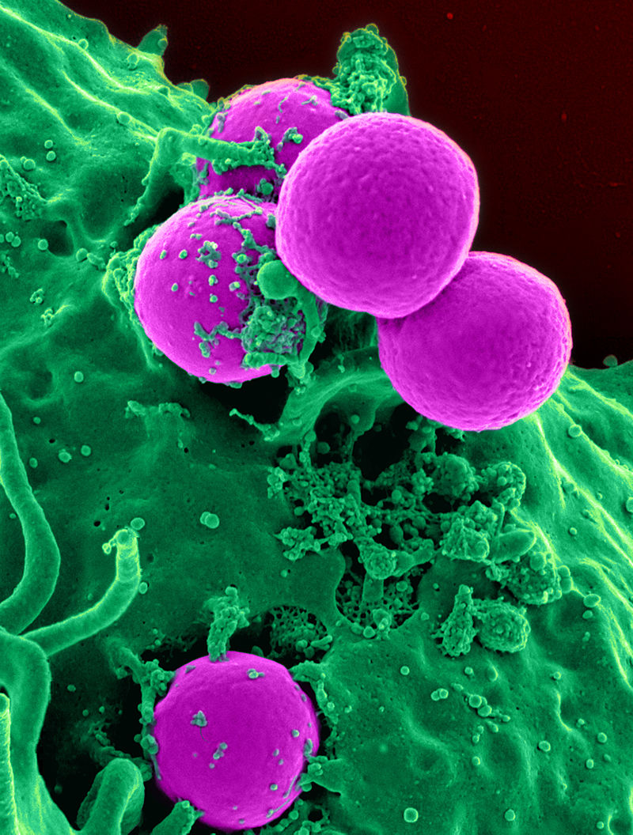
MRSA

Slide 29
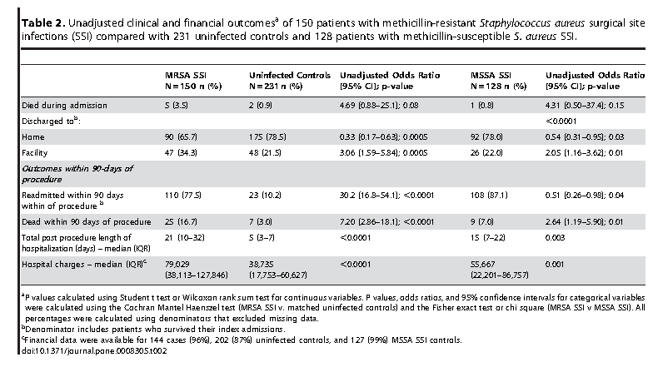
Costs of MSSA vs MRSA in SSSI

Slide 30
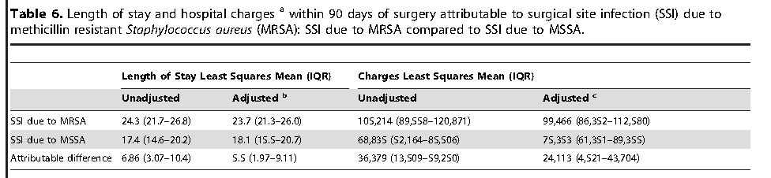
Impact of MRSA on Length of hospital stay and charges

Slide 31
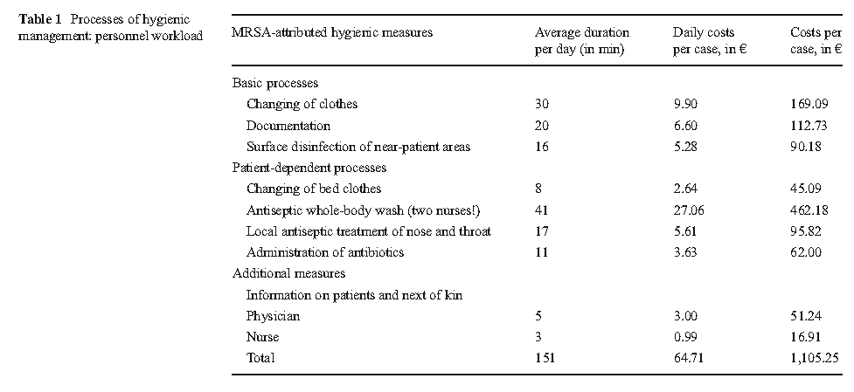

Slide 32
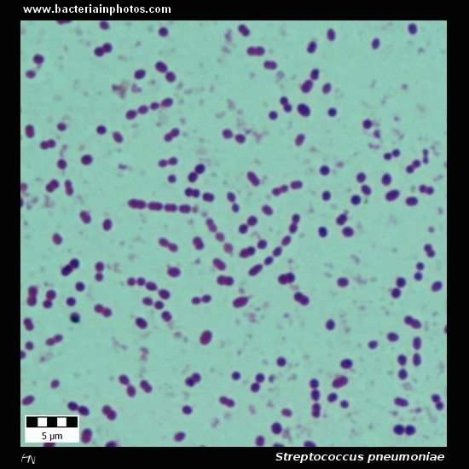
Streptococcus pneumoniae- an under-recognized MDR pathogen
S pneumoniae is the most common cause of community acquired pneumonia
S pneumoniae- is a “serious” pathogen on CDC list
S pneumoniae caused 4 million infections and 22,000 deaths in US alone in 2004.
Strains resistant to the most frequently used antibiotic are increasing
Although few recent cost analyses of CAP/S pneumoniae have been reported
Reynolds et al noted incremental costs of AMR to be $90 million healthcare costs with an estimated$233mio in lost productivity.

Slide 33
Negative impact of AMR on global productivity by 2050

Slide 34
Conclusions
AntiMicrobial Resistance is a global and costly issue
The burden is increasing in morbidity, mortality and financial terms.
An ever widening range of bacterial species are becoming AMR
The ease of mobility and movement of humans (and bugs) is growing for business, pleasure and social reasons
The concept of using most potent agent sooner to save lives, money and antibiotics themselves is not currently accepted
The public understanding of antibiotics is poor to non-existent
Philosophies have to change.
It should be the individual’s responsibility to “save these drugs”!

