Slide 1

Risk of Exposure of Grazing Animals to Ergot Alkaloids Produced by Fungal Endophytes
United States Department of Agriculture
Agricultural Research Service
Glen Aiken, Ph.D.
USDA-ARS Forage-Animal Production Research Unit
Lexington, KY

Slide 2
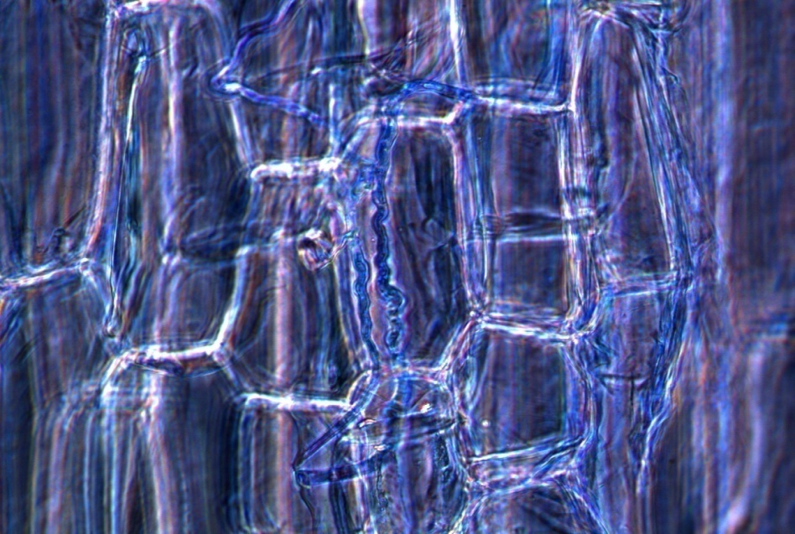

Slide 3
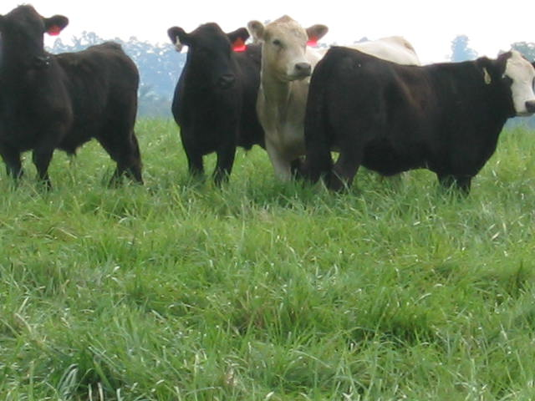
Tall fescue is grown on approximately 35 million acres in the eastern half of the U.S.A., making it the predominant grass utilized for grazing in the region.

Slide 4
Ergot alkaloids tightly bind α-adrenergic receptors in the vasculature to elicit persistent vasoconstriction that hinders the animal’s ability to thermo-regulate.

Slide 5
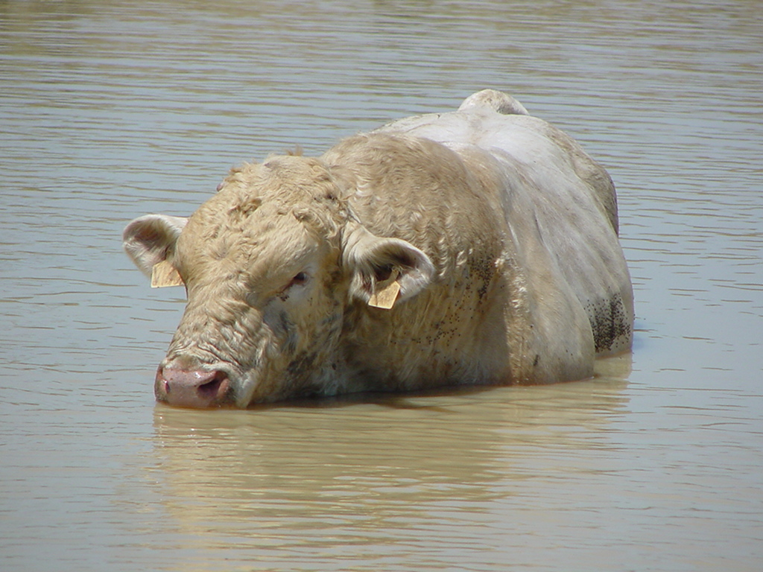
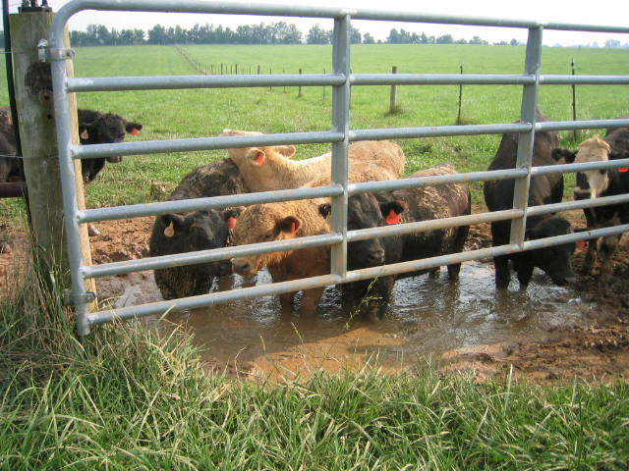
Tall fescue is a persistent and
productive forage, but…..
Livestock productivity, health and well-being
can be compromised!!

Slide 6
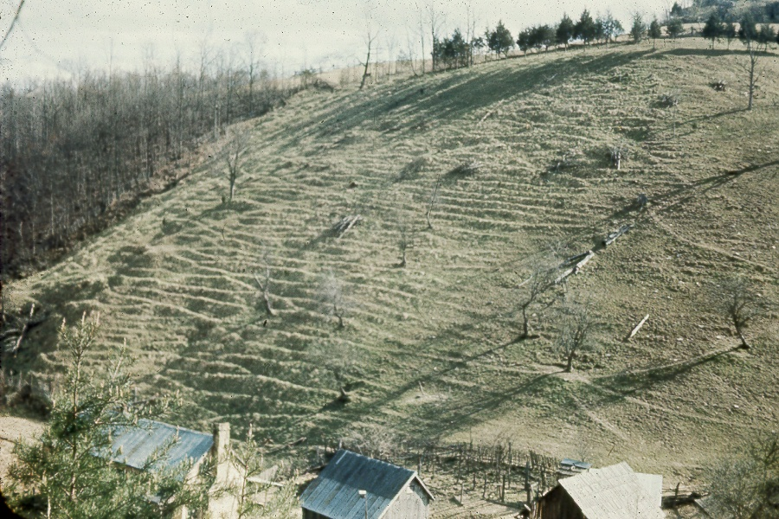
Original seed for the development of ‘Kentucky 31’ seed
was collected from this hillside in Menefee County, Kentucky

Slide 7
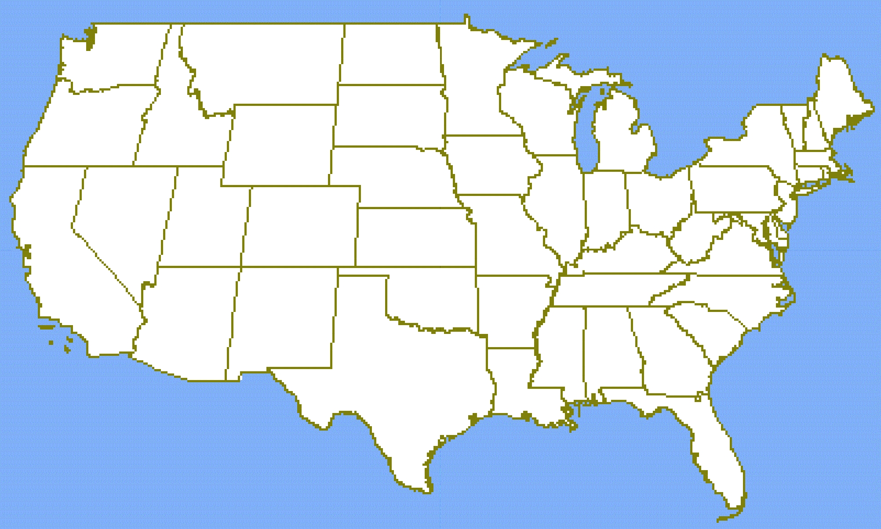
Fescue Belt

Slide 8
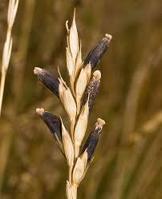
Photo by Doug Waylett
Claviceps fungus
Infects seed and cereal of various grasses

Slide 9
Claviceps can produce:
• Tremorgenic compounds that can cause
the “staggers” conditions
- excessive muscle twitching, incoordination,
and convulations
• Ergopeptines that can induce a toxicosis
similar to fescue toxicosis
- produces high amounts of ergotamine.

Slide 10
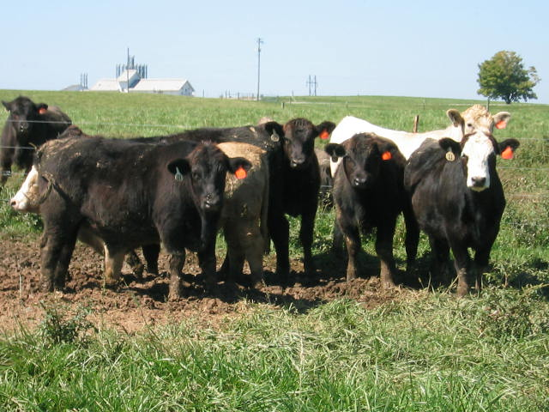
Discussion

