Slide 1
SEPARATION OF CHIRAL NANOTUBES
WITH AN OPPOSITE HANDEDNESS
BY OLIGOPEPTIDE ADSORPTION:
A MOLECULAR DYNAMICS STUDY
Giuseppina Raffaini
Dipartimento di Chimica, Materiali e Ing. Chimica “G. Natta”
Politecnico di Milano - Italy
Separation techniques – Valencia 2016 G. Raffaini

Slide 2
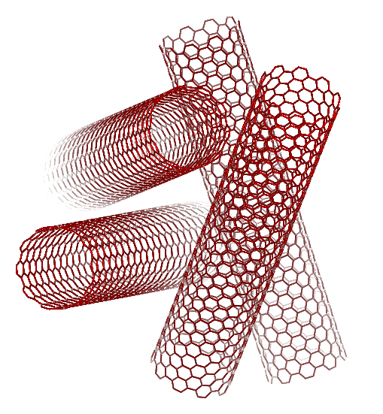
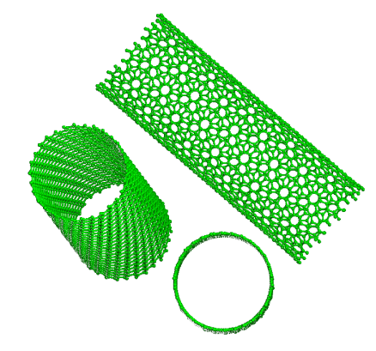
Introduction
Carbon nanotubes
can form non-covalent complexes
with proteins
both on the inner and on the outer surface
Very important key for separation of chiral CNTs:
interaction between chiral CNT surface – chiral aminoacids
protein
surface

Slide 3
Molecular Mechanics and Molecular Dynamics methods
describe at atomistic level both protein and CNT surface
Molecular Mechanics
Energy minimization with respect to all the variables (the atomic coordinates)
of proteins, oligopeptides near CNT surface
 geometry of interaction (conformational changes)
 strength of interaction (interaction energy E_{int}, strain energy E_{strain})
 surface coverage (total or partial) and possible film formation.
Molecular Dynamics
Time evolution of the system at constant (average) T solving the classical equations of motions (Newton) for each atom
 kinetics of adsorption process (kinetics of spreading)
 mobility on the surface
 possible surface ordering induced by the surface considered.

Slide 4
INTERACTION PROTEIN – SURFACE
(our previous work)
Simulation protocol based on MM and MD was proposed
to study protein adsorption (albumin fragments and fibronectin)
on different allotropic carbon surfaces:
Graphite, graphene
Fullerenes (C₆₀, C₇₀)
Carbon Nanotubes (SWCNTs) with:
⧫ a different curvature
 a different handedness
comparing theoretical results
with experimental data
G. Raffaini, F. Ganazzoli, Langmuir, 19, 3403 (2003).
G. Raffaini, F. Ganazzoli, Phys. Chem. Chem. Phys., 8, 2765 (2006).
G. Raffaini, F. Ganazzoli, Langmuir, 29, 4883−4893 (2013).
G. Raffaini, F. Ganazzoli, Journal of Chromatography A, 1425, 221-230 (2015).

Slide 5
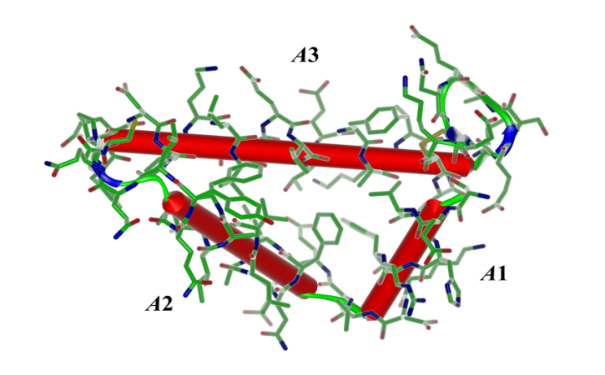
… about albumin fragment (HSA) adsorption
on hydrophobic
- graphite (and graphene) surfaces
- and achiral armchair (8,8) and (10,10) CNT surfaces
selecting substrates with the same surface chemistry
but different curvature
on hydrophilic amorphous PVA

Slide 6

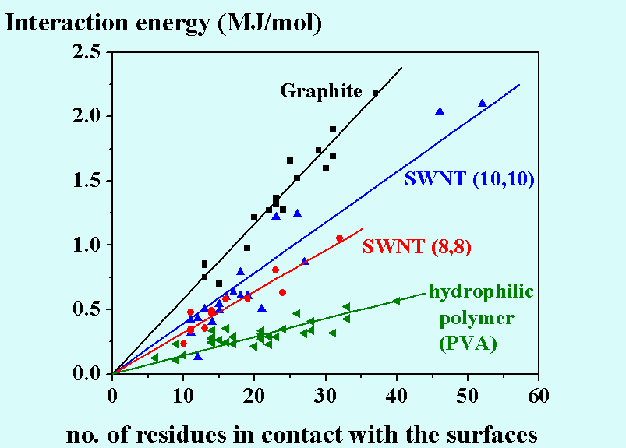
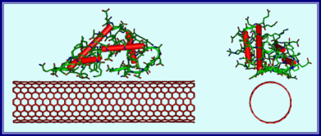

1st result: Initial Adsorption stage
71 kJ/mol
A smaller curvature yields a stronger interaction!
36 kJ/mol
14.5 kJ/mol
The interaction energy increases in the order:
Hydrophilic amorphous PVA surface <
(8,8) CNT < (10,10) CNT < flat GRAPHITE

Slide 7
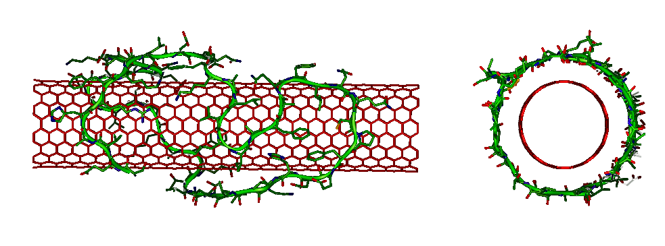
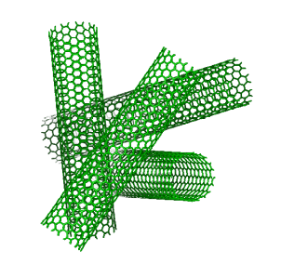
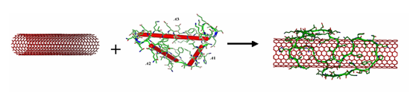
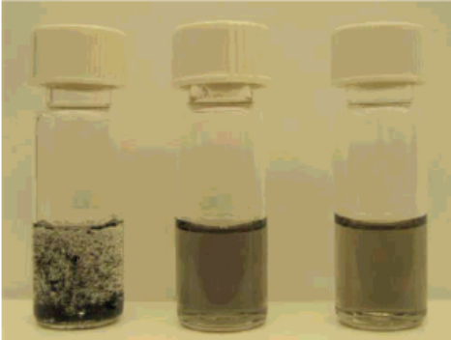
2nd result: Final adsorption stage
on OUTER CNT surface
 Spreading of this soft fragment with surface coverage.
The energetic cost to detach a CNT
from a random aggregate
is less than the energy gain due to adsorption
(calculated after MM and MD runs in the most stable adsorption geometry)
⇒ hence we predicted that:
CNTs can be solubilized in water by proteins
through non covalent interactions
... AS INDEED EXPERIMENTALLY FOUND
JS Dordick, RS Kane et al
Langmuir (2006)
in
water
with
BSA
with
MJL

Slide 8
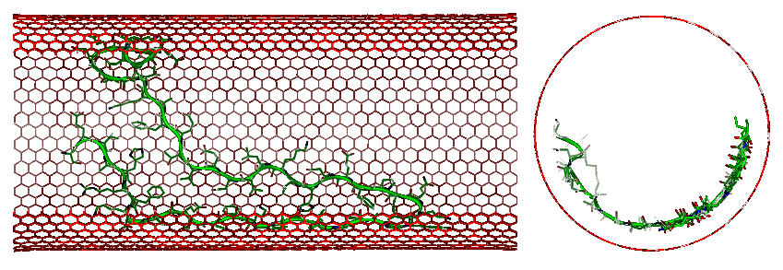
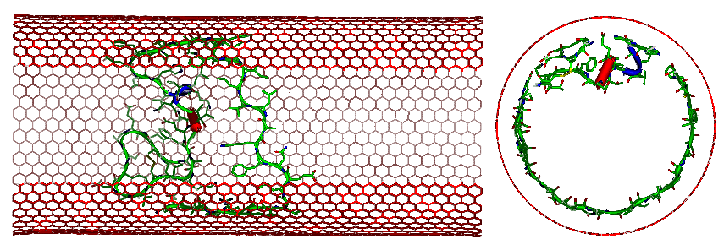
3rd result: Final adsorption stage on INNER CNT surface
 Two molecular conformations
within nanotubes – (30,30) CNT
hairpin
most stable
ring-like
less stable
Parallel arrangement of the backbone strands
with optimization of both:
protein-surface interactions
intra-molecular interactions.

Slide 9
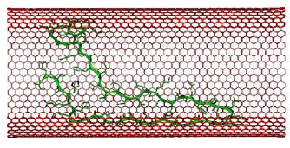
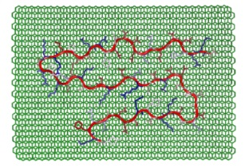
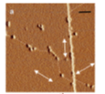
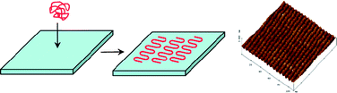
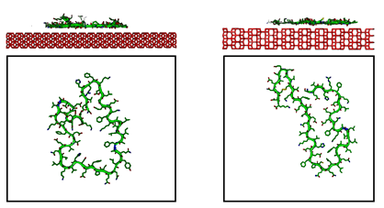
Adsorption on crystalline surfaces
may lead to an intramolecular parallel ordering
of protein backbone strands
on CNT surfaces
on graphite surface, theoretically
and experimentally
on TiO₂ polymorphs
using AFM measurements
O. Cavalleri et al. (2008)
(001) Rutile (100) Anatase
G. Raffaini, F. Ganazzoli, Phil. Trans. R. Soc. A 2012 370, 1444-1462 (2012)

Slide 10
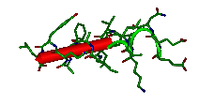
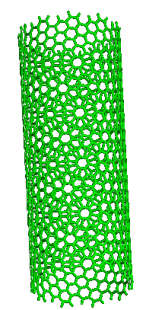
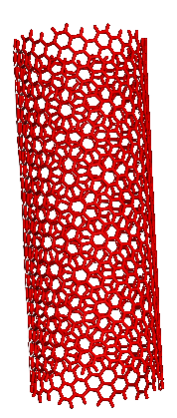
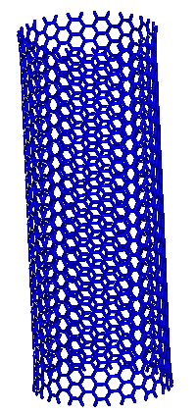
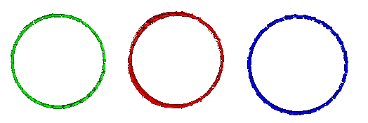
New results: oligopeptide adsorption on chiral CNT
α-helix of albumin fragment
hydrophobic oligopeptide
containing 16 chiral natural aminoacids
on enantiomer chiral SWCNTs
(20,10) and (10,20) CNT surfaces
selecting substrates with same surface chemistry
but different handedness
on achiral (16,16) CNT surface
having the same chemistry
and the same curvature

Slide 11
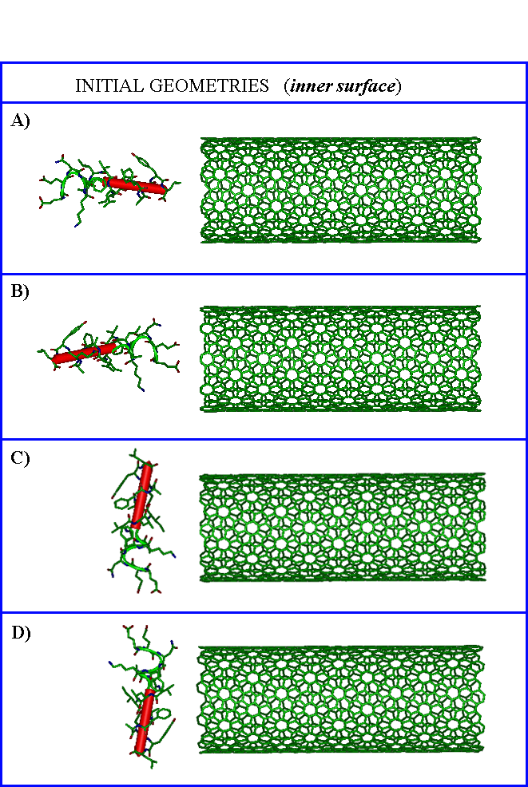
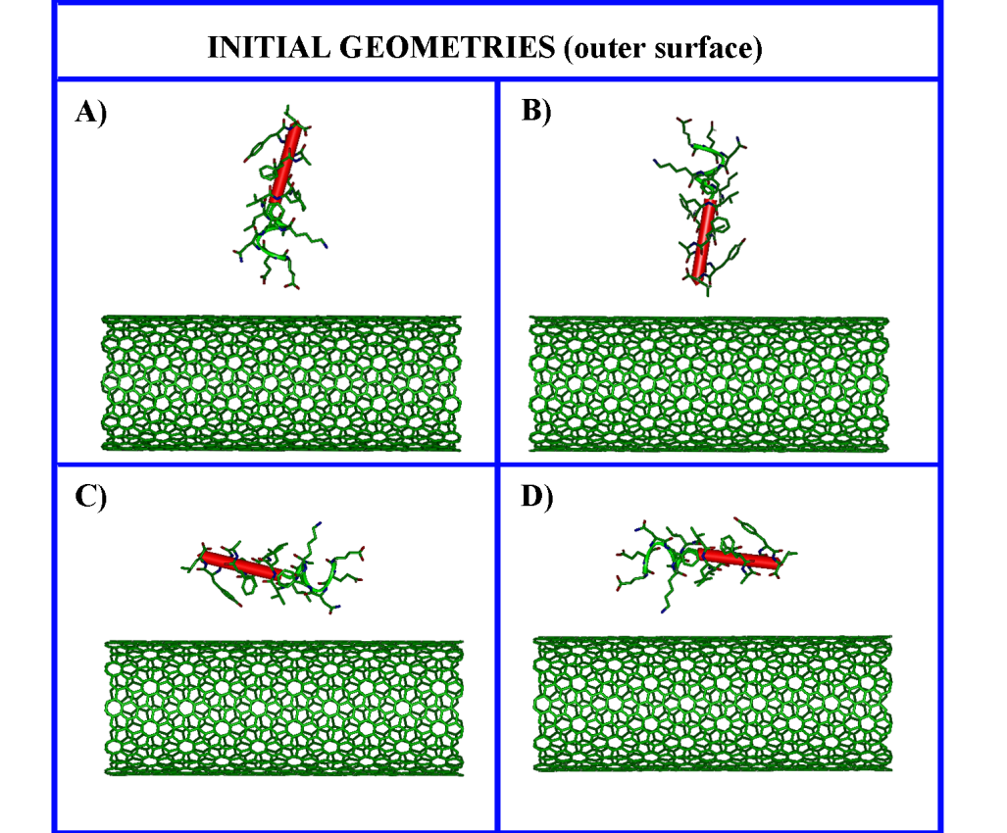
1. Molecular Mechanics ⇒ Initial adsorption stage
Starting with different initial orientations
that can lead to adsorption on the outer and on the inner surface
not assuming a priori insertion within the CNT

Slide 12
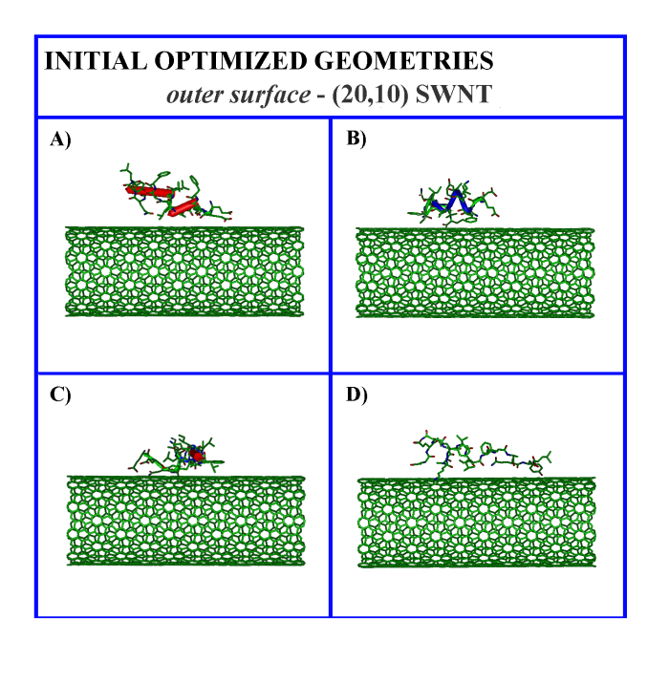
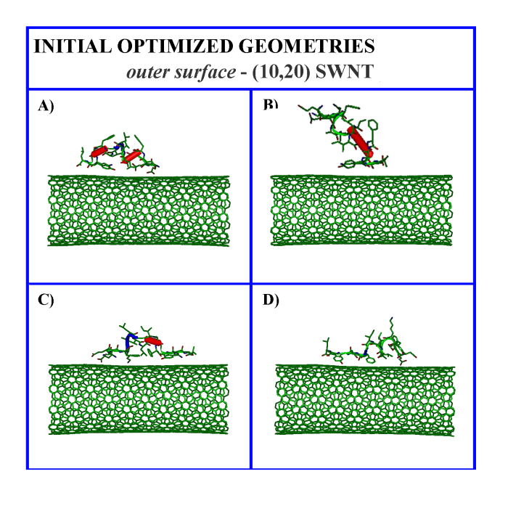
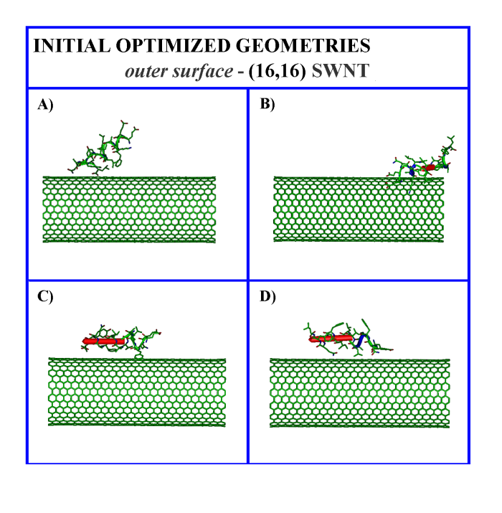
1. Initial adsorption stage after energy minimization on the outer convex surface
Different interaction geometries
    different interaction strengths
Local deformations to enhance the contact surface
Local loss of secondary structure

Slide 13
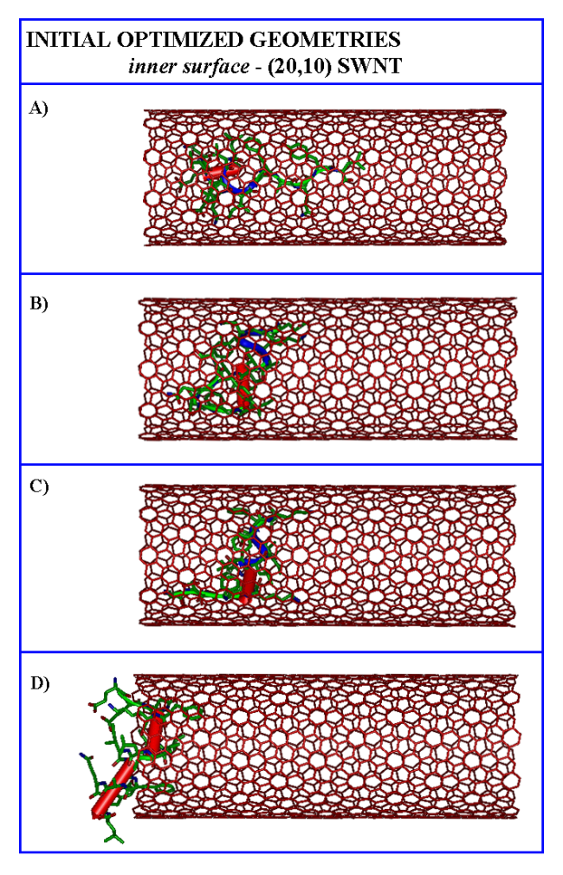
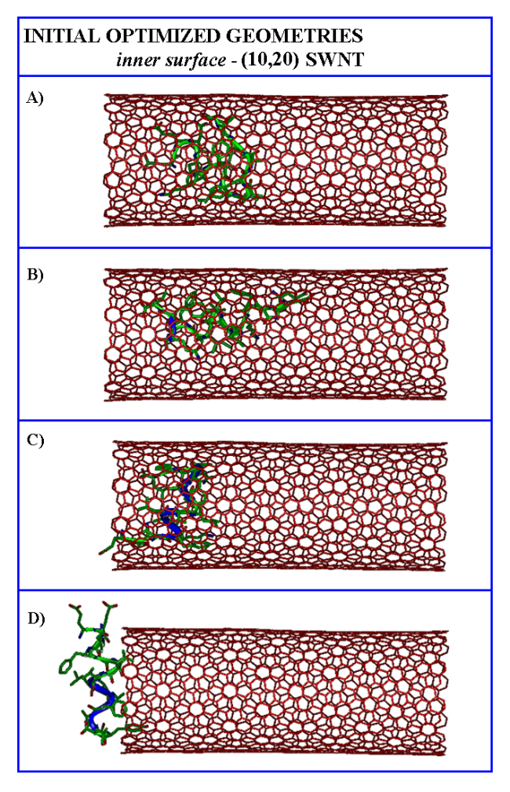
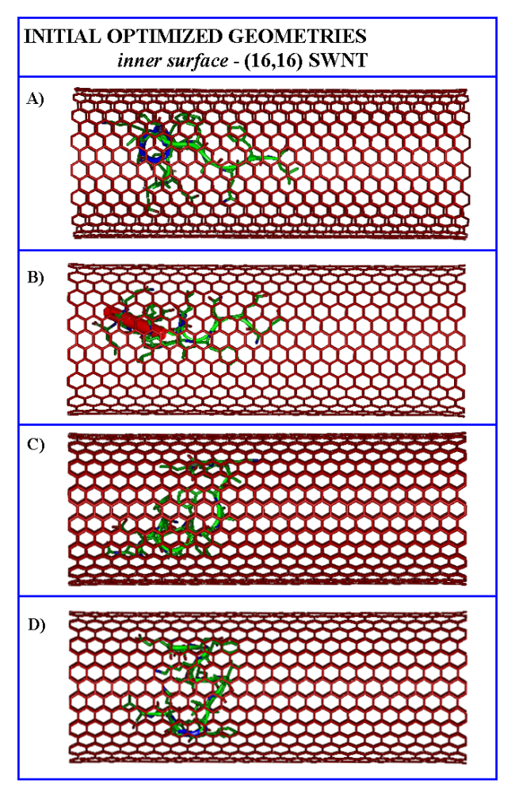
1. Initial adsorption stage after energy minimization on the inner concave surface
Different interaction geometries and different interaction strengths
    encapsulation

Slide 14
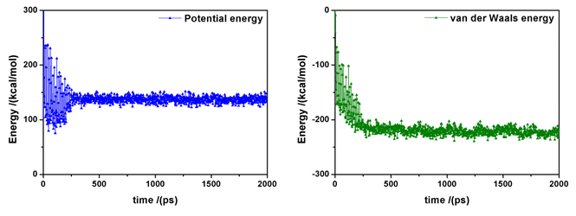

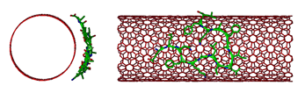
2. MD run ⇒ time evolution of the system at T=300K
inner_(20,10)_SWNT_side.avi outer_(20,10)_SWNT_side.avi inner_(20,10)_SWNT_end.avi outer_(20,10)_SWNT_end.avi

Slide 15
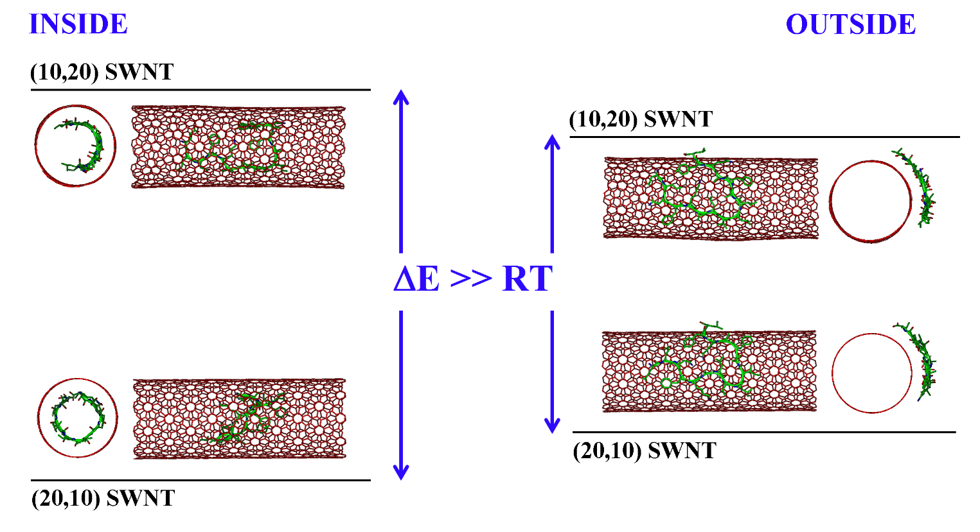
2. MM after MD run ⇒ FINAL adsorption stage
77 kJ/mol
52 kJ/mol
Similar adsorption but larger stability of the complex
formed by the oligopeptide adsorbed
either on the inner or on the outer surface
of the chiral (20,10) SWNT
 Similar stability of the complex on the outer surface
of (10,20) and (16,16) SWNT.

Slide 16
GENERAL CONCLUSIONS
MM and MD simulations are most useful to study at atomistic level:
proteins and, in general, oligopeptides
surface chemistry, nanoscale topography,
curvature of substrates, chirality
About the physisorbed layer we can study:
its structure describing the geometry of interaction
the strength of interaction (E_{int}) over hydrophilic or hydrophobic substrates
In particular, the interaction strength is related with:
- the molecular size affecting the number of residues in contact with the surface
- the hydropathy of the aminoacids in contact with a specific surface
- the particular chemistry and chirality of the substrates.
  G. Raffaini, F. Ganazzoli, Langmuir (2003).
  F. Ganazzoli, G. Raffaini, Computer simulation of polypeptide adsorption on biomaterials, Phys. Chem., Chem. Phys. (2005).
  G. Raffaini, F. Ganazzoli, Macromol. Biosci., 7 (2007).

Slide 17
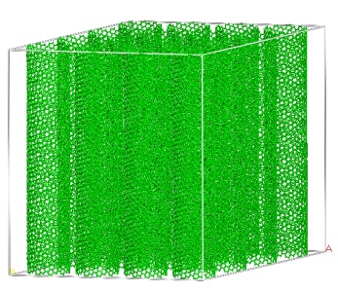
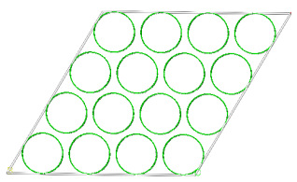
GENERAL CONCLUSIONS
Using MD methods we can following the kinetics of adsorption process:
the dimension and protein ‘rigidity’ play a role in the spreading process
(soft oligopeptides can spread on the surface).
Adsorption on the (20,10) is more favorable than on the (10,20) CNT surface
 natural chiral oligopeptides of a sufficiently large size can be used
for the separation of enantiomer CNTs
in solution or for example covalently attached on substrates
 Membranes of aligned chiral CNT can be used
as stationary phase for example in chromatography
for the separation of chiral molecules
having different dimension, different interaction strength
and different kinetics of diffusion
 then different retention time.
G. Raffaini, F. Ganazzoli, Langmuir, 29, 4883−4893 (2013).
G. Raffaini, F. Ganazzoli, Journal of Chromatography A, 1425, 221-230 (2015).

Slide 18
GENERAL CONCLUSIONS
CNTs are of huge interest for many technological applications
MM and MD methods are a useful tool to better understand:
possible separation of CNTs using peptides
possible separation of proteins
different diffusion of water molecules
in specific channels with different dimensions din_CONC_1NT_8_8_10ns.avi
G. Raffaini, F. Ganazzoli, Journal of Chromatography A, 1425, 221-230 (2015).

Slide 19
Thank you
for your attention

