Slide 1

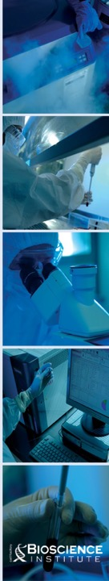


A new, safe and reproducible procedure to improve soft tissue augmentation outcomes

Slide 2

FROM FAT TO EXPANDED
ADIPOSE DERIVED STEM CELL
Autologous Fat Transplant
SVF in Fat scaffold
EXPANDED ADSC
in Fat scaffold

Slide 3

limit of the FAT and SVF in Breast volume retention
 | by FAT | By SVF
Average of volume of fat injected | 151ml | 255ml
Follow up (days) | 140 | 365
% of volume retained | 52.3% | 53%
1 - Choi M et all The volumetric analysis of fat graft survival in breast reconstruction. Plast Reconstr Surg. 2013 Feb;1
2 - Jung HK et all Prospective 1-Year Follow-Up Study of Breast Augmentation by Cell-Assisted Lipotransfer. Aesthet Surg J. 2015 Sep 4

Slide 4
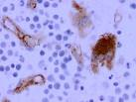
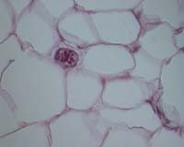
Cells population after the FAT digestion
ADSC are the 0.05-3% of the FAT or SVF
MESENCHIMAL STEM CELLS
FIBROBLASTS
PERICYTES
MACROPHAGES
MYOCYTES
PREADIPOCYTES
ENDOTHELIAL
VASCULAR CELL
Patrick C. Baer and Helmut Geiger, “Adipose-Derived Mesenchymal Stromal/Stem Cells: Tissue Localization, Characterization, and Heterogeneity,” Stem Cells International, vol. 2012

Slide 5
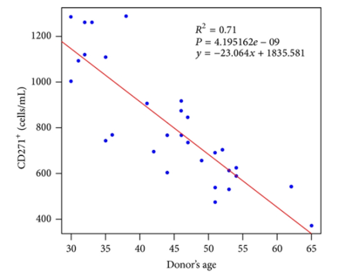
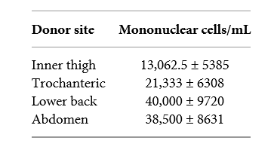
ADSC YIELD
Donor’s age negatively affects ADMSC yield and applications
ADMSC yield depends on the harvest donor site

Slide 6

To obtain 100.000.000 ADSC (not expanded)
they need of 20 lt of FAT
References: Aronowitz et al., Adipose stromal vaular fraction isolation: a head-to-head comparison of four commercial cell separation systems Plastic Reconstr Surg 2013

Slide 7

The Safety

Slide 8
Title | Cohort | Somministration | Target | Follow Up | Results
Safety and complications reporting on the re-implantation of culture-expanded mesenchymal stem cells using autologous platelet lysate technique. | 227 patients | Local injections | orthopedic conditions | 32 months | No neoplastic complications were detected at any stem cell re-implantation site
Autologous expanded adipose-derived stem cells for the treatment of complex cryptoglandular perianal fistulas: a phase III randomized clinical trial (FATT 1: fistula Advanced Therapy Trial 1) and long-term evaluation. | 200 patients | Intralesion injection of adipose-derived stem cells | complex cryptoglandular perianal fistulas | 1 year | Considered a safe treatment
Transplantation of progenitor cells and regeneration enhancement in acute myocardial infarction: final one-year results of the TOPCARE-AMI Trial. | 55 patients | intracoronary | acute myocardial infarction | 5 years | Long-term safety of intracoronary cell therapy and suggests favorable effects on LV function
Mesenchymal stem cells for treatment of steroid-resistant, severe, acute graft-versus-host disease: a phase II study | 55 patients | IV infusion | steroid-resistant, severe, acute GVHD | up to 60 months | Infusion of expanded MSC in vitro might be an effective therapy for patients with steroid-resistant, acute GVHD

Slide 9
Title | Cohort | Somministration | Target | Follow Up | Results
Mesenchymal stem cell transplantation in amyotrophic lateral sclerosis: A Phase I clinical trial. | 19 patients | amyotrophic lateral sclerosis | MSC implanted into the dorsal spinal cord | 9 years | This study shows the safety of MSC transplantation in the central nervous system
Treatment of Knee Osteoarthritis With Allogeneic Bone Marrow Mesenchymal Stem Cells: A Randomized Controlled Trial. | 15 patients | intra-articular injection | Knee Osteoarthritis | 1 year | Feasibility and safety were confirmed and indications of clinical efficacy were identified.
Safety of intravenous infusion of human adipose tissue-derived mesenchymal stem cells in animals and humans | 8 male patients | Intravenously (4x10⁸ cells autologous MSCs | spinal cord injury | 3-month | The systemic transplantation of MSCs appears to be safe and does not induce tumor development.
First-in-Human Case Study: Pregnancy in Women With Crohn's Perianal Fistula Treated With Adipose-Derived Stem Cells: A Safety Study. | 5 woman | Intralesion injection of adipose-derived stem cells | rectovaginal and perianal fistula | 2-years | Do not affect the ability to conceive, the course of pregnancy, pregnancy outcomes, or newborns’ health in female patients

Slide 10
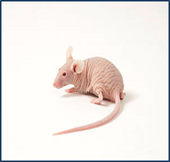
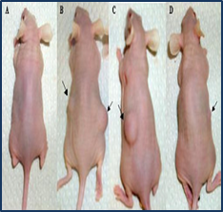

Biological safety tests Institute Zooprofilattico (Italy) for Bioscience
According to the European Pharmacopoeia 7.0 (Chapter 5.2.3).
ADSC were grown in vitro up until the 16th passage
In vitro tumorigenicity: the colony formation test in soft agar gels
In vivo test, into NuNu genotype mice and NOD SCID mice.

Slide 11
 | SAMPLE | MICE | SACRIFICE | NUMBER | HYSTOLOGY
 |  |  |  |  | SKIN | OTHER ORGANS
1 | FAT-47 IV passage | 10 Nu/Nu mice | 20 d/ post-inoculum | 5 | negative | negative
 |  |  | 12 w/ post-inoculum | 5 | negative | negative
2 | FAT-47 VIII passage | 10 Nu/Nu mice | 20 d/ post-inoculum | 5 | negative | negative
 |  |  | 12 w/ post-inoculum | 5 | negative | negative
3 | FAT-47 XII passage | 10 Nu/Nu mice | 20 d/ post-inoculum | 5 | negative | negative
 |  |  | 12 w/ post-inoculum | 5 | negative | negative
4 | FAT-47 XVI passage | 10 Nu/Nu mice 10 NOD/SCID | 20 d/ post-inoculum | 5 Nu/Nu + 5 NOD/SCID | negative | negative
 |  |  | 12 w/ post-inoculum | 5 Nu/Nu + 5 NOD/SCID | negative | negative
Positive control | HEP-2 | 10 Nu/Nu mice 10 NOD/SCID | 20 d/ post-inoculum | 10 | positive | positive
 |  |  | 12 w/ post-inoculum | 10 | positive | positive
Negative control | VERO | 10 Nu/Nu mice 10 NOD/SCID | 20 d/ post-inoculum | 10 | negative | negative
 |  |  | 12 w/ post-inoculum | 10 | negative | negative
NO TUMORIGENESIS
WAS DETECTED
In Vitro Soft agar test:
This test showed that ADSC at all passages were unable to induce transformed colonies indicating the absence of transformation following in vitro cultivation.
In Vivo inoculation tests:
Tumourigenesis was detected neither in athimic mice injected with the different passages of ADSC

Slide 12
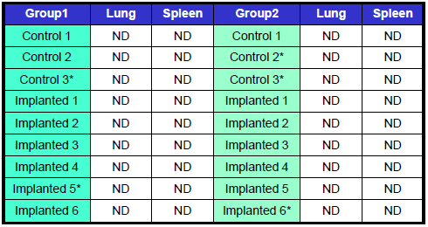
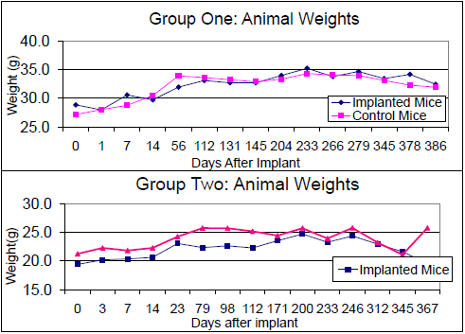
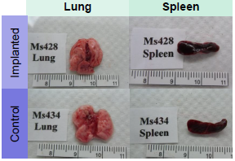

rt-PCR results for mouse lung and spleen. No detection for human cells in the tissue
Human culture-expanded MSC do NOT generate tumours or migrate systemically after implantation in vivo at high doses
There was no significant difference between treated and control group weights
Was not detected any abnormally in the mouse lungs and spleens, harvested one year after implantation

Slide 13
Soft tissue augmentation
the proof of principle

Slide 14
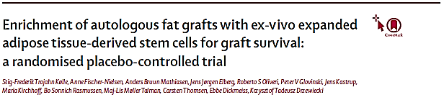
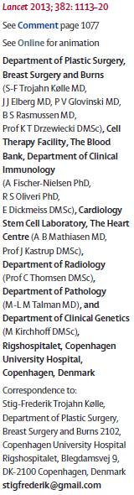
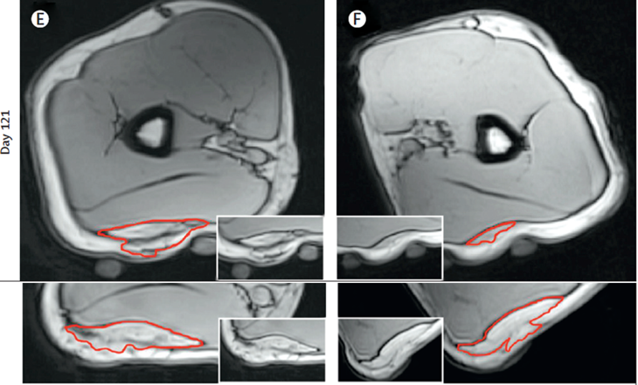
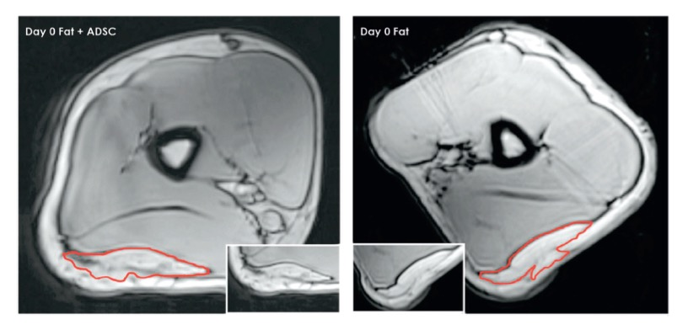
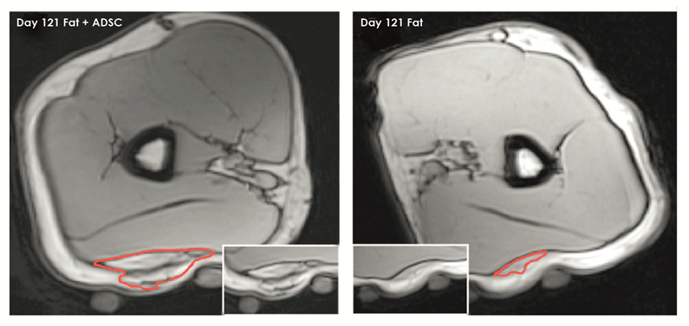
ADSC
FAT

Slide 15
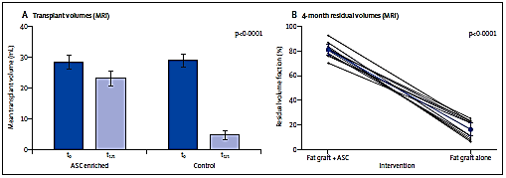
The graft retention and residual volume
VOLUME of the graft after 120 days
ADSC enriched fat grafts….80,9%
FAT……………………………….16,3%

Slide 16
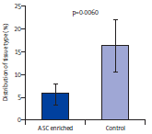
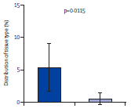
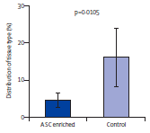
New Tissue Generation and Improved Tissue Quality
Existing Connective Tissue
Newly Formed Connective Tissue
New Tissue Generation
Necrotic Tissue
Improved Tissue Quality

Slide 17

Translation of the scientific study performed by the Copenhagen University Hospital’s staff in the clinical routine in the breast augmentation and in the face
shaping models

Slide 18
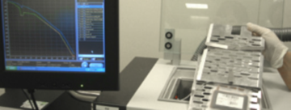
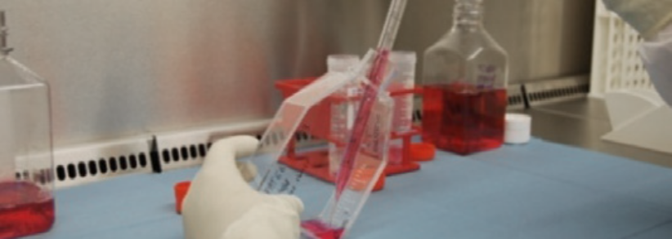
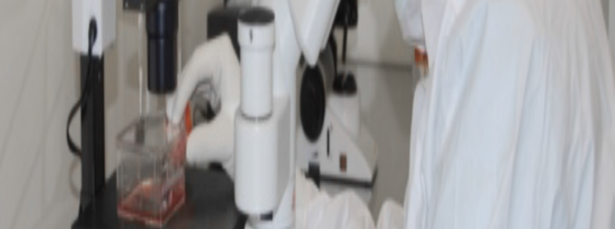
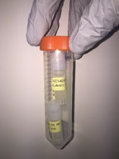

Laboratory Procedures
FREEZING
CELL ISOLATION
in clean room and through sterility tests
CELL EXPANSION
RELEASE

Slide 19
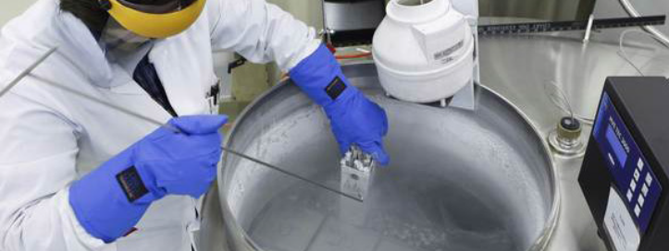
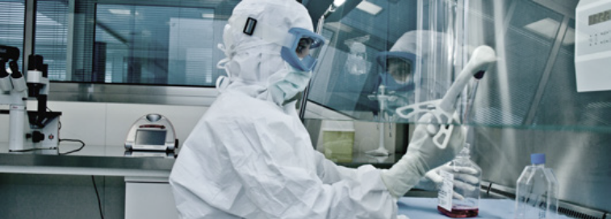
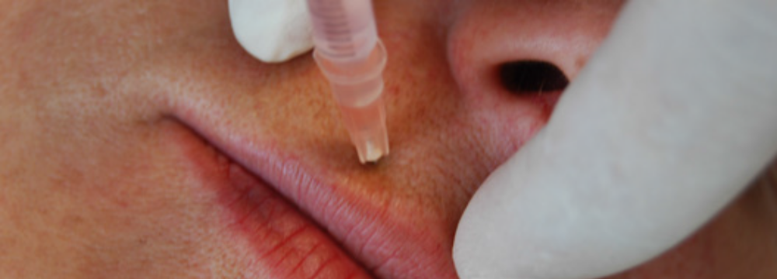

Laboratory Procedures
BANKING
TAWING
RELEASE
THERAPY

Slide 20
BIOSCIENCE INSTITUTE
Clinical Results

Slide 21
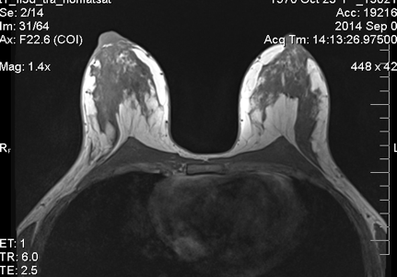
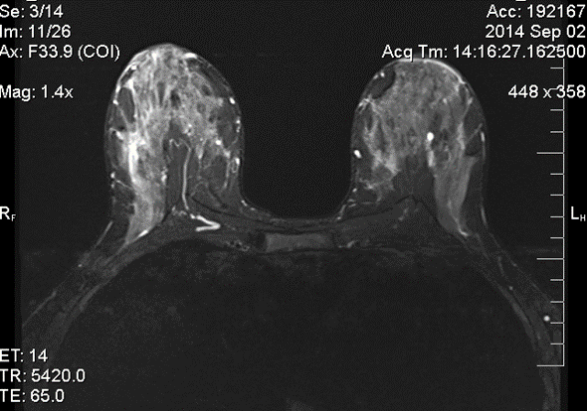
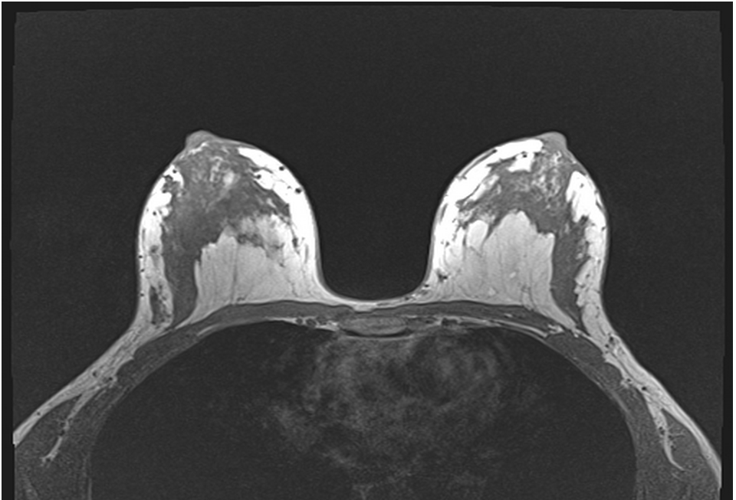
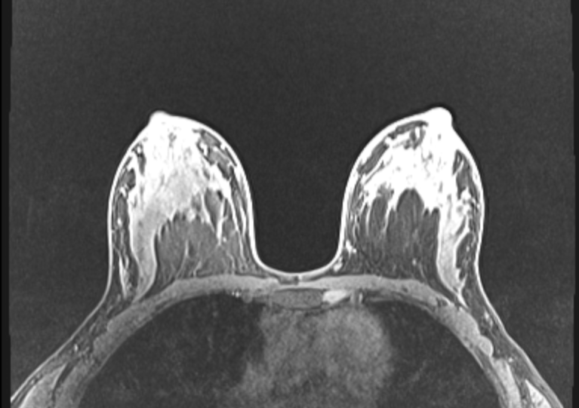

Breast Augmentation – Patient 1
BEFORE
AFTER 12 MONTHS

Slide 22

More of 100% of volume was maintained
 | Right Brest | Left Brest
Initial Breast Volume* | 420ml | 473ml
Volume of Fat Injected* | 280ml (700ml total volume) | 192ml (665ml total volume)
Volume of the Breast after 120 days* | 746ml (106% of initial total volume) | 764ml (115% of initial total volume)
Volume of the Breast after 6 months* | 795ml (113% of initial total volume) | 836ml (126% of initial total volume)
Volume of the Breast after 12 months* | 896ml (128% of initial total volume) | 804ml (121% of initial total volume)
Ratio Cells/ml of fat: 340,000cells/ml
*Data obtained by MRI analysis

Slide 23
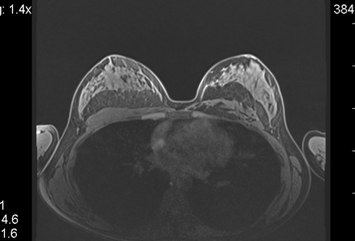
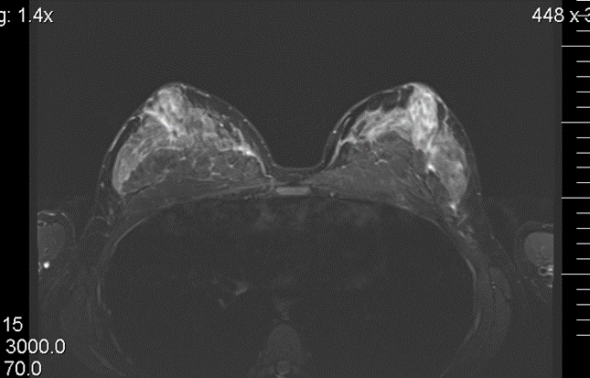
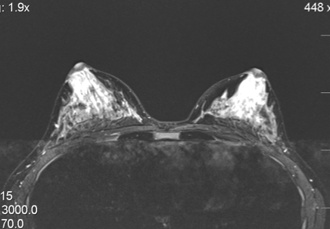
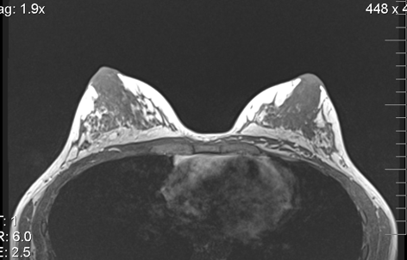
Breast Augmentation – Patient 2
BEFORE
AFTER 6 MONTHS

Slide 24
More of 100% of volume was maintained
 | Right Brest | Left Brest
Initial Breast Volume* | 336ml | 349ml
Volume of Fat Injected* | 334ml (670ml total volume) | 265ml (614ml total volume)
Volume of the Breast after 120 days* | 632ml (94.3% of injected volume) | 547ml (89% of injected volume)
Volume of the Breast after 6 months* | 678ml (101% of injected volume) | 628ml (102% of injected volume)
Ratio Cells/ml of fat: 233,000cells/ml
*Data obtained by MRI analysis

Slide 25
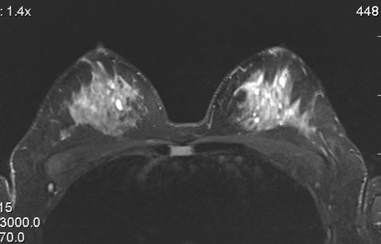
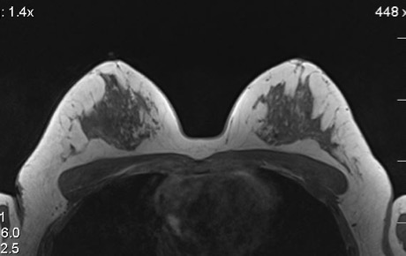
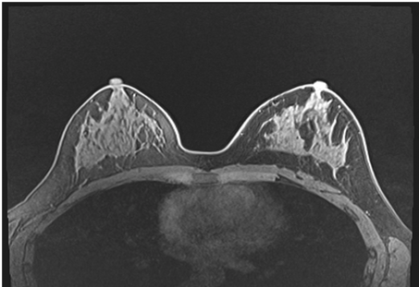
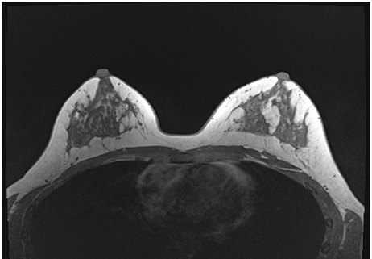
Breast Augmentation – Patient 3
BEFORE
AFTER 12 MONTHS

Slide 26
Around 100% of volume was maintained. BMI stable
 | Right Brest | Left Brest
Initial Breast Volume* | 799ml | 745ml
Volume of Fat Injected* | 246ml (1045ml total volume) | 321ml (1066ml total volume)
Volume of the Breast after 120 days* | 1011ml (96.7% of injected volume) | 1121ml (105% of injected volume)
Volume of the Breast after 1 year* | 973ml (93.1% of injected volume) | 1062ml (99.6% of injected volume)
Ratio Cells/ml of fat: 170,000cells/ml
*Data obtained by MRI analysis

Slide 27
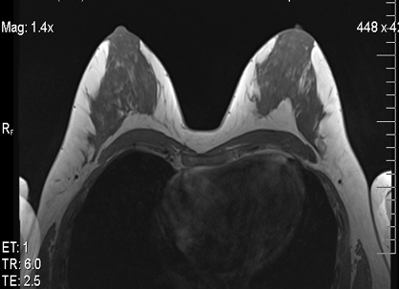
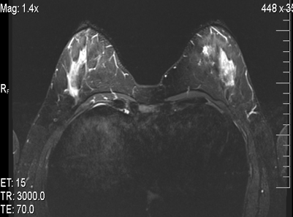
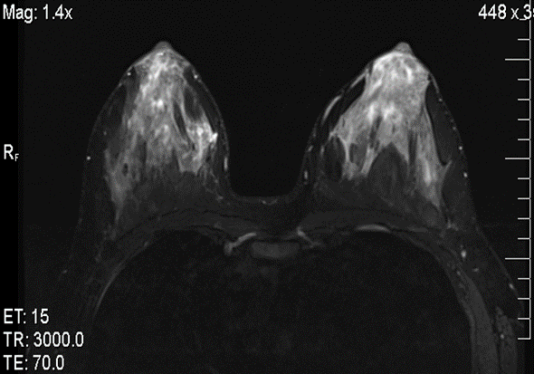
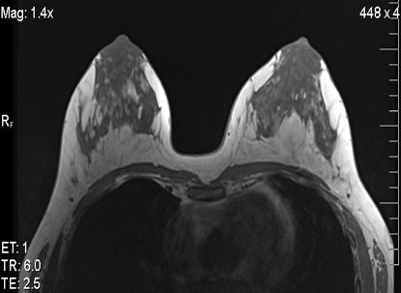
Breast Augmentation – Patient 4
BEFORE
AFTER 6 MONTHS

Slide 28
Around 80% of the volume was maintained
 | Right Brest | Left Brest
Initial Breast Volume* | 786ml | 828ml
Volume of Fat Injected* | 508ml (1,294ml total volume) | 469ml (1,297ml total volume)
Volume of the Breast after 120 days* | 959ml (74.1% of initial total volume) | 1011ml (78% of initial total volume)
Volume of the Breast after 6 months* | 999ml (77% of injected volume) | 1016ml (78.3% of injected volume)
Ratio Cells/ml of fat: 140,000cells/ml
*Data obtained by MRI analysis

Slide 29
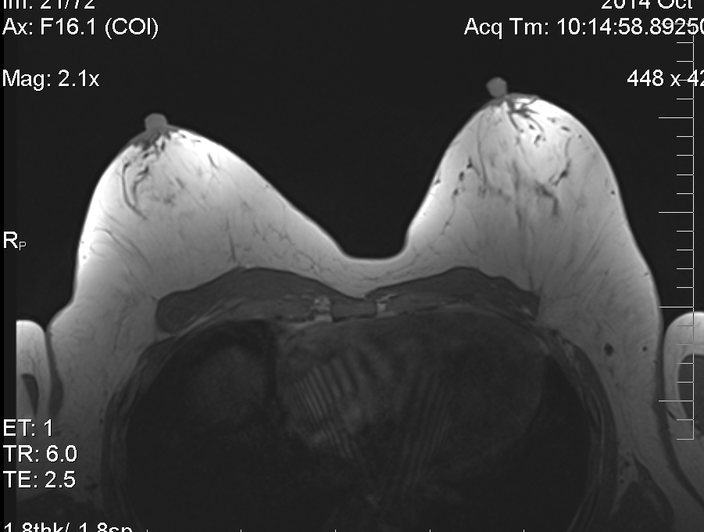
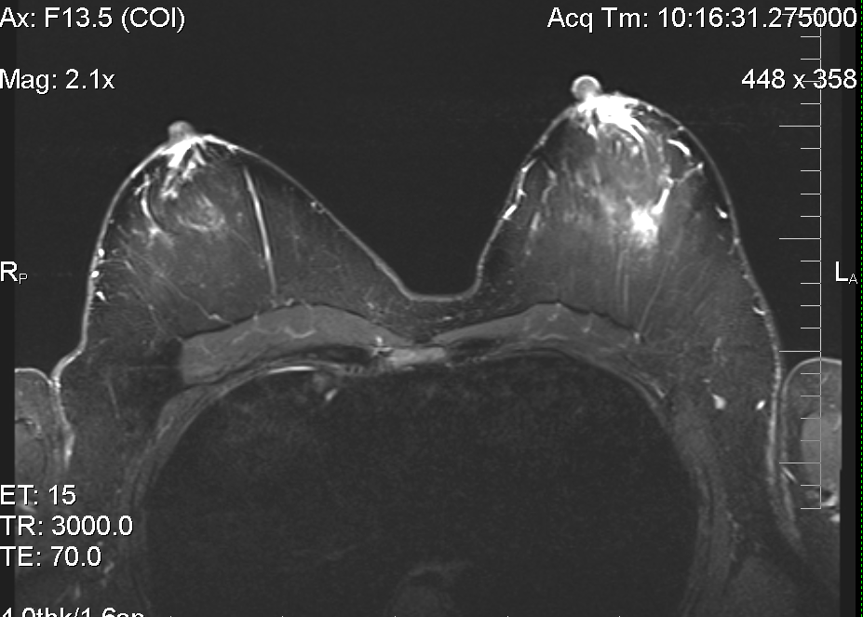
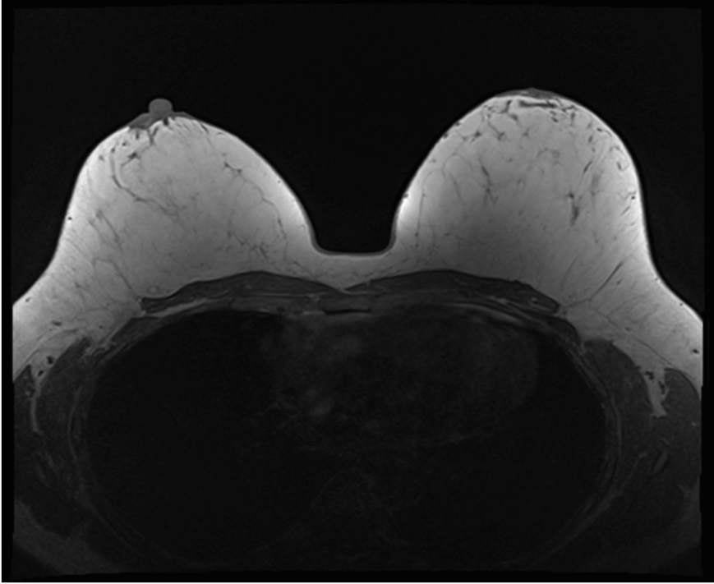
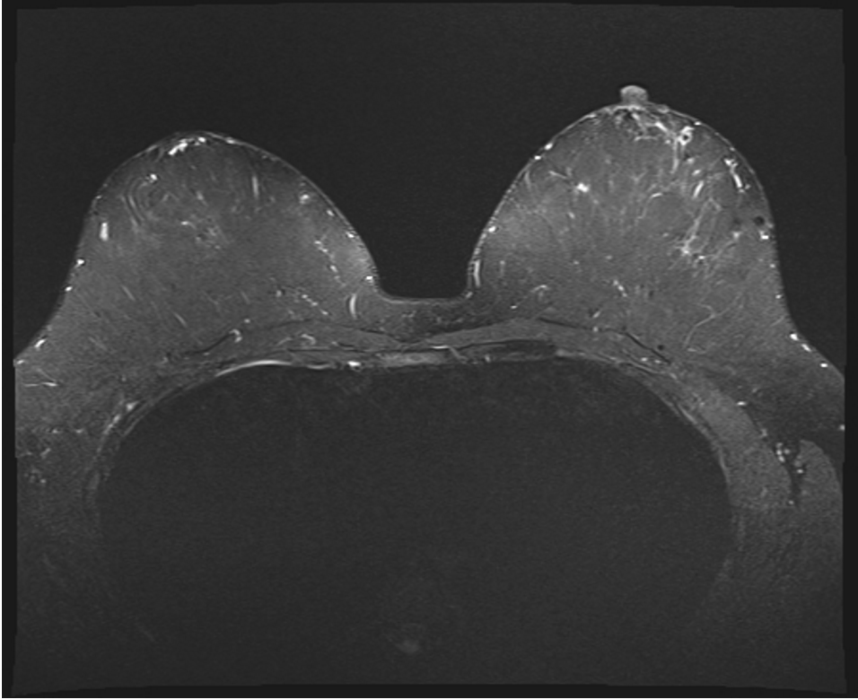
Breast Augmentation – Patient 5
BEFORE
AFTER 12 MONTHS

Slide 30
More of 100% of of volume was maintained.
 | Right Brest | Left Brest
Initial Breast Volume* | 1237ml | 1256ml
Volume of Fat Injected* | 293ml (1530ml total volume) | 376ml (1632ml total volume)
Volume of the Breast after 12 months* | 1704ml (111% of initial total volume) | 1654ml (101% of initial total volume)
Ratio Cells/ml of fat: 149,477cells/ml
*Data obtained by MRI analysis

Slide 31
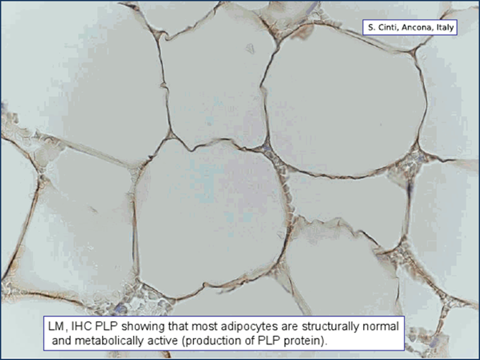

Histological Analisys
Adipocytes are structurally normal and metabolically active

Slide 32
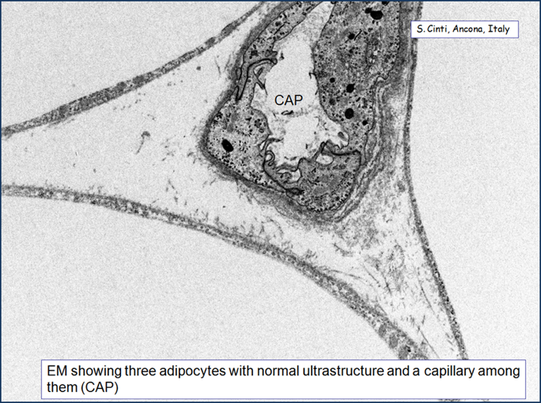
Electronic Microscopy Analysis
Adipocytes with normal ultrastructure and capillary net

Slide 33
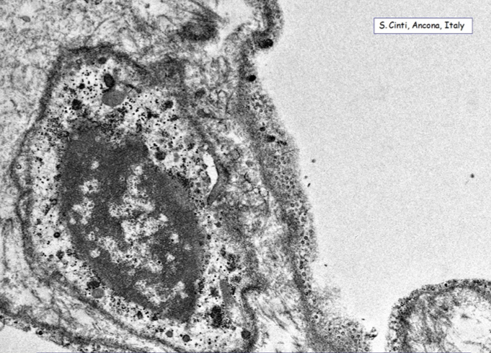
Electronic Microscopy Analysis
Cells differentiation – presence of preadipocite

Slide 34
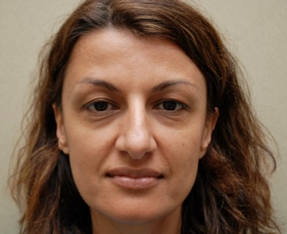







Face Shaping– Patient 1
BEFORE
AFTER 120 DAYS

Slide 35






Face Shaping– Patient 2
BEFORE
AFTER

Slide 36


Skin Rejuvenation - Face Contour Case 1
Forehead
Before
After 180 days

Slide 37


Skin Rejuvenation - Face Contour Case 1
Forehead
Before
After 120 days

Slide 38


Skin Rejuvenation - Face Contour Case 2
Cheek
Before
After 60 days

Slide 39


Slide 40
Results:
Patient Name | Initial BMI | Tretment Date | Initial Breast Volume* (ml) |  | Breast Volume after the treatment* (MSC plus Fat Injected) |  | Follow-up (date) | Patient BMI - Follow-up | Volume of the Breast* (%)
 |  |  | Right | Left | Right | Left |  |  | Right | Left
M.A.K. | 21.5 | Sep-14 | 420ml | 473ml | 700ml (280ml) | 665ml (192ml) | 12 months (Oct 2015) | 22.1 (+2.7%) | 896ml (128%) | 804ml (121%)
V.B. | 17.7 | Sep-14 | 336ml | 349ml | 670ml (334ml) | 614ml (265ml) | 6 months (Feb 2015) | 18 (+1.7%) | 678ml (101%) | 628ml (102%)
N.S. | 21.8 | Sep-14 | 799ml | 745ml | 1045ml (246ml) | 1066 (321ml) | 12 months (Oct 2015) | 21 (-3.7%) | 973ml (93%) | 1062ml (99.6)
S.G. | 26 | Sep-14 | 786ml | 828ml | 1294ml (508ml) | 1297 (469ml) | 6 months (Mar 2015) | 25.6 (-1.6%) | 999ml (77%) | 1016ml (78%)
H.S. | 25.7 | Oct-14 | 717ml | 812ml | 1345ml (628ml) | 1464ml (652ml) | 12 months (Oct 2015) | 26.5 (+3%) | 1231ml (92%) | 1200ml (82%)
L.D.N. | 21.6 | Feb-15 | 551ml | 448ml | 1014ml (463ml) | 988ml (540ml) | 6 months (Aug 2015) | 21.6 (-) | 920ml (91%) | 973ml (99%)
L.E. | 31.7 | Oct-14 | 1237ml | 1256ml | 1530ml (293ml) | 1632ml (376ml) | 12 months (Oct 2015) | 31.4 (-1%) | 1704ml (111%) | 1654ml (101%)
*Data obtained by MRI analysis

Slide 41
Results
Average of fat grafting for each breast : 398ml
Average of fat grafting for each breast (1 YEAR FOLLOW-UP PATIENTS): 374ml
BMI of the patient at 1 year: STABLE
Average of initial volume persisting (TOT. PATIENT) 98.3%
Average of initial volume persisting (1 YEAR FOLLOW-UP PATIENTS)103.5 %

Slide 42

How many FAT for OA TREATMENTS
(considering 1 injection of 10.000.000 ADSC)
SVF
2 liters FAT 10 Million ADSC
1 TREATMENT 2 liters FAT
EXPANDED ADSC
10 ml of FAT 50 Million ADSC
5 TREATMENTS 10 ml FAT

Slide 43
The upgrade of the process
(from FBS to PL)
PAST
Fetal Bovinum Serum
N. days of colture : 21
N. of cells from 20 ml FAT : 5 Millions
N. of passages : 4
Animal free : NO
PRESENT
Human Platelet Lysate
N. days of colture : 12
N. of cells from 20 ml FAT : 100 Millions
N. of passages : 1
Animal Free : yes

Slide 44
Next Upgrade
From
Allogenic platelet lysate
To
Autologous platelet lysate

Slide 45

Thank You

Slide 46
OSTEOARTHRTIS
OA affects over 70 million EU citizens and is responsible for over 80 billion €/a in cost and lost productivity.
OA is a chronic, progressive, and irreversible degenerative joint disease including progressive cartilage deterioration.
conventional OA treatments (acetaminophen, NSAID and opiod analgesics) often result in complications such as limited activity and cannot slow or arrest OA progression.
Surgery (arthroscopy, cartilage repair, marrow stimulation by microfracture, abrasion or drilling of the subchondral bone plate, total joint arthroplasty, and osteochondral grafting) is reserved as a last effort to manage OA symptoms in patients with refractory disease.

Slide 47


Slide 48


Slide 49


Slide 50



Slide 51


Slide 52


Slide 53


Slide 54


Slide 55


Slide 56
osteoarthritis treatments prices

Slide 57
TARGET CANCER
STEM CELL THERAPY

Slide 58


Slide 59


Slide 60





Slide 61


Slide 62


Slide 63


Slide 64

THE USE OF MSC IN ANTI-CANCER THERAPY
MSC PROPERTIES:
TUMOR-HOMING ABILITY
LOCAL DELIVERY OF ANTI-CANCER MOLECULES

