Slide 1

Mesenchymal Stem Cells
from potential risk of tumor to specific anti-tumor therapy
Dr. Giuseppe Mucci
2nd World Bio Summit & Expo
Dubai -10 October 2016

Slide 2



FROM FAT TO EXPANDED ADIPOSE DERIVED STEM CELL
Autologous Fat Transplant
SVF
EXPANDED ADSC

Slide 3

Mesenchymal Stem Cell

Slide 4
Mesencymal Stem Cells
Adipose Derived

Slide 5
Mesenchymal Stem Cell
Adipose Derived
Autologous

Slide 6
Mesenchymal Stem Cell
Adipose Derived
Autologous
Expanded

Slide 7
What is Stem Cell?
ADULTS
HEMATOPOIETIC (HSC)
EMBRYONIC
MESENCHYMAL (MSC)
Bone marrow ADIPOSE TISSUE
Dermis, Placenta, cord tissue, Dental pulp
Bone marrow Cord Blood
Red Blood Cells White Blood Cells
Muscles
Bones Nerves Cartilage

Slide 8
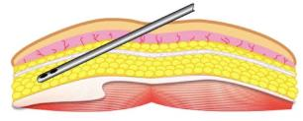
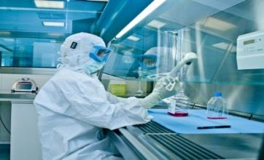

GMP laboratory procedures
Oil layer
LIPOASPIRATE 10-50 ml
WASH AND ENZYMATIC DIGESTION
Adipocytes
Aqueous layer
CELL EXTRACTION
Stromal vascular
fraction (SVF)

Slide 9
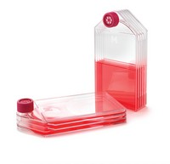
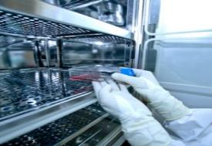
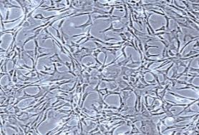

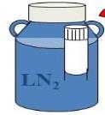

GMP laboratory procedures
CELL CULTURE IN MULTILAYER FLASKS IN hPL
CELL EXPANSION
CRYOPRESERVATION FOR FUTURE TREATMENTS
RELEASE FOR TREATMENTS

Slide 10
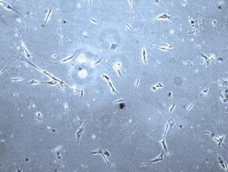
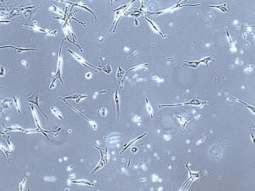
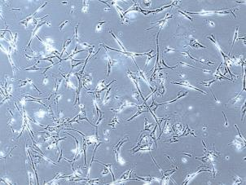
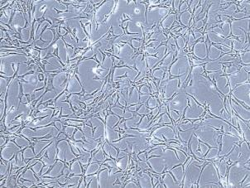
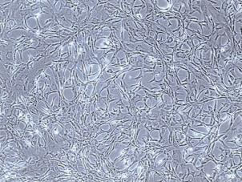
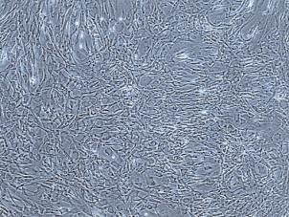
Cell expansion
2 days - 10 %
4 days - 20 %
6 days - 40 %
8 days - 60 %
10 days - 80 %
12 days - 100 %

Slide 11
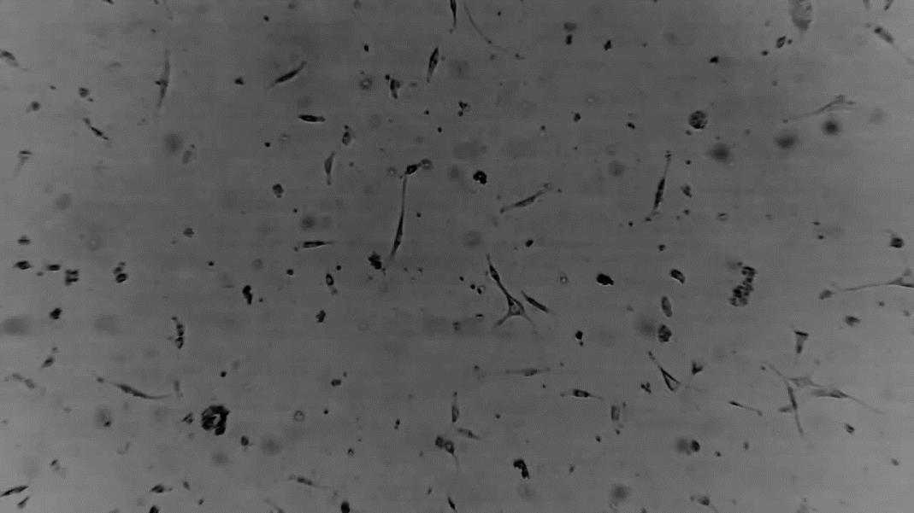
Cell expansion

Slide 12
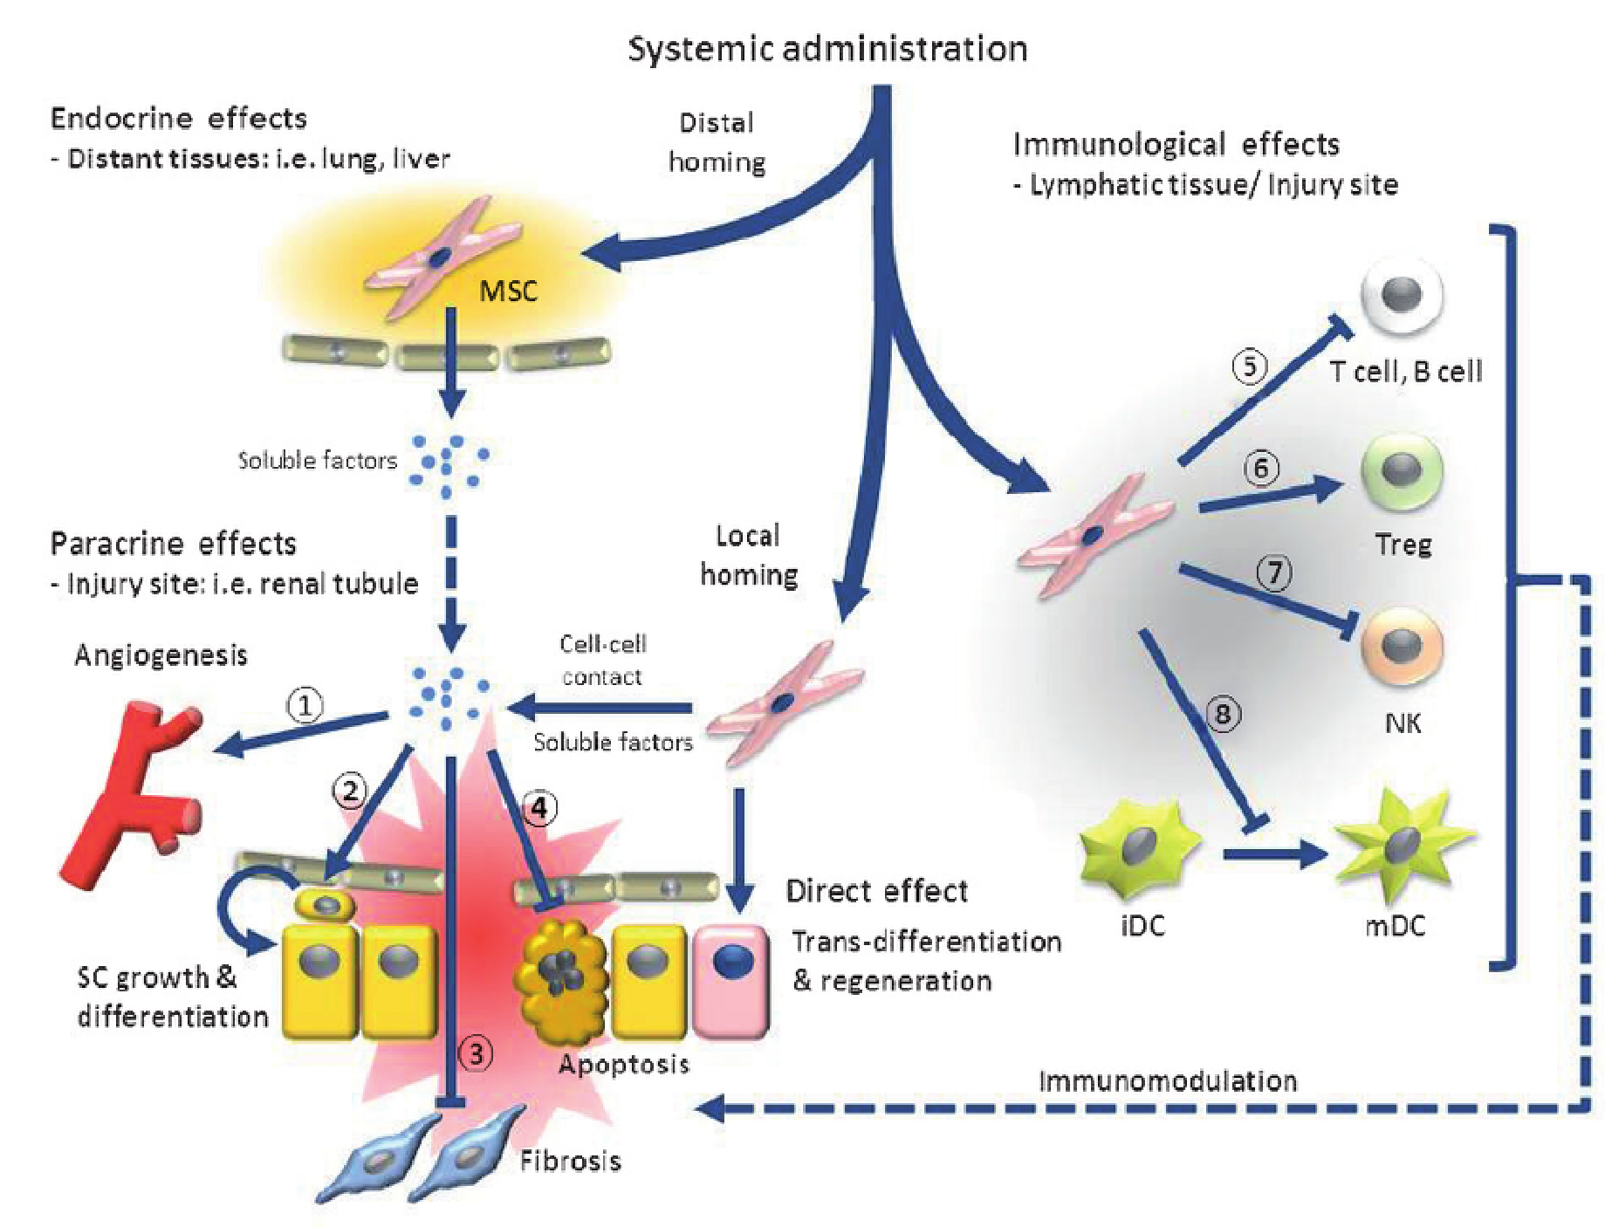
Immunomodulation Effect
MSCs
ADMINISTRATION
KEY ACTIVITIES OF MESENCHYMAL
STEM CELLS
Paracrine Properties
Regenerative Properties

Slide 13
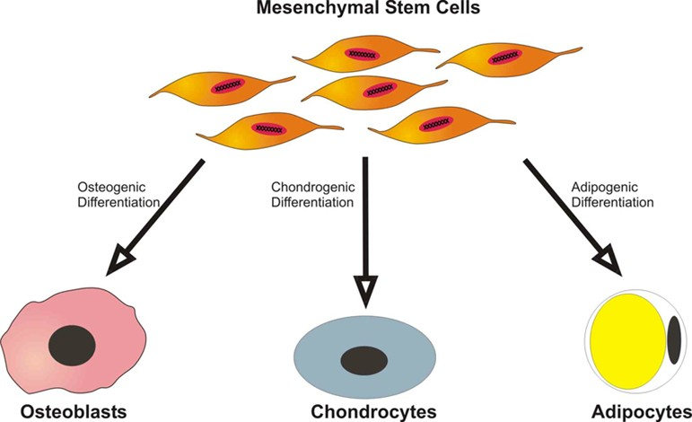
Regenerative Properties of MSCs

Slide 14
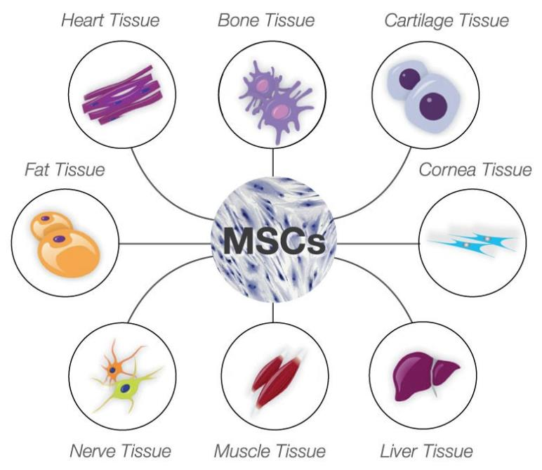
REGENERATIVE PROPERTIES OF MSCS
Differentiation into epidermal and dermal cells:
Repopulation of the wound bed
New extra cellular matrix
Replacing the damaged skin

Slide 15
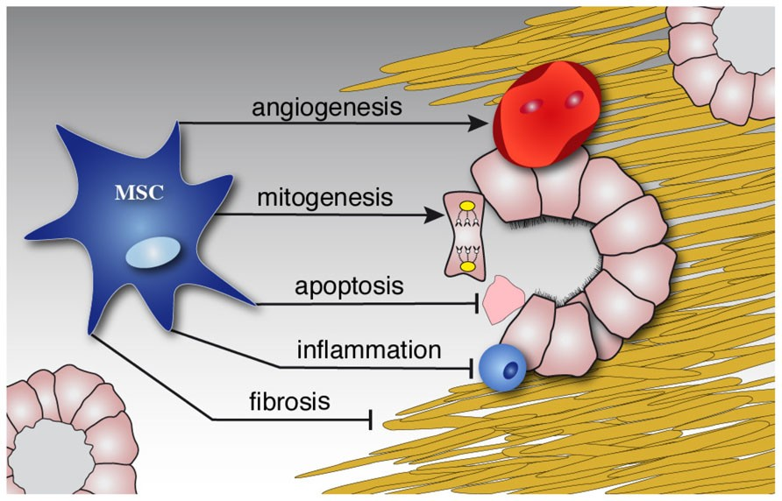
PARACRINE PROPERTIES OF MSC GROWTH FACTORS
Angiogenesis effect
Anti-fibrosis activity
Anti-apoptosis
Chemoattactive proprieties

Slide 16
MSC GROWTH FACTORS VS PRP GF
PRP : GF ONE SHOT RELEASE
TEMPORARY RESULT
MSC GF : GF RELEASE LIFETIME
LONG LASTING RESULT

Slide 17
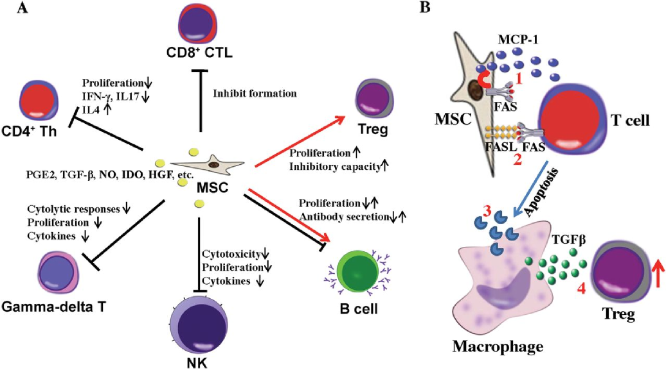
Immunosuppressive factors released
Inhibiting proliferation of immune cells such as T cells, B cells, and natural killer cells
Moving the wound past the state of persistent inflammation

Slide 18
Safety

Slide 19
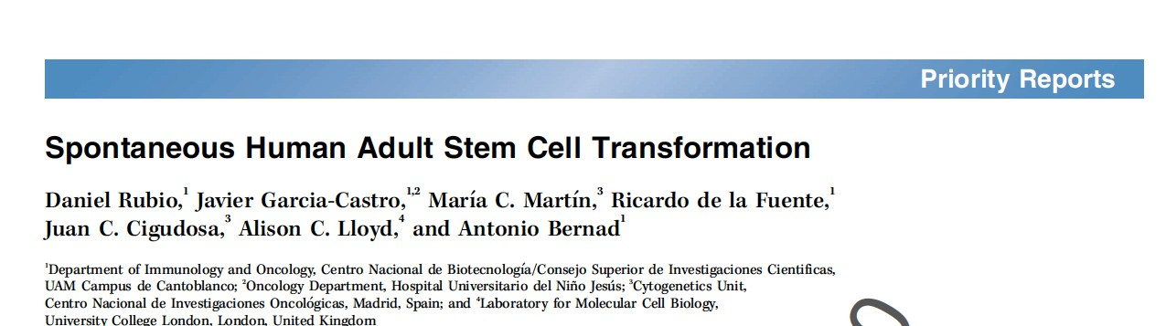
Cancer Res. 2005

Slide 20
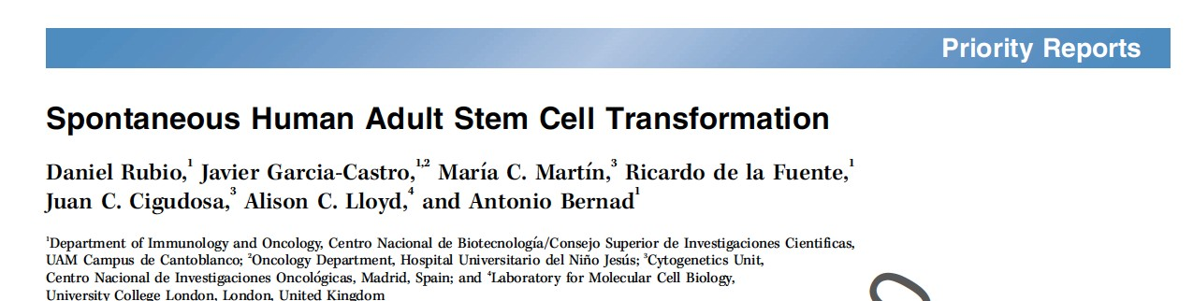
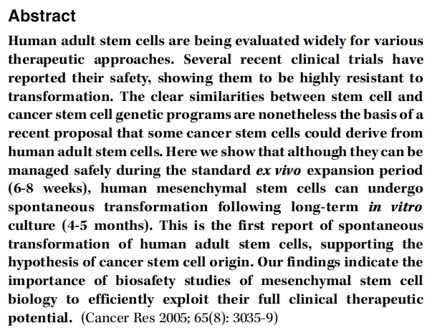

Slide 21
Cohort
Administration
Target
Follow Up
Results
227 Local injections orthopedic conditions 32 months ^{Safe}
treatment
200 Intralesion perianal fistulas 1 year ^{Safe} treatment
_{55 intracoronary} acute myocardial Safe
infarction ^{1 year} treatment
55 IV infusion steroid-resistant, acute GVHD 60 months ^{Safe}
Treatment
19 IV infusion dorsal spinal cord 9 years ^{Safe}
Treatment
15 intra-articular Knee Osteoarthritis 1 year ^{Safe} Treatment
8 IV infusion spinal cord injury 3 months ^{Safe}
Treatment
5 Intralesion injection ^{rectovaginal and} 2 years ^{Safe}
perianal fistula treatment

Slide 22
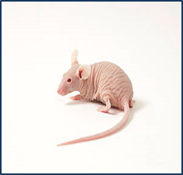
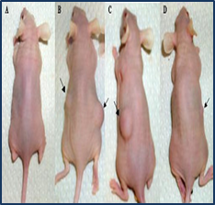
Safety
Biological safety tests performed by the Istituto Zooprofilattico of Brescia (Italy) for Bioscience Institute
In vitro tumorigenicity was assessed through the colony formation test in soft agar gels
For in vivo test, cells were injected subcutaneously into NuNu genotype mice and NOD SCID mice. Animals were checked for nodules formation

Slide 23
NO TUMORIGENESIS WAS DETECTED
 | SAMPLE | MICE | SACRIFICE | NUMBER | HYSTOLOGY
 |  |  |  |  | SKIN | OTHER ORGAN S
1 | FAT-47 IV passage | 10 Nu/Nu mice | 20 d/ post- inoculum | 5 | negative | negative
 |  |  | 12 w/ post- inoculum | 5 | negative | negative
2 | FAT-47 VIII passage | 10 Nu/Nu mice | 20 d/ post- inoculum | 5 | negative | negative
 |  |  | 12 w/ post- inoculum | 5 | negative | negative
3 | FAT-47 XII passage | 10 Nu/Nu mice | 20 d/ post- inoculum | 5 | negative | negative
 |  |  | 12 w/ post- inoculum | 5 | negative | negative
4 | FAT-47 XVI passage | 10 Nu/Nu mice 10 NOD/SCID | 20 d/ post- inoculum | 5 Nu/Nu + 5 NOD/SCID | negative | negative
 |  |  | 12 w/ post- inoculum | 5 Nu/Nu + 5 NOD/SCID | negative | negative
Positive control | HEP-2 | 10 Nu/Nu mice 10 NOD/SCID | 20 d/ post- inoculum | 10 | positive | positive
 |  |  | 12 w/ post- inoculum | 10 | positive | positive
Negative control | VERO | 10 Nu/Nu mice 10 NOD/SCID | 20 d/ post- inoculum | 10 | negative | negative
 |  |  | 12 w/ post- inoculum | 10 | negative | negative
In Vitro Soft agar test:
This test showed that ADSC at all passages were unable to induce transformed colonies indicating the absence of transformation following in vitro cultivation.
In Vivo inoculation tests:
Tumorigenesis was detected neither in athimic mice injected with the different passages of ADSC

Slide 24
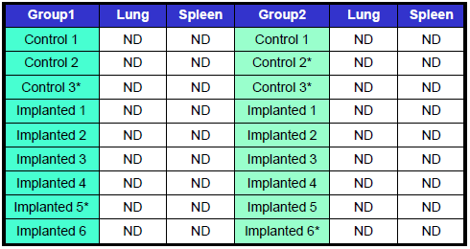
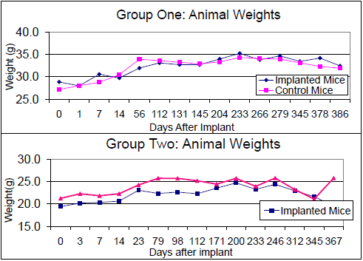
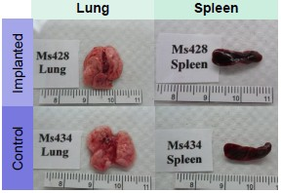
Human culture-expanded MSC do NOT generate tumours or migrate
systemically after implantation in vivo at high doses
rt-PCR results for mouse lung and spleen. No detection for human cells in the tissue
There was no significant difference between treated and control group weights
Was not detected any abnormally in the mouse lungs and spleens, harvested one year after implantation

Slide 25
Safety
Results
In vitro Soft Agar Test:
ADSC at all passages were unable to induce transformed colonies after in vitro cultivation.
In vivo Inoculation Tests:
No tumourigenesis was detected with ADSC at diﬀerent passages
SAMPLE MICE SACRIFICE NUMBER HYSTOLOGY
1 FAT-47 IV passage 10 Nu/Nu mice 20 d/ post-inoculum 5 negative negative
12 w/ post-inoculum 5 negative negative
2 FAT-47 VIII passage 10 Nu/Nu mice 20 d/ post-inoculum 5 negative negative
12 w/ post-inoculum 5 negative negative
3 FAT-47 XII passage 10 Nu/Nu mice 20 d/ post-inoculum 5 negative negative
12 w/ post-inoculum 5 negative negative
4 FAT-47 XVI passage ^{10 Nu/Nu mice} 20 d/ post-inoculum ^{5 Nu/Nu +} negative negative
10 NOD/SCID 5 NOD/SCID
12 w/ post-inoculum ^{5 Nu/Nu + 5 NOD/} negative negative
SCID
Positive control HEP-2 ^{10 Nu/Nu mice} 20 d/ post-inoculum 10 positive positive
10 NOD/SCID
12 w/ post-inoculum 10 positive ^{positive}
Negative control VERO ^{10 Nu/Nu mice} 20 d/ post-inoculum 10 negative negative
10 NOD/SCID
12 w/ post-inoculum 10 negative negative
NO TUMORIGENESIS DETECTED
Biological safety tests performed by the Istituto Zooprofilattico of Brescia (Italy) for Bioscience Institute

Slide 26
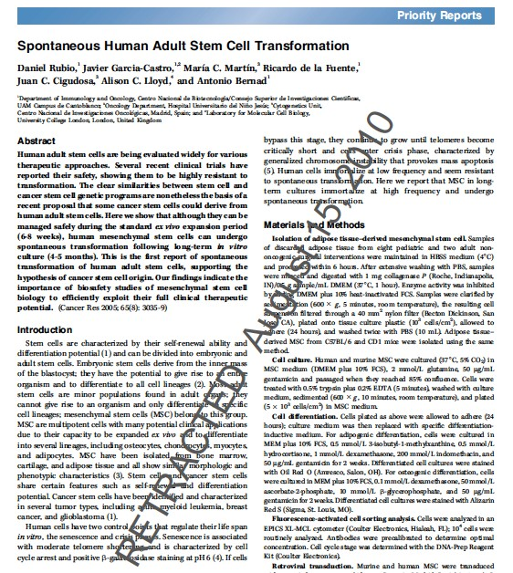

Slide 27
Standardization of dose and quality
THE MUST

Slide 28
SVF
PERICYTES
ENDOTHELIAL VASCULAR CELL
MACROPHAGES
PREADIPOCITES
FIBROBLASTS
OTHER TYPES OF CELLS
MESENCHIMAL STEM CELLS
0.05 - 3%
Zimmerlin L. et al Stromal vascular progenitors in adult human adipose tissue. Cytometry A. 2010;77:22–30.

Slide 29
≈ 5000 ADSC yield from 1 ml Adipose Tissue
300.000
≈ 5000
ADSC
250.000
200.000
150.000
≈ 250.000
cells NOT ADSC
100.000
50.000
≈ 5000 ADSC
0
FAT
SVF
Aronowitz et al., Adipose stromal vascular fraction isolation: a head-to-head comparison of four commercial cell separation systems Plastic Reconstr Surg 2013

Slide 30
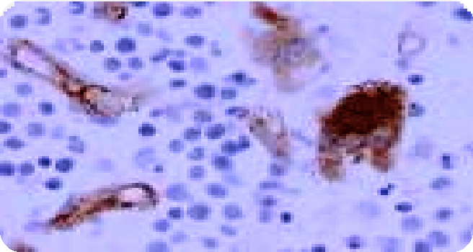
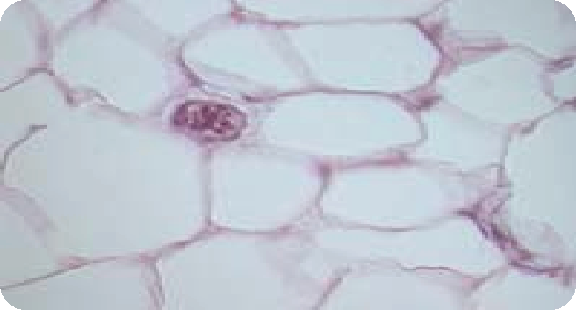









Cells population after the FAT digestion
ADSC are the 0.05-3% of the FAT or SVF
MESENCHIMAL STEM CELLS
MACROPHAGES
FIBROBLASTS
PERICYTES
MYOCYTES
PREADIPOCYTES
ENDOTHELIAL VASCULAR CELL
Patrick C. Baer and Helmut Geiger, “Adipose-Derived Mesenchymal Stromal/Stem Cells: Tissue Localization, Characterization, and Heterogeneity,” Stem Cells International, vol. 2012

Slide 31
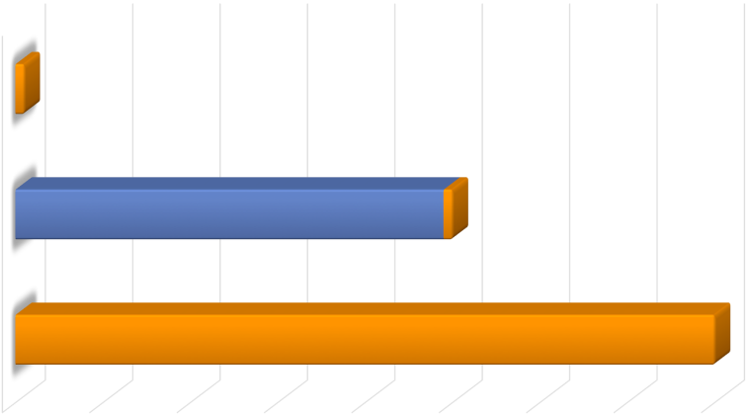

To obtain 100.000.000 ADSC (not expanded) they need of 20 lt of FAT
ADSC yeald from 1ml of Fat Tissue
References: Aronowi* et al., Adipose stromal vaular fraction
isolation: a head-to-head comparison of four commercial cell separation systems Plastic Reconstr Surg 2013
≈5,000 ADSC
FAT
250.000 nucleated cells NOT ADSC
≈5,000 ADSC
SVF
In vitro expanded MSC
≈400,000 ADSC
0
50.000
100.000
150.000
200.000
250.000
300.000
350.000
400.000
TNC MSC

Slide 32
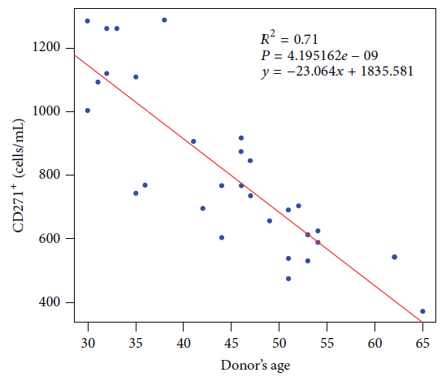
ADSC yield is influenced by a variety of parameters
Donor’s age
negatively affects it
RAQUEL CUEVAS-DIAZ DURAN et al Age-Related Yield of Adipose-Derived Stem Cells Bearing the Low-Affinity Nerve Growth Factor Receptor Stem Cells International Volume 2013 (2013), Article ID 372164

Slide 33
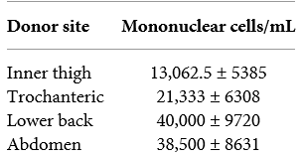
Influence of
site of collection
RAQUEL CUEVAS-DIAZ DURAN et al Age-Related Yield of Adipose-Derived Stem Cells Bearing the
Low-Affinity Nerve Growth Factor Receptor Stem Cells International Volume 2013 (2013), Article ID 372164

Slide 34


 | SVF | Expanded ADSC
Programmable process
Cell composition known
Homogeneous
Donor’s age independent
Site of collection independent

Slide 35
Cell yield

Slide 36
Author
Study
Expanded cells
With FAT
Kølle et al. – 2013
Soft Tissue Augmentation ≈ 20 millions
Lancet
4 liters
Adipoa - 2013 Osteoarthritis Treatment ≈ 10 millions
2 liters
Jo et al. – 2013
Osteoarthritic Knee ≈ 100 millions
Stem Cells
20 liters
Vangsness et al. – 2014
Knee disease ≈ 50 millions
JB&JS
10 liters
Bura et al. – 2014
_{Cytotherapy} Critical Limb Ischemia ≈ 200 millions
40 liters
Bioscience Soft Tissue Augmentation avg. 130 millions
25 liters

Slide 37
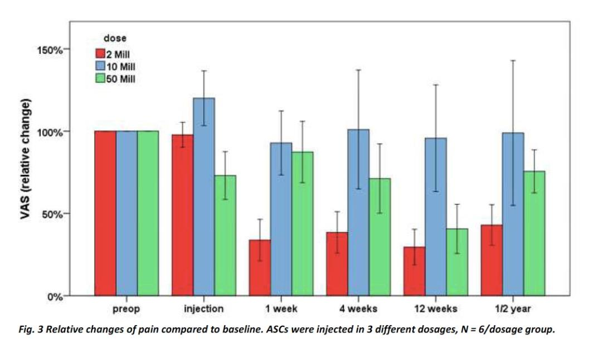

Slide 38











Expanded ADSC
SVF
Adipose tissue
starting material
2
litres
10
ml
ADSC
obtained
10
millions
50
millions
N° of Treatments
(10 M/treatment)
1
1
2
3
4
5
Aronowitz et al., Adipose stromal vascular fraction isolation: a head-to-head comparison of four commercial cell separation systems Plastic Reconstr Surg 2013

Slide 39
Cellular Yield Expansion vs Not Expansion
N° of CELLS | WITH EXPANSION | WITHOUT EXPANSION
≈ 50 Millions | 10 ml | 2 litres
≈ 100 millions | 20 ml | 5 litres
≈ 200/300 millions | 50 ml | 10 litres

Slide 40
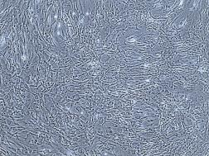
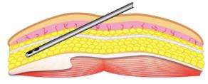
Stromal vascular fraction (SVF)
Adipose tissue
Expanded ADSC
Oil layer
Adipocytes
Aqueous layer
Stromal vascular fraction (SVF)

Slide 41
Proof of concept

Slide 42

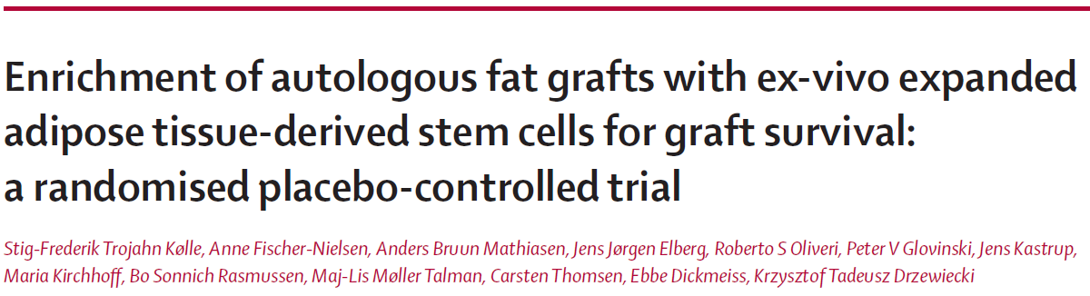

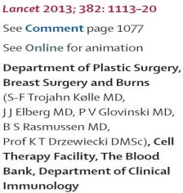
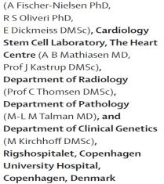

Slide 43
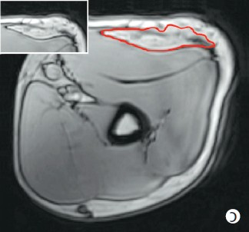
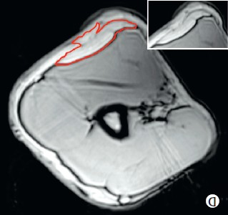


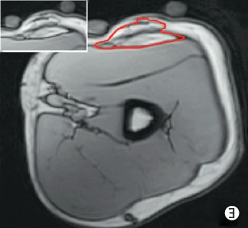
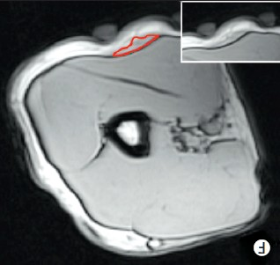


Expanded ADSC + Adipose tissue
Adipose tissue only
Day of
implant
T0
T0
After 121
days
80,9%
16,3%
T 121
T 121
KØLLE et al Enrichment of autologous fat grafts with ex-vivo expanded adipose tissue-derived stem cells for graft survival: a randomised placebo-controlled trial; Lancet 2013; 382: 1113–20

Slide 44
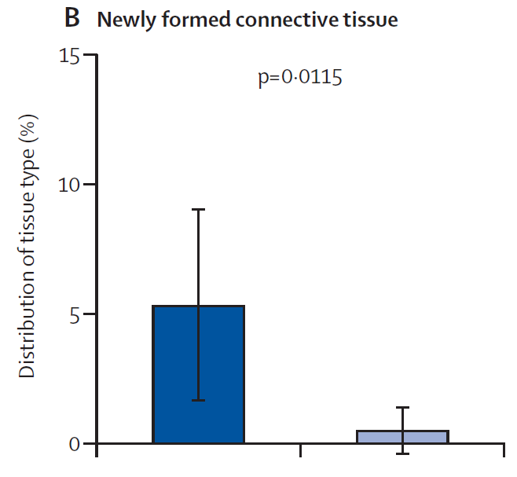
New tissue generation
ADSC +
Adipose tissue
Adipose tissue only
KØLLE et al Enrichment of autologous fat grafts with ex-vivo expanded adipose tissue-derived stem cells for graft survival: a randomised placebo-controlled trial; Lancet 2013; 382: 1113–20

Slide 45
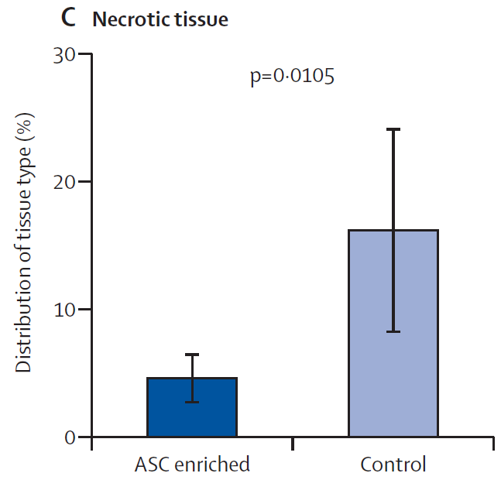
Improved Tissue Quality
ADSC +
Adipose tissue
Adipose tissue only
KØLLE et al Enrichment of autologous fat grafts with ex-vivo expanded adipose tissue-derived stem cells for graft survival: a randomised placebo-controlled trial; Lancet 2013; 382: 1113–20

Slide 46


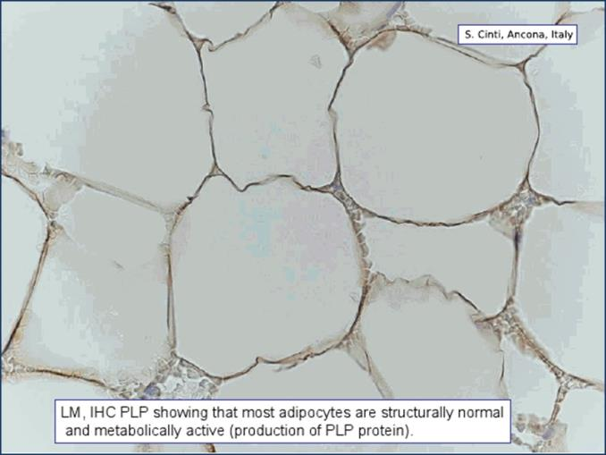
Istological Analisys
Adipocytes are structurally normal and metabolically active

Slide 47

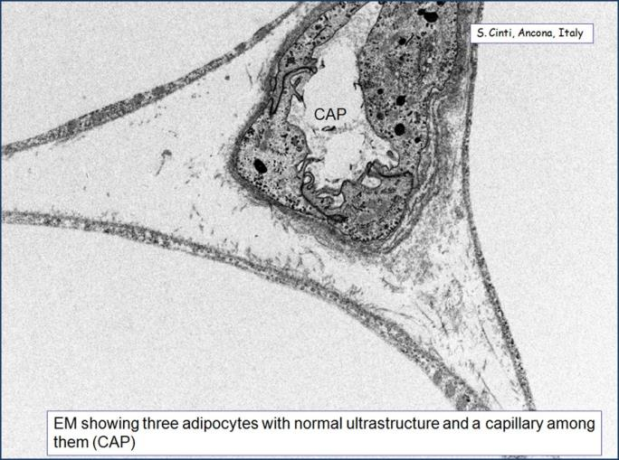
Electronic Microscopy Analysis
Adipocytes with normal ultrastructure and capillary net

Slide 48
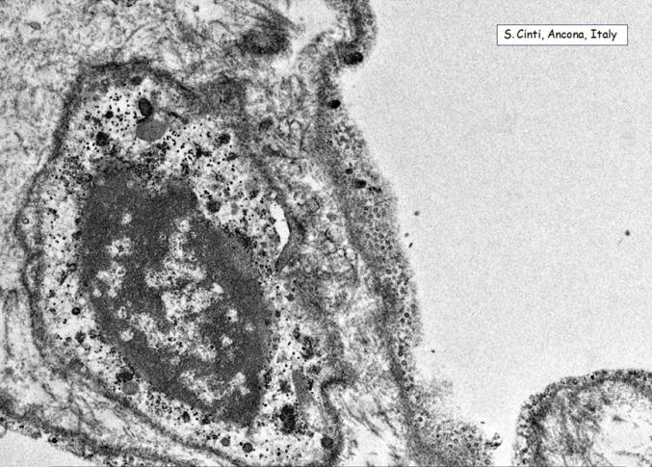
Electronic Microscopy Analysis
Cells differentiation – presence of preadipocite

Slide 49

Case Report
Soft tissue augmentation
Improvement of skin quality

Slide 50

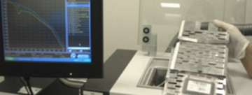
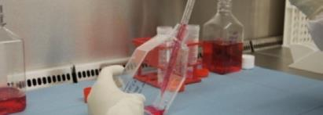

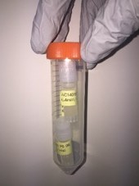
1 - Laboratory Procedures
FREEZING
CELL ISOLATION
in clean room and through sterility tests
CELL EXPANSION
RELEASE & 1° TREATMENT

Slide 51

Clinical Results

Slide 52





Breast Augmentation
BEFORE
AFTER 12 MONTHS

Slide 53

More of 100% of volume was maintained
 | Right Brest | Left Brest
Initial Breast Volume* | 336ml | 349ml
Volume of Fat Injected* | 334ml (670ml total volume) | 265ml (614ml total volume)
Volume of the Breast after 120 days* | 632ml (94.3% of injected volume) | 547ml (89% of injected volume)
Volume of the Breast after 12 months* | 678ml (101% of injected volume) | 628ml (102% of injected volume)
Ratio Cells/ml of fat: 233,000cells/ml
*Data obtained by MRI analysis

Slide 54





Breast Augmentation
BEFORE
AFTER 12 MONTHS

Slide 55
Around 100% of volume was maintained. BMI stable
 | Right Brest | Left Brest
Initial Breast Volume* | 799ml | 745ml
Volume of Fat Injected* | 246ml (1045ml total volume) | 321ml (1066ml total volume)
Volume of the Breast after 120 days* | 1011ml (96.7% of injected volume) | 1121ml (105% of injected volume)
Volume of the Breast after 1 year* | 973ml (93.1% of injected volume) | 1062ml (99.6% of injected volume)
Ratio Cells/ml of fat: 170,000cells/ml
*Data obtained by MRI analysis

Slide 56
Breast Augmentation
Total Volume of Fat Injected | Expanded Cells Injected (millions) | Follow-up | Breast volume at follow-up % | Body weight | Cells/Volume Ratio
.
980 ml 159.5 M 15 months 98% - 0,2 kg 160 000
.
470 ml 130 M 12 months 125 % + 2,7 kg 277 000
.
560 ml 83.6 M 12 months 96 % Stable 150 000
.
1280 ml 128.8 M 12 months 87 % + 2,4 kg 100 000
.
670 ml 100.8 M 12 months 106 % - 0,1 kg 150 000
.
600 ml 133 M 12 months 102 % - 1,0 kg 221 000
.
1000 ml 154.6 M 12 months 95 % - 1,5 kg 155 000
Bioscience Institute internal results

Slide 57
Breast Augmentation
Total Volume of Fat Injected
Expanded Cells Injected (millions)
Breast volume at follow-up
Body weight
Cells/Volume Ratio
Follow-up
 |  |  |  | %
980 ml | 159.5 M | 15 months |  | 98% |  | - 0,2 kg |  | . 160 000
470 ml | 130 M | 12 months |  |  |  | + 2,7 kg
560 ml | 83.6 M | 12 months |  | 96 % |  | Stable |  | . 150 000
1280 ml | 128.8 M | 12 months |  |  |  | + 2,4 kg
670 ml | 100.8 M | 12 months |  | 106 % |  | - 0,1 kg |  | . 150 000
600 ml | 133 M | 12 months |  | 102 % |  | - 1,0 kg |  | . 221 000
1000 ml | 154.6 M | 12 months |  | 95 % |  | - 1,5 kg |  | .
 |  | Bioscien | ce Institute internal results
125 %
.
277 000
87 %
.
100 000
155 000

Slide 58

Scar treatment
Bioscience Institute internal results

Slide 59



Slide 60


Slide 61


Slide 62

Osteoarthritis
ü Osteoarthritis (OA), the most common joint disease, is characterized by degeneration of the articular cartilage that ultimately leads to joint destruction.
ü Since current pharmacological, surgical and chondrocyte based treatment strategies for OA are inadequate, delivery of an appropriate mesenchymal stem cell (MSC) population is currently being the new therapies for OA.

Slide 63


What can the patient expect
After the procedure there will be minimal discomfort in the abdominal area with soreness and bruising lasting anywhere from 1 week to 2 weeks. There will also be some tenderness at the joint from the intra- articular joint injection. This tenderness may last anywhere from 4-6 weeks in some patients. We recommend patients relax and receive as much rest as possible to give their stem cells a chance to heal.

Slide 64

How do stem cell
The majority of complications in osteoarthritis patients are related to the deterioration of cartilage that cushions the ends of bones in your joints. Cartilage is a ﬁrm, slippery tissue that permits nearly frictionless joint motion. In osteoarthritis, this surface become rough. Eventually, if the cartilage wears down completely, patients will be left with bone rubbing on bone.
This stem cell treatment is designed to target these areas within the joints to help with the creation of new cartilage cells. The goal of each stem cell treatment is to inject the stem cells into the joint to create cartilage. Stem cells are also natural anti-inﬂammatories which can assist with osteoarthritis pain and swelling in the joint area.

Slide 65

MSC-based strategies should provide practical advantages for the patient with OA.
use of MSC as progenitor cells to engineer cartilage implants that can be used to repair chondral and osteochondral lesions, or
use of MSC as trophic producers of bioactive factors to initiate endogenous regenerative activities in the OA joint
(Noth et al., 2008).

Slide 66

MSCs and Diabetes Mellitus
Potential role of MSC in the management of diabetic microvascular complications (retinopathy, nephropathy, and neuropathy) and wound healing.
Cell-based therapies may control these complications by diﬀerent potential mechanisms
Bernardi S. et al. Exp Diab Res 2012

Slide 67

MSCs and Wound Healing
MSCs
Another common complication of DM is represented by the prolonged and incomplete wound healing, caused by compromised angiogenesis, diminished cells recruitment, lack of growth factors, and impaired formation of collagen matrix.
Several works have shown that MSC accelerate wound closure by diﬀerentiating into ﬁbroblasts and keratinocytes, and promoting neovascularisation and regeneration of appendages and recruiting inﬂammatory cells into wounds
The same mechanisms that have been shown to enhance wound healing seems to be eﬀective also in the treatment of foot ulcerations
Y. Wu et al. Stem Cells 2010; L. S. Barcelos et al. Circulation Research 2009

Slide 68


One of the most important barriers to treatment in chronic wounds is the presence of excessive inflammation

Slide 69






Patient 31 years old
The translation of the a powerful tool
>6 months wound
on the critical not Diabetic and Renal transplant patien
healing wound cases
History of vascular problem
Already amputated
Wound size: 5x6 cm on the heel

Slide 70



Protocol:
100 million of Adipose derided stem cells (ADSC) were injected in the wound edge and bed using a 6mm needle.
The bed of the
wound 5x5cm with 20
was also
covered by a
collagen
scaffold seeded ADSC
million of

Slide 71

Follow-up 11 days
ØGranulation tissue
ØEdge Vascularization
ØThe patient claim a strong tingling feeling in
the treated area

Slide 72

MSCs treatment on diabetic polyneuropathy
MSCs seRled in the gap between muscle ﬁbers, through production of bFGF and VEGF, induces neovascularization and support regeneration of neural cells that results with improvement of diabetic polyneuropathy
Volarevic V. et al. STEM CELLS 2011

Slide 73




MSCs and new trends for cartilage repair
MSCs implantation in articular cartilage defects has some advantages over autologous chondrocyte implantation (ACI) :
can be isolated from various tissues without causing morbidity to healthy articular cartilage
can be easily expanded without loosing their chondrogenic potential at early passages
the easy and less invasive implantation method might be intra- articular MSCs injection
Moreover…
repaired tissue treated with MSCs showed superior histological characteristics to that treated with chondrocyte implantation
E. Kon et al. Curr Rev Musculoskelet Med. 2012 Andri M.T. Lubis et al Acta Medica Indonesiana,2012

Slide 74



MSCs and osteoporosis
MSCs play an important role in bone modelling and remodelling where they give rise to the osteoblasts necessary for bone formation
MSCs have been used to augment healing of bone fractures
Stem cells treatment
Animal studies have shown
that MSCs infused intravenously target bone and possibly participate in bone formation
Transplantation with autologous MSCs or genetically-modiﬁed MSCs expanded in vitro is a potential treatment strategy to augment bone formation in patients with diverse metabolic and genetic bone diseases, including osteoporosis
Roberts S. et al. Regen Med. 2011; Jones E. et al. Injury 2011 ; Liu Y. et al. Clin Exp Med 2012

Slide 75


Slide 76


Slide 77


Slide 78



Slide 79


How many FAT for OA TREATMENTS
(considering 1 injection of 10.000.000 ADSC)
SVF
10 Million ADSC
2 liters FAT
EXPANDED ADSC
2 liters FAT
1 TREATMENT
10 ml of FAT
5 TREATMENTS
50 Million ADSC
10 ml FAT

Slide 80
Liquid biopsy and
targeted cancer stem cells therapy

Slide 81

Despite considerable improvements in cancer treatment,
along with a number of new therapeutic options,
early detection
still remains the most eﬀective strategy to reduce cancer mortality

Slide 82
Current solid biopsy-based cancer diagnostics :
ü are invasive and induce discomfort
ü have sub-optimal sensitivity
ü cannot be repeated over time
ü cannot be obtained from all patients
(i.e., patients with metastatic foci in vital organs)
and are a snapshot of cancer situation in that very moment

Slide 83

But cancers are characterized by spatial and temporal
intra-tumor heterogeneity which is one of the major hurdle for therapy
and solid biopsy do not provide
real-time monitoring of a tumor
TREATMENT OR NEGATIVE PRESSURE

Slide 84

The puriﬁcation of circulating tumor cells (CTCs) and/or cell- free circulating tumoral DNA (ctDNA) in the bloodstream of virtually all individuals (a.k.a. liquid biopsy), followed by NGS analysis, allows non-invasive and repeated interrogation of the molecular portrait of a tumor and its heterogeneous
characteristics, even at very early stages and in asymptomatic subjects

Slide 85

A simple blood withdrawal allows genetic analysis by NGS of
Circulating Cell-Free Tumoral DNA (ctDNA)
and Circulating Tumoral Cells
(CTC)

Slide 86

ctDNA is single- or double-standed DNA released by the tumor cells into the bloodstream and bears all the diﬀerent kind of mutations of the originating tumor
CTC represent cancer cells that detach from a solid tumor mass and are in the process of colonizing distant organs to give rise to metastasis.
They have been detected in most epithelial cancers, as well as in non-
epithelial cancers

Slide 87
Liquid biopsies can provide cancer genetic information useful as:
Diagnostic marker
Tumor staging marker
Treatment marker
Prognostic marker
that can be used to unravel new cancer genetic proﬁles and speed up the pace towards personalized/precision medicine.

Slide 88

Mesenchymal Stem Cells (MSC) have intrinsic:
- anti-angiogenic and pro-apoptotic properties
- immune-privileged features
- tumor tropism and homing at tumor site
- paracrine secretion
which inﬂuence cellular microenvironment.
Although controversial due to diﬀerences in experimental models, animal hosts and heterogeneity of MSC origin, their anti-tumor eﬀect has been demonstrated in selected cancers

Slide 89

In cancer therapy, MSC can be used:
§ Unmodiﬁed;
§ as vectors to deliver anti-cancer agents for on site expression of therapeutic proteins or suicide products, such as INF-beta and gamma; IL12 and
ItransgeneL24 or TRAIL;
§ as carriers for retroviral or adenoviral vectors expressing tumor suppressed genes; oncolytic viuses and drug-loaded polymeric nanoparticles.

Slide 90
Thanks to the large number and diversity of these preclinical studies using unmodiﬁed and engineered MSC as therapeutic agents for cancer, MSC are currently employed in several clinical trials for ovarian cancer, prostate cancer, neuroblastoma and neck and head cancers.

Slide 91

As a whole, these data highlight the feasibility and the safety of the use of autologous MSC, engineered or unmodiﬁed, to treat speciﬁc types of cancer, early
diagnosed and genetically analysed using liquid biopsy- based NGS.

Slide 92


Slide 93





Slide 94





Slide 95


Slide 96


Slide 98
Thank you for the attention

