Slide 1
eHealth/mHealth
Gisele Roesems
Deputy Head of Unit Health and Well-Being
DG CONNECT
EUROPEAN COMMISSION
2nd International Conference on Health Informatics and Technology
Valencia, July 27th , 2015

Slide 2
eHealth Action Plan 2012 – 2020
Published by the Commission on 7 December 2012
Tackles eHealth challenges related to:
PERSONAL HEALTH (CHRONIC DISEASE MANAGEMENT, PREVENTION AND HEALTH PROMOTION)
HEALTH SYSTEMS (UNLOCKING INNOVATION, ENHANCING PATIENT-CENTRIC CARE, ENCOURAGING ORGANISATIONAL CHANGES, CROSS-BORDER CARE, UNIVERSALITY, EQUITY…)
LEGAL / MARKET ASPECTS (IMPROVING LEGAL AND MARKET CONDITIONS)

Slide 3
Green Paper - context
The eHealth Action Plan 2012-2020 recognised current and potential benefits of mHealth apps, and potential associated risks
  more clarity needed on legal framework
  questions on the use of collected data
  demand for quality and transparency
  eHealth Action Plan announced the Green Paper on mHealth

Slide 4
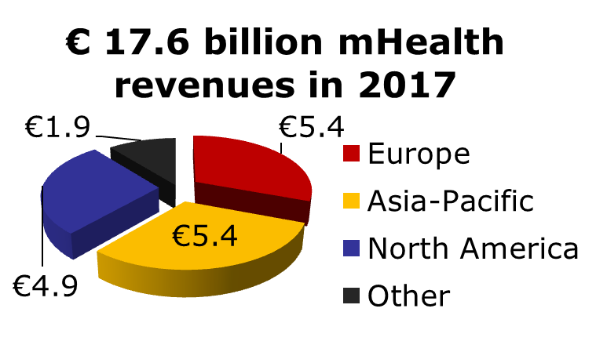
mHealth potential – "triple win"
  Potential for citizens
    → More empowered patients, self-management, engagement
    → More accurate diagnosis and treatment
    → Earlier detection, increased prevention
    → Quality of life
    → Access
  Potential for healthcare
    → more efficient and
    sustainable healthcare
  Market potential

Slide 5
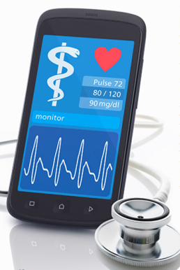
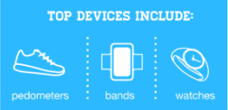

Trends in mHealth
Health and fitness apps are among the fastest growing apps categories in terms of use, with time spent in health and fitness apps growing 51% over the year to August 2014. Localytics, September 2014
Apps + Wearable Devices = The Future of Mobile Health
More than half of today’s health and fitness app users plan to incorporate a wearable device into their lives. Mobiquity, The Appification of Health and Fitness, April 2014
Mobile Health & Wellness 2014, Havas Worldwide Tonic

Slide 6
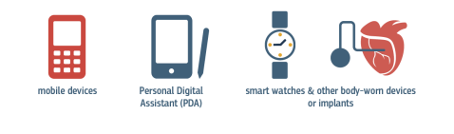
Green Paper on mHealth
The Green Paper (closed July 2014) asked stakeholders for their input on how to overcome the main challenges to mHealth deployment:
  data protection
  big data
  legal framework
  safety and transparency
  mHealth’s role in healthcare systems
  interoperability
  reimbursement models
  liability
  R&I
  international cooperation
  web entrepreneurs' market access

Slide 7
Outcome of the consultation
211 responses received
71% from organisations / 29% from individuals

Slide 8
Results of the consultation
Privacy and security
Importance to give citizens control over their data
User's consent and access controls are crucial
Strong privacy and security tools are needed to build users' trust
Data encryption both "in transit" and "at rest"
Authentication mechanisms, e.g. digital certificates, biometric parameters, tokens etc.
Importance of secured networks settings to prevent data interception
Data minimisation, data protection by design and default

Slide 9
Results of the consultation
Legal Framework
Safety and performance requirements of lifestyle and wellbeing apps should be clarified, through legislation, guidance or certification/quality labelling
Need to clarify the borderline between apps that are medical devices and others, e.g. by guidelines
Strengthened enforcement of medical device and data protection rules needed

Slide 10
Results of the consultation
Safety and transparency
Guarantee of quality and independency of information
Safety requirements/quality guidelines
Need for (voluntary) certification schemes/quality labelling to assess mHealth apps
Sharing and transferring best practices
Importance of standards and guidelines for patient safety
Setting-up of (national) bodies to review mHealth apps

Slide 11
Next steps (1)
Continue involving stakeholders to assess and develop policy actions
  Privacy and security - code of conduct (DPD Art 27)
  Quality and reliability (-> certification / labeling)
    Build on existing public and private initiatives : NHS, BSI (PAS 277)
    Common quality criteria for
      - health apps (accuracy, functionality, usability, transparency, …)
      - app development process (app life cycle)
    Collaboration between public authorities on common assessment methodologies, mutual recognition and a common platform for certified health apps
    EU guidelines for assessing the validity of data for the purpose of linking apps to the EHRs

Slide 12
Next steps (2)
  Assessment of legislation need for safety of digital goods (applicability of GPSD)
Revision of medical devices guidelines (finalisation after adoption of medical devices regulation)
Possible extension of the EU eHealth Interoperability Framework to cover mHealth
Adaptation of consumer legislation to cover digital

Slide 13
Next steps (3)
Follow-up actions to support mHealth deployment under Horizon 2020 (WP2016/2017)
  Patient empowerment
  Use of big data in healthcare
  Digital security
  Digital health literacy
  Interoperability
  Support Member States in deploying mHealth

Slide 14
Thank you for your attention!
Gisele.Roesems@ec.europa.eu
Website: http://bit.ly/EUeHealth
Newsletter: http://bit.ly/eHealthinFocus
Disclaimer: This presentation only represents the views of its author and cannot be seen as binding the Commission in any way.

